Slide 1
Statistics for Non-statisticians
What Matters is an Understanding
Mgr. Maria Králová, Ph.D. ; kralova@econ.muni.cz
Faculty of Economics and Administration, Masaryk University, Brno, Czech Republic

Slide 2
// Computer-aided seminar sessions and why we need it
Data are declared a new class of economic asset like currency or gold
Two extreme teaching approaches: “black board” vs. “black box”
We combine both: computer labs with a „blackboard“ approach
Tasks are demonstrated on real data:
mathematical solution on a blackboard, computation with sw.

Slide 3
What is on a blackboard:
(Tasks: hypothesis testing; estimation and confidence intervals; …)
Translation of the problem from „common language“ to formal language
Formal list of assumptions and its evaluation
Determining appropriate test statistic/pivotal statistic with its distribution
Determining critical region (and p-values)/confidence intervals
Formal decision and its re-formulation into common language
What is done by sw in the „meantime“:
All needed calculations
Some related visualisations
Checking assumptions
Sometimes manipulations to show possible different outcomes to show contrasts

Slide 4
// The infrastructure: people, systems, software
Multiple licence STATISTICA,- „clicking sw.“ for elementary courses
Free R environment - „command line sw.“ for advanced courses
Setting a same standards for 15-18 parallel seminar groups ->
online folder for each session with manuals for teachers and students
Special editor for math expressions for on-line exams

Slide 5
Folder for each session:
the list of problems demonstrating particular topic and the link to related lecture materials
the appropriate data sets for the seminar itself and further for homework tasks
the software instructions providing step by step clues
the handbook for teachers covering not only the solutions of problems but also remarks on what to point out, which question may prompt discussion etc.

Slide 6
// Chalenges
Schedule problem - 380 students in 3 computer labs with 24 seats
during semester
Schedule problem - 380 students in 3 computer labs with 24 seats
during exam period
Security during the exam itself - how to protect against cheating

Slide 7
// How the initiative was received by students
Majority of students appreciate practical approach with understanding:
° not just to substitute numbers into formulas
° or to click on recommended buttons
° but to link the sw output to formal problem description
° and to interpret the results
Part of students take the chance to browse their FB profiles etc.
Some students criticise the final exam with data procesing to be too demanding and complicated

Slide 8
// How the initiative was received by teachers
Majority find it more attractive and beneficial for students so they adjusted fast
It takes more time – precise planning needed
Exam period is for teachers more time consuming; more challenging than correction of „without-data“ tasks
We observe better bachelor and diploma thesis with respect to data analysis

Slide 9
// Future plans
To diversify datasets: up-to-date ane more relevant to students‘ background
To create new subject on data visualisation

Slide 10
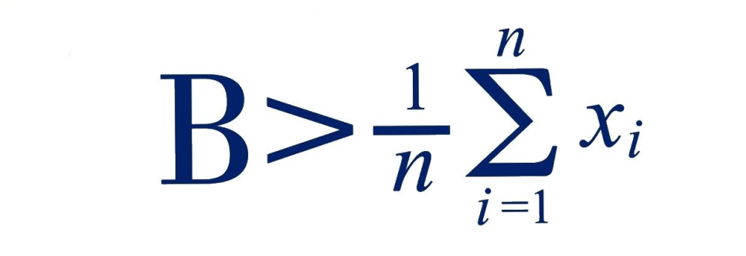
What we say to our students? Do all your best to …

Slide 11



Slide 12

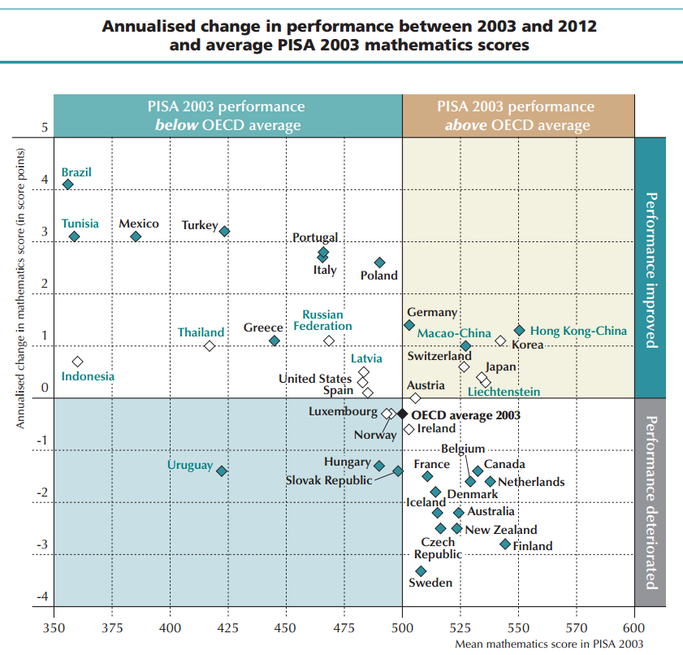
// Introduction
The gap between highschool and university level of knowledge in math keeps getting bigger (1)
The job market sorely needs
graduates with math skills (2)
Czech republic PISA scores
keep getting worse (3)

Slide 13




// Our inspiration
MatRIC Drop-in, University of Agder since 2015
sigma Network, England since 2005
other networks – Ireland, Scotland, Wales, …

Slide 14

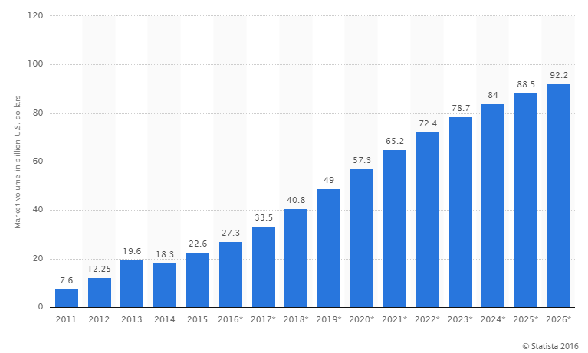
// Why we need it
The market volume for big data is expected to triple by 2026
Significant growth in job demand of big data related vacancies (4)

Slide 15

// The service so far - Spring 2016
Timeframe:
(1 semester)
Total visits:
Unique visitors:
od 22. 2. 2016
do 4. 7. 2016
300
146

Slide 16

// The service so far - Autumn 2016
Timeframe:
(2 semester)
Total visits:
Unique visitors:
od 26. 9. 2016
do 24. 1. 2017
273
137

Slide 17
// The service so far - Spring 2017
Timeframe:
(3 semester)
Total visits:
Unique visitors:
od 6. 3. 2017
do 27.6. 2017
283 (ID - 254)
143

Slide 18

// The service so far - Spring 2016
ESF dominates:
FSS follows:
Other faculties:
Outside MUNI:
249
20
24
7

Slide 19

// The service so far - Autumn 2016
ESF dominates:
FSS follows:
Other faculties:
Outside MUNI:
264
2
5
2

Slide 20
// The service so far - Spring 2017
117
5
4
127
1
ESF dominates:
FSS follows:
Other faculties:
Faculty unspecified:
Outside MUNI:

Slide 21

// The service so far - Spring 2016
Percentage of visits regarding final thesis:
27%

Slide 22
// The service so far - Spring 2017
Percentage of visits regarding final thesis:
17.7%

Slide 23

// The service so far - Spring 2016
Stats and metrics
Average hits per month (website) 1,800
Average time of a visit (website) 00:03:02
Peak reach (Facebook) 1,105
Likes in the first month (Facebook) 228

Slide 24

// The service so far - Autumn 2016
Stats and metrics
Average time of visit (website) 00:02:32
Likes (Facebook) 459

Slide 25
// The service so far - Spring 2017
Stats and metrics
Average hits per month (website) 1 417
Average time of a visit (website) 00:04:50
Likes (Facebook) 467

Slide 26

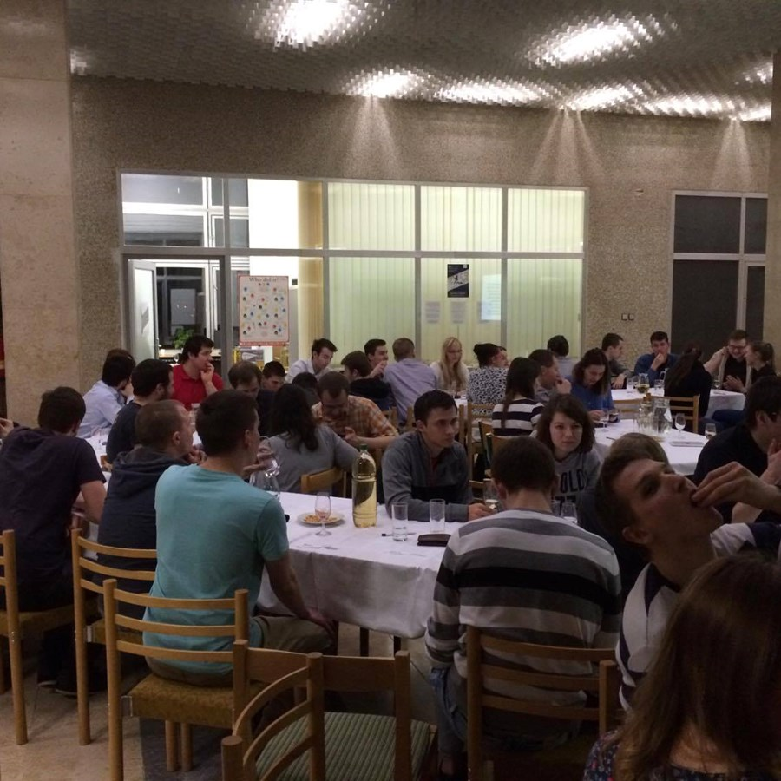
// Events
The Support Centre regularly organizes events for students
„Quantified Nature“ or
„The answer of Kurt Gödel to Pontius Pilate‘s question“
are just a few of them

Slide 27
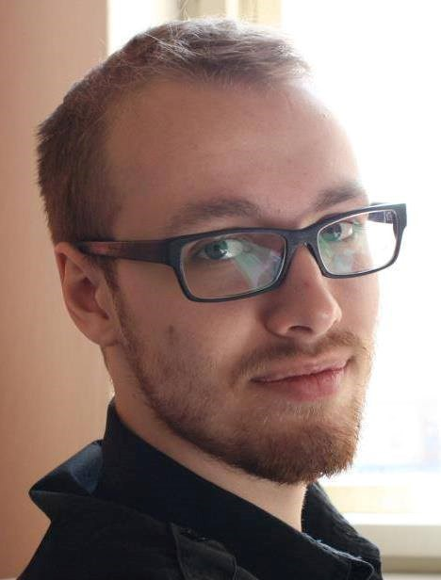
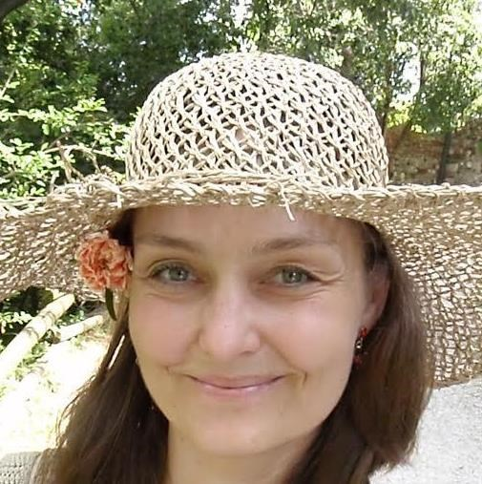
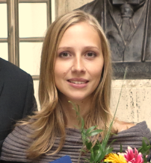
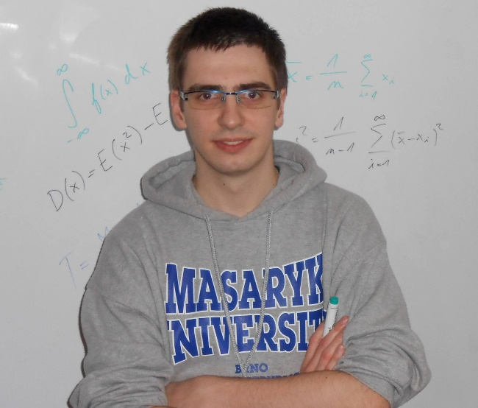
// Our team
So far the Support Centre operated through volunteers.
Students and teachers alike offered their time to help others with math and statistics.

Slide 28

// Visitor feedback (1/3)
„ (…) chci (znovu) projekt pochválit :) zatím jsem konzultaci nepotřebovala, ale to, že centrum funguje a že s ním můžu počítat, je skvělé“ – Respondent 3
„Pan Josef Nešleha vysvětluje opravdu dobře a vždy si našel čas, i když to vypadá, že jeho den má 40 hodin.“ – Respondent 14
„Myslím si, že Maths and Stats Support Centre je skvělý nápad a budu moc rád, pokud jeho fungování bude pokračovat.“ – Respondent 76

Slide 29

// Visitor feedback (2/3)
„(…) veľmi ma potešilo, že sa niečo také vytvorilo, je to super pre študentov. Našťastie som zatiaľ Vašu pomoc nepotreboval ale rád ju využijem v budúcnosti ak bude príležitosť “ – Respondent 65
„Ačkoliv jsem nevyužil jeho služeb, tak jsem ho doporučil několika kamarádům (…) Ti, kteří služeb centra využili, si ho moc pochvalovali.“ - Respondent 76
„Support Centre je super projekt, jsem hrozně rád, že se ho podařilo otevřít! Díky paní doktorce Králové i všem tutorům. :)“ – Respondent 23

Slide 30

// Visitor feedback (3/3)
Visitors liked the most:
Tutors‘ friendly and non-critical approach
Tutor explained all questions
Tutor was able to explain complicated issues in simple terms (6)

Slide 31




// Spreading the idea
3 other support centers were inspired and are taking off
  VŠB Technical University of Ostrava
  - launch in September 2016
  UTB Tomáš Baťa University in Zlín
  - launch in September 2016
  VUT Brno Technical University (FME)
  - launch in September 2017 with support from OP VVV project

Slide 32


// Outlook (1/2)
Engage more people
- spark interest in mathematics and statistics
- break the „I‘m bad at math“ mindset
Improve the website
- reduce bounce rate
- incentivise visitors to browse sylabi
Reduce math and stats failing grades at MU

Slide 33


// Outlook (2/2)
Academic year target budget:
550,000 CZK
  Labor costs
  -two part-time tutors
  Technical background
  -projector
  -interactive whiteboard
  -software and web development
  Marketing
  -leaflets, DTP labor, print

Slide 34

// Sources
(1) http://archiv.ihned.cz/c1-65399490-ustup-maturity-z-matematiky
(2) http://www.statista.com/statistics/254266/global-big-data-market-forecast/
(3) https://www.oecd.org/pisa/keyfindings/pisa-2012-results-overview.pdf
(4) https://acadgild.com/blog/big-data-job-opportunities-in-2016-and-the-coming-years/
(5) Google and Facebook analytics internal data
http://mathstat.econ.muni.cz/
https://www.facebook.com/supportcentre/
(6) Google forms questionnare survey

