Slide 1
Performance Review, Personality Types and Negotiation
Jan Řezáč
03/04/2017

Slide 2

PERFORMANCE REVIEW (appraisal)
 A method by which the job performance of an
employee is documented and evaluated.
 Facilitation of communication,
 Enhancement of employee focus through promoting trust,
 Goal setting and desired performance reinforcement,
 Performance improvement,
 Determination of training needs.

Slide 3
How performance appraisal interview should not look like?
 https://www.youtube.com/watch?v=09b
p 4Muh8

Slide 4
Preparation. Manager
Choose neutral territory,
Let employee confirm date, time, place and content,
Give employee at least 1 week for preparation,
Prepare a comprehensive overview of employee’s performance,
Facts, concrete evidence.

Slide 5
Preparation. Manager
Pay attention:
Goals, stated during previous appraisal interview,
Real successes and failures and their consequences,
Conditions of successes and failures,
Any changes in job description,
Relationship with other employees,
Personal development and self-education.
Use forms provided by company
Open and relaxed atmosphere
Mutual respect
Goal is to gain agreement, it is not the situation where manager commands and employee obeys
Engage employee in discussion

Slide 6
Appraisal process. Manager
DO
Prepare
Listen and ask questions
Concentrate on performance, not personality
Be concrete regarding successes and failures
Gain commitment regarding goals and further actions
DON’T
Press your ideas
Be destructive
AFTER
Control improvement,
Observe for problems

Slide 7
How to do Effective
Performance Appraisals
 https://www.youtube.com/watch?v=E34Z t1cEpFA

Slide 8
Biggest Mistakes Bosses Make In Performance Reviews
 Too vague,
 Everything’s perfect – until it’s not and you’re fired,
 Recency effect,
 No preparation,
 No recognition,
 Not being truthful with employees about their
performance,
 No follow-up,
 No discussion around the report’s career ambitions.

Slide 9
PERSONALITY TYPES:
David Kantor´s Four-Player Model
Move
Bystand
Follow
Oppose

Slide 10
Potential Impact of the Four Player Model
Without movers, there is no direction
Without followers, there is no implementation
Without opposers, there is no correction
Without bystanders, there is no perspective

Slide 11
Roles of the Four Player Model
Movers are not necessarily leaders
Followers are not weak
Opposers are not devil’s advocates
Bystanders can be called “Big Picture Synthesizers and Team Paraphrasers”

Slide 12
Stuck Groups
Individuals get locked into a single form of action
Opposers are punished by the group, or they dominate
There are no strong Movers, or no one ever Follows a move
The Bystander is disabled
Individuals attach double messages to their moves
The team is unable to reach closure and produce results
Lack of capability or flexibility to engage in all four action behaviors

Slide 13
NEGOTIATION
BATNA
Anchoring
Heuristics
Model Example – multicultural negotiation

Slide 14
BATNA: Best Alternative to a Negotiated Agreement
The strategy calls for an alternate plan if the talks start to go out of control
An example is for a buyer to request information from more suppliers before commiting
BATNA should include costs, feasibility, impact and consequences of your alternative

Slide 15
Anchoring
Anchoring means that first perception lingers in mind, affecting later perceptions and decisions
A typical example are companies setting price artificially higher, so they present normal price as a „discount“ compared to the initially high price
This phenomenon holds even if the first anchoring number is completely random, and has a surprisingly large effect

Slide 16
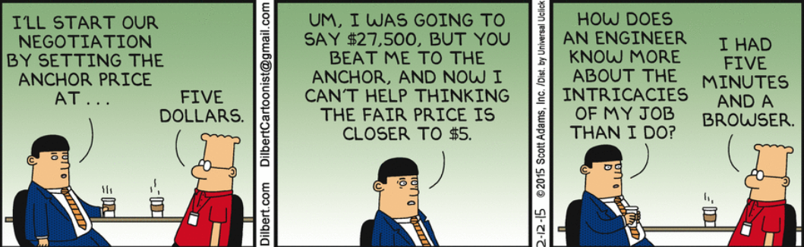

Slide 17
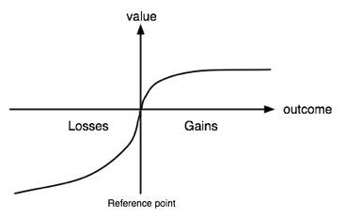
Heuristics
Heuristics (in psychology) is a practical method to solve problems or calculations not guaranteed to be optimal or perfect
A typical example of people using heuristics is them trying to avoid losses
This is useful to negotiatiors, as they might try to frame all decisions in positive way

Slide 18
Sources:
Getting to Yes: Negotiating Agreement Without Giving In, Roger Fisher and William L. Ury. 1981
Kahneman, D.; Tversky, A. (1979). "Prospect Theory: An Analysis of Decision under Risk". Econometrica 47 (2): 263–291.
Negotiation Genius: How to Overcome Obstacles and Achieve Brilliant Results at the Bargaining Table and Beyond, Deepak Malhotra, Max H. Bazerman, 2008
http://info.worldbank.org/etools/docs/library/200854/section06/06g1Section_6_Slides_Four_Player_Model_for_Conversations_sept1.pps
The Family, Politics, and Social Theory (RLE Social Theory), D.H.J. Morgan - 2014

