Slide 1
Innovation

Slide 2
Research and development in the company
Innovation - purposeful innovation results from analysis, systemic review and hard work and can be taught, replicated and learned (Drucker 1993).
Purposeful, systemic innovation begins with the analysis of opportunities. The search must be organized and conducted on a regular basis.

Slide 3
Drucker identified seven sources of opportunity that will ultimately drive innovation:
The organization’s own unexpected successes and failures, and also those of the competition.
Incongruities, especially those in a process, such as production, distribution, or incongruities in customer behavior.
Process needs.
Changes in industry and market structures.
Changes in demographics.
Changes in meaning and perception.
New knowledge.

Slide 4
Innovation has to be simple and it has to be focused.
It should only do one thing or it confuses people and won’t work. All effective innovations are breathtakingly simple. It should focus on a specific need that is satisfied and on a specific end result that it produces.

Slide 5
According to Drucker, there are three conditions that must be met for an innovation to be successful including:
Innovation is work. It requires knowledge, ingenuity, creativity, etc. Plus, innovators rarely work in more than one area, be it finance, healthcare, retail or whatever. This work requires diligence, perseverance and commitment.

Slide 6
To succeed, innovators must build on their own strengths. They must look at opportunities over a wide range, then ask which of the opportunities fits me, fits this company. There must be a temperamental fit with the practitioner and a link to business strategy.

Slide 7
Innovation is an effect in economy and society, a change in the behavior of customers, of teachers, of farmers, of doctors, of people in general. Or, it is a change in a process, in how people work and produce something. Innovation must always be close to the market, focused on the market, and market driven.

Slide 8
Types of innovation
The simplest way to categorize innovation is into two types – incremental and radical.
Incremental innovation is an improvement in an existing thing (e.g. product, process or service).
Radical innovation is finding an entirely new way of doing something. (http://innovationexcellence.com)
Another ones:
https://thegentleartofsmartstealing.wordpress.com/types-of-innovation/

Slide 9
Larry Keeley divides all corporate innovations into ten categories. These are:
Profit model – how you price your product or service and make money. E.g. Gillette innovated with the razor and blades model.
Network – external relationships and partnerships. E.g. Toshiba collaborated with UPS to repair Toshiba laptops.
Structure – how you organize your company. E.g. W. L. Gore has a renowned ‘flat lattice’ where teams form without formal structure.
Process – doing things differently. E.g. Zipcar radically changed the car hire process.
Product performance – new products or features. E.g. Dyson launched a transparent vacuum cleaner with no bag.

Slide 10
Product system – how your product connects. E.g. Mozilla used an army of independent developers to create Firefox and its plug-ins.
Service – additional support and enhancements. E.g. Zappos empowered customer reps to send flowers or order from a competitor.
Channel – how you get to market. E.g. Amazon’s Whispernet service allows users to order and download a Kindle book in one minute.
Brand – the promise you make. E.g. Virgin. From Cola to Space travel, all the many Virgin companies share a fun, challenger image.
Customer Engagement – the client experience. E.g. Blizzard Entertainment’s World of Warcraft gives players a collaborative gaming experience.
(http://innovationexcellence.com)

Slide 11
5 steps innovation process
Idea generation
Advocacy and screening
Experimentation
Commerzialization
Diffusion and implementation

Slide 12
Idea generation
SCAMPER
„S“ substitutes
„C“ combine
„A“ adapt
„M“ modify
„P“ put to other uses
„E“ eliminate
„R“ reverse, rearrange

Slide 13
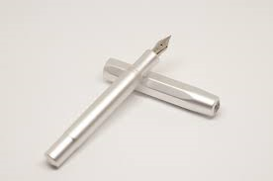

Substitute

Slide 14
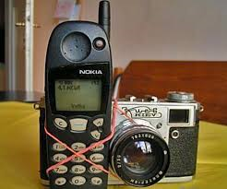

Combine

Slide 15


Adapt

Slide 16


Modify

Slide 17
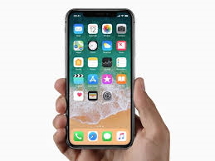
Put to other uses

Slide 18


Eliminate

Slide 19


Reverse, rearrange

Slide 20
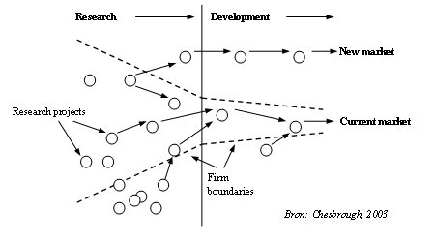
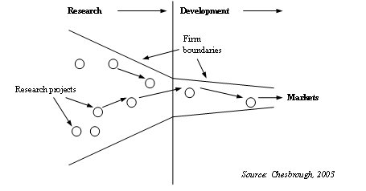
Open vs. Closed innovation
Open
Closed
Open innovation combining internal and external ideas as well as internal and external paths to market to advance the development of new technologies
Traditionally, new business development processes and the marketing of new products took place within the firm boundaries (Figure 1).

Slide 21
Open vs. Closed innovation
Closed Innovation Principles | Open Innovation Principles
The smart people in the field work for us. | Not all the smart people work for us, so owe must find and tap into the knowledge and expertise of bright individuals outside our company.
To profit from R&D, we must discover it, develop it, and ship it ourselves. | External R&D can create significant value: internal R&D is needed to claim some portion of that value.
If we discover it ourselves, we will get it to the market first. | We don’t have to originate the research to profit from it.
The company that gets an innovation to the market first will win. | Building a better business model is better than getting to the market first.
If we create the most and the best ideas in the industry, we will win. | If we make the best use of internal and external ideas, we will win.
We should control our intellectual property (IP) so that our competitors don’t profit from our ideas | We should profit from others’ use of our IP, and we should buy others’ IP whenever it advances our business model.

Slide 22
This means that within the company a shift should take place in the way people look at the company and its environment. Involving other parties when developing new products and technologies can be of great added value. Think for instance about cooperation with other firms in your sector, suppliers, universities, and of course end-users.
The business model plays a crucial role in this is. After all, how and when external knowledge is required and used is to a large extent determined by the companies’ business model which describes how value can be created from innovations and which elements have to be sourced internally or externally.
Reference: Chesbrough, H. (2003), “Open Innovation: The New Imperative for Creating and Profiting from Technology“, Harvard Business School Press.

Slide 23
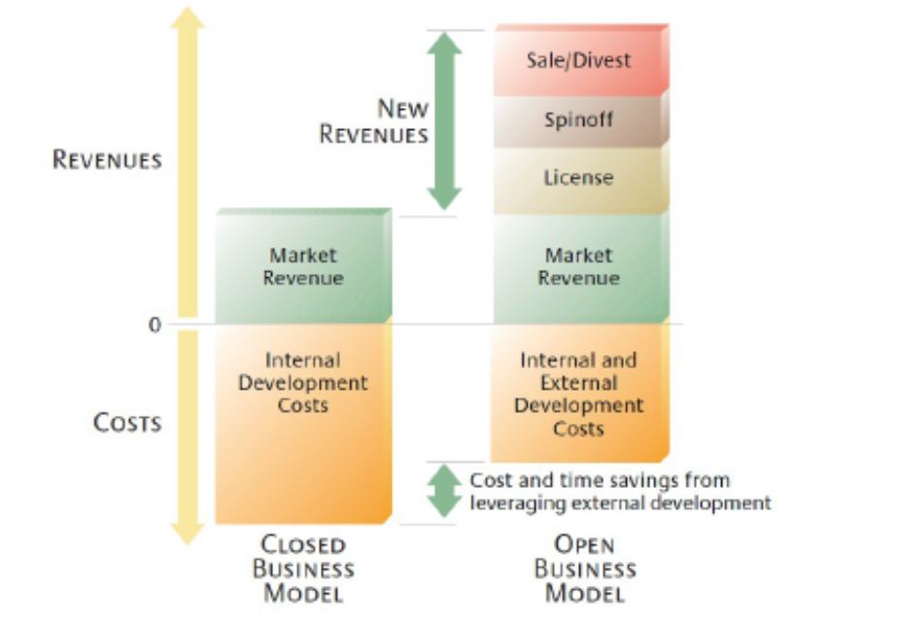

Slide 24
Advantages of open innovation
Open innovation offers several benefits to companies operating on a program of global collaboration:
Reduced cost of conducting research and development
Potential for improvement in development productivity
Incorporation of customers early in the development process
Increase in accuracy for market research and customer targeting
Potential for synergism between internal and external innovations
Potential for viral marketing
West, J.; Gallagher, S. (2006). "Challenges of open innovation: The paradox of firm investment in open-source software". R and D Management. 36 (3): 319. doi:10.1111/j.1467-9310.2006.00436.x
Schutte, Corne; Marais, Stephan (2010). "The Development of Open Innovation Models to Assist the Innovation Process". University of Stellenbosch, South Africa.

Slide 25
Disadvantages of open innovation
Implementing a model of open innovation is naturally associated with a number of risks and challenges, including:
Possibility of revealing information not intended for sharing
Potential for the hosting organization to lose their competitive advantage as a consequence of revealing intellectual property
Increased complexity of controlling innovation and regulating how contributors affect a project
Devising a means to properly identify and incorporate external innovation
Realigning innovation strategies to extend beyond the firm in order to maximize the return from external innovation
West, J.; Gallagher, S. (2006). "Challenges of open innovation: The paradox of firm investment in open-source software". R and D Management. 36 (3): 319. doi:10.1111/j.1467-9310.2006.00436.x
Schutte, Corne; Marais, Stephan (2010). "The Development of Open Innovation Models to Assist the Innovation Process". University of Stellenbosch, South Africa.

Slide 26
Outside and Inside open innovation (zdroj: Nautilus.cz)
Outside – in advantages:
  New radical ideas
  Invention
  Solution
  Technologies
  Patents and other benefits of cooperation

Slide 27
Inside - out
New incomes are generated by the launching the patents and intelectual property on the market.

