Slide 1
Introduction to MS Dynamics NAV IX. (Transfers Orders)
Ing.J.Skorkovský,CSc.
MASARYK UNIVERSITY BRNO, Czech Republic
Faculty of economics and business administration
Department of corporate economy

Slide 2
Layout of the show
First set of slides are showing basic logic
For the first part of the show classic NAV 2009 is used
At the end Transfer order is concisely presented in new 3-tier ERP system MS Dynamics NAV 2016W1

Slide 3
Transfers and locations
Benefits
  Direct control of transfers : where (locations )do we have what (items) at any moment..
  Responsibility of workers in warehouse (Pickers and Pullers)
  Responsibility of drivers
  Setup enables item tracking (batches, lots)
  Better calculation of transport times due to specification of inbound and outbound handling times as well as time of delivery depending on setup of shipping agent services

Slide 4

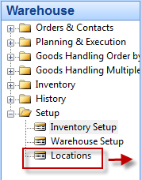
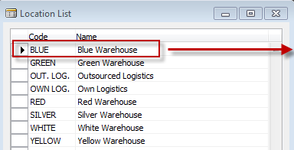
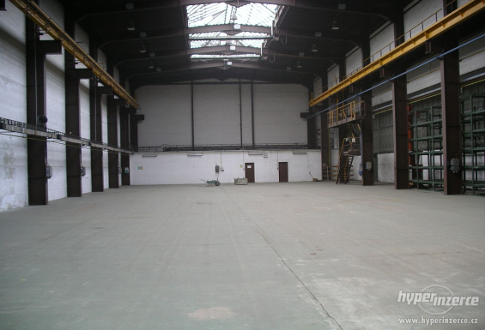
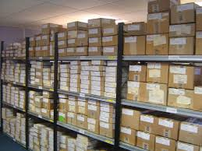
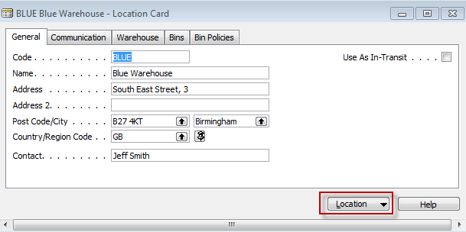
Locations and bins I.
Storage hall (Location)
Storage zone
See bins on
the next slide
Bin

Slide 5
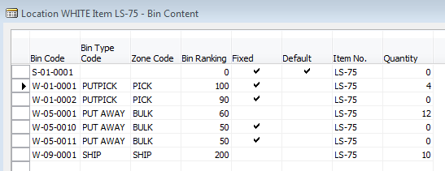
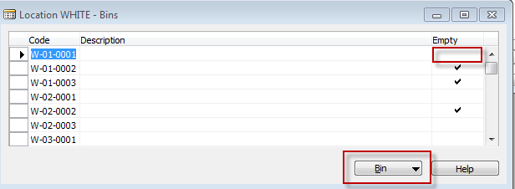
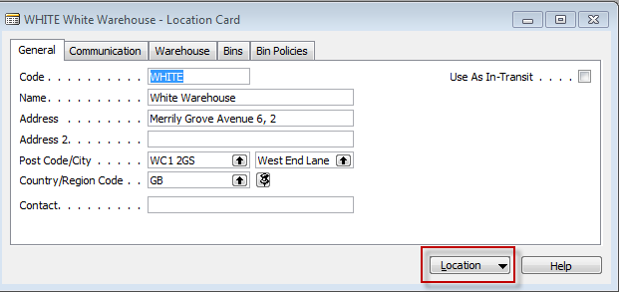
Location White and its bins

Slide 6

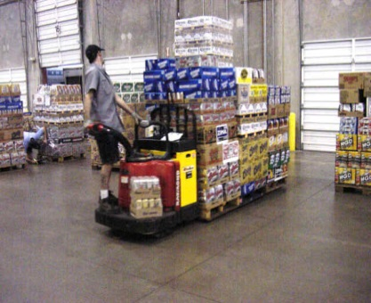

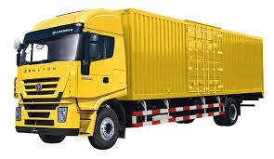
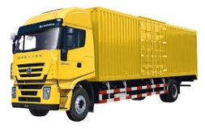
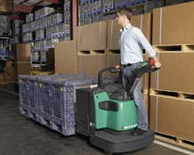
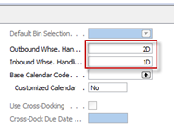
Basic warehouse movements
Put-away
Shipment
Receiving Zone
Inbound (e.g. 1D)
Picking
Outbound (e.g. 2D)

Slide 7
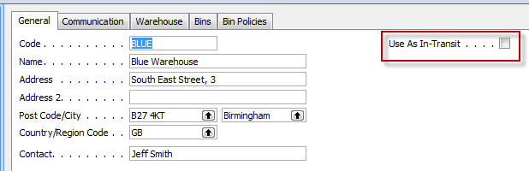
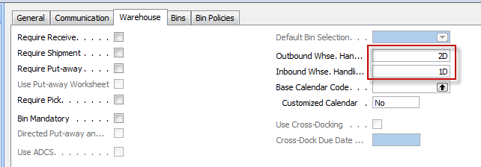
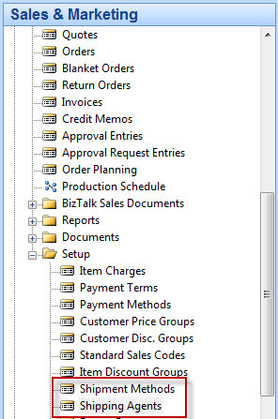

Locations and basic setup shipment

Slide 8
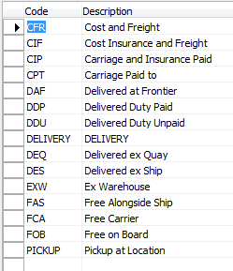


Setup shipment (either from Customer Card, Tab=Shipping or from Sales and Marketing Setup )
Shipment methods
Shipment agents

Slide 9
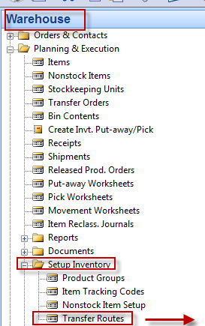
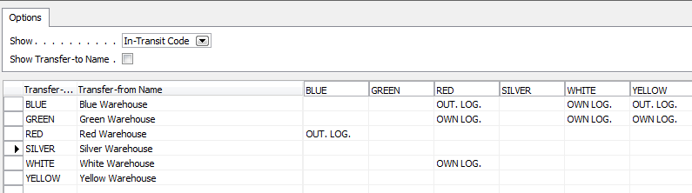
Agent services and Transfer routes
Agent services
Transfer Routes

Slide 10

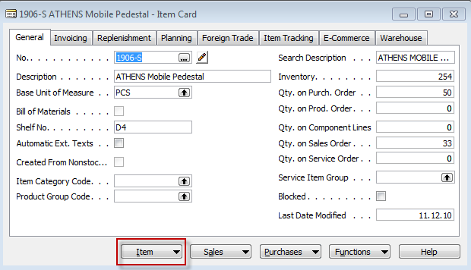
Transfer order
Red Location
Blue Location

Slide 11
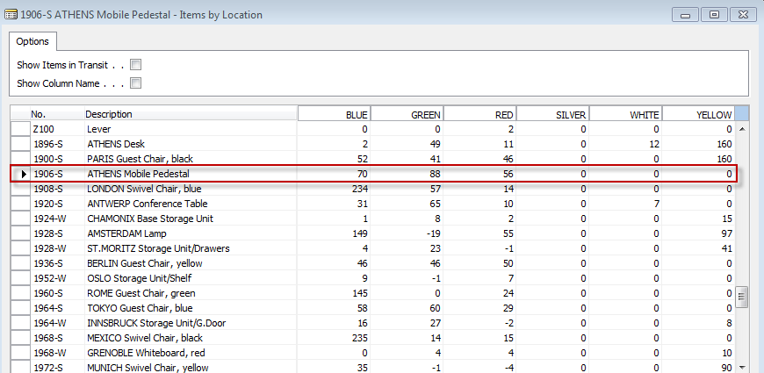
Item by Location (from button Item)

Slide 12
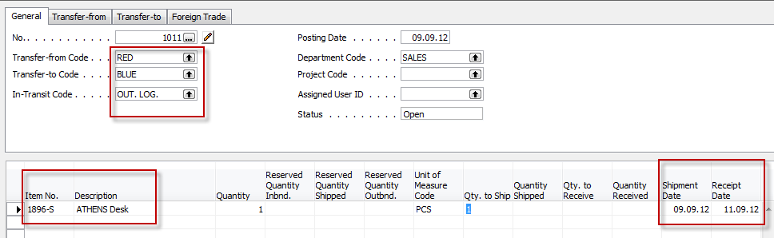
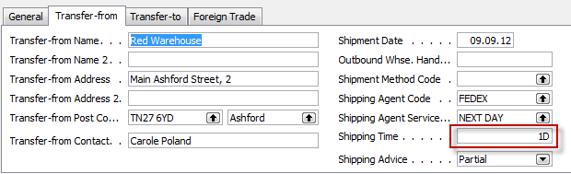
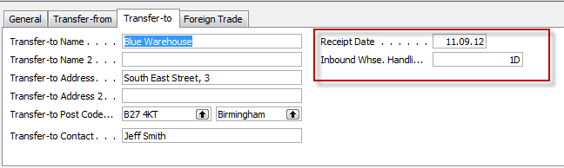
Transfer Order
Next day (1 D ) + Inbound Whse.Handling Time (1D) =2D ->9.9.12+2D=11.9.2012

Slide 13
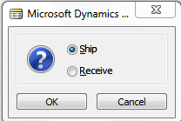
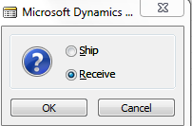
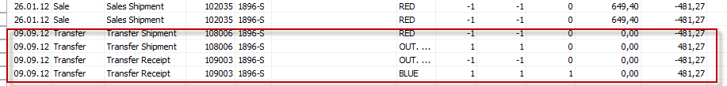
Posting TO (2 times F9)
Item Ledger Entries
The time is same instead of having two dates 9.9.12 and 11.9.12. The reason
is as follows : both movement were posted at same date !!

Slide 14
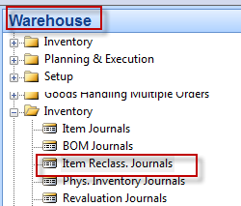

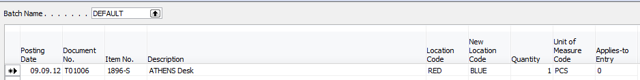
Transfer by use of Item Reclass.Journal
F11
Item Ledger Entries

Slide 15
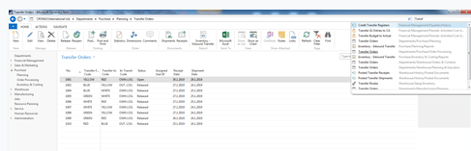
Transfer Order in NAV 2016W1
Go to the searching window and find a string Transfer Orders

Slide 16
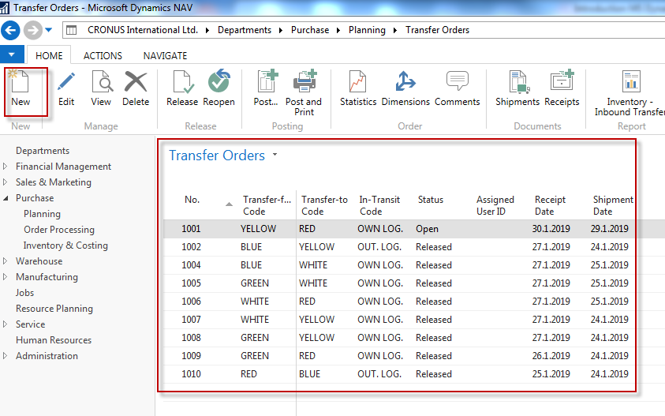
List of Transfer Orders

Slide 17
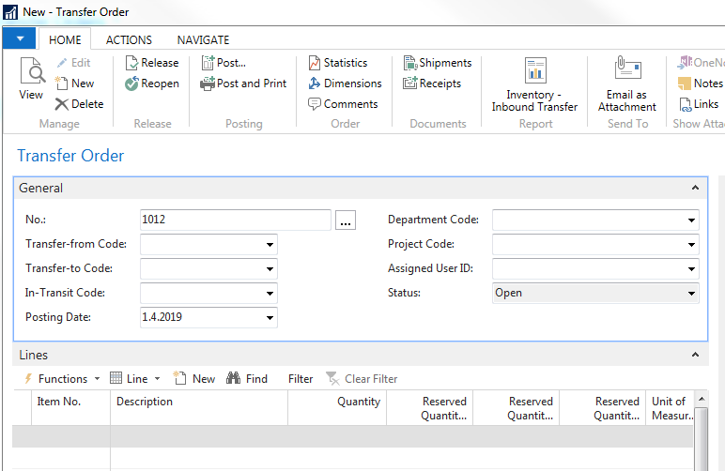
Using icon New and Enter key…
… you create the first part of TO

Slide 18
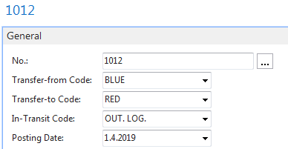
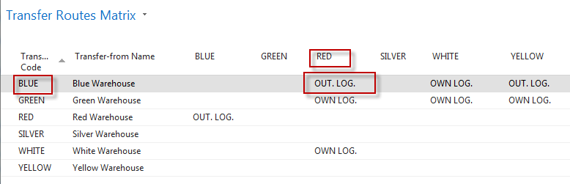
Enter Locations From (BLUE) and To (RED)
In transit code is automatically entered by system due to setup of Transfer Routes,
which could be easily found by use of searching window

Slide 19
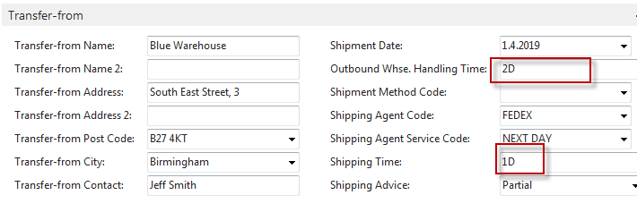
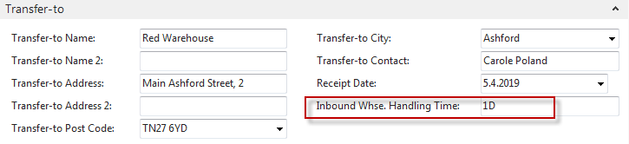
See tabs Transfer from and Transfer to
In order to see inbound and ourbound times
In order to see Shipping time

Slide 20
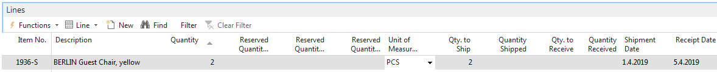
Enter Data into TO lines
Use 1936-S and 2 pcs and see Shipment Date and Receipt Date
Use standard Post key F9 two times (from the location Blue to OUT.LOG and from
OUT.Log to location Red. In between use icon (from list of items)
Item by Location and see by parameter items during shipment time
See next slide

Slide 21
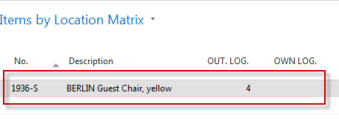
Item by location
Go to item in TO line
Jump to list of items
Icon Navigate
Icon Item by Location
Use filter Show items In transit and filter to this value (1936-S)
Click on quantity (Calculated field) to se item ledger entries

Slide 22
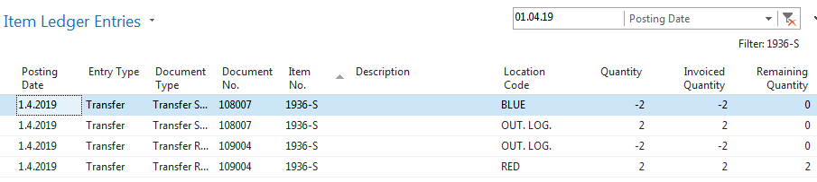
Item ledger entries after TO si completely posted

Slide 23

End of the section IX.

