Slide 1
Introduction to MS Dynamics (Customer Relationship Management)
Ing.J.Skorkovský,CSc.
MASARYK UNIVERSITY BRNO, Czech Republic
Faculty of economics and business administration
Department of corporate economy

Slide 2
CRM – Customer Relationship Management
PROs
It enables to keep track of all prospective customer (suspects and prospects)
Improve sales and marketing service
Company can promote the work it has done for its customers in order to approach prospects
CONs
CRM software may not integrate well with other email and accounting systems
Another disadvantage to a newly implemented CRM software is the learning curve.

Slide 3
CRM – Customer Relationship Management
Relationship management is a customer-oriented feature with service response based on customer input, one-to-one solutions to customers’ requirements, direct online communications with customer and customer service centres that help customers solve their issues.
Sales force automation
Sales promotion analysis
Advertising
Personal selling
Direct marketing
Public relations
automate tracking of a client’s account history
Use of technology (ERP)
Opportunity Management

Slide 4
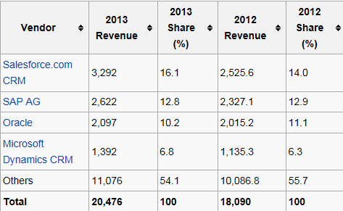
Market leaders
figures in millions of US dollars
Source:

Slide 5
Only Czech course
BPH_PIS 1| 2 !!!!,
MPH_RIOP pouze část
(kontakty, profily,..)
Partially for MPH_AOMA-AOPR !!!!!
Vendor
Statistic :
Costs/Revenue
Customer Entries
Customer
Interaction
Log
Entries
Contact
Card
Salesperson
To-Do
Card
Profile (parameters)
(To-Do)
Assigned
activities
Statistics:
Interactions, Stages,
Chances, Values,..
ABC (Pareto)
analysis
Opportunity
Activity
(code)
Sales Cycle
Stage
Partial Activities
Meeting /Telephone call
Interaction Log
Entries
Stage number
Activity

Slide 6
Objects necessary valid for MPH-AOPM-AOPR (see preceding slide)
Contact card- company ->Vendor (Customer)
Contact card- person ->Vendor (Customer)
Contact Character– profiles, technologies,..
Interactions
Business Opportunities (estimated close date and value, probability,.. )
Sales Cycles
Customer Card creation from Contact card
Quotes
Interaction entries

Slide 7
ERP-CRM
Only Czech course BPH_PIS1| 2 !!!! a MPH_RIOP
20000
70%
Meeting
Task1
Task22
Task p
Opportunity
ERP n
CRM
Customer
Card
QUOTE
ERP 2
ERP 1
Products
Task p+1
Task p+2
Task q
Opportunity
Financial
estimation
Success estimation
in %
Interactions

Slide 8
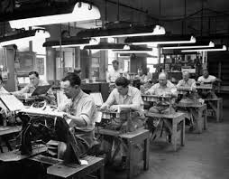
Contact cards
Contact card- company
Contact card- person
Contact Character– profiles, technologies,..
Interactions
Business Opportunities (estimated close date and value, probability,.. )
Sales Cycles
Customer Card creation from Contact card
Quotes

Slide 9
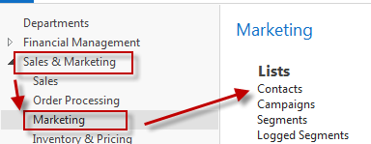
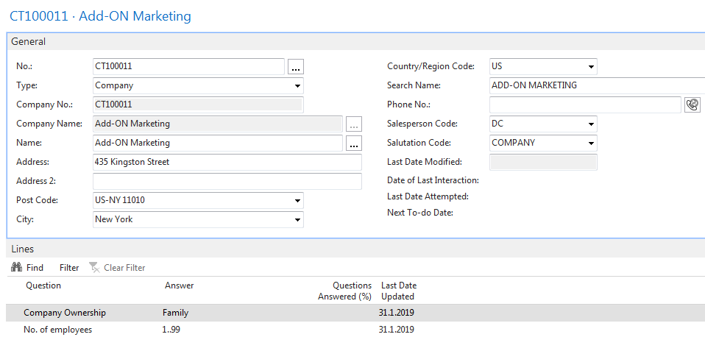
Contact card – company - (Header of the contact card)
Eric Clapton
Luciano Pavarotti
Emir Kusturica
Pïnk
Contact persons type card

Slide 10
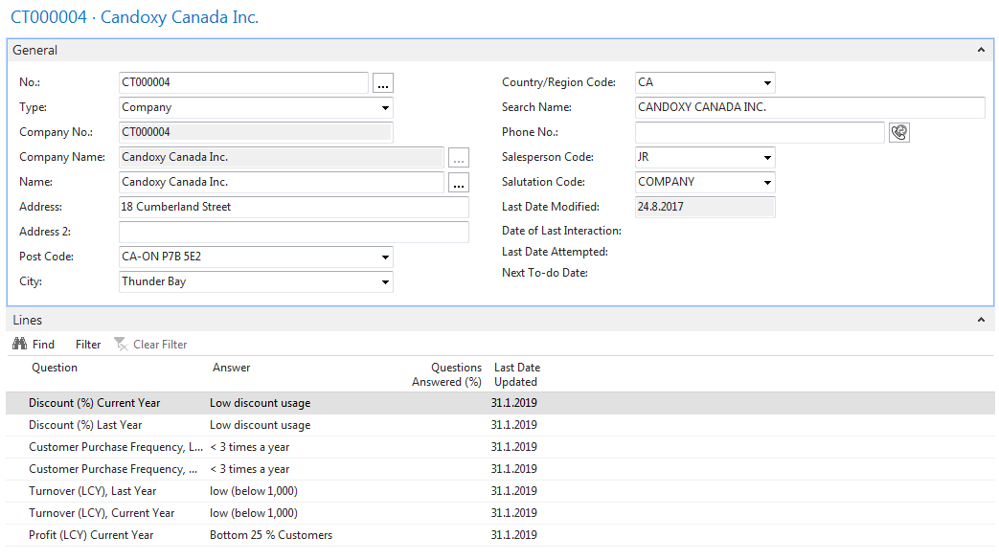
Contact Card-company
Profile

Slide 11
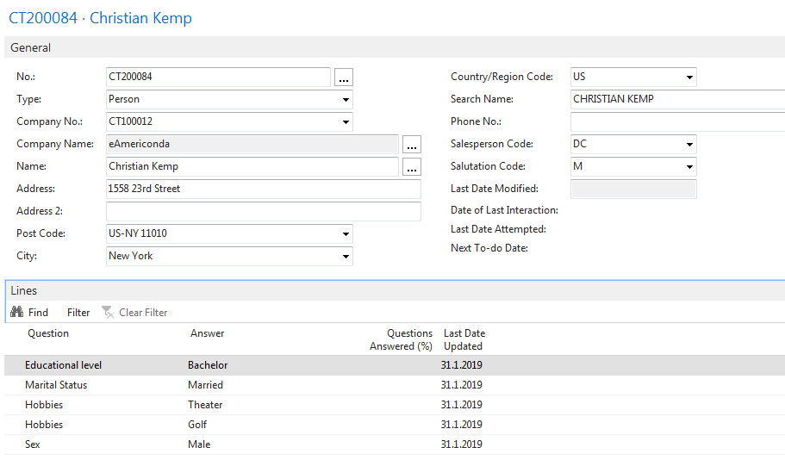
Contact Card- Person
Profile

Slide 12
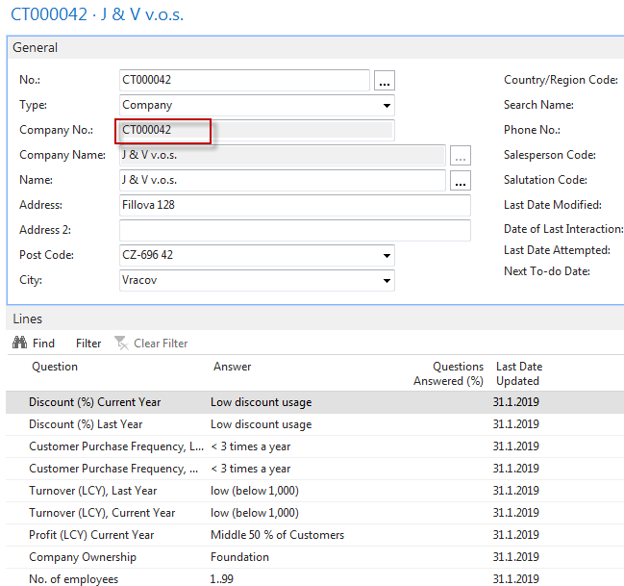
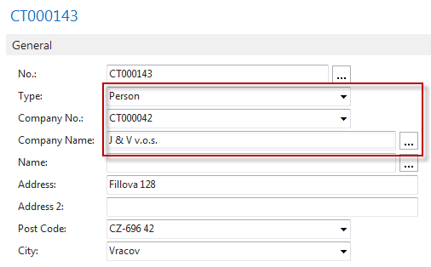
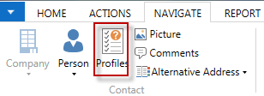
Contact Card- Company-new person - (created from Company card)
See profile settings

Slide 13
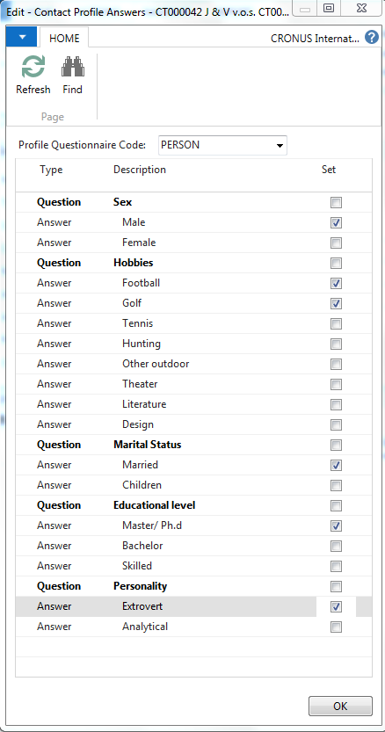
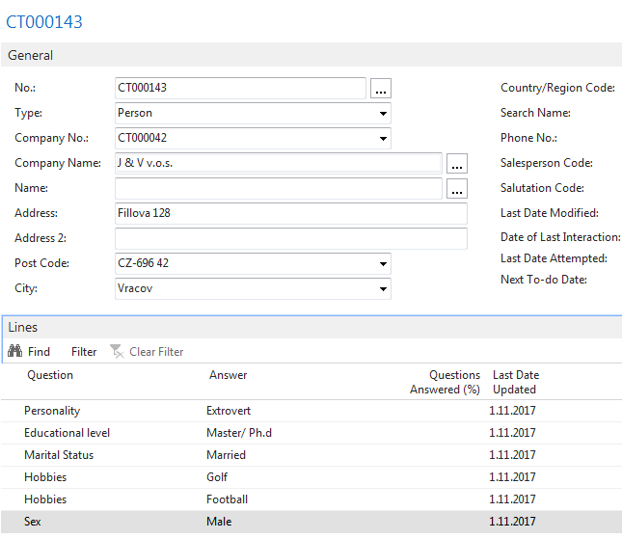
Contact Card- Company-new person - (creation from Company card)

Slide 14
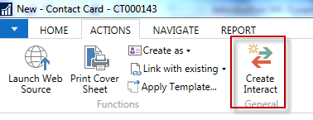
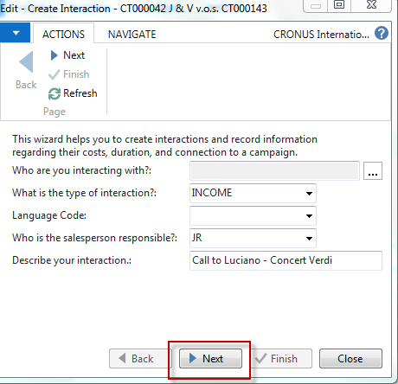
New interaction- use of wizard

Slide 15
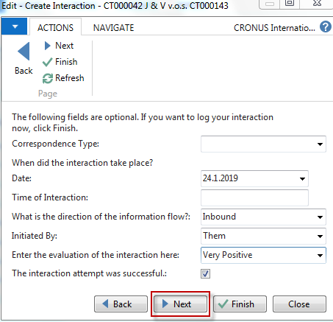
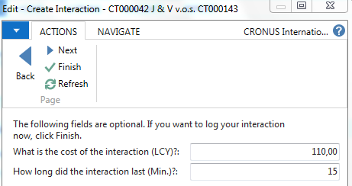
New interaction- use of wizard
Click finish (do not take any optional information into consideration!) and Ctrl-F7

Slide 16
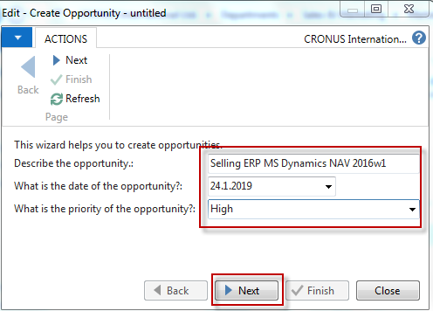
Another CRM area : Opportunity
From searching window

Slide 17
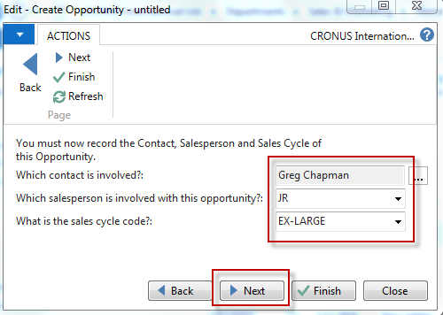
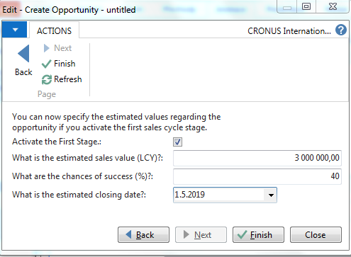
Another CRM area : Opportunity

Slide 18
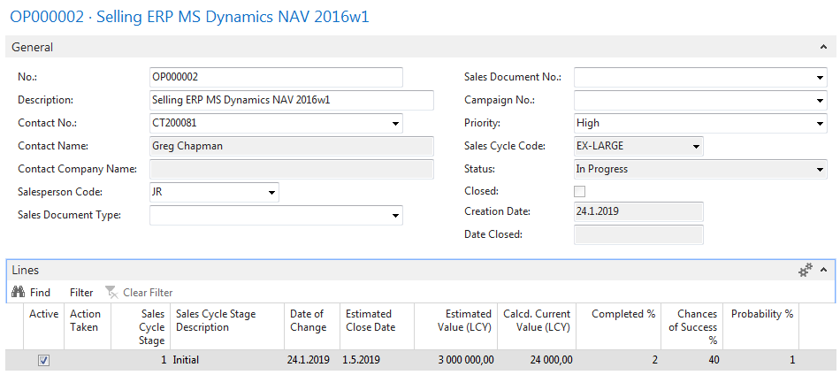
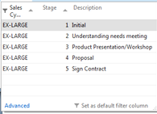
Another CRM area : Opportunity
From here you can create various
To-Dos and and change Sales Cycle stages….

Slide 19
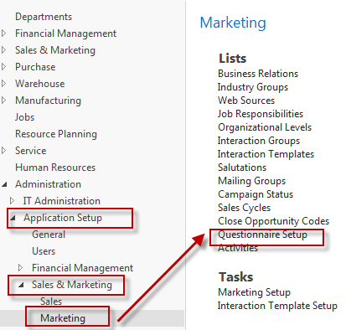
Personal profile creation

Slide 20
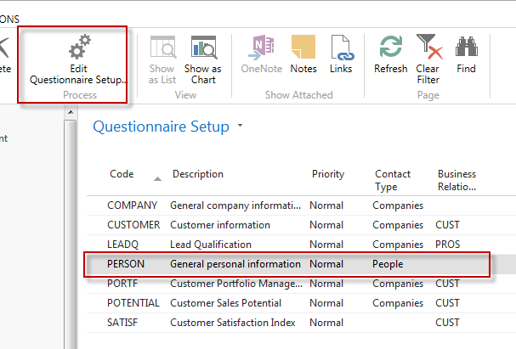
Personal profile creation

Slide 21
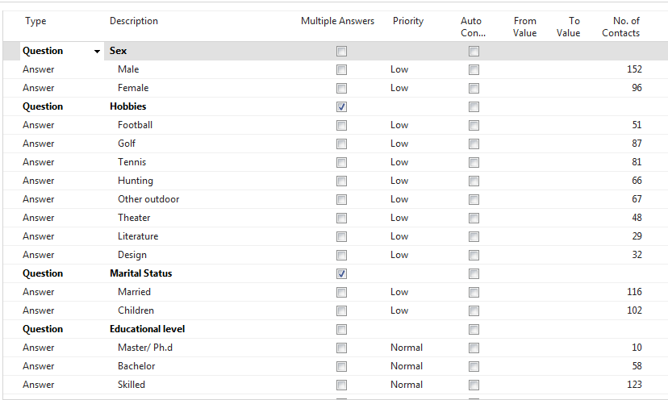
Personal profile creation

Slide 22
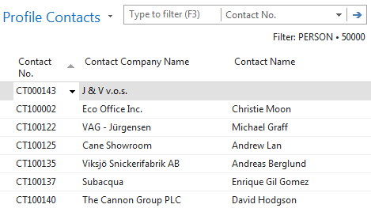
Personal profile creation
We have entered
several lines
All 51 contacts
playing football

Slide 23
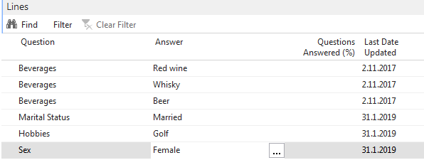
Personal profile creation
Profile of one chosen contact card (type person)

Slide 24
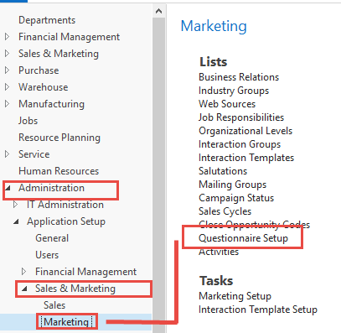
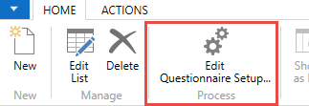
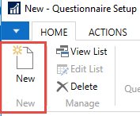
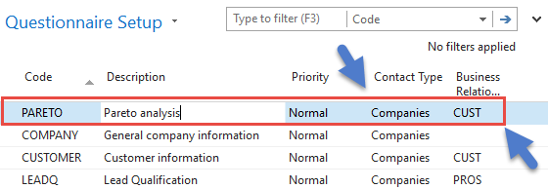
Pareto analysis

Slide 25
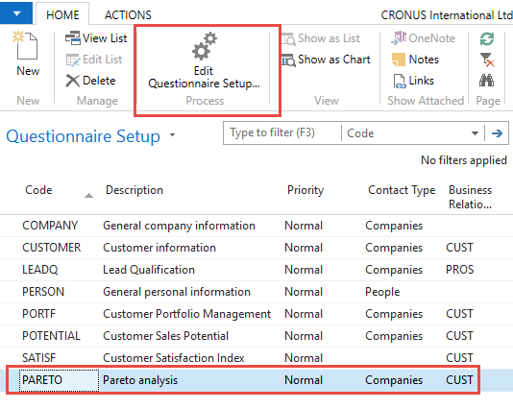
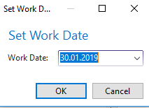
Pareto analysis –specification of questionnaire

Slide 26
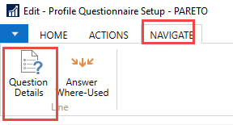
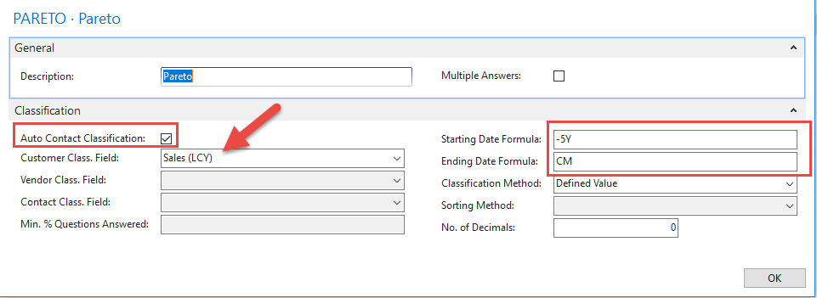
Pareto analysis-specification of question (details)
Starting Date Formula = -5Y means NAV wil trace back all entries
5 years

Slide 27
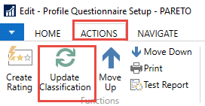
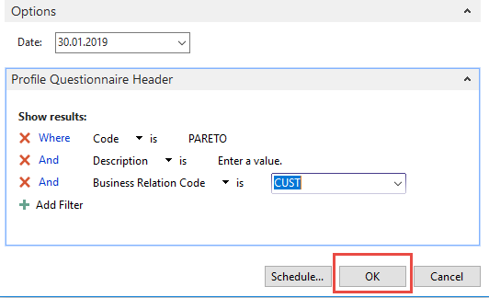
Pareto analysis
Limits for different levels (A-C)

Slide 28
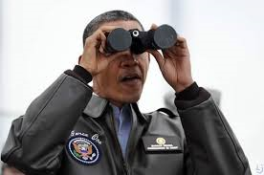
Pareto analysis –results of updated questionnaire

Slide 29
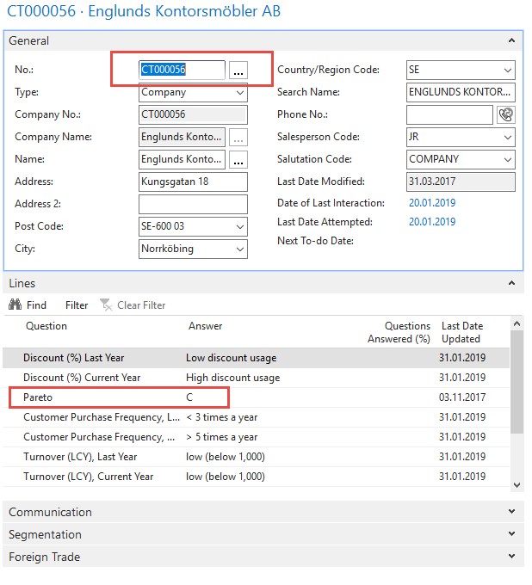
One of Contact Cards marked by code C

Slide 30
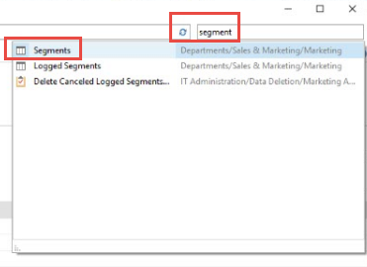
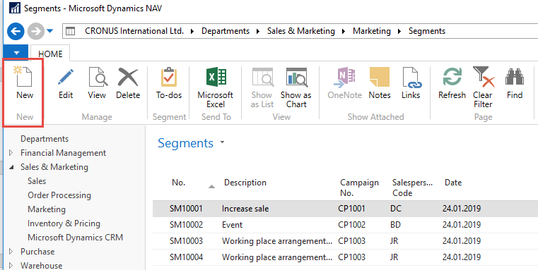
Segments

Slide 31
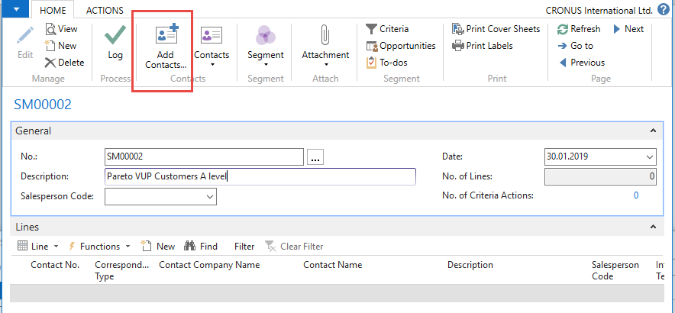
Segments

Slide 32
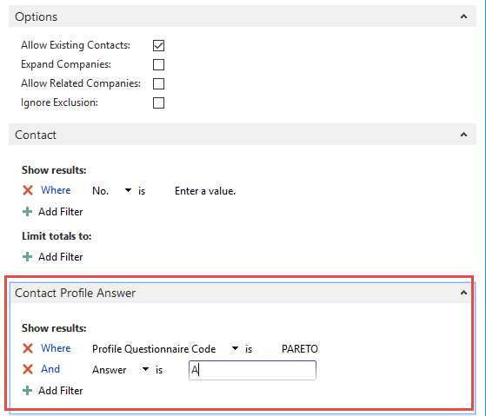
Segments (entering values..)

Slide 33
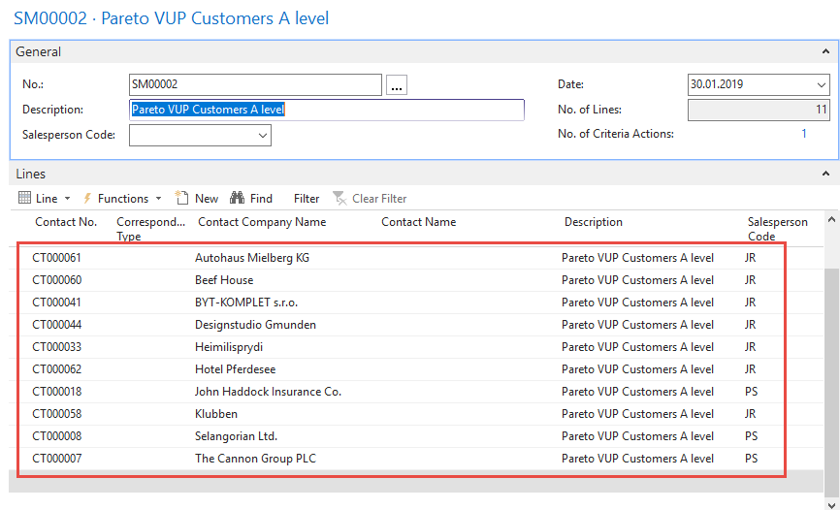
Segments

Slide 34
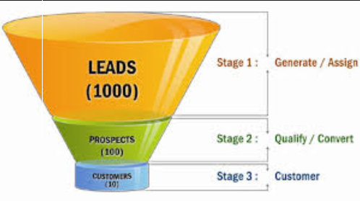
End of the section (Customer Relationship Management)

