Slide 1
Rozdíly ovládání MS Dynamics NAV 2016 (2017)
Windows Client <-> WEB Client
J.Skorkovský – KPH-ESF-MU Brno
S využitím zdrojů DynAA a PWP 80949 a Course 80949 Introduction to Microsoft Dynamics NAV 2016 – materiál editovaný ve WORDu na adrese https://mbspartner.microsoft.com/NAV/CourseModules/1506
a dále pak ve studijních materiálech . Jde o zjednodušení první časti PWP.
With the use of DynAA resources and PWP80949 and Course 80949 Introduction to Microsoft Dynamics NAV 2016 and word material on address https://mbspartner.microsoft.com/NAV/CourseModules/1506
and also in your study material . This is a simplified first part of the original presentation.

Slide 2
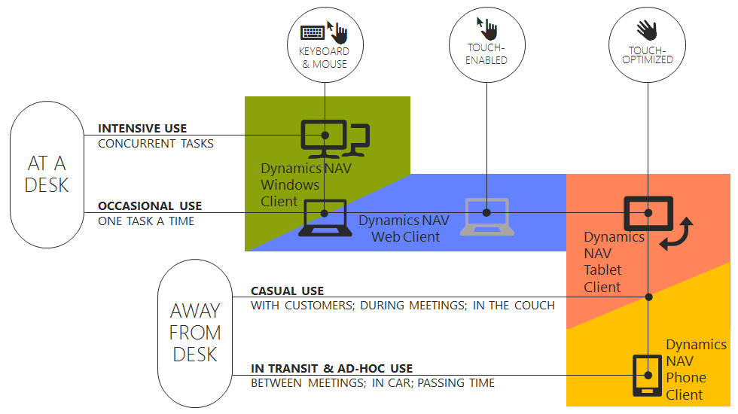
Module 2 - Overview
Windows Client
Web Client
Phone Client
Tablet Client
Outlook Client
Notes:
Before starting to explore Microsoft Dynamics NAV, in this module you will give a short introduction of all the different application areas.
The purpose is to give the audience an idea what NAV can be used for.
You can of course not cover every module in detail. You could however refer to other courses that cover these topics more in detail.

Slide 3
Windows Client
Role Tailored
Intuitive and versatile
Notes:
You can use this slide to show the structure of the ribbon.
Also refer to other Microsoft applications (such as Office) that also use ribbons.

Slide 4
Web Client
View and edit NAV data over the internet
Any web browser
Interface similar to the NAV Windows client
Notes:
You can use this slide to show the structure of the ribbon.
Also refer to other Microsoft applications (such as Office) that also use ribbons.

Slide 5
User Interface - Overview
The Window Client and Web Client Interface.
The Application Menu
My Settings –Web Client
The Ribbon
The Navigation pane.
The List page.
The Card page.
Explore the Role Center.
Notes:
The purpose of this module is to familiarize the audience with the NAV user interface.
You can cover the different components starting at the top, and then move down to the bottom of the window (the status bar).
Try to limit details on personalization, because this is covered in the following module.

Slide 6
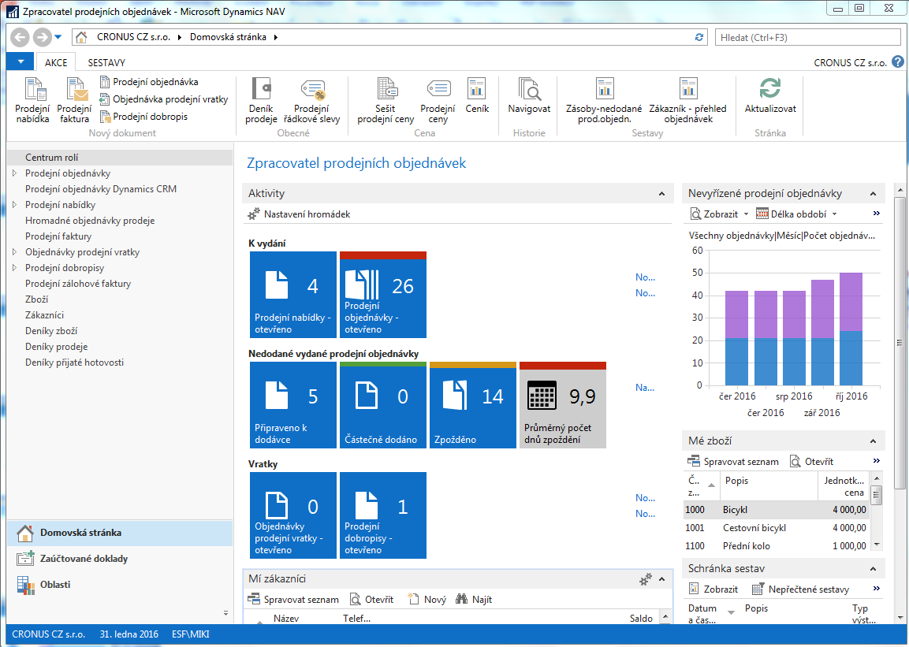
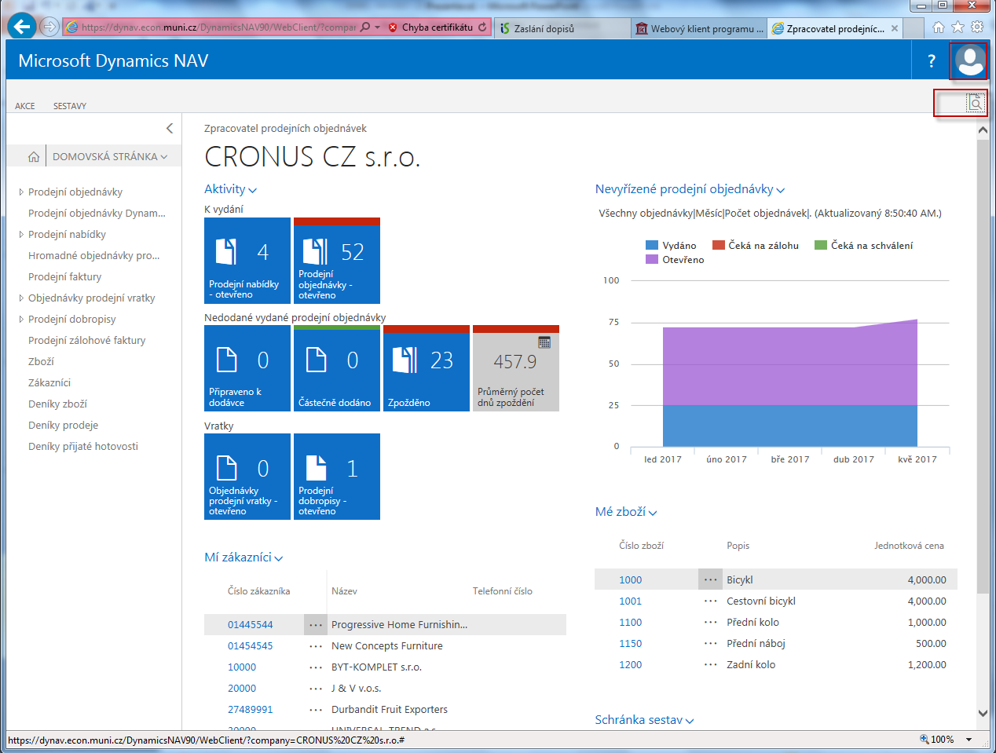
Úvodní obrazovky – opening screens (forms) - CZ
Notes:
Both screens are in Czech language

Slide 7
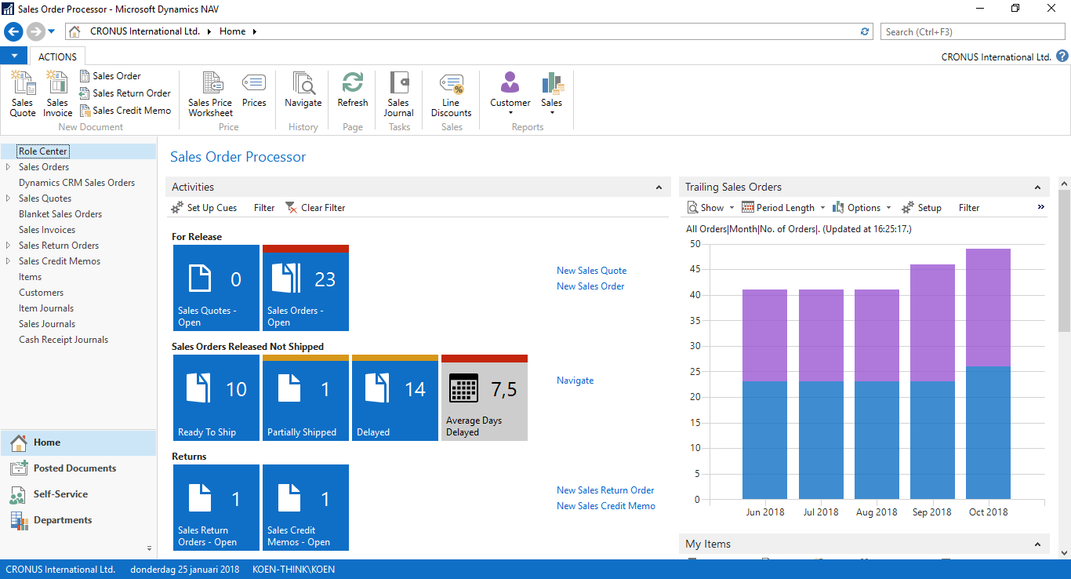
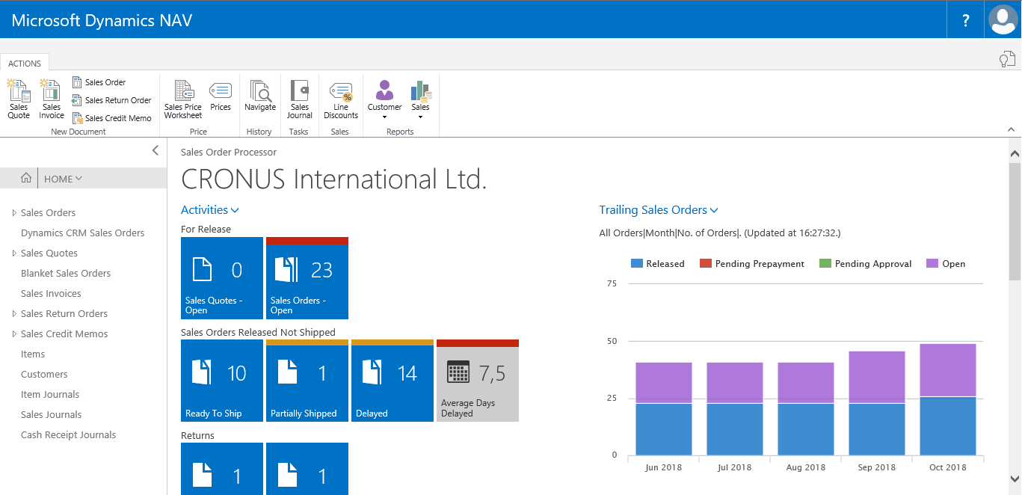
The Windows Client and Web Client Interface -ENG
My Settings
Notes:
You can use this slide to show the structure of the ribbon.
Also refer to other Microsoft applications (such as Office) that also use ribbons.

Slide 8
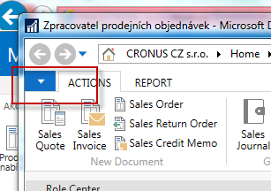
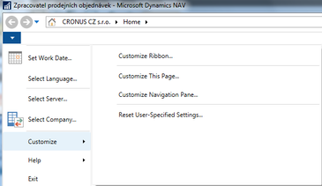
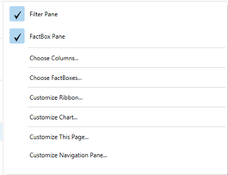
The Application Menu
Only in Windows Client
Change:
  Work Date
  Language
  Server
  Company
Customize
Help
If started from e.g. List window
Notes:
You can use this slide to show the structure of the ribbon.
Also refer to other Microsoft applications (such as Office) that also use ribbons.

Slide 9
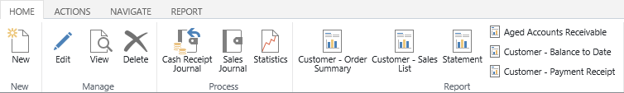
Ribbon and Navigation Pane
Tab
Action
Group
 | Windows client | Web client
Home menu | ✓ | ✓
Additional menus | ✓ | ✓
Departments menu | ✓

Slide 10
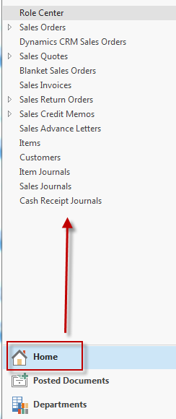
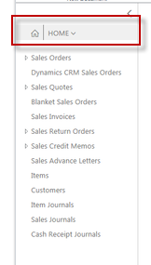
Home menu
Windows Client
Web Client

Slide 11
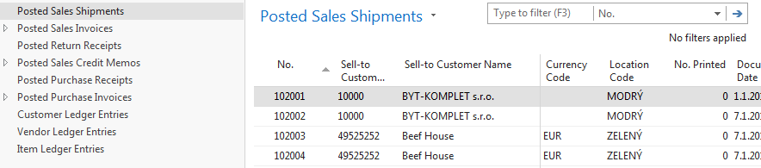
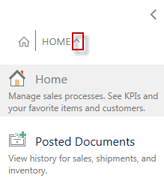
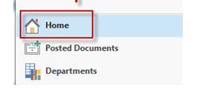
Additional menu
Windows Client
Web Client Additional menu
Additional menu (already exists)

Slide 12
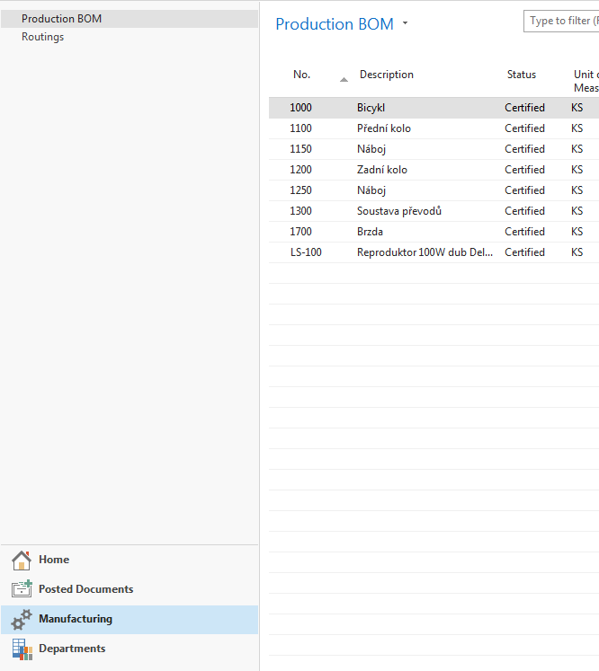
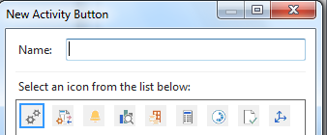
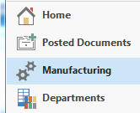
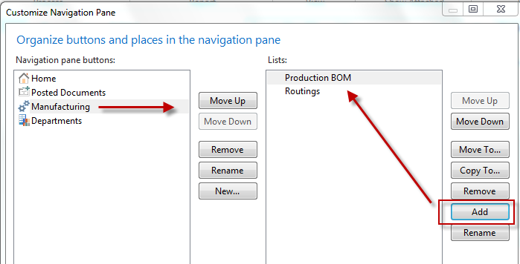
Additional menu- manufacturing
Manufacturing

Slide 13
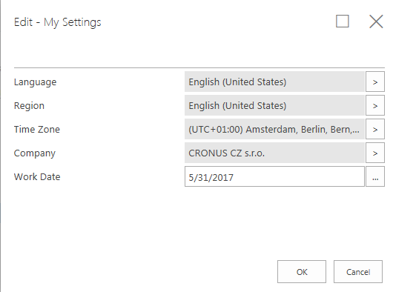

My Settings – not all in our Web client !!
Only in Web Client
Change:
  Role Centre
  Company
  Work Date
  Region
  Language
  Time Zone
My Notifications
Notes:
You can use this slide to show the structure of the ribbon.
Also refer to other Microsoft applications (such as Office) that also use ribbons.

Slide 14
Pages
Card | Worksheet
List | Confirmation dialog
Role Center | List plus
Card part | Navigate page (wizard)
List part | Standard dialog
Document
Notes:
Use this slide to show the different page types, but also emphasize that you will cover the 2 most used types in detail:
Card
List

Slide 15
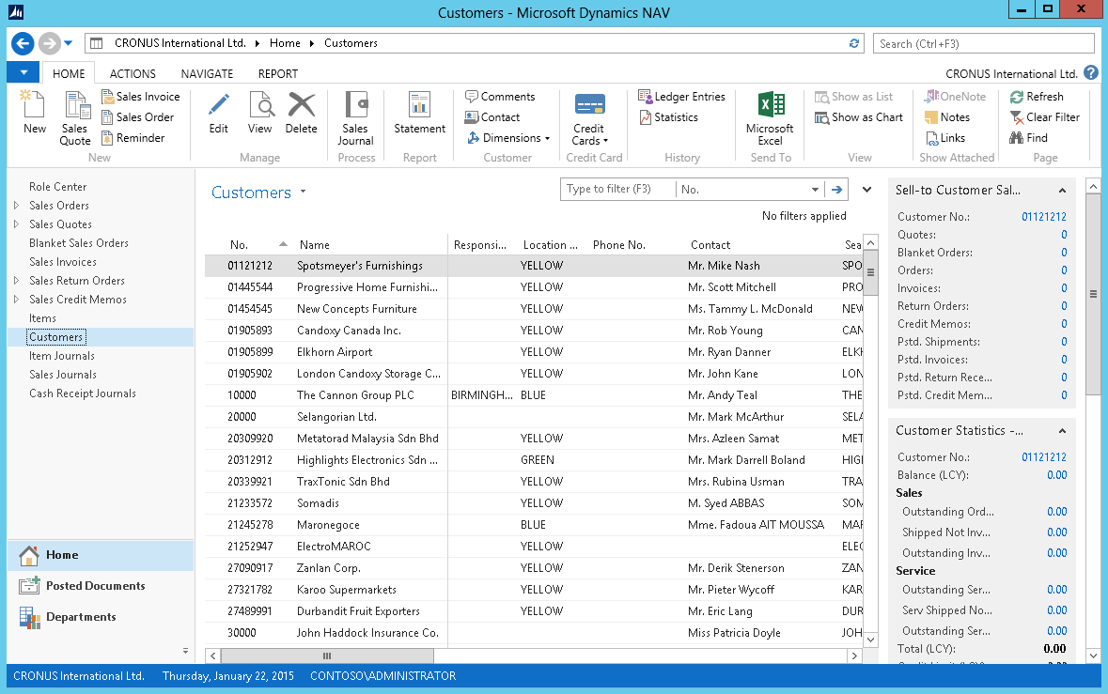
Pages
List Page Windows Client
Ribbon
Filter pane
List
FactBox pane
1
2
4
3
Notes:
After showing this slide and explaining the different components of a list page, go to the application and show some examples of list pages.
Remember to only focus on the interface. Topics such as personalization, filter, search, … are covered in other modules.

Slide 16
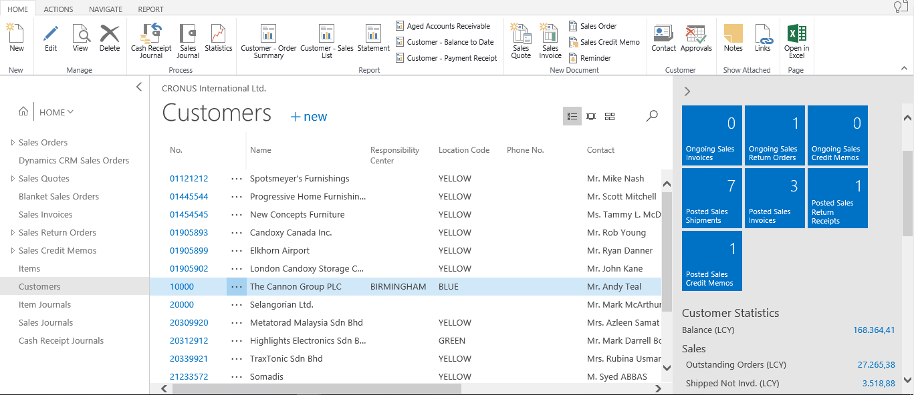
Pages
List Page Web Client
Ribbon
Display & Search
List
FactBox pane
1
2
4
3
Notes:
After showing this slide and explaining the different components of a list page, go to the application and show some examples of list pages.
Remember to only focus on the interface. Topics such as personalization, filter, search, … are covered in other modules.

Slide 17
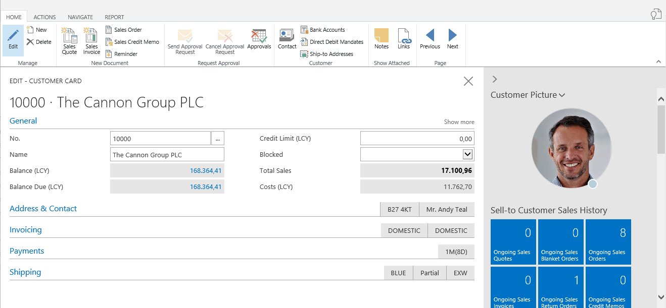
Pages
Card Page
Ribbon
Expanded FastTab
Collapsed FastTab
FactBox pane
1
2
4
3
Notes:
After showing this slide and explaining the different components of a card page, go to the application and show some examples of card pages.

