Slide 1
Instructions Valuation
The very basic of Financial Mathematics
Financial Mathematic
Seminar
Luděk Benada, Dagmar Linnertova
Department of Finance - 402, benada.esf@gmail.com
October 13, 2017
The Study materials prepared by
Mikhail Dmitrievich Balyka
BPF_AFMT

Slide 2
Annuities
Exercise 1
You put 333$ into a bank account 4 times per year (at the beginning of each quarter) for 25 years at 4,5% p.a. Interest is calculated monthly.
‼BUT, to avoid inflation, every quarter you deposit 0,5% more (i.e annuity₂/annuity₁=1,005).
S_{25yrs} - ?
BPF_AFMT

Slide 3
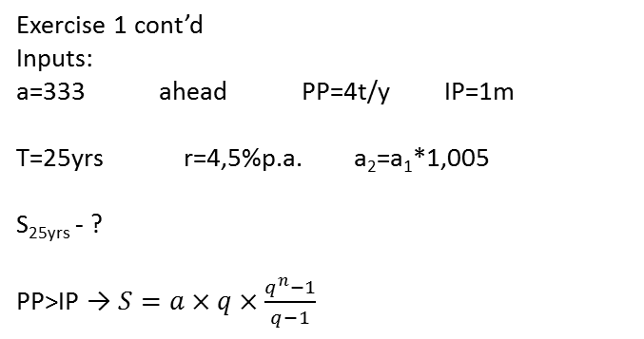
Annuities
Exercise 1 cont’d
Inputs:
a=333 ahead PP=4t/y IP=1m
T=25yrs r=4,5%p.a. a₂=a₁*1,005
S_{25yrs} - ?
PP>IP → $S=a×q×\frac{q^{n}−1}{q−1}$
BPF_AFMT

Slide 4

Annuities
Exercise 1 cont’d
$$S=a×q×\frac{q^{n}−1}{q−1}$$
PP=3 months
a=333 a=333*1,005
a=333*(1+0,045/12)¹²
a=333*1,005*(1+0,045/12)¹²⁻³
BPF_AFMT

Slide 5
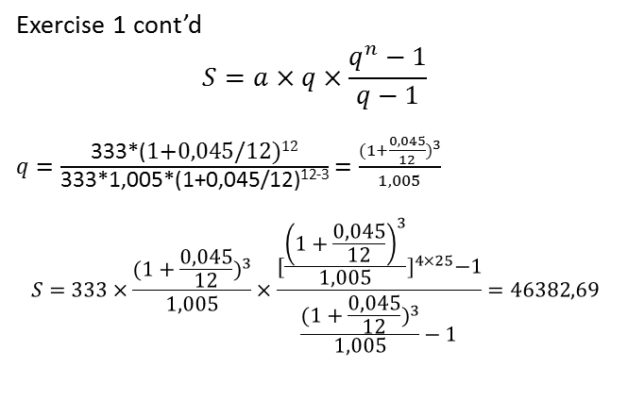
Annuities
Exercise 1 cont’d
$$S=a×q×\frac{q^{n}−1}{q−1}$$
$q=\frac{\text{333∗(}\text{1+0,045/12)}\text{12}}{\text{333∗1,005∗(1+0,045/12)}\text{12−3}}=\frac{{(1+\frac{0,045}{12})}^{3}}{1,005}$
$$S=333×\frac{{(1+\frac{0,045}{12})}^{3}}{1,005}×\frac{{[\frac{{\left(1+\frac{0,045}{12}\right)}^{3}}{1,005}]}^{4×25}−1}{\frac{{(1+\frac{0,045}{12})}^{3}}{1,005}−1}=46382,69$$
BPF_AFMT

Slide 6
Annuities
Exercise 2
You put 200 000$ into a bank account at 2% p.q. You pay 5 000$ to open this account and also at the end of each month you pay a bank fee 200$. Interest is calculated quarterly.
Find the average annual return on this investment
BPF_AFMT

Slide 7
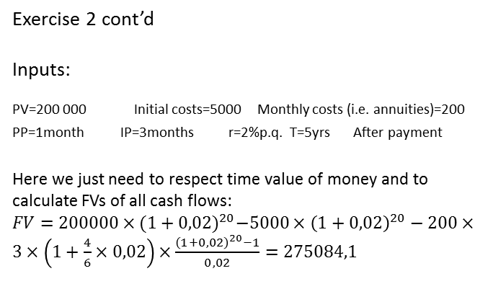
Annuities
Exercise 2 cont’d
Inputs:
PV=200 000 Initial costs=5000 Monthly costs (i.e. annuities)=200 PP=1month IP=3months r=2%p.q. T=5yrs After payment
Here we just need to respect time value of money and to calculate FVs of all cash flows:
$FV=200000×{(1+0,02)}^{20}−5000×{\left(1+0,02\right)}^{20}−200×3×\left(1+\frac{4}{6}×0,02\right)×\frac{{\left(1+0,02\right)}^{20}−1}{0,02}=275084,1$
BPF_AFMT

Slide 8
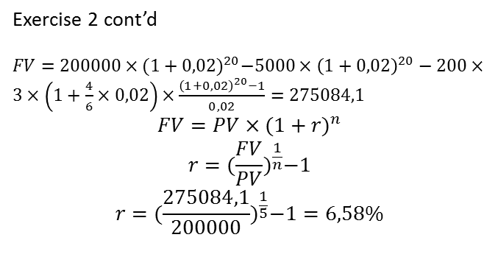
Annuities
Exercise 2 cont’d
$FV=200000×{(1+0,02)}^{20}−5000×{\left(1+0,02\right)}^{20}−200×3×\left(1+\frac{4}{6}×0,02\right)×\frac{{\left(1+0,02\right)}^{20}−1}{0,02}=275084,1$
$$FV=PV×{(1+r)}^{n}$$
$$r={(\frac{FV}{PV})}^{\frac{1}{n}}−1$$
$$r={(\frac{275084,1}{200000})}^{\frac{1}{5}}−1=6,58\%$$
BPF_AFMT

Slide 9
Annuities
Exercise 3
You put 15 000 $ into a bank account at the end of each quarter at 3,7% p.a. for 10 years. Interest is calculated 2 times per year. Tax rate is 15% and it’s calculated at the end of investment’s period
S_{tax} -?
BPF_AFMT

Slide 10
Annuities
Exercise 3 cont’d
Inputs:
a=15 000 PP=3m(after) IP=6m r=3,7% p.a.
T=10 yrs tax=15% TP=10yrs
S_{tax} -?
$$S=a×m×(1+\frac{m−1}{2m}×r)×\frac{{(1+r)}^{n}}{r}$$
To calculate the after tax’s amount of money we need to deduct from our FV a sum of annuities made in one TP
BPF_AFMT

Slide 11
Annuities
Exercise 3 cont’d
$$S=a×m×(1+\frac{m−1}{2m}×r)×\frac{{(1+r)}^{n}−1}{r}$$
To calculate the after tax’s amount of money we need to deduct from our FV a sum of annuities made in one TP
$$S=15000×\{\left[3×\left(1+\frac{3−1}{2×3}×\frac{0,037}{2}\right)×\frac{{\left(1+\frac{0,037}{2}\right)}^{20}−1}{\frac{0,037}{2}}−40\right]×0,85+40\}$$
we deduct our annu-s (# of ‘a’ in one TP)
mult-ing by the % retained after tax and adding back our ‘a’ we will get ‘S’ after tax
BPF_AFMT

Slide 12
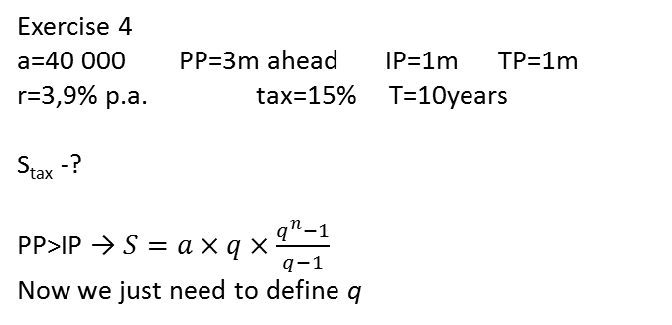
Annuities
Exercise 4
a=40 000 PP=3m ahead IP=1m TP=1m
r=3,9% p.a. tax=15% T=10years
S_{tax} -?
PP>IP → $S=a×q×\frac{q^{n}−1}{q−1}$
Now we just need to define q
BPF_AFMT

Slide 13
Annuities
Exercise 4 cont’d
$$S=a×q×\frac{q^{n}−1}{q−1}$$
As we know tax is calculated from interest
How we can find it:
$$I=PV×\left[{\left(1+r\right)}^{n}−1\right]$$
But in our case n=1, so we can rearrange the formula and find our interest after tax:
$$I=PV×r×(1−tax)$$
Since, our $q={(1+\frac{0,039}{12}×0,85)}^{3}$
BPF_AFMT

Slide 14
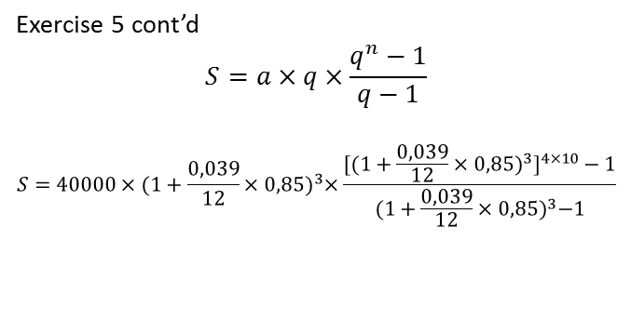
Annuities
Exercise 5 cont’d
$$S=a×q×\frac{q^{n}−1}{q−1}$$
$$S=40000×{(1+\frac{0,039}{12}×0,85)}^{3}×\frac{{{[(1+\frac{0,039}{12}×0,85)}^{3}]}^{4×10}−1}{{(1+\frac{0,039}{12}×0,85)}^{3}−1}$$
BPF_AFMT

Slide 15
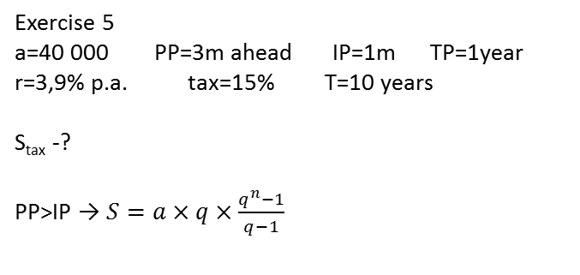
Annuities
Exercise 5
a=40 000 PP=3m ahead IP=1m TP=1year
r=3,9% p.a. tax=15% T=10 years
S_{tax} -?
PP>IP → $S=a×q×\frac{q^{n}−1}{q−1}$
BPF_AFMT

Slide 16
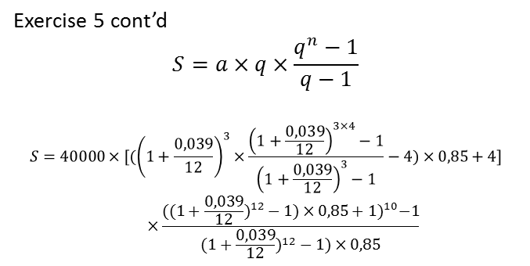
Annuities
Exercise 5 cont’d
$$S=a×q×\frac{q^{n}−1}{q−1}$$
$$S=40000×[({\left(1+\frac{0,039}{12}\right)}^{3}×\frac{{\left(1+\frac{0,039}{12}\right)}^{3×4}−1}{{\left(1+\frac{0,039}{12}\right)}^{3}−1}−4)×0,85+4]×\frac{{(({1+\frac{0,039}{12})}^{12}−1)×0,85+1)}^{10}−1}{({1+\frac{0,039}{12})}^{12}−1)×0,85}$$
BPF_AFMT

Slide 17
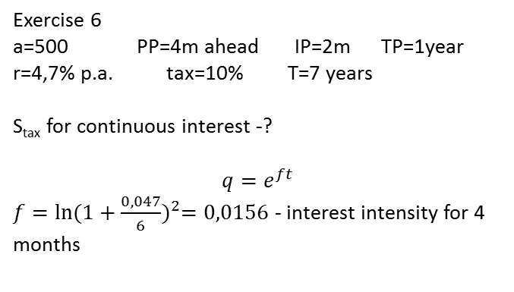
Annuities
Exercise 6
a=500 PP=4m ahead IP=2m TP=1year
r=4,7% p.a. tax=10% T=7 years
S_{tax} for continuous interest -?
$$q=e^{ft}$$
$f=\ln{{(1+\frac{0,047}{6})}^{2}=0,0156}$ - interest intensity for 4 months
BPF_AFMT

Slide 18
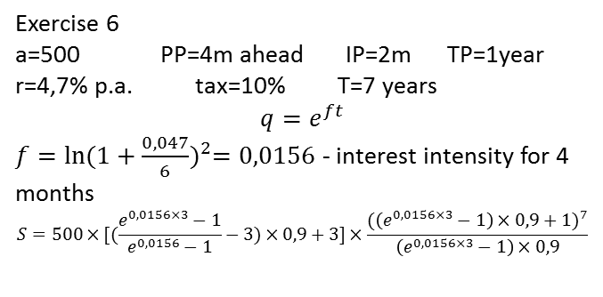
Annuities
Exercise 6
a=500 PP=4m ahead IP=2m TP=1year
r=4,7% p.a. tax=10% T=7 years
$$q=e^{ft}$$
$f=\ln{{(1+\frac{0,047}{6})}^{2}=0,0156}$ - interest intensity for 4 months
$$S=500×[(\frac{e^{0,0156×3}−1}{e^{0,0156}−1}−3)×0,9+3]×\frac{{(\left(e^{0,0156×3}−1\right)×0,9+1)}^{7}}{\left(e^{0,0156×3}−1\right)×0,9}$$
BPF_AFMT

