Slide 1
Primary activities - Operations
Inbound logistic
Operations
Outbound logistic

Slide 2
Operations - production
Production can simply be defined as the activity of transformation raw materials or components into finished products
Production strategy is concerned with guiding investment decision. Decision made today provide guidelines for future production operations
Production policy - Process of manufacture, machine requirements, factory layout, storage and handling systems, skills required in workmen and their method of training

Slide 3
Basic questions connected with the production
Should resources be placed in production rather than in other areas of a business?
Decide capacity needed to meet agreed production and corporate objectives and when production should commence?
Decide where plant should be located and the type of technology to use.

Slide 4
Types of production are determinated by amount of repetition, range of products, quality.
Factory location and layout is determinated by availability of land, labour, raw materials, climate, local regulations or by-laws, climate, social facilities
Production organization is determined by RandD, estimating, standardization, simplification and specialization, quality control, purchasing, maintenance of plant, equipment and buildings, production control, management of energy.

Slide 5
Factors of production to consider are:
Amount of repetition
Range of products
Quality

Slide 6
Types of production
Job ( unit) production
Batch production
Flow production

Slide 7
Job ( unit) production
Customer oriented – customer requires single product made to his specifications e.g. Suit
Demand can be only broadly forecteing
No production stocks
Wider variety of machines and equipment

Slide 8
Batch production
Quantity of products or components are made at the same time
There is a repetition, but not continous production
Production often for stock
Flow production

Slide 9
Flow production
Continuos production of products of a more or less identical nature
Machine is continually used for one product
Must be a continuos demand for the products

Slide 10
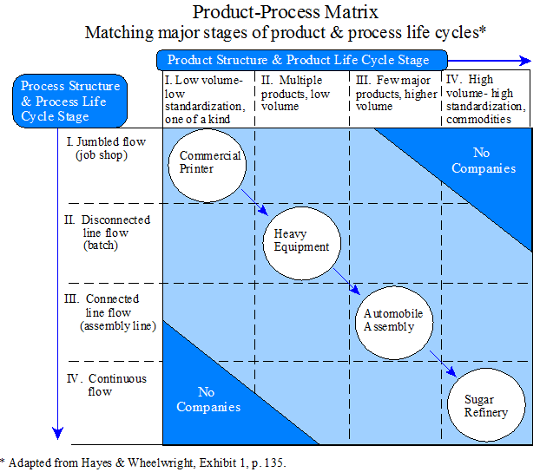

Slide 11
Types of production (Drucker)
Custom-order production – production according the customer demand (units)
Rigid mass production – is the manufacture of large quantities of standardized products, frequently utilizing assembly line technology. Mass production refers to the process of creating large numbers of similar products efficiently. Mass production is typically characterized by some type of mechanization, as with an assembly line, to achieve high volume, the detailed organization of materials flow, careful control of quality standards and division of labor.

Slide 12
Flexible mass production Flexible mass production, however, uses standardization of parts to make possible diversity of end products.
What both principles of mass production have in common is that the final product is assembled out of standardized parts
Process or flow production - Flow production involves a continuous movement of items through the production process.
The main disadvantage is that with so much machinery it is very difficult to alter the production process.
This makes production inflexible and means that all products have to be very similar or standardised and cannot be tailored to individual tastes

Slide 13
Tradition production system vs. JIT system
The traditional approach adopts a functional organization designed to minimize manufacturing costs for the particular component. A JIT system organizes the intermediate processes to respond directly to demands from later stages of production. This distinction can be referred to as the difference between 'cost-push' and 'demand-pull'. (Edmond D'Ouville, T. Hillman Willis & C. Richard Huston Production Planning & Control Vol. 9 , Iss. 5,1998 )

Slide 14
Tradition production system vs. Lean manufacturing
 | Traditional Manufacturing | Lean Manufacturing
Scheduling | Forecast – push | Customer Order – pull
Production | Stock | Customer Order
Lead Time | Long | Short
Batch Size | Large ‒ Batch & Queue | Small ‒ Continuous Flow
Inspection | Sampling ‒ by inspectors | 100% ‒ at source by workers
Layout | Functional | Product Flow
Empowerment | Low | High
Inventory Turns | Low – <7 turns | High – 10+
→ Flexibility | Low | High

Slide 15
Tradition production system
Rely on the accuracy of the schedules based on MPS (Master Production Schedule) including the information about the customers, demand and lead times. These information are based on the
Short planning system called RRPS (Resource requirement planning system). RRPS is the plan for requirements of productive resources including machine/equipment, workers, fund based on the Production Plan. It is to calculate the requirements of each resource by period, referring to the product load profile, based on the planned production by month.
Especially used for job production.

Slide 16
Lean manufacturing
Known as pull system, it works works the opposite way as the tradition production system
everything is focused on the following stage of production and its needs (Customer Order Driven). It is used for producing the goods at the same rate as customers use it.
This system is also known as: Toyota Production System (Toyota), Stockless Production, Action Workout (GE), the commonly accepted name is Just In Time (JIT) manufacturing.

Slide 17
Production scheduling
have a major impact on the productivity of a process. In manufacturing, the purpose of scheduling is to minimize the production time and costs, by telling a production facility when to make, with which staff, and on which equipment. Production scheduling aims to maximize the efficiency of the operation and reduce costs.
is the process of arranging, controlling and optimizing work and workloads in a production process(wikipedie.org)

Slide 18
Regulized schedules and linear output
High –volume assembly industries
Tendency to schedule in work shifts – interval between production runs, or units.

Slide 19
Irregular schedules and output
Sales are uncertain about how much product to expect from operations, it tries to keep protective- and costly- buffer stocks in the distribution system.

Slide 20
Planning the Production Program
Based on demand forecasts and orders plan the production quantities for the (main) products for the „next“ periods
2 variants:
Aggregate Planning
(aggregated view, tactical planning, medium run)
few product groups for the next (months), quarters, or years
capacities can be adjusted (hiring/firing, overtime, holidays, subcontracting ...)
Master Production Scheduling
(more detailed view, operational planning, short run)
all main end products for next few shifts, days, or weeks (or months)
capacities more or less fixed (except for overtime)
Typically solved as an LP model

Slide 21
Aggregate Planning
2 extreme scenarios in case of seasonal demand:
Always produce the demand (forecast)
„Synchronisation“ (zero inventory plan)
→ cost of hiring/firing, overtime, subcontracting, idle time, …
Always produce average yearly demand (high utilization)
„Emancipation“ (level workforce plan)
→ inventory holding cost
Goal:
Trade-off between these costs ⇒ minimize total costs
Solution by column minimum procedure

Slide 22
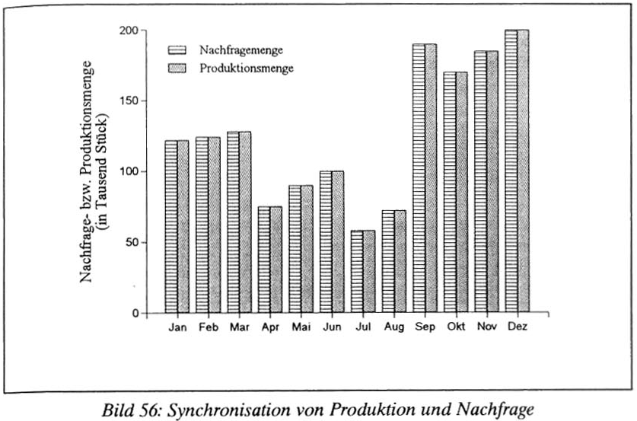
Synchronisation
Synchronisation:
No active planning, just reaction on demand (forecasts)
Always produce the demand (forecast)

Slide 23
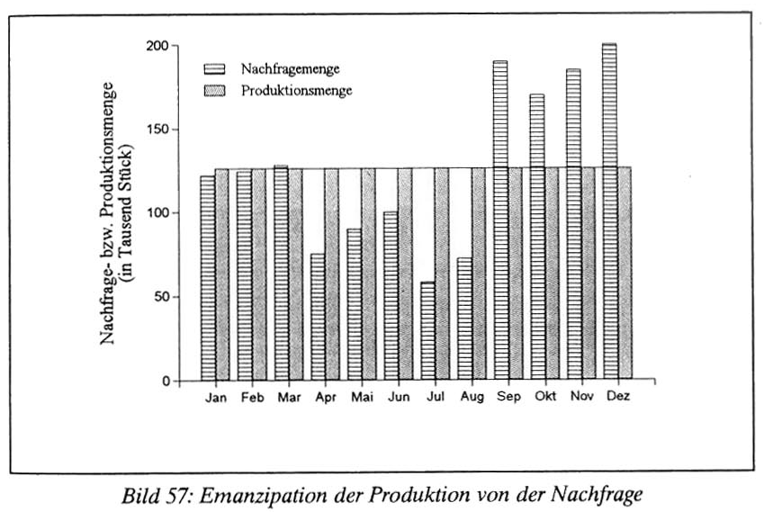
Emancipation
Emancipation:
More or less constant demand, constant (high) resource utilization, fluctuating demand is fulfilled by building up and depleting inventory.
Constant Production
Build up Inventory
Reduce Inventory

Slide 24
Column Minimum Procedure
In each period regular capacity can be extended at extra cost
(overtime, subcontracting, …)
Cope with fluctuating demand (capacity shortages):
Produce more than demand – build up inventory, OR
Use extra capacity
Solution a special case (just one product group) as a TP
In each cell (row t … production period, half row k … capacity type, and
column τ … demand period) the unit extra cost are:
c_{tkτ} = u_{k} + h(τ - t)
where: u_{k} ... Extra cost (per unit) of production using extra capacity k (e.g. overtime)
h ... Inventory holding cost per unit and per period,
h(τ - t) ... Inventory holding per unit if produced τ - t periods early
Solve as transportation problem using Column Minimum Procedure

Slide 25
Calculation optimal batch size
The optimal batch size is at the minimum of the aggregation of transformation and holding costs. The aggregated values form a kind of U-shape, hence the name: U-Curve optimisation.
The more items I transfer at once the lower the overall transaction cost is. On the other hand, the more items I have in a batch the larger my inventories are, which increases the holding cost

Slide 26
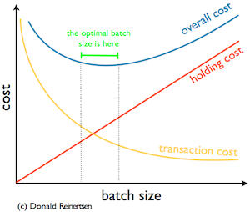
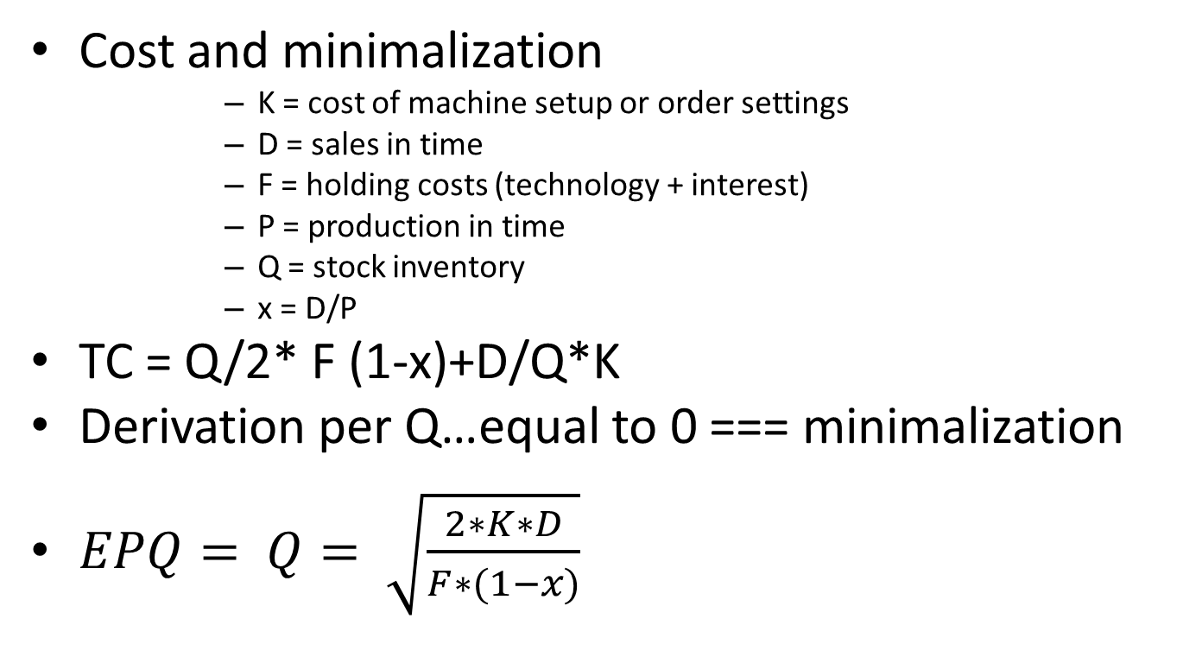
Cost and minimalization
      K = cost of machine setup or order settings
      D = sales in time
      F = holding costs (technology + interest)
      P = production in time
      Q = stock inventory
      x = D/P
TC = Q/2* F (1-x)+D/Q*K
Derivation per Q…equal to 0 === minimalization
$EPQ= Q= \sqrt{\frac{2∗K∗D}{F∗(1−x)}}$

Slide 27
Production organization
Mass (line, flow) production – layout of machines according to production process
Workshop production – machines in workshops according to their function
Grouped production – mix of above
On-site production – production factors are travelling to product ( construction industry)
Production nest – unified production centres
  Job enrichment – increased control power
  Job enlargement – increased range of jobs

Slide 28
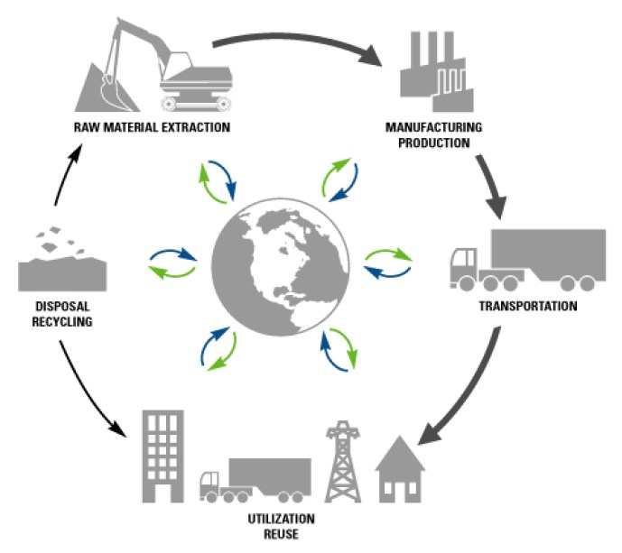
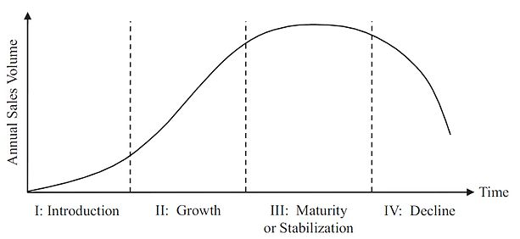
Product lifecycle
2 ways of knowledge: management approach vs. Marketing approach

Slide 29
Product lifecycle management (Source: wikipedia.org)
PLM there are five primary areas:
Systems engineering (SE) is focused on meeting all requirements, primarily meeting customer needs, and coordinating the systems design process by involving all relevant disciplines. An important aspect for life cycle management is a subset within Systems Engineering called Reliability Engineering.
Product and portfolio management (PPM) is focused on managing resource allocation, tracking progress, plan for new product development projects that are in process (or in a holding status). Portfolio management is a tool that assists management in tracking progress on new products and making trade-off decisions when allocating scarce resources.
Product design is the process of creating a new product to be sold by a business to its customers.
Manufacturing process management (MPM) is a collection of technologies and methods used to define how products are to be manufactured.
Product data management (PDM) is focused on capturing and maintaining information on products and/or services through their development and useful life. Change management is an important part of PDM/PLM.

Slide 30
Product lifecycle marketing
4 stages:
Introduction to the market
Growth stage
Maturity stage
Saturation and decline stage

Slide 31
Introduction to the market
This is the stage in which the product has been introduced first time in the market and the sales of the product starts to grow slowly and gradually and the profit received from the product is nominal and non-attained. The market for the product is not competitive initially and also the company spends initially on the advertisement and uses various other tools for promotion in order to motivate and produce awareness among the consumers, therefore generating discerning demands for particular brand. The products start to gain distribution as the product is initially new in the market and in this stage the quality of the product is not assured and the price of the product will also be determined as low or high.⁽Anderson & Zeithaml, Carl R. & Carl P. ,1984). )
costs are very high
slow sales volumes to start
little or no competition
demand has to be created
customers have to be prompted to try the product
makes little money at this stage

Slide 32
Growth stage (wikipedie.org)
In the growth stage, the product is present already in the market and the consumers of the products are habitual of the product and also there is quick growth in the product sales as more new and new customers are using and trying and are becoming aware of the product. The customers are becoming satisfied from the product and they bought it again and again. The ratio of the product repetition for the trial procurement risen and also at this level, the competitors have started to overflow the market with more appealing and attractive inventions. This helps in creating increased competition in the market and also results in decreasing the product price.
costs reduced due to economies of scale
sales volume increases significantly
profitability begins to rise
public awareness increases
competition begins to increase with a few new players in establishing market
increased competition leads to price decreases

Slide 33
Maturity stage
In maturity stage, the cost of the product has been decreased because of the increased volume of the product and the product started to experience the curve effects. Also, more and more competitors have seen to be leaving the market. In this way very few buyers have been left for the product and this results in less sales of the product. The decline of the product and cost of attaining new buyers in this level is more as compare to the resulted profit. The brand or the product differentiation via rebating and discounts in price supports in recalling the outlet distribution. Also, there is a decline in the entire cost of marketing through enhancing the distribution and promotional efficiency with switching brand and segmentation. (Griffin, Abbie , 1997)
costs are decreased as a result of production volumes increasing and experience curve effects
sales volume peaks and market saturation is reached
increase in competitors entering the market
prices tend to drop due to the proliferation of competing products
brand differentiation and feature diversification is emphasized to maintain or increase market share
industrial profits go down

Slide 34
Saturation and decline
In this stage, the profit as well as the sales of the product has started to decline because of the deletion of the product from the market. The market for the product in this stage, started to show negative rate of growth and corroding cash flows. The product, at this stage may be kept but there should be less adverts. ⁽Steffens, Paul,2002)
costs become counter-optimal
sales volume decline
prices, profitability diminish
profit becomes more a challenge of production/distribution efficiency than increased sales

Slide 35
BCG matrix
BCG matrix (or growth-share matrix) is a corporate planning tool, which is used to portray firm’s brand portfolio or SBUs on a quadrant along relative market share axis (horizontal axis) and speed of market growth (vertical axis) axis.
(https://www.strategicmanagementinsight.com/tools/bcg-matrix-growth-share.html)

Slide 36
BCG matrix is a framework created by Boston Consulting Group to evaluate the strategic position of the business brand portfolio and its potential. It classifies business portfolio into four categories based on industry attractiveness (growth rate of that industry) and competitive position (relative market share). These two dimensions reveal likely profitability of the business portfolio in terms of cash needed to support that unit and cash generated by it. The general purpose of the analysis is to help understand, which brands the firm should invest in and which ones should be divested.
(https://www.strategicmanagementinsight.com/tools/bcg-matrix-growth-share.html)

Slide 37
Market growth rate. High market growth rate means higher earnings and sometimes profits but it also consumes lots of cash, which is used as investment to stimulate further growth. Therefore, business units that operate in rapid growth industries are cash users and are worth investing in only when they are expected to grow or maintain market share in the future.
(https://www.strategicmanagementinsight.com/tools/bcg-matrix-growth-share.html)

Slide 38
Relative market share. One of the dimensions used to evaluate business portfolio is relative market share. Higher corporate’s market share results in higher cash returns. This is because a firm that produces more, benefits from higher economies of scale and experience curve, which results in higher profits. Nonetheless, it is worth to note that some firms may experience the same benefits with lower production outputs and lower market share.
(https://www.strategicmanagementinsight.com/tools/bcg-matrix-growth-share.html)

Slide 39
There are four quadrants into which firms brands are classified:
Dogs: Strategic choices: Retrenchment, divestiture, liquidation
Stars:Strategic choices: Vertical integration, horizontal integration, market penetration, market development, product development
Question marks:Strategic choices: Market penetration, market development, product development, divestiture
Cows:Strategic choices: Product development, diversification, divestiture, retrenchment

Slide 40
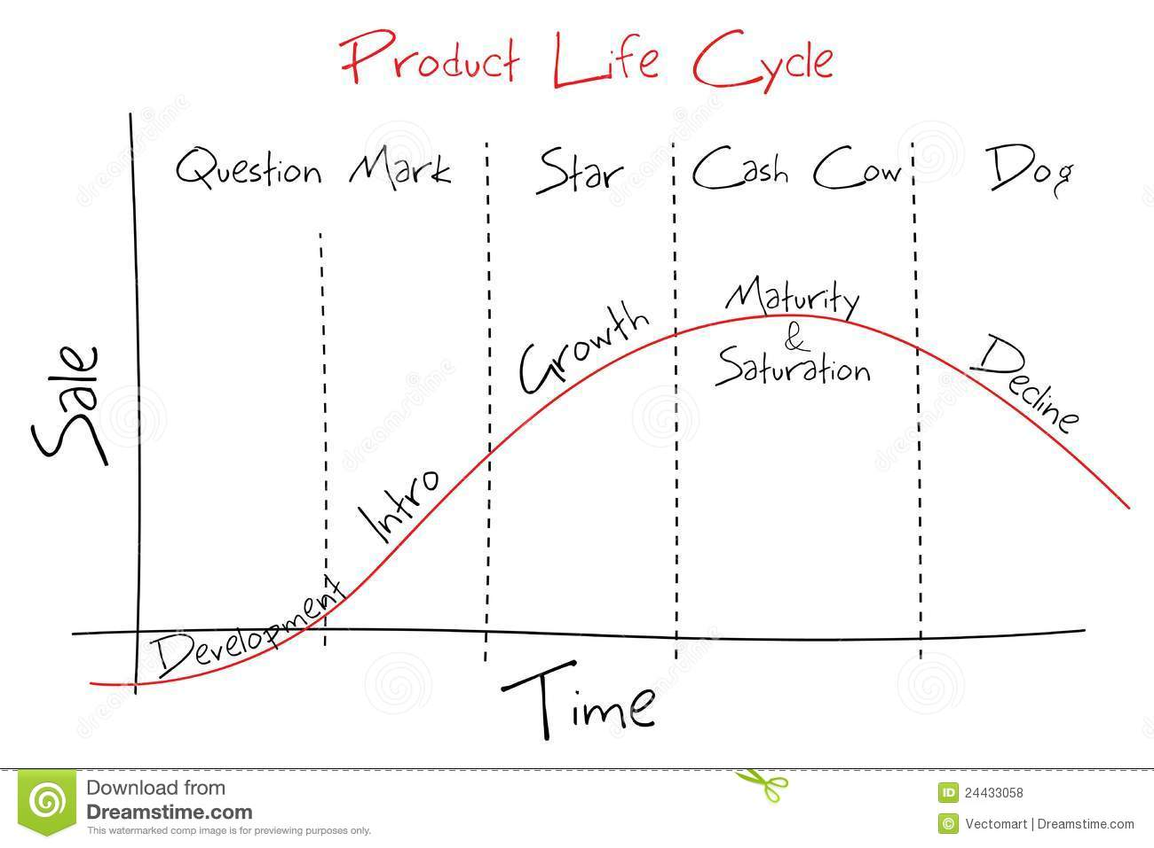
BCG matrix and product life cycle
Zdroj: www.dreamstime.com

