Slide 1
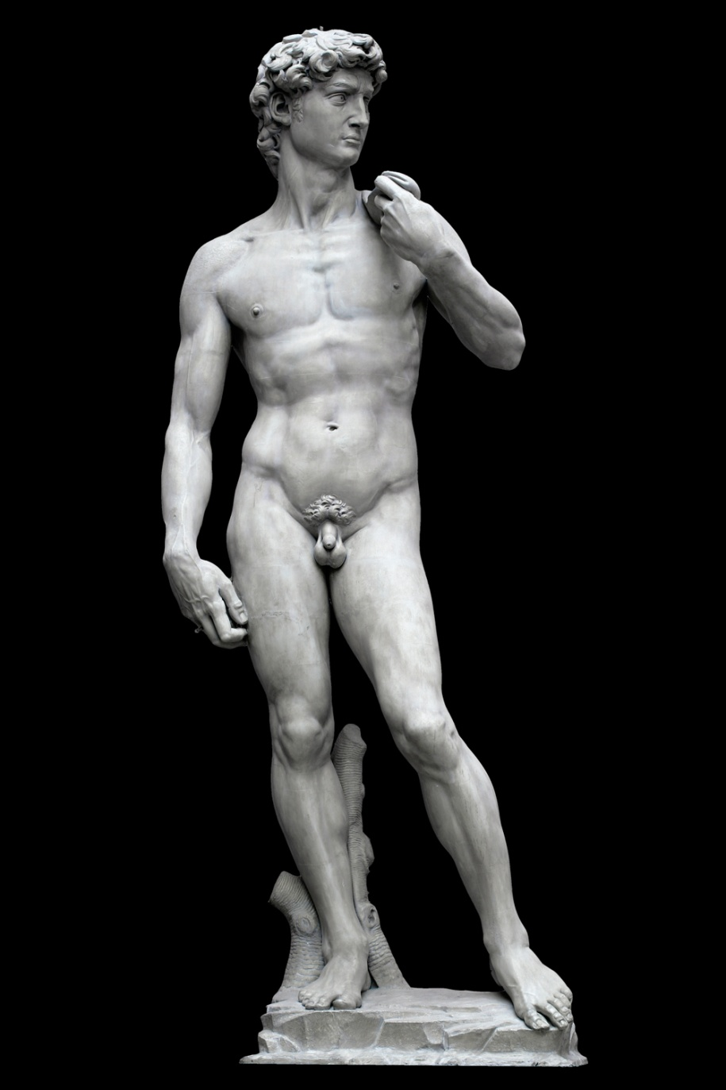
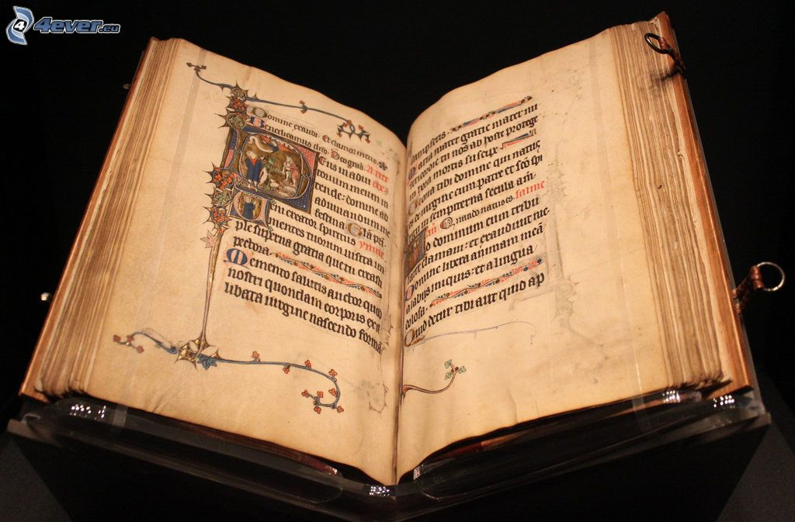
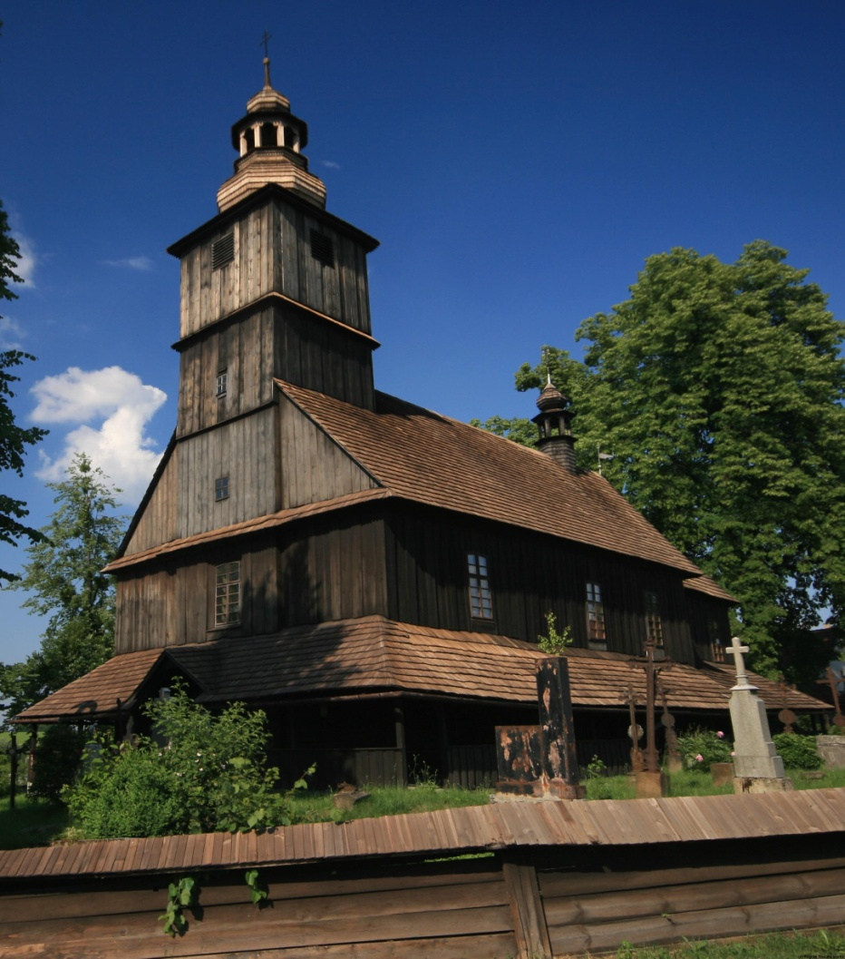
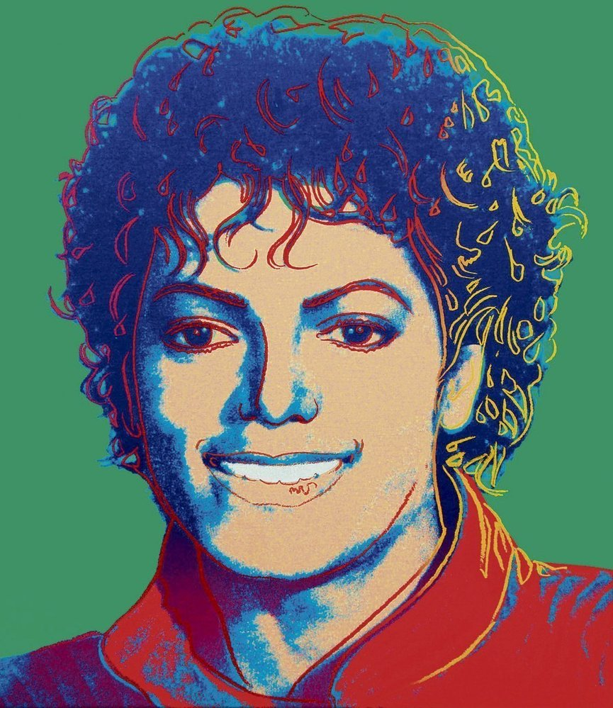
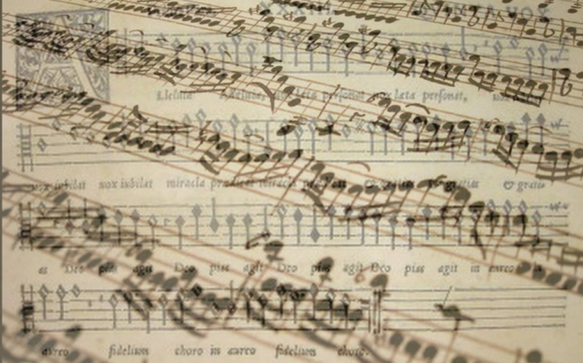
Public support of culture

Slide 2
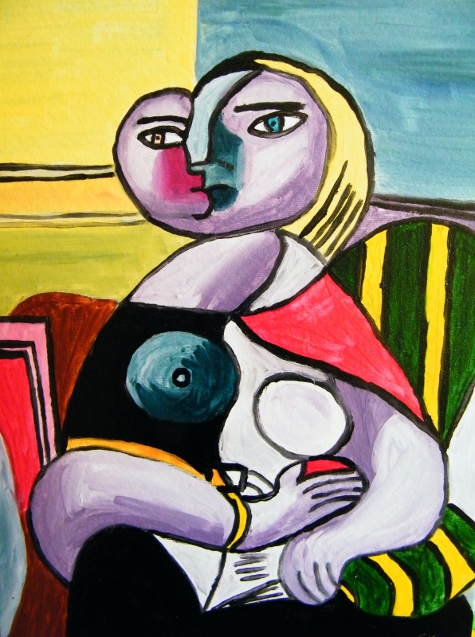
1. WHAT DOES TERM HIGH CULTURE MEAN?

Slide 3
High culture
High culture:
„ This is the culture of the elite and usually refers to artistic endeavors such as music, dance, theater, certain writing, architecture, etc.“[CCSU]
The artistic entertainment and material artifacts associated with a society's aristocracy or most learned members, usually requiring significant education to be appreciated or highly skilled labor to be produced. [Your dictionary]

Slide 4
High culture
Motivation:
Achievement of catharsis
mental cleansing, mystical purification of the soul from all sensual,
Uplifting of the spirit
To show social status
Escape from the real world

Slide 5
2. WHAT DOES TERM POPULAR CULTURE MEAN?

Slide 6
Popular culture
Popular culture (also „pop culture“)
Culture based on the tastes of ordinary people rather than an educated elite. [oxford dictionary]
music, TV, cinema, books, etc. That are popular and enjoyed by ordinary people, rather than experts or very educated people [Cambridge dictionary]

Slide 7
Popular culture
Motivation:
Possibility of social interaction
Escape from the real world
Have a fun

Slide 8
How wage affect attendance in events

Slide 9
3. – 4. What does indirect and direct state support mean?

Slide 10
Indirect support
-Indirect support is represented by activities which support those who are supporting directly some culture activity
-main characteristic is that the support doesnt directed to concrete culture organization
Tax reduces for donators
Social contributions

Slide 11
Direct support
Money from sales revenues
Foundations and foundations funds
Other founds (e.g. state fund for Czech cinematography)
Communal obligations to support local organizations
Donations and sponsorship
Lottery and bets
Public collections

Slide 12
5. How does state lottery works?

Slide 13
State lottery
Long tradition several countries
UK
20% of profit come into culture
Finland
Profit is divided in sport and cultural activities

Slide 14
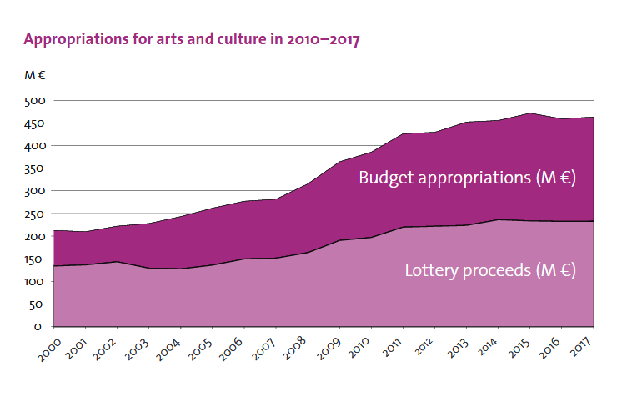
Finland state lottery

Slide 15
6. Mission of ministry of culture

Slide 16
Ministry of culture
Competence of the Ministry
State administrative body for
the arts;
cultural and educational activities;
cultural monuments;
matters relating to churches and religious societies;
matters relating to the press, including publication of the non-periodical press and other information means;
the preparation of draft laws and other legal regulations in the area of radio and television broadcasting;
implementation of the Copyright Act;
production and trade in the area of culture

Slide 17
Ministry of culture
Expenditures of ministry
448 mil euros
1 % of state expenditures

Slide 18
Ministry of culture
State | Expenditures in million euros | % state expenditures
Czech Republic | 448 mil. | 1 %

Slide 19
7. What percentage of total expenditures does government spend for….

Slide 20
What percentage of total expenditures does government spend for…
Cultural services
0,4%
Religion and other community activities
0,1 %
Broadcasting and publishing services
0,2 %

Slide 21
What percentage of total expenditures does government spend for….
Country | Cultural services | Religion and other community activities | Broadcasting and publishing services
EU 28 | 0,4 % | 0,1 % | 0,2 %
Czech R. | 0,6 % | 0 % | 0,2 %
Spain
France
Finland

Slide 22
8. Financing of religions

Slide 23
Financing of religions
In Czech Republic are religion independent to state since 2012
Due to act no.428/2012 about religion property settlement
Religions will receive property which belongs to it before 1948
Religions will receive financial compensation for the property that can not be reversed
Government has no duty do financially support religions

Slide 24
Financing of religions
Options of relation between state and religions
Religions are independent Cultural services
USA
Czech republic (since 2012)
Religions are part of public sector
Germany-tax for religions
Czech Republic (before 2012)
Religions are semi independent
Italy – tax assignation (0,8 % of personal revenue tax)
Spain – tax assignation (0,52 % of personal revenue tax)

Slide 25
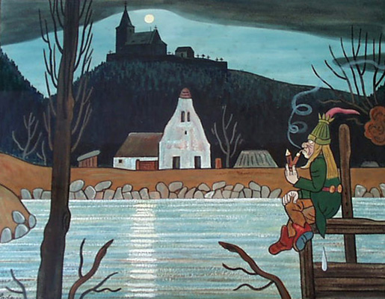
Conclusion

Slide 26
Conclusion
Culture can be financing by market, private support, public support
Most of culture segment are not self-sufficient
They are dependent on the support
State support has two forms
Direct (sponsorship, lotteries, communal obligations, founds and foundations funds…)
Indirect (tax reduction, social contribution )
Government spend 1 % of total expenditures for culture

Slide 27
Usefull links
(1)
http://web.ccsu.edu/faculty/harmonj/atlas/definitions.html
http://www.yourdictionary.com/high-culture
https://dictionary.cambridge.org/dictionary/english/pop-culture
(5) http://minedu.fi/documents/1410845/4150031/The+State+supports+arts+and+culture/bb45a827-60ba-4c16-8cda-3882fc74fe97
(6) http://ec.europa.eu/eurostat/statistics-explained/index.php/File:Mean_household_cultural_expenditure_by_expenditure_purpose,_2010.png
(7) https://ec.europa.eu/eurostat/statistics-explained/images/8/8f/Total_general_government_expenditure_on_recreation%2C_culture_and_religion%2C_2016_%28%25_of_GDP_%25_of_total_expenditure%29.png

Slide 28
UNESCO monuments in Czech republic

Slide 29
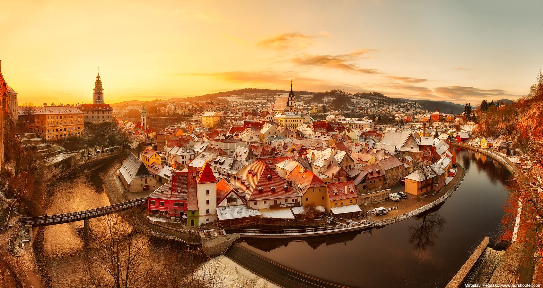

Slide 30
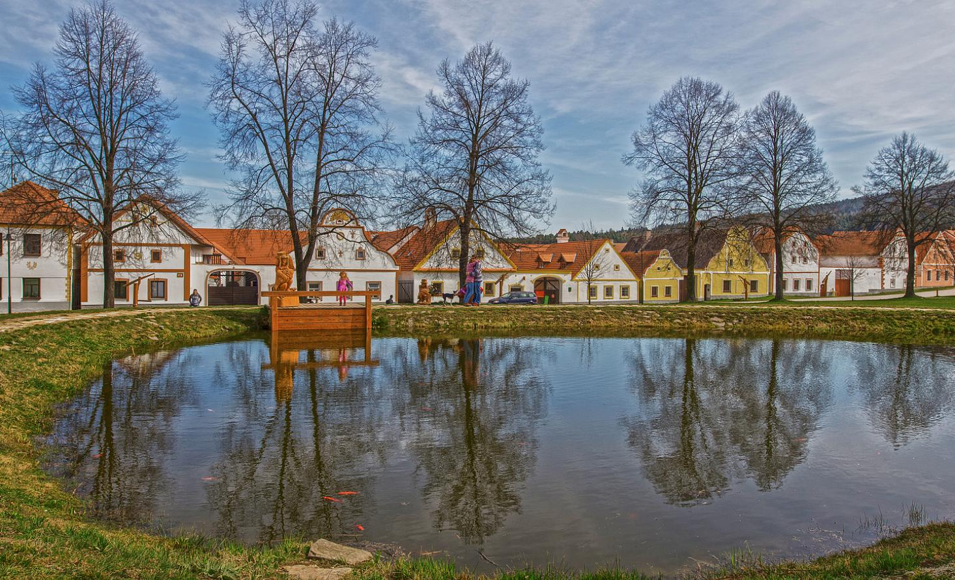

Slide 31
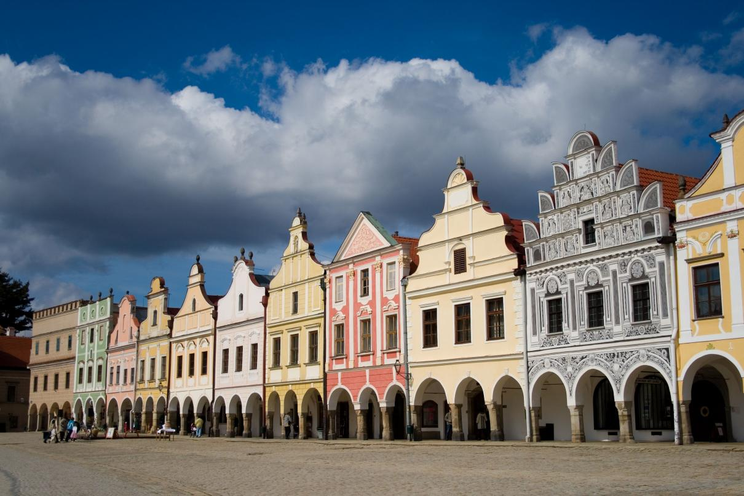

Slide 32
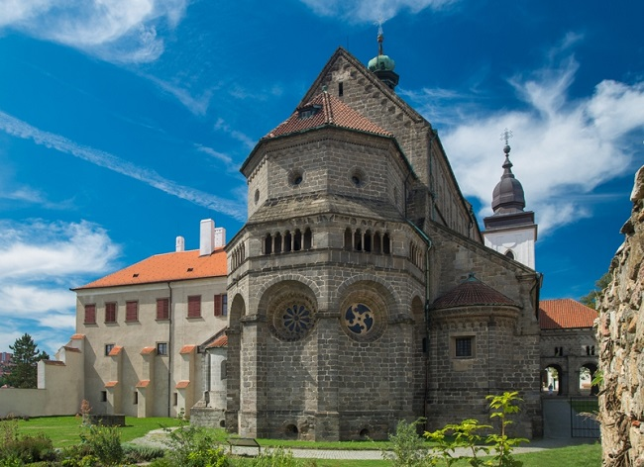

Slide 33
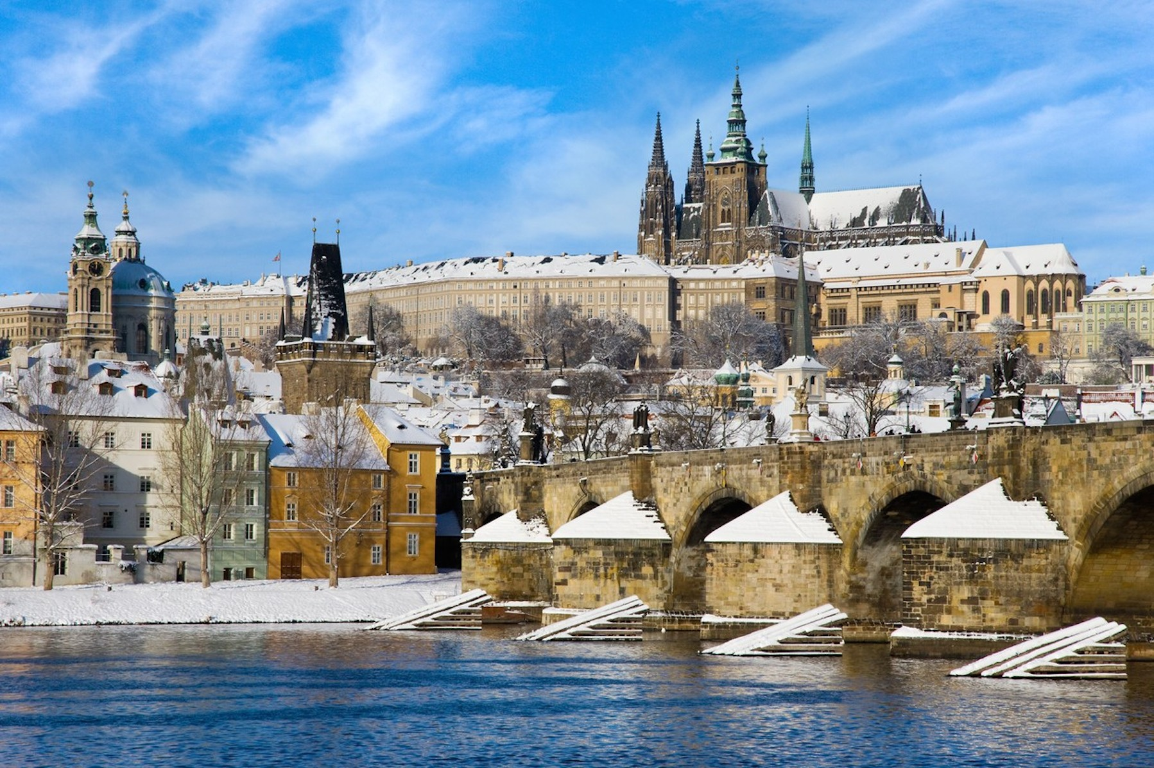

Slide 34
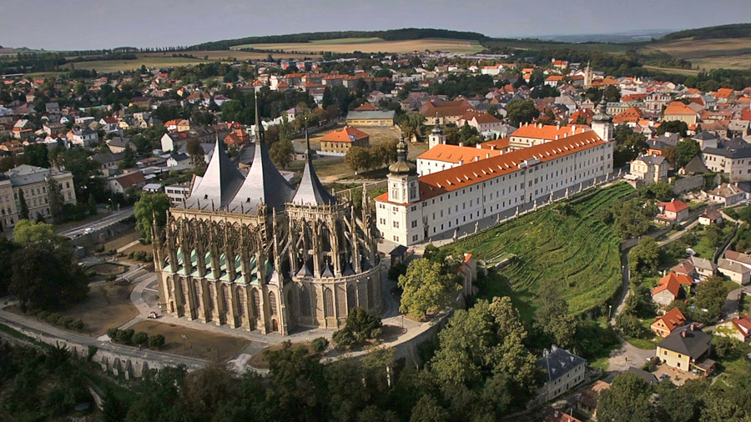

Slide 35
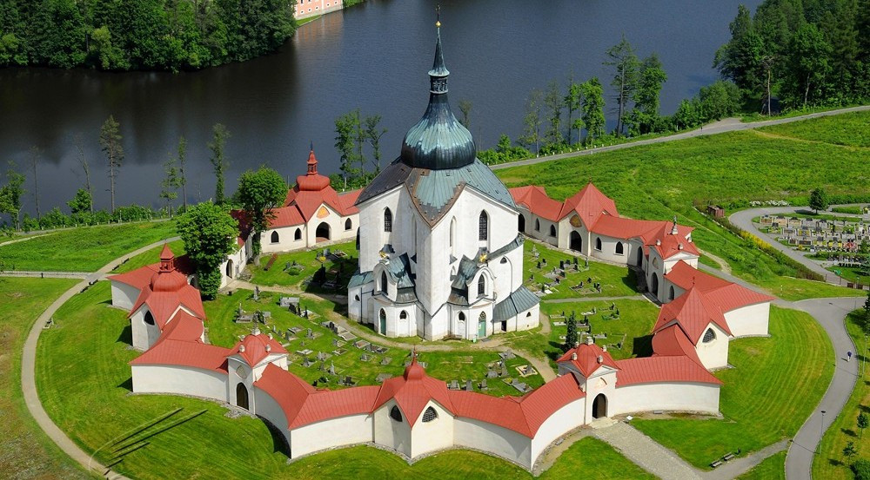

Slide 36
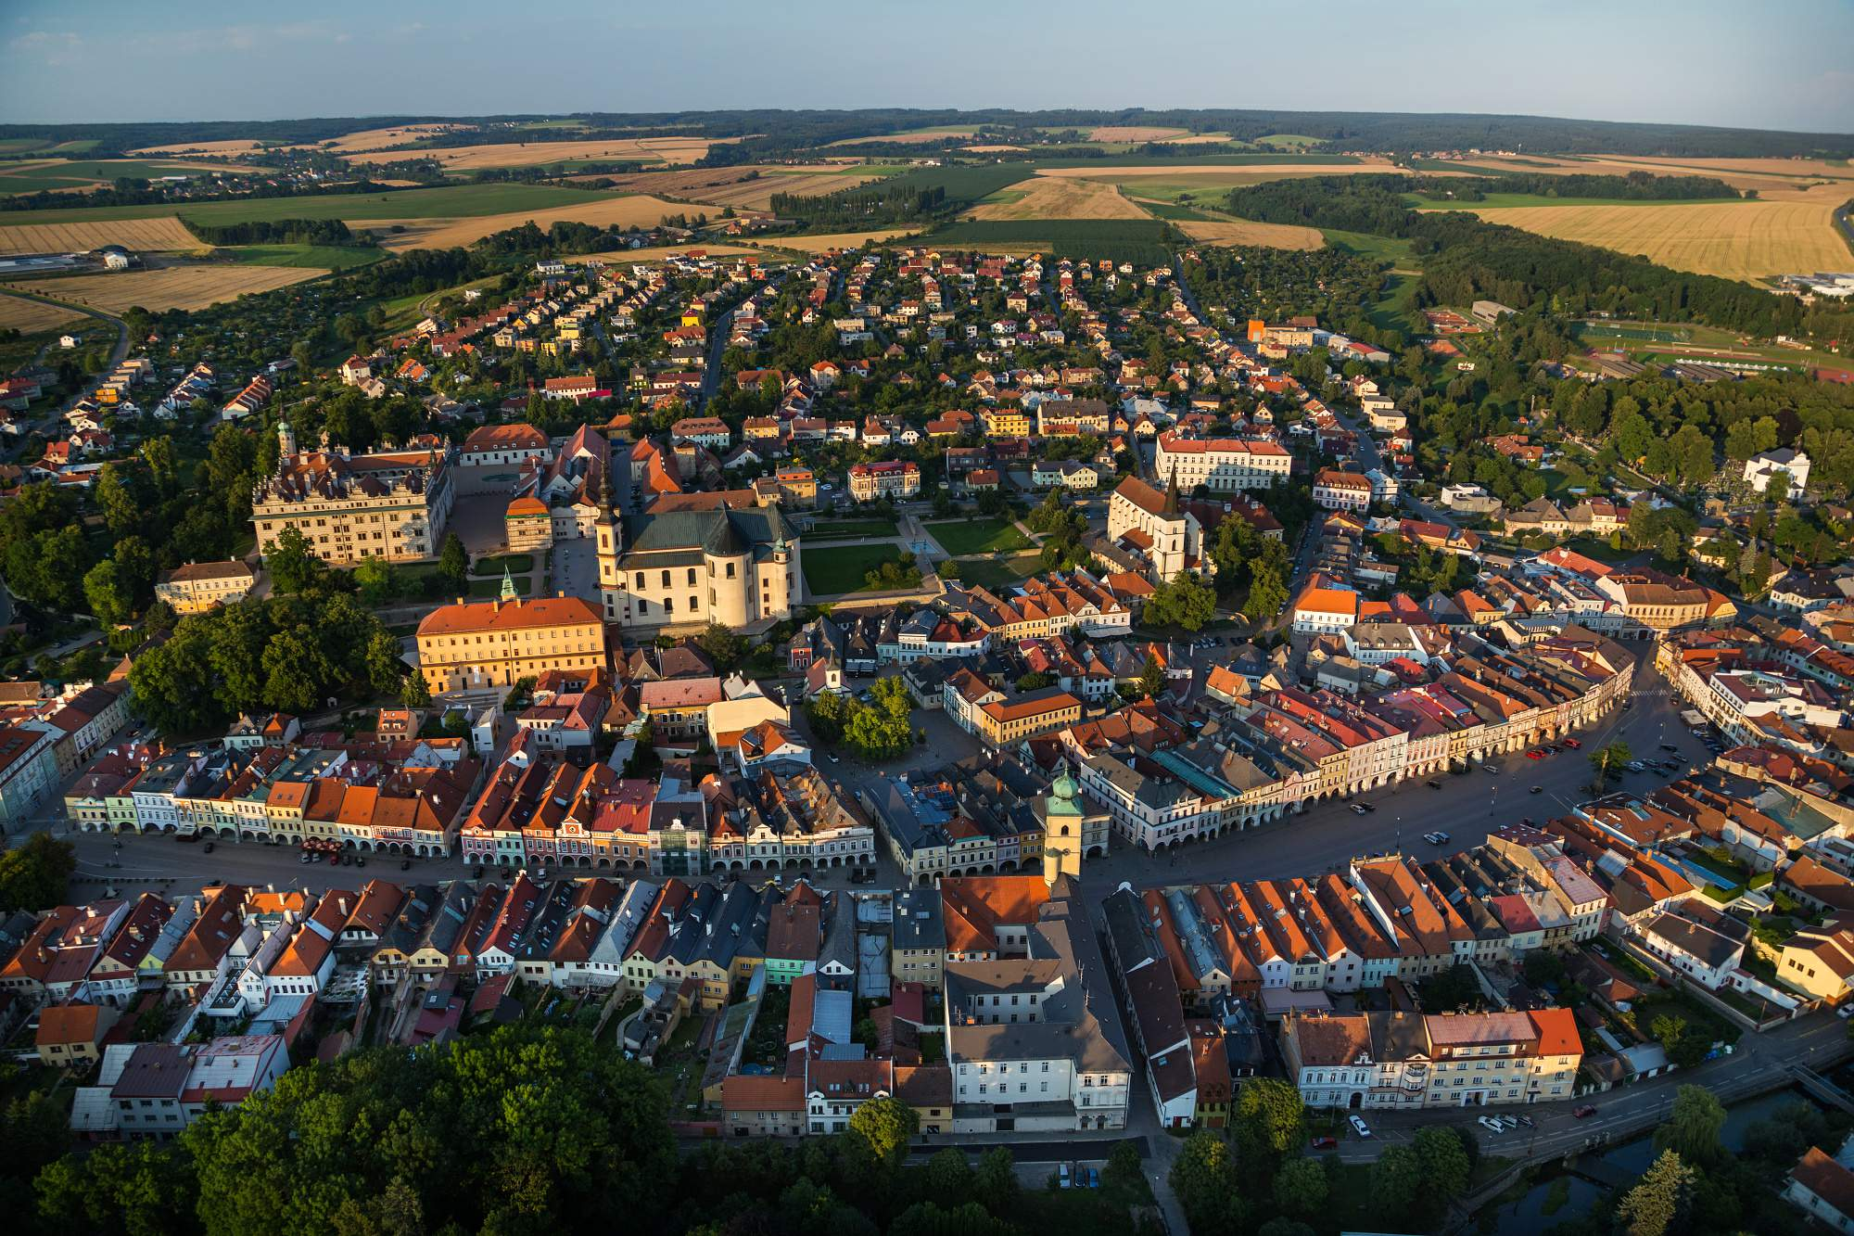

Slide 37
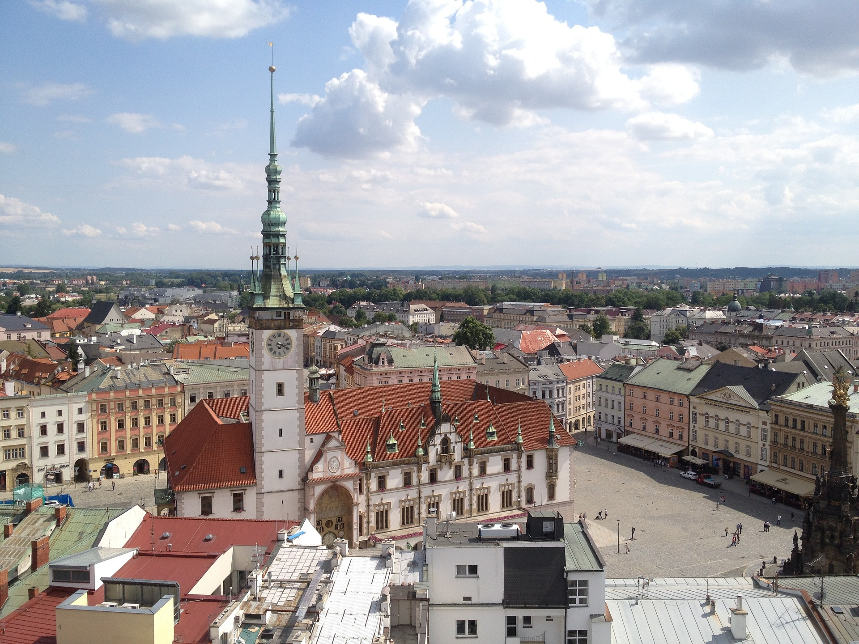

Slide 38
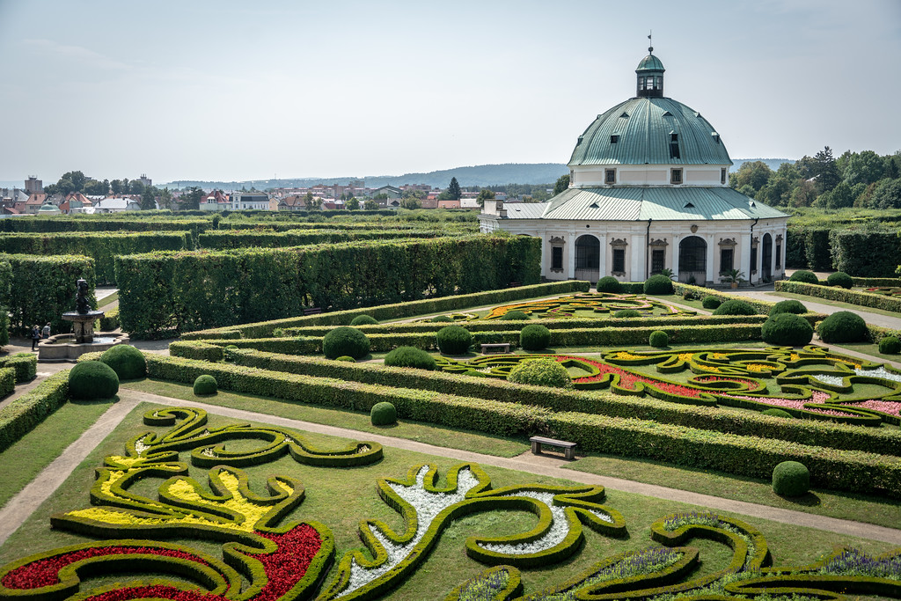

Slide 39
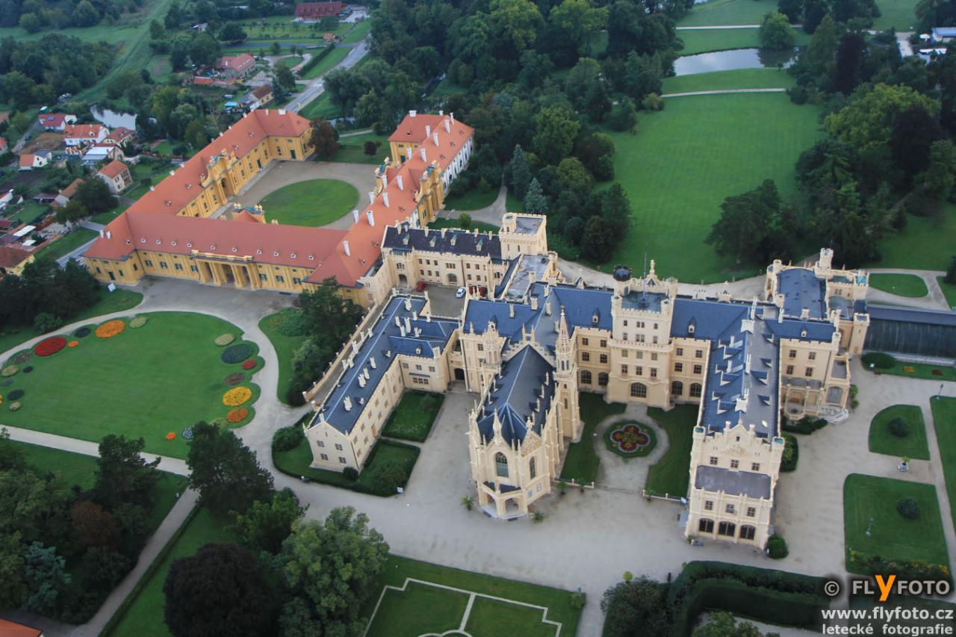

Slide 40
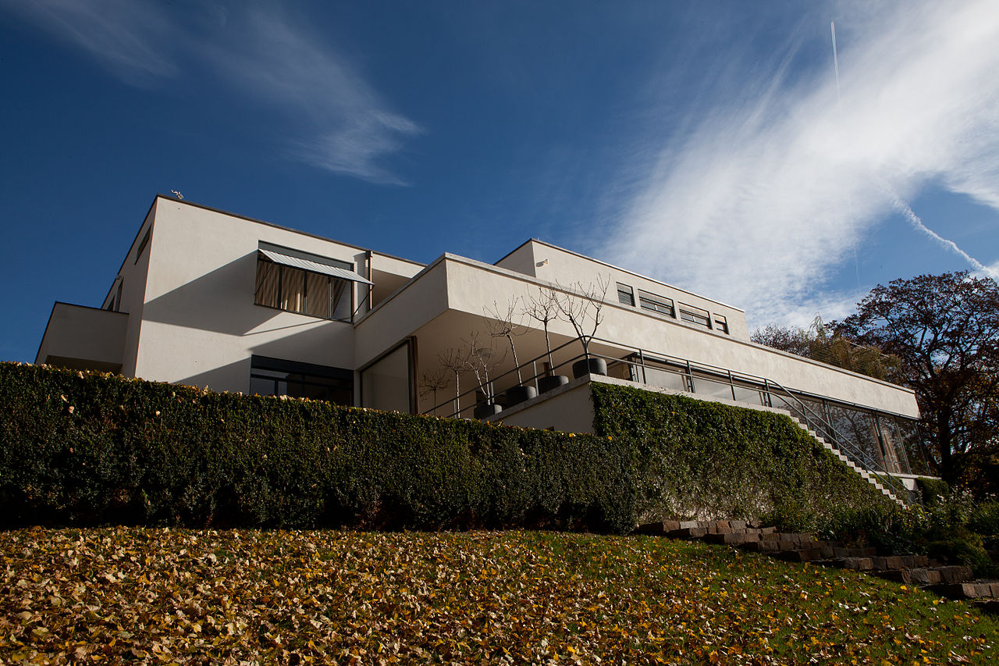

Slide 41
Český Krumlov

Slide 42
Holašovice

Slide 43
Telč

Slide 44
Třebíč

Slide 45
Praha

Slide 46
Kutná Hora

Slide 47
Žďár nad Sázavou

Slide 48
Litomyšl

Slide 49
Olomouc

Slide 50
Kroměříž

Slide 51
Lednice

Slide 52
Brno

