Slide 1
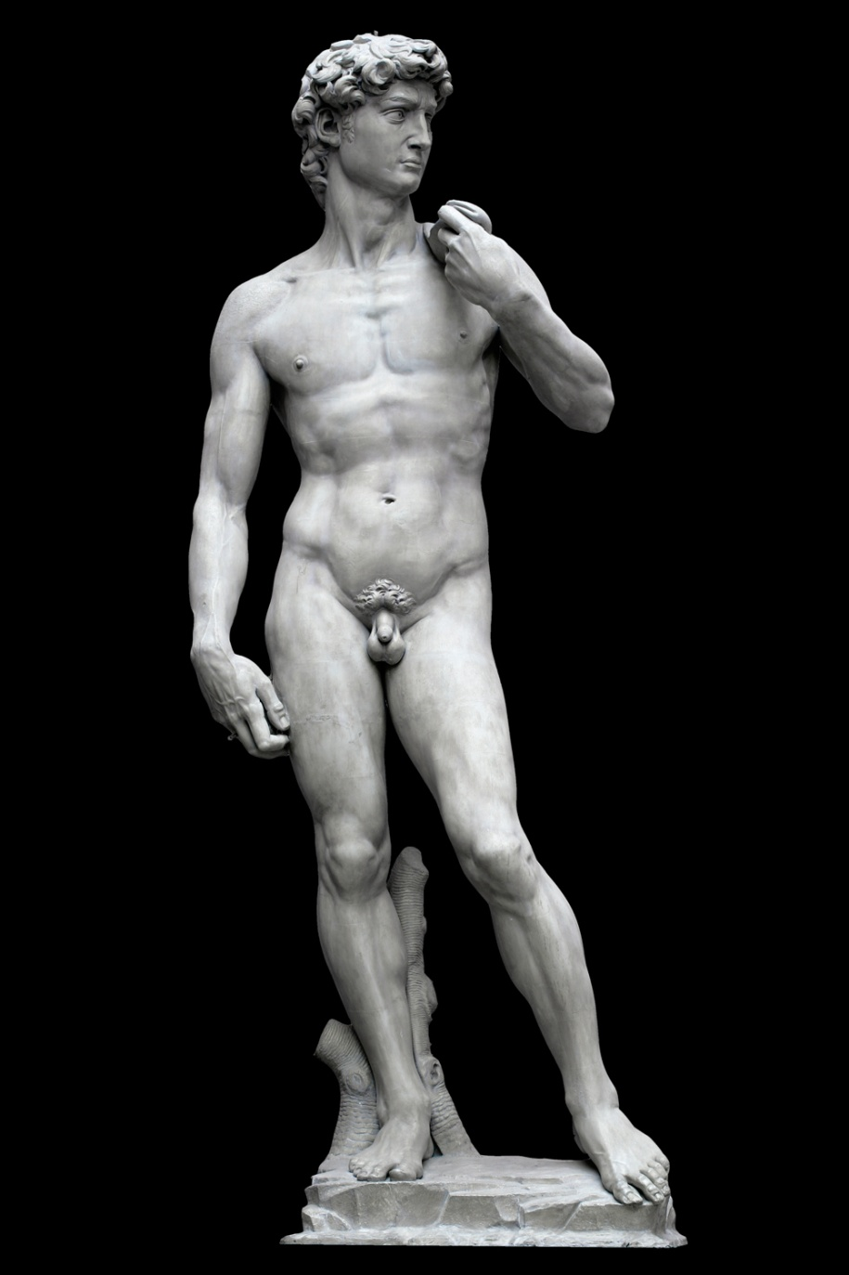
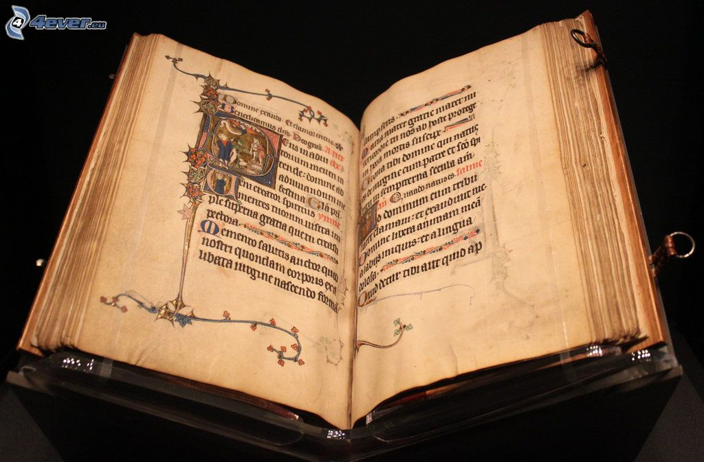
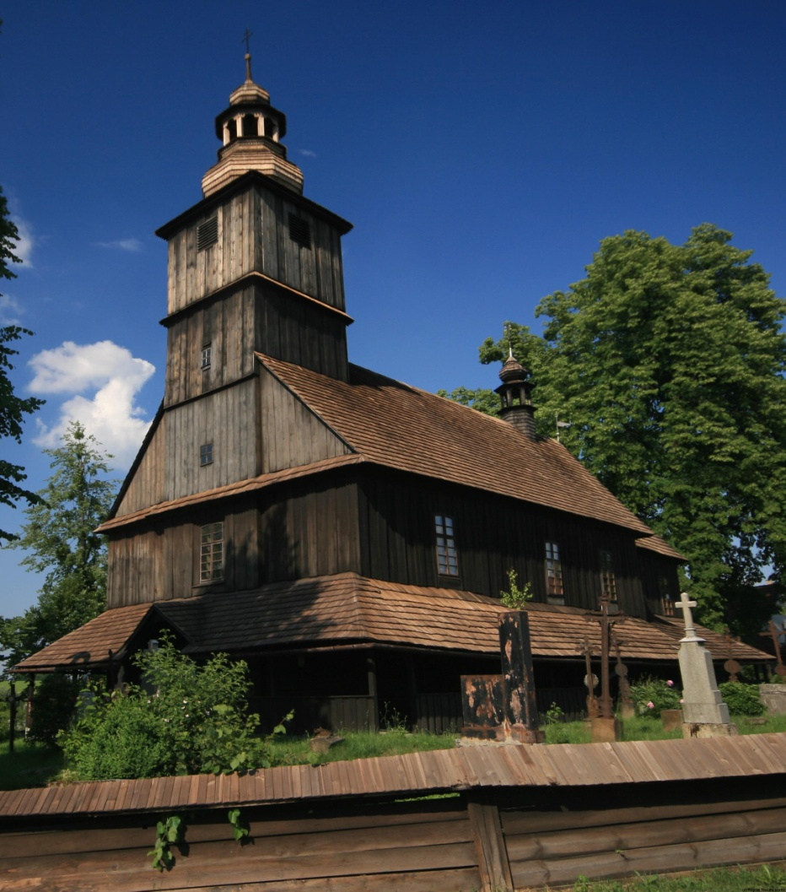
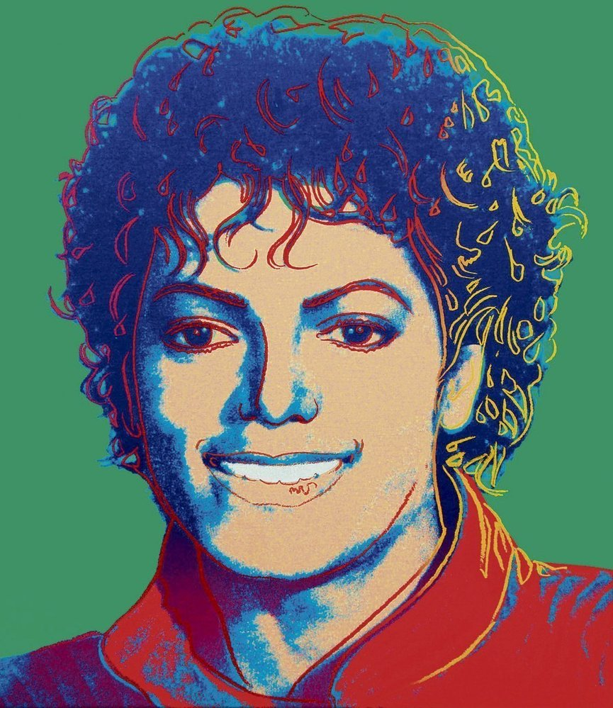
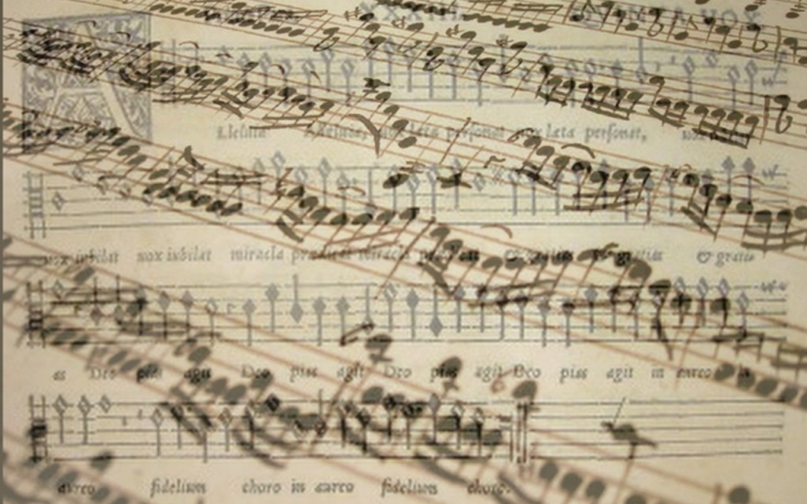
Culture and Mass Media Economy Basic information
Ing. Vojtěch Müllner

Slide 2
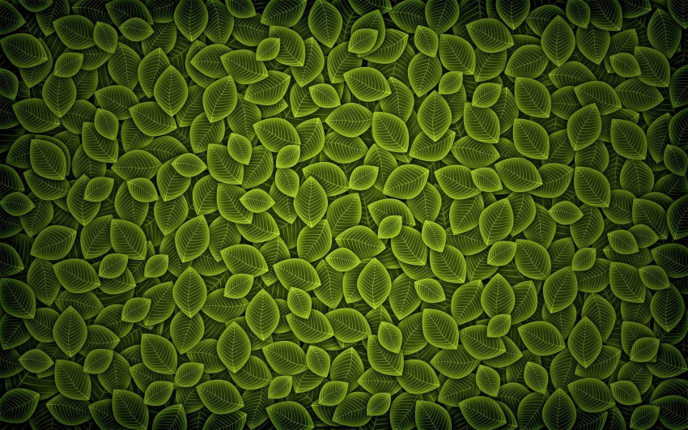
Contacts
Ing. Vojtech Müllner
Contact:
347683@mail.muni.cz
Vojtech.Mullner@econ.muni.cz
Office no. 416

Slide 3
Objectives of the course
Introduce economic substance of culture and mass media
Let student think about ways to satisfy cultural needs of people
Introduce concrete cultural institutions

Slide 4
Study methods
Lecture session
Group work
Excursions to institutions

Slide 5
Schedule
Schedule spring 2018
Date | Place | Topic | Tutor
19th February | First class session (class P312) | Introduction to the course-data | Vojtěch Müllner
26th February | Second class session (class P312) | Economy of Culture | Vojtěch Müllner
5th March | Third class session (class P312) | Public Support of Culture | Vojtěch Müllner
2nd April | Fourth class session (class P312) | Mass Media economy | Vojtěch Müllner
23rd April | Fifth class session (class P312) | Marketing for Cultural organizations | Vojtěch Müllner
7th May | Excursion in the center of Brno | Sightseeing tour in the center of Brno | Vojtěch Müllner
8th May | Janacek Theatre | Visit of performance “Carmen” (written by Georges Bizet) | Vojtěch Müllner
14th May | Sixth class session (class P312 ) | Final exam | Vojtěch Müllner

Slide 6
Obligatory part of Course
Take part in at least 2 of 4 class session
Take part in sightseeing tour in the center of Brno
Visit performance of opera “Carmen”
Visit permanent exhibition in Moravian gallery
Write a final exam

Slide 7
Class session
First part
Work in small groups
Group deal with list of questions
Second part
Discussion and presentation of results
Tutors presentation and advanced explanation
Study method
Work with online materials
Necessary to have in group at least one devises with WI-FI

Slide 8
Sightseeing tour in the center of Brno
Tour will be in time of class session
Sightseeing tour will be realize in any weather
Duration of sightseeing tour will be approximately 90 minutes
You will get basic information per email

Slide 9
Visit of the performance “Carmen”
“Carmen” is play written by Georges Bizet Important information
Date and time: Wednesday 8th April in 19:00
Meeting time and place: 18:40 in front of Janacek Theatre
Dress code: decent clothes or formal clothes
Each student buys ticket by himself (reservation are available on web sites http://www.ndbrno.cz/programme?method=newProgram&params[from]=&params[month]=5&params[year]=2019 )
Don’t forget to buy ticket in time because the OFFER IS LIMITED

Slide 10
Visit permanent exhibition in Moravian gallery
Each student should by himself visit permanent exhibition in Moravian gallery during spring semester.
The permanent exhibitions are without entrance fee.
To evidence your attendance on exhibition I ask you to bring me till 7th May the ticket.
Link:http://www.moravska-galerie.cz/moravska-galerie/navsteva-mg/vstupne.aspx?lang=en

Slide 11
Final exam
To set the test must student fulfill obligatory part of course Culture and Mass Media Economy
The final test will be written on 14th May in classroom P312
The test consists of 20 multiple choice questions (only one question is right). Total time for writing the test is 30 minutes

Slide 12
Final exam (cont.)
Evaluation of the test is as follows:
Total points in % | grade
100%-95% | A
94% - 85% | B
84% - 75% | C
74% - 65% | D
64% - 60% | E
<60% | F

Slide 13
Short paintings Quiz
Who is author of these paintings?

Slide 14
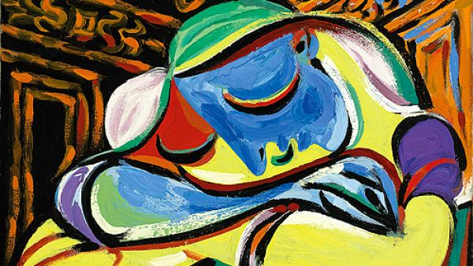

Slide 15
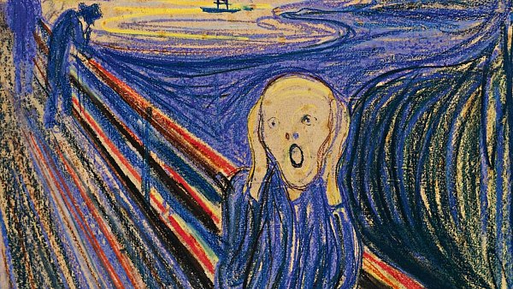

Slide 16
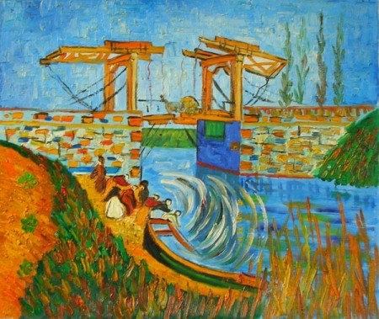

Slide 17
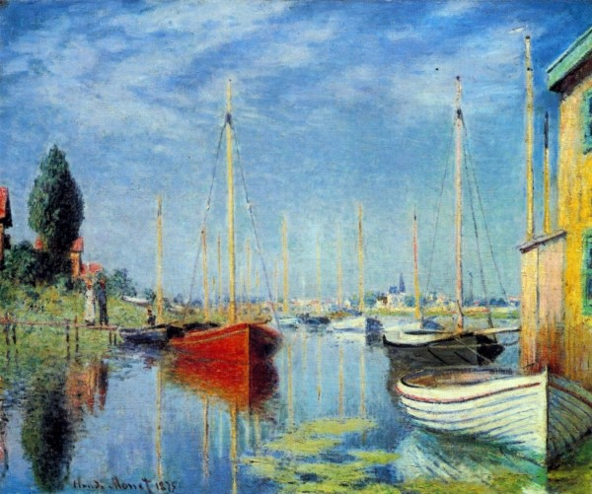

Slide 18
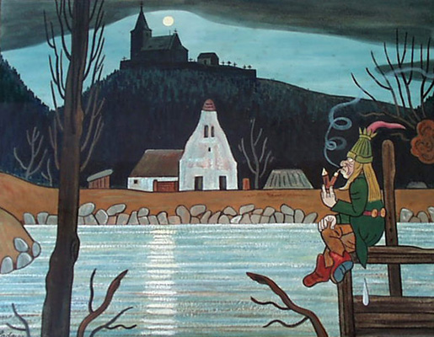

Slide 19
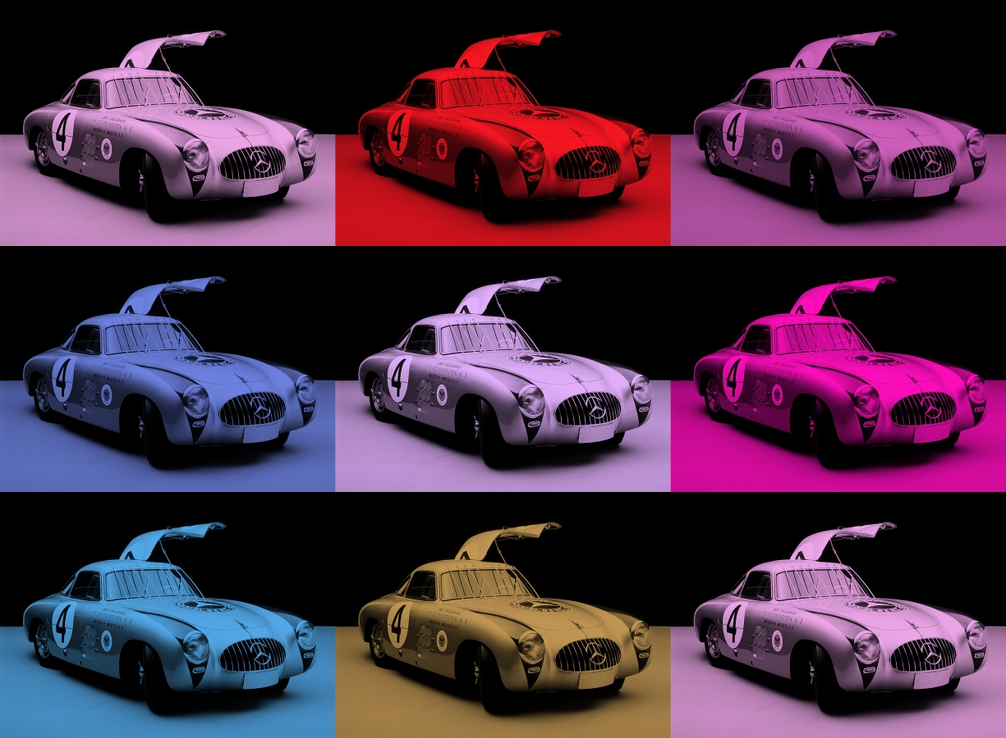

Slide 20
Results
Pablo Picaso
Edvard Munch
Vincent Van Gogh
Claude Monet
Josef Lada
Andy Warhol

