Slide 1
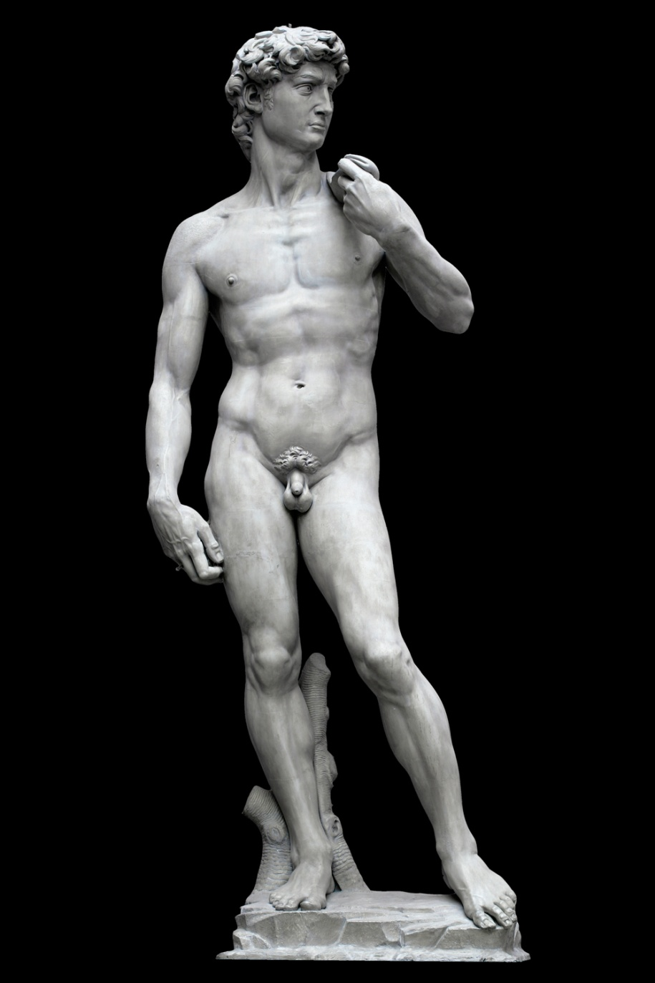
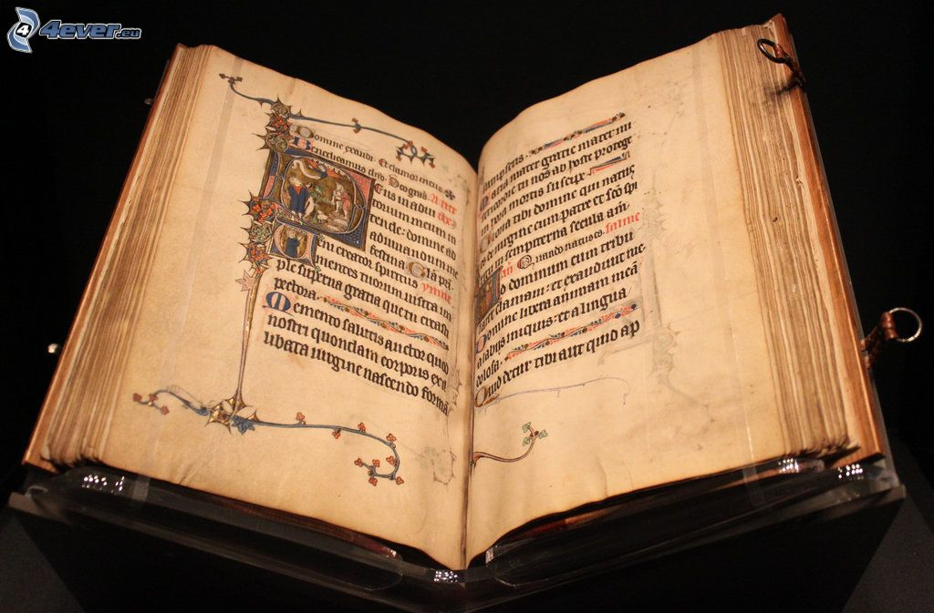
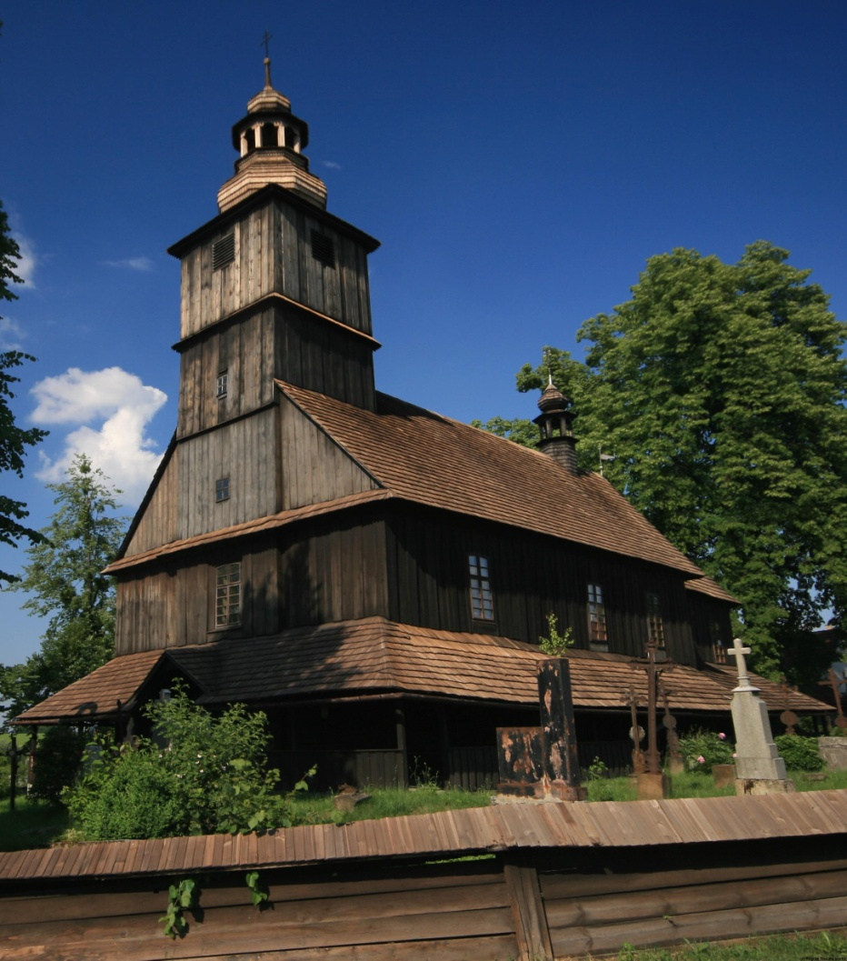
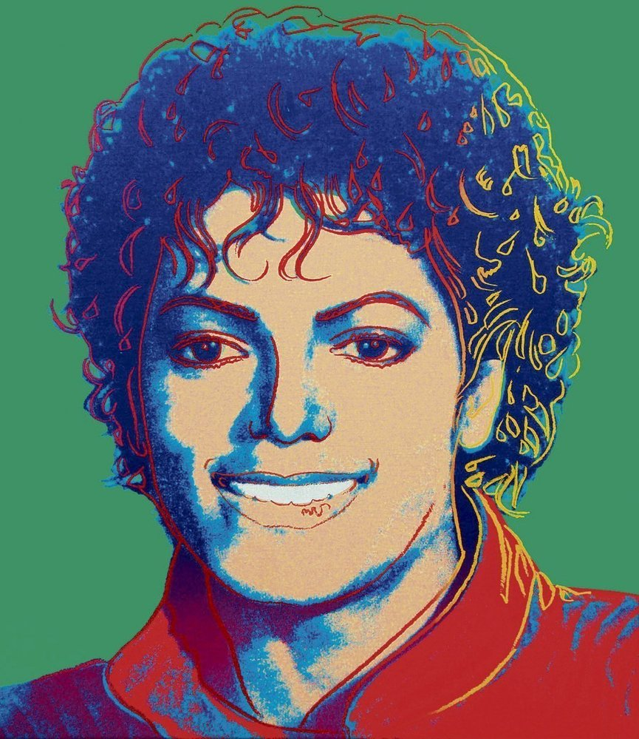
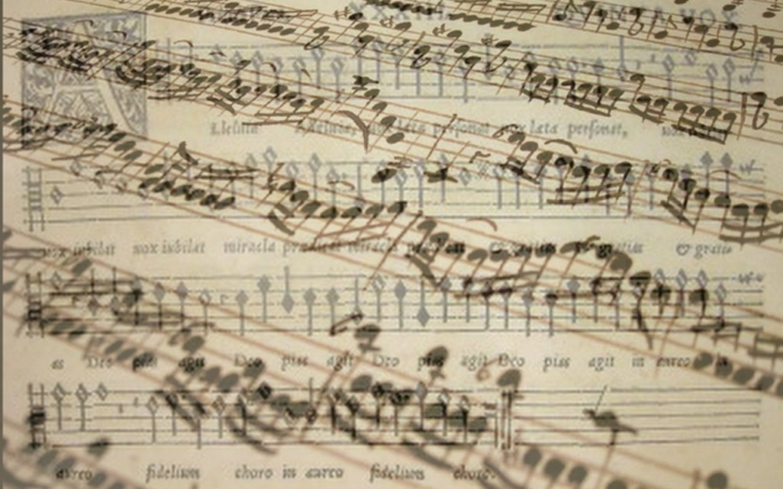
Marketing for Cultural Organizations

Slide 2
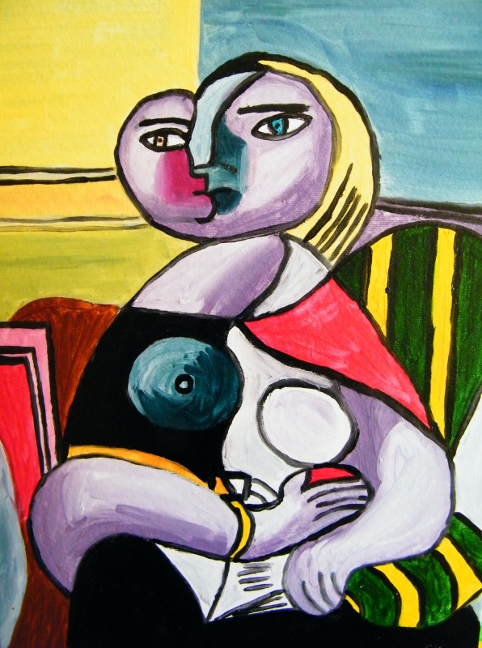
What does the term marketing mean?

Slide 3
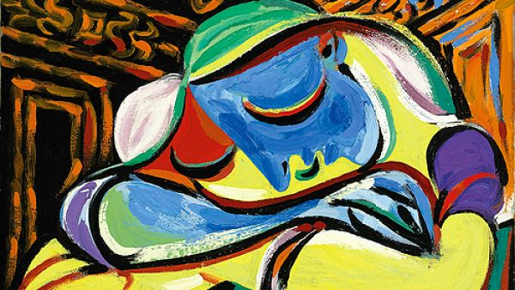
What does the term marketing mean?
Marketing – “the process of planning and executing the conception, pricing, promotion, and distribution of ideas, goods and services to create exchanges that satisfy individual and organizational goals” (Bennet, 1995)
The action or business of promoting and selling products or services, including market research and advertising. (Oxford dictionary)

Slide 4
What is swot analysis?

Slide 5
SWOT analysis
A study undertaken by an organization to identify its internal strengths and weaknesses, as well as its external opportunities and threats.
(Oxford dictionary)
Analysis of internal and external factors
Internal: strengths and weaknesses
External: opportunities and treats

Slide 6
Strengths of cultural organizations
Long tradition
Relatively stable number of visitors
Stable support from state and local governments
…

Slide 7
Weaknesses of cultural organizations
Art is highly dependent upon public support
Some of state supported cultural organizations don‘t know what they consumer wants
Traditional cultural organization are attracting only little segment of population
…

Slide 8
Opportunities for cultural organizations
Consumers living in multimedia and cross-cultural environment want more combinations of art forms and delivery methods
New technology has enabled people to experience music and visual arts from around the world
TV broadcasting
Internet and streaming services
Answer to societal changes
More stressful life than a generation ago
Give opportunities to escape from real life

Slide 9
Threats for cultural organizations
Current generation doesn’t view high art as inherently more valuable than pop culture that shapes their lives
Changes in strategy of financing cultural organizations
Market-oriented method of funding culture

Slide 10
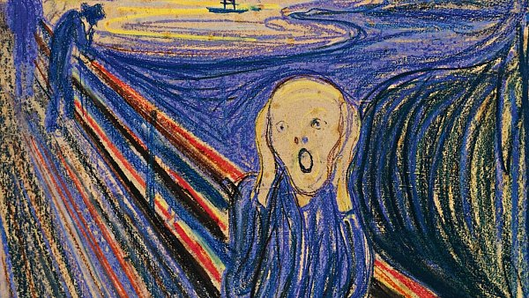
What instruments of marketing do you know?

Slide 11
What instruments of marketing do you know?
Examples of marketing instruments
Marketing plan
7 Ps
4 Ps
SWOT analyses
Analyze of company and its business environment
PEST
Product, economy, social, technology
SMART goals
Specific, measureable, attainable, realistic/relevant, time bassed
Branding

Slide 12
Mahen Theatre
What they do
Propagation of product
Communication with customers
Reaching new customers by advertising and propagation
Billboards, several cultural events focused on diffetent segments of customers
Improving product according audience
Numbers of plays which are popular

Slide 13
Mahen Theatre
What they didn‘t do
Propagation of mission
Limited offer of activities for business branch
Business meetings, business ceremony…

Slide 14
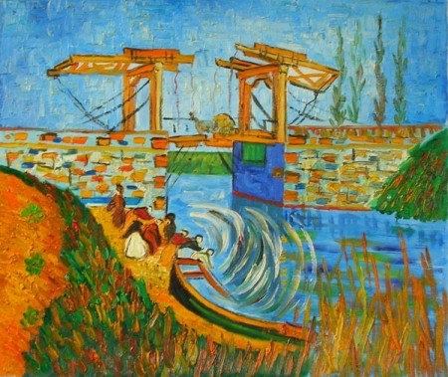
What does marketing plan mean?

Slide 15
What does marketing plan mean?
Statement of Organizational Mission
Each organization is established for the purpose of achieve main goal
Without goal we cannot find the best way for our organization
Environmental Analysis
(e.g. purchasing power of population, location of action, demographic factors, etc.)
Competitor Analysis
„We need to know our enemies“
Understanding Buyer Motivation
Why are the customers interested in our product?
Segmentation
What are the group of our customers?
What are the main specification of these groups?

Slide 16
What does marketing plan mean?
Research Plan
Product Analysis
What are the benefits of our product?
What are the weak part of our product?
SWOT analysis
Distribution Analysis
How deliver product to customers?
Pricing Options
Comes from our price policy
Promotional Plan

Slide 17
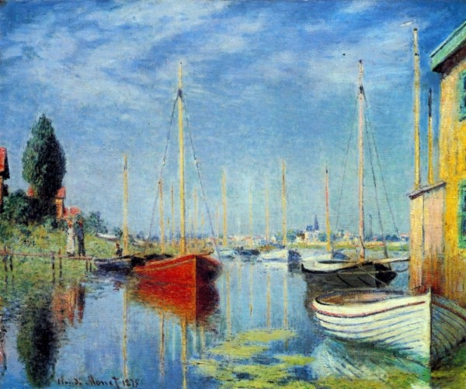
What does marketing mix mean?

Slide 18
Marketing mix
A planned mix of the controllable elements of a product's marketing plan

Slide 19
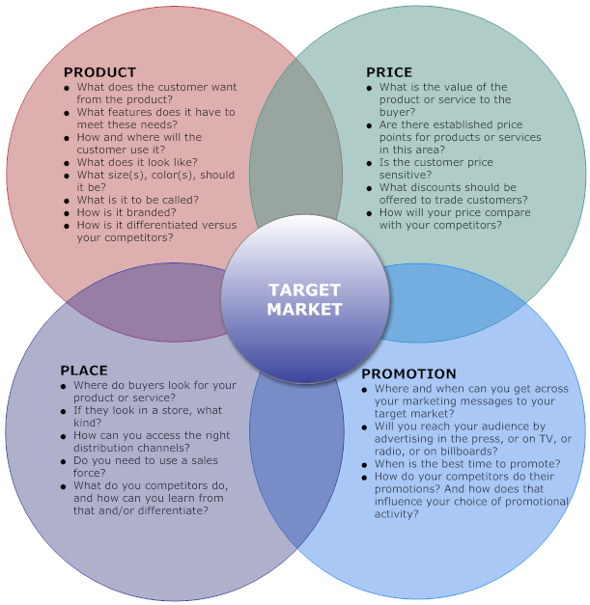
Marketing mix

Slide 20
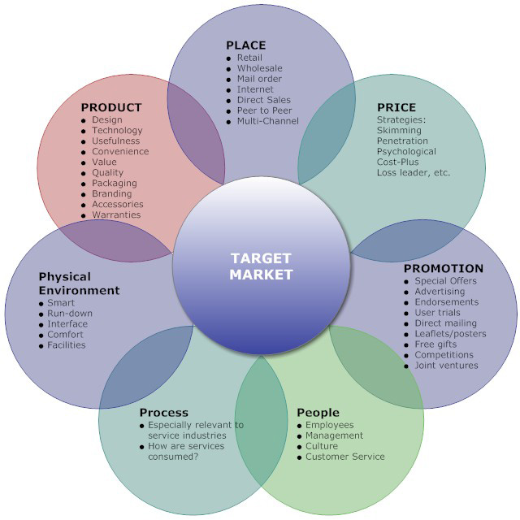
Marketing mix

Slide 21
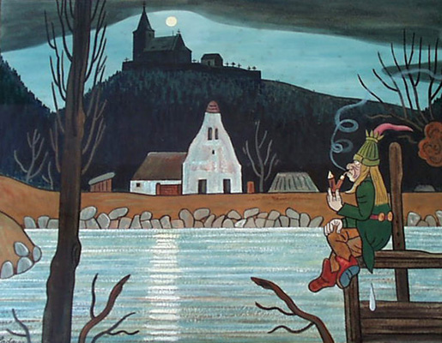
What specification has customer of cultural organizations?

Slide 22
What specification has customer of cultural organizations?
Group of Ready-to-Buy Customers
must be impressed by our product
Loyal group of customers/Repeat Customer
They visit theatre/cinema/museum periodically
Group of Impulse Buying Customers
Follow the trends and feelings
Group of Sale or Discount Customers
Follow the best offer
Potential Customers
All of the people

Slide 23
How to attract each of customers group?
Group of Ready-to-Buy Customers
Propagation of product
Loyal group of customers/Repeat Customer
Benefit program for loyal customers (special offers, VIP events…) you should show them, that they are very important
Group of Impulse Buying Customers
Advertising, direct communication, transparent propagation
Group of Sale or Discount Customers
System of discounts and sales
Delivery of information through massive canals
Potential Customers

Slide 24
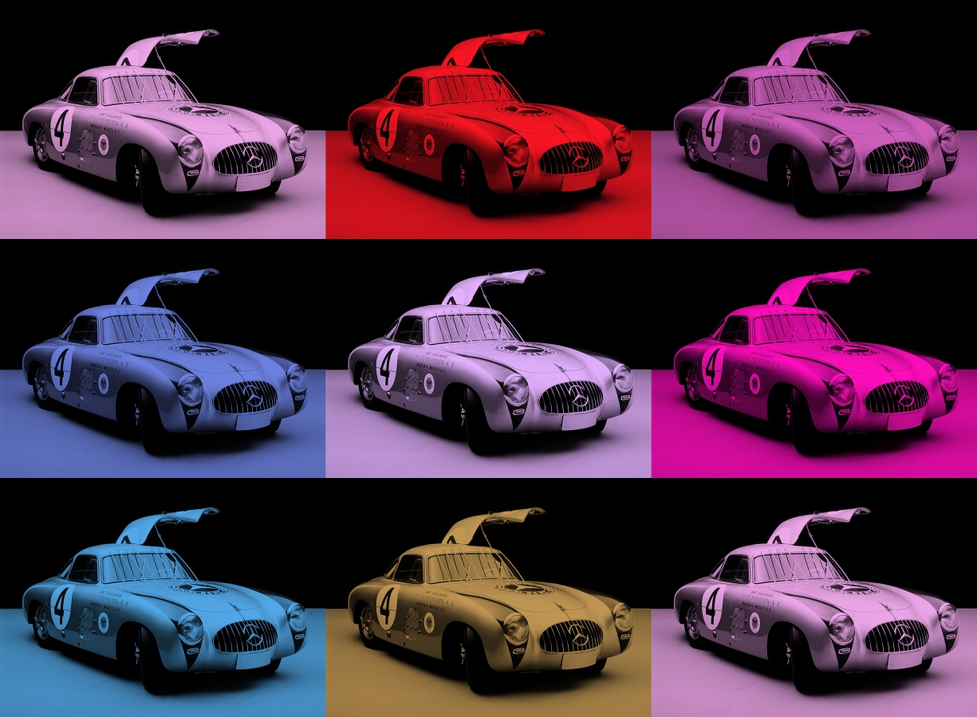
What is customers motivation to buy cultural products?

Slide 25
Customers motivation
Social Ritual
For the traditional high art audience, attendance may be an affirmation of their social values
Self-improvement
„Culture is mirror of our behavior“
Symbol of social status
Higher class are more interested of culture
Need of catharsis
Satisfaction through culture

Slide 26
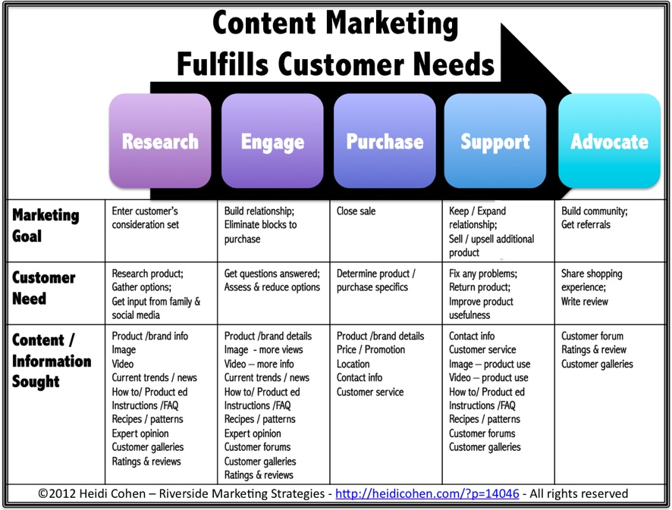
Relationship between customers needs and marketing

Slide 27
conclusion
Marketing is process of planning and making strategies
Challenge for cultural organizations is:
answer to societal changes
Attract more customers
Cultural organizations can use the same marketing instruments as business companies
Specification is product and group of customers

Slide 28
Sources
Usefull link:
https://www.slideshare.net/assim_t/marketing-instruments
Sources:
KOLB, B. M. Marketing for Cultural Organizations ISBN-13: 978-0415626972
https://heidicohen.com/content-marketing-future/
http://marketingmix.co.uk/

Slide 29
Sightseeing tour

Slide 30
Sightseeing tour
Date: 7th May
Place: City centre
Place of the meeting:
Zelný trh (near fontain Parnas)
Meeting time: 16:05
Duration: 75 minutes
!!PLEASE COME IN TIME!!

Slide 31
Place of the meeting

Slide 32
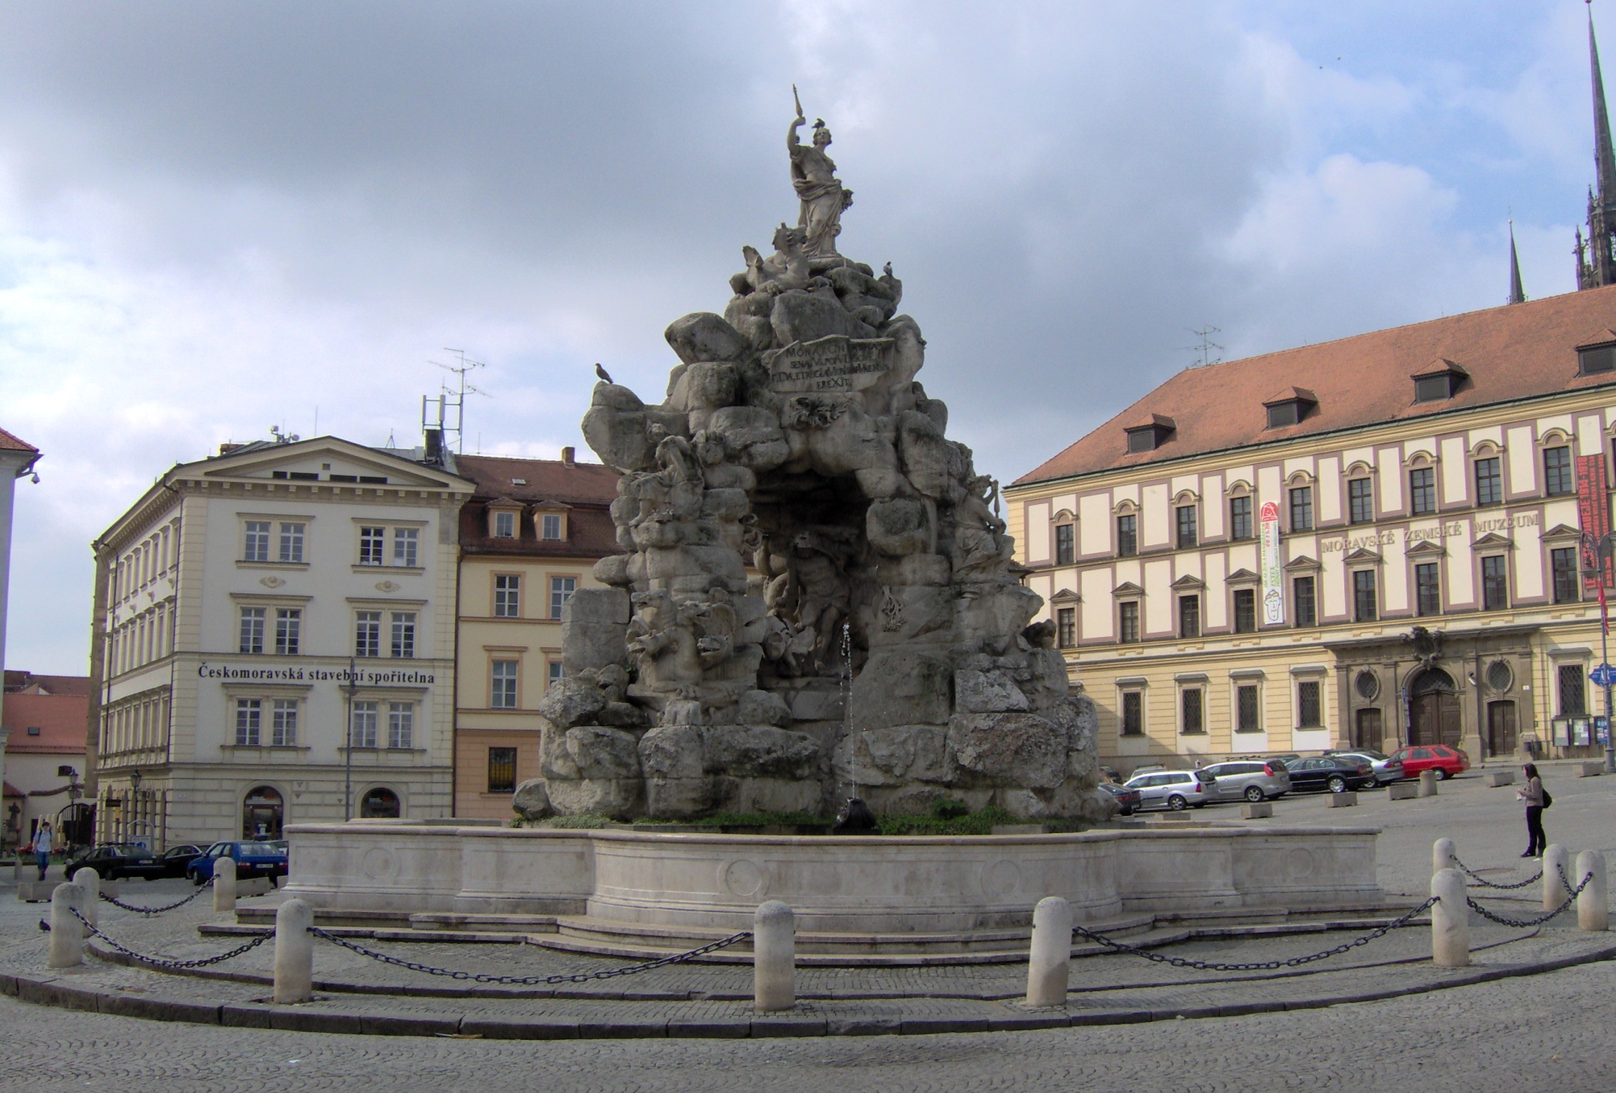
Place of the meeting

Slide 33
Visit of the performance “Carmen”

Slide 34
Visit of the performance “Carmen”
“Carmen” is play written by Georges Bizet
Important information
Date and time: Wednesday 8th May in 19:00
Meeting time and place: 18:40 in front of Janacek Theatre
Dress code: decent clothes or formal clothes
Each student buys ticket by himself (reservation are available on web sites (http://www.ndbrno.cz/programme?method=newProgram&params[from]=&params[month]=5&params[year]=2019)
Don’t forget to buy ticket in time because the OFFER IS LIMITED

Slide 35
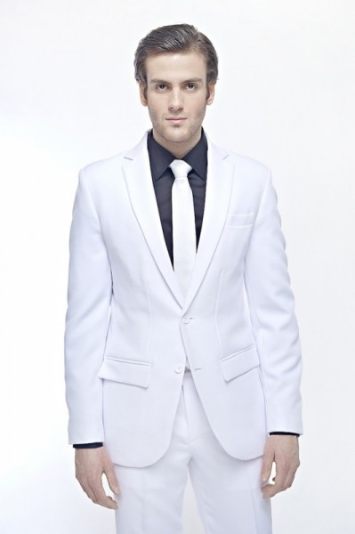
Visit of the play “Carmen”

Slide 36
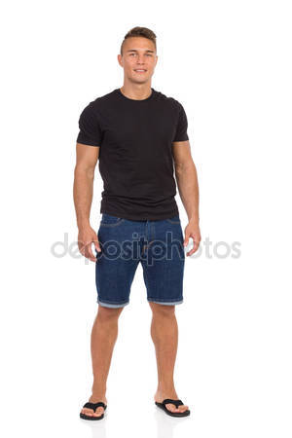
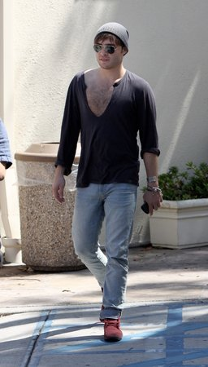
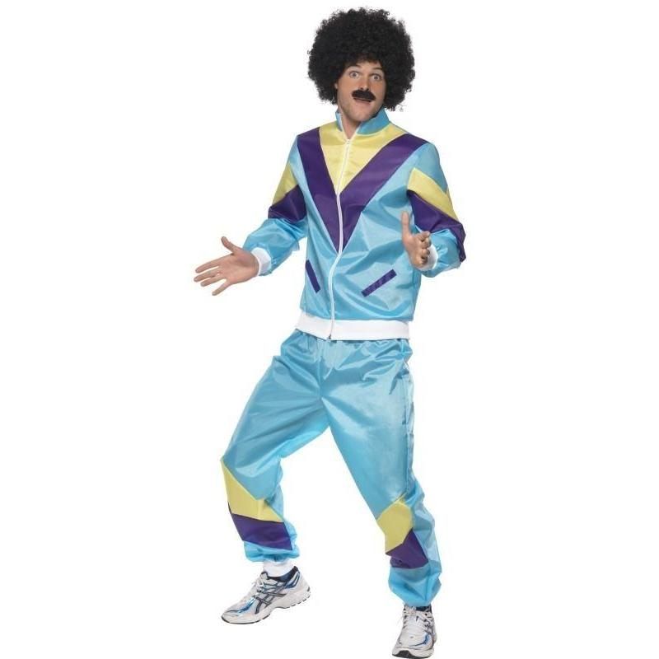
Visit of the play “Carmen”

Slide 37
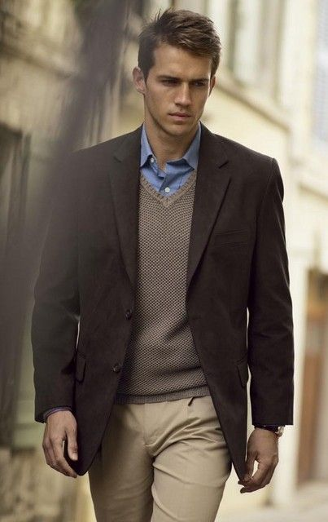
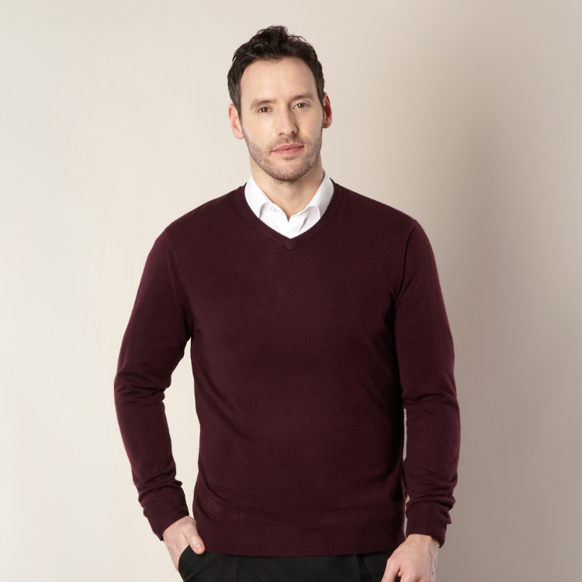
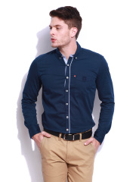
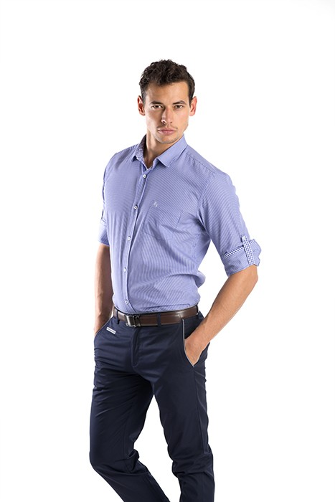
Visit of the play “Carmen”

Slide 38
Visit of the play “Le Comte Ory”
18:40 in front of
Janacek Theatre

Slide 39
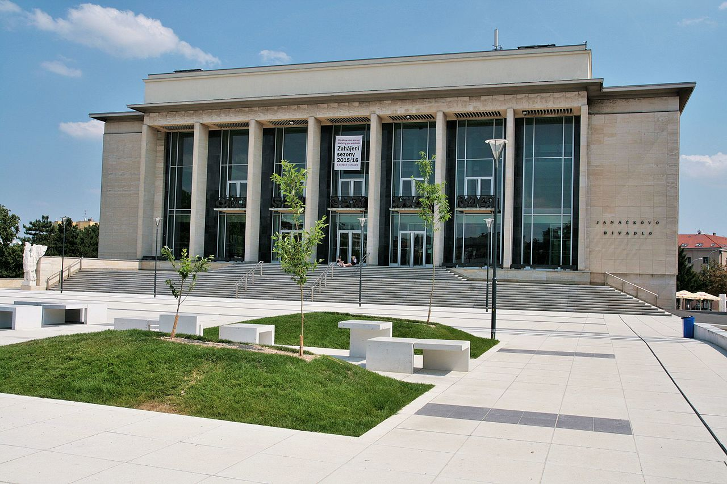
Visit of the play “Carmen”

Slide 40
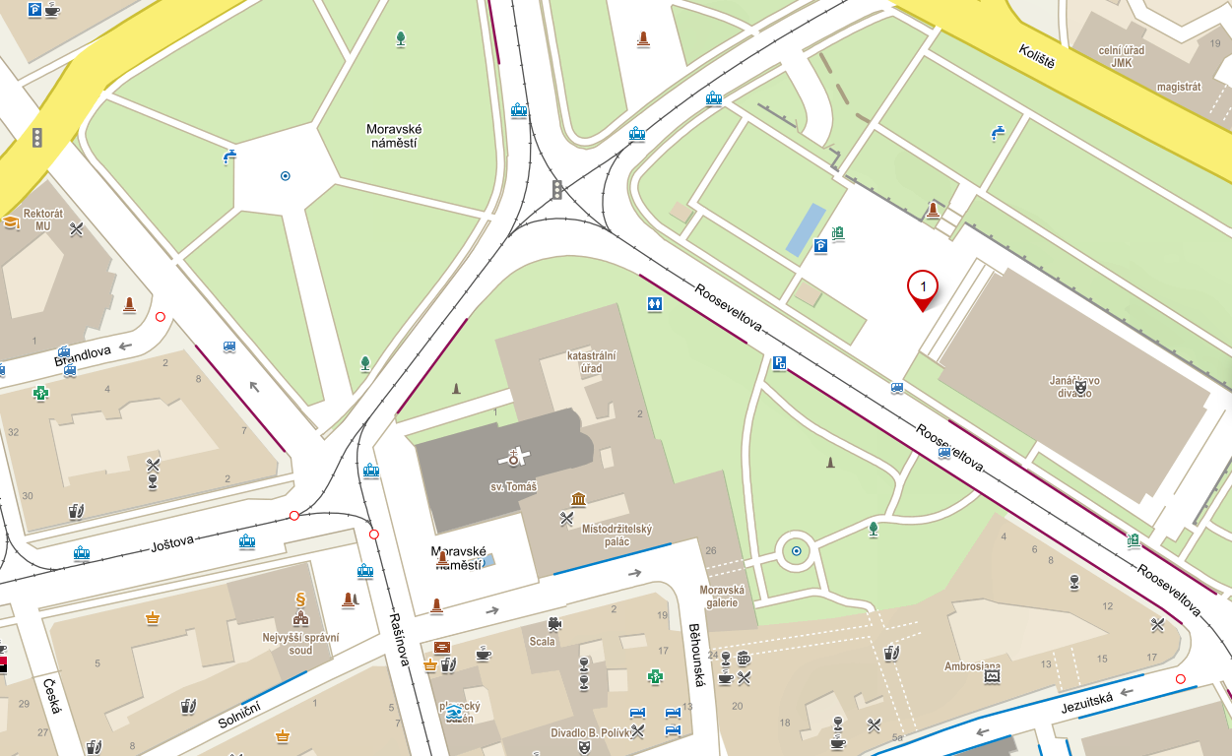
Visit of the play “Carmen”

Slide 41
Thank you for your attention

