Slide 1
Data + Technology
=
Great UX + Accurate risk
Michal Kročil
May 2019

Slide 2
To challenge the status quo of everyday finance
via exceptional customer experience
by being at the forefront
in delivering cutting edge technology.
Purpose
of Twisto

Slide 3
01
Understanding the environment
Fraudulent / Irresponsible / Distressed
Implications
02
Mitigation of threats
Data sources and processing
Modelling / Technology
Non-scoring tools

Slide 4
01
Understanding
the environment

Slide 5
Everything moves fast.
Borders are blurred.

Slide 6
Reasons for customer ending in default
50%
40%
10%
of defaulters know from the very beginning, they are not going to play by the rules
of defaulters do not take the responsibilities and consequence seriously
of defaulters have the intention to repay back but do not have the means or attention to do so
Fraud
Irresponsible
Distressed
Distribution highly dependent on: ticket size, duration, purchased product, standard of identification

Slide 7
Fraudsters
Mitigation
actively trying to find any weak spots
different level of sophistication
different level of „investment“
1
2
3
4
5
6
7
Goods attractivity
Delivery methods
Identity verification
Application scoring
KO criteria
Velocity
Anomalies
The critical thing is to identify them and prevent them from completing the transaction. Once it is completed, very thin chances of recovering any money.
Mistakes must not be repeated!

Slide 8
Irresponsible
trying to „get away with it“
younger and lower education
not necessarily evil people
pressure / opportunity / rationalization
Mitigation
1
2
3
4
5
Positioning / Marketing
Psychology of communication
Intensity scaling
Application scoring
2nd chances?
They might prove to be profitable customers at the end but they need to be well navigated. Do not try to change them! Understand them and work with how they are.
Psychology!

Slide 9
Distressed
Out of money
Complicated life situations
Disoriented / ashamed
Mitigation
1
2
3
4
5
6
Prevention / early recognition
Behavioral scoring
Notifications scaling
Ease of 1st step
Customer support
Recovery options
You should be friendly and make an effort to win them back. They might become great success stories.
Fraudsters and Irresponsible might pretend to look like Distressed. Hard to distinguish.
Prevention and care!

Slide 10
02
Mitigation of
threats

Slide 11
UX
vs.
Risk

Slide 12
Complexity needs to stay.
But customer needs to be shielded from it by technology.

Slide 13
Data
Think about
1
2
3
4
5
6
7
8
9
Customer-entered data
Transaction details
Delivery method
Technical data
Shopping history
„Framework data“
Behavioral data
Interaction data
3rd party data
As few directly from customer as possible
As many from other sources as possible
Regularly reconsider data sources
Pre-processing
Check consistency
Junk in = junk out
Paid sources / Margin
Perfect data collection, understanding and making them work for you is obviously one of the most critical aspects of any highly automated online operations.

Slide 14
Modelling
Think about
1
2
3
4
5
6
7
8
9
Data source consistency
Data quality and volume
Target variable homogeneity
Technological environment
IT implications
Accuracy measurement
Robustness
Monitoring vs. Recalibration
Cut-offs (DR vs. Contribution margin)
Scoring and CLTV
History -> Prediction
Credit risk vs. Fraud risk
Application / Behavioral
Cool and important, but plays its role efficiently only as long as it is situated in an environment that provides support in case of inaccurate assessment (= fall back plan).

Slide 15
Non scoring tools
Think about
Complementary to scoring
Not as accurate and sexy
More robust
Passportable internationally
1
2
3
4
5
6
7
Product / process rules
KO rules
Verification scaling
Relationships
Velocity
Anomalies
Manual review
No single tool that we use is the „silver bullet“ for risk mitigation. Well cultivated environment in which particular tools complement each other. We approach the risk from different vectors and that does the trick.

Slide 16
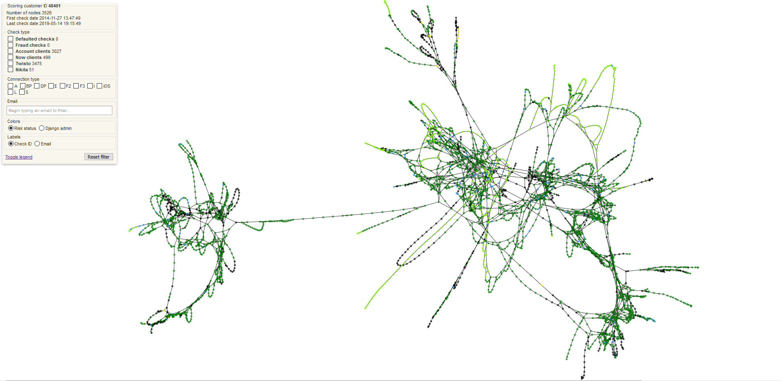

Slide 17
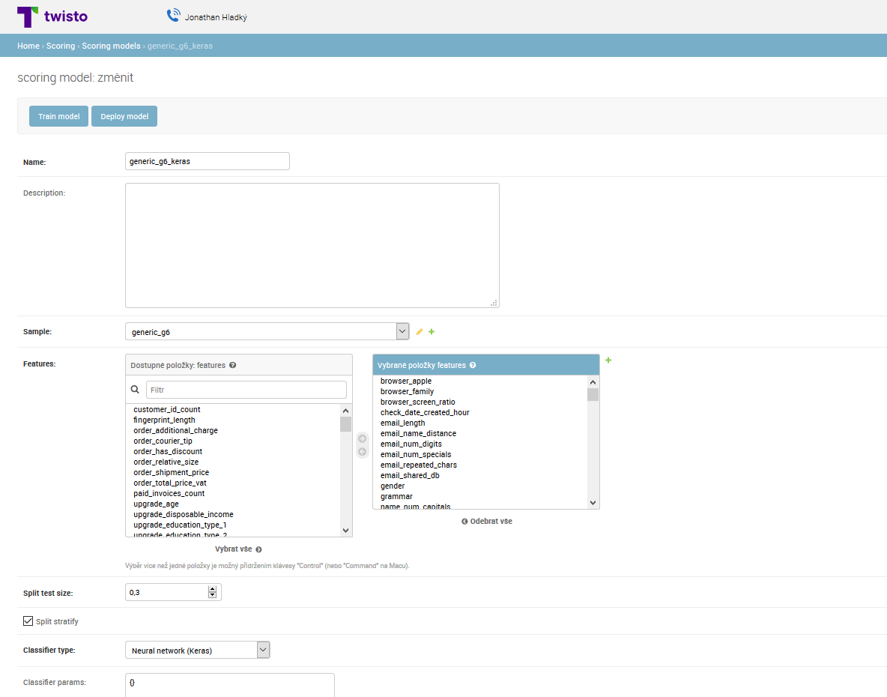
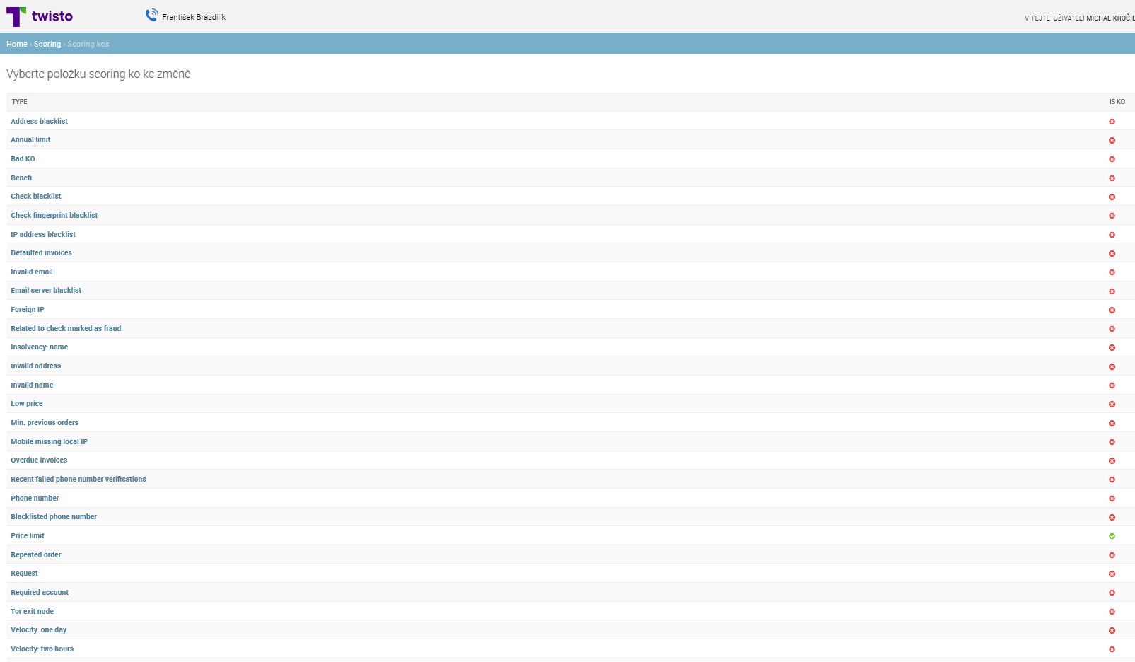
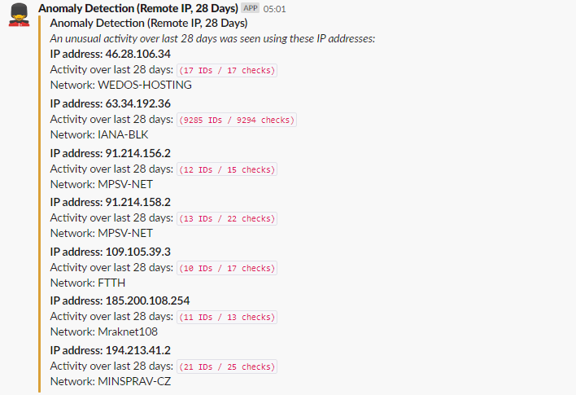
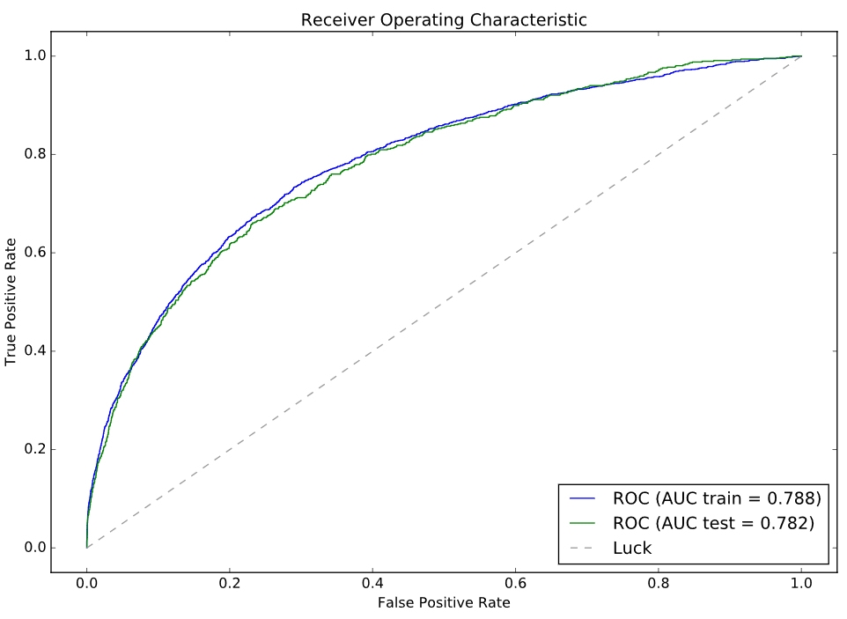
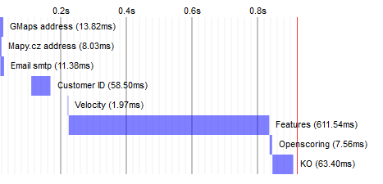

Slide 18
+ Data + Technology
+ People
= Success

Slide 19
Thank you!
Michal Kročil
michal.krocil@twisto.cz
+420 608 966 643

