Slide 1
Performance Management Systems
(PMS)

Slide 2
The term „performance“
performance levels:
  performance of individuals
  enterprise performance (incl. enterprise divisions)
  supply chain performance
definition:
  in a broader sense
  = achievement of predetermined objectives of an enterprise
  (e.g measured by satisfaction of each stakeholder group)
  in a narrower sense
  = financially measured appreciation of capital
  (e.g. measured by ROE, ROA,...)
Notes:
How would you define PERFORMANCE?

Slide 3
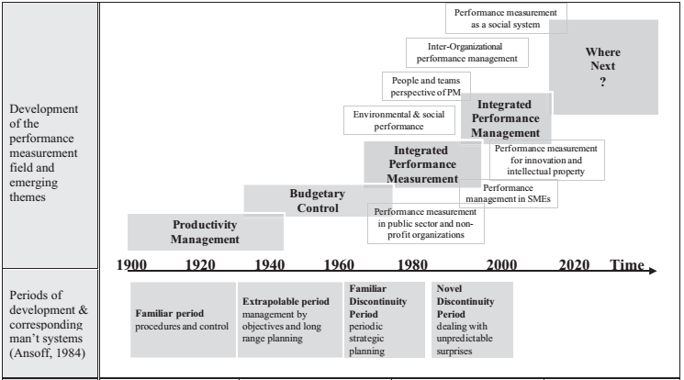
Trends in Performance Management
Source: Bititci, U., Garengo, P., Dörfler, V., Nudurupati, S. (2012) : Performance Measurement: Challenges for Tomorrow. International Journal of Management Reviews, vol. 14, issue 3, s. 305-327, p. 312

Slide 4
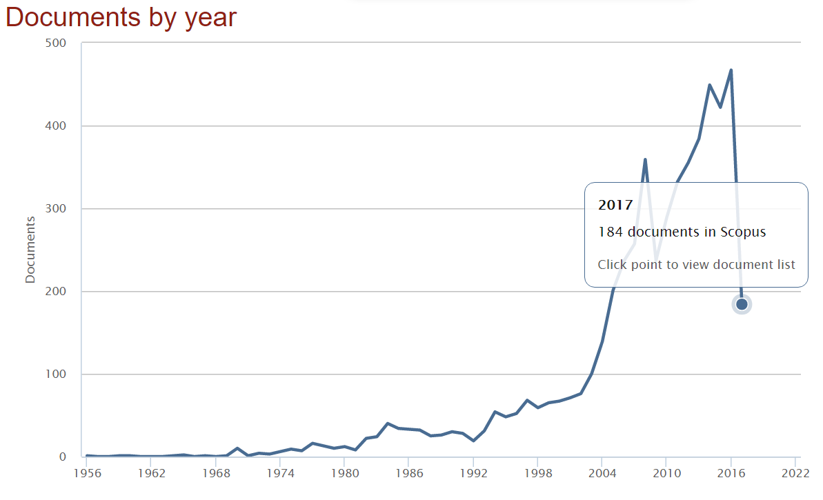
„Management Control System“ (MCS) becomes popular term next to „Performance Management Systems“
Scopus
  TOPIC: ("Management control system") OR TOPIC: (MCS)
    TITLE-ABS-KEY ( "Management Control System" OR "MCS" ) AND ( LIMIT-TO ( SUBJAREA , "ENGI" ) OR LIMIT-TO ( SUBJAREA , "BUSI" ) OR LIMIT-TO ( SUBJAREA , "ECON" )

Slide 5
What is
Management Control system (MCS)?
„Management control refers to a set of processes and mechanisms used by managers to inﬂuence the behaviour of individuals and groups towards more or less predetermined objectives.“
(D.S. Bedford, T. Malmi in Management Accounting Research 27 (2015) 2–26)

Slide 6
Performance Management
Performance
Measurement
Management control system
Performance
Management
(and
Control) Systems
= PMS

Slide 7
Different types of controls applied in organizations
  Merchant and Van der Stede (2007):
Action (or behavioural) controls
Personnel and cultural
(or clan and social) controls
Results (or output) controls

Slide 8
Different types of controls
  Merchant and Van der Stede (2007):
Action (or behavioural) controls
  Consist of:
    Behavioural constraints (e.g. PC password; limits,...)
    Preaction reviews (scrutiny and approval of action plans before employee can undertake a course of action)
    Action accountability (e.g. work rules; codes of conduct)
Personnel and cultural
(or clan and social) controls
Results (or output) controls

Slide 9
Different types of controls
  Merchant and Van der Stede (2007):
Action (or behavioural) controls
Personnel and cultural
(or clan and social) controls
  Personnel controls build on employees natural tendencies to control themselves (emphasis is on selection, training and job design).
  Cultural controls represent a set of values, social norms and beliefs that are shared by members of an organization and that influence their actions.
Results (or output) controls

Slide 10
Different types of controls
  Merchant and Van der Stede (2007):
Action (or behavioural) controls
Personnel and cultural
(or clan and social) controls
Results (or output) controls
  resemble cybernetic* control system
  focus is on reporting information
  about the outcomes of work effort
  stages:
    Establishing performance measures
    Establishing performance targets
    Measuring performance
    Providing rewards or punishments
*cybernetics = the field of science concerned with processes of communication and control (especially the comparison of these processes in biological and artificial systems

Slide 11
Advantages and disadvantages of different types of controls
Action (or behavioural) controls
  Direct link between control mechanism and the action.
  Measurement problems do not apply.
  Not feasible where cause-and-effect relationships are not well understood or easily observable.
  Best suited to stable conditions.
Personnel and cultural (or clan and social) controls
  Few harmful side-effects and inexpensive to operate
  Appropriate only in certain circumstances
Results (or output) controls
  Can be applied where knowledge of desirable actions is lacking.
  Space for creativity of employees, because focus is on outcomes

Slide 12
Management accounting control systems (MACS)
Tend to be the predominant controls in most organizations because:
  Monetary measure provides a means of aggregating results from dissimilar activities.
  Profitability and liquidity are essential for company survival and success.
  Financial measures enable common decision rules to be applied.
  Measuring results in financial terms enables managers to be given more autonomy.

Slide 13
Management accounting control systems (MACS)
Two core elements:
  Formal planning processes for establishing performance expectations.
    e.g. budgeting, long-term planning, standard costs
  Responsibility accounting
    Cost or expense centres
      standard cost centres (output can be measured)
      discretionary cost centres (output cannot be measured)
    Revenue centres
    Profit centres
    Investment centres

Slide 14
Management accounting control systems (MACS)
MACS process involves:
  Setting performance targets.
  Measuring performance.
  Comparing performance
  against target.
  Analysing variances
  and taking remedial actions.
Responsibility accounting is implemented by issuing performance reports
about variances between budgeted (planned) and actual performance.
compare with the same idea behind standard costing method

Slide 15
MACS
Typical reporting structure

Slide 16
Strategic control
Responsibility Accounting as typical MACS focuses on tactical and day-to-day horizons
strategic control requires nonfinancial measurement of performance as well
  Strategy Maps and BSC

Slide 17
Strategy map and Balanced Scorecard (BSC)
Kaplan, Norton (2004)

Slide 18
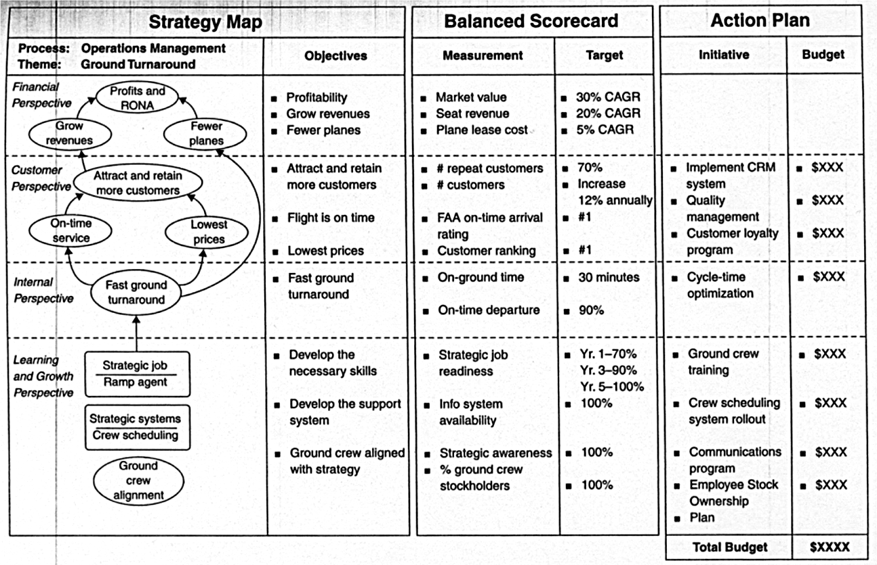

Slide 19
References:
ATKINSON, A.A., KAPLAN, R.S., MATSUMURA, E.M., YOUNG, M.S. (2012): Management Accounting : Information for Decision-Making and Strategy Execution. 6th Ed. Upper Saddle River (New Jersey): Pearson. ISBN 978-0-13-702497-1
Bititci, U. – Garengo, P. – Dörfler, V. – Nudurupati, S. (2012) : Performance Measurement: Challenges for Tomorrow. International Journal of Management Reviews, 2012, vol. 14, issue 3, pp. 305-327.
Chenhall, R.H. (2003): Management control systems design within its organizational context: Findings from contingency-based research and directions for the future. Accounting, Organizations and Society, 2003, vol. 28, pp. 127-168.
Drury, C. (2012): Management and Cost Accounting. 8th ed. Andover (Hampshire): Cengage Learning EMEA, 2012.
Ferreira, A. – Otley, D. (2009): The design and use of performance management systems: An extended framework for analysis. Management Accounting Research, 2009, vol. 20, pp. 263-282.
Franco-Santos, M. – Lucianetti, L. – Bourne, M. (2012): Contemporary performance measurement systems: A review of their consequences and a framework for research. Management Accounting Research 23, 2012, pp. 79–119
Malmi, T. – Brown, D. A. (2008): Management control systems as a package: opportunities, challenges and research directions. Management Accounting Research, 2008, vol. 19, pp. 287-300.
Tessier, S. – Otley, D. (2012): A conceptual development of Simons’ Levers of Control framework. Management Accounting Research, 2012, vol. 23, pp. 171-185.

