Slide 1
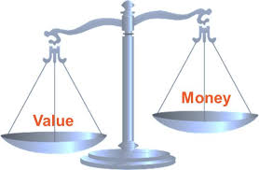
PUBLIC PROJECT DESIGN AND EVALUATION
02_SROI analysis

Slide 2


Headlines from your country:
What happened around the world last week?

Slide 3

Lecture content
Social return on investment (SROI) is a systematic way
of incorporating social, environmental, economic and other values into decision-making processes.
Like traditional cost-benefit analysis (CBA), SROI includes
a ratio; in this case a Social Return on Investment ratio.
The aspect of stakeholder perspectives is essential
in the SROI approach.
This lecture covers
the theory and practice
of performing SROI analysis.

Slide 4

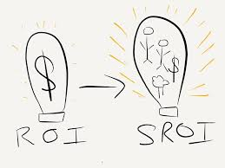
PLEASE NOTE!
Social return on investment (SROI)
is a principles-based method for measuring
extra-financial value (i.e., environmental and social value not currently reflected in conventional financial accounts) relative to resources invested.

Slide 5
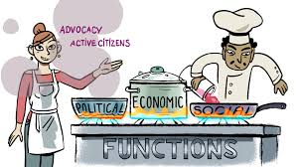
Third sector impact
The Third Sector Kitchen:
preparing a dish for the common good

Slide 6
Everybody is talking about „impact“… a fuzzy term!
Outcome
(Social) Effects
(Social) Impact
Output
(Social) Value
(Social) Return
Success

Slide 7
Its all about success! What is success?
…the positive result of an effort
…the occurrence of an intended, desired outcome
…the result of economic activity, recorded or expressed in monetary terms
…completing an objective or reaching a goal
What does success mean in the case of public projects?

Slide 8
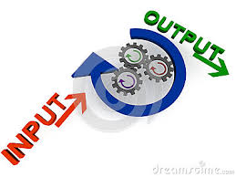
What are Outputs?
Outputs are those products
and services that directly result
from the activities of an organization, project or program (and the related efforts).
Outputs can be controlled by the management in terms of their type and scale.
Outputs can often be measured more directely compared to impacts. They are often measured with indicators (KPI) – especially when a whole organisation is being assessed.
Notes:
CS

Slide 9

Output = Success?
Are activities and their outputs
the purpose of an organization?
If activities are only the means
to an end: Is it enough to focus only on outputs in order to assess their success?
Is increase in output always essential? Does efficiency increase mean success?
To what extent do support processes contribute to the success? Preconditions for a successful performance? Own KPIs?
Does performance measurement really measure the dimensions which are central for the success of the organization?

Slide 10

What is Outcome?
Outcomes refer to those changes (positive and/or negative) that are noted to the beneficiaries (people, groups, society) of an intervention, after an intervention has taken place.
Outcomes may occur short-term, medium-term and long-term
Outcomes may occur at micro-, meso- and macro-level
Outcomes may generally occur on six topical dimensions:
- economic, ecological, social, cultural, political, psychical
and physiological
Outcomes have to be measured,
analysed and valued differently
for each stakeholder
Notes:
CS

Slide 11
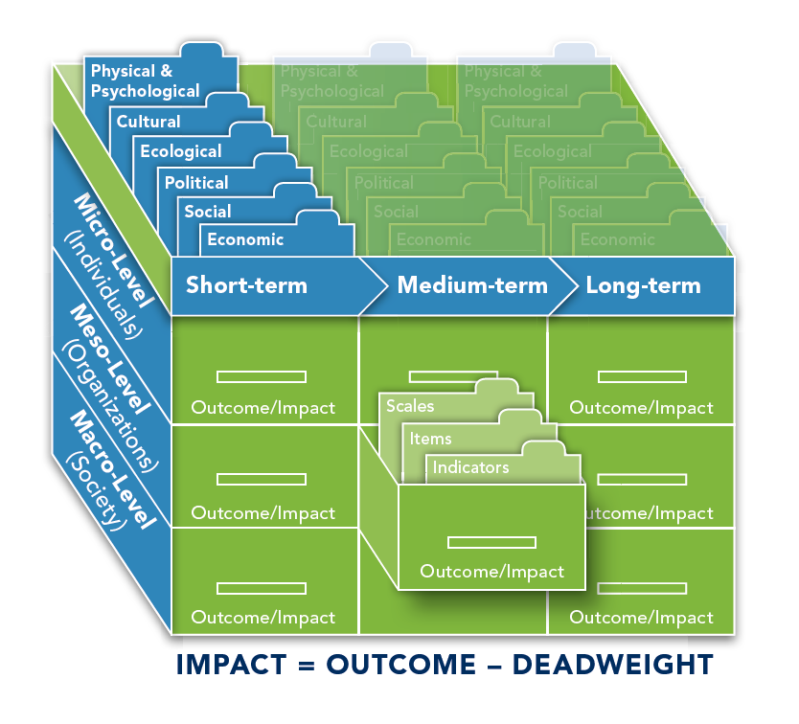
Impact box
Quelle: Schober, C./Rauscher O. (2014): „Was ist Impact? Gesellschaftliche Wirkungen von (Nonprofit) Organisationen. Von der Identifikation über die Bewertung bis zu unterschiedlichen Analyseformen.“, Working Paper, NPO&SE Kompetenzzentrum WU Wien. Download unter: https://www.wu.ac.at/fileadmin/wu/d/cc/npocompetence/downloads/impact_gesellschaftliche_wirkungen_von_nonprofit_organisationen.pdf
English version coming soon.

Slide 12
Outcome = Success?
Outcomes have to be understood
in broader terms than typical success
dimensions
A comprehensive consideration of outcomes allows an overall assessment of organisations or programs/projects beyond the organisational success => Organisations can be successful in terms of efficiency/effectiveness but still have an overall negative outcome (Externalities)
Comprehensive impact analyses consider unintended outcomes

Slide 13
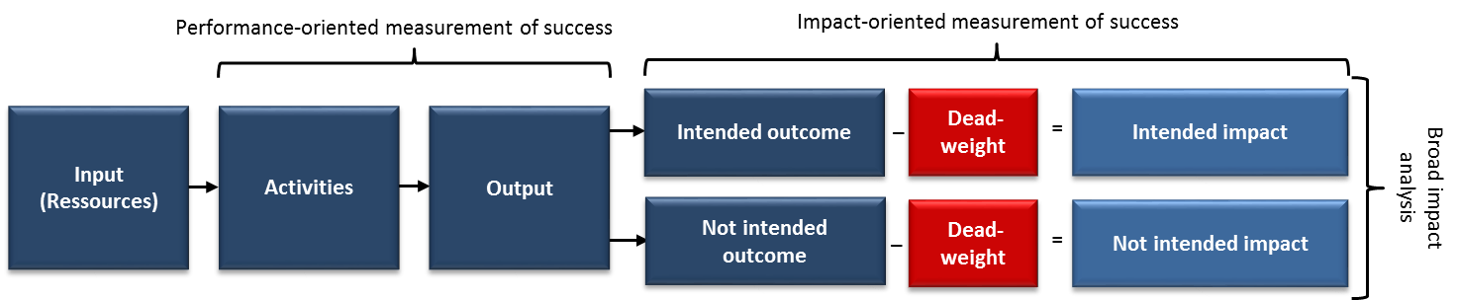
Impact value chain/Logic Model
Quelle: Schober, C./Rauscher O. (2014): „Was ist Impact? Gesellschaftliche Wirkungen von (Nonprofit) Organisationen. Von der Identifikation über die Bewertung bis zu unterschiedlichen Analyseformen.“, Working Paper, NPO&SE Kompetenzzentrum WU Wien. Download unter: https://www.wu.ac.at/fileadmin/wu/d/cc/npocompetence/downloads/impact_gesellschaftliche_wirkungen_von_nonprofit_organisationen.pdf
English version coming soon.
Notes:
OR

Slide 14
Impact Model
Stakeholder A
Input
Activties
Output
Outcome
minus Deadweight
Impact
Project 1
Stakeholder B
…
Stakeholder X
Stakeholder A
Input
Activties
Output
Outcome
minus Deadweight
Project 2
Stakeholder B
…
Stakeholder X
Stakeholder A
Input
Activties
Output
Outcome
minus
Deadweight
Project 3
Stakeholder B
…
Stakeholder X
Notes:
OR

Slide 15
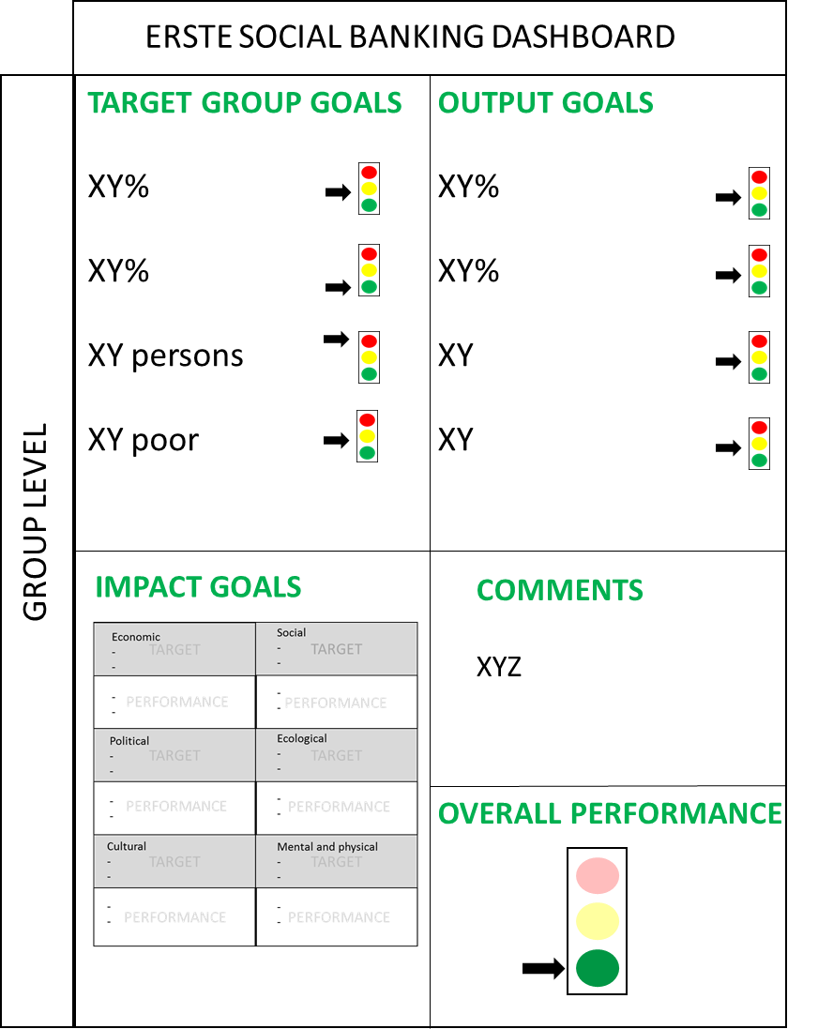
Presentation of the results
The main results of the data-analysis are presented in a dashboard focusing on the four relevant sections.
Dashboards contain indicators that can be aggregated from project
comparable results and recognizability throughout the whole project period
Notes:
CS

Slide 16
“impact goals” a strategic target-performance scheme*
Social
-
-
-
-
TARGET
TARGET
Economic
-
-
-
-
PERFORMANCE
PERFORMANCE
TARGET
Ecological
-
-
-
-
Political
-
-
-
-
TARGET
PERFORMANCE
PERFORMANCE
TARGET
TARGET
Cultural
-
-
-
-
Mental and physical
-
-
-
-
PERFORMANCE
PERFORMANCE
* Developed by Rauscher, O./Schober, C. (2015): “Wirkungsanalyse”. In: Eschenbach et al.: Management der Nonprofit-Organisationen. Bewährte Instrumente im praktischen Einsatz. Schäffer-Pöschel Verlag, Stuttgart
Notes:
CS

Slide 17
SROI describes the VALUES of changes to stakeholders by using financial proxies to represent values not usually captured in a market economy – social, community and environmental benefits
SROI gives a voice to stakeholders that have been excluded in the past, e.g. disabled workers in social firms and their families
SROI is based on standard accounting and commercial investment principles
SROI makes sense to funders as a way of representing the value created by an activity and helps communicate of the value of the work to ‘the people that matter’
SROI involves measuring change – what funders are really looking to invest in

Slide 18
Inputs
Outputs
Outcomes
Impacts
Theory of Change
For each stakeholder (e.g. disabled workers, their families, their community, their state support agencies, local employers and businesses etc.) we look at:
Inputs - resources invested in the activity
Outputs – the description of the activity e.g. 20 disabled people employed
Outcomes - changes to people resulting from the activity, i.e., a new job, increased income, improved stability in life, improved quality of life
Indicators of change – how do we know change has happened
Quantities of change – how many of the stakeholder group experience change
Financial proxies – how we value the change
Impact = Quantities times proxies, less reductions to reflect that some change happens anyway and some change is created by other factors

Slide 19

SROI project: Ethiopia – educational activities

Slide 20

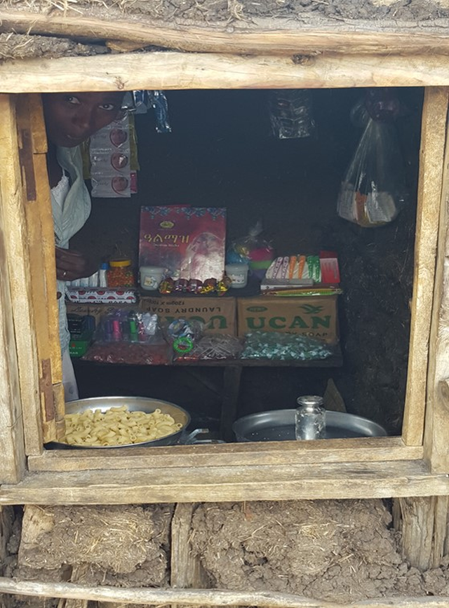
SROI projects: Ethiopia – start-ups

Slide 21

SROI project: Ethiopia – new school

Slide 22

SROI project: Ethiopia – impact assessment

Slide 23
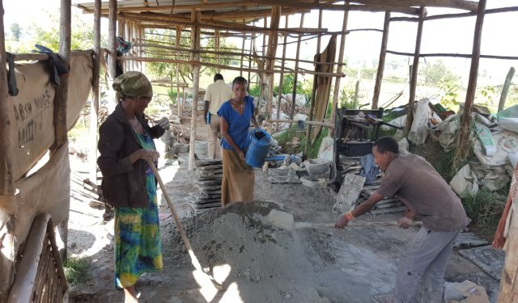
SROI project: Ethiopia – production of ovens

Slide 24

SROI project: Ethiopia – backyard gardening

Slide 25
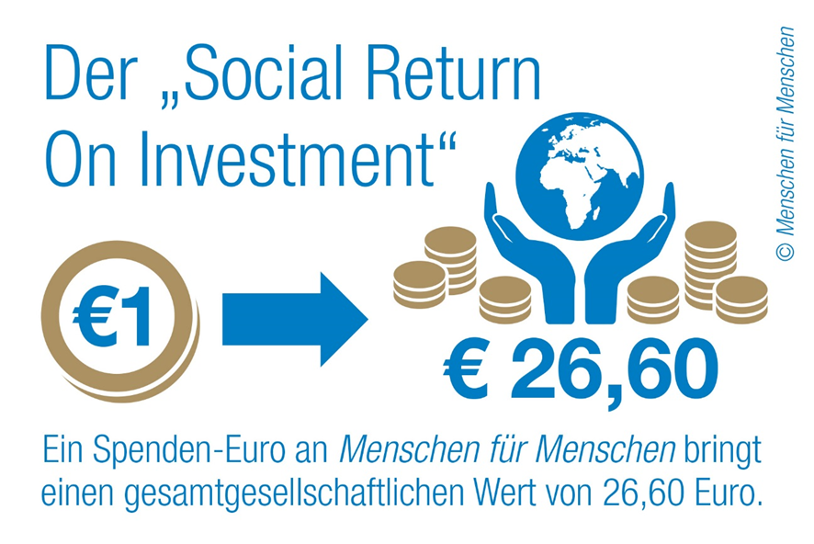
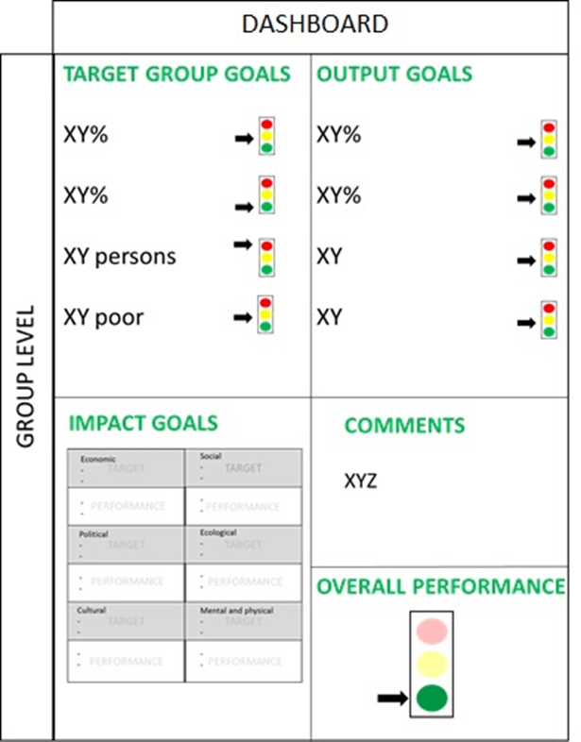
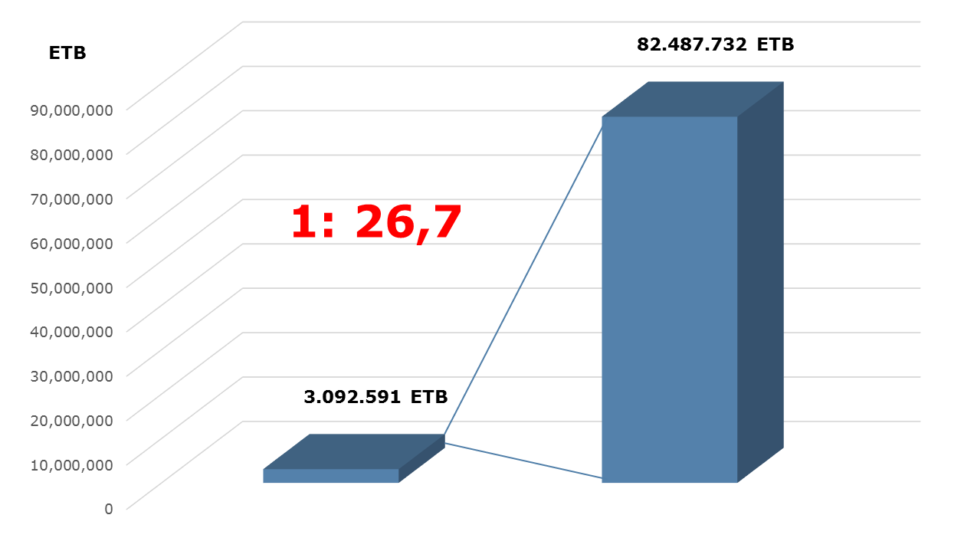
Vaceková et al., 2016

Slide 26

SROI calculations – group activity (excel)

Slide 27




Discussion – limts and merits of SROI analysis

Slide 28


Useful links:
Global Value Exchange Database:
http://www.globalvaluexchange.org/
NPC:
http://www.thinknpc.org/publications/mapping-outcomes-for-social-investment/
SIAA:
http://www.siaassociation.org/

Slide 29

Thank you for your attention!

