Slide 1
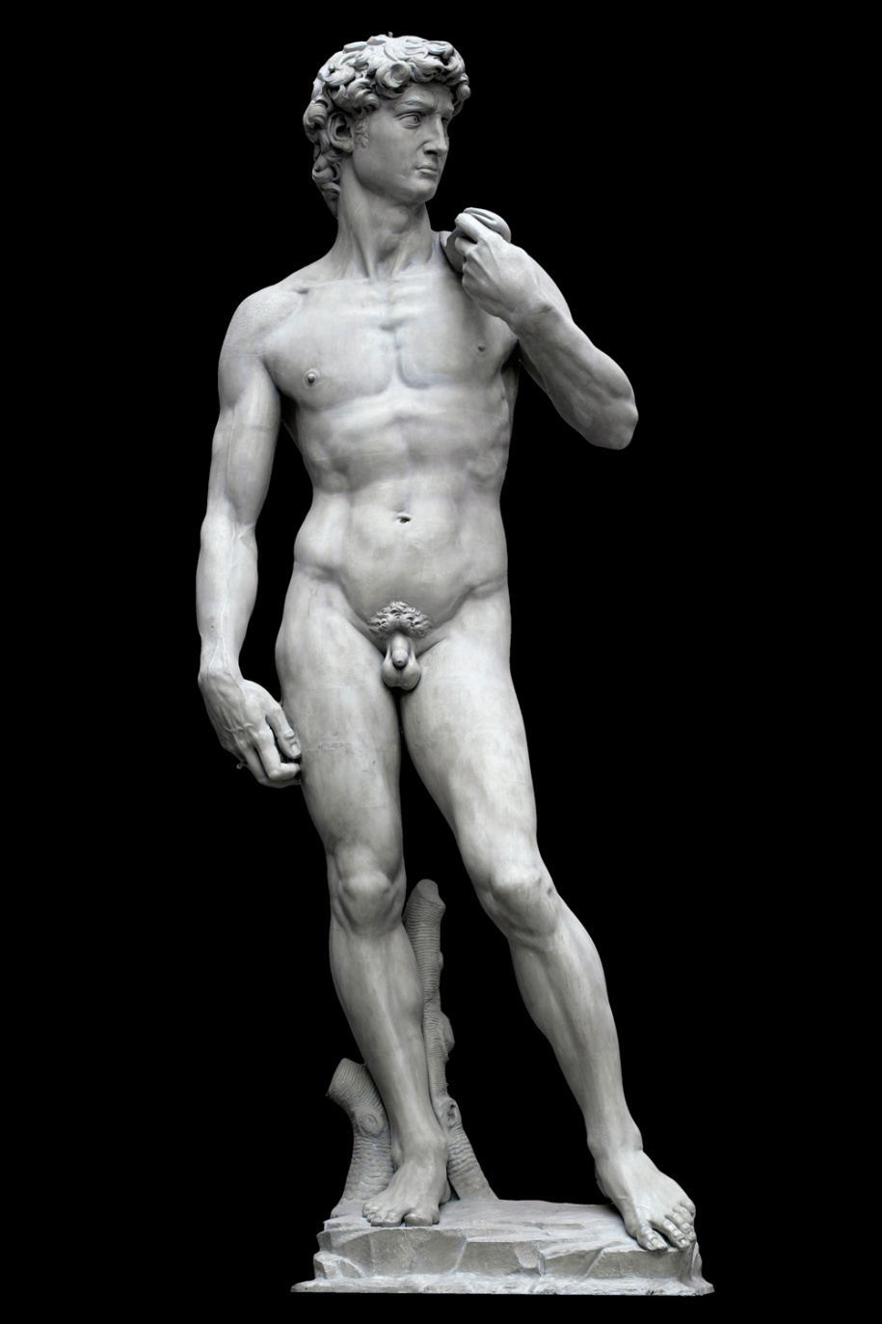
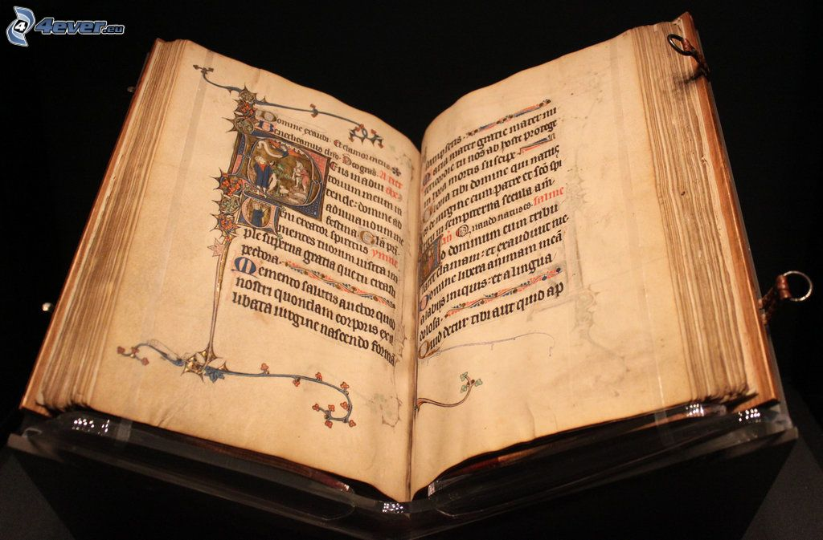
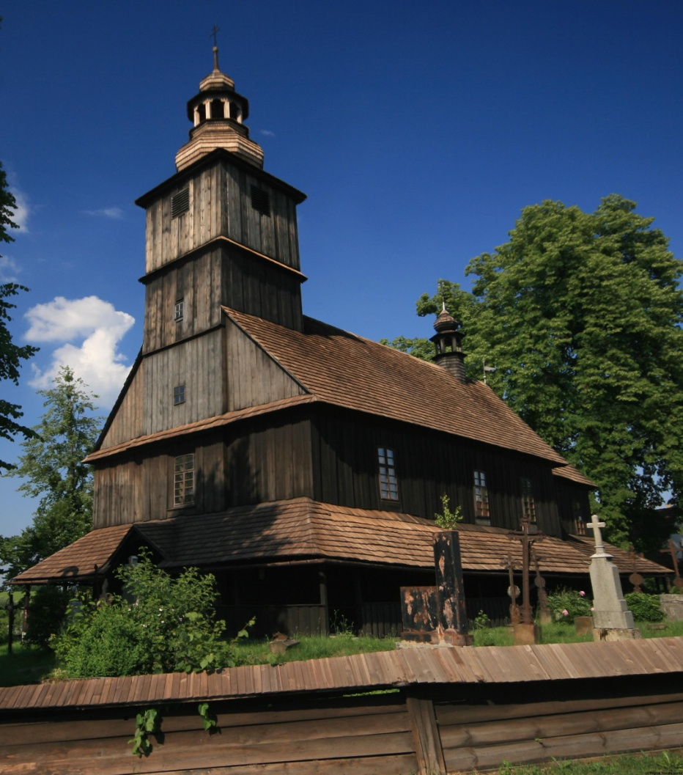

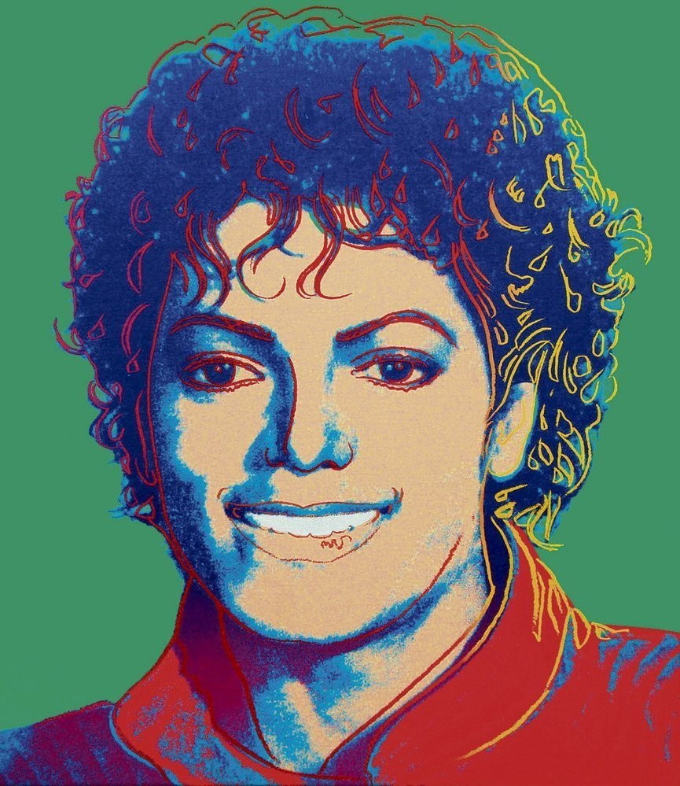
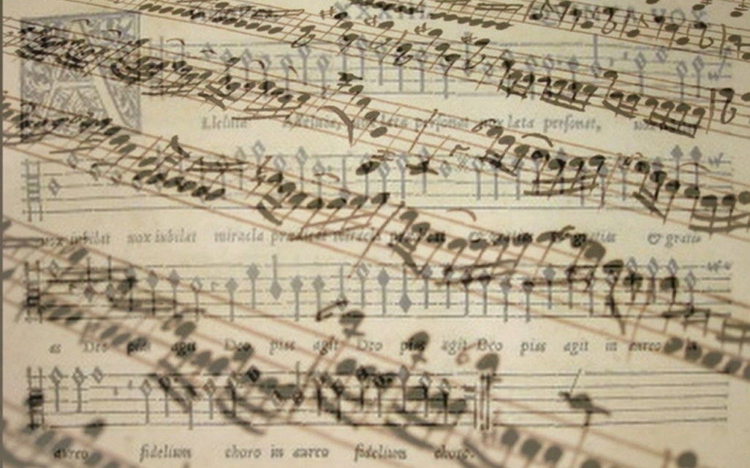
Public support of culture

Slide 2

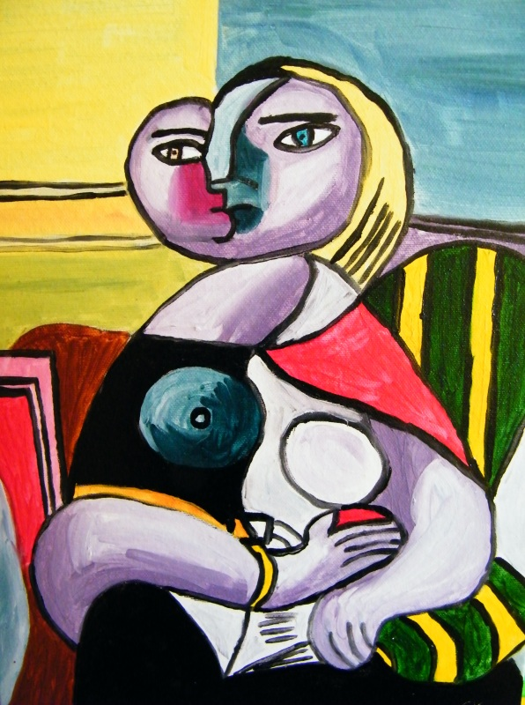

1. WHAT DOES TERM HIGH CULTURE MEAN?

Slide 3
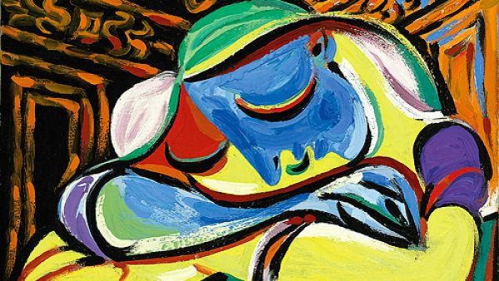

High culture
High culture:
„ This is the culture of the elite and usually refers to artistic endeavors such as music, dance, theater, certain writing, architecture, etc.“[CCSU]
The artistic entertainment and material artifacts associated with a society's aristocracy or most learned members, usually requiring significant education to be appreciated or highly skilled labor to be produced. [Your dictionary]

Slide 4
High culture
Motivation:
Achievement of catharsis
  mental cleansing, mystical purification of the soul from all sensual,
Uplifting of the spirit
To show social status
Escape from the real world

Slide 5
2. WHAT DOES TERM POPULAR CULTURE MEAN?

Slide 6
Popular culture
Popular culture (also „pop culture“)
Culture based on the tastes of ordinary people rather than an educated elite. [oxford dictionary]
music, TV, cinema, books, etc. That are popular and enjoyed by ordinary people, rather than experts or very educated people [Cambridge dictionary]

Slide 7
Popular culture
Motivation:
Possibility of social interaction
Escape from the real world
Have a fun

Slide 8
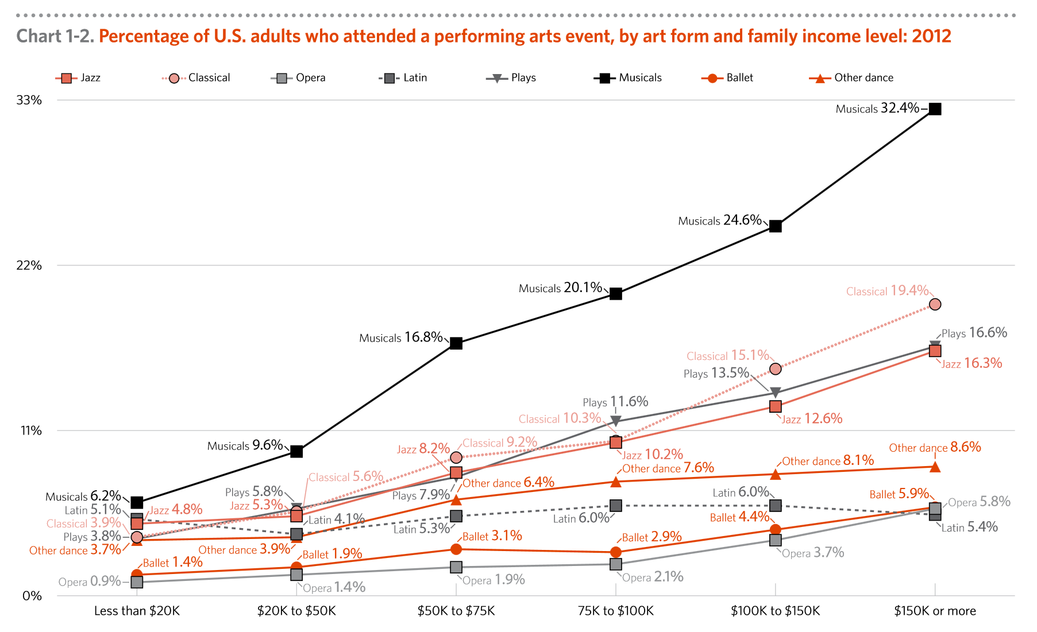
How wage affect attendance in events

Slide 9
3. Alternative models of public support of culture

Slide 10
Alternative models of public support of culture
Hillman-Chartrand model of relationship:
Role of government as:
  Facilitator
  Patron
  Architect
  Engineer

Slide 11
Alternative models of public support of culture
FACILITATOR
Government doesn't intervene in the process of production
The position of artists is mostly dependent on income from production(ability to attract audiences)
Important role of donators
Homogenization of culture
  little space for artistic experiments
E.g. USA

Slide 12
Alternative models of public support of culture
PATRON
Creation of Arts Councils
Support of high culture production
Distance between state and art
The role of state is to decide about the volume of support
  The concrete distribution of support is managed by councils
Focus on self-sufficiency
E.g. VB

Slide 13
Alternative models of public support of culture
ARCHITECT
Support of art through state institutions (ministries)
Artists are often employees of cultural institutions
High dependence on support from public funds (mainly subsidies)
Risk of artistic stagnation, moral hazard
E.g. France

Slide 14
Alternative models of public support of culture
ENGINEER
The aim may not be an artistic experience, but a political goal
The government owns all funds for support of culture
The government form a resolution about
  Size of support
  Supported activities, institutions and artist
Artist are absolutely depended on state support
Membership in artists' unions - enforceable, censorship
E.g. the Czech Republic before 89, totalitarian regimes (North Corea, SSSR…)

Slide 15
4. What does indirect and direct state support mean?

Slide 16
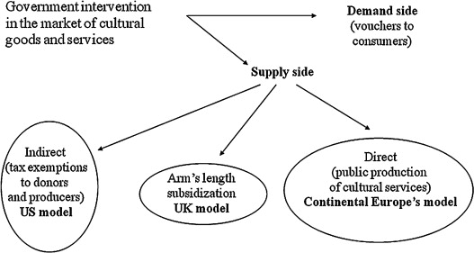
Government intervention in market of cultural goods and services

Slide 17
Indirect support
-Indirect support is represented by activities which support those who are supporting directly some culture activity
-main characteristic is that the support doesnt directed to concrete culture organization
Tax reduces for donators
Social contributions

Slide 18
Direct support
Money from sales revenues
Foundations and foundations funds
Other founds (e.g. state fund for Czech cinematography)
Communal obligations to support local organizations
Donations and sponsorship
Lottery and bets
Public collections

Slide 19
5. How does state lottery works?

Slide 20
State lottery
Long tradition several countries
  UK
    20% of profit come into culture
  Finland
    Profit is divided in sport and cultural activities

Slide 21
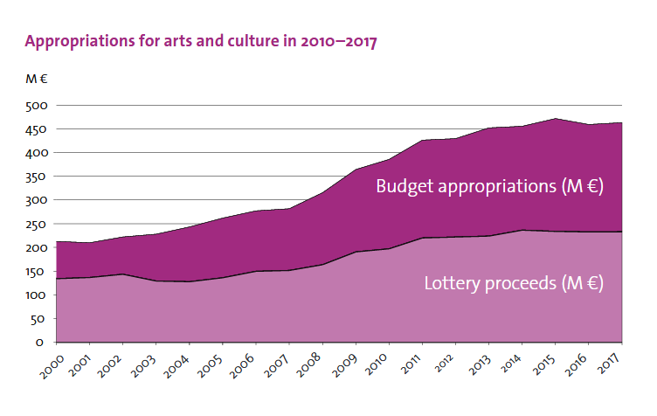
Finland state lottery

Slide 22
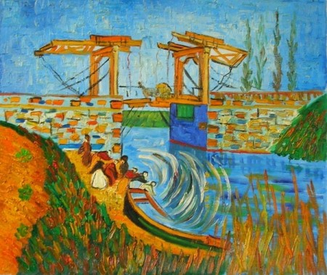
6. Mission of ministry of culture

Slide 23
Ministry of culture
    Competence of the Ministry
    State administrative body for
      the arts;
      cultural and educational activities;
      cultural monuments;
      matters relating to churches and religious societies;
      matters relating to the press, including publication of the non-periodical press and other information means;
      the preparation of draft laws and other legal regulations in the area of radio and television broadcasting;
      implementation of the Copyright Act;
      production and trade in the area of culture

Slide 24
Ministry of culture
    Expenditures of ministry
    448 mil euros
    1 % of state expenditures

Slide 25
Ministry of culture
State | Expenditures in million euros | % state expenditures
Czech Republic | 448 mil. | 1 %

Slide 26
7. What percentage of total expenditures does government spend for….

Slide 27
What percentage of total expenditures does government spend for…
  Cultural services
  0,4%
  Religion and other community activities
  0,1 %
  Broadcasting and publishing services
  0,2 %

Slide 28
What percentage of total expenditures does government spend for….
Country | Cultural services | Religion and other community activities | Broadcasting and publishing services
EU 28 | 0,4 % | 0,1 % | 0,2 %
Czech R. | 0,6 % | 0 % | 0,2 %
Spain
France
Finland

Slide 29
8. Financing of religions

Slide 30
Financing of religions
  In Czech Republic are religion independent to state since 2012
    Due to act no.428/2012 about religion property settlement
    Religions will receive property which belongs to it before 1948
    Religions will receive financial compensation for the property that can not be reversed
    Government has no duty do financially support religions

Slide 31
Financing of religions
  Options of relation between state and religions
  Religions are independent Cultural services
    USA
    Czech republic (since 2012)
  Religions are part of public sector
    Germany-tax for religions
    Czech Republic (before 2012)
  Religions are semi independent
    Italy – tax assignation (0,8 % of personal revenue tax)
    Spain – tax assignation (0,52 % of personal revenue tax)

Slide 32
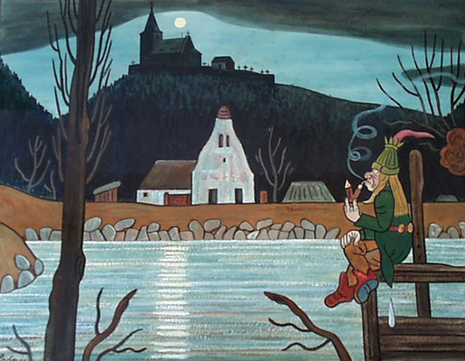
Conclusion

Slide 33
Conclusion
Culture can be financing by market, private support, public support
Most of culture segment are not self-sufficient
  They are dependent on the support
State support has two forms
  Direct (sponsorship, lotteries, communal obligations, founds and foundations funds…)
  Indirect (tax reduction, social contribution )
Government spend 1 % of total expenditures for culture

Slide 34
Usefull links
  (1)
  http://web.ccsu.edu/faculty/harmonj/atlas/definitions.html
  http://www.yourdictionary.com/high-culture
  https://dictionary.cambridge.org/dictionary/english/pop-culture
  (5) http://minedu.fi/documents/1410845/4150031/The+State+supports+arts+and+culture/bb45a827-60ba-4c16-8cda-3882fc74fe97
  (6) http://ec.europa.eu/eurostat/statistics-explained/index.php/File:Mean_household_cultural_expenditure_by_expenditure_purpose,_2010.png
  (7) https://ec.europa.eu/eurostat/statistics-explained/images/8/8f/Total_general_government_expenditure_on_recreation%2C_culture_and_religion%2C_2016_%28%25_of_GDP_%25_of_total_expenditure%29.png

