Slide 1
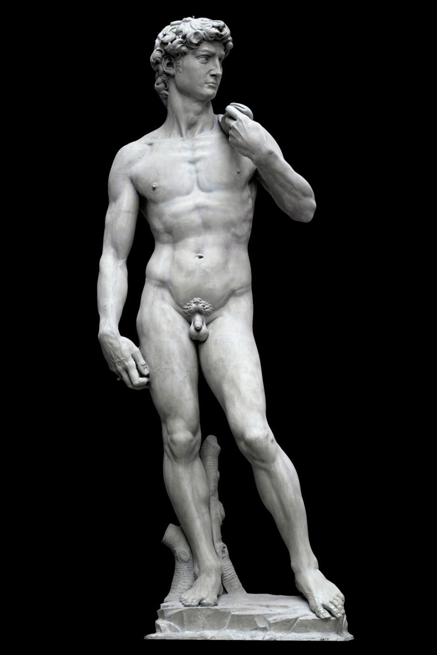
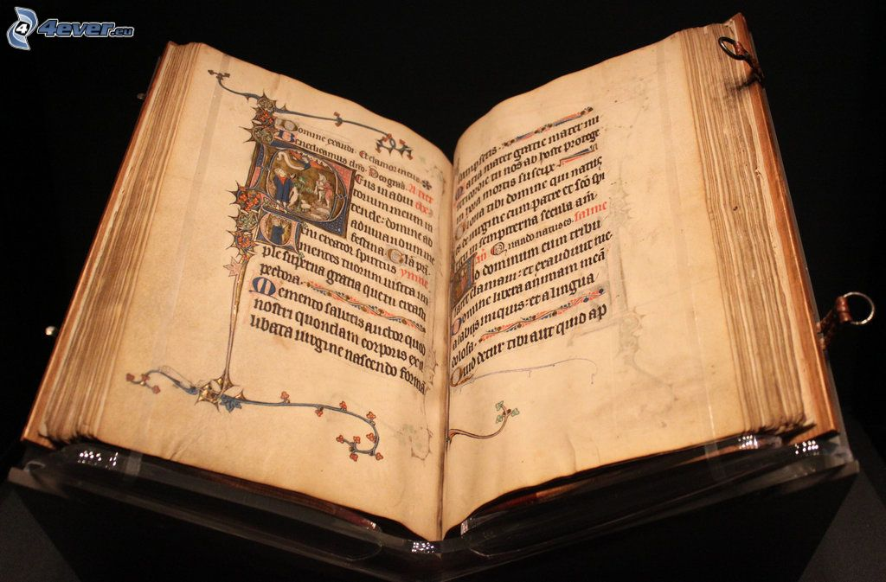
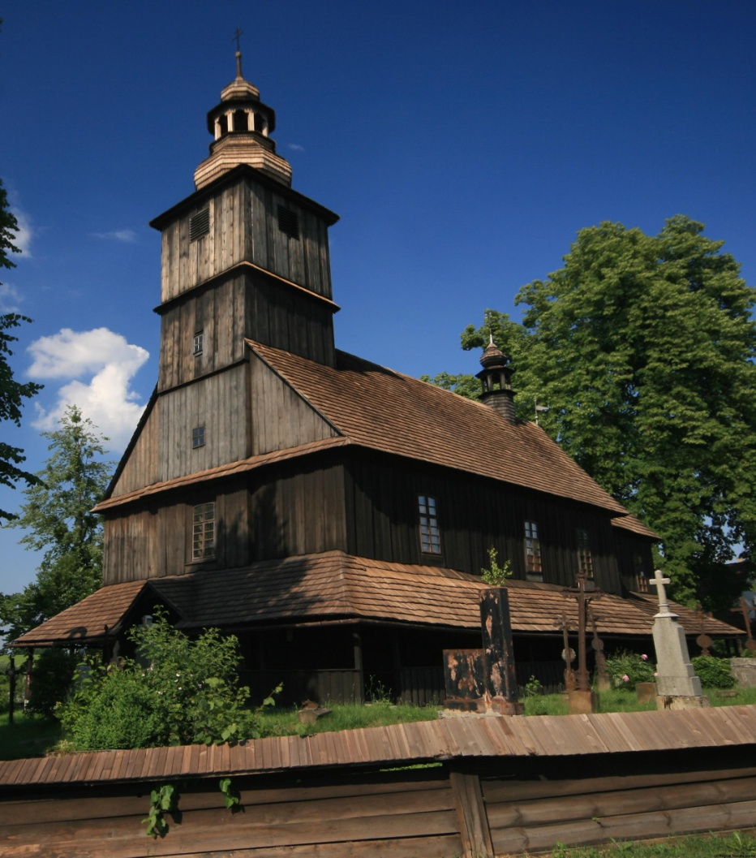

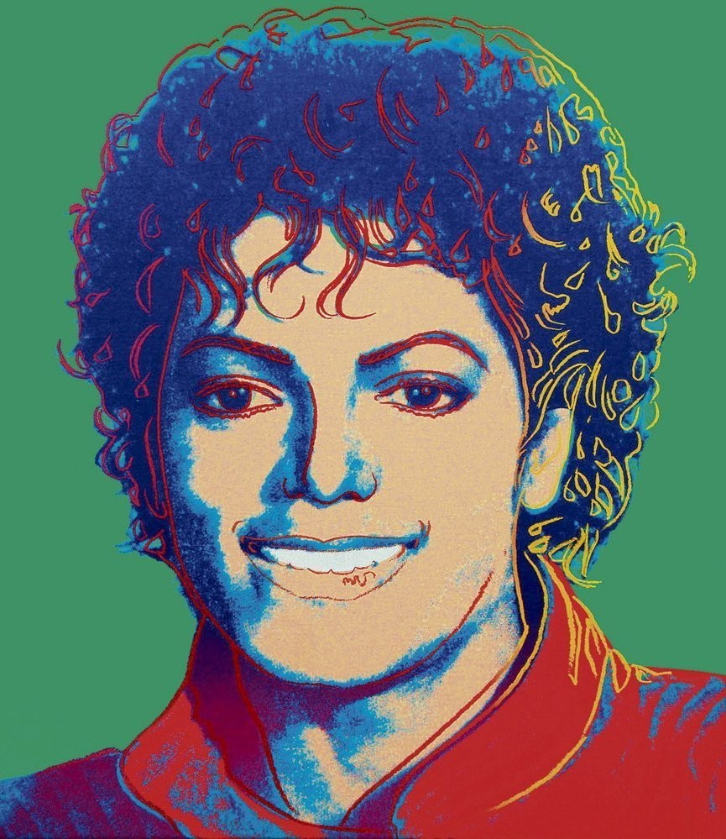
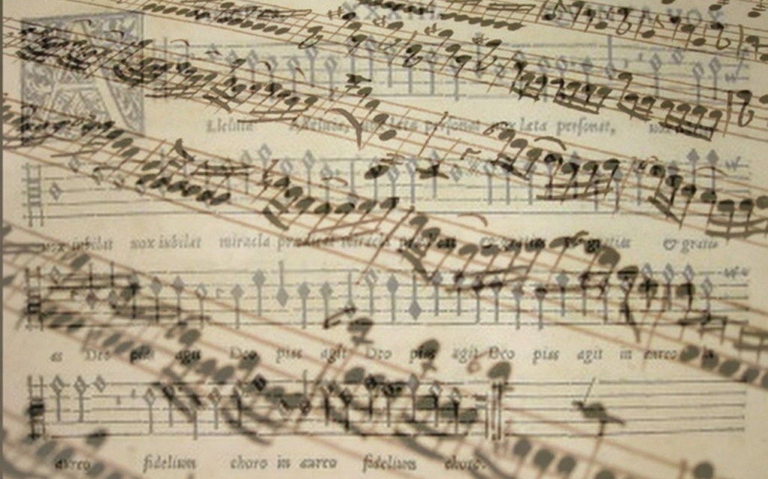
Mass media economy

Slide 2

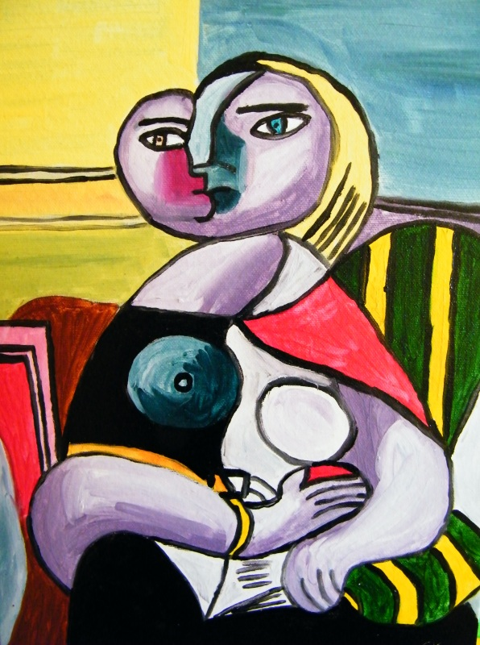

1. definition of mass media

Slide 3
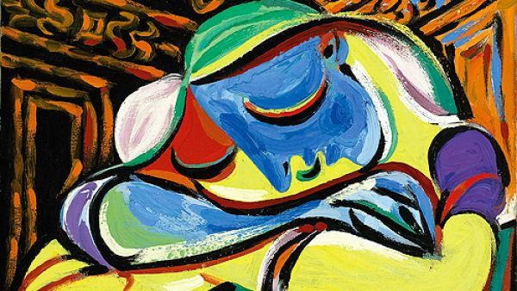

Find definition of mass media
Dictionary
  Origin of term (1920-1925)
characteristic:
  „any of the means of communication, as television or newspapers, that reach very large numbers of people“
  „newspapers, television, radio, and the internet. The mass media has become one of the main instruments of political change.“ (Cambridge dictionary)

Slide 4
2. WHAT KIND OF MASS MEDIA DO YOU KNOW?

Slide 5
What kind of media do you know?
Broadcast (radio, television)
Publishing
Print media (newspapers, magazines, books, etc.)
Recorded music
Cinema, films
Outdoor media (billboards)
Internet media – many mass media services (websites, blogs)

Slide 6
  Areas of mass media impact?
Information
Education
Entertainment
Formation
Regulation
Culture

Slide 7
3. MILESTONES OF MASS MEDIA DEVELOPMENT

Slide 8
Milestones of mass media development
Newspapers in Europe
1566 Venice
  handwritten news sheets that circulated widely in Venice as early as 1566.
1609 Germany
  the first printed weekly published newspapers
  they were heavily censored by the government
  they reported only foreign news
1695 England
  English government relaxed censorship
  newspapers flourished in London and a few other cities
1830 high speed presses
  Sunk cost help to expand newspapers

Slide 9
Milestones of mass media development
Radio broadcasting
1905-1906 broadcasting of music and talk
1920-1923 start commercial broadcasting
1922-500 radio stations in USA
  BBC
TV Broadcasting
30‘s first television station WRGB
  1936 BBC TV station
1954 color television
2014 smart television

Slide 10
Milestones of mass media development
Historical milestones
Internet
70‘s
Youtube
2005
Facebook
2004
Instagram
2010
TikTok
2017

Slide 11
4. Ownership of mass media

Slide 12
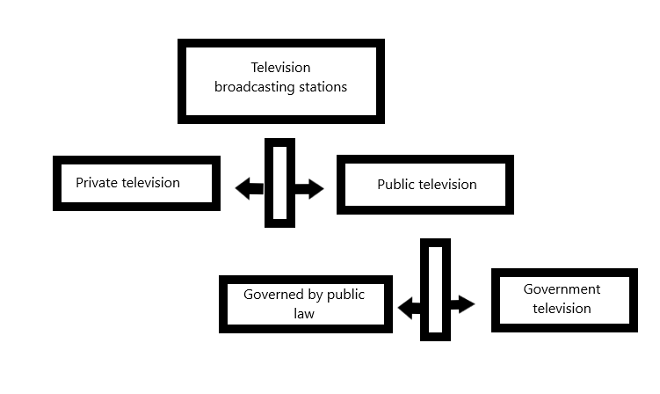

Slide 13
Public x Private
Public vs. private
No commercial vs commercial media vs. Government media
public
+ Demand to independence
+ Program diversity
+ Objectiveness
Needs of public support
Political pressure
Low pressure to financial efficiency

Slide 14
How can we divide broadcasting media?
private
+ Pressure to financial efficiency
+ Generally without political pressure
+ Financial independent
- Need support from advertisement
- Under pressure of owners
Focused of gain
Tabloid

Slide 15
How can we divide broadcasting media?
Government media
+ less advertisement
+ focused on information
+focused on human capital development
Low financial independency
Existing tendency to propaganda
Lower pressure to economic efficiency

Slide 16
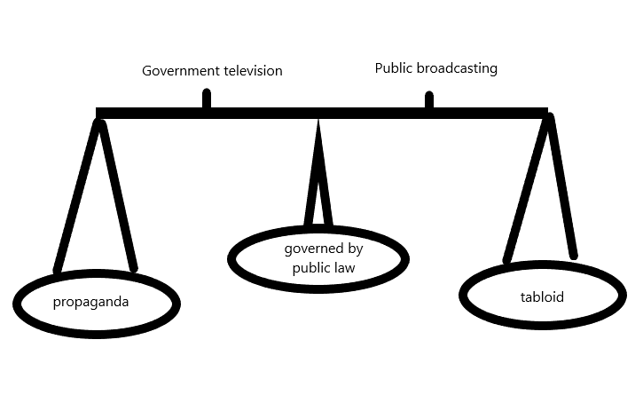

Slide 17
5. Copyright

Slide 18
Arguments for and against regulations
Term copyright
„The exclusive and assignable legal right, given to the originator for a fixed number of years, to print, publish, perform, film, or record literary, artistic, or musical material. “ (oxford dictionary)

Slide 19
6. Copyright protection associations

Slide 20
Arguments for and against regulations
Czech Republic OSA
is a professional association of composers, lyricists and musical publishers which was established in 1919
„The mission of OSA is the management of economic copyrights of composers, lyricists, the heirs of copyrights and publishers by law or based on an agreement. At present, OSA manages rights for the territory of the Czech Republic based on a contracting relationship directly with the rights holder or with its foreign sister society and offers repertoire of three and half million rights holders from various parts of the world, including 9,429 domestic rights holders as of 31 December 2017“

Slide 21
8. REGULATION OF BROADCASTING

Slide 22
Arguments for and against regulations
Program diversity / Tendency to homogeneity
  Competition, funding from advertiser reduce program diversity and neglect minority tastes, duplicating popular programs
Monopolistic market
Asymmetric information (advertising)
Social and political effects
Externality

Slide 23
Arguments for and against regulations
Merit goods
E.g. program with explicit violence
  Induces (influence) actual violence from some viewers (externality)
  Immoral even if not affecting people’s behavior (merit good)

Slide 24
  What types of regulation do you know?
Generally regulation by law
  Mandatory rate of national broadcasting
  Regulation of broadcasting violence, sexual scene,… etc.
Regulation of ownership
Regulation of program content
Controls
Licensing

Slide 25
9. WHAT METHOD OF FINANCING TV BROADSASTING DO YOU KNOW?

Slide 26
What method of financing Television broadcasting do you know?
Broadcasting fees paid by viewers/listeners
Concession fees paid by commercial operators
Other sources of public funding
  Direct support
  Indirect support
Radio/television advertising
Radio/television sponsorship
Subscription fees for pay services
Other revenue
Mixed funding

Slide 27
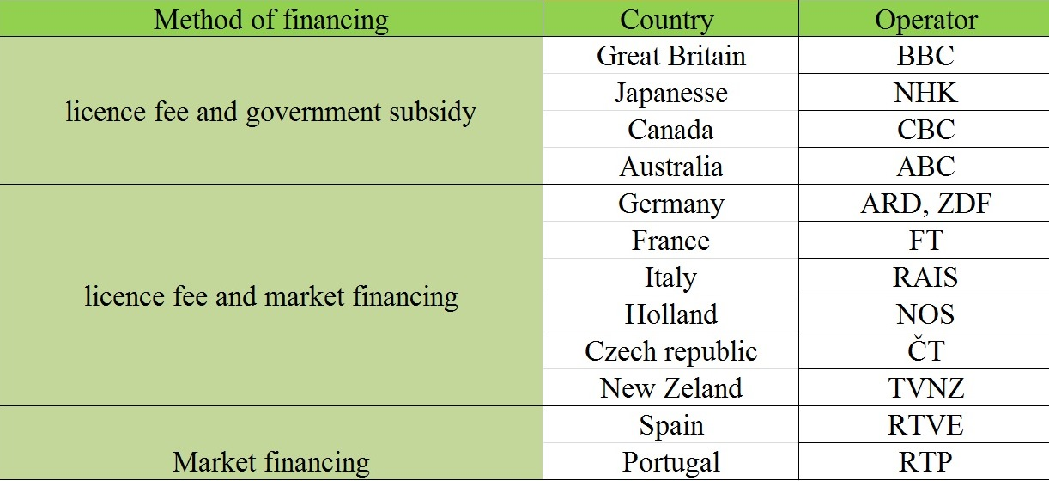
What method of financing Television broadcasting do you know?

Slide 28
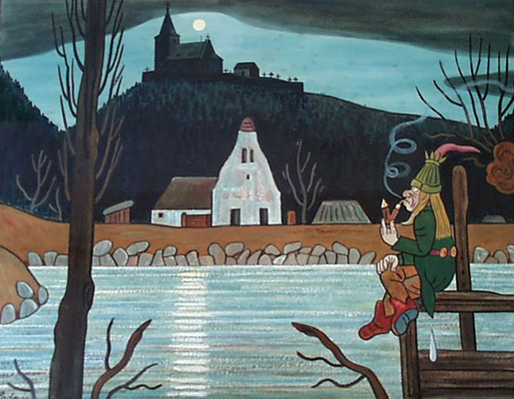
Conclusion

Slide 29
Conclusion
Term mass media cover tv broadcasting, radio broadcasting, newspapers, billboards and internet
Mass media are:
  Private x public
  Commercial x noncommercial
Mass media can be financing by:
  Market
  Government subsidy
  License fees

Slide 30
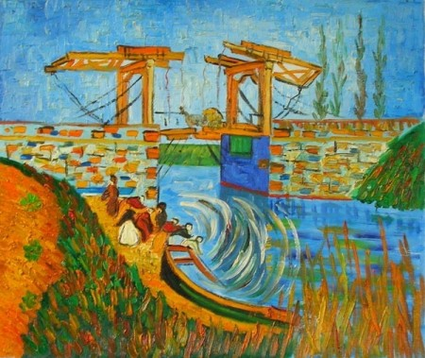
Use full links
  http://dictionary.cambridge.org/dictionary/english/mass-media
  https://www.ebu.ch/files/live/sites/ebu/files/Publications/EBU-MIS%20-%20Funding%20of%20PSM%202015%20-%20Public%20version.pdf
  http://unesdoc.unesco.org/images/0012/001240/124058eo.pdf

