Slide 1
Kepner-Tregoe Methodology
(English version - částečně)
Skorkovský
Department of business economy
Developed by Charles H. Kepner and Benjamin B. Tregoe in the 1960s.

Slide 2

The formulation of a problem is far more essential than its solution, which may be merely a matter of mathematical or experimental skill”
- Albert Einstein
Formulace problému je mnohem důležitější než jeho řešení,
které může být pouze otázkou matematické nebo experimentální dovednosti.

Slide 3
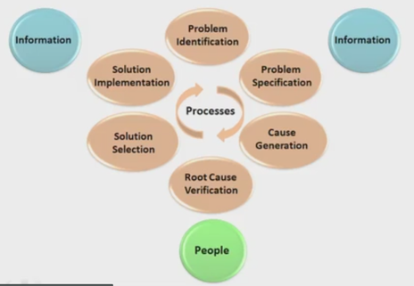
Related actions – na sebe navazující akce
(Formulace problému=identifikace a specifikace)
Resource: taken from K&T vidoes
1
2
6
3
5
4
1 – nezvládnutí pandemické situace
2 – vysoké počty nakažených, vysoká smrtnost, ….
3 – odpírači, nedůvěra obyvatelstva v nařízení, každý hraje jenom na sebe,..
4 - neschopnost vlády
5 - změna ve vládě, nové metody obrany proti viru, očkovací centra, kampaň pro očkování ,…

Slide 4

Apollo 13 – Houston, Houston, do you read me ? We have a big problem….!
The Apollo 13 team is famous for bringing back the astronauts stranded in space by solving difficult and complex problems. The teams solving the problems has used the Kepner-Tregoe (KT) methodology !

Slide 5
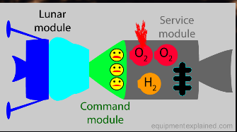
Appolo 13 – description (problem and solution)
https://spectrum.ieee.org/tech-history/space-age/apollo-13-we-have-a-solution
https://prezi.com/_ohiqi4xzcxt/tier-v-problems-and-solutions-on-apollo-13/

Slide 6
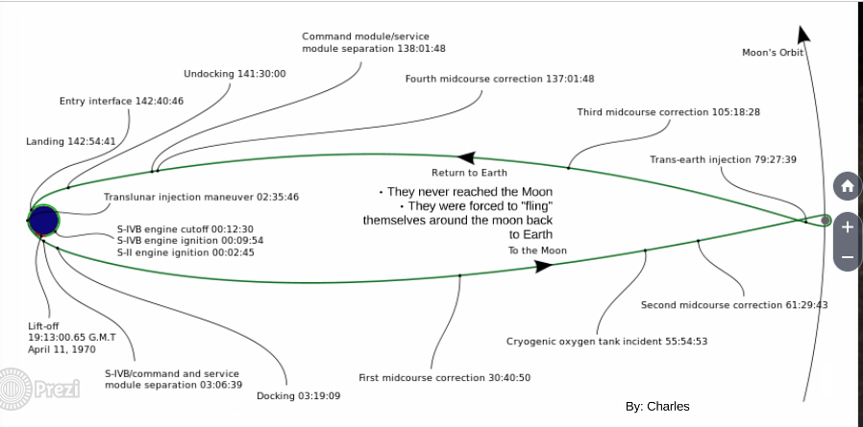
Appolo 13 – description (problem and solution)

Slide 7
Kepner Tregoe is used for decision making (finding best possible choice) – (nalezení nejlepšího možného rozhodnutí)
It is a structured methodology for gathering information and prioritizing and evaluating it. (strukturovaný přístup jak shromáždit informace a dát jim správnou prioritu)
It is very detailed and complex method applicable in many areas, which
is much broader than just idea selection. (detailní a komplexní metoda , kterou je možné aplikovat v různých oblastech- není to pouze výběr plánu respektive nápadu jak řešit problém)
It is called also a root cause analysis and decision-making method. (jde o analýzu klíčového problému – úzkého místa)
It is a step-by-step approach for systematically solving problems, making decisions, and analyzing potential risks. (přistup, kde s postupuje krok po kroku, analyzuje se klíčový problém, rozhodne se o způsobu řešení. Provádí se analýza risku s tím spojeného)
Restore
Detection
Repair
CRT
K-T
Ishikawa + Pareto
Incident
Solved incident
Diagnosis
Repair
Time

Slide 8
Postup
Nemusíte být zrovna astronauti, abyste mohli tuto metodu uplatnit v praxi.
Pravdou je, že se vám bude hodit v jakékoliv práci – zvlášť pokud se pohybujete
v manažerské oblasti. Následuje popis 4 základních kroků
Vyhodnocení situace
Orientujte se. Situace může vypadat složitě, ale po základní analýze
budete mít jasno. Udělejte si seznam toho, co je potřeba řešit včetně priorit.
Analýza problému
Popište příčiny. Nakonec najdete, kde je zakopaný pes (Ishikawa, CRT)
3. Rozhodovací analýza
Problém a příčinu už znáte. Najděte možné řešení. Zkuste to vícekrát a proveďte
PROS a CONS hodnocení.
4. Analýza rizik
Nepřehledné situace, nežádoucí jevy, nebezpečí špatného rozhodnutí,
nesprávné nastavení priorit toho co se má řešit a jak se to má řešit.

Slide 9
K-T areas – grafické znázornění předchozích kroků
Other possible problem analysis
Decision
analysis
Assessment
(Appraisal)
Existing
problem
analysis
1. Assessment (appraisal) – priorities assigned to current situation
2. Existing Problem analysis – to find root problem (cause)
3. Decision analysis – to select way to react (MaxiMax,MaxiMin,..)
4. Future problem analysis (risk analysis)
Appraisal=review= assessment=evaluation = Hodnocení
Source : Kepner-Tregoe

Slide 10
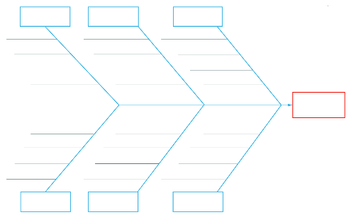
CRT-Ishikawa
12
3
1
2
4
3
7
OR
4
7
2
12
CRT
2
6
1
6
1
Root problem
3
4
Requirement
Prerequisite
 | 1 | 2 | 3 | 4 | 6 | 7
John | 8 | 7 | 4 | 3 | 5 | 6
Caroline | 9 | 5 | 7 | 8 | 5 | 6
Mean | 8,5 | 6 | 5,5 | 5,5 | 5 | 6
P1
Alternative 1
R1
1
EC
Conflict
1
= Nature (see, forest, mountains, jungle, river,..)
R2
P2
Alternative 2
2
= Hotel type
Root problem contrary
3
= Amenities (pool, golf course, wellness,.. )
4
= Period (spring, summer, fall, winter).
Alternative means how to solve problem and what kind of pay-off you will get

Slide 11
Vyhodnocení situace – doplnění již sdělených informací
Identify concerns (problems) by listing them (detection) – (identifikace problémů a jejich seznam)
Separate the level of concern (importance, magnitude and level of influence) – (míra důležitosti -> intenzita vlivu)
Set the priority level to measure seriousness of impacts (influence), urgency and growth potential (nastavení úrovní priorit- co řešit dříve a co později)
Decide what action to take next (step by step approach)
(jak problém postupně řešit)
Plan for who is involved, what they will be doing, where they will be involved, when it happened and the extent of involvement (magnitude)
KDO – CO – KDE – KDY - ROZSAH
Klíčové otázky K-T metody

Slide 12

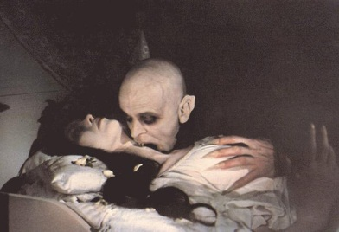

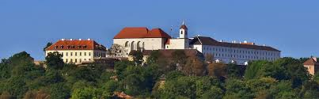
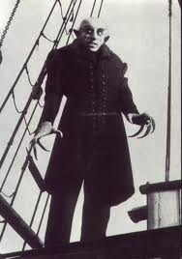


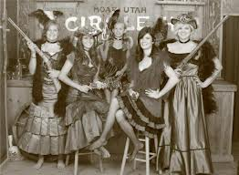

WHO WHAT WHEN WHERE EXTENT
Where not
What not
Magnitude
Who not
When not

Slide 13
Decision making ( výběr mezi více alternativami – část rozhodovací analýzy- krok 3)
Identify what is being decided (quality, used methods) - co bylo rozhodnuto
Establish and classify objectives (main ones, minor ones,..) – goals- důležité a méně důležité cíle
Separate the objectives (cíle) into must (must to have) and want (nice to have) categories (we have to assign importance factors from 1-10, where 10 is the most important want objective) and assign criterion rating (weights)
Generate the alternatives (we can do it that way or we can take another way as well)
Evaluate the alternatives by scoring the wants against the main objective – see next slides
Review adverse (harmful) consequences of your corrective steps (risk evaluation, risk assessment)
Make the best possible choice what to do
Možno při přednášce přeskočit, protože to máme na dalším snímku česky

Slide 14
Udělat rozhodnutí (výběr mezi více alternativami za různých okolností)
O čem se má rozhodovat a jak (kvalita, použité metody)
Klasifikace cílů (mdůležité, méně důležité..)
Rozdělení cílů na must (must to have) a want (nice to have) kategorie
(přiřadíme faktory důležitosti 1-10, kde 10 je nejdůležitější faktor (váha) pro všechny want cíle)
Navrhneme alternativy (různé metody řešení)
Vyhodnotíme alternativy s pomocí bodů faktorů důležitosti přiřazených k want cílům vhledem k cíli hlavnímu
Posoudit nepříznivé (škodlivé) důsledky svých nápravných kroků (hodnocení rizika) a potvrzení a realizace té nejlepší volby
Udělejte nejlepší možnou volbu

Slide 15
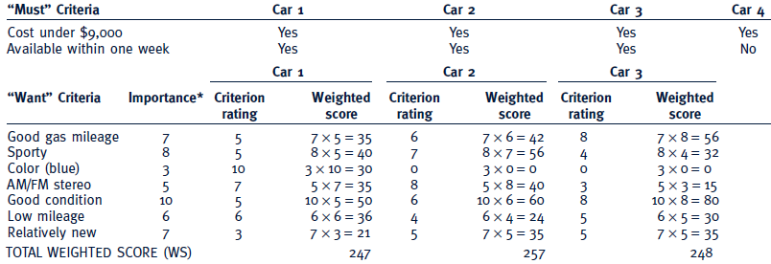
Criteria rating
See similar example on the next slide
Importance can be understood as a Satisfaction score, meaning desirable but not essential.
Criteria rating is related to want criteria and every car property

Slide 16
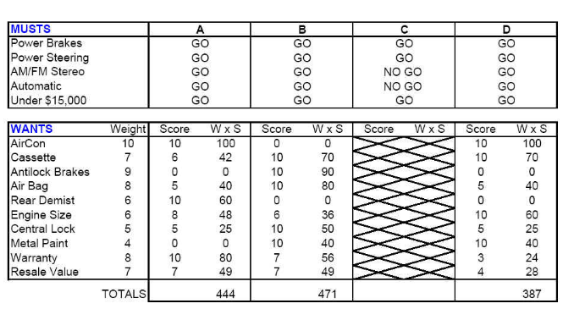
Which car to buy ?
Criterion rating
Importance score, meaning desirable but not essential.
Zákazníci by to rádi měli, ale není to vůbec nutné a nepřináší to žádnou velkou hodnotu

Slide 17
Step 1 and Step 2
Step 1 Problem: Pick a replacement vehicle for the motor pool fleet
The definition of the problem dictates the requirements. As the vehicle is for a motor pool, the requirements will differ from those for a family car, for example.
Step 2 Requirements:
1. Vehicle shall be made in U. S. A.
2. Vehicle shall seat at least four adults, but no more than six adults
3. Vehicle shall cost no more than $28,000
4. Vehicle shall be new and the current model year

Slide 18
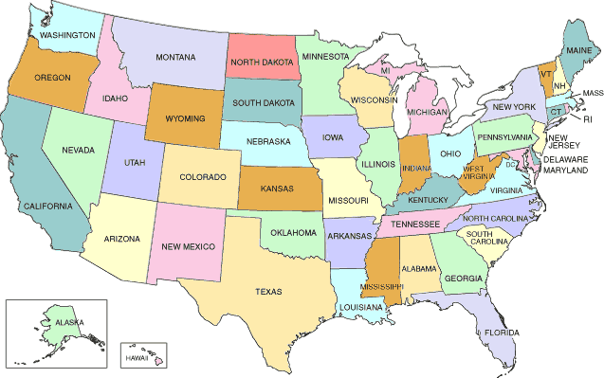
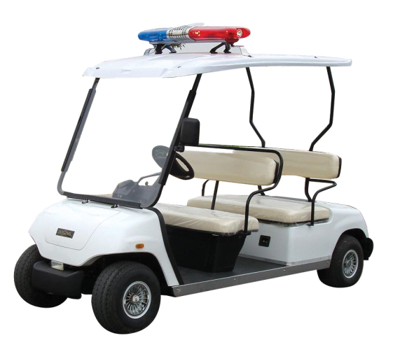
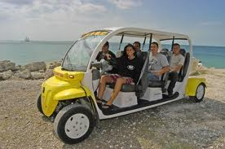

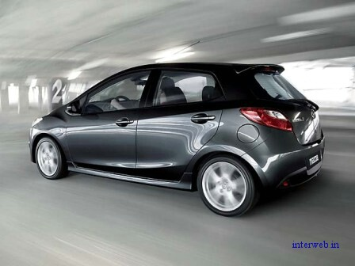
Min
Max 28000 USD
Max
New car
(current model)

Slide 19
Step 3 and Step 4
Step 3 Goals:
· Maximize passenger comfort
· Maximize passenger safety
· Maximize fuel-efficiency
· Maximize reliability of the car
· Minimize investment cost
Step 4 Alternatives:
There are many alternatives but the requirements eliminate the consideration of a number of them:
Requirement 1 eliminates the products not manufactured in the USA
Requirement 2 eliminates vans, buses, and sports cars (Ferrari no !!!!)
Requirement 3 eliminates high-end luxury cars
Requirement 4 eliminates used vehicles

Slide 20
Step 5
Step 5 Criteria:
“Maximize comfort” will be based on the combined rear seat leg and shoulder room. (Note: front seat passenger leg and shoulder room was found to be too nearly the same to discriminate among the alternatives.) 5
“Maximize safety” will be based on the total number of stars awarded by the National Highway Traffic Safety Administration for head-on and side impact. 10
“Maximize fuel efficiency” will be based on the EPA fuel consumption for city driving. 7
“Maximize reliability” will be based on the reliability rating given each vehicle by a consumer product testing company. 9
“Minimize Cost” will be based on the purchase price. 10
Weighted criteria vector C(5,10,7,9,10) are values assigned by decision makers !!!!

Slide 21
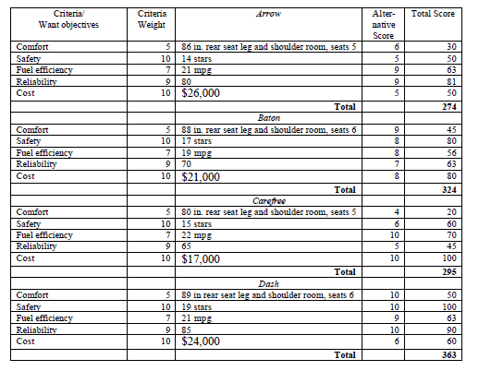
Kepner-Tregoe table
(for 4 cars : Arrow, Baton, Carefree and Dash)

Slide 22
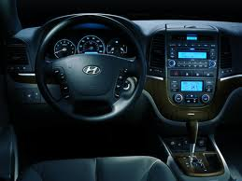
Last step – Validation (check)
Last Step Validate Solution:
The totals of the weighted scores show that the Dash most nearly meets the wants/goals (or put another way, has the most “benefits”). Dash meets all the requirements and solves the problem !!!

Slide 23
Uncover and handle problems
(Analýza problému) – kroky 1-4 (snímek 8)
State the problem (definition and description of the problem)
Specify the problem by asking (důležité otázky, které nyní budeme probírat na příkladech):
what is and what is not, who is and who is not, where is and where is not
Develop possible causes of the problem (similar to CRT or Ishikawa) – (detekce příčin- opět viz snímek 8)
Test and verify possible causes (testování a verifikace možných příčin)
Determine the most probable cause (root cause) -(nalezení klíčového problému)
Verify any assumptions (verifikace předpokladů)
Try the best possible solution and monitor what will be a situation after applied correctives step (aplikace zpětné vazby- korekce nežádoucího stavu)

Slide 24
Description
Who is not
What is not
Where is not
When is not
Extent
Who is not
What is not
Where is not
When is not
Extent
Priority
(urgency)
Priority
(urgency)
Description
Description
Problem 1
Problem N
Causes
Situation
Causes
Situation
Who
What
WhereWhenExtent
Who
What
WhereWhenExtent
Big
problems
Solution (corrective action) 1
Solution (corrective action) 1
Solution (corrective action) X
Solution (corrective action) Y
Problem 1´
Problem N´
Smaller
problems

Slide 25
Decomposition, priorities and causes
Sub-problem 1
Priority1
Problem 1
Sub-problem N
Priority N
Problem 1
Sub-problem 1
Cause 1
Problem 2
Sub-problem N
Cause N
Problem 2

Slide 26
Example of problem manifestation (decrease of performance)
Change
Performance
(výkon)
Planned performance (plánovaná hladina výkonu)
Unfavourable deviation
  What do we see, hear, feel,
  taste, or smell that tells us
  there is a deviation?
Real performance
time
Change
Final effect of the = PROBLEM (e.g. server crashed, hard disk with database crashed)
  Then we have to ask : Who, What, Where, When, and to what Extent –Size (how much, how many)?
  And opposite types of questions as well.

Slide 27
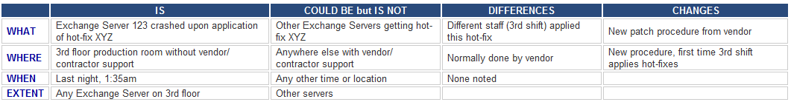
Server crashed !!!! (home study !!!)
Server crashed (this is a very poor problem definition)
The e-mail system crashed after the 3rd shift support engineer applied hot-fix XYZ to Exchange Server 123 (better definition of the problem)
Comment : WHO is not mentioned here but could be Different staff (3 shift) –see table
History (and best practice) says that the root cause of the problem is probably due to some recent change. WHAT, WHERE, WHEN and EXTENT will be shown on next slides

Slide 28
Test the Most Probable Cause home study
Clarifying problem Analysis (example)
We have to ask (where Qi =QUESTION i) :
Question IS IS NOT
What (identify) Q1 Q2
Where (locate) Q3 Q4
When (timing) Q5 Q6
Extent (magnitude) Q7 Q8
See next slides

Slide 29
Problem Analysis - What
Is
Is Not
What specific object(s) has the deviation?
What is the specific deviation?
What similar object(s) could have the deviation, but does not? (It did not happen)
What other deviations could be reasonably observed, but are not? (It did not happen)
Example for Is :
1. What specific object IS related to the defect?
Inventory Valuation Objects in database A
2. What specifically is the defect (deviation)?
Inventory Adjustment does not work
1-> see setup of the database and see differences
2->see algorithm used for calculation and parameters used.
You can see , that in production calculation related
algorithm is not functional
Example for Is Not :
1. What specific object IS NOT related to the defect?
Inventory Valuation Objects in database B
2. What specifically is not the defect (deviation)?
Adjustment is working – good setup in database B
1 -> Setup has another parameters ON
2-> Algorithm is used also for production where not error
occurs

Slide 30
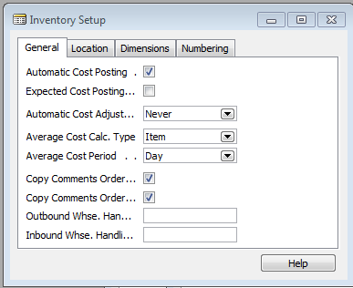
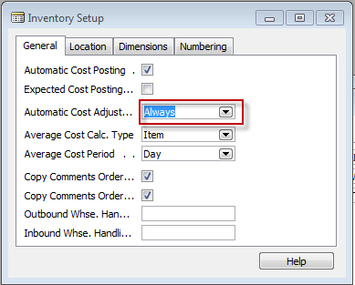
See two MS Dynamics Setup screens
(related to the problem specified recently)

Slide 31



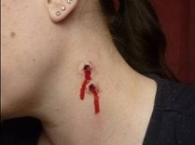


Back to vampires :Problem Analysis - What
Is
Is Not
What specific object(s) has the deviation?
What is the specific deviation? - bites on the neck
What similar object(s) could have the deviation, but does not? (It did not happen)
What could the specific deviation? but does not? (It did not happen) – bites=stigma, anemia
česnek
Example for Is :
1. Nice young girl´s neck and strange
look of anemic person
Example of Is Not :
Girl with garlic in her hands
No bites
Healthy

Slide 32
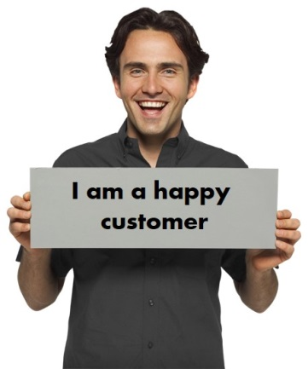

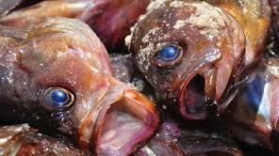

Example for What IS and What IS NOT
Customer X and Customer Y both use product B but only to customer X was sent the wrong product so the object IS Customer X , but IS NOT Customer Y
X
Y
Customer X
Product B
Customer Y

Slide 33


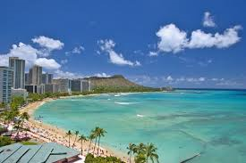
Example for When and IS and IS NOT
Customer X and Customer Y both use product B but only customer X was sent the wrong product if Salesman Tony was on holiday in this time and Saleswomen Linda was in charge, so the object IS Saleswomen Linda , but IS NOT Salesman Tony
X
Y
Linda
Tony

Slide 34
Problem Analysis - When
Is
Is Not
When was the deviation observed first (clock and calendar time)?
When since that time has the deviation been observed?
When, in the object’s history or life cycle, was the deviation observed first?
When else could the deviation have been observed first, but was not?
When else since that time could the deviation have been observed, but was not?
When else, in the object’s history or life cycle, could the deviation have been observed first, but was not?
See example next slide

Slide 35
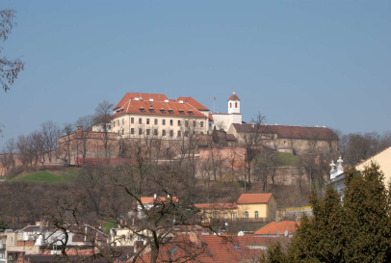


Another example for What IS and What IS NOT as well as Where IS and Where IS NOT
IS girl Sarah visited Dracula lower castle without a bunch of garlic, but IS NOT not the one (Emily) having bunch of garlic and visiting Špilberk castle in Brno
Dracula Castle
(Where IS)
Špilberk Brno
(Where IS NOT)
Sarah
(What IS)
Emily
(What IS NOT)

Slide 36
Problem Analysis - Where
Is
Is Not
Where is the object when the deviation is observed? (geographically)
Where is the deviation on the object?
Where else could the object be when the deviation is observed, but is not?
Where else could the deviation be located on the object, but is not?
Example for Is :
Old castle in the mountains (Romania)
Where IS : Romanian Carpathian mountains
where it is very easy to meet a lot of vampires
there
Example for Is Not
1. Brno castle Špilberk
Where IS NOT possible to meet vampires
(only lovers and children and seniors)

Slide 37
Problem Analysis - Confirm True Cause
Analýza problému a potvrzení pravé příčiny jeho vzniku
What can be done to verify any assumptions made?
How can this cause be observed at work?
How can we demonstrate the cause-and-effect relationship (e.g. Current Reality Tree or Ishikawa Fishbone Diagram)?
When corrective action is taken, how will results be checked?

Slide 38
Let’s Look At Some Problems!

Slide 39
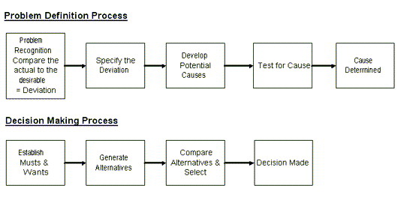
Systematic Problem Solving
Decision making Overview

Slide 40
Planning the Next Steps
Problem Analysis
    Do we have a deviation?
    Is the cause unknown?
    Is it important to know the cause to take effective action?
If the answer is YES to ALL three listed problems above, than you have a big problem, Huston !!!

Slide 41
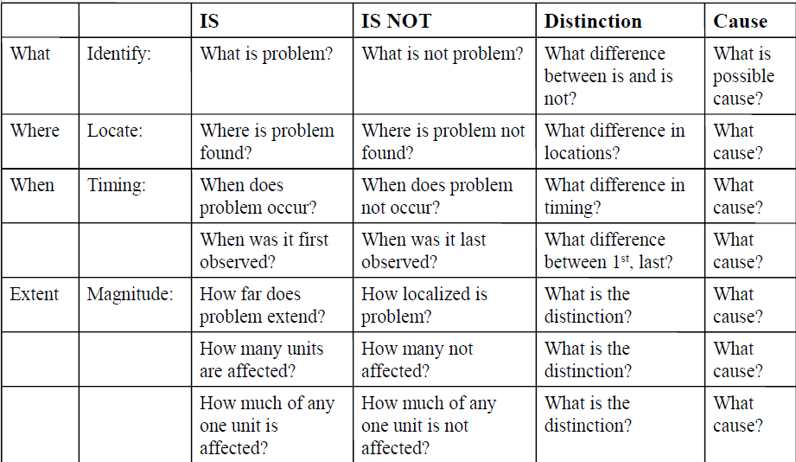
Problem analysis table template
(Home study)

Slide 42
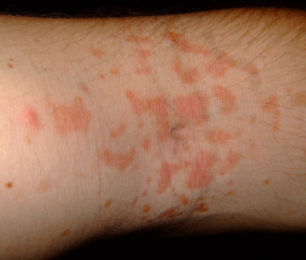
Problem description (example)
On a new model of airplane, flight attendants develop rash on arms, hands, face (only those places). It only occurs on flights over water.
Usually disappears after 24 hours. No problems on old planes over those routes.
Does not affect all attendants on these flights, but same
number of attendants get it on each flight. Those who get rash have no other ill effects.
No measurable chemicals, etc., in cabin air.
Rash arm ->

Slide 43

Results ????

Slide 44
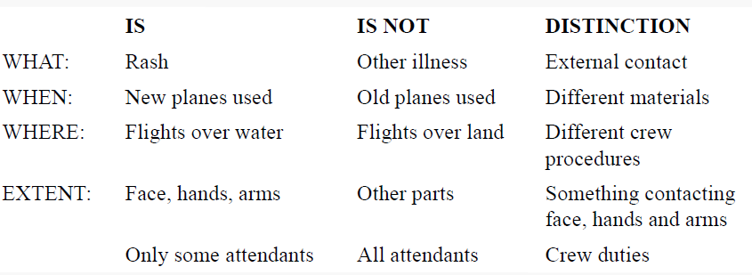
Problem analysis real table
Distinction=Difference

Slide 45
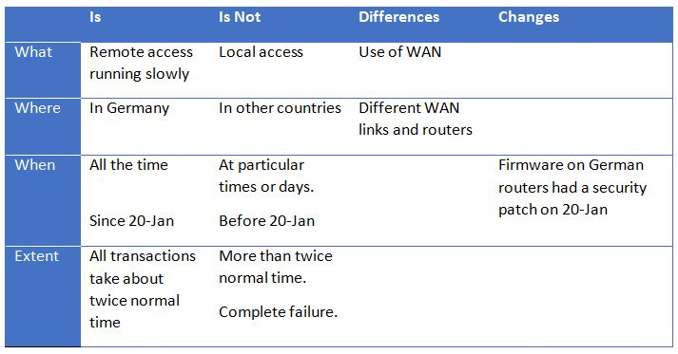
Problém s rychlosti připojení

Slide 46
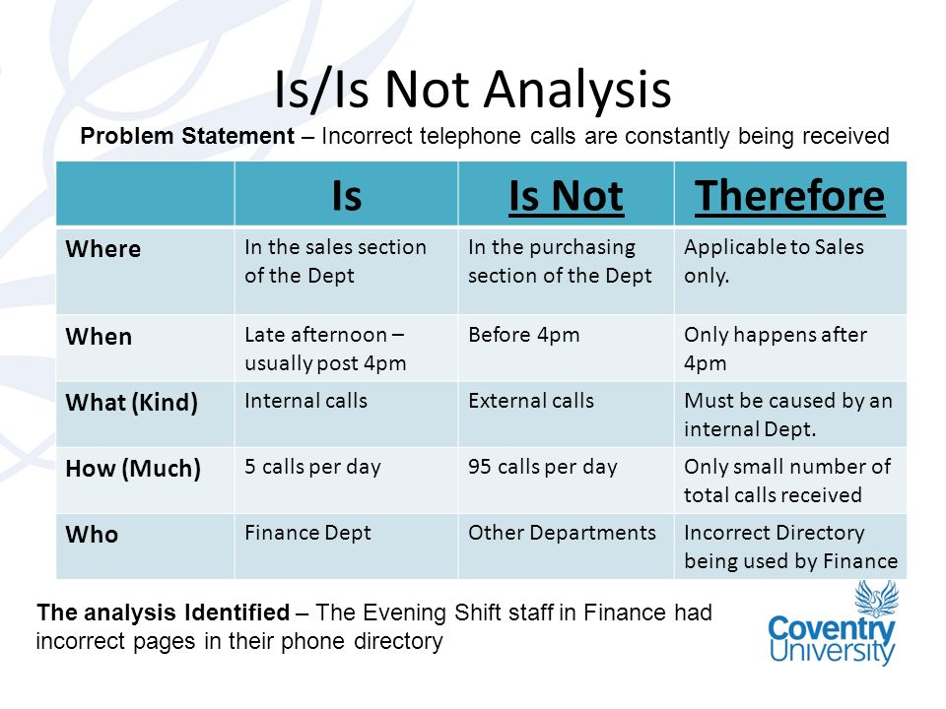
Stále jsou přijímány nesprávné telefonáty

Slide 47
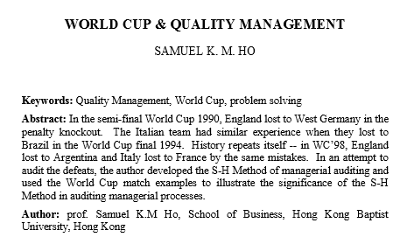
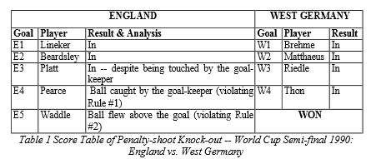

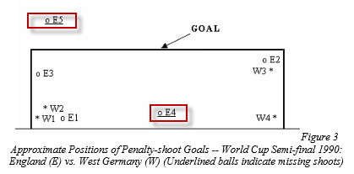

Matice na dalším snímku

Slide 48
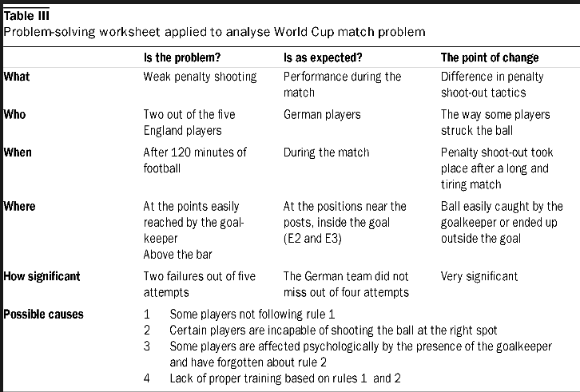
Example of analysis

Slide 49
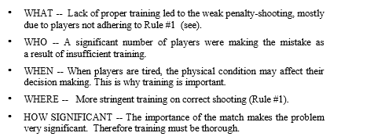
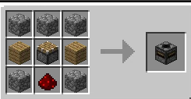
Viz další snímek s vazbou na to, co manažer na letišti řeší
(177) Rapid Problem Analysis - YouTube
Vysvětlení co je to transposer, o kterém se ve videu mluví
https://technicpack.fandom.com/wiki/Transposer

Slide 50
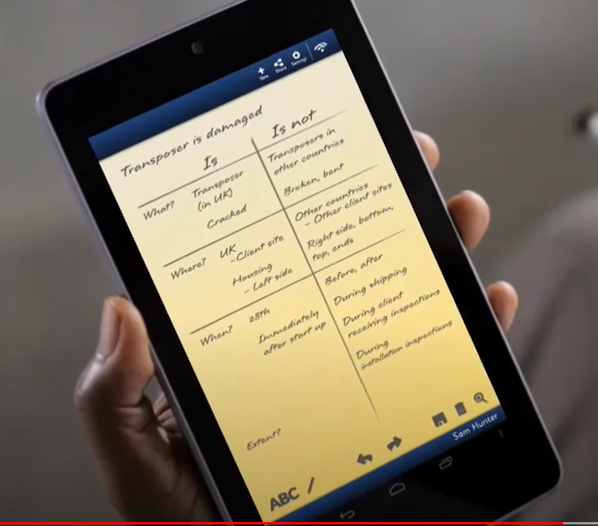
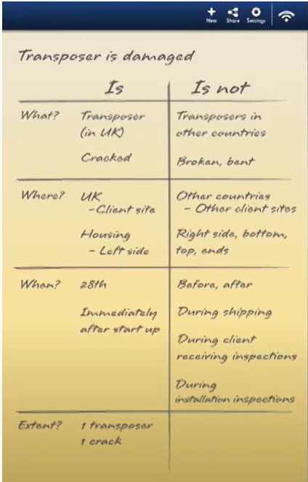
Dohlédněte to video až do konce ! Je tam řešení !!

Slide 51

Thanks for Your attention

