Slide 1
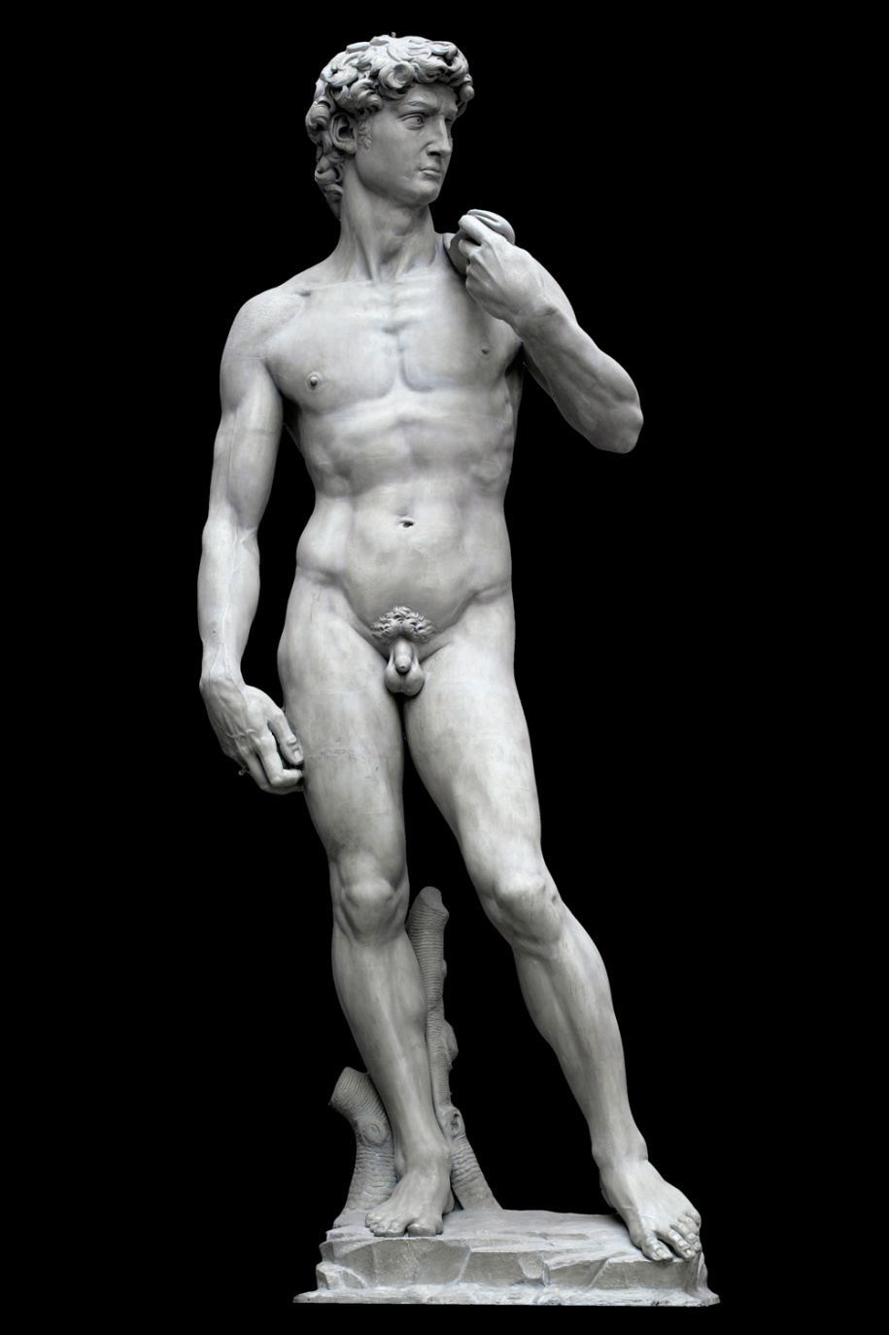
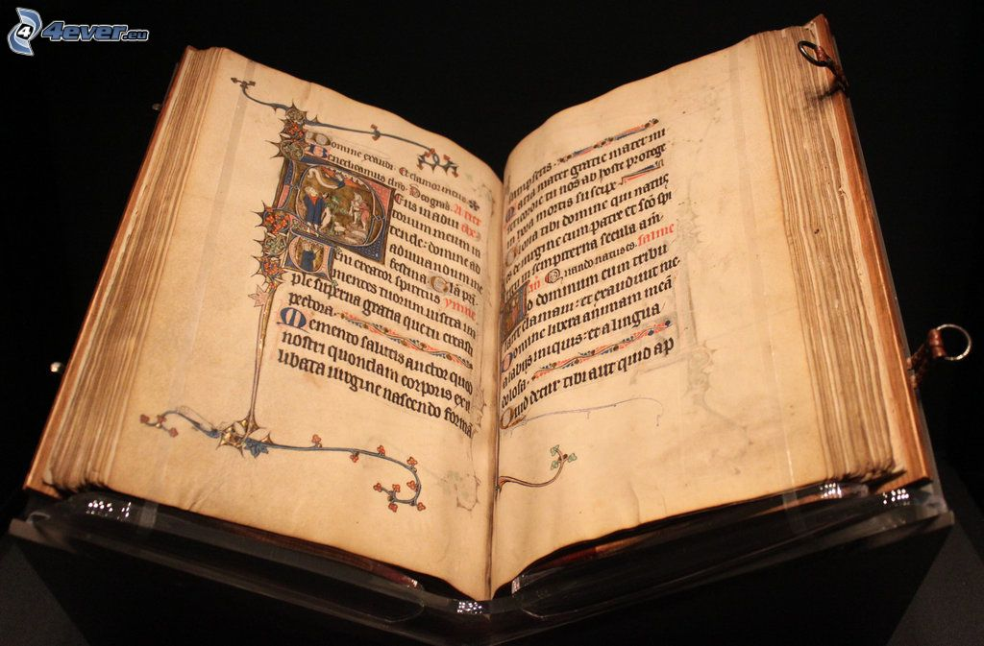
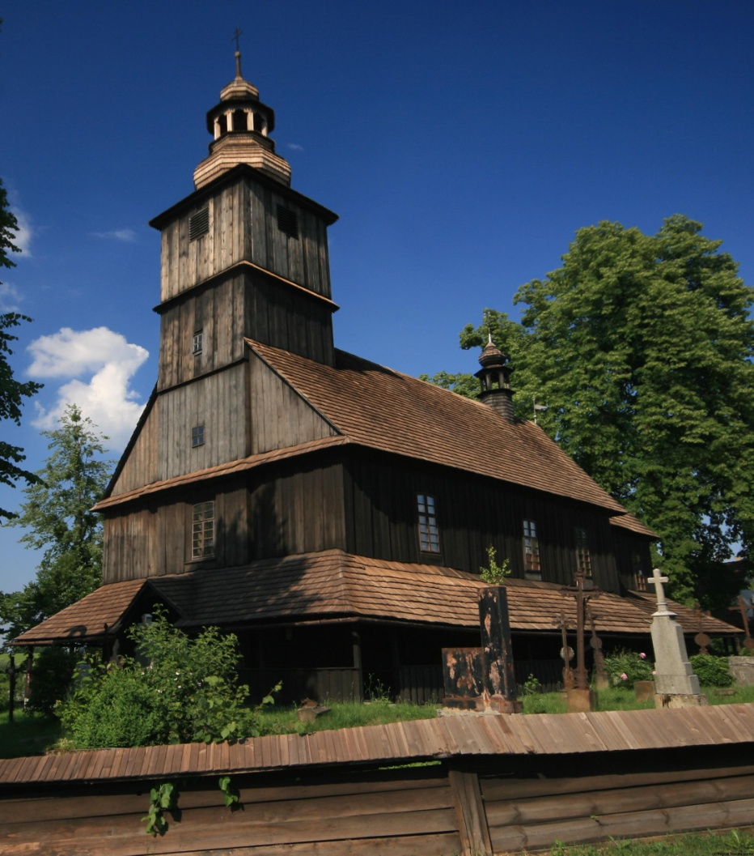

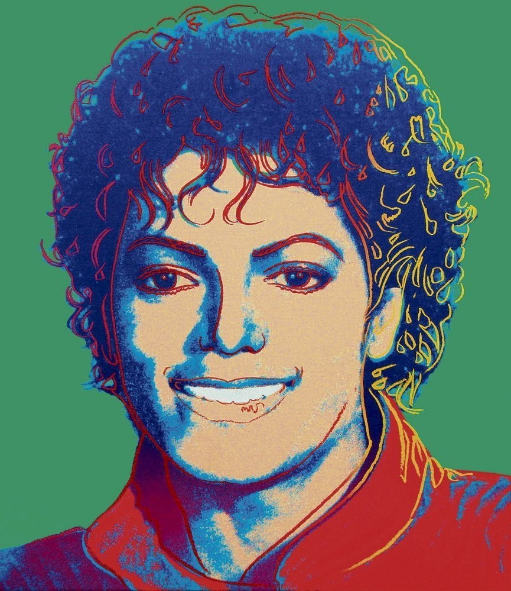
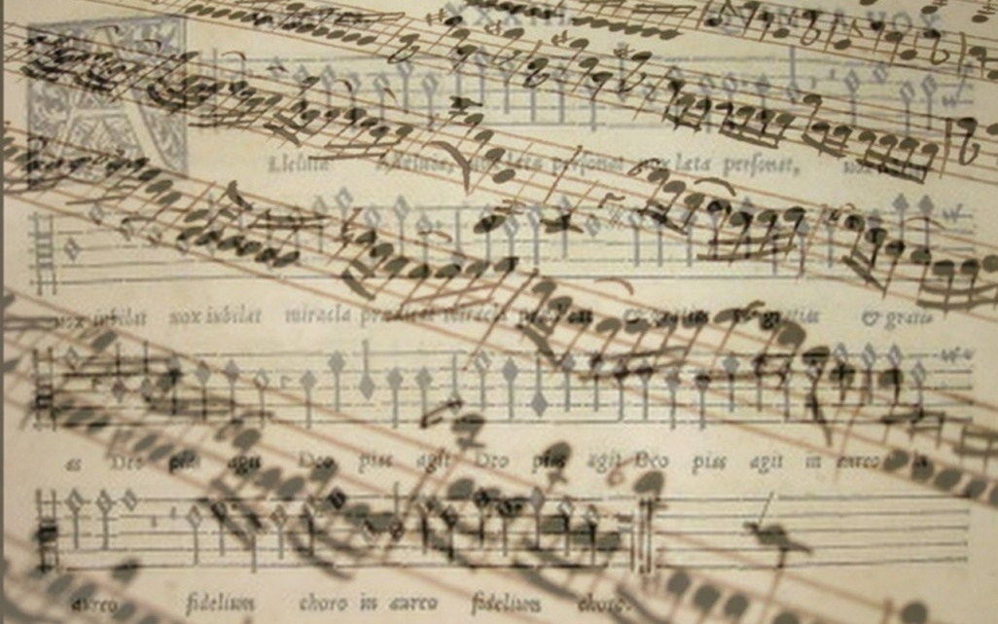
Public support of culture

Slide 2
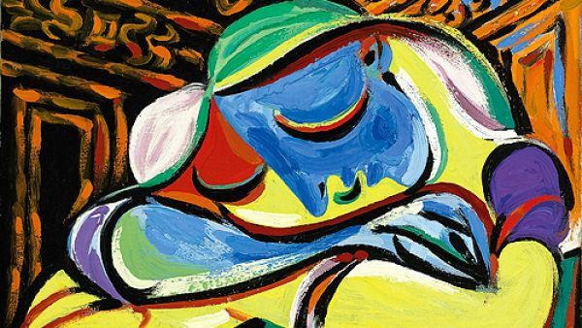

1. Financial Self sufficiency of cultural organization

Slide 3
Financial self-sufficiency
Key factors of self sufficiency
Financially self sufficient areas
  Popular culture
Financially dependent areas
  Traditional culture

Slide 4
2. Arguments for and against public support of culture

Slide 5
Dominant arguments for public support of culture
Equality of opportunity
Positive externalities
Culture as a public good
Support of new forms of art
Culture as a symbol of prestige
Merit good
Multiplier effect
Low productivity of area of culture

Slide 6
Dominant arguments against public support of culture
Redistribution from poor to rich
Deformation of market by public subsidies
Low multiplier effect

Slide 7
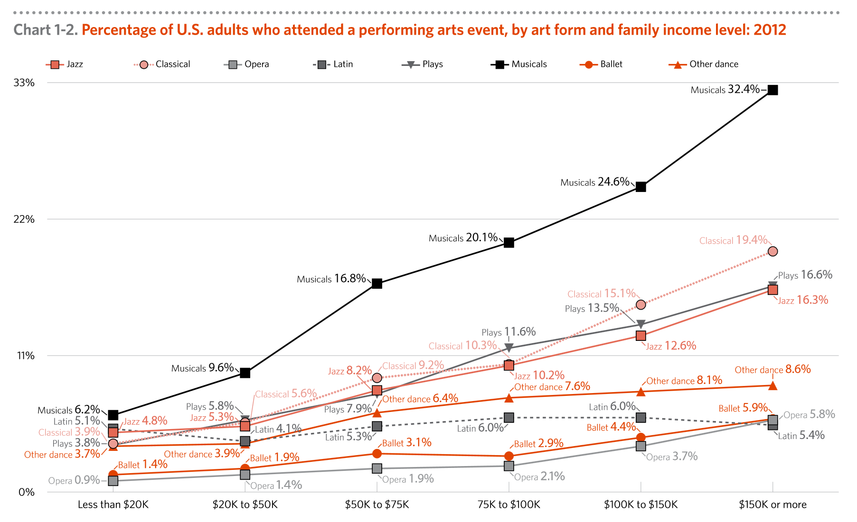
Dominant arguments against public support of culture

Slide 8
3. Alternative models of public support of culture

Slide 9
Alternative models of public support of culture
Hillman-Chartrand model of relationship:
Role of government as:
  Facilitator
  Patron
  Architect
  Engineer

Slide 10
Alternative models of public support of culture
FACILITATOR
Government doesn't intervene in the process of production
The position of artists is mostly dependent on income from production(ability to attract audiences)
Important role of donators
Homogenization of culture
  little space for artistic experiments
E.g. USA

Slide 11
Alternative models of public support of culture
PATRON
Creation of Arts Councils
Support of high culture production
Distance between state and art
The role of state is to decide about the volume of support
  The concrete distribution of support is managed by councils
Focus on self-sufficiency
E.g. VB

Slide 12
Alternative models of public support of culture
ARCHITECT
Support of art through state institutions (ministries)
Artists are often employees of cultural institutions
High dependence on support from public funds (mainly subsidies)
Risk of artistic stagnation, moral hazard
E.g. France

Slide 13
Alternative models of public support of culture
ENGINEER
The aim may not be an artistic experience, but a political goal
The government owns all funds for support of culture
The government form a resolution about
  Size of support
  Supported activities, institutions and artist
Artist are absolutely depended on state support
Membership in artists' unions - enforceable, censorship
E.g. the Czech Republic before 89, totalitarian regimes (North Corea, SSSR…)

Slide 14
4. What does indirect and direct state support mean?

Slide 15
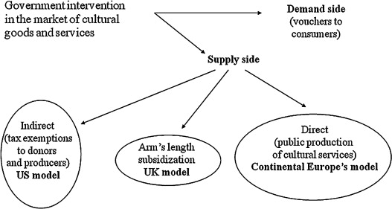
Government intervention in market of cultural goods and services

Slide 16
Indirect support
-Indirect support is represented by activities which support those who are supporting directly some culture activity
-main characteristic is that the support doesn't directed to concrete culture organization
Tax reduces for donators
Social contributions

Slide 17
Direct support
Money from sales revenues
Foundations and foundations funds
Other founds (e.g. state fund for Czech cinematography)
Communal obligations to support local organizations
Donations and sponsorship
Lottery and bets
Public collections

Slide 18
5. How does state lottery works?

Slide 19
State lottery
Long tradition several countries
  UK
    20% of profit come into culture
  Finland
    Profit is divided in sport and cultural activities

Slide 20
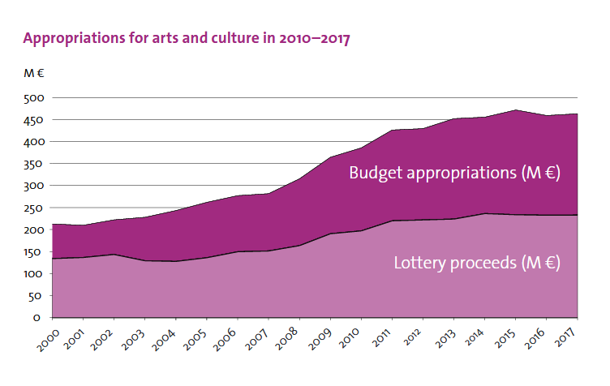
Finland state lottery

Slide 21
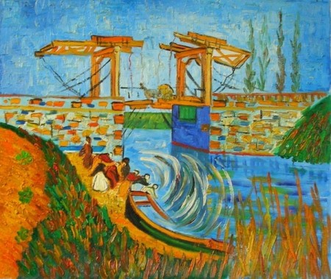
6. Mission of ministry of culture

Slide 22
Ministry of culture
    Competence of the Ministry
    State administrative body for
      the arts;
      cultural and educational activities;
      cultural monuments;
      matters relating to churches and religious societies;
      matters relating to the press, including publication of the non-periodical press and other information means;
      the preparation of draft laws and other legal regulations in the area of radio and television broadcasting;
      implementation of the Copyright Act;
      production and trade in the area of culture

Slide 23
Ministry of culture
    Expenditures of ministry
    448 mil euros
    1 % of state expenditures

Slide 24
8. Financing of religions

Slide 25
Financing of religions
  In Czech Republic are religion independent to state since 2012
    Due to act no.428/2012 about religion property settlement
    Religions will receive property which belongs to it before 1948
    Religions will receive financial compensation for the property that can not be reversed
    Government has no duty do financially support religions

Slide 26
Financing of religions
  Options of relation between state and religions
  Religions are independent Cultural services
    USA
    Czech republic (since 2012)
  Religions are part of public sector
    Germany-tax for religions
    Czech Republic (before 2012)
  Religions are semi independent
    Italy – tax assignation (0,8 % of personal revenue tax)
    Spain – tax assignation (0,52 % of personal revenue tax)

Slide 27
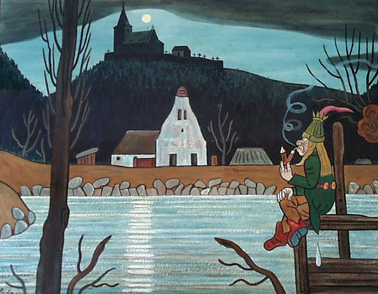
Conclusion

Slide 28
Conclusion
Culture can be financing by market, private support, public support
Most of culture segment are not self-sufficient
  They are dependent on the support
State support has two forms
  Direct (sponsorship, lotteries, communal obligations, founds and foundations funds…)
  Indirect (tax reduction, social contribution )
Government spend 1 % of total expenditures for culture

Slide 29
Usefull links
  (1)
  http://web.ccsu.edu/faculty/harmonj/atlas/definitions.html
  http://www.yourdictionary.com/high-culture
  https://dictionary.cambridge.org/dictionary/english/pop-culture
  (5) http://minedu.fi/documents/1410845/4150031/The+State+supports+arts+and+culture/bb45a827-60ba-4c16-8cda-3882fc74fe97
  (6) http://ec.europa.eu/eurostat/statistics-explained/index.php/File:Mean_household_cultural_expenditure_by_expenditure_purpose,_2010.png
  (7) https://ec.europa.eu/eurostat/statistics-explained/images/8/8f/Total_general_government_expenditure_on_recreation%2C_culture_and_religion%2C_2016_%28%25_of_GDP_%25_of_total_expenditure%29.png

