Slide 1
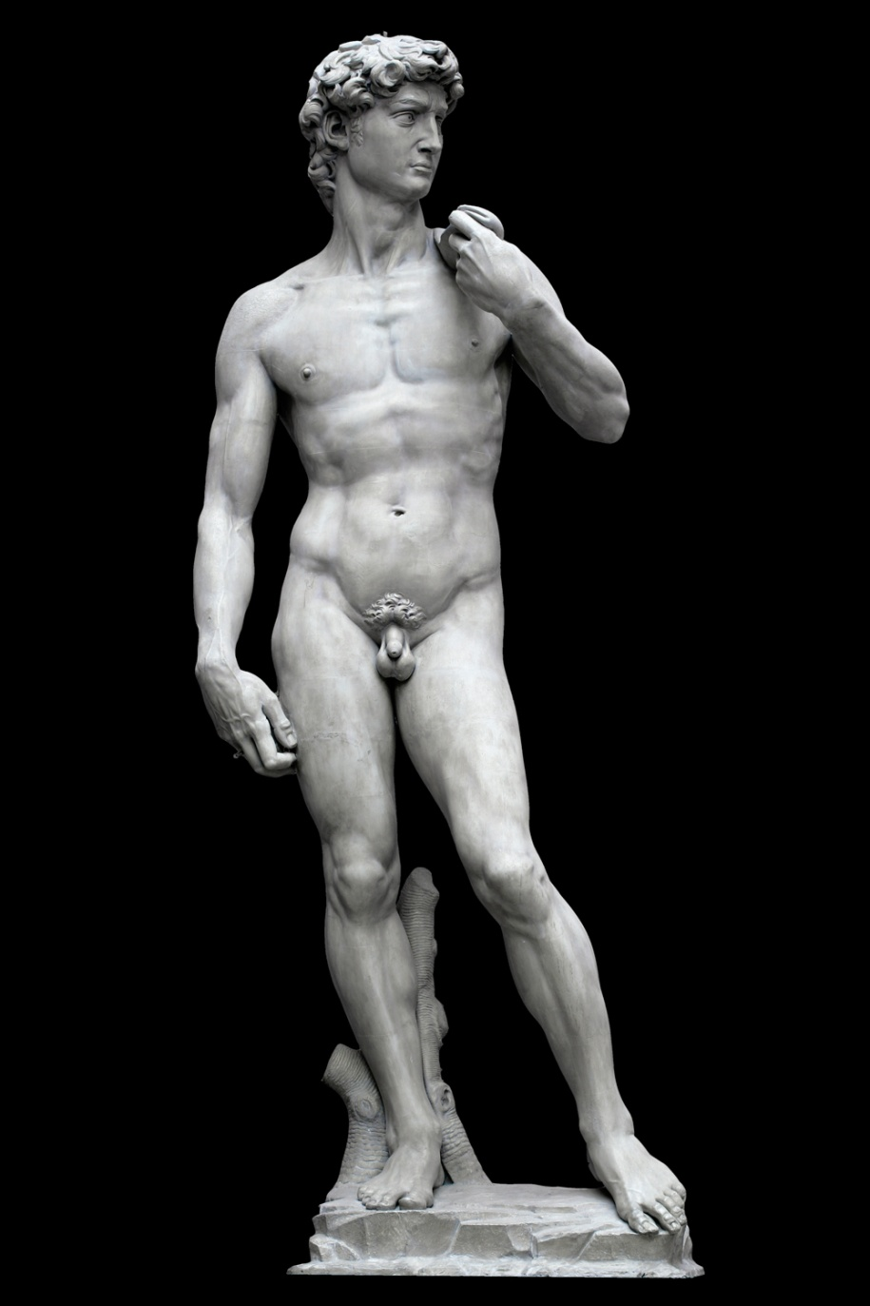
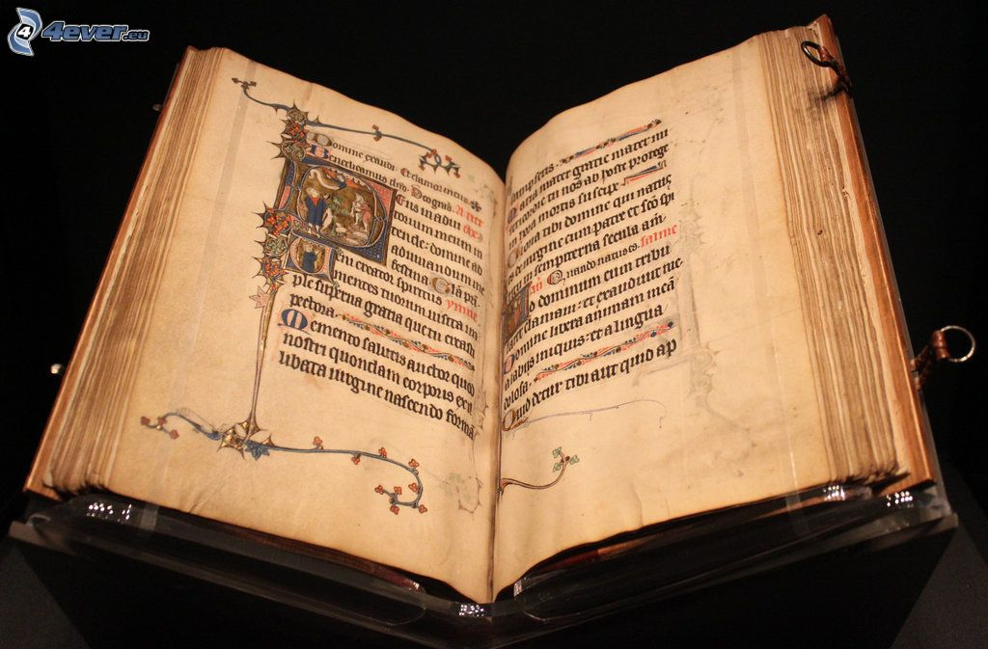
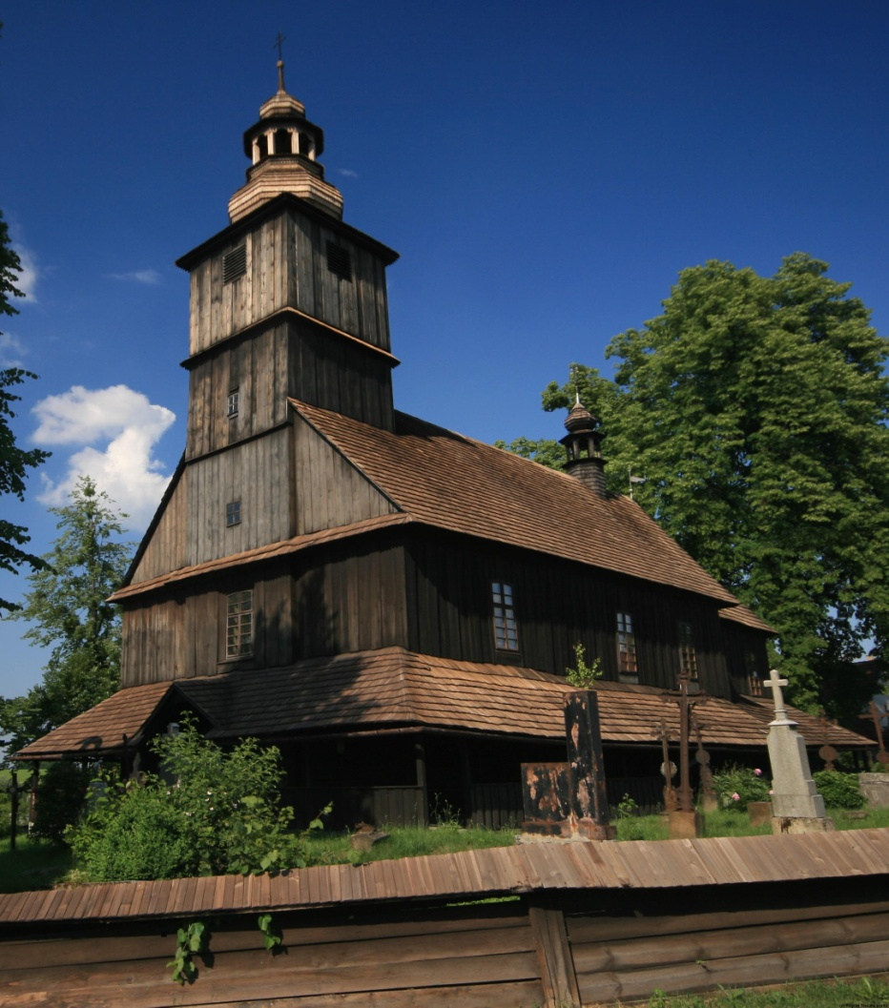
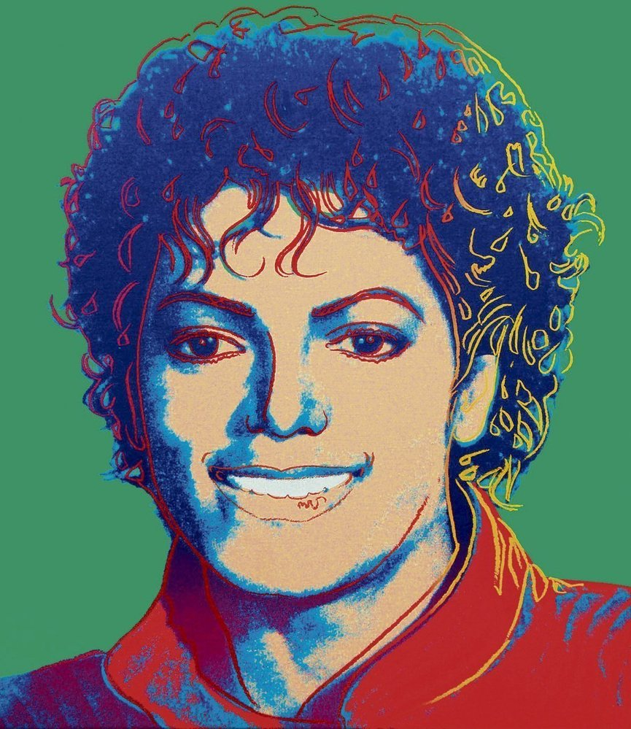
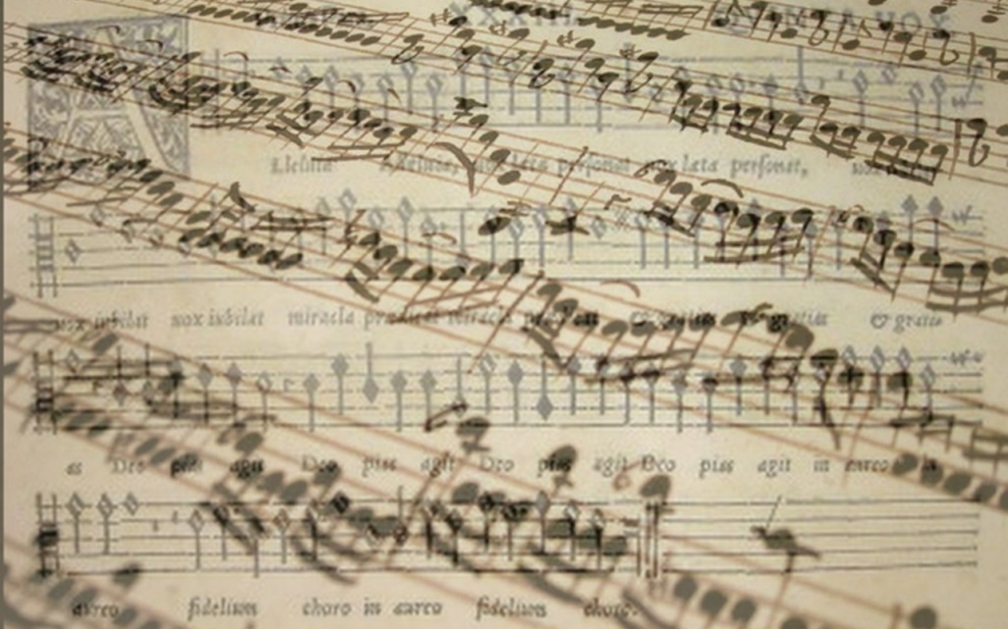
Marketing for Cultural Organizations

Slide 2
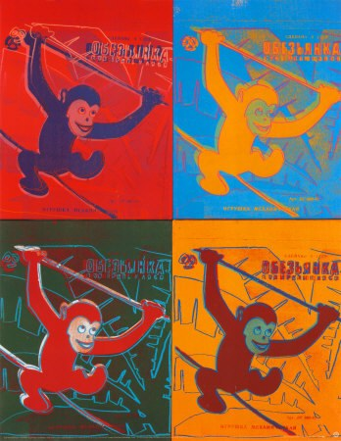
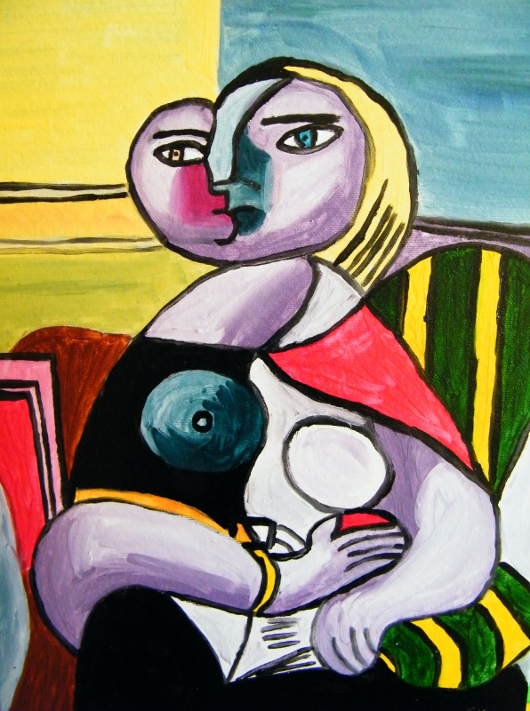
1.What does the term marketing mean?

Slide 3
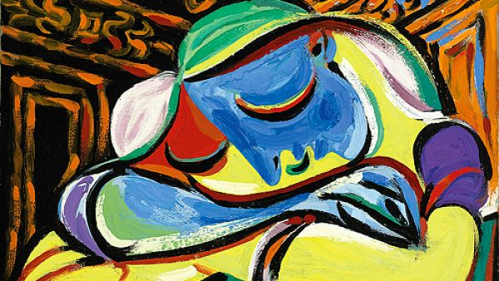
What does the term marketing mean?
Marketing – “the process of planning and executing the conception, pricing, promotion, and distribution of ideas, goods and services to create exchanges that satisfy individual and organizational goals” (Bennet, 1995)
The action or business of promoting and selling products or services, including market research and advertising. (Oxford dictionary)

Slide 4
Fundraising
“the act of collecting or producing money for a particular purpose, especially for a charity“ (Cambridge dictionary)
„Fundraising or fund-raising is the process of seeking and gathering voluntary financial contributions by engaging individuals, businesses, charitable foundations, or governmental agencies.“ (Wikipedia)

Slide 5
Marketing x Fundraising
Fundraising
Increasing the total turnover of organization
Donors
Increasing sales
Improving product
Marketing
Focused on market competition
Focused on product

Slide 6
2. Marketing in culture

Slide 7
Marketing in culture
Specifics of products in culture
Some product are made without connection to current demand
Artist statement
Culture goods made in the past
Some cultural sectors do not reflect current demand
Some products are attractive only temporarily in particular time
Demand which changed in time
Political satire etc.
Some culture organizations have character of non-profit organization
Importance of fundraising
Less space to focus on product

Slide 8
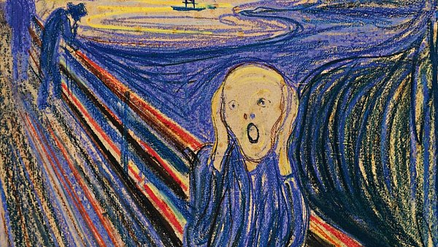
3. Segmentation of market with culture products

Slide 9
Segmentation of market with culture products
Factors of market segmentation:
Age
Sex
Education
Socio-economic background
Social status
Ethnic origin
Culture background
Geographical factors
Characteristic of locality
Barriers to accessibility
….

Slide 10
Segmentation of market and pricing policy
Market segmentation can increase revenues
Discount for selected groups
Students discount
Seniors discount
Group discount
Children free policy
Discounts for specific time period
Less exposed times
Less exposed part of season
Differentiation of products
Less quality product
Exclusive products
Extra services
Limited editions
VIP tickets

Slide 11
4. Ways of marketing communication

Slide 12
Ways of marketing communication
Media of communication
TV broadcasting
Radio broadcasting
Social media
Youtube
Facebook
Instagram
TikTok
Printed media
Direct communication with customer
Communication with selected groups
Schools
Interests group

Slide 13
Ways of marketing communication
Message of communication
Promotion of product
Create a relationship with customer
Create the feeling of product need
Share the part of organization life
Inform about the news
…

Slide 14
5. competition in the market

Slide 15
Competition in the market
Effect of Competition and rivalry
Pressure to marketing activity
It can increase the interest of audience
It can increase the total cost
Price of market product include 10 % -50 % cost of marketing
Pressure to quality of product
According actual demand
It can affect the long term quality in negative way
Some segments of culture are in the position of monopoly of oligopoly
UNESCO monuments
Well-known institutions
Colosseum
Eiffel tower
…

Slide 16
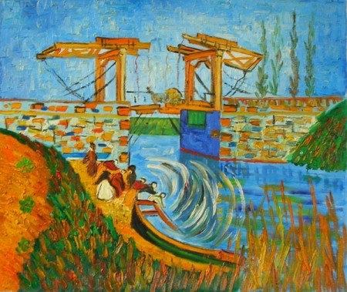
7. What does marketing plan mean?

Slide 17
What does marketing plan mean?
Statement of Organizational Mission
Each organization is established for the purpose of achieve main goal
Without goal we cannot find the best way for our organization
Environmental Analysis
(e.g. purchasing power of population, location of action, demographic factors, etc.)
Competitor Analysis
„We need to know our enemies“
Understanding Buyer Motivation
Why are the customers interested in our product?
Segmentation
What are the group of our customers?
What are the main specification of these groups?

Slide 18
What does marketing plan mean?
Research Plan
Product Analysis
What are the benefits of our product?
What are the weak part of our product?
SWOT analysis
Distribution Analysis
How deliver product to customers?
Pricing Options
Comes from our price policy
Promotional Plan

Slide 19
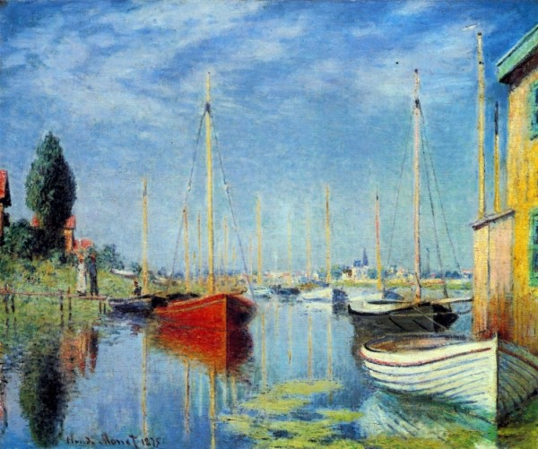
8. What does marketing mix mean?

Slide 20
Marketing mix
A planned mix of the controllable elements of a product's marketing plan

Slide 21
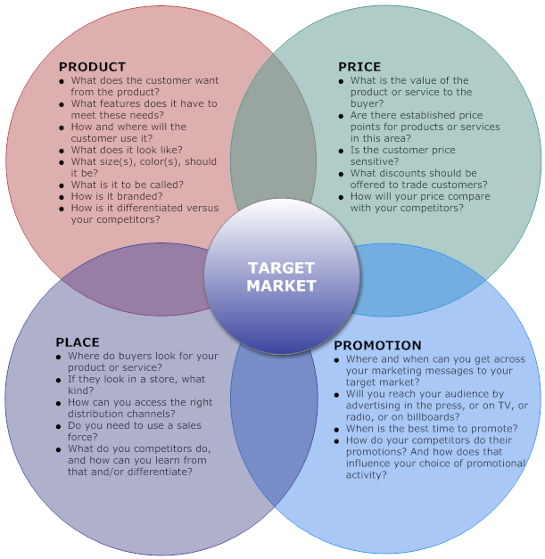
Marketing mix

Slide 22
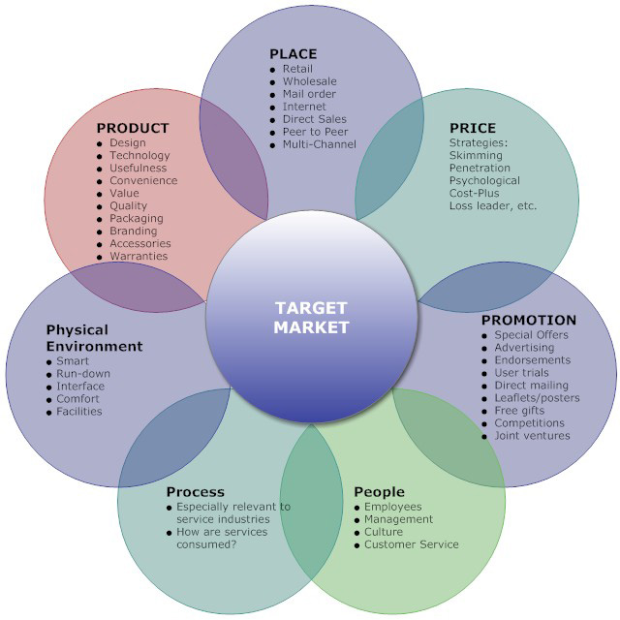
Marketing mix

Slide 23
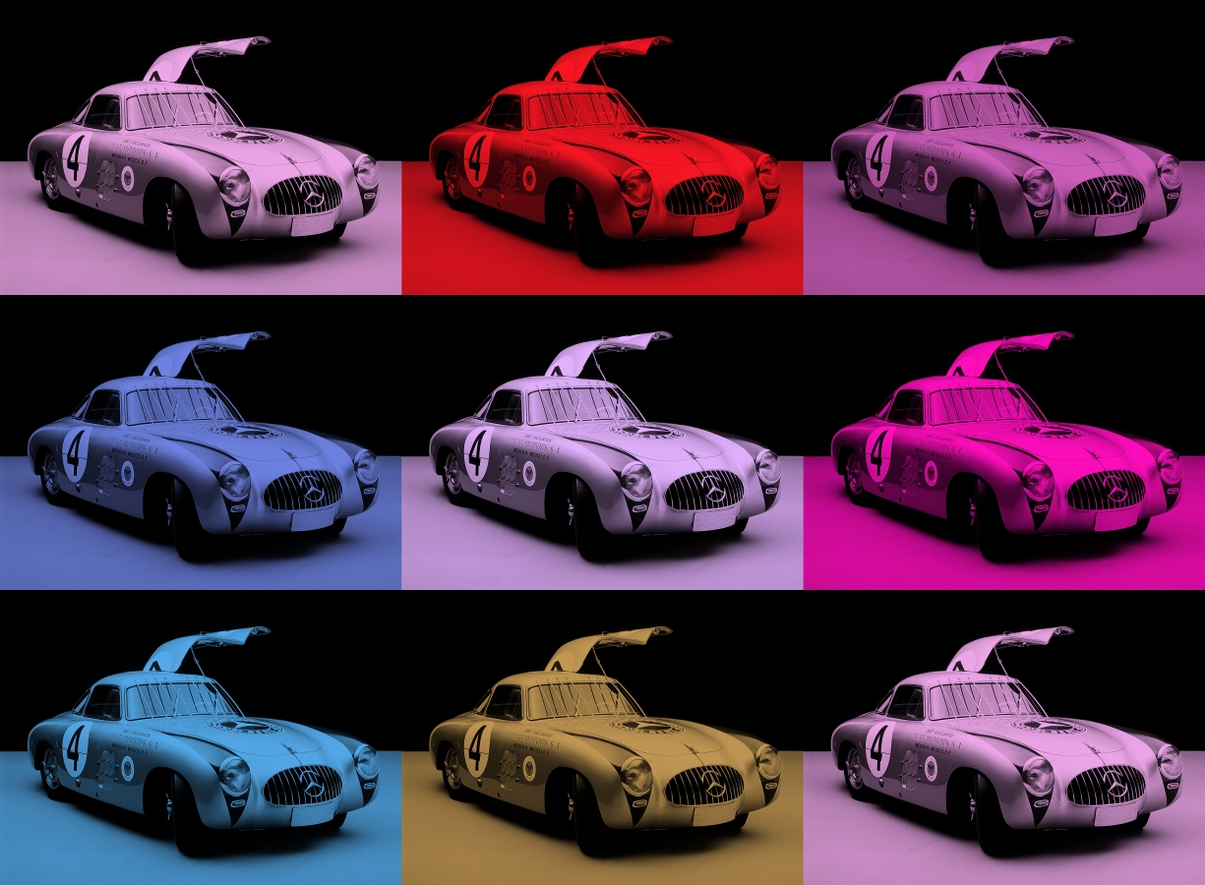
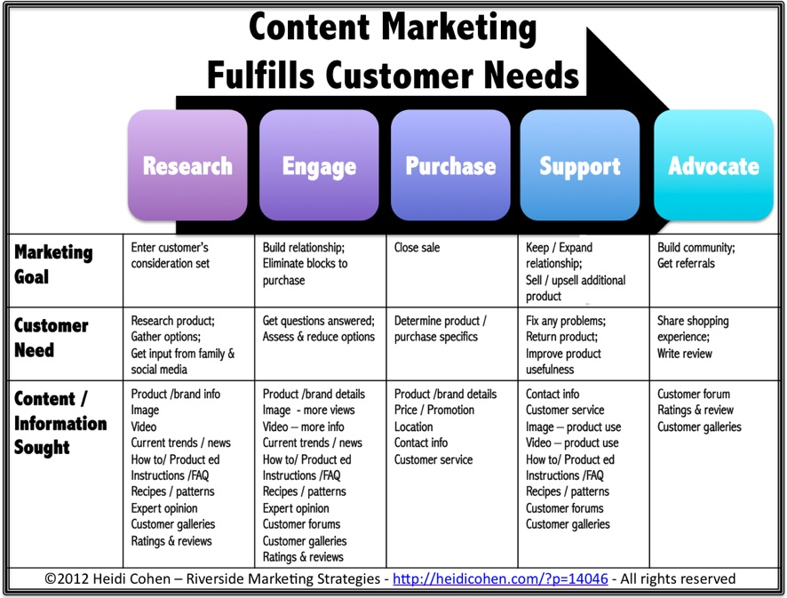
Relationship between customers needs and marketing

Slide 24
conclusion
Marketing is process of planning and making strategies
Challenge for cultural organizations is:
answer to societal changes
Attract more customers
Cultural organizations can use the same marketing instruments as business companies
Specification is product and group of customers

Slide 25
Sources
Useful link:
https://www.slideshare.net/assim_t/marketing-instruments
Sources:
KOLB, B. M. Marketing for Cultural Organizations ISBN-13: 978-0415626972
https://heidicohen.com/content-marketing-future/
http://marketingmix.co.uk/

Slide 26
Thank you for your attention

