Slide 1
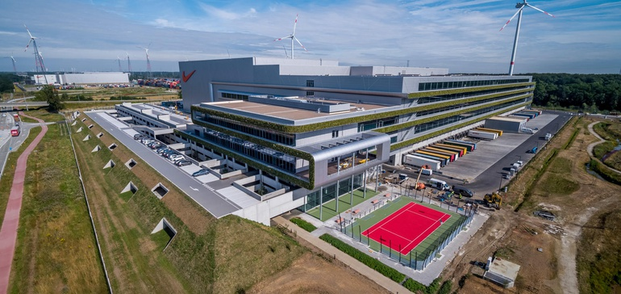
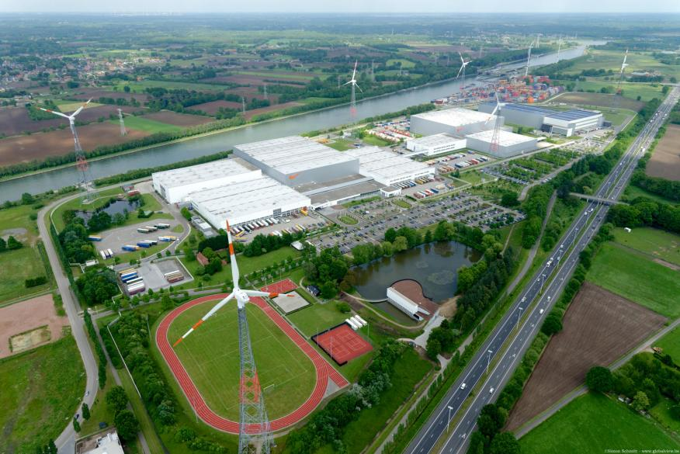
Logistika a SCM
Case study: Centralised distribution at Nike
Notes:
he latest milestone in Nike’s move to zero carbon and zero waste to help protect the future of sport.

Slide 2
Central distribution centre in Laakdal characteristics
200.000 m2
Serves 45.000 customers in EMEA with footwear, apparel and equipment
Workforce stands at 1.350 (off peak) to 2.300 (at a peak) operational staff
Areas served from the centre – Russia, Turkey, South Africa,
coordinates all the logistical activities between 200 factories, clients in 55countries
along the Albert Canal about 45 km east of the port ofAntwerp and adjacent to a large inland container terminal
automated high warehouse for storing goods, a low warehouse across three floors for handling goods, an office block with social amenities, a technical block with offices and technical facilities.
https://youtu.be/Pta-vP0M3x8
Notes:
The distribution center expands Nike’s European Logistics Campus, which opened in 1994 and today is comprised of six distribution facilities across Ham, Laakdal, Meerhout and Herentals.

Slide 3
Distribution pipeline
Deliveries are time-critical because of the seasonal nature of the business
¼ of the volume of shipments directly to the customers (largers customers supplied with full pallets, no consolidation needed)
Some retailers share weekly point of sale data with Nike to enable replenishing based on actual sales data
Selected shipments are dealt with material handling operations (VAS( - labelling, re-packing)
First satellite centre for Russia with small inventories opened to enable faster local replenishment of selected products

Slide 4
Nike´s supply chain
Notes:
Nike’s products can be delivered to their European customers via three differentsupply chain models:- Directly from the factory to the customer (one container/one customer);- From the factory to the customer via a deconsolidation center (one container/multiplecustomers);- From the factory to the customer via the ELC in Laakdal.The third supply chain model (see Figure 10) implies that finished footwear andapparel products first go from the factories in Asia to a consolidator and then to a port ofloading in Asia. Most of Nike products are manufactured in China and Vietnam and regularcontainer liner services then transport the manufactured goods to Europe. After thecontainerized products are discharged in the ports of Rotterdam, Antwerp or Zeebrugge,they are then transferred directly to the Laakdal distribution center, in most cases by inlandcontainer barge. The adjacent WCT terminal in Meerhout has regular barge connectionswith the container load centers located in the Rhine-Scheldt Delta.

Slide 5
Questions
Why to distribute directly without utilizing centralized distribution centre?
Why to use satellite centres (like the one in Russia)
What are the pros and cons of locating materials handling operations , such as labelling and packaging, in a disttibution centre, as opposed to in a factory?
What are the pros and cons for a company to také on the materiál handling services as opposed to leaving them to retail customers
Notes:
add value to a rather standardized product

Slide 6
Court Distribution Center
The use of 100% renewable energy, sourcing energy from five locally generated sources: wind, solar, geothermal, hydroelectric and biomass.
In addition to railways and highways, surrounding infrastructure includes a network of canals, enabling 99% of inbound containers to reach the local container park by water. This eliminates some 14,000 truck journeys each year, reducing associated carbon emissions.
More than 95% of waste generated on-site is recycled.
Notes:
The latest expansion of Nike’s Europe
(For instance, pathways used by employees around the facility are made from recycled footwear material.
an Logistics Campus, spanning four locations in Belgium,

Slide 7
Court Distribution Center
Ham in Belgium
The Court is 1.5 million square feet and operates completely from wind, solar, geothermal, hydroelectric and biomass power
The distribution center expands Nike’s European Logistics Campus, which opened in 1994 and today is comprised of six distribution facilities across Ham, Laakdal, Meerhout and Herentals.

Slide 8
Other warehouse management decisions

Slide 9
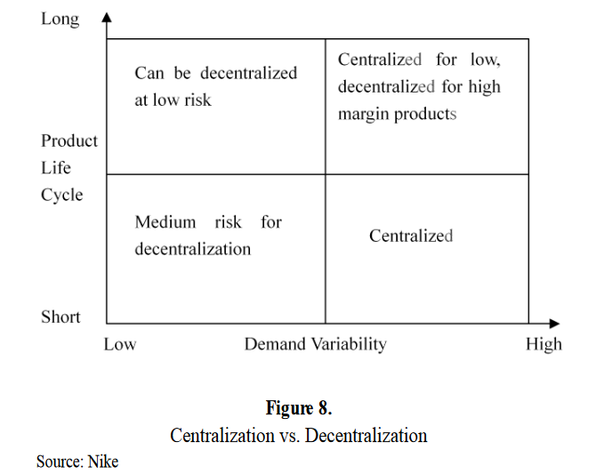
Central distribution centre in Laakdal decision
changing from 32 decentralized DCs prior to 1994 to 1 EDC, Nike has benefittedfrom big savings on inventory costs and close-outs at the end of each season
While thesavings on warehousing and transportation costs were limited, Nike took into account atrade-off between the product life cycle and demand variability

Slide 10
Benefits
Consolidation of inbound shipments
Lower inventory levels
Better delivery service

Slide 11
Location decision
he Laakdal facility is located along the Albert Canal about 45 km east of the port ofAntwerp and adjacent to a large inland container terminal
Central location called the gate to europe
products can reach any part of Europe within 4 days
infrastructure support for intermodal transportation (albret canal, highway conection to germany, rail,)

Slide 12
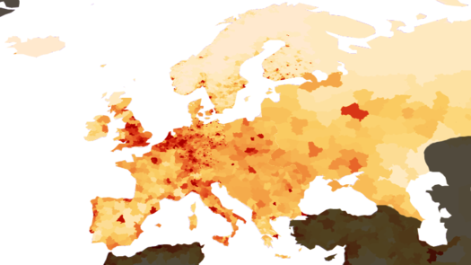
Notes:
Hustota obyvatel a blue banana – koridor – odděluje aktivní a pasivní prvky, koridor nejvíce urbanizopvaný

Slide 13
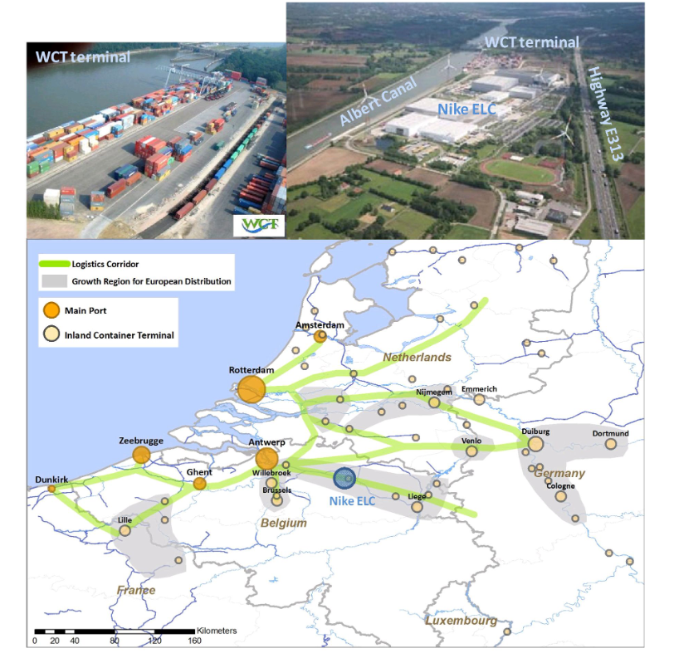
Notes:
Central location - Laakdal is located in the south-eastern part of the province ofAntwerp in Flanders, which is often called the gate to Europe. About 60% of Europeanpurchasing power is located within 300 miles of Flanders. More than 800 Europeandistribution centers are located in Flanders, and if including all of Belgium and theNetherlands, the number hits around 2000 EDCs. Being located in the central part of the
Blue banana of Europe, Nike’s ELC is well positioned and its products can reach any part ofEurope within 4 days.Infrastructure - The infrastructure support for intermodal transportation near the Nikefacility in Laakdal is very good. As mentioned earlier, the ELC is positioned next to theAlbert Canal (which connects Antwerp to Liège and the Meuse River) and the WCT inlandcontainer terminal in Meerhout. As a result, 96% of Nike’s inbound flow is delivered bywater via regular container barge services coming from the ports of Antwerp, Rotterdamand Zeebrugge. The barge dependency of Nike’s inbound flows also adds to itsenvironmental friendly business focus. Besides the excellent inland waterway access, theELC is very close to highway E313 which connects Antwerp to Germany. The cargoairports of Brussels and Liège are also within a 100km distance. In March of 2007, Nikewelcomed its first inbound container delivery via rail. The first outbound rail left thefacility in October of 2008. The addition of rail means that the Laakdal facility hastri-modal access to the gateway ports in Benelux and the European hinterland.Other important location factors which were identified by Nike relate to theco-operation with local authorities, the availability of an educated work force and theintegration process within Nike Be

Slide 14
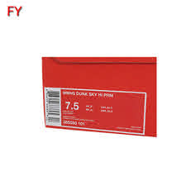
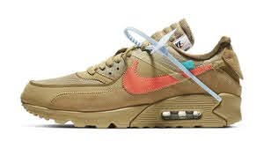
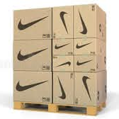
VALS
quality control
cross-docking,
product labeling,
shoebox labeling,
The application of security tags,
outer carton labeling,
palletizing,
final packaging, and order picking for Nike’s online store orders.
transfer of loose shirts, T-shirts and pants onto hangers in order to make the products shop ready.
Notes:
. About 30% of the products are sent to thecustomers directly without repacking, while the remaining 70% of the products are processed on an item basis in the facility. Big customers with massive order volumes, such as Footlocker, receive the products directly from the Laakdal ELC without repacking. For repacked goods, the logistics system in the ELC is aimed at deconsolidation and reconsolidation. On the inbound side containers are deconsolidated into cartons and then into individual product items. After order picking, the individual items are reconsolidated into cartons, followed by the palletization of the cartons and outbound shipment via truck in a few cases also by trailer on rail

