Slide 1
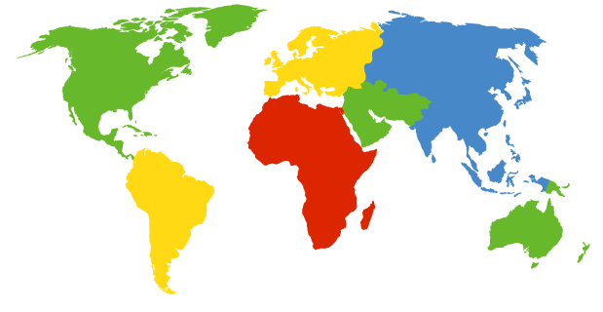
Neziskový sektor v mezinárodním srovnání

Slide 2
Identifikace srovnávacího projektu:
The Johns Hopkins Comparative Nonprofit Sector Project is a systematic effort to analyze the scope, structure, financing, and role of the private nonprofit sector in a cross-section of countries around the world in order to improve our knowledge and enrich our theoretical understanding of this sector, and to provide a sounder basis for both public and private action towards it.
The project utilizes a comparative, empirical approach that relies heavily on a team of local associates in the target countries and involves a network of local advisory committees.
Center for Civil Society Studies
Institute for Policy Studies
The Johns Hopkins University
3400 N. Charles Street
Baltimore, MD 21218-2688, USA
Phone: 410-516-5463
Fax: 410-516-7818
E-mail: cnp@jhu.edu
Web site: http://www.ccss.jhu.edu/index.php?section=content&view=9&sub=3&tri=8

Slide 3


Project Countries
The Johns Hopkins Comparative Nonprofit Sector Project
Denmark
Belgium
Norway
The
Netherlands
Finland
Switzerland
United Kingdom
France
Denmark
Sweden
Austria
Czech Republic
Germany
Italy
United States
Poland
Romania
Russia
Slovakia
Canada
Ireland
Hungary
Mexico
Spain
Japan
Portugal
Egypt
Korea
Venezuela
Morocco
Lebanon
The Philippines
Colombia
Ghana
Israel
India
Kenya
Thailand
Pakistan
Brazil
Tanzania
Uganda
Chile
Argentina
South Africa
Peru
Australia
New Zealand

Slide 4
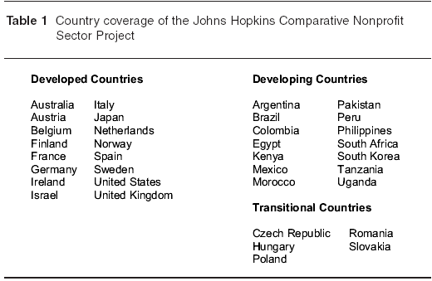
Kterých zemí se projekt týká…

Slide 5
Kdo spolupracoval
Argentina - Mario Roitter
Australia - Mark Lyons
Austria – Ulrike Schneider
Belgium - Jacques Defourny & Sybille Mertens
Brazil - Leilah Landim & Neide Beres
Canada – Michael Hall
Chile – Ignacio Irarrazaval
Colombia - Rodrigo Villar
Czech Republic - Martin Potucek & Pavol Fric
Denmark – Ole Gregersen & Thomas Boje
Egypt – Amani Kandil
Finland – Susan Sundback
France - Edith Archambault
Germany - Annette Zimmer & Eckhard Priller
Hungary - István Sebestény &
Renata Nagy
India – Rajesh Tandon & S.S. Srivastava
Ireland - Freda Donoghue
Israel - Benjamin Gidron
Italy – Gian Paolo Barbetta
Japan - Naoto Yamauchi
Kenya – Karuti Kanyinga
Korea, Republic of - Tae-Kyu Park
Lebanon – Hashem el-Husseini
Mexico - Gustavo Verduzco & CEMEFI
Notes:
5

Slide 6
Morocco - Salama Saidi
The Netherlands - Paul Dekker & Bob Kuhry
New Zealand - Massey University & Statistics New Zealand
Norway - Hakon Lorentzen & Karl Henrik Sivesind
Pakistan – Muhammad Asif Iqbal
Peru - Felipe Portocarrero & Cynthia Sanborn
The Philippines - Ledivina Cariño
Poland - Ewa Les & Slawomir Nalecz
Portugal – Raquel Campos Franco
Romania - Carmen Epure
Russia – Oleg Kazakov
Slovakia - Helena Woleková
South Africa - Mark Swilling
Spain - Jose Ignacio Ruiz Olabuenaga
Sweden - Tommy Lundstrom & Filip Wijkstrom
Switzerland – Bernd Helmig
Tanzania - Laurean Ndumbaro & Amos Mhina
Thailand – Amara Pongsapich
Uganda – John-Jean Barya
United Kingdom – Les Hems & Karl Wilding
United States - Lester Salamon & Wojtek Sokolowski
Venezuela – Rosa Amelia Gonzalez
Notes:
6

Slide 7
…a kterých typů organizací:
Organizations, i.e., they have an institutional presence and structure;
Private, i.e., they are institutionally separate from the state;
Not profit distributing, i.e., they do not return profits to their managers or to a set of “owners”;
Self-governing, i.e., they are fundamentally in control of their own affairs;
Voluntary, i.e., membership in them is not legally required and they attract some level of voluntary contribution of time or money.

Slide 8
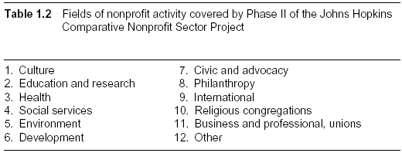
…a jakých aktivit:

Slide 9
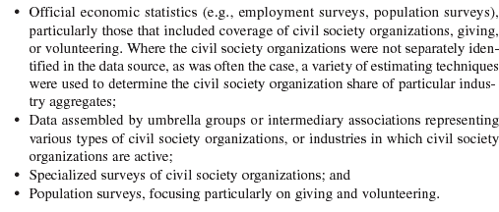
4 typy zdrojů dat

Slide 10
Hlavní zjištění projektu

Slide 11
1. Neziskový sektor jako významná ekonomická síla
In the first place, in addition to its social and political importance, the civil society sector turns out to be a considerable economic force, accounting for a significant share of national expenditures and employment. More specifically, in just the 35 countries for which they have collected information:

Slide 12
1995-1998
A $1.3 trillion industry. The civil society sector had aggregate expenditures of US$1.3 trillion as of the late 1990s, with religious congregations included. This represents 5.1 percent of the combined gross domestic product (GDP) of these countries.
The world’s seventh largest economy. To put these figures into context, if the civil society sector in these countries were a separate national economy, its expenditures would make it the seventh largest economy in the world, ahead of Italy, Brazil, Russia, Spain, and Canada and just behind France and the U.K.
A major employer. The civil society sector in these 35 countries is also a major employer, with a total workforce of 39.5 million full-time equivalent workers including religious congregations.

Slide 13
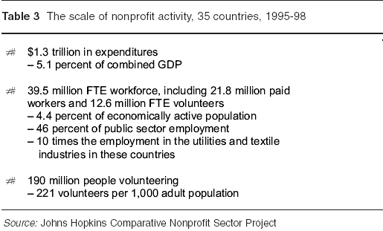
Kdyby byl neziskový sektor samostatnou ekonomikou:

Slide 14
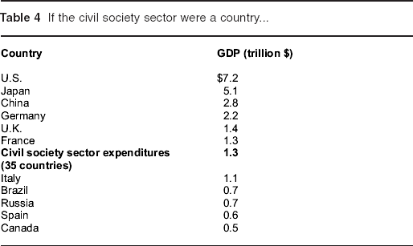
Kdyby byl neziskový sektor samostatnou ekonomikou (1995):

Slide 15
If the civil society sector were a country...2000
The Johns Hopkins Comparative Nonprofit Sector Project
Country
GDP (trillion $)
United States
$11.7
Japan
4.6
Germany
2.7
United Kingdom
2.1
Civil Society Land
Expenditures (40 Countries)
1.9*
France
1.9
China
1.7
Italy
1.2
Canada
1.0
Spain
1.0
Brazil
0.6
Russia
0.6
* In 2004 U.S. Dollars
Source of GDP Figures: World Bank

Slide 16
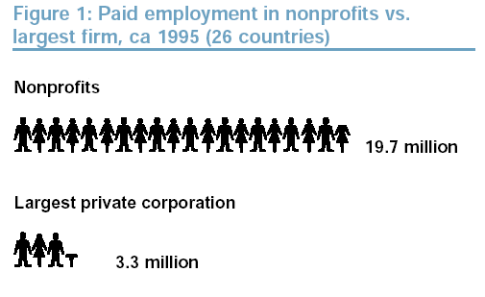
1995

Slide 17
Employment in Civil Society Organizations vs. Largest firms 2000
The Johns Hopkins Comparative Nonprofit Sector Project
Civil Society Organizations
48 million
Largest Private Companies
4 million

Slide 18
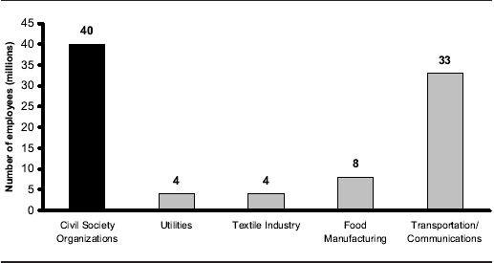
Kdyby byl neziskový sektor samostatnou ekonomikou – zaměstnanost:

Slide 19
Civil Society Organization Workforce in context, 40 countries
The Johns Hopkins Comparative Nonprofit Sector Project

Slide 20
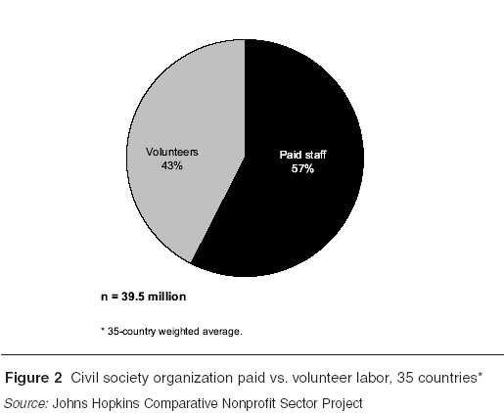
Neziskový sektor - zaměstnanost

Slide 21
CIVIL SOCIETY ORGANIZATION PAID VS. VOLUNTEER LABOR, 36 COUNTRIES
The Johns Hopkins Comparative Nonprofit Sector Project
Paid Workers
56%
Volunteers
44%
n=65.5 million
(including religion)

Slide 22
2. Rozdíly mezi zeměmi
In the first place, countries vary greatly in the overall scale of their civil society workforce.
the civil society sector workforce —volunteer and paid — varies from a high of 14 percent of the economically active population in the Netherlands to a low of 0.4 percent in Mexico.

Slide 24
CSO workforce as a share of the economically active population, by country 2000
The Johns Hopkins Comparative Nonprofit Sector Project

Slide 25
CSO workforce as a share of the economically active population, by country 2000
The Johns Hopkins Comparative Nonprofit Sector Project

Slide 26
VOLUNTEERS AS % OF CSO
WORKFORCE, BY COUNTRY CLUSTER
The Johns Hopkins Comparative Nonprofit Sector Project
All countries
38%
Developed
39%
Developing
37%
Nordic
64%
Africa
54%
Anglo-Saxon
37%
Central Europe
32%
Latin America
30%
Welfare Partnership
32%
Asian Industrialized
24%
0%
20%
40%
60%
80%
% of CSO Workforce

Slide 27
Rozvinuté vs. rozvojové a tranzitivní ekonomiky
Developed vs. developing and transitional countries. Civil society sector is relatively larger in the more developed countries.
  In fact, the civil society organization workforce in the developed countries is proportionally more than three times larger than that in the developing countries (7.4 percent vs. 1.9 percent of the economically active population, respectively).
    This is so, moreover, even when account is taken of volunteer labor and not just paid employment.
The relatively limited presence of civil society organizations in the developing countries does not, of course, necessarily mean the absence of helping relationships in these countries.
  To the contrary, many of these countries have strong traditions of familial, clan, or village networks that perform many of the same functions as civil society institutions. What is more, there are considerable differences in the scale of civil society activity even among the less developed countries.

Slide 28
Rozdíly v zapojení dobrovolníků

Slide 31
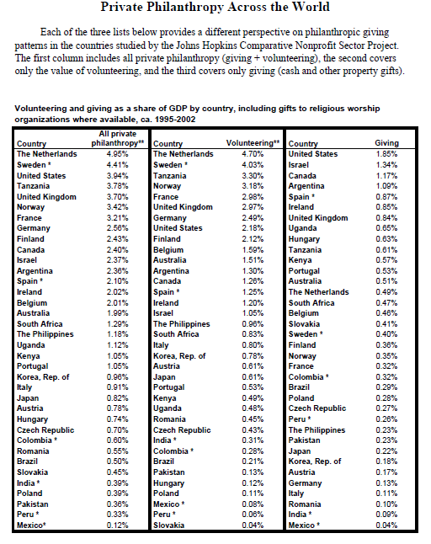

Slide 32
Vybraná data, vybrané země…

Slide 33
The Johns Hopkins Center for Civil Society Studies
Value Added as % of GDP, NPIs vs. Selected Industries, Canada, 2000
7.9%
% of GDP
Volunteers
NPIs
6.1%
5.1%
2.3%
1.5%
1.4%
Retail Trade
Mining, oil & gas extractions
Nonprofit sector
Accommodations & food services
Agriculture
Motor Vehicle Manufacturing

Slide 34
Contribution to GDP, Volunteers vs. Selected Industries, Canada
The Johns Hopkins Center for Civil Society Studies
15
Billions of Canadian $
$14.1 billion
10
$12.8 billion
5
$6.1 billion
Motor Vehicle Mfg.
Volunteers
Agriculture

Slide 35
The Johns Hopkins Center for Civil Society Studies
Value Added as % of GDP, NPIs* vs. Selected Industries, Belgium, 2003
% of GDP
5.0 %
4.8%
2.4%
1.6%
1.1%
Hotels & Restaurants
Construction
NPIs
Utilities
Agriculture & Fishing
* Without Volunteers

Slide 36
The Johns Hopkins Center for Civil Society Studies
NPI Share of Belgian Value Added, Selected Fields
SOCIAL SERVICES
66.6%
HEALTH
42.7%
CULTURE & RECREATION
26%
10%
50%
80%
Percent of Total Value

Slide 37
The Johns Hopkins Center for Civil Society Studies
Average Annual Change in GDP and GDP Contribution of NPIs
GDP
NPI
5%
4.7%
4.2%
4.3%
4.3%
3.3%
1.3%
1%
Belgium
(2000-2003)
Canada
(1997-2001)
USA
(1996-2004)

Slide 38
3. NS není jen poskytovatelem služeb
Service functions involve the delivery of direct services such as education, health, housing, economic development promotion, and the like.
Expressive functions involve activities that provide avenues for the expression of cultural, religious, professional, or policy values, interests, and beliefs. Included here are cultural institutions, recreation groups, religious worship organizations, professional associations, advocacy groups, community organizations and the like.
---The distinction between expressive and service functions is far from perfect, of course, and many organizations are engaged in both.

Slide 39
… i tak lze říci, že:
Service functions dominate in scale. From the evidence available, it appears that the service functions of the civil society sector clearly absorb the lion’s share of the activity.
  Excluding religious worship, … an average of over 60 percent of the total paid and volunteer full-time equivalent workforce of the civil society sector in the 32 countries for which we have activity data work for organizations primarily engaged in service functions.

Slide 40
DISTRIBUTION OF CIVIL SOCIETY WORKFORCE, BY FUNCTION
The Johns Hopkins Comparative Nonprofit Sector Project
Service
64%
Education
23%
Social Services
19%
Culture
19%
Expressive
32%
Misc. Advocacy
13%
Health
14%
Other 4%
Development
8%

Slide 41
A ještě ke službám:
Education and social services are the dominant service functions. Among the service activities of the civil society sector, education and social services clearly absorb the largest share.
  Over 40 percent of the nonprofit workforce—paid and volunteer—is engaged in these two service functions on average.

Slide 42
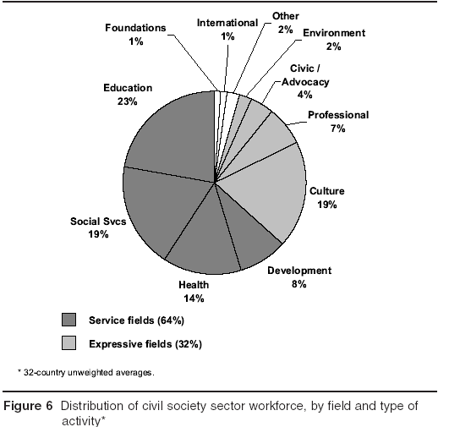
Rozdělení zaměstnanosti v NS dle typu aktivity

Slide 43
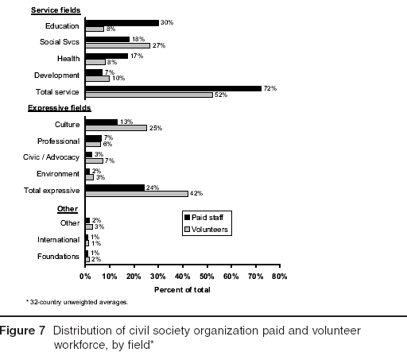
Dobrovolníci a typy aktivit

Slide 44
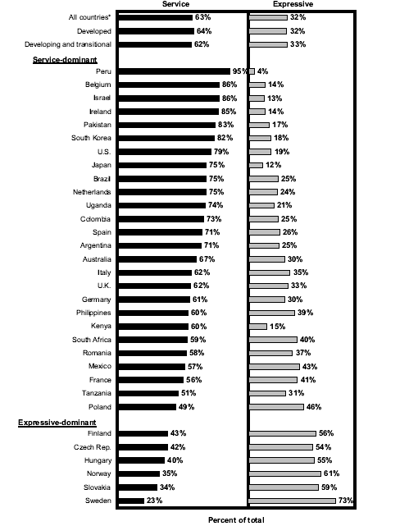

Slide 45
Odchylky od obecných vzorců
The first of these relates to the Nordic countries of Finland, Norway, and Sweden.
The second relates to the countries of Central and Eastern Europe (the Czech Republic, Hungary, Slovakia, and, to a slightly lesser extent, Poland).
  In both of these groups of countries organizations primarily engaged in expressive activities absorb a larger share of the civil society workforce than do those engaged in the service functions. The most likely explanation for this is that in both groups of countries the state assumed a dominant position in both the financing and delivery of social welfare services, leaving less room for private, civil society organizations.

Slide 46
To se týká nás…
In Central Europe this was a product of the imposition of a Soviet-style regime in the aftermath of World War II. While this regime concentrated social welfare services in the hands of the state and discouraged, or prohibited, the emergence of independent civil organizations, it did sanction the limited creation of professional and recreational organizations, many of which survived into the post-Communist era.

Slide 47
A tohle Seveřanů:
In the Nordic countries, by contrast, a robust network of grassroots labor and social-movement organizations took shape during the late nineteenth century and pushed through a substantial program of social welfare protections financed and delivered by the state.
  This limited the need for active civil society involvement in service provision but left behind a vibrant heritage of citizen-based civil society activity in advocacy, recreation, and related expressive fields.

Slide 48
Co dodat:
While the structure of the civil society sector in these two groups of countries is similar, however, the scale of the sector differs widely.
  In particular, the civil society sector in the Central and Eastern European countries remained quite small nearly a decade after the overthrow of the Soviet-type regimes.
  By contrast, in the Nordic countries, a sizable civil society sector remains in existence today, though it is largely staffed by volunteers and engaged in a variety of cultural, recreational, and expressive functions.

Slide 49
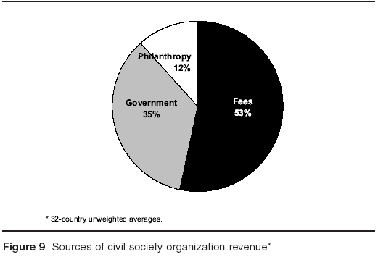
4. Zajímavá struktura příjmů

Slide 50
SOURCES OF CIVIL SOCIETY REVENUE (32 COUNTRYAVERAGE)
The Johns Hopkins Comparative Nonprofit Sector Project
Philanthropy
12%
Fees
53%
Government35%

Slide 51
Platby a poplatky
Fees are the dominant source of revenue.
  In the 32 countries on which revenue data are available,23 over half (53 percent) of civil society organization income comes, on average, not from private philanthropy but from fees and charges for the services that these organizations provide and the related commercial income they receive from investments and other commercial sources, including dues.

Slide 52
Veřejné zdroje
Significant public sector support.
Nor is philanthropy the second largest source of civil society organization revenue internationally. That distinction belongs, rather, to government or the public sector.
  An average of 35 percent of all civil society organization revenue comes from public sector sources, either through grants and contracts or reimbursement payments made by governmental agencies or quasi-nongovernmental organizations such as publicly financed social security and health agencies.

Slide 53
Omezená role filantropie
Limited role of private philanthropy.
  Private giving from all sources—individuals, foundations, and corporations—accounts for a much smaller 12 percent of total civil society organization revenue in the countries we have examined, or one-third as much as government and less than one-fourth as much as fees and charges.

Slide 54
Philanthropy as share of GDP, selected countries, 1995-2004
The Johns Hopkins Center for Civil Society Studies

Slide 55
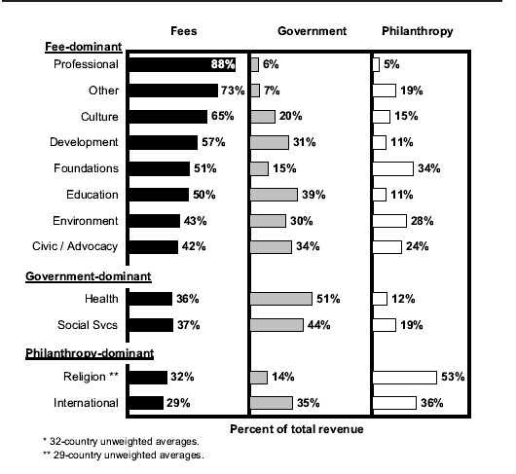
Srovnání zemí podle typů zdrojů

Slide 56
SOURCES OF CIVIL SOCIETY ORGANIZATION
REVENUE, BY COUNTRY
The Johns Hopkins Comparative Nonprofit Sector Project
FEE DOMINANT
Fees, Charges
Public Sector
Philanthropy
All Countries
53%
35%
12%
Philippines
92%
5%
3%
Mexico
85%
9%
6%
Kenya
81%
5%
14%
Brazil
74%
15%
11%
Argentina
73%
19%
7%
S. Korea
71%
24%
4%
Colombia
70%
15%
15%
Peru
70%
18%
12%
Australia
63%
31%
Sweden
6%
62%
29%
9%
Italy
61%
37%
3%
Poland
60%
24%
15%
Norway
58%
35%
7%
Finland
58%
36%
6%
U.S.
57%
31%
13%
Slovakia
55%
23%
22%
Hungary
55%
27%
18%
Tanzania
53%
27%
20%
Japan
52%
45%
3%
Pakistan
51%
6%
43%
Spain
49%
32%
19%
Czech Rep.
40%
47%
39%
14%
0%
20%
60%
80%
0% 20% 40% 60% 80%
0% 20% 40% 60% 80%

Slide 57
SOURCES OF CIVIL SOCIETY ORGANIZATION REVENUE, BY COUNTRY
The Johns Hopkins Comparative Nonprofit Sector Project
Government Dominant
Fees, Charges
Public Sector
Philanthropy
All Countries
53%
35%
12%
Ireland
Belgium
Germany
Israel
Netherlands
France
Austria
U.K.
Romania
South Africa
16%
77%
7%
19%
77%
5%
32%
64%
3%
26%
64%
10%
39%
59%
2%
35%
58%
8%
43%
50%
6%
45%
47%
9%
29%
45%
26%
32%
44%
24%
0%
20%
60%
80%
0% 20% 40% 60% 80%
0% 20% 40% 60% 80%
40%
% may not add up to 100% due to rounding

Slide 58
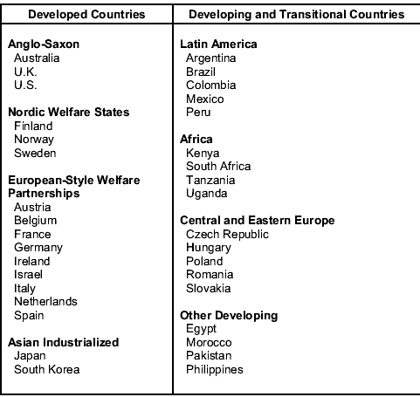
5. Regionální vzorce

Slide 59
Regionální vzorce - Central and Eastern Europe
…Notable, perhaps, is the extremely small scale of the civil society sector in these countries—engaging only one-fourth as large a proportion of the economically active population as the overall 35-country average.
  Indeed, the civil society sector in these countries is smaller than in any of the other regions we examined, including the developing countries of Africa and Latin America. Also notable is the relatively large presence of expressive activity within what little civil society sectors exist in these countries.

Slide 60
Regionální vzorce - Central and Eastern Europe
This is likely a reflection of the social welfare policies of the Soviet-era governments, which relied on direct provision of the most important social services by the “workers’ state” and discouraged reliance on private voluntary groups, including those affiliated with religious groups.
  An embryonic civil society sector was tolerated in these countries, but largely for social, recreational, and professional purposes, and even then at least partly as vehicles for state control. In the aftermath of the collapse of the state socialist regimes, a number of these sanctioned organizations were able to make the transition into nonprofit status, often with the aid of captured state resources (buildings, equipment, and occasionally subsidies), and their relatively sizable presence is reflected in the data.

Slide 61
Regionální vzorce - Central and Eastern Europe
One particularly ironic byproduct of this peculiar history of civil society development in Central and Eastern Europe is the relatively high level of reliance on philanthropic support on the part of the region’s civil society organizations.
  Ironically, despite its socialist past, philanthropy constitutes a larger share of the revenues of civil society organizations in this region than in any other region (20 percent vs. an all-country average of 12 percent).
    One explanation for this may be that when state enterprises were transformed into private firms, they spun off into nonprofit organizations many of the health and recreational services they previously provided to their workers free of cost, but they continued some degree of financial or in-kind support to these activities. Since these state enterprises became private firms, however, this support shows up in our data as private charity.

