Slide 1
Altruism and Reciprocity
Miloš Fišar
BPV_IEBE Introduction to Experimental and Behavioral Economics

Slide 2

ALTRUISM

Slide 3
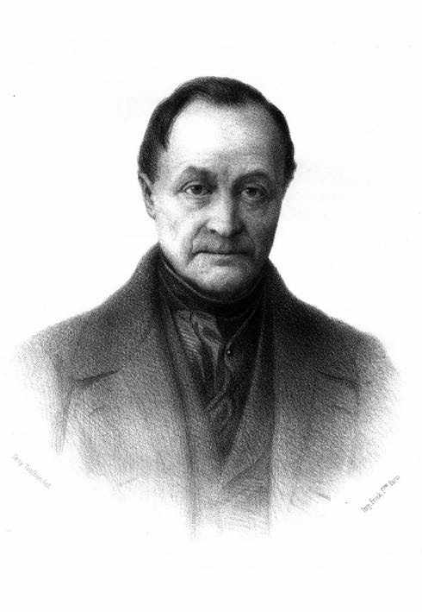
What is ALTRUISM?
Merriam-Webster dictionary
  unselfish regard for or devotion to the welfare of others
  behavior by an animal that is not beneficial to or may be harmful to itself but that benefits others of its species
Cambridge English dictionary
  willingness to do things that ​bring ​advantages to ​others, ​even if it ​results in ​disadvantage for yourself
origin
  from French altruisme,
  from Italian altrui 'somebody else',
  from Latin alteri huic ' to another'
  in 19th century philosopher Auguste Comte began to use altruism as antonym to egoism

Slide 4
How to measure altruism?
Can you measure altruism when you see it?
Self-Report Altruism Scale
  ex-post or ex-ante measurement for altruism
  20 (14 in adapted version) questions
  answers 1=Never/Once/More than once/Often/5=Very often
  measures
    what subjects really did
    what would they do

Slide 5
Self-Report Altruism Scale
  Rushton, P. C., R. (1981). The altruistic personality and the self-report altruism scale. Personality and Individual Differences, 2(4), 293-302.

Slide 6
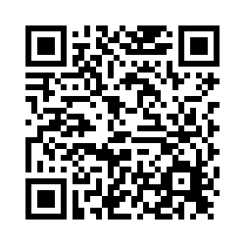
How altruistic are you?
How often would you exhibit the following behaviors?
https://wumarketing.eu.qualtrics.com/jfe/form/SV_aarYym8Bj8k9BtQ
Notes:
How often you exhibit the following behaviors?

Slide 7
Adapted version of Self-Report Altruism Scale
Notes:
How often you exhibit the following behaviors?

Slide 8
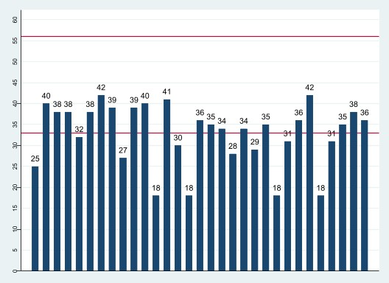
Your altruistic score - all

Slide 9
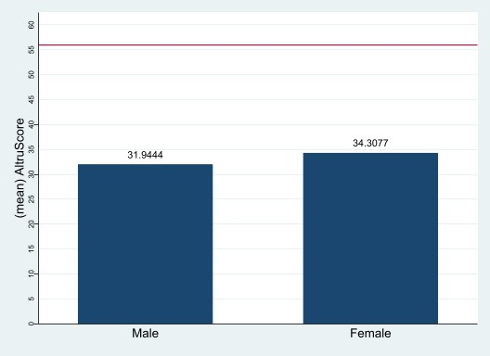
Your altruistic score - gender

Slide 10
Another way to measure altruism - Experiment
Experiments allow you to observe altruistic behavior (Andreoni, Harbaugh, & Vesterlund, 2010)
  Prisoner's Dilemma
  Public Goods Game
  Dictator/Ultimatum Game
  Trust Game

Slide 11
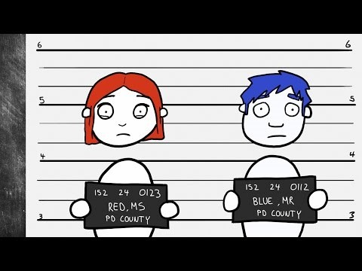
Prisoner's Dilemma
https://youtu.be/t9Lo2fgxWHw

Slide 12
Prisoner's Dilemma
standard game theory example originating in 1950 Flood-Dresher (quasi-)experiment (Flood 1952, 1958)
there exist thousands of studies using PD in economics, psychology, political science, …

Slide 13
Prisoners’ Dilemma
Cooperation is the key to success in the game (Kelly and Stahelski, 1970; Roth and Murningam, 1978; and other)
Cooperation might be triggered by altruism but more likely by reputation (Kreps, et al., 1982). The participants cooperate if they believe there is a chance someone is actually altruistic.
Andreoni and Miller (1993) found that 20% of subjects have to be altruistic to support equilibria findings
  The conclusion is supported by other studies (e.g. Camerer and Weigelt, 1988; McKelvey and Palfrey, 1992; Andreoni and Samuelson, 2006)
Notes:
Andreoni and Miller (1993) - found significant evidence for reputation

Slide 14
Public Goods Game
Original: Marwell and Ames. "Experiments on the provision of public goods. I. Resources, interest, group size, and the free-rider problem." American Journal of sociology (1979)
One of the most standard game in experimental economics.
Each player contributes to common or private account.

Slide 15
Public Goods Game
You play in groups of 4 players for 10 rounds. The composition of the group is the same in all 10 rounds.
At the beginning of each round, each player receives an endowment of 20 tokens and can decide how many tokens to contribute to the common project.
Each token contributed to the project will be multiplied by 2 and distributed equally among all 4 members of the group. Therefore, each player receives 0.5 tokens for each token contributed to the project by any member.
Tokens not contributed to the common project are kept by the player.

Slide 16
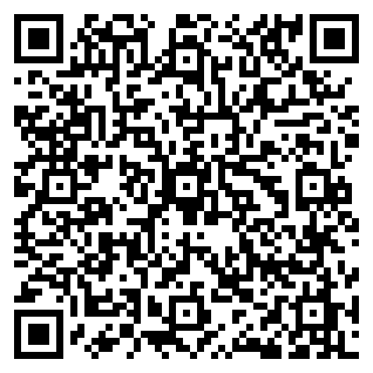
Public Goods Game
Login
go to: https://classex.uni-passau.de
choose: Masaryk University
choose: Introduction to Behavioral and Experimental Economics
choose: participant
enter password: IEBE2021
https://classex.uni-passau.de/bin/index.php?automatic=fwB8tmeRG-Ps_yHljj59WQ

Slide 17
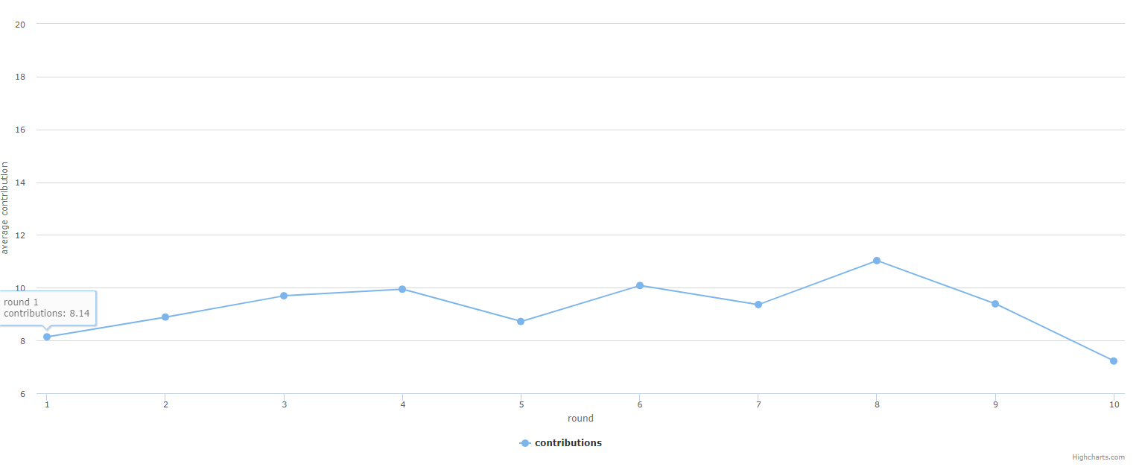
Public Goods Game – your results

Slide 18
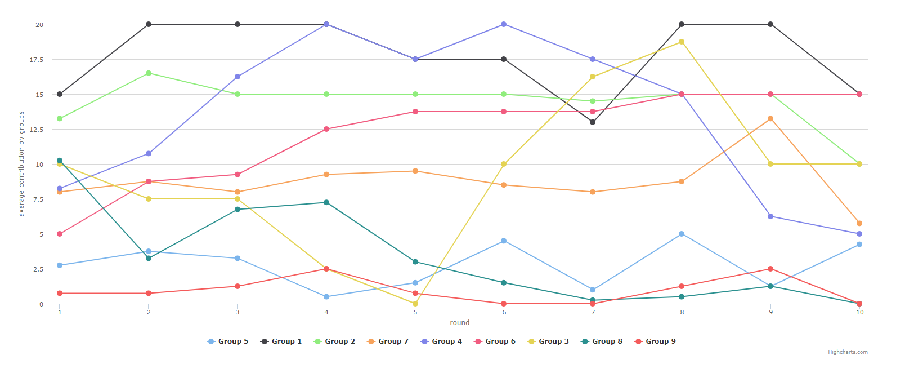
Public Goods Game – your results

Slide 19
Public Goods Game
Original: Marwell, Gerald, and Ruth E. Ames. "Experiments on the provision of public goods. I. Resources, interest, group size, and the free-rider problem." American Journal of sociology (1979)
One of the most standard game in experimental economics.
Each player contributes to common or private account. Usually:
  Each player gets same percentage of total private account contributions.
  Contributions are multiplied by a coefficient >1.
The group's total payoff is maximized when everyone contributes all of their tokens to the public pool.
Dominant strategy is zero contribution by every player to common account  experimental results show a different story.
  Results show, that average contribution is significantly above zero (Isaac and Walker, 1988; Isaac, Walker and Williams, 1994; Andreoni, 1988; Andreoni and Croson, 2008; Palfrey and Prisbrey, 1996)

Slide 20
Public Goods Game
Applicable on charitable giving, fundraising, transportation etc.
Treatment variations:
  Opened communication in the middle of the experiment.
  Possibility of punishment.
    People do punish (↓contribution ↑punishment) and cooperation increases (Fehr Gächter, 2000)
    “Counter fire“ lowers cooperation (Nikiforakis, 2008)
    Stronger punishment increases contributions (Denant-Boemont, 2007)
    Anonymous punishment is more efficient (Denant-Boemont, 2007)

Slide 21
Public Goods Game
Any error or variance in data could be viewed as altruism (Ladyard, 1995)
Experiments shown that:
  Warm-glow dominates altruism (Palfrey and Prisbey, 1997)
  Altruism dominates warm-glow (Goeree, Holt and Laury, 2002)
  Both warm-glow and altruism are evident in PGG (Bolton and Katok, 1998; Eckel, Grossman and Johnston, 2005)
warm-glow = emotional reward of giving to others

Slide 22
Ultimatum and Dictator Game
Ultimatum Game
Dictator Game
Proposer and Responder bargain over a division of a given sum of money.
  Proposer: makes an offer how to split the sum
  Responder: accepts or rejects
    if accepted they split the money
    if rejected neither gets anything
Dictator and Recipient bargain over a division of a given sum of money.
  Dictator: splits the sum
  Recipient: is informed of endowment left by the dictator

Slide 23


Dictator Game
can send all, nothing or part of his endowment of 100 Euro to
makes no decision

Slide 24
Dictator Game
Login
go to: https://classex.uni-passau.de
choose: Masaryk University
choose: Introduction to Behavioral and Experimental Economics
choose: participant
enter password: IEBE2021
https://classex.uni-passau.de/bin/index.php?automatic=fwB8tmeRG-Ps_yHljj59WQ

Slide 25
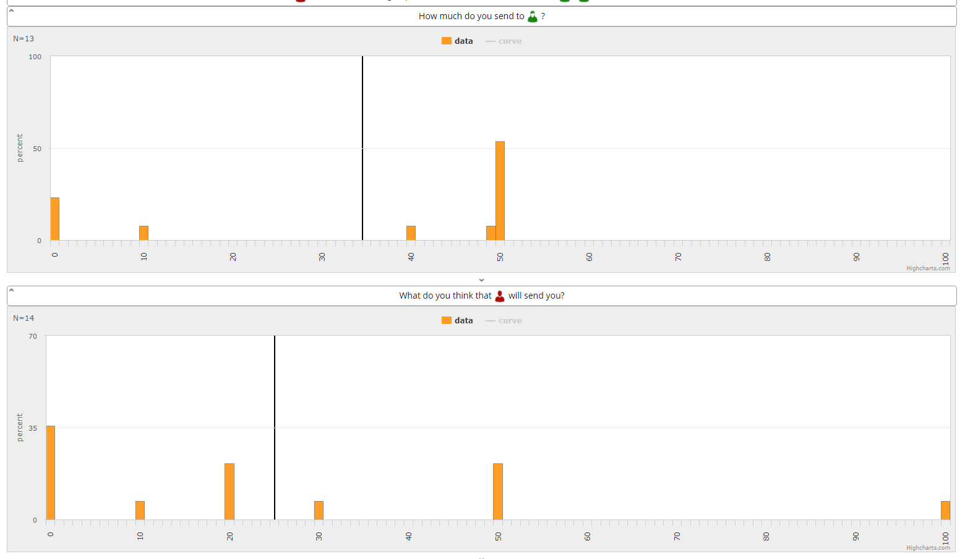
Dictator Game – your results

Slide 26
Ultimatum and Dictator Game
Ultimatum Game
Dictator Game
Proposer and Responder bargain over a division of a given sum of money.
  Proposer: makes an offer how to split the sum
  Responder: accepts or rejects
    if accepted they split the money
    if rejected neither gets anything
unique subgame perfect equilibrium the proposer suggests the responder the smallest amount possible and the responder accepts
Dictator and Recipient bargain over a division of a given sum of money.
  Dictator: splits the sum
  Recipient: is informed of endowment left by the dictator
unique subgame perfect equilibrium: the dictator takes it all

Slide 27
Dictator Game
Proposers choose a fair deal (Güth, Schmittberger and Schwarze, 1982) but is it altruism?
  Answered by Forsythe, et al. (1994) by removing 2nd stage of the game: in average 25% of the endowment was shared
Andreoni and Miller (2002) investigated altruism by gender
  men are more likely to maximize total payments to both subjects
  women are more likely to equalize payments to both
  ⇨ men are more altruistic when giving is cheap and women when it is expensive

Slide 28
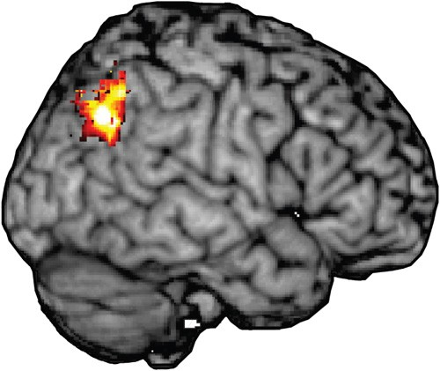
What factors drive the altruism
Culture (Roth et al., 1991; Henrich et al., 2001)
Psychological development and socialization (Harbaugh and Krause, 2000)
Our brain (Tankersley, Stowe and Huettel, 2007)

Slide 29
Trust Game
2 players; both receive same endowment
Player 1 (sender) may send some amount of his money to Player 2 (receiver)
  whatever he/she sends will be tripled on the way
Player 2 makes similar choice:
  send some amount of the now-tripled money back to Player 1, or not

Slide 30
Trust Game (if there is time)
Login
go to: https://classex.uni-passau.de
choose: Masaryk University
choose: Introduction to Behavioral and Experimental Economics
choose: participant
enter password: IEBE2021
https://classex.uni-passau.de/bin/index.php?automatic=fwB8tmeRG-Ps_yHljj59WQ

Slide 31
Trust Game
2 players; both receive same endowment
Player 1 (sender) may send some amount of his money to Player 2 (receiver)
  whatever he/she sends will be tripled on the way
Player 2 makes similar choice:
  send some amount of the now-tripled money back to Player 1, or not
transfer of 0 is subgame perfect equilibria for sender
transfer of 0 is a dominant strategy for receiver

Slide 32
Trust Game
Transfer from Player 2 is often slightly below average transfer from Player 1 (Berg, Dickhaut, McCabe, 1995)
60% of senders and 42% receivers are motivated by altruism (Cox and Deck, 2005)
reciprocity is clearly present in the Trust Game (Charness and Haruvy, 2002; Gneezy, Guth and Verboven, 2000)

Slide 33

RECIPROCITY

Slide 34
What is RECIPROCITY?
Merriam-Webster dictionary
  a situation or relationship in which two people or groups agree to do something similar for each other, to allow each other to have the same rights, etc. : a reciprocal arrangement or relationship
Cambridge English dictionary
  behavior in which two ​people or ​groups of ​people give each other ​help and ​advantages
origin
  from Latin reciprocus meaning returning.

Slide 35
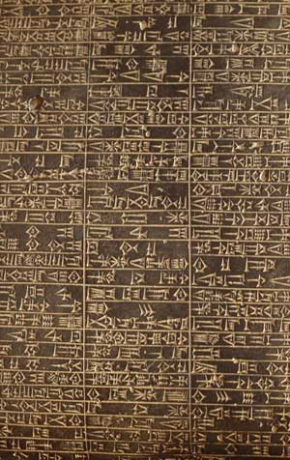
Reciprocity
social rule that says that we should “repay“
differs from altruism in a manner that a response is expected
Might be find in Hammurabi’s code (~1750 BC):
“If a man put out the eye of another man, his eye shall be put out.”
Used make someone follow a rule
→ e.g. law, wages are reciprocal

Slide 36
Positive vs Negative Reciprocity
Positive
  a motivation to adopt a generous action that benefits someone else, at one’s own material cost, because that person’s intentional behavior was perceived to be beneficial to oneself.
Negative
  a motivation to adopt an action that harms someone else, at one’s own material cost, because that person’s intentional behavior was perceived to be harmful to oneself

Slide 37
Reciprocity in experiments
It is confirmed that direct positive reciprocity is frequent in experiments (Diekmann, 2004)
40-66% of subjects display non-selfish behavior (Fehr and Gächter, 2000)
Negative reciprocity is measured by means of a Moonlighting Game (Abbink et al., 2000) where one player can take money from other, who can punish in return

Slide 38
Moonlighting Game
2 players
both endowed with $12
Player 1 can:
  take money (up to $6) from Player 2
  or transfer money (up to $6) to Player 2 (amount transferred is tripled)
Player 2 can:
  transfer money (up to 18) to Player 1
  or spend money (up to 6) to reduce Player 1’s payoff (by three times the amount spent)
subgame perfect equilibrium:
  Player 1 will take the maximum possible amount from Player 2
  Player 2 will neither punish nor return any money
Abbink, K., Irlenbusch, B., & Renner, E. (2000). The moonlighting game: An experimental study on reciprocity and retribution. Journal of Economic Behavior & Organization, 42(2), 265-277.

Slide 39
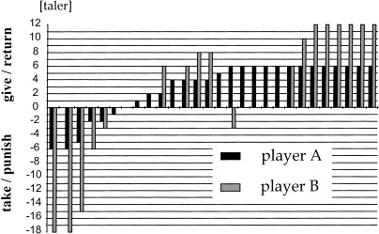
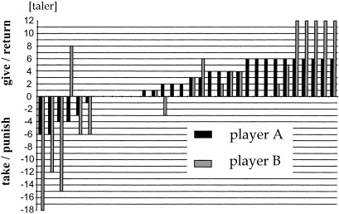
Moonlighting Game
Abbink, Irlenbusch, & Renner (2000)

Slide 40
Moonlighting Game
retribution (punishment for breaking the contract) is more compelling than reciprocity because the hostile actions are punished more often than friendly actions rewarded (Abbink, Irlenbusch, & Renner, 2000)
first players are not afraid of negative reciprocity (Cox et al., 2002)

Slide 41

Bribery Game
Essential characteristic of corruption is reciprocity
  Both negative and positive
2 (Abbink et al., 2002) or 3 player game (Alatas et al., 2009)
Player 1 “FIRM” may offer a bribe
Player 2 “OFFICIAL” either rejects or accepts it
Player 3 “CITIZEN” may punish

Slide 42
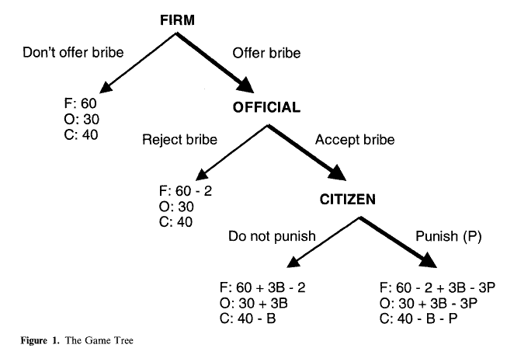
Bribery Game

Slide 43
Bribery Game
Reciprocity and trust may lead to stable exchange of benefits (corruption) even when own payoffs are not maximized (Abbink et al., 2002)
Women are less likely to offer bribes and more likely to punish corruption but it varies across countries. Variation might be explained by different roles of women (Alatas et al., 2009).
However, we found that women are less likely to offer bribes and less likely to punish corruption (Fišar, et al., 2016).

Slide 44
Is altruism and reciprocity only human’s domain?
http://www.ted.com/talks/laurie_santos
Chen, M. K., Lakshminarayanan, V., & Santos, L. R.. (2006). How Basic Are Behavioral Biases? Evidence from Capuchin Monkey Trading Behavior.Journal of Political Economy, 114(3), 517–537.

Slide 45
Thank you for your attention
If you have any question, feel free to ask in the Teams Group or write me an email: milos.fisar@wu.ac.at

Slide 46
Literature
Abbink, K., Irlenbusch, B., & Renner, E. (2000). The moonlighting game: An experimental study on reciprocity and retribution. Journal of Economic Behavior & Organization, 42(2), 265-277.
Abbink, K., Irlenbusch, B., & Renner, E. (2002). An experimental bribery game. Journal of Law, economics, and organization, 18(2), 428-454.
Andreoni, J. (1988). Privately provided public goods in a large economy: the limits of altruism. Journal of public Economics, 35(1), 57-73.
Andreoni, J., & Croson, R. (2008). Partners versus strangers: Random rematching in public goods experiments. Handbook of experimental economics results, 1, 776-783.
Andreoni, J., & Miller, J. (2002). Giving according to GARP: An experimental test of the consistency of preferences for altruism. Econometrica, 70(2), 737-753.
Andreoni, J., & Miller, J. H. (1993). Rational cooperation in the finitely repeated prisoner's dilemma: Experimental evidence. The economic journal, 103(418), 570-585.
Andreoni, J., & Samuelson, L. (2006). Building rational cooperation. Journal of Economic Theory, 127(1), 117-154.
Andreoni, J., Harbaugh, W. T., & Vesterlund, L. (2010). Altruism in experiments. In Behavioural and experimental economics (pp. 6-13). Palgrave Macmillan, London.
Bolton, G. E., & Katok, E. (1998). An experimental test of the crowding out hypothesis: The nature of beneficent behavior. Journal of Economic Behavior & Organization, 37(3), 315-331.
Camerer, C., & Weigelt, K. (1988). Experimental tests of a sequential equilibrium reputation model. Econometrica: Journal of the Econometric Society, 1-36.
Chen, M. K., Lakshminarayanan, V., & Santos, L. R.. (2006). How Basic Are Behavioral Biases? Evidence from Capuchin Monkey Trading Behavior.Journal of Political Economy, 114(3), 517–537.
Cox, J. C., & Deck, C. A. (2005). On the nature of reciprocal motives. Economic Inquiry, 43(3), 623-635.Alatas et al., 2009)
Denant-Boemont, L., Masclet, D., & Noussair, C. N. (2007). Punishment, counterpunishment and sanction enforcement in a social dilemma experiment. Economic theory, 33(1), 145-167.
Diekmann, A. (2004). The power of reciprocity: Fairness, reciprocity, and stakes in variants of the dictator game. Journal of conflict resolution, 48(4), 487-505.
Eckel, C. C., Grossman, P. J., & Johnston, R. M. (2005). An experimental test of the crowding out hypothesis. Journal of Public Economics, 89(8), 1543-1560.
Fehr, E., & Gachter, S. (2000). Cooperation and punishment in public goods experiments. American Economic Review, 90(4), 980-994.
Fehr, E., & Gächter, S. (2000). Fairness and retaliation: The economics of reciprocity. Journal of economic perspectives, 14(3), 159-181.
Fišar, M., Kubák, M., Špalek, J., & Tremewan, J. (2016). Gender differences in beliefs and actions in a framed corruption experiment. Journal of Behavioral and Experimental Economics, 63, 69-82.
Flood, M. M. (1952). A preference experiment (Series 2, Trials 2, 3, 4). RAND CORP SANTA MONICA CALIF.
Flood, M. M. (1958). Some experimental games. Management Science, 5(1), 5-26.

Slide 47
Literature
Forsythe, R., Horowitz, J. L., Savin, N. E., & Sefton, M. (1994). Fairness in simple bargaining experiments. Games and Economic behavior, 6(3), 347-369.
Goeree, J. K., Holt, C. A., & Laury, S. K. (2002). Private costs and public benefits: unraveling the effects of altruism and noisy behavior. Journal of public Economics, 83(2), 255-276.
Güth, W., Schmittberger, R., & Schwarze, B. (1982). An experimental analysis of ultimatum bargaining. Journal of economic behavior & organization, 3(4), 367-388.
Harbaugh, W. T., & Krause, K. (2000). Children's altruism in public good and dictator experiments. Economic Inquiry, 38(1), 95-109.
Henrich, J., Boyd, R., Bowles, S., Camerer, C., Fehr, E., Gintis, H., & McElreath, R. (2001). In search of homo economicus: behavioral experiments in 15 small-scale societies. American Economic Review, 91(2), 73-78.
Isaac, R. M., & Walker, J. M. (1988). Communication and free‐riding behavior: The voluntary contribution mechanism. Economic inquiry, 26(4), 585-608.
Isaac, R. M., & Walker, J. M. (1988). Group size effects in public goods provision: The voluntary contributions mechanism. The Quarterly Journal of Economics, 103(1), 179-199.
Isaac, R. M., Walker, J. M., & Williams, A. W. (1994). Group size and the voluntary provision of public goods: Experimental evidence utilizing large groups. Journal of public Economics, 54(1), 1-36.
Kelley, H. H., & Stahelski, A. J. (1970). Social interaction basis of cooperators' and competitors' beliefs about others. Journal of personality and social psychology, 16(1), 66.
Kreps, D. M., Milgrom, P., Roberts, J., & Wilson, R. (1982). Rational cooperation in the finitely repeated prisoners' dilemma. Journal of Economic theory, 27(2), 245-252.
Ledyard, J. O. (1995). Is there a problem with public goods provision. The handbook of experimental economics, 111-194.
Marwell and Ames. "Experiments on the provision of public goods. I. Resources, interest, group size, and the free-rider problem." American Journal of sociology (1979)
McKelvey, R. D., & Palfrey, T. R. (1992). An experimental study of the centipede game. Econometrica: Journal of the Econometric Society, 803-836.
Nikiforakis, N. (2008). Punishment and counter-punishment in public good games: Can we really govern ourselves?. Journal of Public Economics, 92(1-2), 91-112.
Palfrey, T. R., & Prisbrey, J. E. (1996). Altuism, reputation and noise in linear public goods experiments. Journal of Public Economics, 61(3), 409-427.
Palfrey, T. R., & Prisbrey, J. E. (1997). Anomalous behavior in public goods experiments: how much and why?. The American Economic Review, 829-846.
Roth, A. E., Prasnikar, V., Okuno-Fujiwara, M., & Zamir, S. (1991). Bargaining and market behavior in Jerusalem, Ljubljana, Pittsburgh, and Tokyo: An experimental study. The American economic review, 1068-1095.
Roth, A.E. and Murnighan, J.K. "Equilibrium Behavior and Repeated Play of the Prisoners' Dilemma," Journal of Mathematical Psychology, Vol. 17, 1978, 189-198.
Rushton, P. C., R. (1981). The altruistic personality and the self-report altruism scale. Personality and Individual Differences, 2(4), 293-302.
Tankersley, D., Stowe, C. J., & Huettel, S. A. (2007). Altruism is associated with an increased neural response to agency. Nature neuroscience, 10(2), 150-151.

