Slide 1
Luca Corazzini
(luca.corazzini@unive.it)
MUNI, Brno, May 13th 2021
Behavioral Economics and Health Behaviors: Insights from Cancer Screening Programs

Slide 2
Behavioral Economics and Health Behaviors: Insights from Cancer Screening Programs
The Good Outcomes of Bad News. A Field Experiment on Formatting Breast Cancer Screening Invitation Letters
Cervical Cancer Screening Invitations in Low- and Middle- Income Countries: Evidence from Armenia

Slide 3
The Good Outcomes of Bad News. A Field Experiment on Formatting Breast Cancer Screening Invitation Letters
American Journal of Health Economics, 6(3), 372-409, 2020
Marco BERTONI
(UNIPD)
Luca CORAZZINI
(UNIVE)
Silvana ROBONE
(UNIVA)

Slide 4
Scheme of the presentation
Motivation
Related literature
Institutional context
Experimental design
Results
Conclusion

Slide 5
Motivation (1)
Among women, breast cancer is the most common neoplastic disease worldwide and the second most common cause of cancer mortality in developed countries (IARC 2012)
  1.7 million new cases in 2012, accounting for 25% of all new cancer cases in women. Estimated number of 521,900 deaths in 2012
  Breast cancer is associated with an overall cost of about 0.5-0.6% of the total health care expenditure of developed countries (OECD 2009)

Slide 6

Motivation (2)
A mammography every two years lowers the risk of dying through breast cancer by up to 40%, namely 8 deaths prevented per 1,000 screened women (Lauby-Secretan et al. 2015).
This measure is also highly cost-effective (Cutler 2008, Moore et al. 2009)
As of March 2014, screening programs based on EU indications were active in almost all the EU28 member states.
Unfortunately, take-up rates were still below the EU target rate (75%) in many states (Altobelli and Lattanzi 2014)

Slide 7
This paper
We run a randomized field experiment in the province of Messina (Sicily) to study how the take-up rate responds to costless manipulations of the invitation letters
Manipulations along two dimensions: framing (either negative or positive) and enhancing or not information
In comparison to the baseline, when combining the loss frame with enhanced information on the negative consequences of not taking the mammography, the take-up rate increases by 25% (2.5 pp). No effect for the other manipulations.
The effect is larger among subjects with lower baseline take-ups: those living farther away from the screening site, residing in municipalities with low education, or with no recent screening experience
Mechanism: perceived importance and urgency of the screening. Women exposed to the letter combining the loss frame with enhanced information on the negative consequences of not taking the mammography are less luckily to reschedule/post-pone the screening visit

Slide 8
Scheme of the presentation
Motivation
Related literature
Institutional context
Experimental design
Results
Conclusion

Slide 9

Related literature – the framework
Nudge (Thaler and Sunstein 2008): any aspect of the choice architecture that alters people’s behavior in a predictable way without forbidding any options or significantly changing their economic incentives
“Information disclosure” as a form of nudging: providing individuals with more information about the consequences of their choices (Sunstein 2014) may affect their behavior and promote good practices.
“Gain-loss framing” (Tversky and Kahneman 1981) in health persuasion. Rothman and Salovey (1997) distinguish between:
  Prevention behaviors: non-risky and help in maintaining good health (a gain);
  Detection behaviors: risky and serve to identify illnesses (a loss)
Gain-framed messages are more effective at promoting prevention behaviors and loss-framed messages at promoting detection ones

Slide 10
Related literature – relevant examples and our contributions
Meyerowitz and Chaiken (1987): loss-framed messages are more effective than gain-framed messages in motivating college students to perform breast self-examinations
Banks et al. (1995): loss-framed videos are more effective than gain-framed videos in enhancing women aged 40+ to self-report mammography utilization
Bourmand et al (2016): providing a 12-page information leaflet does not increase take-up rate for breast cancer screening.
Goldzahl, Hollard and Jusot (2017): (i) a new logo on the envelope; (ii) patient-approved clarity in the letter’s content; (iii) a combination of the two previous treatments; (iv) information on the number of women receiving mammograms in the recipient’s area of residence do not affect take-up rate for breast cancer screening
Our contributions:
  combine information & framing - wholly new and effective form of nudging,
  field experiment built within the actual LHA’s screening program,
  administrative data on actual take-up rate,
  assess heterogeneous effects.

Slide 11
Scheme of the presentation
Motivation
Related literature
Institutional context
Experimental design
Results
Conclusion

Slide 12
Institutional context (1)
EU recommendations (European Parliament, 2003, 2006):
  women aged 50-69 should take a mammography every two years;
  the invitation letter must provide information about the screening program;
  qualified radiologists and modern dedicated X-ray equipment/image receptors;
  double reading procedure
ITALY: national breast cancer screening program included in the Basic Healthcare Parameters (Livelli Essenziali di Assistenza) since 2001
LHAs responsible for the implementation of the screening program
Take-up rates are still relatively low and exhibit a strong North-South gap

Slide 13
Institutional context (2)
The Province of MESSINA:
  92,048 women aged 50-69 targeted by the screening program;
  8 districts: Messina, Taormina, Milazzo, Lipari, Barcellona Pozzo di Gotto, Patti, Mistretta, Sant’Agata Militello;
  5 health care centers: the Ospedale “San Vincenzo” in Taormina, the Poliambulatorio in Messina, the Ospedale “Barone Romeo” in Patti, the Presidio Ospedaliero in Sant’Agata Militello (Sant’Agata Militello and Mistretta), the Presidio Ospedaliero “G. Fogliani” in Milazzo (Milazzo, Barcellona Pozzo di Gotto and Lipari)
Starting with a pilot study in 2014 and reaching population-level coverage in 2015, the Messina LHA has implemented the national breast cancer screening program by inviting all women aged 50-69 to take a free mammography every two years
Very low take-up rate, below 15% in both 2015 and 2016. Pressing need to intervene.

Slide 14
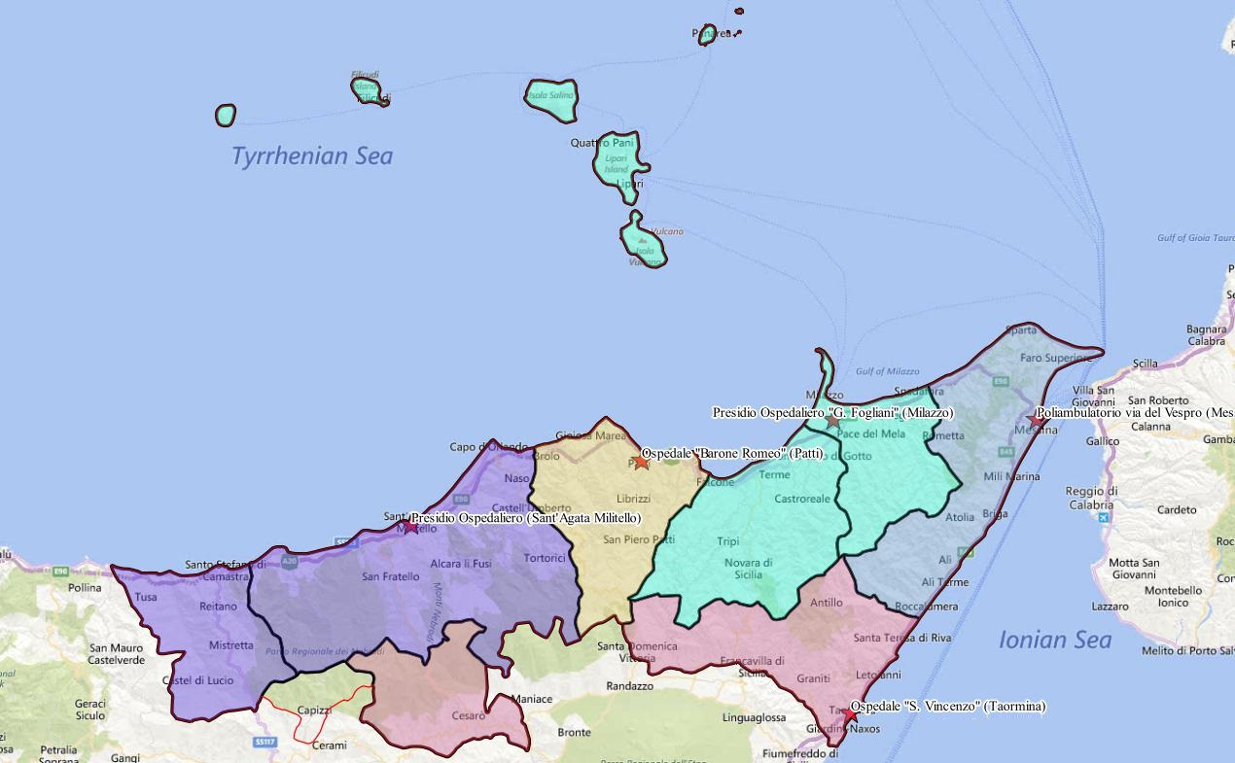
Institutional context (3)

Slide 15
Scheme of the presentation
Motivation
Related literature
Institutional context
Experimental design
Results
Conclusion

Slide 16
Experimental design: the manipulations
 | INFORMATION INCLUDED | INFORMATION EXCLUDED
GAIN FRAME | “Enhanced - Gain” “Scientific studies demonstrate that participating in breast cancer screening programs can have relevant positive effects on the treatment of an early diagnosed disease: it reduces the mortality rate, allows for less extensive surgeries, more effective treatments, with higher chances of recovery.” | “Restricted - Gain” “Scientific studies demonstrate that participating in breast cancer screening programs can have relevant positive effects on the treatment of an early diagnosed disease.”
LOSS FRAME | “Enhanced – Loss” “Scientific studies demonstrate that not participating in breast cancer screening programs can have relevant negative effects on the treatment of a lately diagnosed disease: it increases the mortality rate, implies more extensive surgeries, less effective treatments, with lower chances of recovery.” | “Restricted – Loss” “Scientific studies demonstrate that not participating in breast cancer screening programs can have relevant negative effects on the treatment of a lately diagnosed disease.”

Slide 18
Experimental design: procedures
Screening centers provide a yearly stock of slots – enough to satisfy the needs of the target population – evenly distributed throughout the year
Women randomly allocated to screening slots by LHA computer system
Our manipulations affected women invited for screening during Feb 13 – Mar 19 2017
We sent a different letter to women invited in each week
Letters sent 3 weeks before the mammography by a professional private mail company – no information available on actual letter delivery

Slide 19
Data
Administrative archives of Messina’s Local Health Authority
  Screening take-up
  Hospital providing the screening
  Demographic information
  Previous screening experience (invitation and take-up)
Administrative archive of the mail company managing the delivery of the invitation letters
  Date of invitation → treatment status
  Home address → home-hospital travel time (STATA georoute module)
Total: 6,194 subjects
→ The experiment interests <10% of the target population, each letter received by <2% of it → spillover effects are unlikely

Slide 20
Scheme of the presentation
Motivation
Related literature
Institutional context
Experimental design
Results
Conclusion

Slide 21
Results - descriptive statistics

Slide 22
Results - descriptive statistics

Slide 23
Results - balancing

Slide 24
Main results

Slide 25
Main results

Slide 26
Robustness tests (1)
Only one week per treatment: seasonality?
Redo the analysis on data for same screening weeks in previous years, when all subjects received the same letter

Slide 27
Robustness tests (2)
Remaining identification concern are group-specific time effects
  Example: “Breast cancer awareness month” takes place in October every year. It could have raised take-up rates independently of the experiment, had the latter taken place in October
Special festivities or public holidays: not in our experimental weeks
Concurring campaigns on breast cancer: indirect evidence - Google Trends data

Slide 28
Robustness tests (2)

Slide 29
Robustness tests (3)
Slight imbalance in E-G week
Yet, 5mm/day cannot cause disarray
Ambiguous effects on take-up
  Increases travel time
  Decreases opp. cost of leisure
Empirically, random rain unrelated to take-up
As expected, effects unchanged by its inclusion as a control

Slide 30
Robustness tests (4)
8th March General Strike took place during the “enhanced-gain” manipulation
  Modest participation (<25% interested workforce, mostly concentrated in school sector)
  No significant heterogeneity in daily take-up rate within the strike week
  If we assumed take-up rate for the 8th of March was as high as the highest take-up rate during the week (11.7% for Thu 9), weekly take-up rate would be 11.1%, and difference with baseline would be 1.2 pp, below Minimum Detectable Effect

Slide 31
Robustness tests (5)
Statistical Inference: a problem of multiple testing?
We are simultaneously testing the effects of four manipulations against a baseline
  If a single test is performed at the 5% level of confidence and the null hypothesis being tested is true, we expect a 5% chance of incorrectly rejecting it
  If N=4 independent tests are simultaneously carried out and all corresponding null hypotheses are true, the probability of at least one incorrect rejection is equal to 18.5%
List, Shaikh and Xu (2016): resampling-based method for testing multiple null hypotheses simultaneously in experimental settings with multiple treatments
“Enhanced-loss” effect still significant with p = 0.082
Standard Bonferroni-Holm procedure (more conservative) gives p = 0.096

Slide 32
Heterogeneous effects

Slide 33

Postponement conditional on participation
Mechanisms: perceived importance and urgency of the screening
$$P=postponement, D=participation, T=Treatment$$
$$\frac{dPr\left(P|D\right)}{dT} =\frac{1}{\operatorname{Pr}\left(D\right)}\left[\frac{ dPr\left(P,D\right)}{dT}−\frac{dPr\left(D\right)}{dT}\operatorname{Pr}\left(P | D\right)\right]$$
 | (1) | (2)
 | LPM | LPM
Enhanced - Loss | -0.323*** | -0.319***
 | (0.068) | (0.068)
Observations | 6,194 | 6,194
Covariates | No | Yes

Slide 34
Scheme of the presentation
Motivation
Related literature
Institutional context
Experimental design
Results
Conclusion

Slide 35
Conclusion
Loss frame and enhanced information increase the take-up rate by 25% (2.5pp) relative to the baseline. Other treatments are instead ineffective.
The effect is stronger for subjects living farther away from the health care centers: letter formatting can overcome the cost to take the mammography
“Enhanced – Loss” letter increases the perceived importance and urgency of participating in the screening program (psychological “unpacking” effect, see Van Boven and Epley 2003 and Angelini et al. 2017)
Back of the envelope calculations. Screening saves 8 out of 1,000 screened women (Lauby-Secretan et al. 2015). Extending our results on the overall target population in Messina (90,000 women): 18 lives saved AT ZERO COST
Concerns about over-diagnosis: “breast cancers that would never have been diagnosed or never caused harm if women had not been screened”… BUT over-diagnosis in Italy is low - between 1 and 4.6% (Puliti et al. 2012)

Slide 36
Implications for policy makers
European guidelines for quality assurance in breast cancer screening and diagnosis: invitations to the screening program should be positively framed (e.g. 9 out of 10 recalled women are found to be normal rather than 1 out of 10 recalled women will have cancer)
Our experimental findings do not lend empirical support to this advice, and would call for an update of the guidelines to ensure that the highest possible take-up rate is achieved, at least for areas comparable to Messina
Future research: re-do the experiment in areas with higher baseline take-up rate (but very hard to convince LHAs to participate)

Slide 37
Behavioral Economics and Health Behaviors: Insights from Cancer Screening Programs
The Good Outcomes of Bad News. A Field Experiment on Formatting Breast Cancer Screening Invitation Letters
Cervical Cancer Screening Invitations in Low- and Middle- Income Countries: Evidence from Armenia

Slide 38
Cervical Cancer Screening Invitations in Low- and Middle- Income Countries: Evidence from Armenia
Social Science and Medicine, 273, 113739, 2021
Armenak ANTINYAN
(Zhongnan U)
Marco BERTONI
(UNIPD)
Luca CORAZZINI
(UNIVE)

Slide 39
Scheme of the presentation
Motivation
Institutional context
Experimental design
Results
Conclusion

Slide 40
The project in a nutshell
Collaboration between Armenia National SDG Innovation Lab (joint initiative of UN and the Government of the Republic of Armenia, supported by the UNDP) and the Ministry of Health of the Republic of Armenia
The study is aimed at increasing the uptake of a cervical cancer screening program that runs in the Republic of Armenia
  To the best of our knowledge, the first RCT in the developing world that studies the impact of invitation letters and reminders on (cervical) cancer screening uptake

Slide 41
Cervical cancer (CC)
CC is the fourth most frequent cancer among women in the world, with roughly 570,000 new cases in 2018 (9.3% of all female cancers) (GLOBOCAN, 2018)
Yearly, around 90% of deaths occur in low- and middle-income countries (LMIC):
  Absence of organized screening programs or low participation if a program is present (e.g., Gakidou et al., 2008; O’Donovan et al., 2019; Sankaranarayanan, 2001)
  In the last 40 years Sharp decline of cervical cancer incidence in high-income countries due to organized screening programs

Slide 43
CC screening
Luckily, CC is one of the most preventable among the relevant human cancers.
  Mono-causal genesis: infection of the uterine cervix with human papillomavirus (HPV) needs to persist for many years to generate cancer.
Main prevention devices (European Commission, 2015):
  Population-based HPV vaccination of girls aged 12+
  Population-based Pap-test screening of women aged 25-64, every 3 years
  This has been recently substituted by the introduction of HPV testing every 5 years for women above 30

Slide 44
CC screening programs in LMICs
Despite large benefits, lack of infrastructures and scarce health care resources limit the possibility to implement adequate screening activities in LMICs (Lazcano-Ponce et al, 1999; Rao 2012)
When in place, low participation in these programs (WHO, 2002) due to:
  Information gaps, cultural and socio-economic barriers
In HICs, invitation letters and reminders stimulate participation in CC screening programs (Decker et al., 2013; Eaker et al., 2011; Radde et al., 2016; Tavasoli et al., 2016)
Some evidence that framing of letters also matters (Bertoni et al., 2020)
Lack of research on how these results extend to LMICs

Slide 45
Why invitation letters and reminders may not work in LMICs?
Absence of insurance and low income
  patients frightened to detect any illness as they would it impossible to get treated if cancer is detected - which in turn may deter attendance
Traditional cultural values (even about medical exams)
Distrust toward the medical system (corruption and low quality)
Response to screening programs and various invitation strategies can be different between HIC and LMIC

Slide 46
What do we do?
We worked with the Health Ministry of Armenia and Armenia SDG Innovation Lab to evaluate the effects of invitation letters and reminders aimed at enhancing screening participation

Slide 47
Scheme of the presentation
Motivation
Institutional context
Experimental design
Results
Conclusion

Slide 48
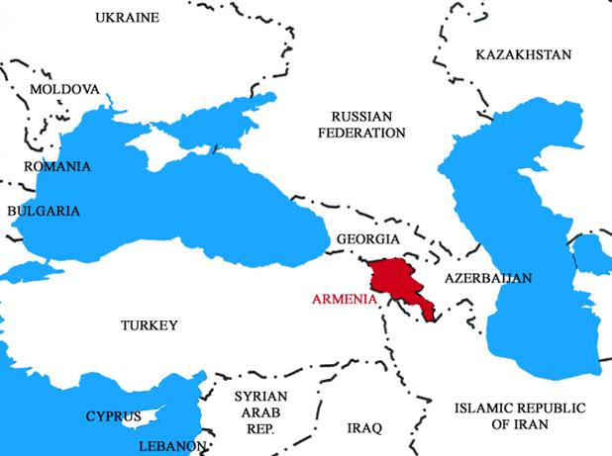

Armenia
Post-communist, middle income country in transition
Population: about 3,000,000
GDP per capita: 4,000 USD (2017)
Poverty: 25.7% (2017)
CC Incidence:
Armenia= 8.4, Europe=11.2
CC Mortality:
Armenia= 5.6, Europe=3.8
Notes:
https://www.cia.gov/library/publications/the-world-factbook/geos/am.html)
https://www.adb.org/countries/armenia/poverty

Slide 49
CC screening and treatment in Armenia
Screening
  Up to 2014: opportunistic screening not through PAP testing (pay out of pocket if you want to do it)
  Since 2015: "Disease Prevention and Control Project in Armenia" project funded by the World Bank (2015-2020)
  One free screening slot for each woman aged 30-60 every three years
  No invitation system. Mostly advertised using classical advocacy tools as TV and radio programs, leaflets in supermarkets
  As of Feb 19, participation was not satisfactory for the Government

Slide 50
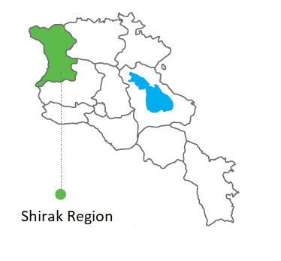
The region of interest
44% of the population below the poverty line (the highest poverty rate in Armenia)
Population 251,941 (2011 Census)
Urban: 146,908 (58.3%)
Rural: 105,033 (41.7%)
Notes:
At this point we do not have the medical map in English, but we will try to produce it for the paper.
The big green area in the middle of the photo is the capital city of the region (Gyumri), in which 6 medical institutions are concentrated. The green circles are the medical institutions, the black circles are the communities/villages/cities served by these medical institutions. The other medical institutions are mainly concentrated in major cities of the region. I THINK THIS MUCH IS ENOUGH, but if you need more info about medical institutions let me know.

Slide 51
Scheme of the presentation
Motivation
Institutional context
Experimental design
Results
Conclusion

Slide 52
Experimental design
We manipulate
  Presence of a letter
  Presence of a reminder on top of the letter (Altmann & Traxler, 2017, Calzolari & Nardotto, 2016)
  The frame of the invitation letters and reminders (Positive framing; Negative Framing; Concerned for others framing) (Rothman and Salovey, 1997; Bertoni et al 2019; Du, Li, Lu & Lu, 2019)
8 treatments (different invitations) + 1 control (no invitation)

Slide 53
The letter frames
Neutral (slightly positive invitation):
  Please note that scientific studies demonstrate that participating in cervical cancer screening programs can have relevant positive effects on the treatment of an early diagnosed disease.
Negative Framing:
  Please note that scientific studies demonstrate that not participating in cervical cancer screening programs can have relevant negative effects on the treatment of a lately diagnosed disease: it increases the mortality rate, implies more extensive surgeries, less effective treatments, with lower chances of recovery.
Concern for Others:
  Your family members, relatives and friends expect you to live a long and healthy life with them. Detecting and curing a potential cancer at early stages can help you fulfil their expectations. Go to the screening for your loved ones!

Slide 54
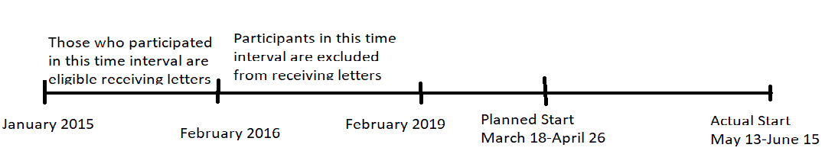
Assignment to treatments
Shirak target population: about 36,000 eligible women aged 30-60 who have not attended the program as of Feb 2019 (or attended in 2015/2016)
20,800 people receiving letters
  Letters received 3 weeks before the scheduled week
  Reminders received 1 week before the scheduled week
Those individuals who did not receive letters are kept as the «control group»

Slide 55
Randomization
We opted for individual-level randomization, stratified by GP
Select a share of patients per GP in letter sample equal to share of patient per GP in the population
Each letter type was equally represented within GP
Day of letter delivery also independently and individually randomized

Slide 56
Sample allocation and treatments
Letters pool (N=20800)
Negatively Framed Letter (N=5200)
Neutral Letter (N=10400)
Negatively framed reminder (1/2)
(N=2600)
No reminder (1/2)
(N=2600)
Negatively framed rem. (N=2600)
No reminder
(N=2600)
Neutral reminder
(N=2600)
Concern for others rem. (N=2600)
Concern for others Letter (N=5200)
No reminder (1/2)
(N=2600)
Concern for others reminder(1/2)
(N=2600)
The RCT was implemented in Shirak province between May-July, 2019

Slide 57
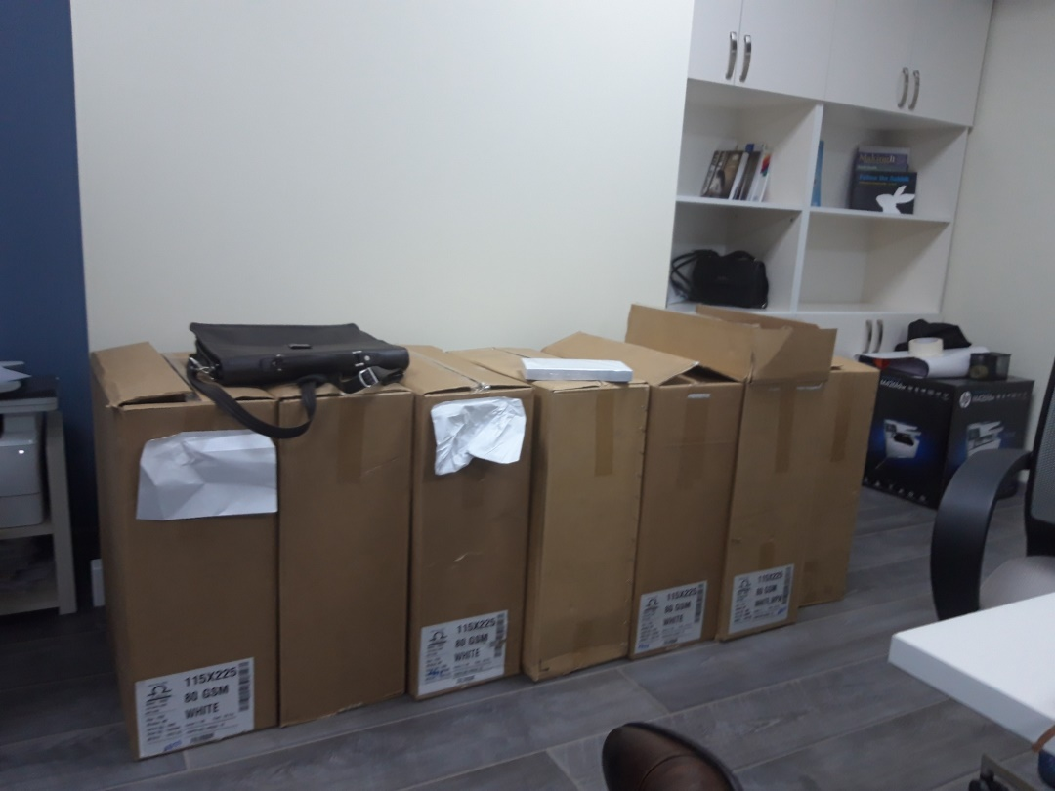
Implementation

Slide 58
Data
Internal records of the hospitals
Background data (date of birth, place of residence, GP id)
Take-up:
  For the time being: we measure take-up until 19 July 2019

Slide 59
Scheme of the presentation
Motivation
Institutional context
Experimental design
Results
Conclusion

Slide 60
Prima facie evidence: regional data

Slide 61
Screening Participation by Treatment Group

Slide 62
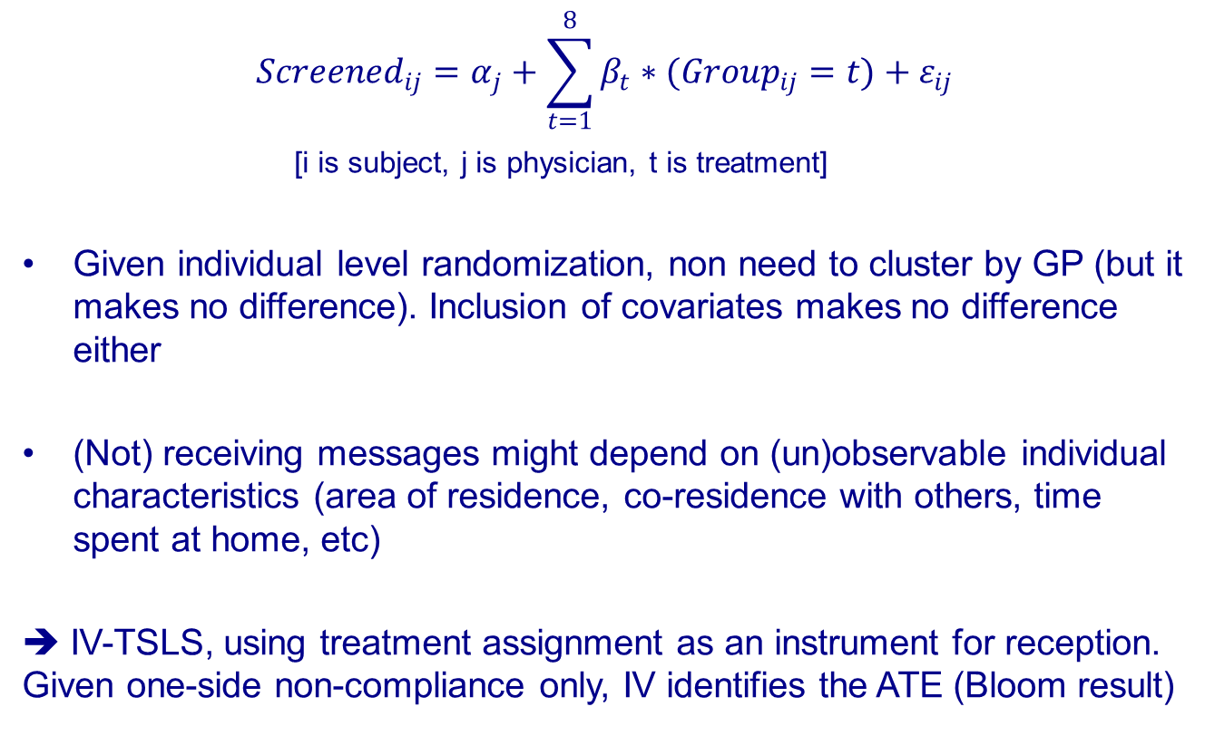
Econometric specification
$$Screened_{ij}=α_{j}+\sum_{t=1}^{8}{β_{t}∗(Group_{ij}=t)}+ε_{ij}$$
[i is subject, j is physician, t is treatment]
Given individual level randomization, non need to cluster by GP (but it makes no difference). Inclusion of covariates makes no difference either
(Not) receiving messages might depend on (un)observable individual characteristics (area of residence, co-residence with others, time spent at home, etc)
➔ IV-TSLS, using treatment assignment as an instrument for reception. Given one-side non-compliance only, IV identifies the ATE (Bloom result)
Notes:
Considering that receiving letter and reminder depends on observable and unobservable individual characteristics (area of residence, say, or co-residence with others, time spent at home, and so on), we elect not to estimate Equation (3) by OLS. Instead, we use Two-Stage Least Squares, and take the two dummies Lij and Rij for the randomly assigned type of invitation sent to each subject as instrumental variables. The corresponding first-stage equations model letter and reminder reception as functions of letter and reminder dispatch, and are specified as follows: LetterReceivedij =αj + ρ10Lij + ρ11Lij Χ Rij + v1ij (4) LetterReceivedij ΧReminderReceivedij = αj + ρ20Lij + ρ21Lij Χ Rij + v2ij (5) TOT effects in Equation (3) can be obtained as the ratios of the ITT effects in Equation (2) to the first-stage effects in Equations (4) and (5), i. e. φ0 = δ0/ρ10 and φ1 = δ1/ρ12.

Slide 64
Scheme of the presentation
Motivation
Institutional context
Experimental design
Results
Conclusion

Slide 65
Conclusions
To the best of our knowledge the first RCT that studies the impact of invitation letters and reminders on (cervical) cancer screening participation in the developing world
We find huge impact of invitations letters on cancer screening participation in LMICs
An invitation letter is particularly effective if followed by a reminder
Framing of the letters does not seem to matter

Slide 66
Thanks a lot for your attention!
(luca.corazzini@unive.it)

