Slide 1
Kvantifikace dopadů mergers

Slide 2
Oligopoly

Slide 3
Vězňovo dilema
 |  | B
 |  | talk | silent
A | talk | A = 2, B = 2 | A = 0, B = 5
 | silent | A = 5, B = 0 | A = 1, B = 1
 |  | Coca-cola
 |  | advertise | not-advertise
Pepsi | advertise | P = 3, C = 3 | P = 13, C = -2
 | not-advertise | P = -2, C = 13 | P = 8, C = 8

Slide 4
Cournout oligopoly

Slide 5
Cournout oligopoly
Homogenous good
Competing in quantities
Preferences -> biggest profit
Evaluating Cournout:
  Estimate residual demand
  Estimate marginal revenue given the other firm`s quantity
  Firm 1: marginal revenue = marginal costs
  Firm 2: marginal revenue = marginal costs
  Solve

Slide 6
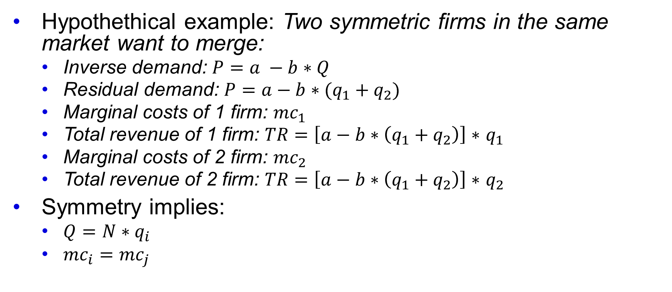
Cournout oligopoly: merger control
Hypothethical example: Two symmetric firms in the same market want to merge:
  Inverse demand: $P=a −b∗Q$
  Residual demand: $P=a−b∗(q_{1}+q_{2})$
  Marginal costs of 1 firm: ${mc}_{1}$
  Total revenue of 1 firm: $TR=\left[a−b∗\left(q_{1}+q_{2}\right)\right]∗$ $q_{1}$
  Marginal costs of 2 firm: ${mc}_{2}$
  Total revenue of 2 firm: $TR=\left[a−b∗\left(q_{1}+q_{2}\right)\right]∗$ $q_{2}$
Symmetry implies:
  $Q=N∗q_{i}$
  ${mc}_{i}={mc}_{j}$

Slide 7
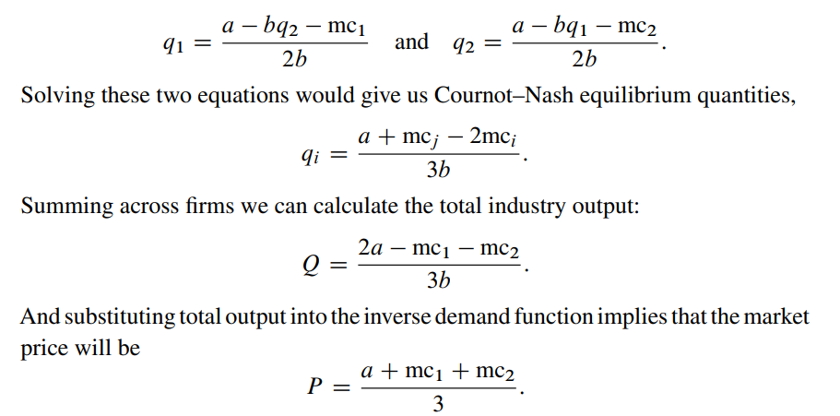
Cournout oligopoly: pre-merger

Slide 8
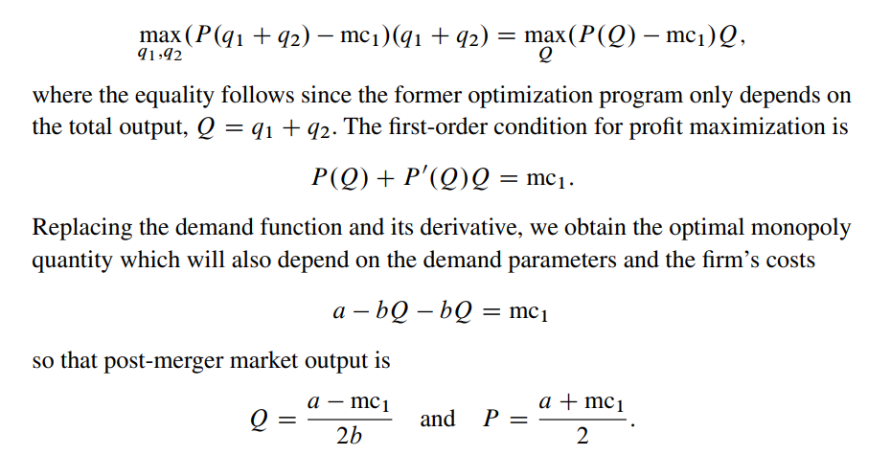
Cournout oligopoly: post-merger

Slide 9
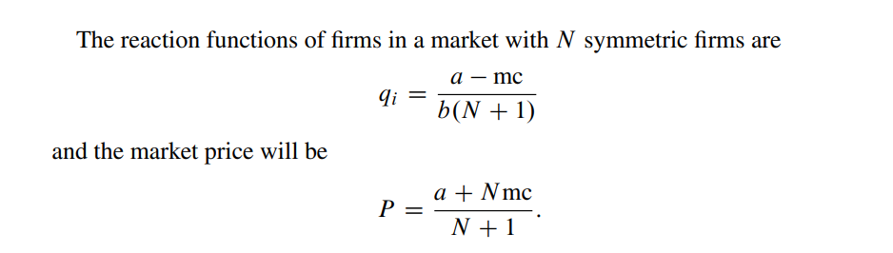
Cournout oligopoly: reaction functions

Slide 10
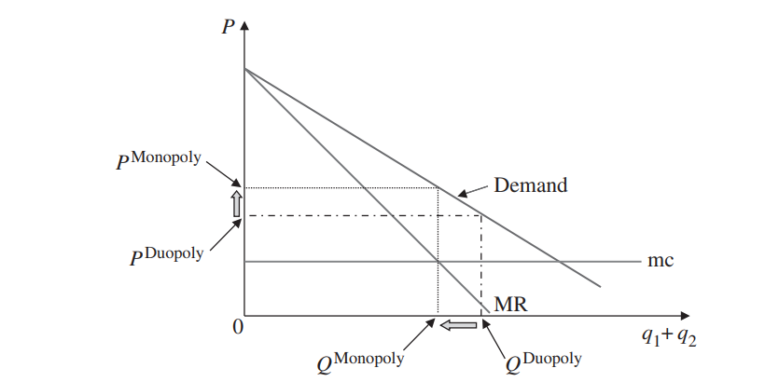
Hypothetical merger: results

Slide 11
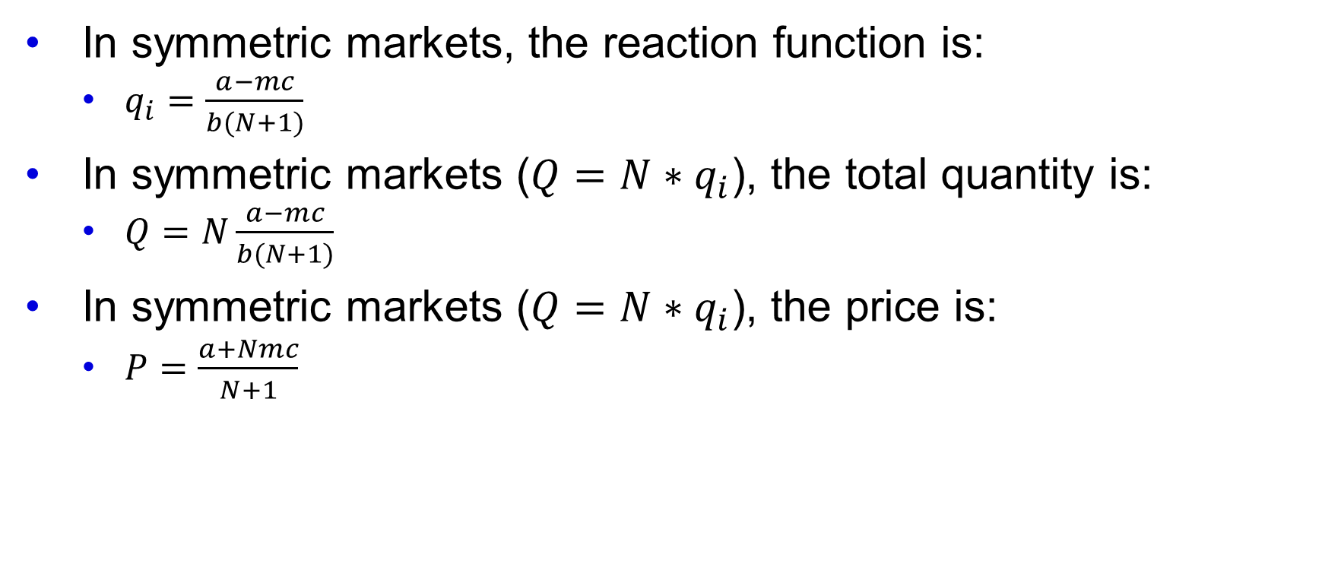
I hate maths, what should I do?
In symmetric markets, the reaction function is:
  $q_{i}=\frac{a−mc}{b(N+1)}$
In symmetric markets ($Q=N∗q_{i}$), the total quantity is:
  $Q=N\frac{a−mc}{b(N+1)}$
In symmetric markets ($Q=N∗q_{i}$), the price is:
  $P=\frac{a+Nmc}{N+1}$

Slide 12
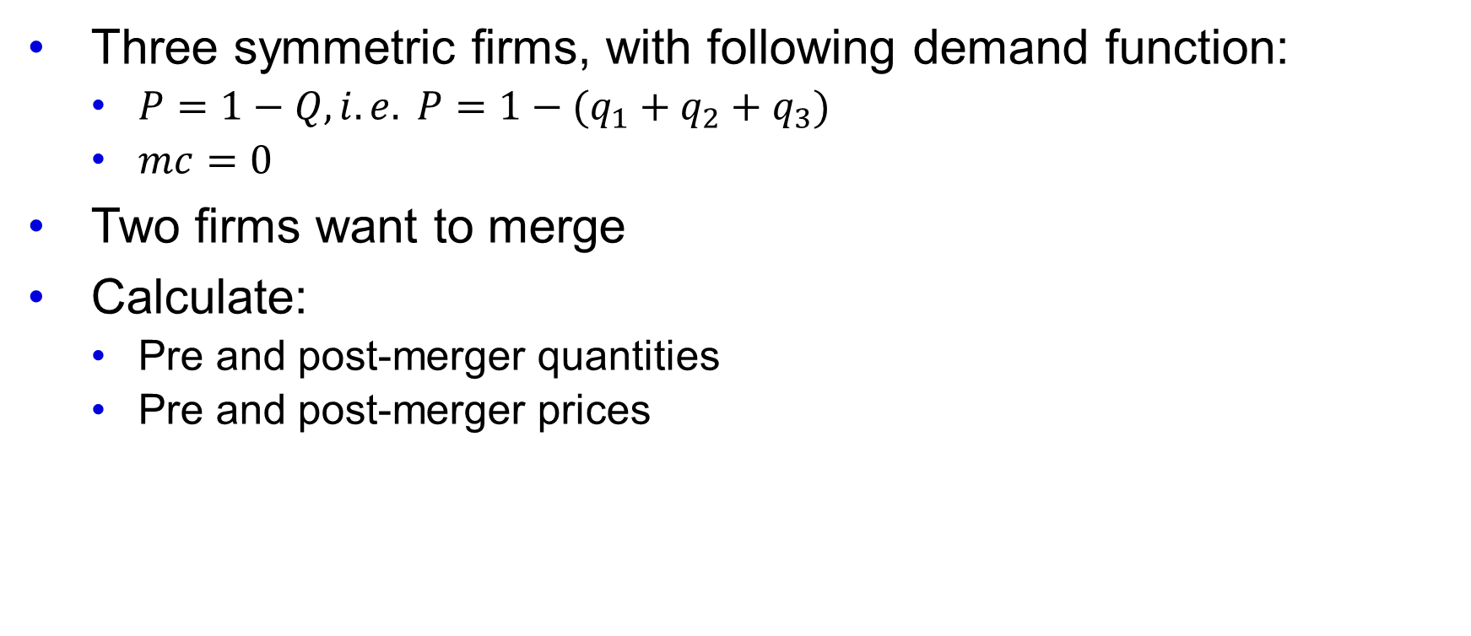
Case study
Three symmetric firms, with following demand function:
  $P=1−Q, i.e. P=1−(q_{1}+q_{2}+q_{3})$
  $mc=0$
Two firms want to merge
Calculate:
  Pre and post-merger quantities
  Pre and post-merger prices

