Slide 1
Strategic Human Resource Management

Slide 2
Introduction
Corporate Strategy
Work Design
Indirect Compensation
Performance Management
Personnel Planning
Direct Compensation
Socialization
Recruitment
Training
Selection
Development
Performance Appraisal
Staffing
Compensation
Performance

Slide 3
Corporate Strategy

Slide 4
Section Overview
This section focuses on Corporate Strategy
We will link Leadership, Culture, and staffing to Strategy
4

Slide 5
Corporate Strategy
The direction an organization takes with the objective of achieving business success in the long term.
Recent approaches focus on the need for companies to adapt to and anticipate changes in the business environment.
The formulation of corporate strategy involves establishing the purpose and scope of the organization's activities and the nature of the business it is in, taking the environment in which it operates, its position in the marketplace, and the competition it faces into consideration.
Corporate planning and business plans are used to implement corporate strategy.

Slide 6
Corporate Planning Horizons
Strategic Plans
Tactical Plans
Operational Plans
2 – 5 years, based on industry
6 months – 3 years, based on industry
Day-to-Day, Week-to-Week….

Slide 7
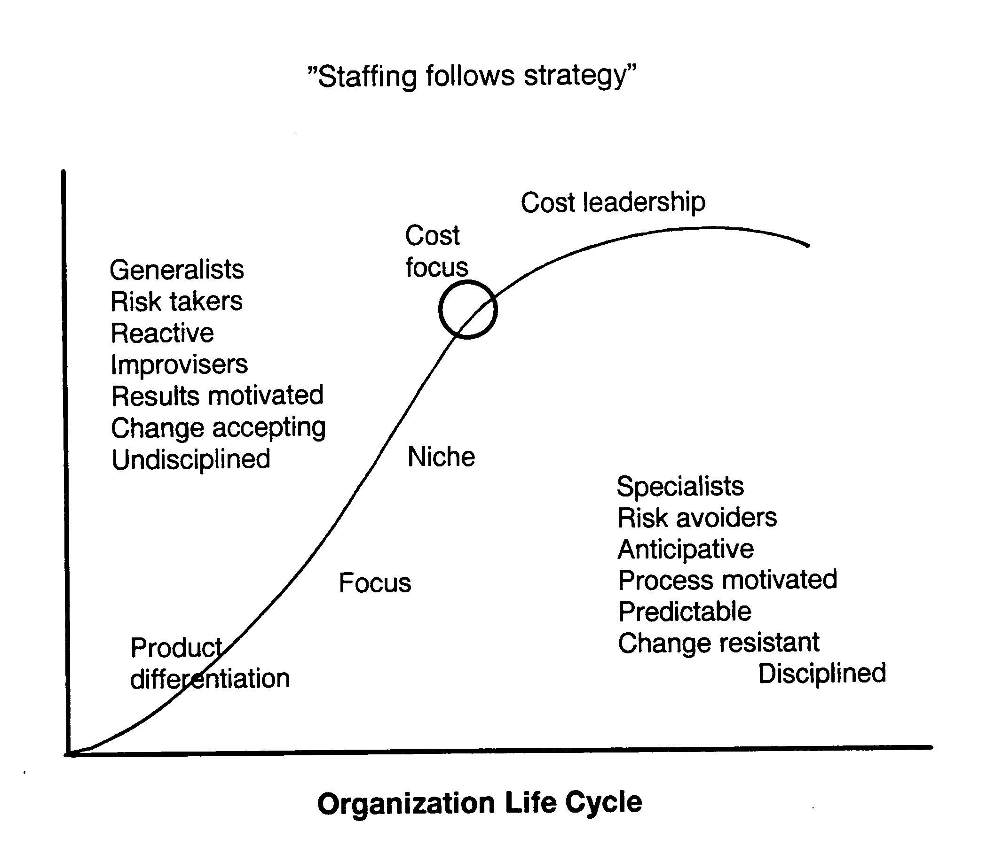
Staffing follows Strategy

Slide 8
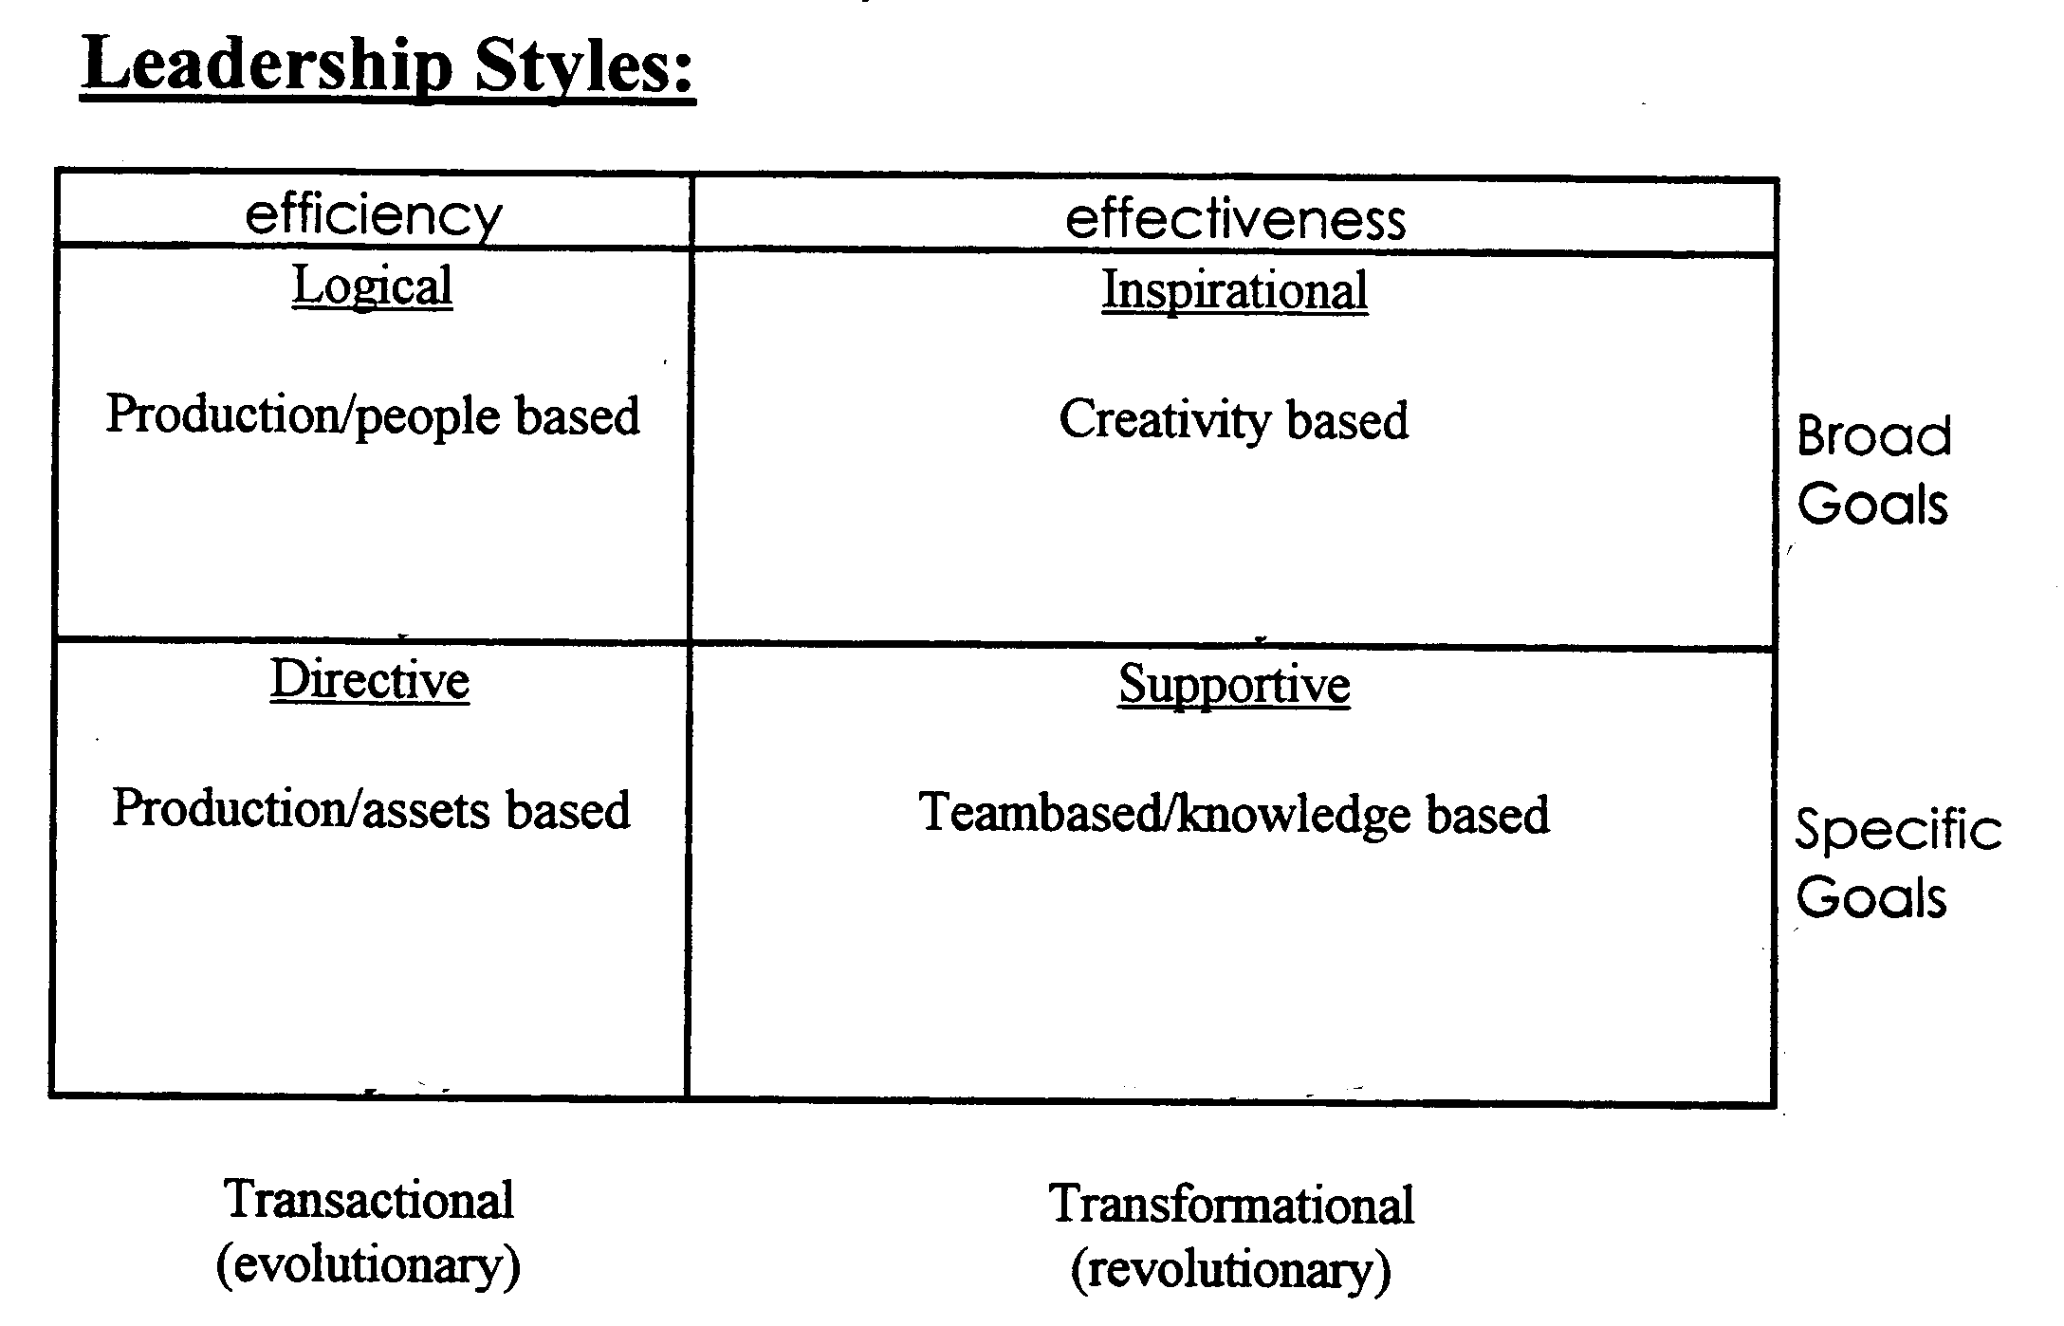
Leadership Styles

Slide 9
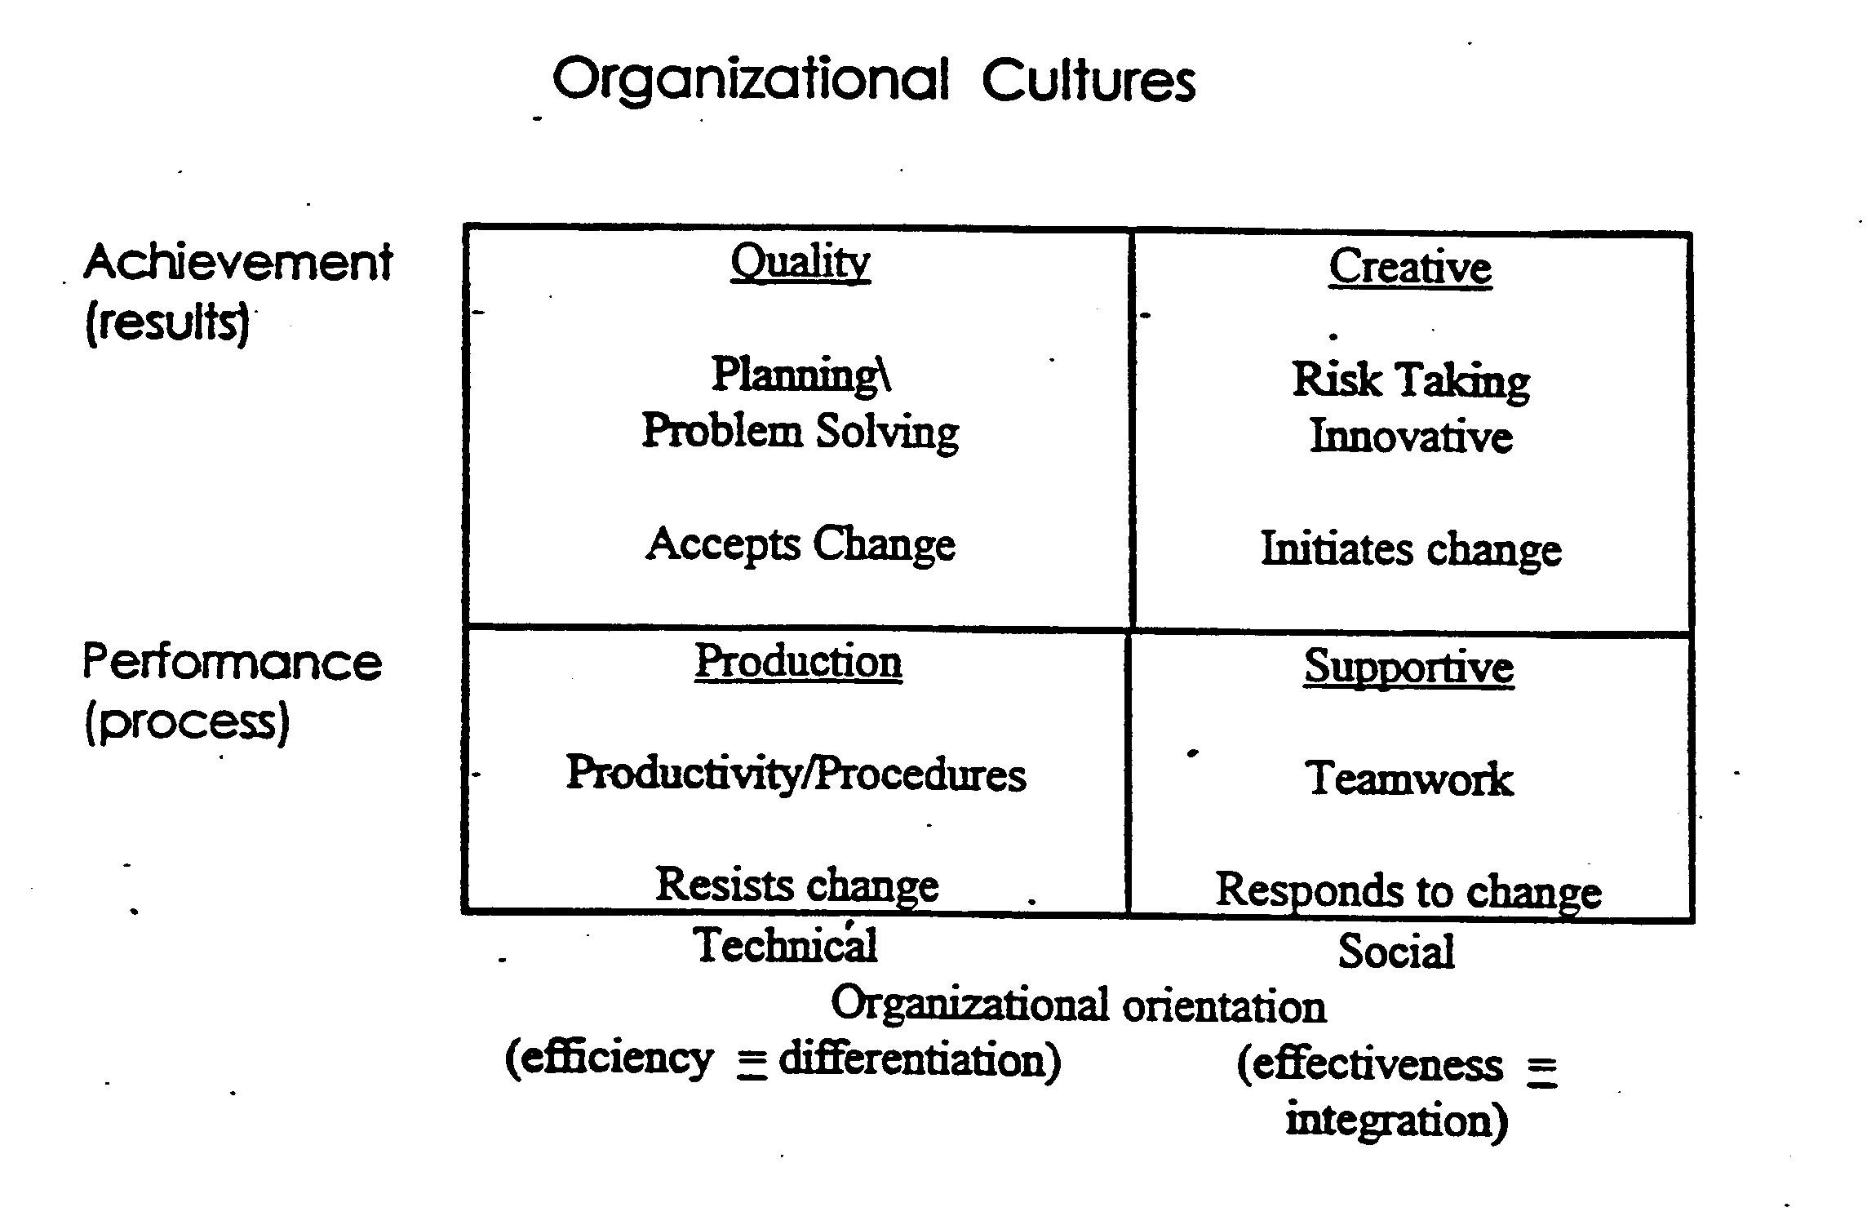
Organizational Cultures

Slide 10
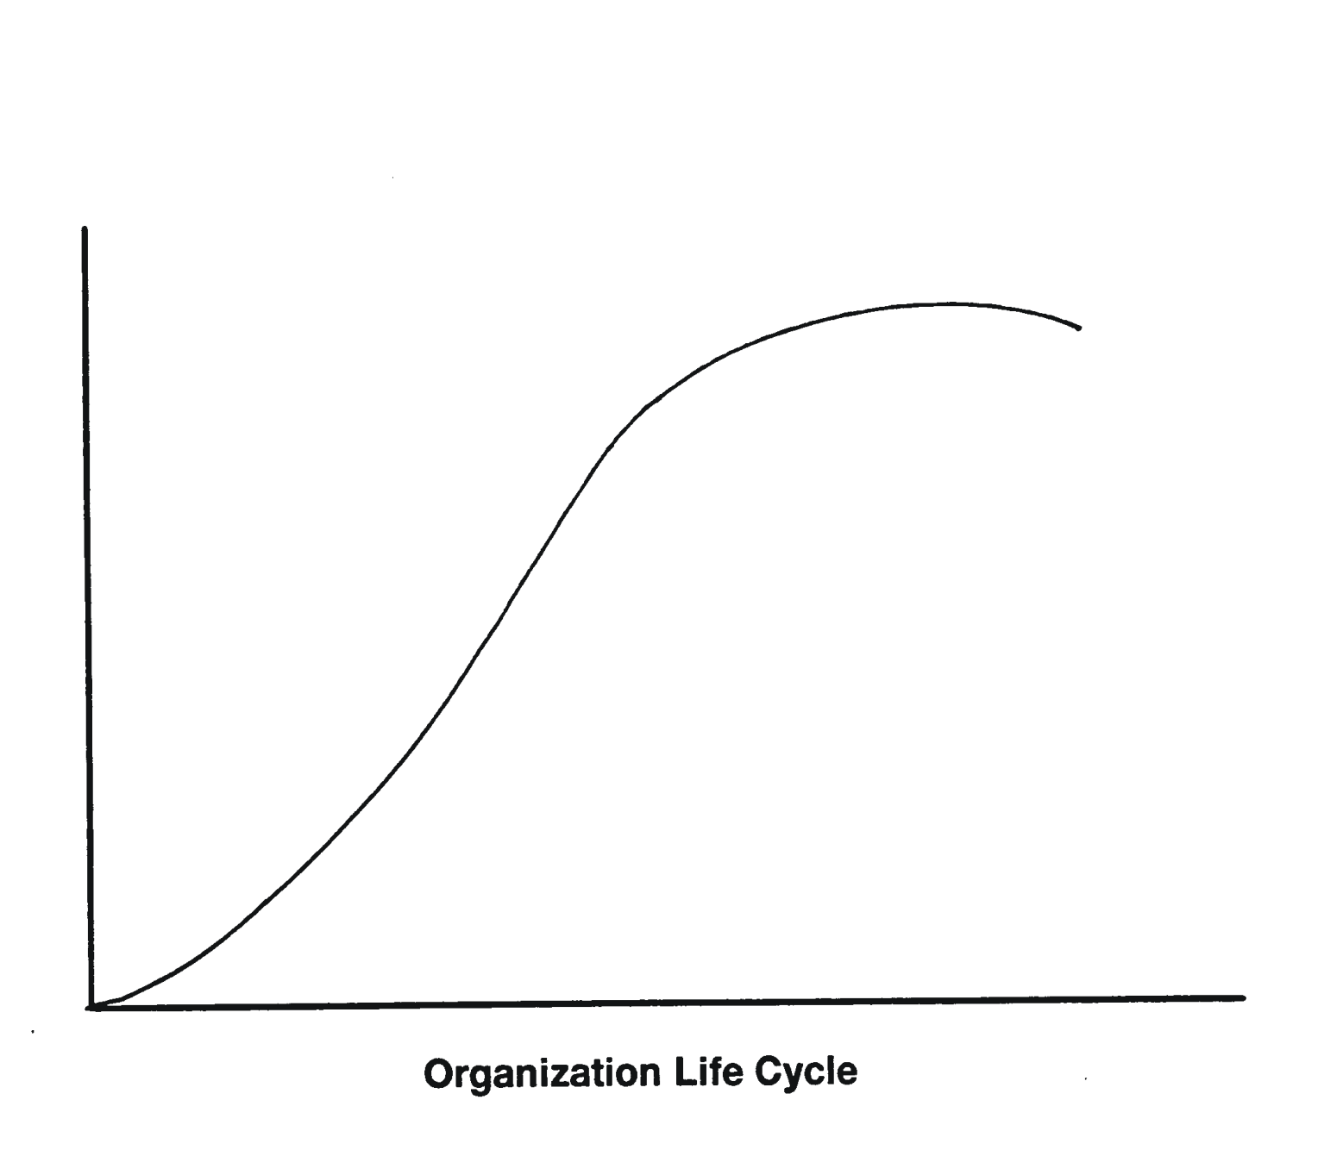
Culture and Leadership
“Culture/Leadership follows Strategy”
Directive Leadership
Production Culture
Logical Leadership
Quality Culture
Effectiveness
Efficiency
Supportive Leadership
Supportive Culture
Inspirational Leadership
Creative Culture
Transformational
Transactional
Revolutionary
Evolutionary

Slide 11
Staffing:
Work Design

Slide 12
Section Overview
This section focuses on job design, analysis and their relationship to job descriptions and specifications.
We will link this to Corporate Strategy.

Slide 13
Job Analysis
Definition of Job Analysis: systematically identifying tasks, duties and responsibilities expected to be performed in a job as well as competencies to be successful
Uses of Analysis:
  Realistic Job information
  Identifies reporting relationships
  Provides data for job descriptions/specifications
  Information for Business Process Engineering
13

Slide 14
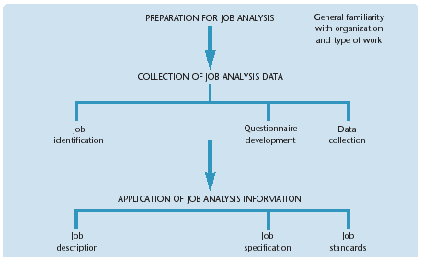
Steps in Job Analysis

Slide 15
Sources of Information
Job Incumbents (SME)
Supervisors (SME)
Trained Analysts
Selecting Sources:
  Each has strengths and weaknesses
  Use more than one source
  Use others included in the appraisal process
15

Slide 16
Data Collection Methods
Observations: Job analyst observes employee and documents the job information. Video monitoring and recording may be used.
Interviews: Job analyst conducts structured interviews. Good for jobs where observation will not work.
Questionnaire: Standard questionnaire administered to large number of employees performing the job.
Diaries: Job holder and supervisors keep a task diary for several weeks. Job analyst translates the diary into analysis data.
16

Slide 17
Job Analysis Techniques
Methods Analysis focuses on job elements by looking at flow and movement
Functional Job Analysis (FJA) rates jobs on extent they work with data, deal with people, handle things
Standardized Job Analysis Questionnaires rate job behaviors. Generally applicable to a wide variety of jobs
17

Slide 18
Job Analysis Techniques
Customized Task and Work behaviour Inventories focus on a listing of tasks or work behaviours for a job or group of jobs with rating provisions for each item.
Management Position Description Questionnaire is a standardized questionnaire with 197 items related to management functions
18

Slide 19
Job Design
Determining job tasks and responsibilities employees are expected to perform
Key issues to consider:
    Which tasks should be emphasized
    How simple or complex are these tasks
    How many tasks can employees perform
    How much flexibility is given to employees
19

Slide 20
Why Perform Job Design
Each job is unique and adds value in different ways
How employees will perform their jobs will affect employees’ contributions
Ensure jobs meet organizational requirements as well as employee needs.
20

Slide 21
Approaches to Job Design
Mechanistic Approach
Human Factors Approach
Motivational Approach

Slide 22
Mechanistic Approach
Scientific management pioneered by Frederick Taylor in 1911 sought to maximize efficiency
Emphasized standardization of production processes
Time and motion studies were conducted
Job specialization focused on breaking jobs down into core elements
Repetition increased skill and speed
22

Slide 23
Mechanistic Approach (cont’d)
Job simplification removed decision-making authority from employees and placed it with a supervisor
Training requirements were reduced
Still used today, often in a modified approach
  Fast Food Industry
  Piece-part Manufacturing
  UPS
23

Slide 24
Using the Mechanistic Approach
Advantages
  Ensures Predictability
  Provides job clarity
  Clear responsibility
  High measurability
Disadvantages
  Can be boring for employee
  Absenteeism
  Turnover
  Lack of employee growth

Slide 25
Human factors Approach
Based on the study of human motor skills, looks at:
  Physical dimensions of the human body
  Principles of physical movement
  Human physiology
Understanding the human body aids in the design of tools, equipment, work places, etc
Focuses on ergonomics

Slide 26
Human factors Approach (cont’d)
Used in conjunction with the mechanistic approach to reduce fatigue
Helps increase labour pool by accommodating aging workers and physical disabilities
Helps find ways to accommodate Principle of Reasonable Accommodation

Slide 27
Using the Human Factors Approach
Advantages
  Accommodates disabled and older workers
  Less physical strain
  Reduces job related injuries
  Greater employee comfort
Disadvantages
  May be very costly
  Factors regarding disabled or older workers
  Not possible in some cases

Slide 28
Motivational Approaches
Maximize employee motivation to perform
Focused on making jobs more interesting, challenging and complex
Individual Contemporary Approach
  Focuses on individual motivational requirements
  Suited to workforces that have a growth need
Team Contemporary Approach
  Focuses on social motivation concept
  Suited to work that requires diversity in decision making

Slide 29
Individual Contemporary Approach
Based on 5 positive personal & work outcomes:
  High motivation, quality work performance, satisfaction, low absenteeism, and low turnover
Requires work that enables obtainment of 3 psychological states:
  Meaningfulness, responsibility, knowledge of results
Design based on 5 core job dimensions:
  Skill variety, job significance, job identity, autonomy, feedback
29

Slide 30
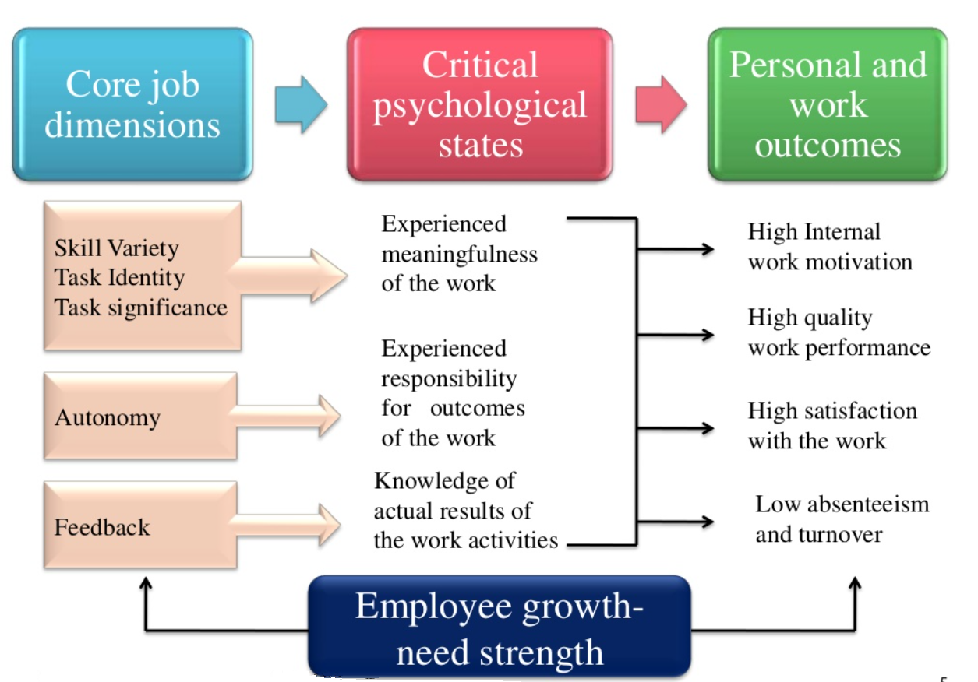
Job Characteristics Model
30

Slide 31
Design Strategies for Core Dimensions
Job enlargement:
  Assign additional tasks, increase volume or skill variety of the work
  Task identity increases when employee completes a whole and identifiable piece of work
Job rotation:
  moving workers from one job to another in a systematic manner
  Increases task variety and boosts job identity and scope of purpose
31

Slide 32
Design Strategies (cont’d)
Job enrichment
  increasing level of responsibility or control over tasks of a job
  Increases autonomy, job significance
Empowerment
  employees have input and authority over how they work and participate in decisions
  Increases autonomy, job significance

Slide 33
Job Autonomy
Recruitment and selection must consider ability to handle workplace freedom
Flat hierarchy with open and strong vertical and horizontal communication
Decision making boundaries are well defined
Responsibility and accountability are linked and is paramount
High quality performance is prized and expected from all
Employee satisfaction is a core value

Slide 34
Using the Individual Contemporary
Approach
Advantages
  High employee satisfaction
  Provides growth opportunity
  Reduces boredom
  Improves morale
Disadvantages
  Generally, requires higher pay
  Hard for people who like high standardization and routine
  Hard to do with some industries and jobs
  Large changes required in HR System
  May be costly to implement

Slide 35
Team Contemporary Approach
Groups who work collaboratively toward a common goal
    Dedicated work teams—well defined, stable, full-time members
    Parallel teams—cross functional group to address problem or issue (members retain their formal positions as well)
    Project teams—exist for limited time to accomplish an objective
    Self-managed teams— dedicated work team where members work collaboratively to make decisions, hire, plan, schedule work, and accomplish goals

Slide 36
Team Member Requirements
Advocating: sell their point of view to members
Inquiring: learn to listen and interview
Tension Management: create constructive conflict and manage tension
Sharing Responsibility: align personal goals with team objectives, create shared outcomes
Leadership: participate in leading the team to success
Valuing Diversity: value team members diversity
Self-awareness: accept constructive criticism, be self critical

Slide 37
Using the Team Contemporary
Approach
Advantages
  High social interaction
  Provides variety
  Higher innovation and creativity
  Easier to implement quality circles, TQM
  Reduces absenteeism
Disadvantages
  Some people want to work alone
  Highly specialized, technical jobs are not suitable
  Requires interpersonal training and skills
  May require extensive structural changes to organization and HR System

Slide 38
Alternative Work Arrangements
Required due to:
  Changing workforce demographics
  High costs of commuting
  Desire for greater personal time
  Other personal requirements
Reduce tensions caused by time conflicts
Increases employer attractiveness

Slide 39
Popular Alternatives
Flexible Schedules
Compressed Workweeks
Permanent Part-time Employment
Electronic and Industrial Cottage
Work from Home

