Slide 1
Corporate power and politics

Slide 2
Contents
The strange case of Carly Fiorina
Why are you here
Leadership and power
Power and dependence
Power bases and tactics
Three dimensions of the political landscape
Politics and political behavior
Abuse of power
So what?

Slide 3

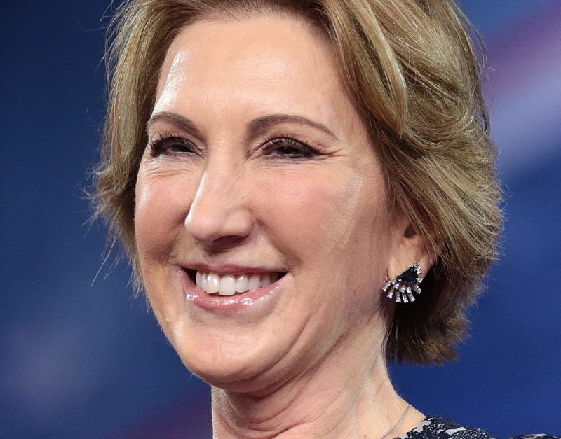


Carly Fiorina
CEO of HP between 1999-2005
Oversaw a fusion with Compaq

Slide 4
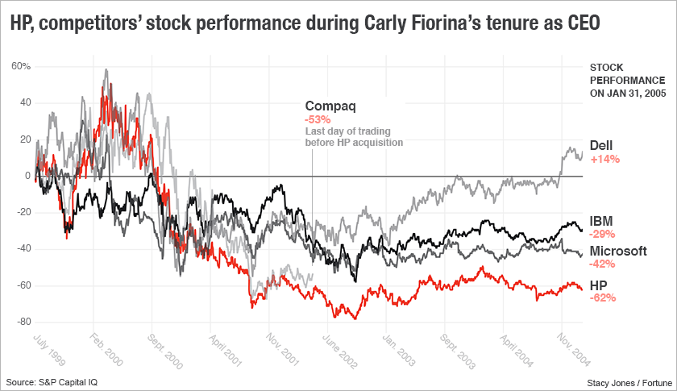

Slide 5
Changes during time as CEO
Board of directors reduced from 14 members (1999) to 11 members (2000)
Share value reduced by cca. 50%
No changes in dividends
Increased rewards for board members
  100 000-105 000 (2000) to 200 000 (2004)

Slide 6
Why are you here?

Slide 7
Leadership vs. Power
Leadership perspective
Role of the individual
Downward influence
Goal congruence
Power perspective
Role of individual, group, organization
Down, up, lateral influence
Dependence

Slide 8
What is power
Power
Capacity of person A to influence person B in such a way that B acts in accordance with A’s wishes.
Dependence
Relationship between two people, where one controls something that the other wants.

Slide 9
What makes dependence?
Person A controls something that is:
Important
Scarce
Difficult to replace
Person B is dependent on person A
Person A has power over person B
Person B needs that something

Slide 10
Bases of power (French & Raven model)
Formal
  Coercive
  Reward
  Legitimate
Personal
  Expert
  Referent
Greater satisfaction, commitment, performance

Slide 11
Power tactics
Methods of transforming the power base into results:
  Legitimacy
  Rational persuasion
  Inspirational goals
  Consultation
  Exchange
  Personal appeal
  Ingratiation
  Pressure
  Coalitions

Slide 12
Applying power tactics
Upward (on your superior)
  Rational persuasion, coalitions
Downward (on your subordinates)
  Rational persuasion, inspiration, pressure, consultation, ingratiation, exchange, legitimacy
Lateral (on your peers)
  Rational persuasion, consultation, ingratiation, exchange, legitimacy, personal appeals, coalitions

Slide 13
Selectorate theory (model by De Mesquita et al.)

Slide 14
Selectorate theory (model by De Mesquita et al.)
There is no such thing as an absolute ruler.
A person can divide the environment into three dimensions:
  Nominal selectorate (Exchangeables)
  Real selectorate (Influentials)
  Winning coalition (Essentials)

Slide 15
Selectorate theory (model by De Mesquita et al.)
Stay in power and achieve goals, people obtain the support of Influentials and Essentials by giving them rewards
These rewards come at the expense of Exchangeables

Slide 16
Selectorate theory (model by De Mesquita et al.)
Rules for rulers:
  Keep the winning coalition as small as possible,
  Keep the nominal selectorate as large as possible,
  Control the rewards,
  Reward Essentials to keep them loyal,
  Don’t take rewards away from essentials to give them to Exchangeables.

Slide 17
Back to Carly Fiorina

Slide 18
What is politics?
Using power to achieve goals
Engaging in Political Behavior
  Activities not part of formal role
  Attempts to influence the distribution of advantages

Slide 19
Why Political behavior
Differences between individual and organizational goals
Limited resources
Ambiguous, unclear, subjective methods of distributing rewards
Personality traits
It is almost inevitable

Slide 20
Effects of politics
Job satisfaction
Performance
Stress, anxiety
Employee turnover
Depends on corporate culture, personality, political ability

Slide 21
Abuse of power
Forms
  Bullying
  Corruption
  Sexual Harassment
  …
Minimize abuse of power:
  Create clear rules
  Make reporting abuse easy and safe
  Investigate every report
  Punish abusers
  Educate

Slide 22
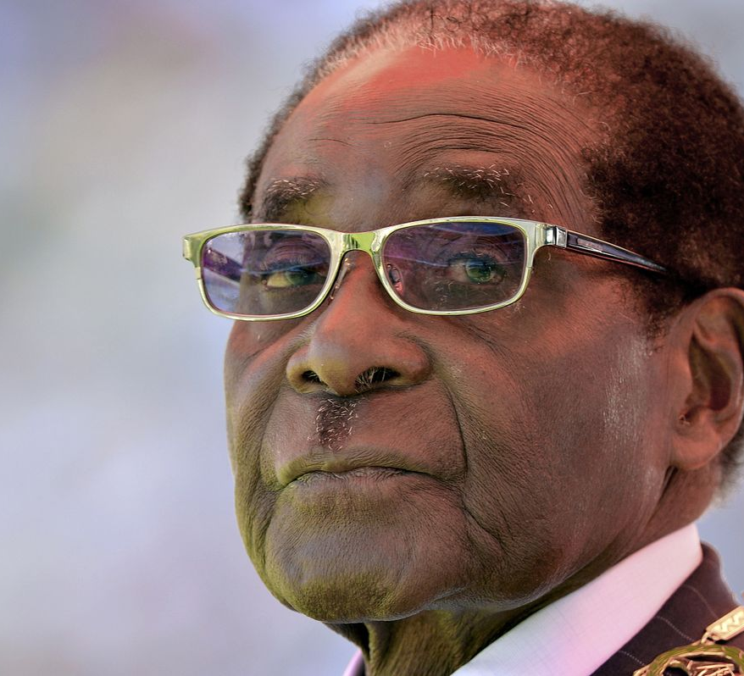
Abuse of power

Slide 23
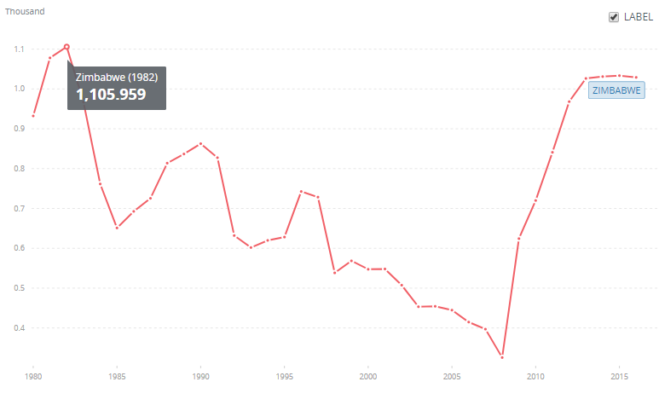
Abuse of power Zimbabwe GDP per capita

Slide 24
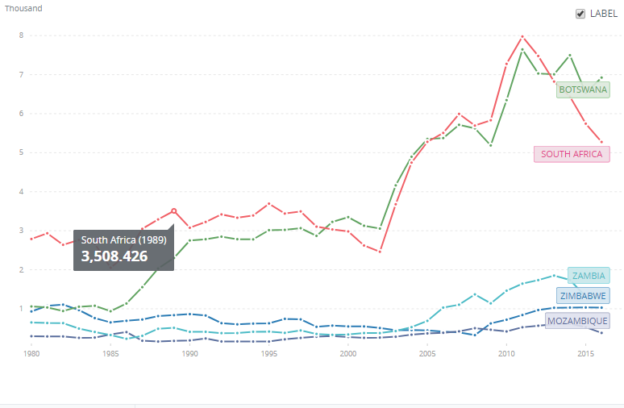
Abuse of power Zimbabwe GDP per capita

Slide 25
Abuse of power – additional indicators
May 2008 – massive inflation
Portion of population living off less than 1 USD/day
  36% (1990) -> 80% (2006)
Life expectancy
  59 (1990) -> 37 (2005)
44% of citizens suffer from malnutrition, although 70% of citizens are farmers (2008)

Slide 26
Abuse of power – Collapse of Zimbabwe
1997 – buying electoral support
1998 – increased food prices -> unrest
Land redistribution (2000)
  70% of land taken without compensation and given to the poor
  „Local courts twice ruled that farm occupation was illegal and ordered government to drive off veterans and their supporters. As a result, Mugabe's land grabbing effectively crippled Zimbabwe‘s commercial industry“
  Foreign aid to Zimbabwe stopped
  Public sector financed by printing money

Slide 27
Abuse of power – Specific measures
Buying support of war veterans (Essentials) with state land
Control over food supply and food aid -> buying votes with food (Influentials)
Land redistribution to buy the support of the poor (Influentials)
Loyalty rewarded by distributing housing (Influentials, Essentials)
All of this at the expense of everyone else (Interchangeables)
Political opposition and dissidents’ property destroyed

Slide 28
Lessons
You can gain power by making others dependent on you – obtain something that is necessary, scarce, and difficult to replace
Others will try to do the same
Avoid making others feel powerless or threatened – people will do horrible things if they feel like they will lose the power they have
You can get a more accurate picture of a situation by taking politics into account

Slide 29
Sources
Robbins, S. P., & Judge, T. A. (2017). Organizational Behavior. Pearson Education Limited
De Mesquita, B. B., & Smith, A. (2011). The dictator's handbook: why bad behavior is almost always good politics. PublicAffairs.

