Slide 1
Foundations of Business Projects
spring 2024

Slide 2
How the course is oganized
- lectures in the form of videos
- limited class time
- (lots of) self-study
- teamwork on a class project
=> lots of hard work outside of class
=> very demanding on self-organization, discipline and responsibility.

Slide 3
Self-study resources
interactive sylabus in the IS
  all important info about the course
  incl. course schedule
  incl. details about seminar project assignment
video course in the IS
  10 video lectures
  MUST SEE source
  assigned for particular weeks during semester (see interactive sylabus)
PRINCE2 textbook
  MUST READ source (absolutely necessary)
  available in the library
  available on-line throuch the libray websice = E-loans servlice (login required)
consultations with teacher
  on demand – send me an e-mail
  I am here to help, but you need to let me help you

Slide 4
Why We Need Project Management?

Slide 5
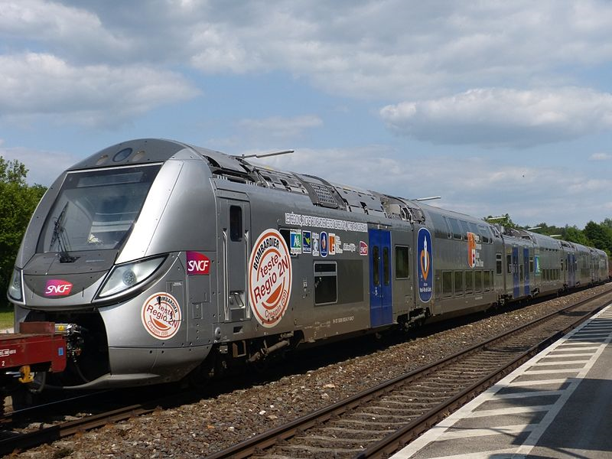
SNCF / RFF, France
€68 million with approximately 1,000 stations left to modify
Notes:
Société Nationale des Chemins de fer Français (SNCF) purchased 2,000 new trains.
After first arrival of trains it was found that they were too wide to fit into many of the stations.
Forced to modify trains or modify old stations.

Slide 6
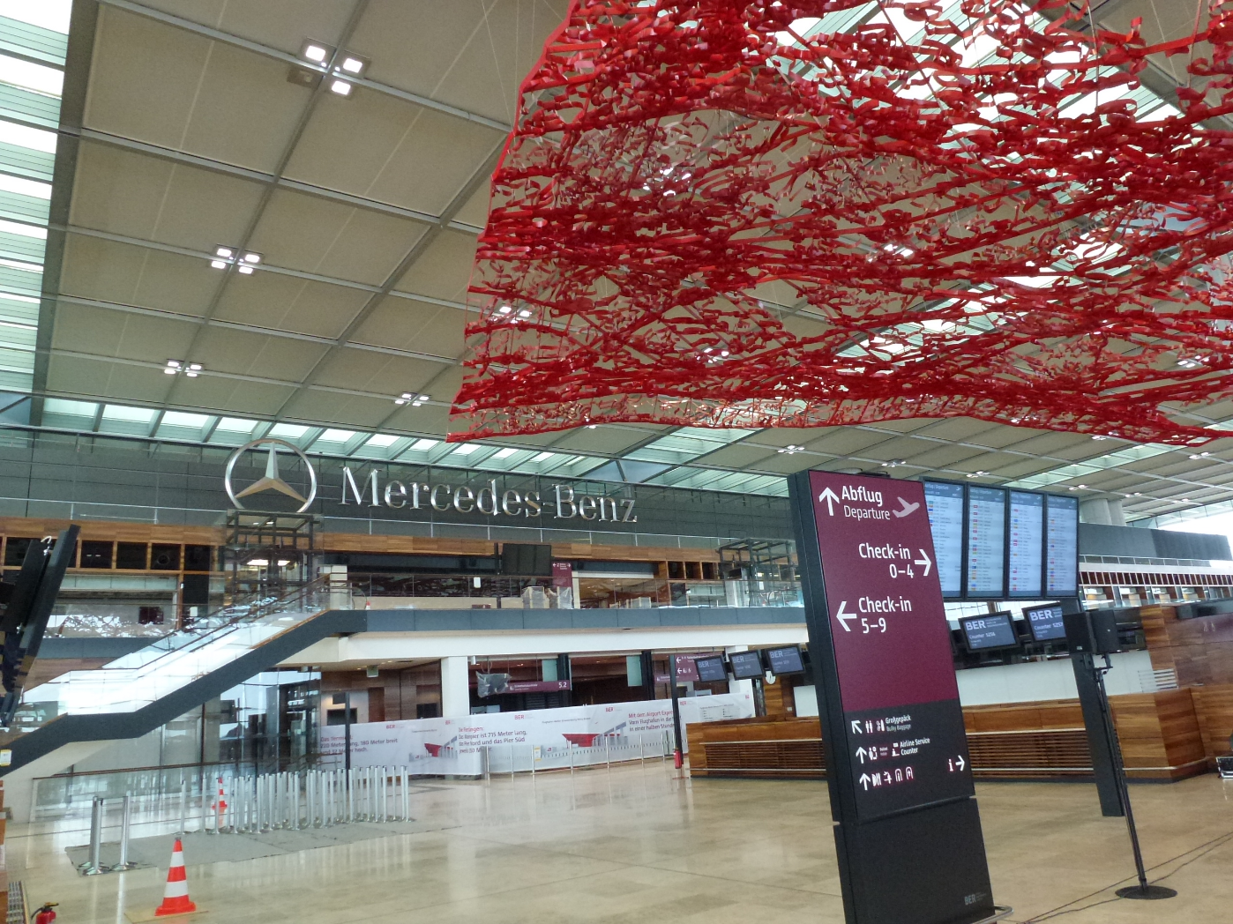
Brandenburg Airport, Berlin, Germany
From €1.2 billion to approximately €5 billion
Notes:
Berlin, Germany
15 years to design.
Construction started in 2006, target opening date of October 2011.
Construction Planning company went out of business, project completion delayed to June 2012.
Physical construction ended and testing began in November 2011.
By May 2012 it was found that the fire protection and alarm systems were not to specification or to building code.
Smoke extraction systems did not work.
In all, over 66,500 defects were found of which over 34,000 are significant and 5,845 are critical.
New opening dates range from 2016 to 2019.

Slide 7
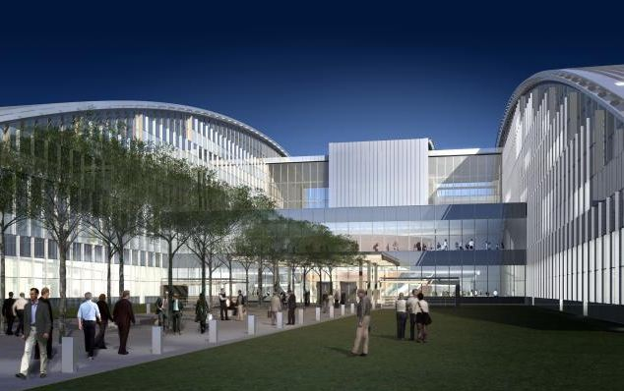
NATO HQ, Brussels, Belgium
Over 10 years behind, over double the cost
Notes:
Original opening date was 2005, moved to 2017… maybe.
Original cost was between €365 and 460 million, new estimate is closer to €1.25 billion.

Slide 8
Why Projects Fail
Lack of project justification, no valid business case.
Insufficient attention to quality from the start and through development.
Poorly defined outcomes, confusion over what the project needs to achieve.
Lack of communication amongst stakeholders.
Poorly defined roles and responsibilities amongst project personnel.
Poor cost and time estimating.
Poor planning and resource coordination.
Insufficient measurables and lack of progress control.
Lack of quality control.

Slide 9
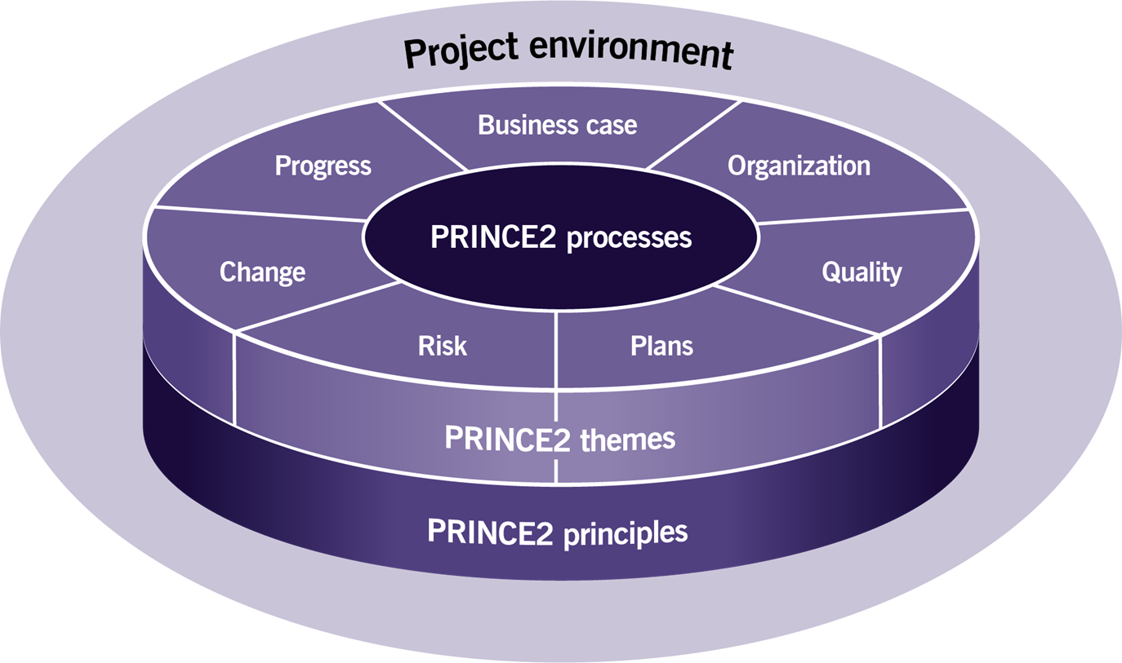
Our project management approach
based on PRINCE2 (6th ed.)
  7 Principles comprised of obligations and best practices.
  7 aspects of project management defined as themes to be addressed continually and in parallel throughout the project.
  7 PRINCE2 processes address the chronological flow of the project through its lifecycle intertwined with actions pertaining to various themes.

Slide 10
PRINCE2 structure
7 principles
7 themes
7 processes
Continued Business Justification
Learn From Experience
Defined Roles And Responsibilities
Manage By Stages
Manage By Exception
Focus On Products
Tailor To Suit The Environment
Business Case
Organisation
Quality
Plans
Risk
Change
Progress
Starting up a project
Initiating a project
Directing a project
Managing a stage boundary
Controlling a stage
Managing product delivery
Closing a project
You will need to know them all.

Slide 11
Your team project
… designed to help you understand through practice
Team parameters
Project parameters
Deliverables
- 6 teams
- 4 members / team
- international = at least 1 member from a different country
- content to be defined by the team (and agreed with the teacher)
- designed as PRINCE2 project
- quality matters (not quantity)
- quality = PRINCE2 is being followed.
- project brief (incl. outline business case)
- project plan
- presentation of the project plan
Your continuous active participation in teamwork is required.
You need to be responsible to help your team earn important points for the final grade.
Start your work right away.
Use consultations whenever you are stuck.
Plan your work and mind deadlines.
Be precise and rigorous.
Strictly follow PRINCE2 recommen- dations incl. strucutre

Slide 12
Project brief (incl. Outline Business Case)
Deliverable 1 = 15 % of the final grade
PROJECT BRIEF
is used to provide full and firm foundation for the initiation of the project and is created during starting up a project.
Composition (structure)
Project definition – explains what the project needs to achieve. It covers the background, definition of project objectives, desired outcomes, project scope and exclusions, constraints and assumptions, and project tolerances.
Outline business case (see previous slide)
Project product description – explaining quality expectations and acceptance criteria.
Project management team structure – describing the role of those in the project management team.
(OUTLINE) BUSINESS CASE
defines the justification for undertaking a project based on estimated costs against the anticipated benefits to be gained and offset by any associated risks.
Composition (structure)
  Reasons for undertaking the project
  (Business) options = how to reach the goals. => analysis and reasoned recommendation for which one option to choose => project approach
    Do nothing
    Do the minimum
    Do something
  Expected benefits – desired outcomes (qualitative and quantitative) should be expressed in measurable terms.
  Expected dis-benefits – (potential) negative outcomes of project activities
  Timescale
  (Estimated) costs
  (Expected) major risks

Slide 13
Presentation (of the Project Plan)
Deliverable 2 = 10 % of the final grade
the full project plan will be presented
oral presentation will take 10 – 12 mins.
every team member required to participate
visual aids (slides) for presentations will be prepared and uploaded
feedback can be used to refine the final draft of your project plan

Slide 14
Project plan (final draft)
Deliverable 3 = 35 % of the final grade
Definition
provides a statement of how and when objectives are to be achieved, by providing the major products, activities and resources required for the scope of the plan. It identifies the management stages and other major control points.
A plan should cover not just the activities to create products but also the activities to manage product creation.
Composition (structure)
planning assumptions;
products description;
tolerances – time, cost and scope tolerances;
budgets – time and cost budgets, including provisions for risk and changes;
schedule – incl. a Gannt chart and work breakdown structure;
monitoring and control details

Slide 15
Exam
Written test = 40 % of the final grade
in-class, paper based
during examination period
mock-up test to help you see what the real thing will be like
30 questions, 40 mins
multiple choice, 4 options, 1 option always correct
1 point per correct answer, no negative points for errors.
overal final grade for the course consists of all four deliverables.
minimum passing mark is 60 % of the grade points.

Slide 16
Immediate next steps
Forming Teams (in-class activity)
Organizing Teams
- communicate
- cooperate
- plan your work
Define your project
- problem definition
- goal of the project
- project outcomes
Start self-study
- videos
- textbook reading
Important deadlines
Important deadlines
Important deadlines
ASAP
Create a document identifying your team members and defining your project (see above).
Send by e-mail to teacher by March 3
To be consulted at our next in-class meeting on March 6
individual out-of-class activity as per the schedule in the interactive syllabus

Slide 17
Questions?

