Slide 1
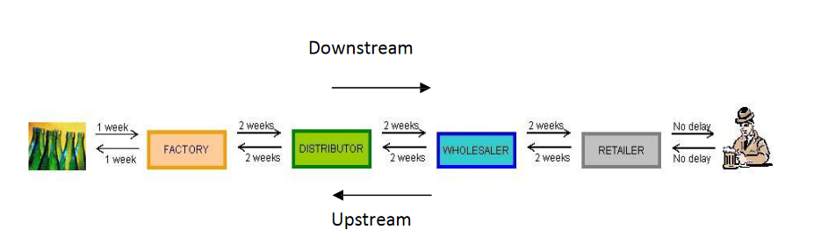

Slide 2
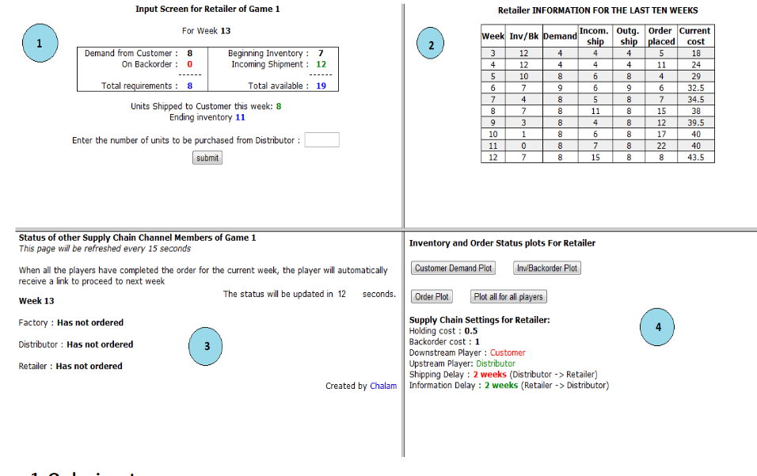

Slide 3
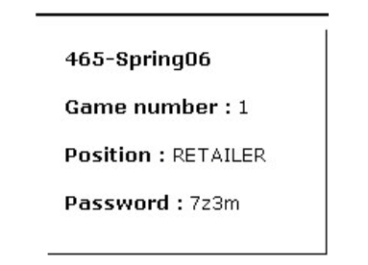
http://scgames.bauer.uh.edu/viewallgames.asp
Masaryk_university

