Slide 1
Human resource management in perspective
Petr Smutný

Slide 2
Agenda for today
What is HRM and why is it important?
Perspective 1: STRATEGIC
Perspective 2: ORGANIZATIONAL
Perspective 2: CULTURAL and BEHAVIORAL
HRM for beter PERFORMANCE
Q & A

Slide 3
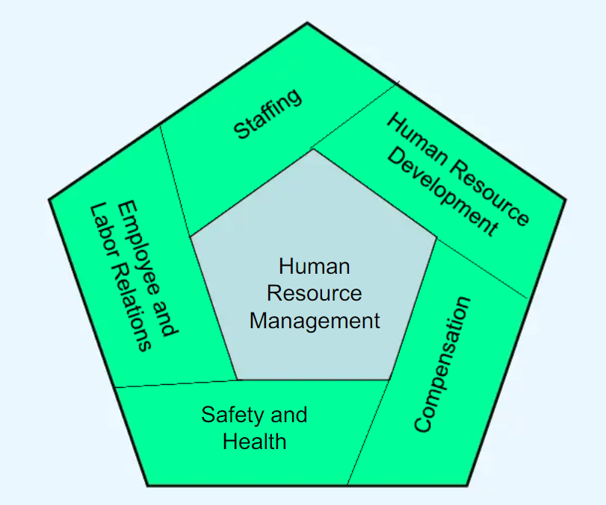
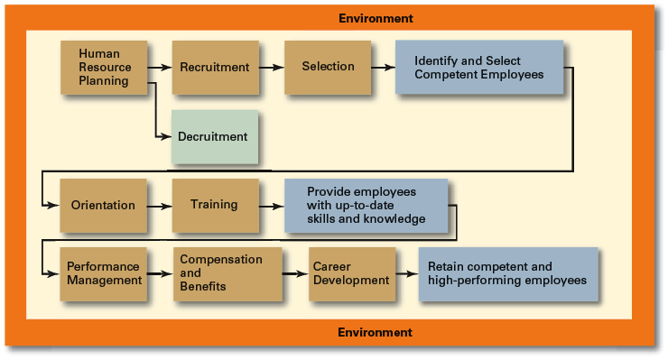
What is HRM?
… everything associated with employment relations in an organization.
personnel management vs. high performance HRM.

Slide 4
Why is HRM important?
As an important strategic tool
  HRM helps establish an organization’s sustainable competitive advantage.
As a necessary part of the organizing function of management
  Selecting, training, and evaluating the work force
Adds value to the firm
  High performance work practices lead to both high individual and high organizational performance.

Slide 5
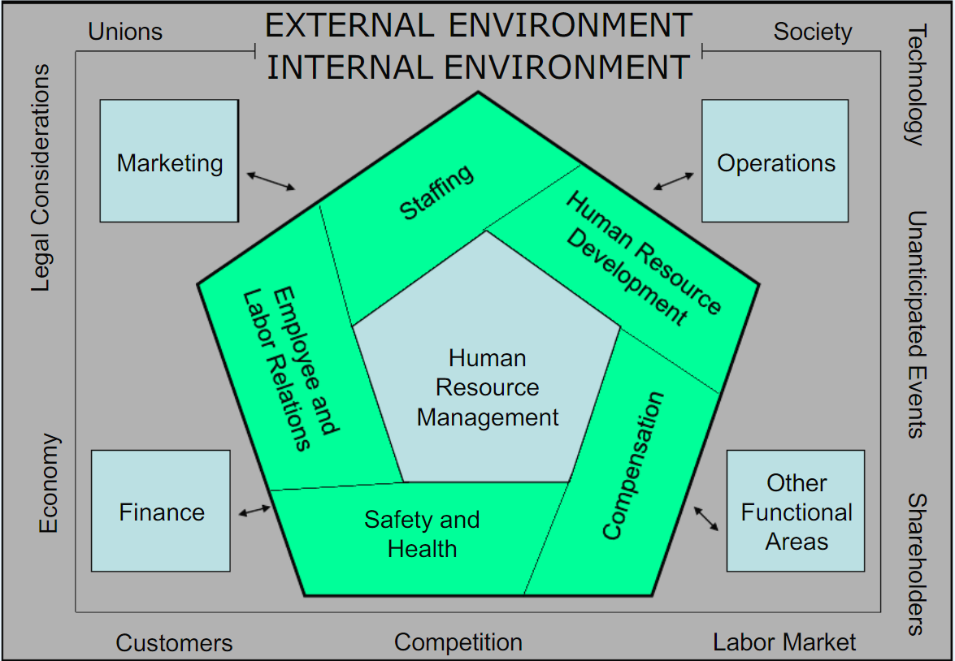
Reality is much more complicated…
HRM is
  just one of (many) functions of an organisation performs
  happening within an organizational setting (organizational structures)
  influenced by factors within an internal environment
  facing constraints from external environment and stakeholders
  Balancing these (often contradictory) contingencies requires strategic perspective…

Slide 6
Perspective 1: STRATEGIC

Slide 7
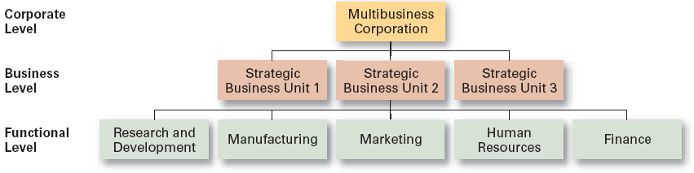
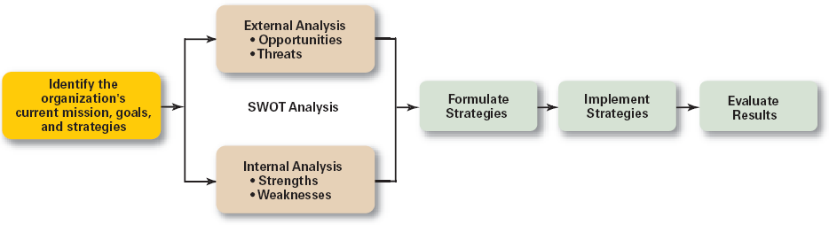
Strategic management in a nutshell
Strategy = the approach selected to achieve specified goals in the future. A broad and long-term view is taken of where the business is going.
overall plan for the entire organization and its strategic business units
focused on how an organization should compete in each of its SBUs (strategic business units).
concerns each organizational function, and how that organizational unit or division assigned that function will achieve its strategic objectives (a part of the business/competitive strategy).

Slide 8
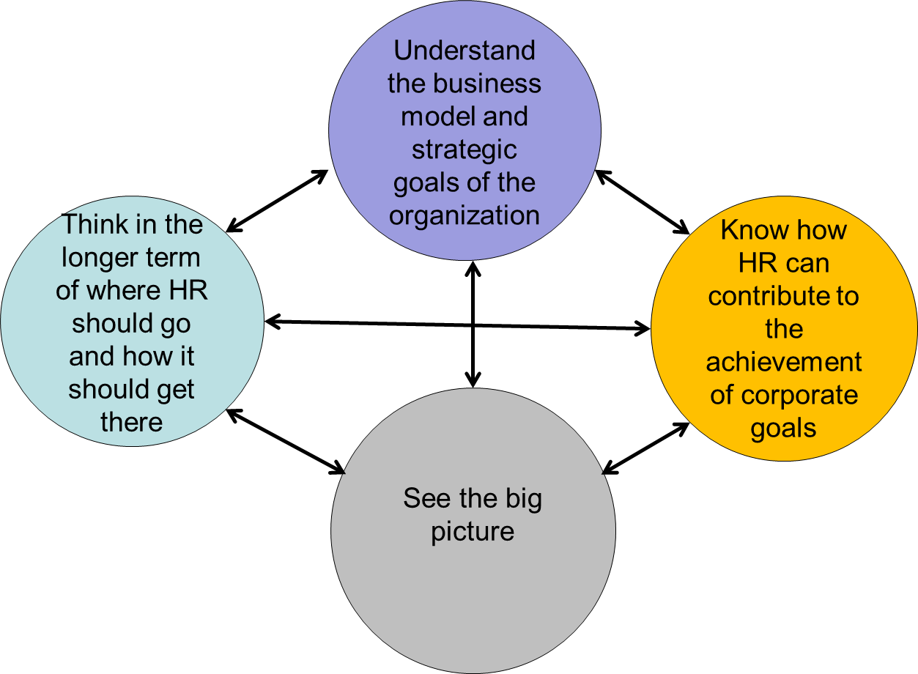
Strategic HRM
An approach to HRM in which
  a broad and long-term view is taken of where the business is going
  activities are managed in ways which ensure that this strategic thrust is maintained
Goals of strategic HRM
  Take a longer term view of where HR should be going and how to get there
  Make sure that integration or ‘fit’ between HR and business strategies is achieved
  Decide how coherent and mutually supporting HR strategies should be developed and implemented
  How members of HR function should adopt a strategic approach
  to enable an organization to achieve its GOALS).

Slide 9
HR strategies (defined)
HR strategies
specify what the organization is proposing to do about people management generally or in particular areas of HRM.
are governed or at least influenced by the overall approach adopted to strategic HRM.

Slide 10
Strategic HRM and HR strategies
Corporate strategy
Business priorities
Business needs
Skills and capabilities
Leadership
Organization and operating model
Culture
HR capabilities
HR structure and operating model
Practices, policies and processes
Drives
Enables
People and organization strategy
Drives
Enables
HR strategy

Slide 11
HR strategies (continued)
General HR strategies
Specific HR strategies
describe the overall system or bundle of complementary HR practices that the organization proposes to adopt or puts into effect in order to improve organizational performance.
three types of general strategies are:
High-performance management
High-commitment management
High-involvement management
set out what the organization intends to do in areas such as:
HR analytics
knowledge management
corporate social responsibility
engagement
organization development
resourcing
diversity and inclusion
talent management
learning and development
reward
employee relations
employee well-being

Slide 12
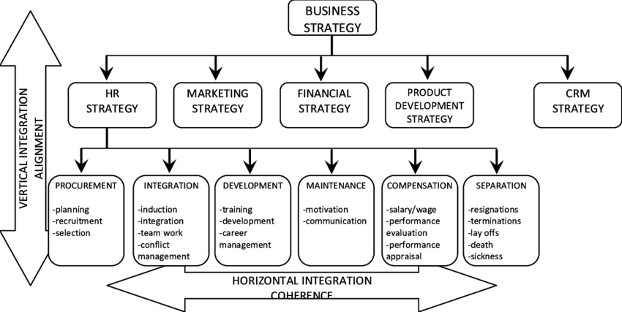
The need for alignment and integration
Strategies need to be implemented. Implementation is facilitated trough organizational structures…

Slide 13
Perspective 2: ORGANIZATIONAL

Slide 14
Organization structure
  = the formal arrangement of jobs within an organization.
  Organizing is a process involving decisions about six key elements:
    Work specialization
    Departmentalization
    Chain of command
    Span of control
    Centralization and decentralization
    Formalization
Structure always follows strategy.

Slide 15
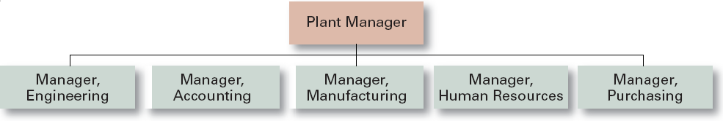
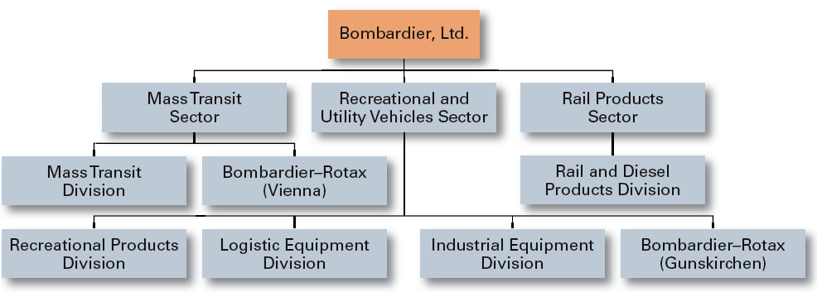
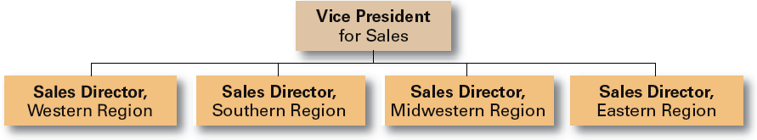
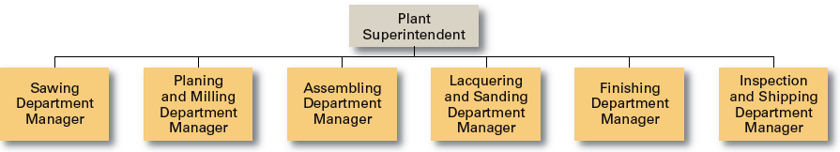
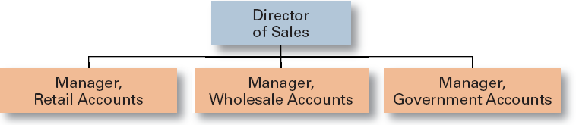
Different types of organizational strucutres…
Types of departmentalization
Functional
  by functions performed
Product
  by product line
Geographical
  on the basis of territory or geography
Process
  on the basis of product or customer flow
Customer
  by type of customer and needs

Slide 16
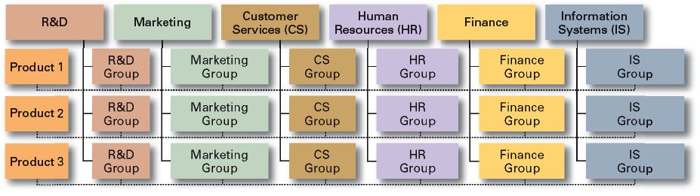
… are typically combined
Matrix structure

Slide 17
Why is it important for HRM?
It influences HRM strategies and processes.
Organizational sturcture
Coordinates diverse organizational tasks.
Establishes relationships among individuals, groups, and departments.
Establishes formal lines of authority.
Allocates and deploys organizational resources.
Different structures do this in different ways.

Slide 18
HR strategies implementation
To ensure the effective delivery of HR strategies it necessary to
formulate practical strategies – ones that can be readily put into effect
involve line mangers and other employees
communicate
build skills
monitor and evaluate
manage change
This is done with and through other people - so organizational culture matters…

Slide 19
Perspective 3: CULTURAL and BEHAVIORAL

Slide 20
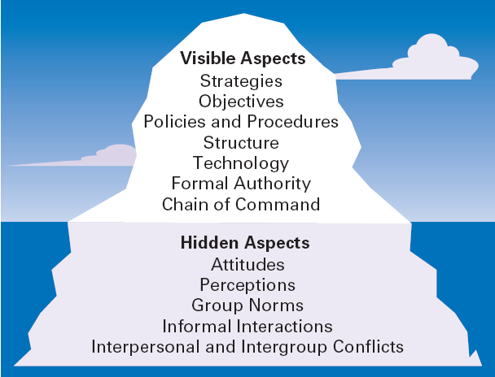
Organisation as an iceberg

Slide 21
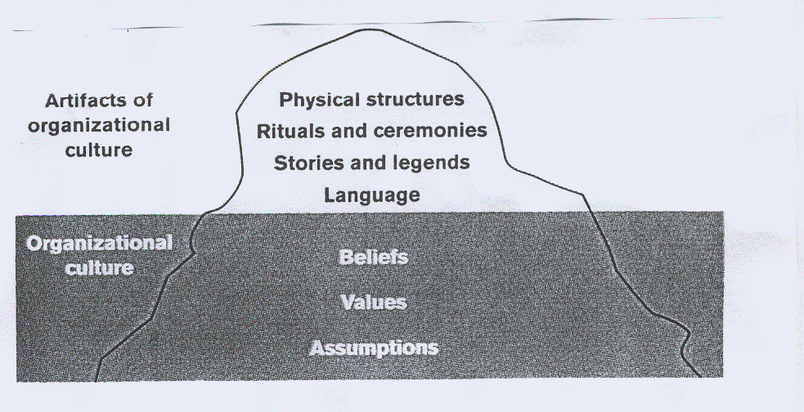
Organisational culture defined
A system of shared meanings and common beliefs held by organizational members that determines, in a large degree, how they act towards each other.
„The way we do things around here.”

Slide 22
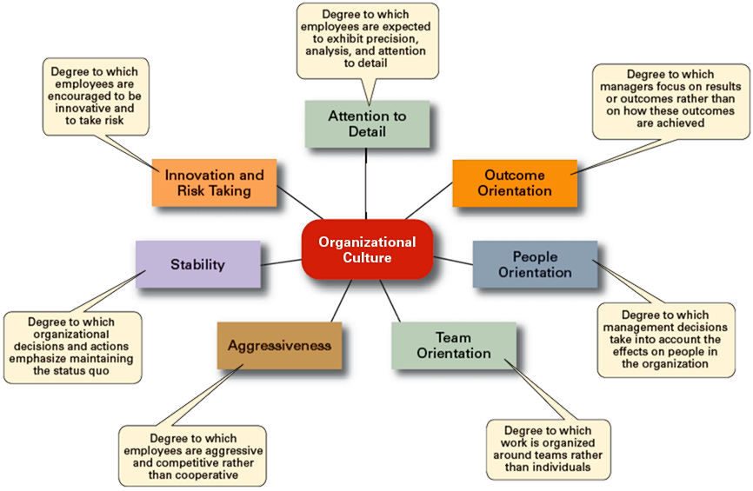
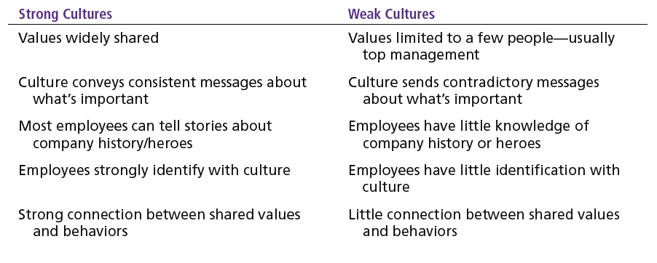
Why does this matter?
It influences how people, teams and organisations behave.
  What (managerial) actions the organization recognizes as proper or improper on its behalf
  What (organizational) activities the organization values and encourages
  The overall strength or weakness of the
  organizational culture

Slide 23
HRM for better PERFORMANCE

Slide 24
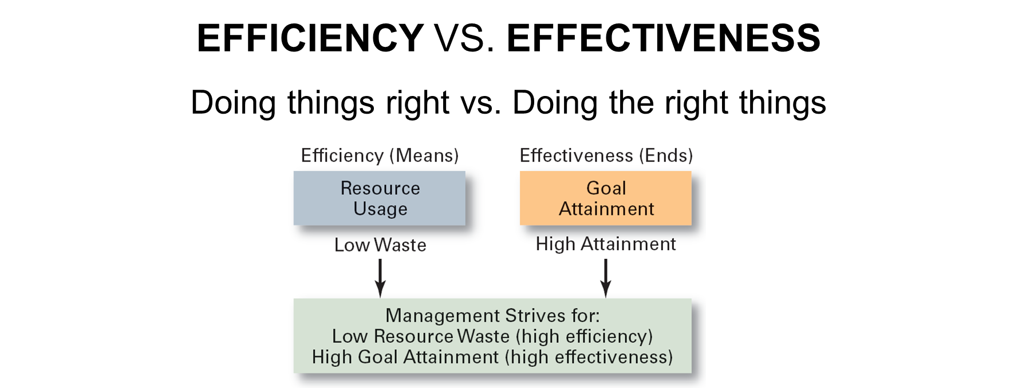
Performance is important
HRM strategies and processes must help organizations perform better.

Slide 25
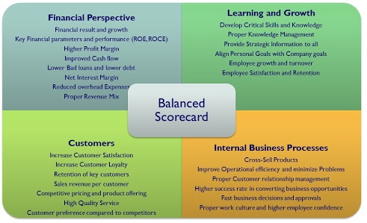
Measuring organizational performance
Traditional view
Contemporary systems
owners‘ perspective
predominantly financial metrics
  profitability
  productivity
more stakeholders taken into account
multidimensional measurement

Slide 26
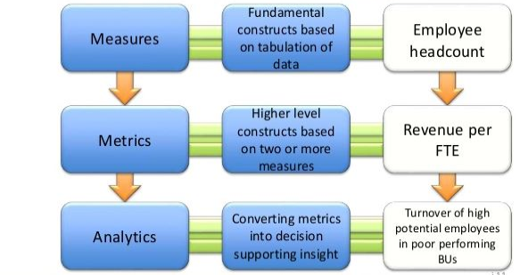
HRM and performance
HR metrics, measurement and analysis
consensus emerging
around existence of
HRM performance link
quantification remains difficult
assessing costs and benefits of HR strategies
evidence-based + data-driven decisions
benchmarking
systematic collection of (quantitative) data is needed

Slide 27
Q & A

Slide 28
Prepare for the seminar
read chapter 3 of the textbook:
WILTON, Nick. An introduction to human resource management. Fifth edition. Los Angeles: Sage, 2022. ISBN 978-1-5297-5370-7.
  available in the library – PER 430
  available on-line through E-loans service: Holdings: An introduction to human resource management / (muni.cz) – click „E-loans“ on the page (university login required)
review the lecture slides

Slide 29
THANK YOU

