Slide 1
Literature review assignment Discussion
Academic writing
Seminar 6

Slide 2
Features of academic writing (refreshing)

Slide 3
Academic writing is…
Focused and well structured
An academic text is not just a collection of ideas about a topic—it needs to have a clear purpose. Start with a relevant research question or thesis statement, and use it to develop a focused argument. Only include information that is relevant to your overall purpose.
A coherent structure is crucial to organize your ideas. Pay attention to structure at three levels: the structure of the whole text, paragraph structure, and sentence structure.

Slide 4
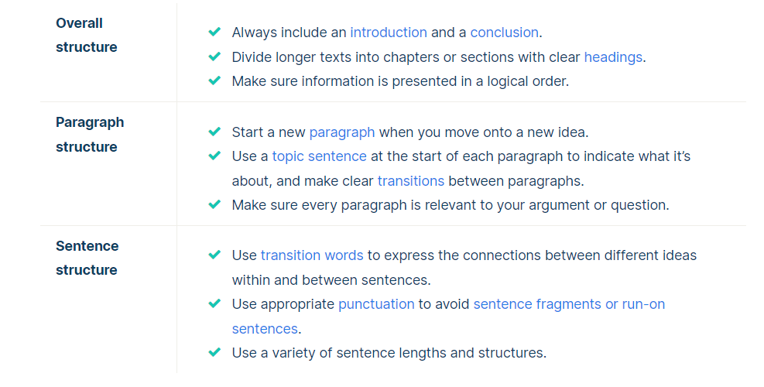
Structure

Slide 5
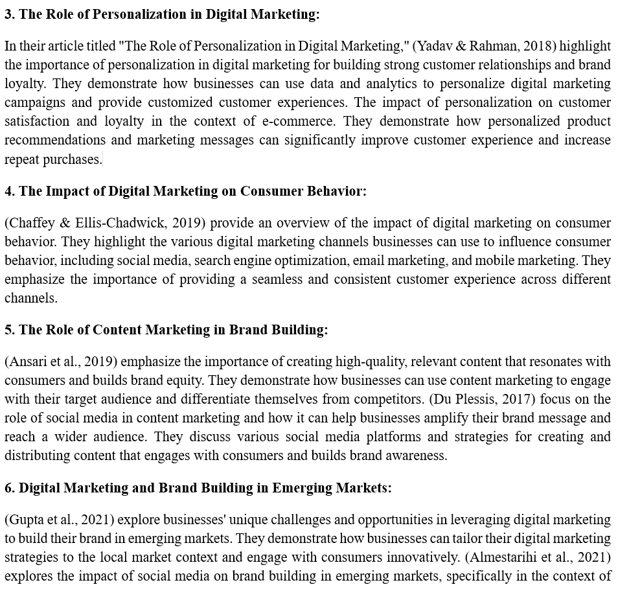

Slide 6
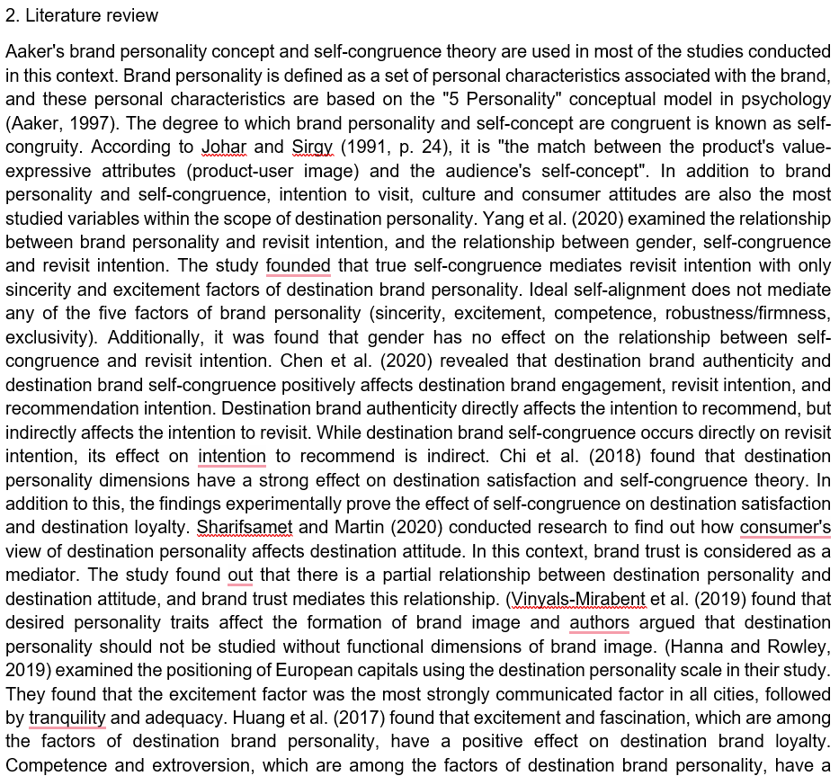

Slide 7
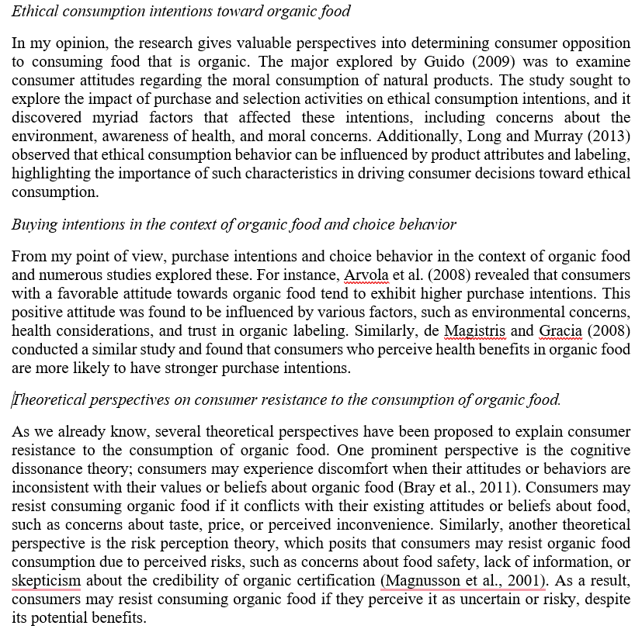

Slide 8
Topic sentence is important
The topic sentence is the first sentence of the paragraph.
Sometimes referred to as a focus sentence
Topic sentence helps organize the paragraph by summarizing the information in the paragraph.
Tips:
Identify the main point in your paragraph
Write a sentence that connects to your main idea with a what and a why. State what the topic is and why it matters.
Topic sentence gives readers something interesting to think
https://www.indeed.com/career-advice/career-development/how-to-write-a-topic-sentence

Slide 9
Topic sentence examples
An organization is like an organism whose flow of information is imperative for its functioning.
Fast fashion is readily available, inexpensively made part of fashion industry.
One of the primary causes of the generational wealth gap is differences in savings behavior between generations.
Dating apps have significantly changed the way people approach romantic relationships, driving a move toward online and mobile dating.

Slide 10
Transition words to connect sentences
Even more so than that, Connelly and Zweit (2005)…
… some of the research before that…
What is more …
According to the report entitled…
According to this survey …
An article presented in Health Affairs,

Slide 11
Academic writing is not…
Personal
Academic writing generally tries to avoid being too personal. Information about the author may come in at some points—for example in the acknowledgements or in a personal reflection—but for the most part the text should focus on the research itself.
Always avoid addressing the reader directly with the second-person pronoun “you.” Use the impersonal pronoun “one” or an alternate phrasing instead for generalizations:
As a teacher, you must treat your students fairly.
As a teacher, one must treat one’s students fairly.
Teachers must treat their students fairly.

Slide 12
The use of the first-person pronoun “I” is increasingly accepted in academic writing.
When you refer to yourself, it should be for good reason. You can position yourself and describe what you did during the research, but avoid arbitrarily inserting your personal thoughts and feelings:
Unacceptable
In my opinion…
I think that…
I like/dislike…
Acceptable
I conducted interviews with…
I argue that…
I hope to achieve…

Slide 13
Academic writing is not…
Long-winded
Many students think their writing isn’t academic unless it’s over-complicated and long-winded. This isn’t a good approach—instead, aim to be as concise and direct as possible.
If a term can be cut or replaced with a more straightforward one without affecting your meaning, it should be. Avoid redundant phrasings in your text, and try replacing phrasal verbs with their one-word equivalents where possible:
Interest in this phenomenon carried on in the year 2018.
Interest in this phenomenon continued in 2018.

Slide 14
Repetition is a part of academic writing— for example, summarizing earlier information in the conclusion—but it’s important to avoid unnecessary repetition. Make sure that none of your sentences are repeating a point you’ve already made in different words.

Slide 15
Avoid the shopping list literature review
‘He said, she said”
Williams (1985) discovered... Stevens (1988) conducted similar experiments and find that … Later Randle (1991) concluded that…
By focusing on writers rather than the substantive issue under discussion, you may end up listing and then trying to draw things together. Your goal is not to summarise who said what but on interpretations of the term.

Slide 16
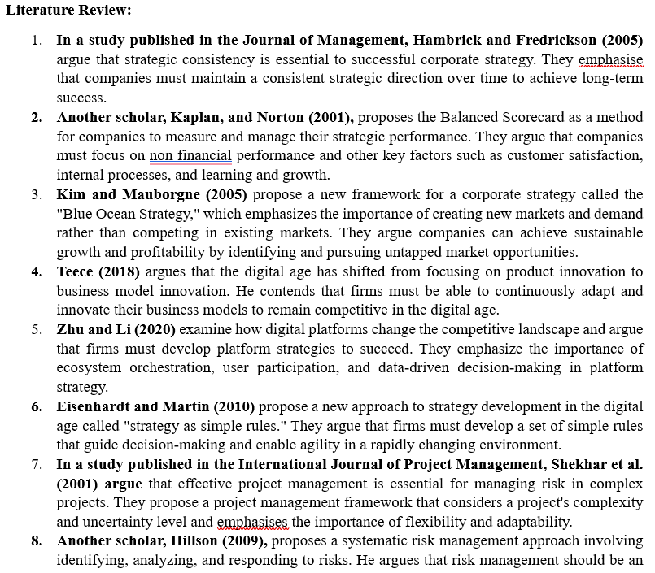
This is a shopping list not literature review

Slide 17
Connect sources
One of the most significant theoretical explanations for performance budgeting is that it can aid in the better allocation of public resources. Policymakers may guarantee that resources are allocated toward programs and initiatives that are most successful in attaining desired goals by tying budgeting to performance outcomes. This can lead to increased efficiency and effectiveness in government spending (Jones & Lynch, 2006).
There is evidence that performance budgeting improves budget outcomes. According to Poterba and Rueben (1999), states that used performance budgeting had better fiscal results, such as reduced deficits and improved credit ratings. Similarly, LaLumia and Lovell (2012) discovered that performance-based budgeting was connected with greater budgetary performance in US municipal governments.

Slide 18
Connect sources
Several strategies have been proposed to address the generational wealth gap. These strategies aim to increase intergenerational mobility, redistribute wealth, and improve access to opportunities for those from disadvantaged backgrounds. One approach to addressing the generational wealth gap is through policies aimed at increasing intergenerational mobility. This includes measures like improving access to education and affordable housing, which can help reduce the wealth gap by providing opportunities for those from low-income backgrounds (Chen & Corak, 2008). Another approach is through redistributive policies, such as progressive taxation and inheritance taxes, which can help redistribute wealth and reduce the concentration of wealth in older generations (Keister & Moller, 2000). These policies can help ensure greater economic and social equality by reducing the barriers to wealth accumulation faced by those from low-income backgrounds.

Slide 19
Basic In-Text Citation Styles
Author | Parenthetical citation | Narrative citation
One author | (Luna, 2020) | Luna (2020)
One author with a quote | (Luna, 2020, p. 37) | Luna (2020) (p. 37)
Two authors | (Salas & D’Agostino, 2020) | Salas and D’Agostino (2020)
Three or more authors | (Martin et al., 2020) | Martin et al. (2020)
Group of authors | (OECD, 2020) | OECD (2020)
In parenthetical citations, use an ampersand (&) between names (Salas & D’Agostino, 2020)
In narrative citations, spell out the word “and” Salas and D’Agostino (2020)
Works with the same author and same date
(Judge & Kammeyer-Mueller, 2012a)
(Judge and Kammeyer-Mueller, 2012b)
If multiple authors within a single reference share the same surname
(Chen & Chen, 2019)

Slide 20
APA citation style (problems)
Kannan, P. K., & Li, H. (2017) explain
Ganie et al.'s (2023) study gives …
Mbah and Wasum (2022) refer to Jones (2022) highlighting
Shokeen and P.K. Bhoyar's (2023) study offers
(Kushwah et al., 2019) explore the study to understand
… no certainty of safety. (Morgan & Ross, 2015) In 2013, the …
In contrast, Park et al. Address the …
However, Lien, C. H., Wen, M. J., Huang, L. C., & Wu, K. L. (2015) identify

Slide 21
Use proper APA in-text citation style
Incorrect: Kannan, P. K., & Li, H. (2017) explain …
Correct: Kannan and Li (2017) explain …
Incorrect: Ganie et al.'s (2023) study gives …
Correct: Ganie et al. (2023) study gives …
Incorrect: Shokeen and Bhoyar's (2023) study offers …
Correct: Shokeen and Bhoyar (2023) offers …
Incorrect: (Kushwah et al., 2019) explore the study to understand …
Correct: Kushwah et al. (2019) explore the study to understand …
Incorrect: … no certainty of safety. (Morgan & Ross, 2015) In 2013, the …
Correct: … no certainty of safety (Morgan & Ross, 2015). In 2013, the …
Incorrect: In contrast, Park et al. Address the …
Correct: In contrast, Park et al. (2020) address the …

Slide 22
Avoid making strong claims
This literature review aims to provide a comprehensive overview of the current state of research …
I would conduct further research as mentioned to erase any doubts about partial moderating factors because just CSR in itself contains a broad spectrum of constructs.
In my opinion, the influence of COVID-19 on air transport is clear.
This literature review informs about all possible obstacles derived from wrong product consumption.

Slide 23
Shorcuts
Define early and use them throughout the text
Project management is characterized for being a discipline constantly struggling with changes in the environment, aiming to be flexible enough to handle those changes end deliver the stablished outcomes. However, after the COVID-19 pandemic, the project management had to adapt beyond the previously known standards. The proposed work aims to describe how project management is dealing with the post-pandemic situation, which are the biggest challenges and what should be considered by PM (Project Management) professionals to be better prepared for the new conditions the pandemic brought to the world economy.

Slide 24
References (Bibliography)
List of references is placed at the end of a work.
Each entry provides the author, date, title, and source of the work.
The reference allows readers to identify and retrieve the source.
Sources are listed in alphabetical order by the author last name.
You should have a reference entry for every source you cite.

Slide 25
I avoid informal terms and contractions.
I avoid second-person pronouns (“you”).
I avoid emotive or exaggerated language.
I avoid redundant words and phrases.
I avoid unnecessary jargon and define terms where needed.
I present information as precisely and accurately as possible.
I use appropriate transitions to show the connections between my ideas.
My text is logically organized using paragraphs.
Each paragraph is focused on a single idea, expressed in a clear topic sentence.
Every part of the text relates to my central thesis or research question.
I support my claims with evidence.
I use the appropriate verb tenses in each section.
I consistently use either UK or US English.
I format numbers consistently.
I cite my sources using a consistent citation style (APA style).

