Slide 1
Typology and family business
Lecture 2

Slide 2
Types of enterprises
Foreigners willing to set up a business in Czech Republic can choose from one of the four main types of companies: branch office, partnership, limited liability company and joint stock company.

Slide 3
Types of enterprises
According the ownership:
Individual
Family
Private
Collective
Utilities
State
Mixed
According the organisational form:
Single proprietorship
Partnership
  With unlimited liability
  With limited liability
  With additional liability
  Commandite
Joint stock company

Slide 4
Types of enterprises
According the activity
  Production
  Financial
  Intermediary
  Insurance
According to the size
  Micro
  Small
  Medium
  Large

Slide 5
Types of enteprises in Czech Republic
In the Czech Republic, the most common forms of business are limited liability company and joint stock company. Other alternative business forms are general partnership and branch office.

Slide 6
Limited liability company
Translation - (společnost s ručením omezeným - s.r.o.)
can be formed of one to fifty members. One person can be both the sole owner and executive.
The s.r.o. does not have a board of directors. Each of the contributors has the right to make decisions independently if the partnership agreement does not state otherwise.
A registered capital of at least CZK 1 (5 euro cents) is needed for a limited liability company in Czech Republic and 30% of the share capital must be paid before the registration at the Commercial Register. For non-monetary contributions, they have to be clearly settled in the statutory papers. For a company with one stakeholder, the full registered capital must be paid before the company is registered in the Commercial Register.

Slide 7
Joint stock company
Translation: akciová společnost
It is commonly used for large companies. To set up a joint stock company, there must be either a founder’s deed by one shareholder (a legal entity) or an association of individuals or legal entities through a memorandum. For companies with more than one shareholder, the statutory body is the board of directors with no fewer than three members. The joint stock company must establish a supervisory board of at least three members.
The minimum share capital required by the Czech law is CZK 2 million (approx 78,000 EUR). If the joint stock company is set up by public offering, the minimum share capital must be CZK 20 million. An audit is compulsory if at least one of the criteria is met: a net turnover over CZK 80 million, over 50 employees or a balance sheet over CZK 40 million.
Source: https://www.czechcompanyincorporation.com/czech-company-types

Slide 8
General commercial partnership
Translation: veřejná obchodní společnost - v.o.s.)
all partners are liable with all their property. The management has to be formed by at least two persons. The advantage of a general partnership is that you do not need the initial investment.
Source: https://www.czechcompanyincorporation.com/czech-company-types

Slide 9
Cooperatives
Translation: Družstvo
Co-operatives are formed by at least 5 members (or at least 2 legal entities) to undertake business for the economic or social benefit of its members.
The amount of registered capital (minimum CZK 50,000) and the amount of each members' basic investment must be entered in the Commercial Register.
An indivisible fund of at least 10% of the registered capital must be created at the time of incorporation. At least 10% of the profits after tax must be must be transferred annually to the indivisible fund until such time as it reaches a minimum of 50% of the registered capital.
Members are not liable for the debts/obligations of the co-operative.
Foreigners may only be statutory representatives of the co-operative if they have a Czech residency permit.
The audit requirements are the same as for a limited liability company.
Source: www.mzv.cz

Slide 10
Limited partnership
A limited partnership is formed by two or more natural persons or legal entities of which at least one general partner must assume unlimited liability and is responsible for the obligations of the partnership.
The limited partners are only responsible for the obligations of the partnership up to the level of un-paid contributions as originally recorded in the Commercial Register.
A partnership agreement must be drawn up.
The entry in the Commercial Register must also include the partners' names and addresses or the partnership's registered office, a statement as to who are the limited and unlimited partners, the amount of paid-in capital by each limited partner and any outstanding amounts at the time of registration.
Only general/unlimited partners are permitted to actively manage the partnership.
The audit requirements are the same as for a limited liability company
Source:www.mzv.cz

Slide 11
NACE classification
The Statistical classification of economic activities in the European Community, abbreviated as NACE, is the classification of economic activities in the European Union (EU); the term NACE is derived from the French Nomenclature statistique des activités économiques dans la Communauté européenne. Various NACE versions have been developed since 1970.
NACE is a four-digit classification providing the framework for collecting and presenting a large range of statistical data according to economic activity in the fields of economic statistics (e.g. production, employment and national accounts) and in other statistical domains developed within the European statistical system (ESS).
(Source:ec.europa.eu)

Slide 12
Structure and coding of NACE
NACE consists of a hierarchical structure (as established in the NACE Regulation), the introductory guidelines and the explanatory notes. The structure of NACE is described in the NACE Regulation as follows:
first level consisting of headings identified by an alphabetical code (sections),
second level consisting of headings identified by a two-digit numerical code (divisions),
third level consisting of headings identified by a three-digit numerical code (groups),
fourth level consisting of headings identified by a four-digit numerical code (classes).

Slide 13
Specifics of production enterprises
Three main production methods :
  jobbing or one-off production, involves producing custom work, such as a one-off product for a specific customer or a small batch of work in quantities usually less than those of mass-market products (tayloring of expensive man suits)
  Batch production - the object in question is created stage by stage over a series of workstations, and different batches of products are made (cars)
  Mass production – also known as flow production or continuous production, is the production of large amounts of standardized products, including and especially on assembly lines

Slide 14
Specifics of production enterprises (www.open.edu)
Economists often distinguish three broad sectors of the economy(www.open.edu):
The primary sector - involves extracting and harvesting natural products from the earth (for example, agriculture, fishing and mining).
The secondary sector - consists of processing (for example, the processing of food stuffs produced by agriculture), manufacturing and construction. That is to say, the secondary sector takes the products from the primary sector and does something more with them.
The tertiary sector - provides services, such as retail services, entertainment or financial services.
The fourth sector - is made up of intellectual activities, such as education

Slide 15
Specifics of production enterprises – Agriculture and forestry
Dependence on natural conditions
Temporal discrepancy of production and operation processes – typically for vegetable production – growth of wheat and its harvest
Seasonality
Results:
  Complicated organization of work
  High demands on manufacturers – needs of knowledge and adaptability
  Unstable working hours and unstable profit

Slide 16
Specifics of production enterprises – Building and construction enterprises
Jobbing production on building site
Long production cycle
The product is intangible, production is moving
Dependence on natural conditions
Difference of work, machines, production processes

Slide 17
  Services
Specifics of services according Kotler et al. 2005:
Inseparability character of service refers to the fact that services are produced and consumed at the same time and that they cannot be separated from their providers, whether the providers are people or machine
Variability - Services are variable and difficult to control. This is because they greatly depend on who provides the service as well as when, where and how they are provided
Intangibility means that cannot be seen, tasted, felt, heard or smelled before they are bought thus the customer cannot evaluate it.
Perishability - service is that they cannot be stored for later use or sale.

Slide 18
Specific of services
Breakdown of economic activities according (Foot and Hatt):
Terciary:
Restaurants and hotels, Haircare and beauty shops, Laundry and cleaning, Maintenance and repair
Quaternary:
Transportation, Retailing, Communications, Finance and insurance, Property, Government
Quinary: refining and extending human capacities
Helath, education, research, recreation arts

Slide 19
Specific of services
management should closely look at the seven marketing mix of the services described above. ( Product, price, place, promotion, + people, process, psychical evidence
They should select the physical attribute carefully while making the price simple and clear to their customers. The management should create a culture so that the staffs have a clear vision on what role they play in creating loyal customers

Slide 20
  Small and medium enterprises
small and medium-sized enterprises, abbreviated as SMEs: fewer than 250 persons employed;
SMEs are further subdivided into: micro enterprises: fewer than 10 persons employed;
small enterprises: 10 to 49 persons employed;
medium-sized enterprises: 50 to 249 persons employed;
large enterprises: 250 or more persons employed.
The number of persons employed should not be confused with employees or full-time equivalents; 'persons employed' includes employees but also working proprietors, partners working regularly in the enterprise and unpaid family workers.
Source: eurostat.eu

Slide 21
Pros and cons of SME´s
Simple structure
Flexibility
Faster response to customer needs
Inventiveness and innovations
Quick to react to changing market conditions
Uniqueness
Catering for limited or niche markets
Suppliers of big enterprises
Low market share
Limited budget
inability to compete with larger companies
limited borrowing power
Limited resources to invest in marketing, development etc.
Vulnerability to late payments
Less negotiating power with suppliers
Worse orientation in legal questions

Slide 22
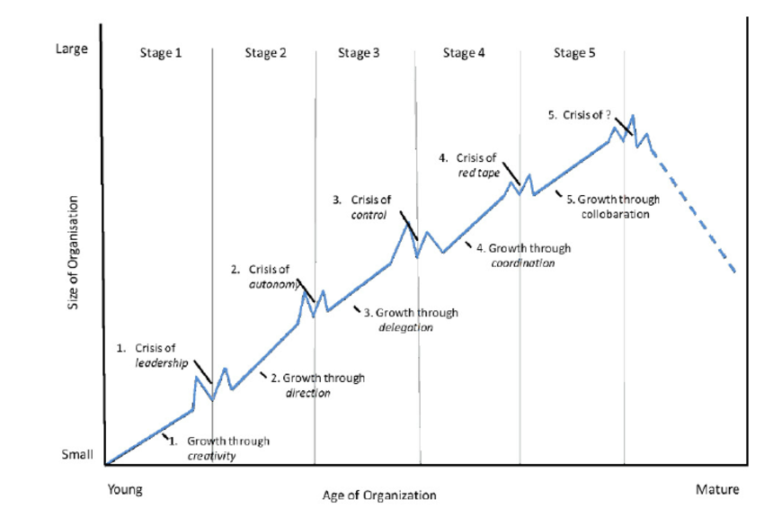
Organisation growth
Greiner´s growth model :
Groth through creativity
  Leadership crisis
Growth through direction
  Autonomy crisis
Growth through delegation
  Control crisis
Growth through coordination
  Red-tape crisis
Growth through collaboration ( cooperation)
  Crisis ?

Slide 23
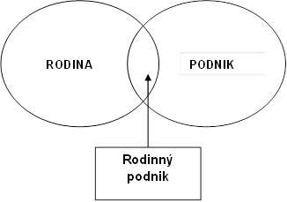
  Family business
Models of circle – ( Leach, 1996, Taquiry, Davis, 1996, Donckels, Frolich, 1991)
Family
Business
Family business

Slide 24
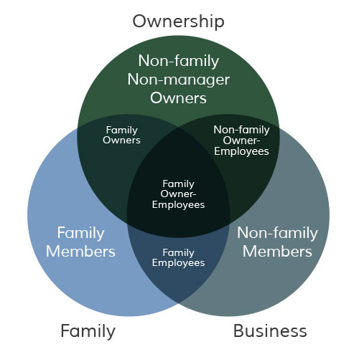
Family business
The Three-Circle Model of the Family Business System was developed at Harvard Business School by Renato Tagiuri and John Davis in 1978.

Slide 25
Family business
Family business | Non-family business
Good relationship with employees | Neutral relationship with employees
Risk averse | Inclination to the risk
Orientation towards the sustainability | Orientation towards profit
Family financing | Bank financing
Nepotism | Lot of employees
Small number of employees | Professionalization of the firm
Orientation towards local market | Orientation toward foreign markets
Low capital intensity | High capital intensity
Lack of strategic planning | Good strategic planning
Centralization towards the family | Decentralization and autonomy
Customer orientation
Emphasis on history
Emphasis on quality
Innovativeness

Slide 26
Family business in the Czech Republic
In 2012, the Czech Civil Code, Act. No 89/2012 Coll., introduced the new institute of family enterprise as completely new term in the Czech Civil law.
According to the Civil Code of the Czech Republic (Občanský zákoník České republiky, 2014), the family business is considered as an establishment, where the spouses, or at least one of them, are working together and where the other relatives up to the third degree or those related to husbands and connected via
brothers-in-law up to the second stage are working, and where some of those people are the owners of such establishment (Koráb, Petlina 2015)

