Slide 1
COSTs
Cost analysis; Cost classification; Cost according the volume of providing outputs; Production theory

Slide 2
revenues, COSTS, profit and their relation
Production – transform of inputs into output
Inputs – production factors = all of them!
In accounting = the current assets, depreciation (as a cost), and overhead costs
Outputs = in accounting = stock of finished good, unfinished goods, etc. (usually also current assets)

Slide 3
COSTs analysis
Production = amortization or consumption of production factors. This amortization or consumption is called costs.
Importance? Stakeholders!
Goal is to have the lowest sustainable costs possible…?

Slide 4
Cost as a term
Many points of view:
Per operation – calculation costs
Per place of origin and responsibility
Per typology of costs – cost types
Per time
Per production volume – capacity costs

Slide 5
Calculation costs
Per operation stage – in all production phases
Important for price creation + portfolio creation
Price calculation
+ Base price of the product
- Discounts to customers
- Volume
- Season
- Other
= Price after changes
- Costs
= Profit/Loss

Slide 6
General calculation formula
+ Direct material
+ Direct work
+ Other direct costs
= Total manufacturing costs
+ Overhead costs – supply
+ Overhead costs – management
= Operation costs
+ Overhead costs – sales
= Total operation costs
+ (Profit)
= (Sale price)

Slide 7
Unit vs. overhead costs
unit costs (prime costs / per-unit costs)
costs that are directly caused (induced) by a unit of any kind of business output
overhead (overheads)
supplement to unit costs
in particular the costs of operation, maintenance, management

Slide 8
Direct vs. indirect costs
direct costs
directly attributable to a specific type of performance
always unit costs
overheads associated with the type of performance (e.g. single-purpose mould, machine, etc.)
indirect costs
cannot be directly attributed to product types
different calculation methods are used for the assignment

Slide 9
Variable vs. fixed costs
variable costs
increase in line with the growth in activity
what are we assessing variability for?
usually the total output
number of units sold, or units of final production produced
can be assessed e.g. also in relation to the output of the centre
(e.g. hours of repairs carried out by the Repair Service Centre)
fixed costs
within a certain range of production unchanged, then a change by a jump

Slide 10
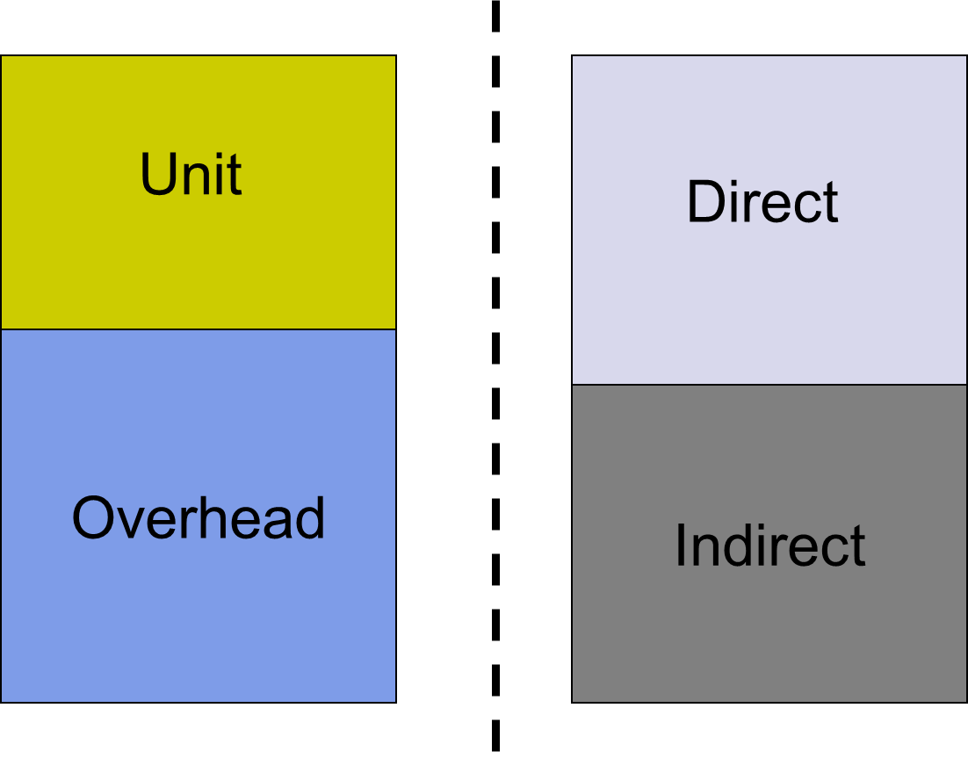
Unit vs. direct

Slide 11
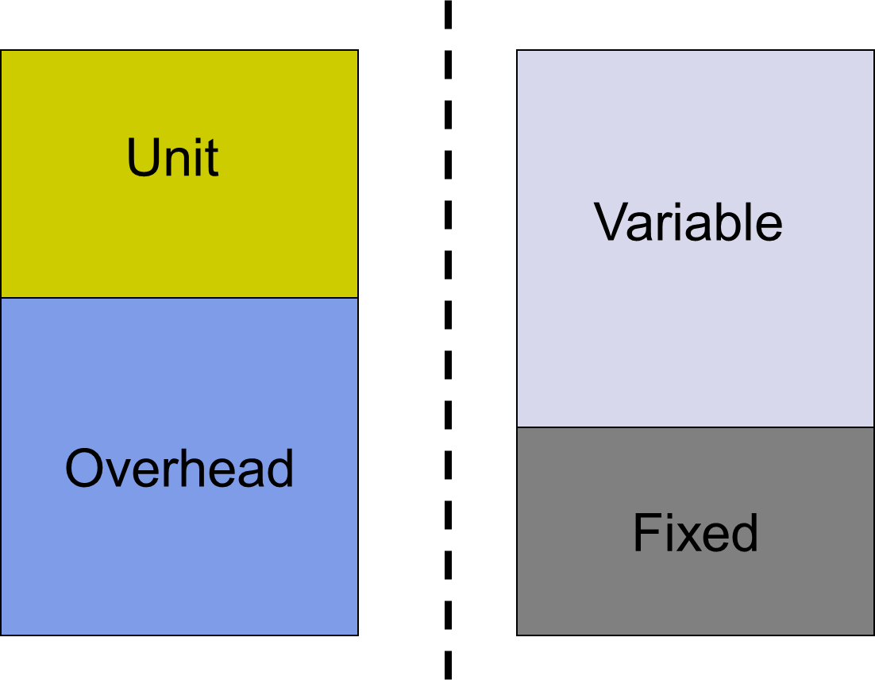
Unit vs. variable

Slide 12
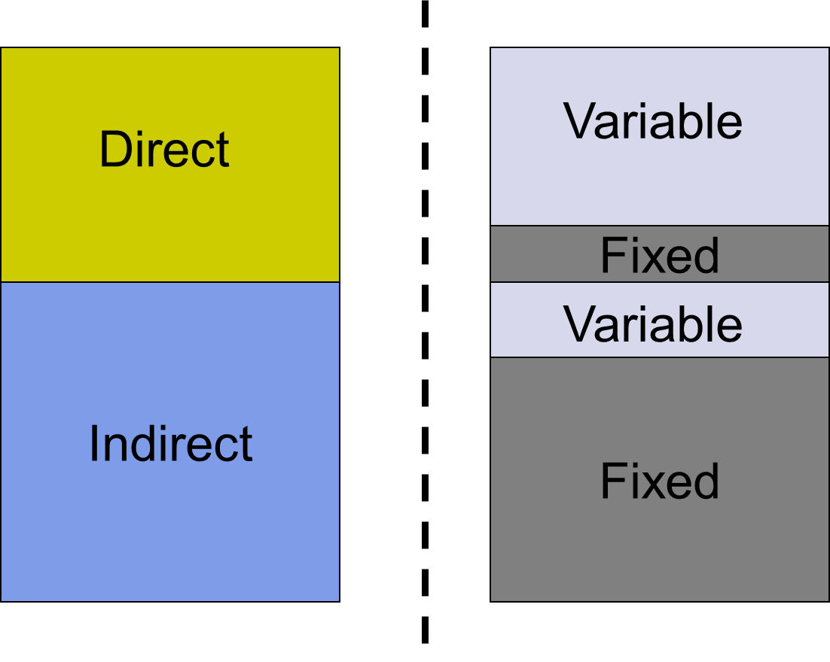
Direct vs. variable

Slide 13
Cost as a term
Many points of view:
Per operation – calculation costs
Per place of origin and responsibility
Per typology of costs – cost types
Per time
Per production volume – capacity costs

Slide 14
Place of origin and responsibility
Cost center
Economic structure of the company
Importance? – further lectures and courses – calculations, controlling

Slide 15
Cost center
Separated, independent technologically closed cycle
Independency and responsibility of the „center“ workers for operations, production and revenues/costs
Mapping of real costs of operations – availability of info for calculations
Local perspective – should be closed quarters

Slide 16
Cost as a term
Many points of view:
Per operation – calculation costs
Per place of origin and responsibility
Per typology of costs – cost types
Per time
Per production volume – capacity costs

Slide 17
Typology of costs – cost types
From accounting – Czech standards.
(see papers!) - Sample chart of accounts
Czech standards vs. IFRS vs. US GAAP

Slide 18
IFRS – International Financial Reporting Standards
Transfer of the national economies to the IFRS
Doing IFRS you can MEAT one problem (US GAAP)

Slide 19
IFRS adoption around globe
https://www.ifrs.org/use-around-the-world/use-of-ifrs-standards-by-jurisdiction/#use-of-ifrs-accounting-standards-by-jurisdiction

Slide 20
Generally Accepted Accounting Principles – US GAAP
Civil law vs. common law
adopted by the U.S. Securities and Exchange Commission (SEC)
Historical cost principle
Financial Accounting Standards Board (FASB)

Slide 21
Cost as a term
Many points of view:
Per operation – calculation costs
Per place of origin and responsibility
Per typology of costs – cost types
Per time
Per production volume – capacity costs

Slide 22
Time centric
Elementary distribution
Theoretical economists – national economies theory
Long term – over 1 year
Short term – under 1 year

Slide 23
Dispute
Economic theory vs. business economics theory
Economic theorist says – in short term there are variable and fixed costs. In long run, there are only variable costs.
Business economist says – there are variable and also fixed cost in both long and short run.

Slide 24
Microecnomics 
Volume of production | Total costs | Total fixed costs | Average fixed costs | Variable costs | Average variable costs | Average total costs | Increment in the volume | Increment of total costs | Marginal costs
Q | TC | TFC | AFC | VC | AVC | ATC | ΔQ | ΔTC | MC
0 1 2 3 10 15 18 | 200 208 216 224 275 314 340 | 200 200 200 200 200 200 200 | - 200 100 67 20 13 11 | - 8 16 24 75 114 140 | 0 8 8 8 7,5 7,6 7,8 | - 208 104 74,7 27,5 20,9 18,9 | - 1 1 1 7 5 3 | - 8 8 8 51 39 26 | - 8 8 8 7,3 7,8 8,7

Slide 25
Microecnomics
Point of ceasing/stopping production
LR: P ≥ AC
SR: P ≥ AVC

Slide 26
Cost as a term
Many points of view:
Per operation – calculation costs
Per place of origin and responsibility
Per typology of costs – cost types
Per time
Per production volume – capacity costs

Slide 27
Volume variability
Costs distributed by the linking to the volume produced.
Costs connected to the volume – variable costs
Costs independent of volume – fixed costs (not always truth)

Slide 28
Variable vs. fixed costs
variable costs
increase in line with the growth in activity
what are we assessing variability for?
usually the total output
number of units sold, or units of final production produced
can be assessed e.g. also in relation to the output of the centre
(e.g. hours of repairs carried out by the Repair Service Centre)
fixed costs
within a certain range of production unchanged, then a change by a jump

Slide 29
General formula for costs
TC = TFC + Q * AVC

Slide 30
REVENUES, costs, profit and their relation
Revenues are simple and from microeconomics:
P * Q
In the accounting (Sample chart of accounts!)
usually from the sale of goods and services to customers.
Revenue is also referred to as sales or turnover. (in CZ ☹ )

Slide 31
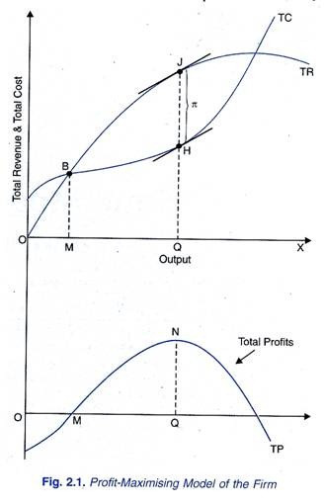
REVENUES
Goal is to have the highest sustainable revenues possible…?
What about taxes?

Slide 32
Profit☺
Revenues – costs = profit.
This one is subject to taxation.
Top goal is to have the highest sustainable goal possible…?

Slide 33
Rehearsal
Tax rate for the natural person?
Tax rate for the law entity?
EBIT vs. EAT
Usage?

Slide 34
EBIT or EAT?
ROA = E???/ Assets
ROE = E???/ Equity
ROS = E???/ Sales

Slide 35
OUT OF ABEC
CBA – Cost benefit analysis
Based on predictions of future cash flows
Takes account of time value of money
Requires all costs and benefits to be given a monetary value
ABC – Power graph
ABC/M – Activity based costing/management

Slide 36
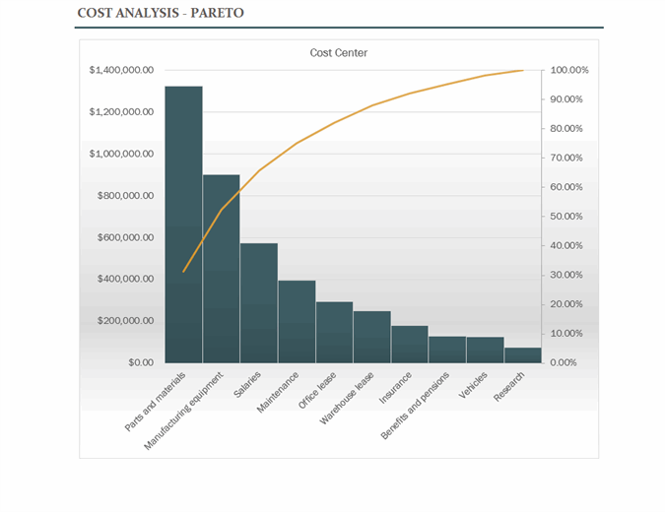
ABC – Power graph

Slide 37
Thank you

