Slide 1
Demand
The basis for demand ▪ industry and firm demand ▪ demand analysis, demand forecasting… lecture and seminar

Slide 2
Demand - theoretical

Slide 3
Change (movement) of demand curve
Changes in the prices of related goods (substitutes and complements).
Changes in disposable income.
Changes in tastes and preferences. Tastes and preferences are assumed to be fixed in the short-run (habits).
Changes in expectations.

Slide 4
Demand and its characteristics (Kotler, Keller)
Negative demand — Consumers dislike the product and may even pay to avoid it.
Nonexistent demand — Consumers may be unaware of or uninterested in the product.
Latent demand — Consumers may share a strong need that cannot be satisfied by an existing product.
Declining demand — Consumers begin to buy the product less frequently or not at all.
Irregular demand — Consumer purchases vary on a seasonal, monthly, weekly, daily, or even hourly basis.
Full demand — Consumers are adequately buying all products put into the marketplace.
Overfull demand — More consumers would like to buy the product than can be satisfied.
Unwholesome demand — Consumers may be attracted to products that have undesirable social consequences.

Slide 5
Demand analysis
The knowledge of demand for our products is one of the key success factors for our company and presents the competitive advantage for the firm. The estimation of demand is easy in short-term range…
…but very challenging in long-term range (external factors).

Slide 6
90 types of demand Kotler, Keller in 2007
Companies can prepare as many as 90 different types of demand estimates for six different product levels, five space levels, and three time periods. Each demand measure serves a specific purpose.
The potential market is the set of consumers with a sufficient level of interest in a market offer.
The available market is the set of consumers who have interest, income, and access to a particular offer.

Slide 7
90 types of demand Kotler, Keller in 2007

Slide 8
Target market
The target market is part of the qualified available market the company decides to pursue.
The penetrated market is the set of consumers who are buying the company’s product.
STP!
Segmentation - divide
Targeting - rule
Positioning - programe

Slide 9
Market demand
Market demand for a product is the total volume that would be bought by a defined customer group in a defined geographical area in a defined time period in a defined marketing environment under a defined marketing program. Market demand is not a fixed number, but rather a function of the stated conditions. For this reason, is called the market demand function. (Kotler, Keller 2007)

Slide 10
Market demand level – level of sales

Slide 11
Analysis and planning
Q1 – market minimum would take place without any demand stimulating expenditures ( for example on marketing)
Q2 – market potential– marketing expenditures beyond a certain level would not stimulate much further demand.
The distance between Q1 and Q2 shows the overall marketing sensitivity of demand.
If the difference between Q1 and Q2 is large, that means expansible market – good for investing in marketing
If the difference between Q1 and Q2 is small, that means non-expansible market – not affected by the level of marketing expenditure.

Slide 12
Market forecast – There can be only one actual level of industry marketing expenditure. The market demand corresponding to this level of expenditure is called the market forecast .
Market potential – limit approached by market demand as industry marketing expenditures approach infinity for a given marketing environment.
Company demand – is the company´s estimated share of market demand at alternative levels of company marketing effor in a given time period.

Slide 13
Methods of demand estimation
Problem definition
to define clearly the problem to be tackled
Exploratory research
to identify information gaps and specify the need for further research
Quantitative research
utilising a sufficiently large and random sample to enable market segment size to be stimated and strenghtof opinions to be gauged.
Analysis and interpretation
following data colection, statistical techniques and models can be employed to turn the data generated into meaningful information to help with segmentation
Usually market research.
STEPS:

Slide 14
Basic methods of demand estimation can be divided as (Horáková, Kubát, 2002):
1) Subjective and open-minded
2) Quantitative and qualitative
3) Simple and analytical
Subjective methods – connected with intuition, opinions and knowledge of interested persons (expert opinions)
Open – minded methods – based on the raw data collection – statistic methods are used to evaluate the gained data.
Quantitative methods – include surveys, observation or experimentation, regression statistics, statistic analysis
Qualitative methods – unstructured or semi-structured interviewing methods designed to encourage respondents to reply freely and express their real feeling, opinion and motivation.
Simple methods – estimation of only one variable.
Analytical methods – demand estimation based on the correlation and relations between more variables

Slide 15
How to mesure demand practically?
History
Statistics from the ERP systems, warehousing
Advantages – precise internal and external data
Dissadvantages – future might not derived from past
Actual and close future – ERP, club cards, crowdfunding, crowdsourcing
Distant future – big trends, demographics, weak signals

Slide 16
Factors influencing demand – non-price
Price is short term
The key is long term
Economics
Social
Disponible income.
Preferences.
Politics
Legal factors
Consumers expectations.
Prices of supplements or complements.
Number of consumers.
Age.
Environmental
Technological

Slide 17
Factors influencing demand – non-price
Price is short term
The key is long term
Economics
Social
Disponible income.
Preferences.
Politics
Legal factors
Consumers expectations.
Prices of supplements or complements.
Number of consumers.
Age.
Environmental
Technological
PESTLE

Slide 18
Theoretical aspects
Demand increases if:
Lower complement price
Fashion shows up
Income rise (normal goods)
Population increase
Expected price rise
Demand lowers if:
Income rise (inferior goods)
Lowering substitute price
Expected lowering of income

Slide 19
Apple iPhone sales

Slide 20
Why all these?
Bullwhip effect
Estimation of sales and especially cash-flow
Investment planning
Production/storage/employment planning
The answer to the questions - what, how much and for how much... and all this to whom...

Slide 21
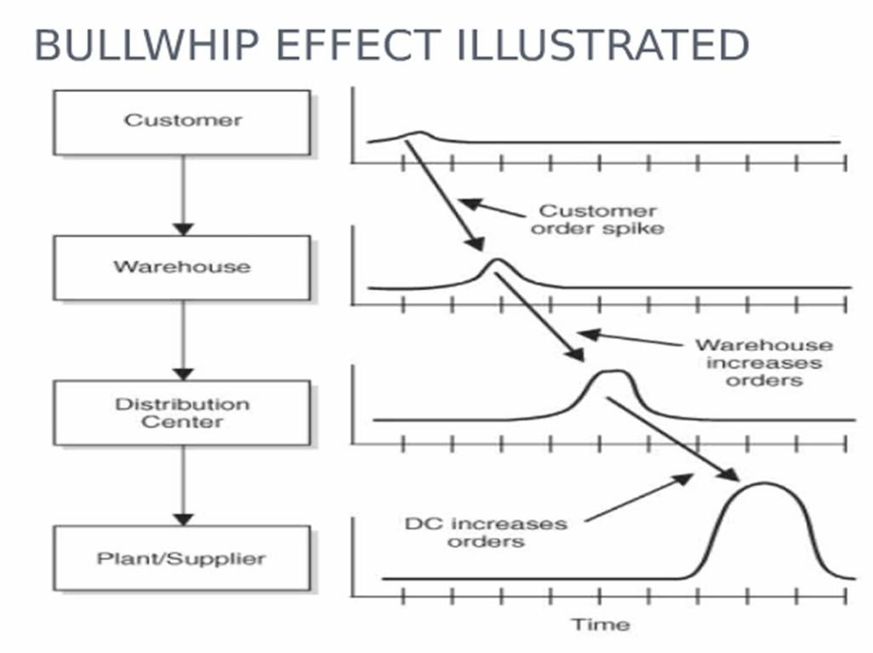
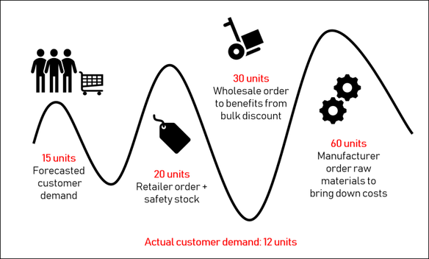
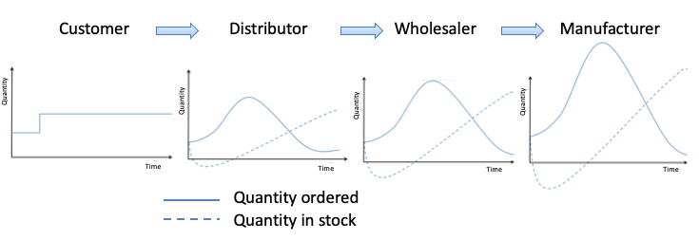
Bull whip?

Slide 22
EKB Model (Engel, Kollat, Blackwell)
Consumer behaviour entails "all activities associated with the purchase, use and disposal of goods and services, including the consumer's emotional, mental and behavioural responses that precede or follow these activities“.
(Kardes, F., Cronley, M. and Cline, T., Consumer Behavior, Mason, OH, South-Western Cengage, 2011 p.7 )

Slide 23
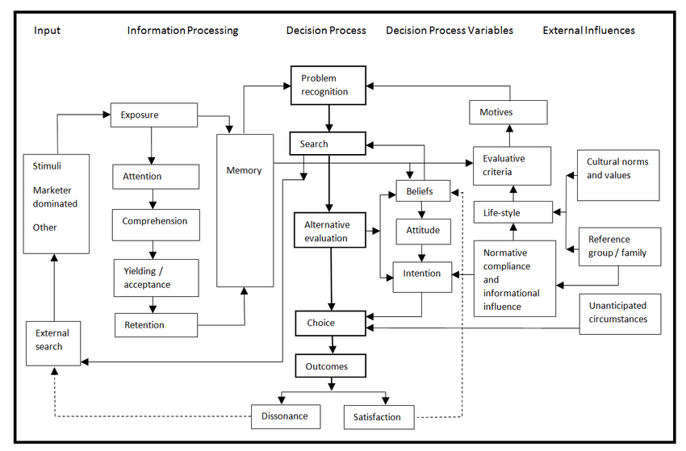

Slide 24
Consumer behaviour
Purchasing behavior can also be affected by external influences, such as:
Culture and subculture: based on age, geographic, religious, racial, and ethnic differences
Social class – very difficult to measure, division in society according educational attainment, income and occupation
Reference group – individual makes the decision according to values being used by someone else ( family, friends, sport team, political party etc.).
Opinion leader – influence people due to his/her product knowledge, expertise or credibility

Slide 25
Consumer behaviour
https://www.youtube.com/watch?v=zVplgl3-pRM
Types?
Impulsive – MUST have RIGHT NOW!!!!!!!!!!
Habitual – common goods same quality and functions
Extensive – expensive goods
Limited – medium range goods, selecting, browsing but not too much

Slide 26
Seminar demand

Slide 27
Task 1
How will the demand for the following products differ in the selected country and how would you determine it? State when the demand for products will be higher, lower, constant and why?
Sugar
Wood – fuel for heating
Construction work
Summer clothes
Petrol
Flour
Solar Panels
Cell phones

Slide 28
Task 2
There are numerous non-price factors affecting demand…
Try to think about what non-price factors are likely to affect world-wide demand on the car market? (list at least 5 factors)

Slide 29
Task 3
Name at least two products you have been shopping:
Impulsively
Habitualy
Extensively
Limitedly

Slide 30
Thank you…

