Slide 1
Price Developing pricing strategies and programs
BPH_MAR1 & BPH_AMA1
Ondřej Částek
castek@econ.muni.cz
Notes:
1

Slide 2
What can you expect
Price and its consequences
Pricing – the process, goals, strategies
Initiating and responding to price changes

Slide 3
Notes:
https://skimgroup.com/app/uploads/2015/10/pricing-600x400-c-center.png

Slide 4
Price and its consequences
Price in the marketing mix
Price and strategy
Difficulties of setting the price
Psychological aspects
Influence of technologies
Notes:
https://www.google.com/url?sa=i&url=https%3A%2F%2Fwww.freshbooks.com%2Fhub%2Fleadership%2F12-real-world-pricing-strategy-examples&psig=AOvVaw1z8K33c5hmMSG-oJYkjZyz&ust=1715107966602000&source=images&cd=vfe&opi=89978449&ved=0CBIQjRxqFwoTCLD2_7jZ-YUDFQAAAAAdAAAAABAS

Slide 5
Setting a price
Selecting the Pricing Objective
Determining Demand
Kotler and Keller, Marketing Management.
Estimating
Costs
Analyzing Competitors
Selecting a Pricing Method
Selecting the Final Price
Notes:
https://images.inc.com/uploaded_files/image/1920x1080/getty_492600467_97053897045000_66911.jpg

Slide 6
Setting a price: Objectives
Price has to follow positioning
strategy (objectives)
Major objectives survival
maximum current profit
maximum market share
maximum market skimming
product-quality leadership

Slide 7
Setting a price: Determining Demand
How: past data
surveys (but distorted answers)
price experiments
= a need for statistical analyses
We need to estimate both the position of the demand curve and its curve, e.g. the price elasticity = sensitivity to price changes.

Slide 8
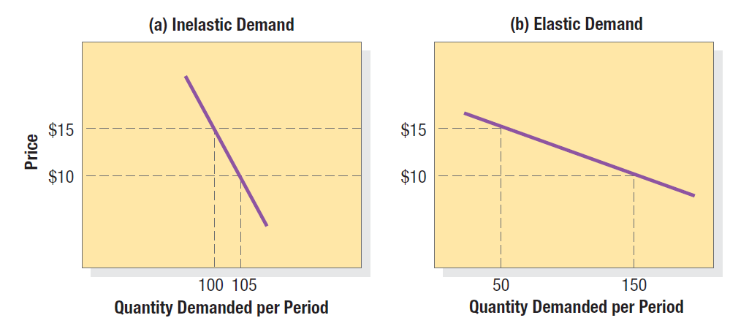
Demand elasticity
Kotler and Keller, Marketing Management.

Slide 9
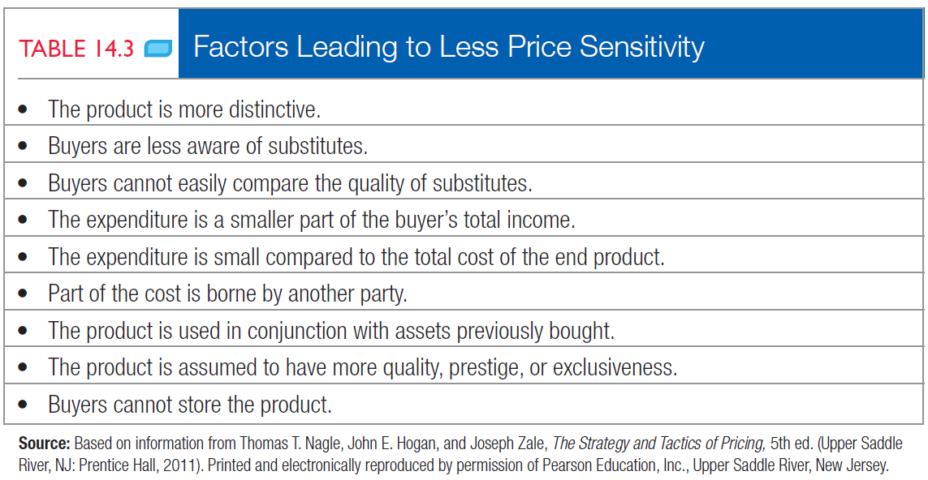
Inelastic demand
Kotler and Keller, Marketing Management.

Slide 10
Setting a price: Estimating Costs
Fixed (overhead), variable, total, average, marginal, long-term, short-term, learning curve…
Does not have to be met
costs determine price
but can also happen
price determines costs
(target costing)

Slide 11
Setting a price: Analyzing Competitors
Competitors‘ costs, prices, offers
Will the competitor react? How?

Slide 12
Setting a price: Which Method?
Which pricing method to select?
Markup pricing
Target-return pricing
Perceived value pricing
Value pricing
Going-rate pricing
Auction-type pricing

Slide 13
Setting a price: Which Method?
Kotler and Keller, Marketing Management.
Notes:
Přidat obrázek 14.4 s. 395 v 14 ed.

Slide 14
Setting a price: the Final Price
How will our customers perceive the price?
Is it in concord with positioning and other elements of the marketing mix?
What will be the impact on other companies on the market?
How about to give it for free?

Slide 15
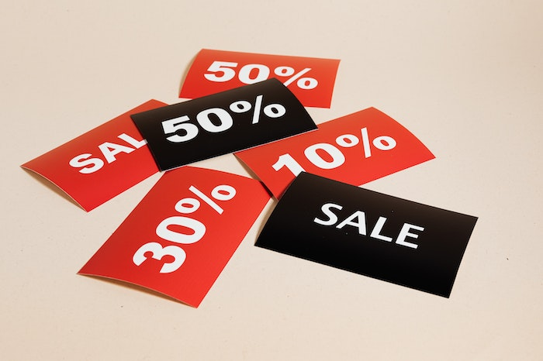
Setting a price: Adapting the Price
Geographical pricing
Promotional pricing
Price discounts and allowances
Differentiated pricing
Initiating and responding to price changes
Notes:
https://images.crowdspring.com/blog/wp-content/uploads/2023/04/11155251/pexels-karolina-grabowska-5650026.jpg

Slide 16
Where to study from
Obligatory:
Chapter 14 Developing Pricing Strategies and Programs in Kotler and Keller, Marketing Management,14th ed. from p. 382.
or
Chapter 16 Developing Pricing Strategies and Programs in Kotler and Keller, Marketing Management,15th ed. from p. 482.
or
Kapitola 14 Příprava cenových strategií a programů v Kotler a Keller, Marketing Management, přeloženo z anj., 14. vyd., 2013, od s. 149. [MAR 543] - dostupné v Bookportu
Rozšiřující: Kapitola 9 v Zamazalová a kol., Marketing, 2. vyd., 2010.

