Slide 1
Business Central Introduction
Selling and Purchasing
Ing.J.Skorkovský,CSc.
Department of Business Management
Faculty of Business and Administration
Masaryk University Brno
Czech Republic

Slide 2
Most importatnt objects in purchasing and selling
Customer card
Vendor card
Item card
Locations
G/L Account

Slide 3
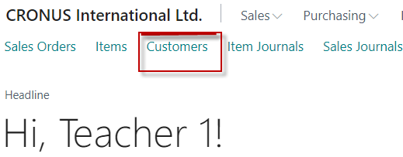
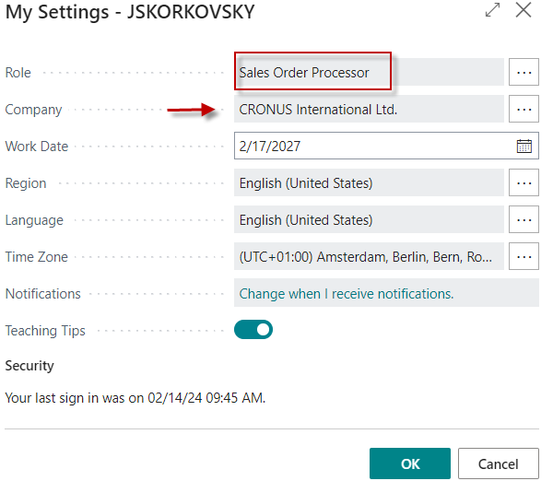
Customer card access

Slide 4
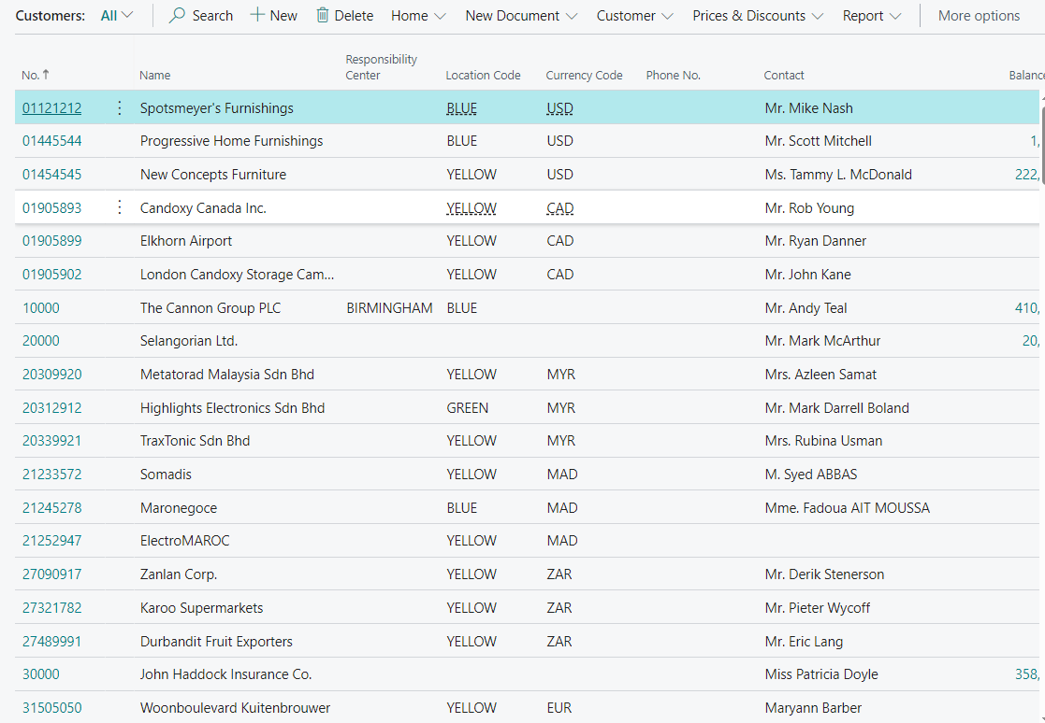
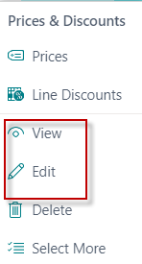
List of customers
See next slide

Slide 5
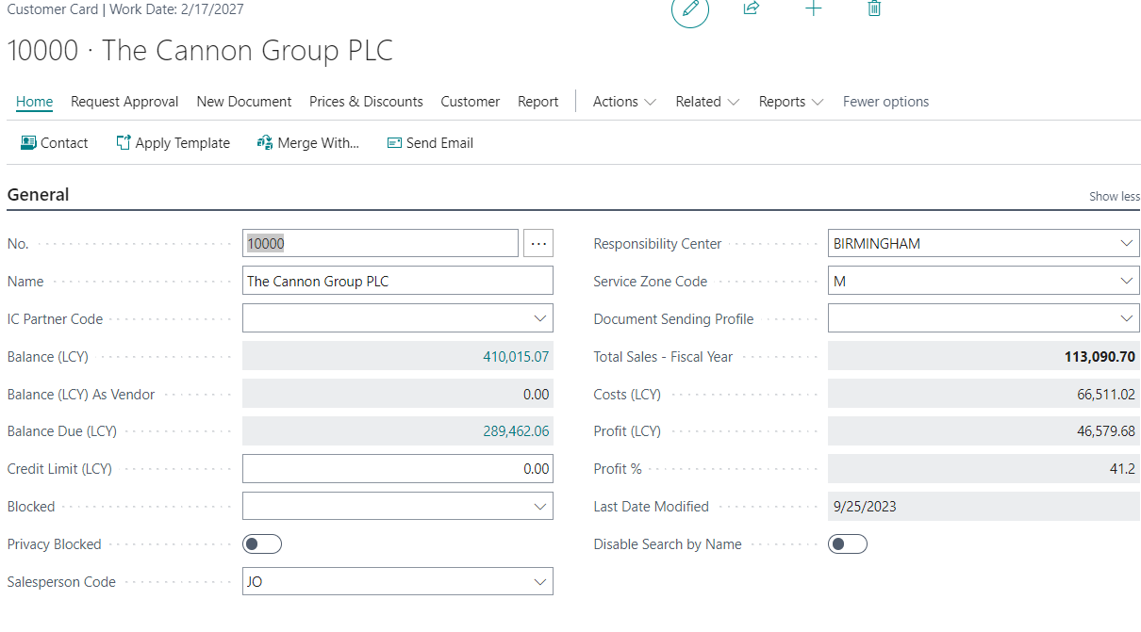
Customer card –tab General

Slide 6
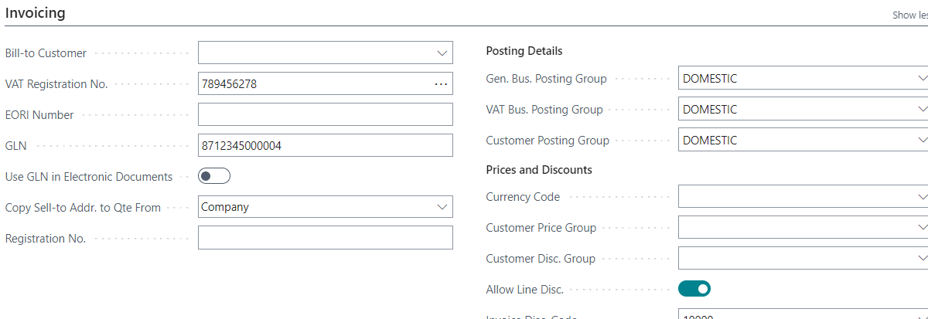
Customer card –tab Invoicing

Slide 7
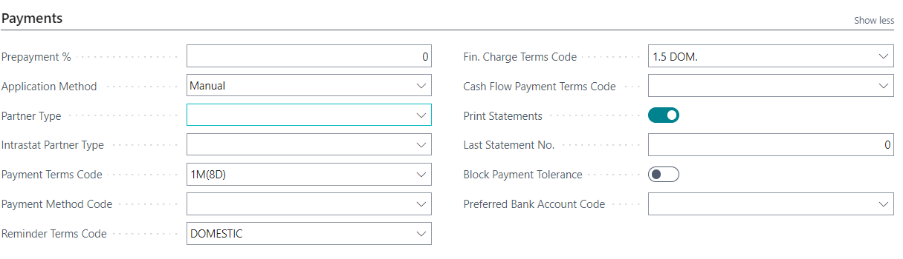
Customer card –tab Payments

Slide 8
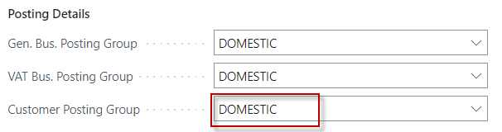
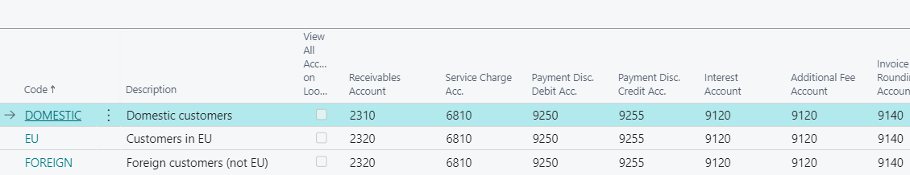
Relation to G/L accounts-> Pre-accounting of accounts related to sales (předkontace) – one of three approaches

Slide 9

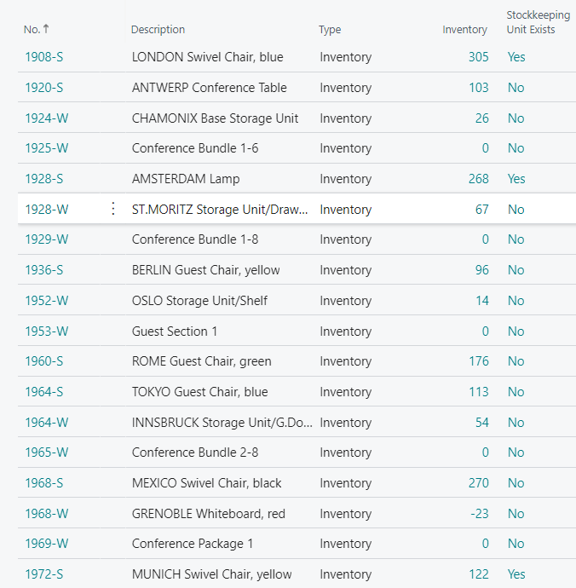
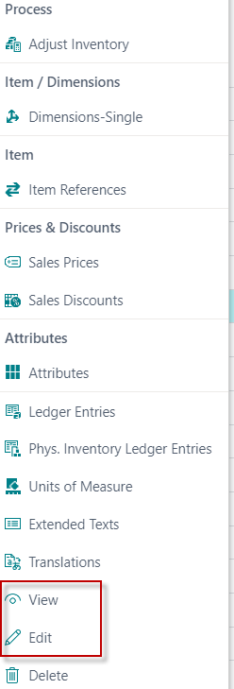
Item card (from list to card)
See Item CARD

Slide 10
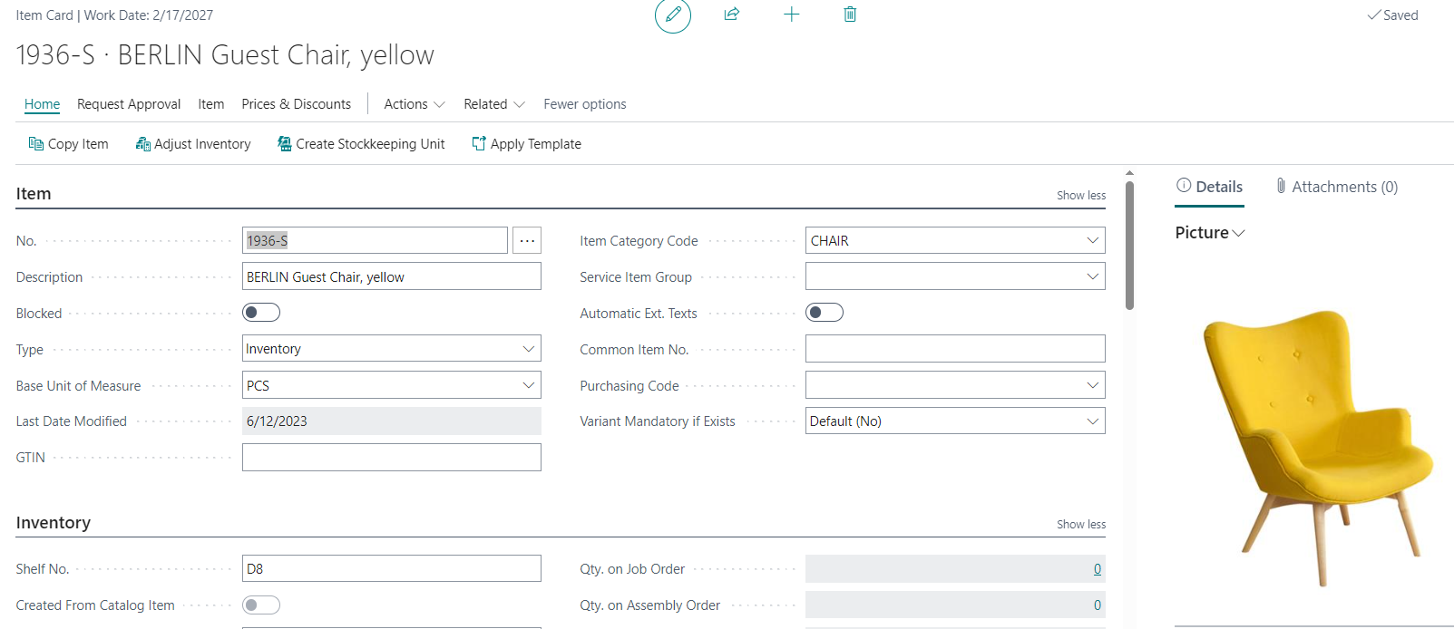
Item card – tab General

Slide 11
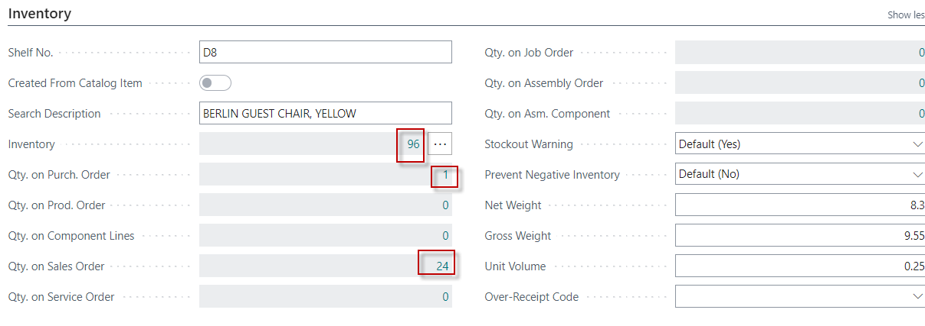
Item card –tab Inventory

Slide 12
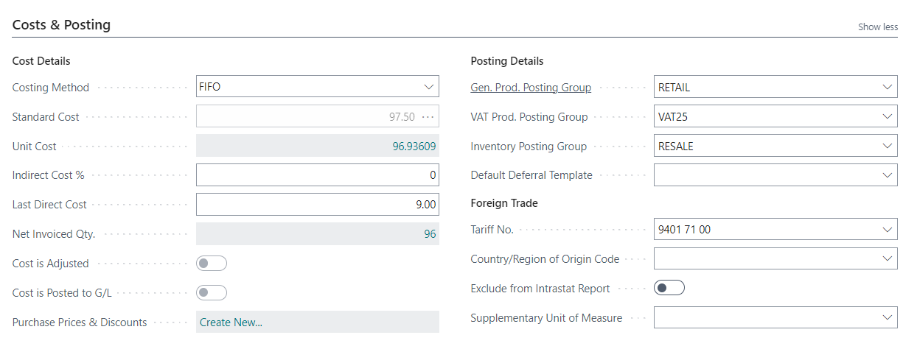
Item card – tab Costs &Posting

Slide 13
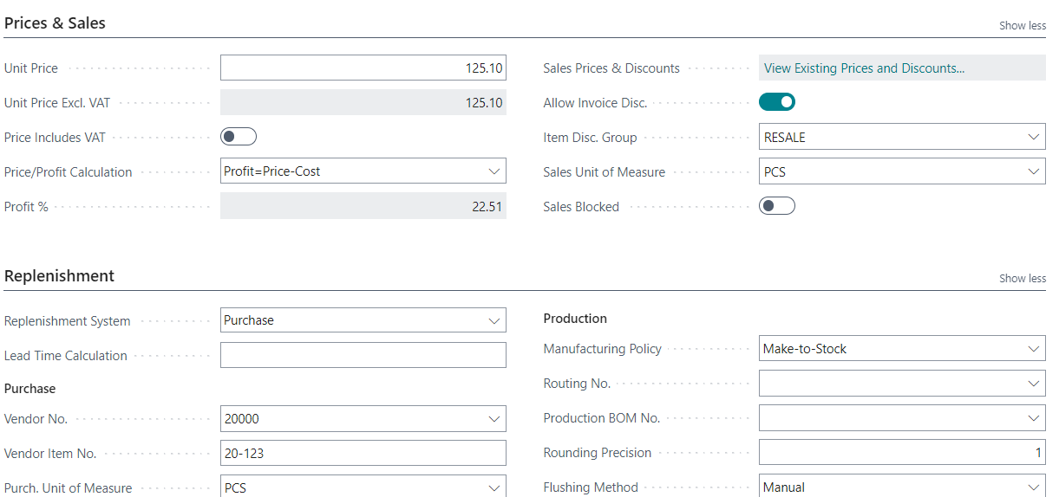
Item card – tab Prices & Sales and tab Replenishment

Slide 14
Vytváření prodejní objednávky
Zákazník
Ctrl-N
Hlavička prodejní objednávky
Nutno zadat množství
3
Řádek (řádky) prodejní objednávky
Zboží

Slide 15
Vytváření nákupní objednávky
Dodavatel
Ctrl-N
Hlavička nákupní objednávky
Nutno zadat množství
3
Řádek (řádky) nákupní objednávky
Zboží

Slide 16
The basics of double entry accounting presented
on Sales Order posting
Link between amounts posted to general ledger accounts and customer items ledger entries
See next slide

Slide 17
Double-entry booking (Selling process –> Sales Order->Sales Invoice)
Customer
Account (2310)
Revenue
Account (6110)
VAT (25%)
Account (5610)
Customer
Debit
Credit
Debit
Debit
Credit
Parameters
Credit
125
125
100
25
Invoice (1st)
Sales Order Header
Payment (2nd)
Bank (2920)
Relace CZ a ENG účtů
311 - 2310
602 - 6110
343 - 5610
221 - 2920
Debit
Credit
125
Sales Order Line
Balance on Customer card =
125 ->100+25
Parameters
Balance on Customer card =
0 ->125-125
Item card
125
125
-100
-100
-25
-25
Note: the amounts in total entries do not match the amounts in the animated
example. It is only an explanation that the relevant entries (transactions)
are created gradually during the business example
125

Slide 18
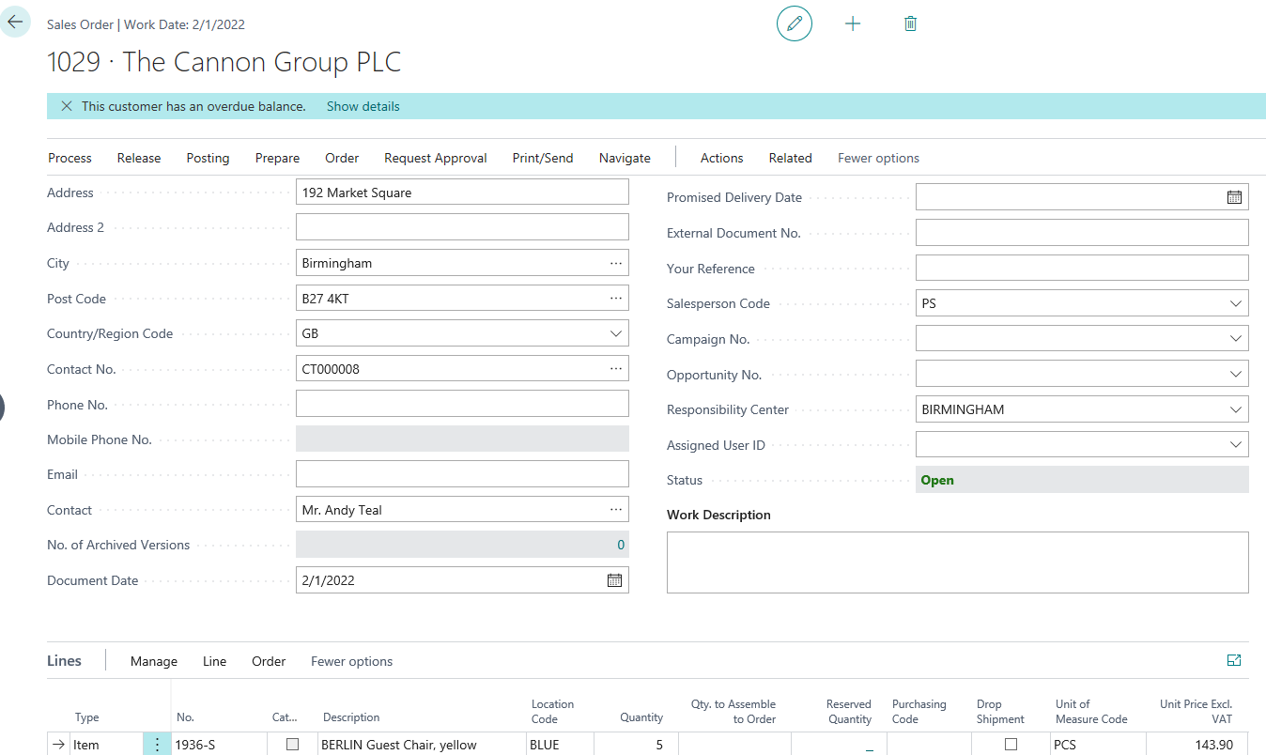
Sales Order
The sales order printing will be demonstrated in the classroom and is not part of this presentation

Slide 19
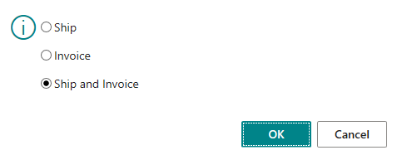
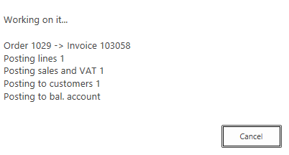
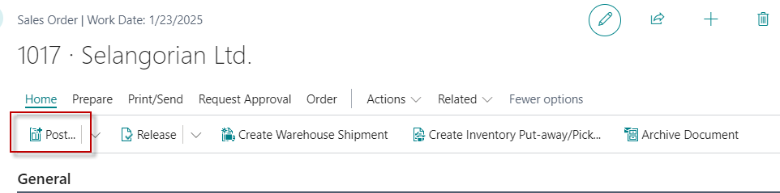
Sales Invoice (F9)
Three possible options
Either use the F9 key or find the Post icon. It is easier and therefore faster to use keyboard shortcuts.
Post Icon or F9
BC creates all
entries
G/L Entries
Item Ledeger Entries
Customer Ledger Entries
Results of posting
Sales Order

Slide 20
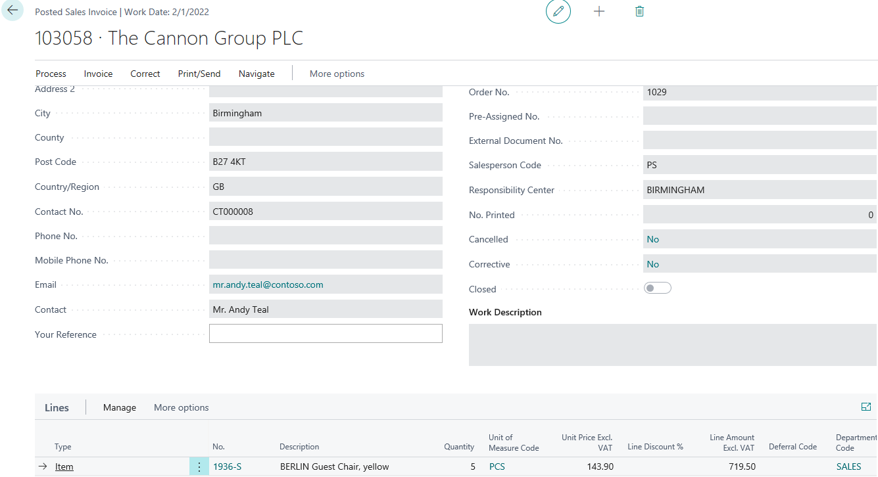
Posted Sales Invoice (after posting by F9 hot key)

Slide 21
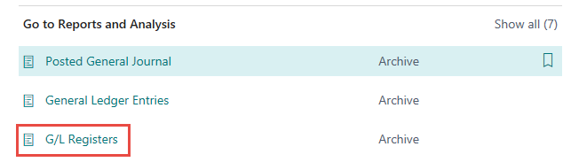
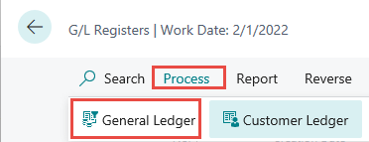
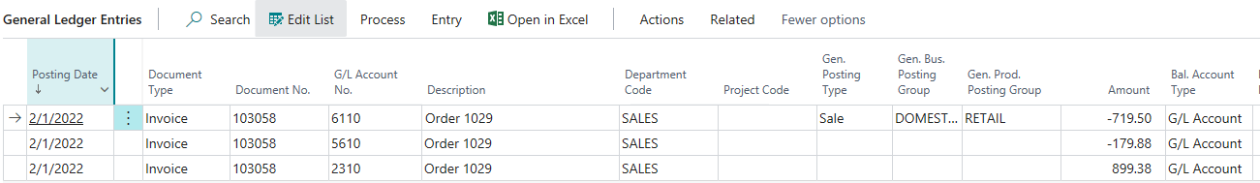
General Ledger (impacts) – One way to get at it
+ Sign -> Debit , - Sign -> Credit
719,50+179,88=899,38

Slide 22
Demand creation – Sales Order (only theory so far)
Reasons - instructions for creating the model
  Planning - calculation of replenishment and Creation of Purchase Order (PO)
  Creation of two different PO covering demand with different costs
  Posting both PO (Purchase Order documents)
  Partly posting of Sales Order (For example, not everything was delivered by Vendor )
  See applied Item Ledger Entries (this affects stock levels)
  See important fields on the Item card
  Inventory Adjustment (will be explain at the end of the course PIS1 - and the startd of PIS2 course)
  See the impact on item General Ledger Entries
  See the impacts on Value entries (will be explain more in detail later – only PIS2 course !!!!)

Slide 23

Logic
Business Central supports supply planning for wholesale companies where the resulting supply orders can only be transfer and purchase orders.
The main interface for this planning work is the Requisition Worksheet page,
Which will be shortly described by tutor (only PIS2 coursce).
Material Requirement Planning
Netting
Vendor card
Customer card
Requisition worksheet
Proposals to replenish warehouse
Parameters
Parameters
Value entry
Sales Item ledger entry
Purchase Order Header
Sales Order Header
Purchase Item ledger entry
Purchase Item ledger entry
Value entry
Purchase Order Line
Sales Order Line
Value entry
Parameters
Item card
Parameters
Item card
Raw Data
Balancing
Replenishment
Demand

Slide 24
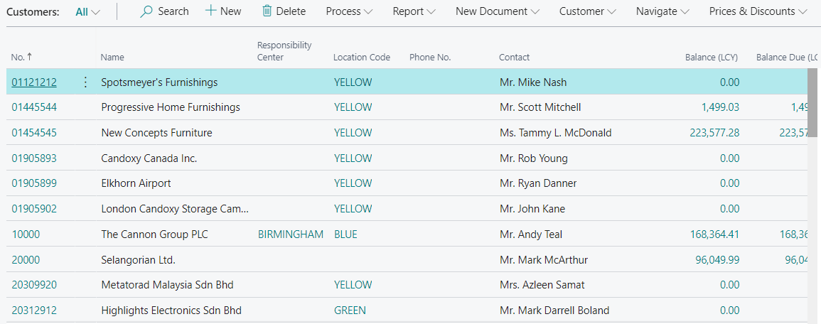
Customer card (already presneted in this show)
Customer list

Slide 25
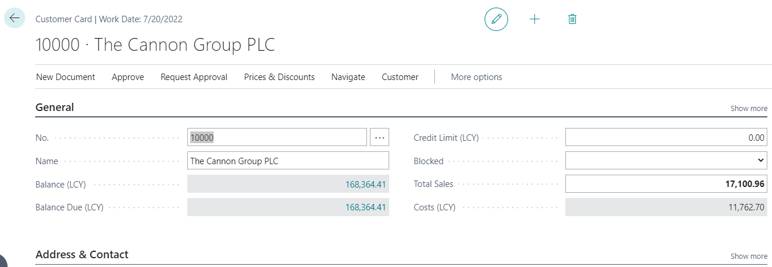
Customer card – access to entries from caclulation field
Ctrl-F7
Customer ledger entries

Slide 26
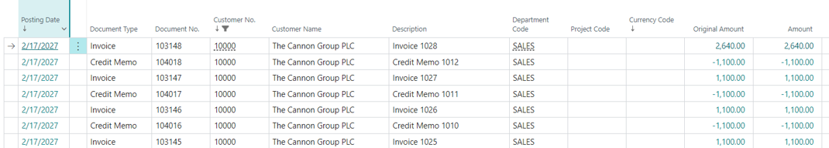
Customer ledger entries from the card
Customer card
Ctrl-F7

Slide 27
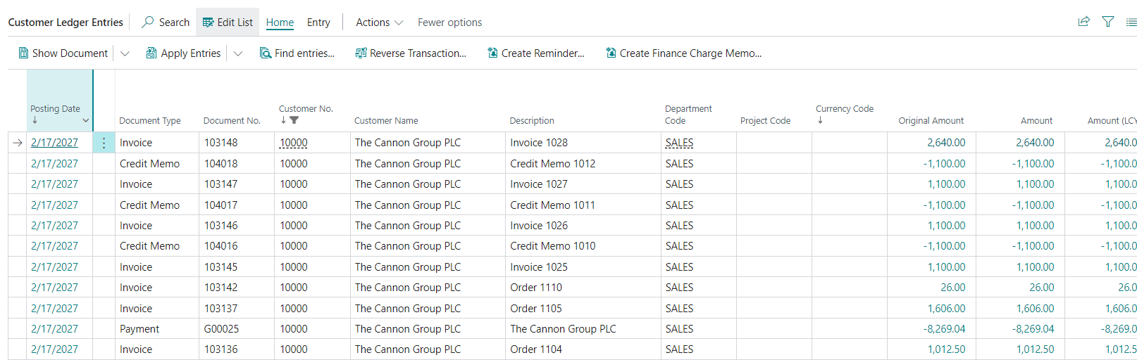
Customer entries – part of the file

Slide 28
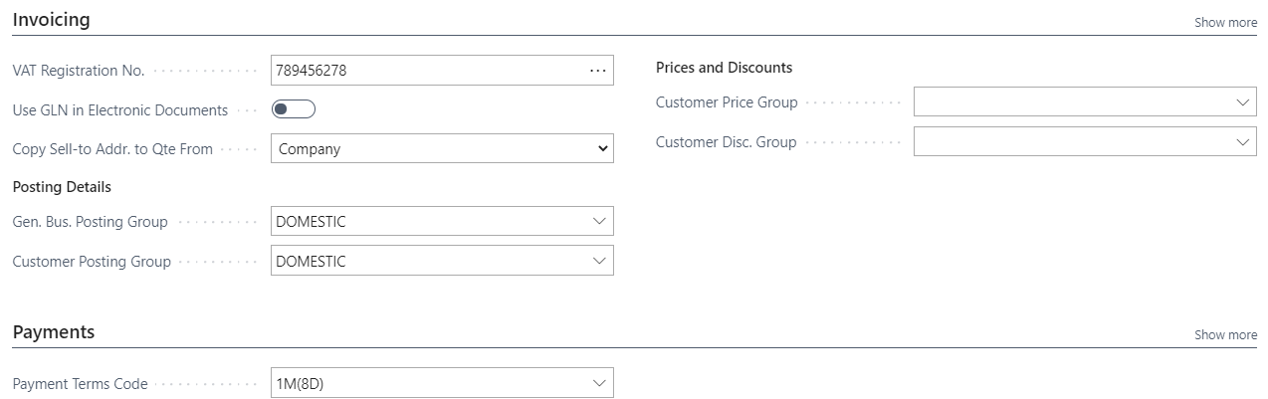
Customer card – already presented

Slide 29
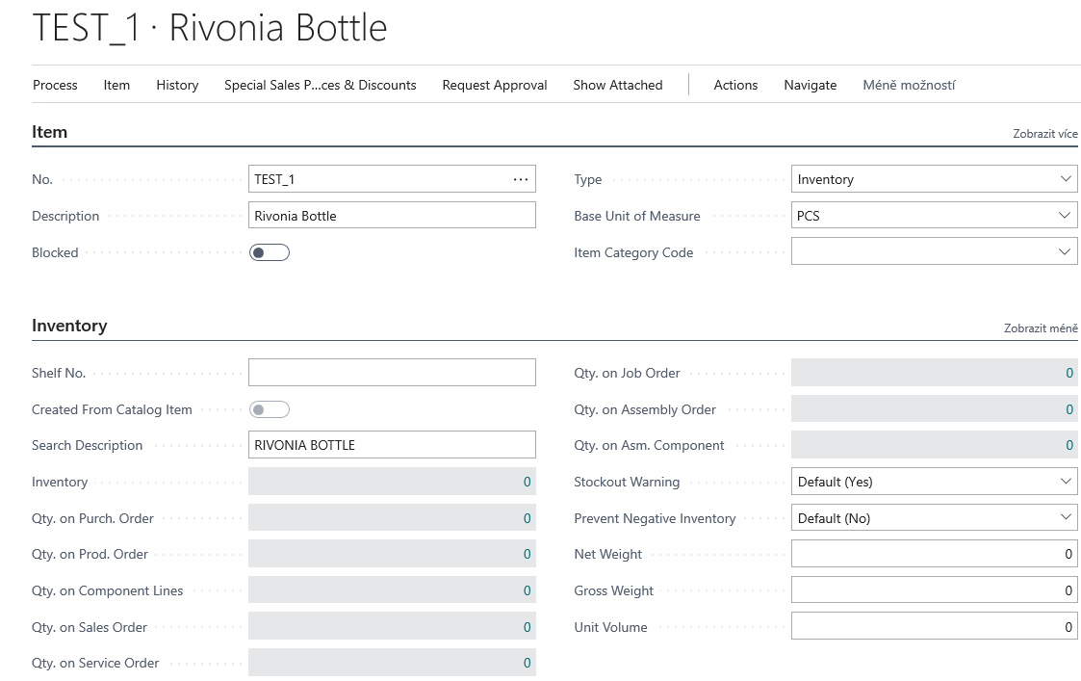
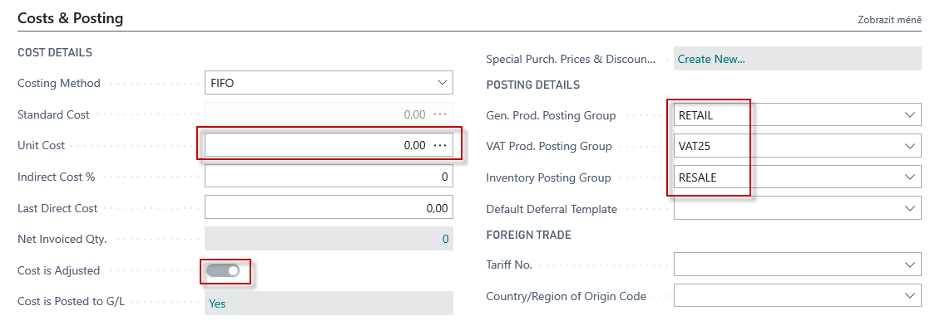
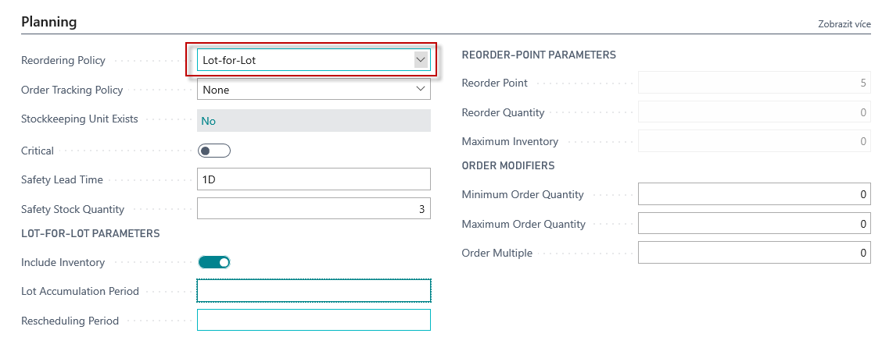
New item card (FIFO)
Lot Accumulation period explanation on the next slide
Lot-for-lot : The quantity is calculated to meet the sum of the demand that comes due in the time bucket.

Slide 30
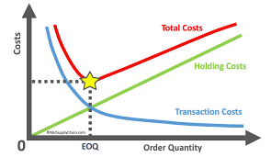
Lot- for- Lot-> Economic Order Quantity
Instead of three different purchases over time, everything is purchased only once
Quantity
Quantity
One purchase
Time
Time

Slide 31
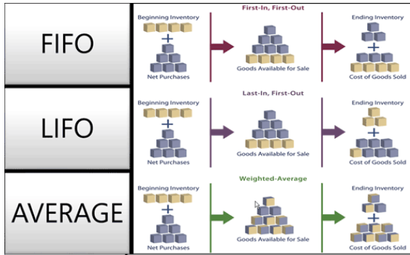
FIFO costing method (home study)
An item's unit cost is the actual value of any receipt of the item, selected by the FIFO rule.
In inventory valuation, it is assumed that the first items placed in inventory are sold first.

Slide 32
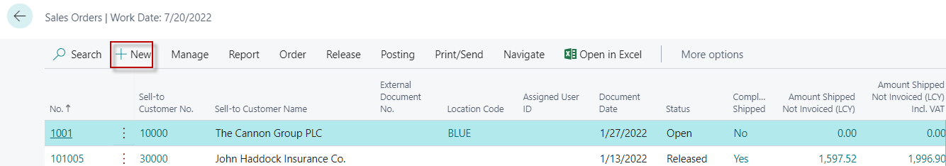
New Sales Order
To find Sales orders you can use searching window !!!!
List of Sales Orders already created but not posted so far

Slide 33
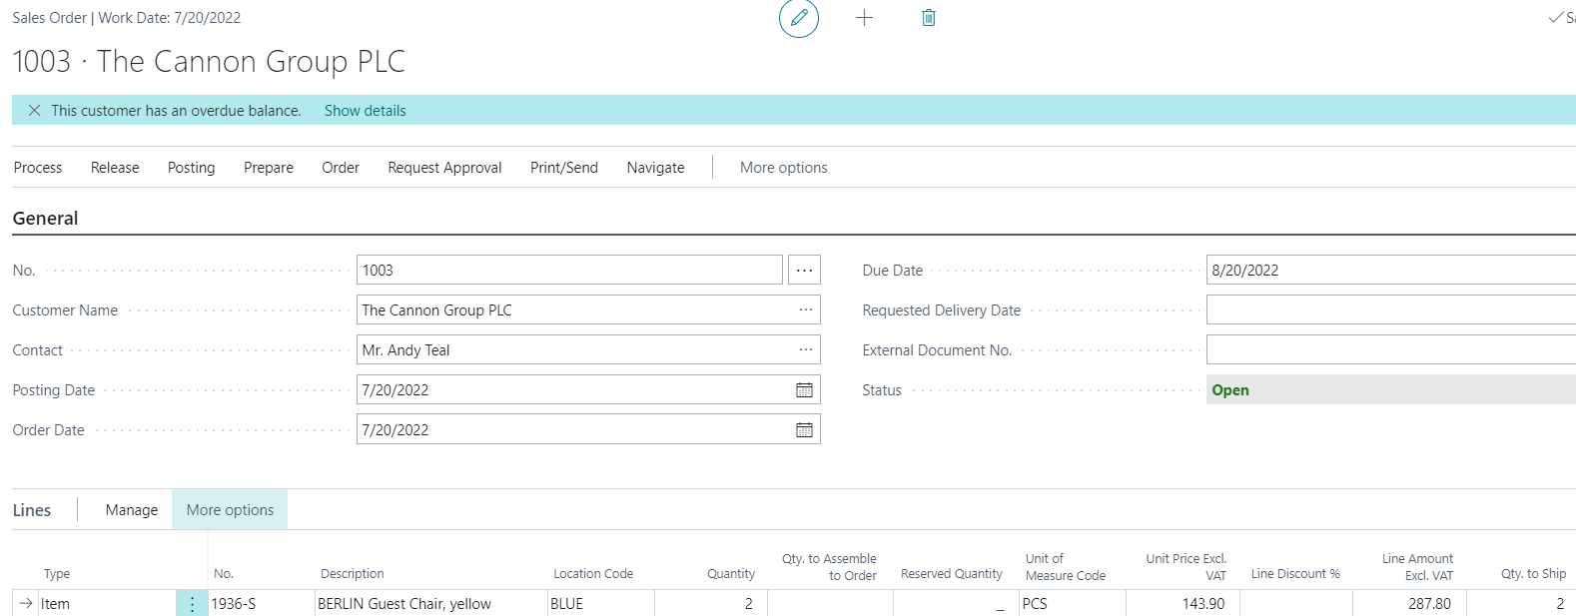
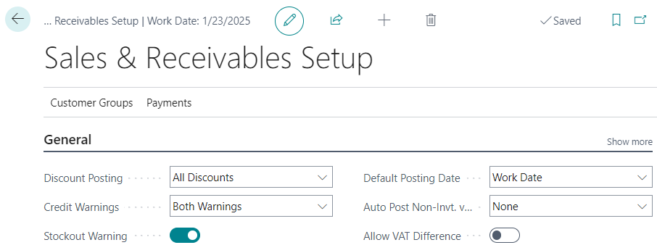
Sales Order created
It's just a warning based on Sales and

Slide 34
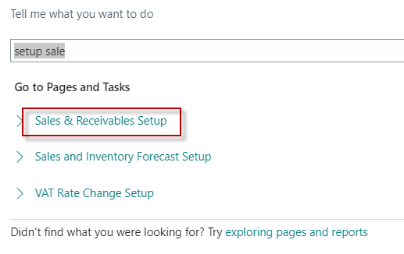
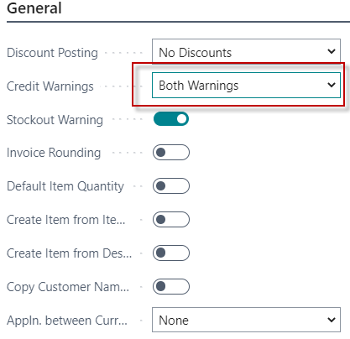
Setting warning types in BC
Credit limit (LCY)
Overdue
Both Warning
No Warning
Options
Credit Limit (LCY)
Specifies the maximum amount you allow the customer to exceed the payment balance before warnings are issued.
Learn more
Explanation : LCY=Local Currency (in ourt model = British pound - thanks to the fact that we work with an English demo database, which is used as a demo database worldwide)

Slide 35
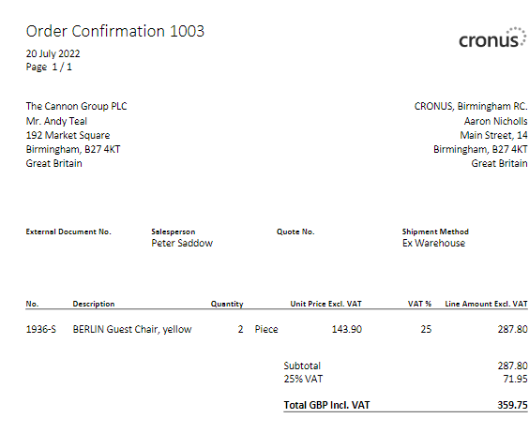
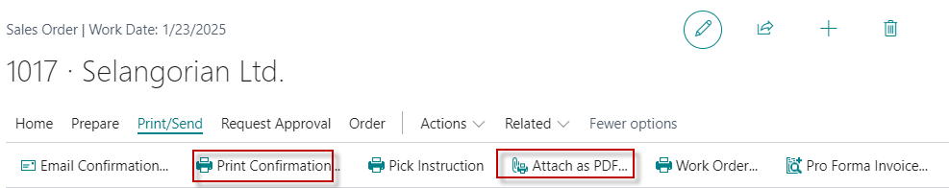
Sales Order Print confirmation->Preview only
It can also be in format pdf

Slide 36
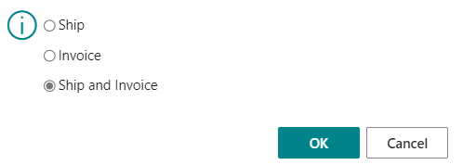
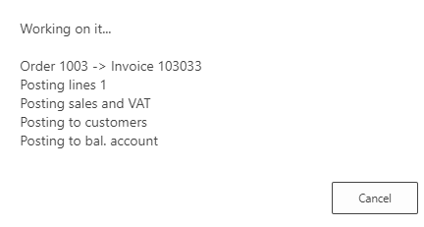
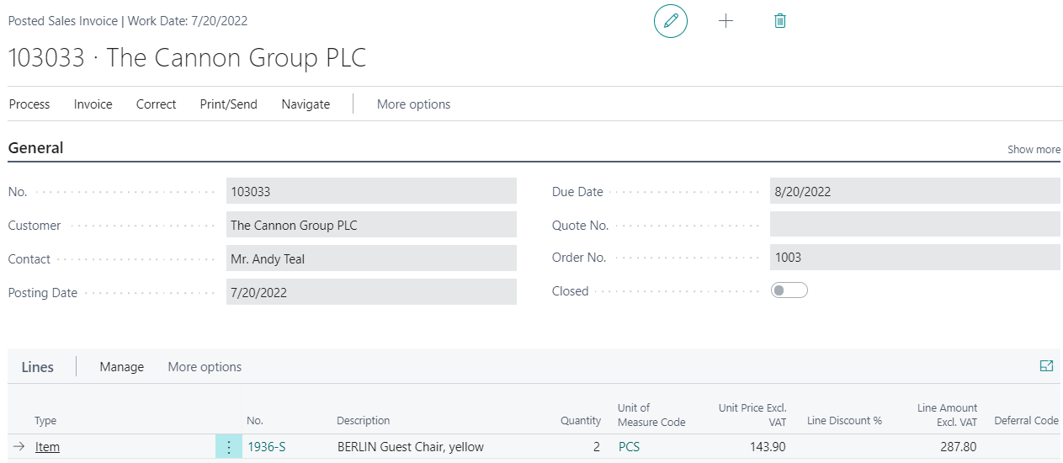
Sales Order posting (by use hot key F9)->Result->Sales invoice
You can also find it in BC
using the search window

Slide 37
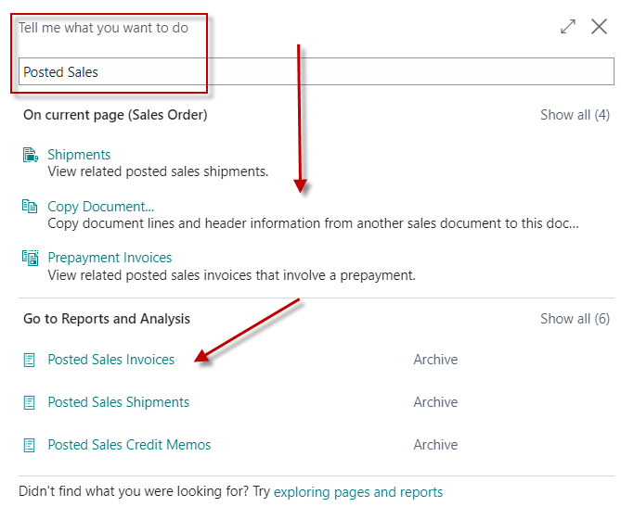
List of all Posted Sales Invoices

Slide 38
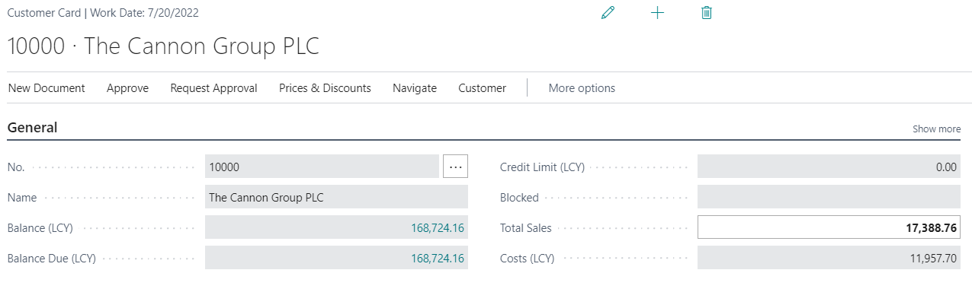
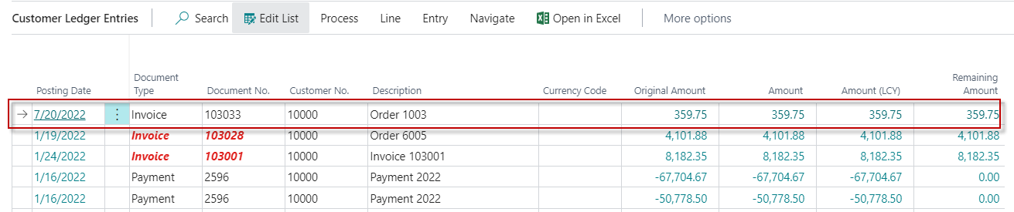
Customer Ledger Entries (raw data) - review
Ctrl-F7

Slide 39
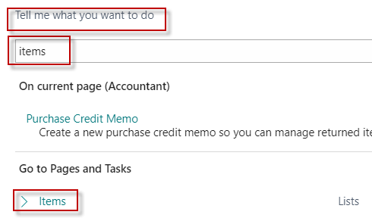
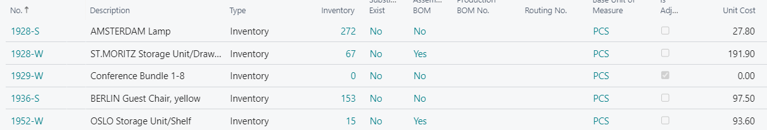
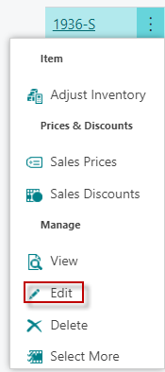
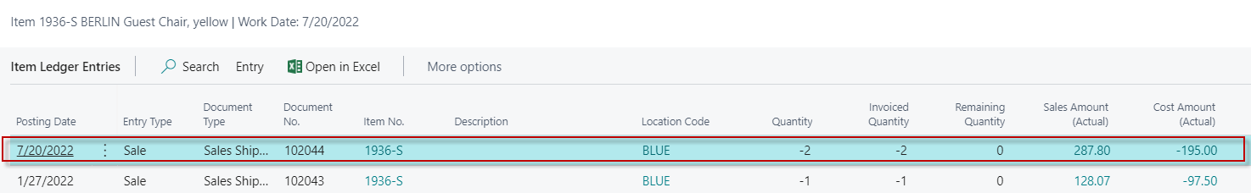
Item Ledger Entries
Edit
Item card 1936-S
Ctrl-F7
Costs, selling prices, decrease or increase in stock levels)

Slide 40




General Ledger Entries

Slide 41



Purchase Order – List of Vendors
Vendor Card

Slide 42


Purchase Order – Vendor Card

Slide 43


General Ledger Settings – already presented
Link to the general ledger account settings on which the purchase order, that will become the purchase invoice will be posted
See tab Invoicing and options : Show more fields, Select from
full list->Edit list->Option Setup
Vendor card –> one card = one chosen parameter
Item card –> one card=one chosen parameter

Slide 44


Purchase Order – document (Header and Lines)

Slide 45

Purchase Order (PO) – document (Header and Lines)
Where there is
an orange asterisk
you need to add always
the data !!!!

Slide 46


PO- Preview

Slide 47



PO - preview posting by appropriate icon
G/L Entries see next slide
Invoice (could be modified by personalize feature-adding fields)
Presented in BC - 2
Inventory (could be modified by personalize feature-adding fields)

Slide 48

General Ledger Registers-> Archive

Slide 49

PO – General Ledger Entries - preview

Slide 50



PO – F9 posting

Slide 51



Use of items journal (in our case to purchase)
F9
See created Item entries

Slide 52

One partd od the Item card

Slide 53

Created item ledger entries (transactions)

Slide 54

Not a single day without a joke !!!
Máš pravdu. Asi jsme napřed měli postavit ten hrad a teprve potom ten vodní příkop.

Slide 55


