Slide 1
Introduction to MS Dynamics
Customer Relationship Management - Pareto analysis – theory
(For a very simple demonstration used in the tutorial, see file BC - 8-3 )
Ing.J.Skorkovský,CSc.
MASARYK UNIVERSITY BRNO, Czech Republic
Faculty of economics and business administration
Department of business management

Slide 2
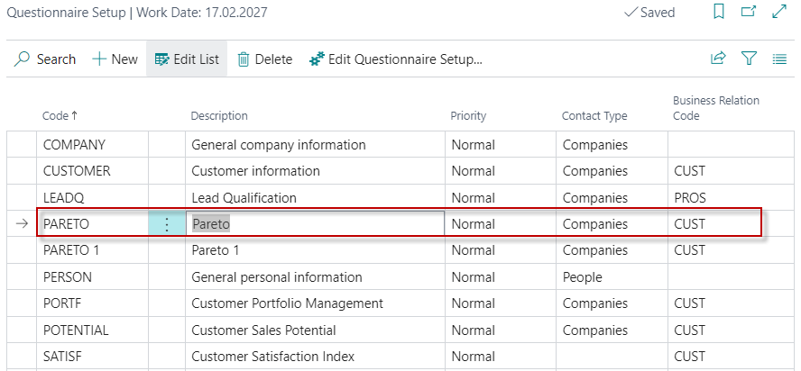
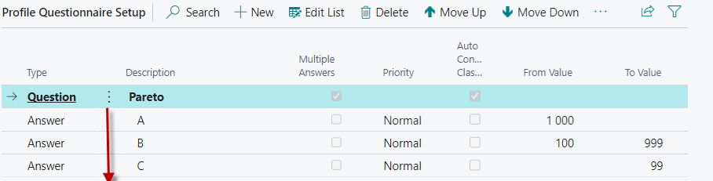
Pareto Analysis setup

Slide 3
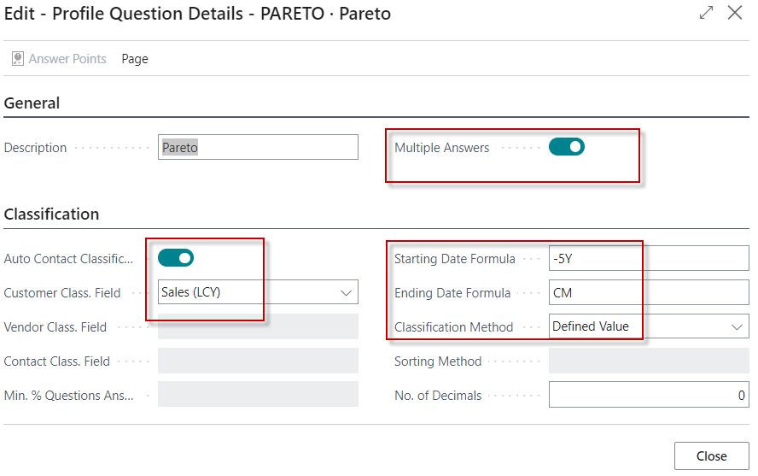
Pareto Analysis setup – Question Details

Slide 4
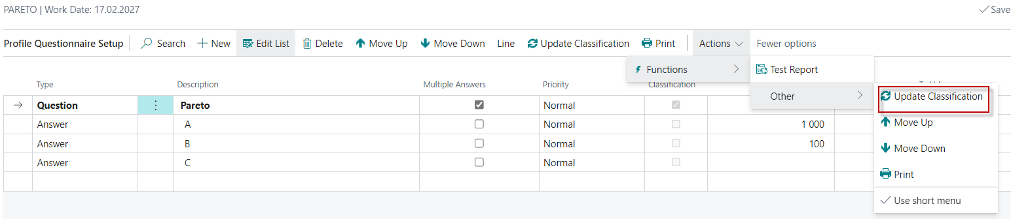
Pareto Analysis
We have already manually entered the amount limits for each category (A-C)
You must check Automatic evaluation
Run Update (update classification)
You will get the number of contacts (customers) falling into that category
1
2
3

Slide 5
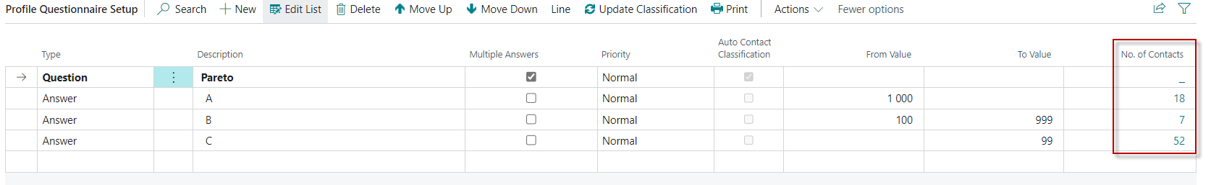
Pareto Analysis
4

Slide 6
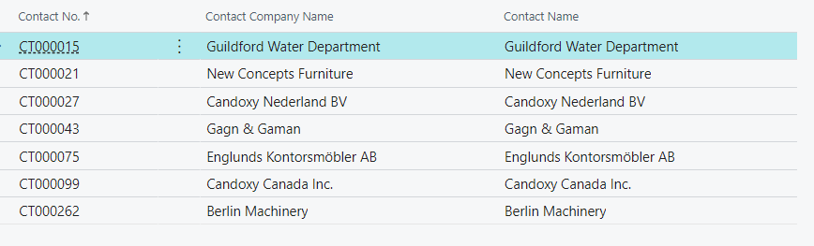

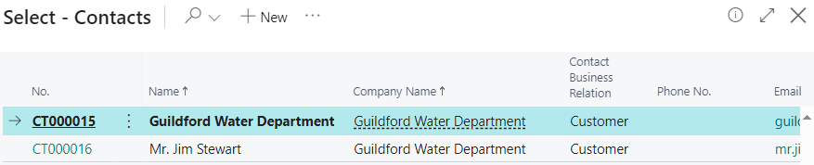
Pareto Analysis
By expanding the number of contacts (calculated field) and
we have used B for our model) we got :

Slide 7
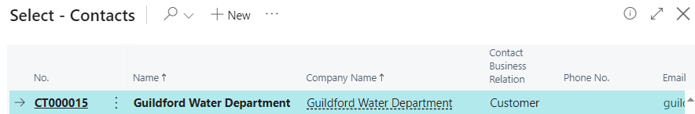
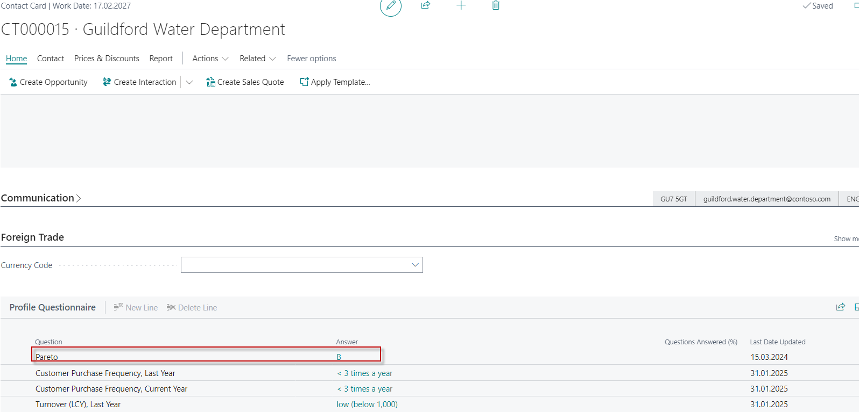
Pareto Analysis

Slide 8
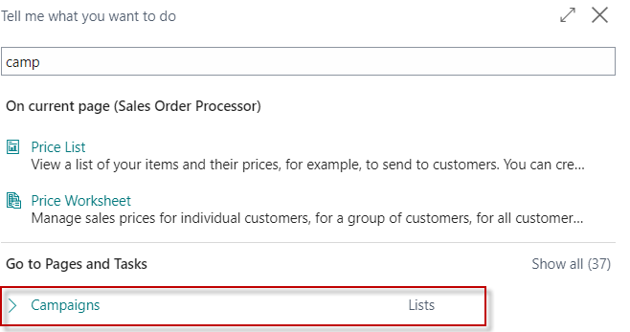
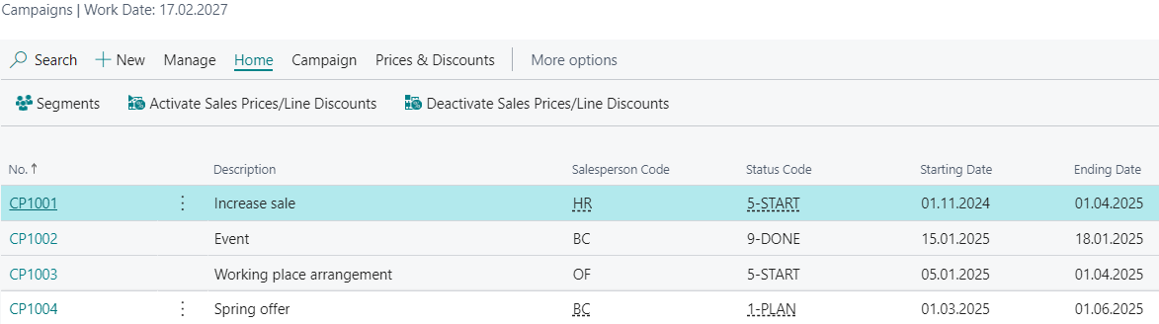
Campaign Setup – use of setup Sales Price Lists

Slide 9
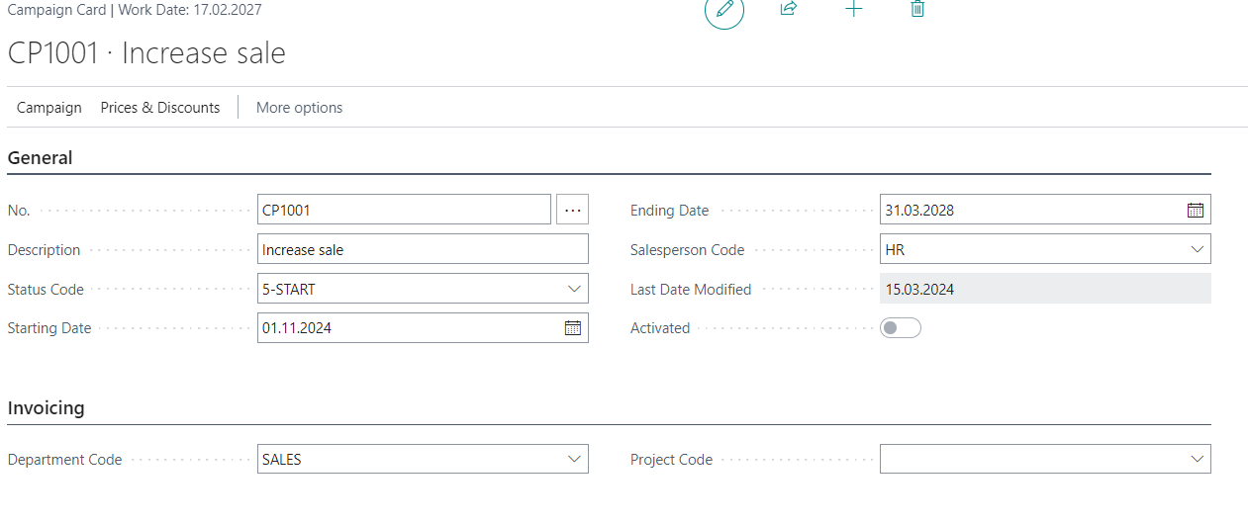
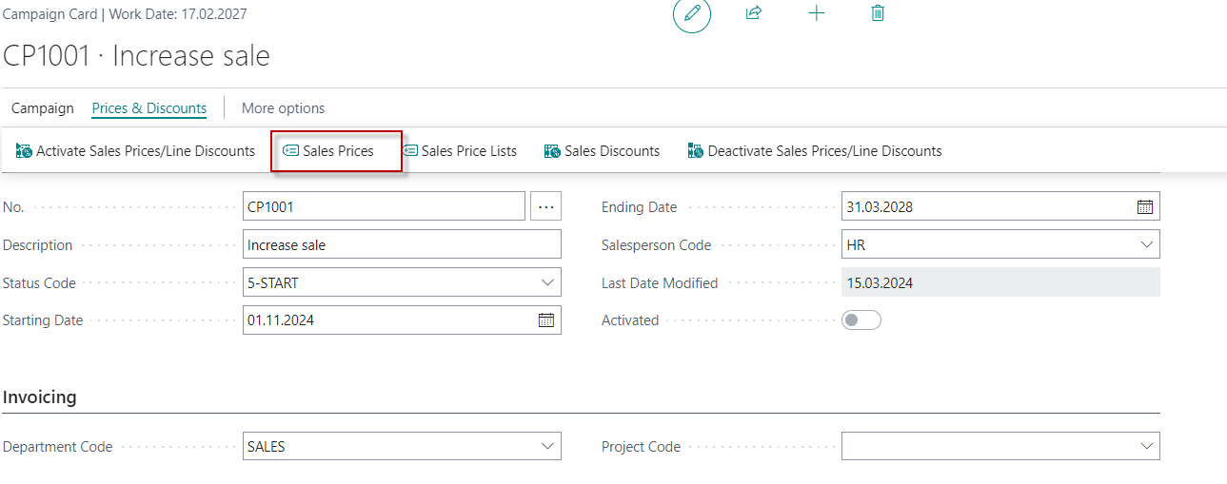
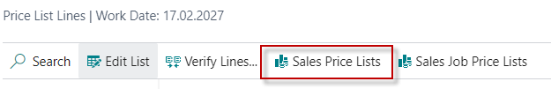
Campaign Setup

Slide 10
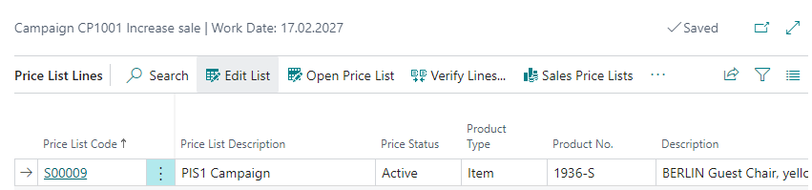
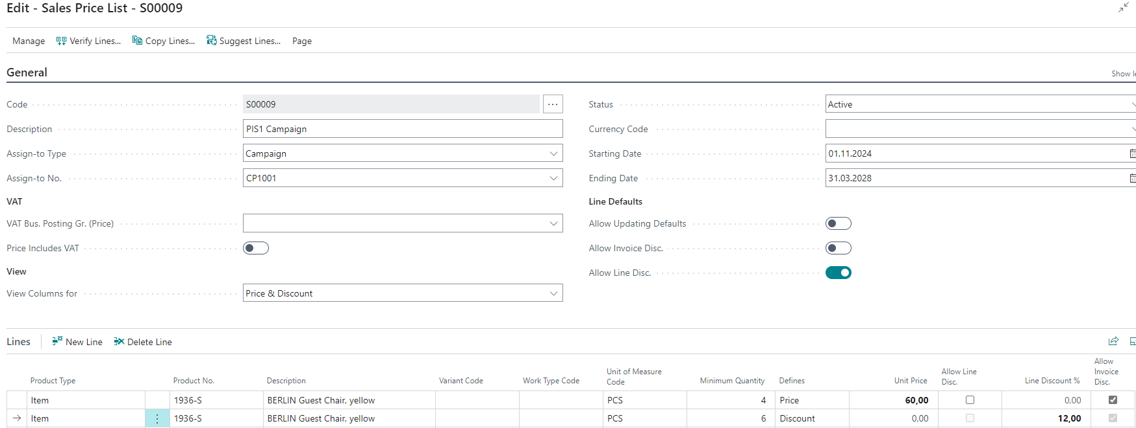
Campaign Setup Sale Price List

Slide 11
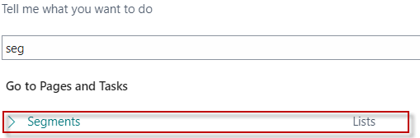
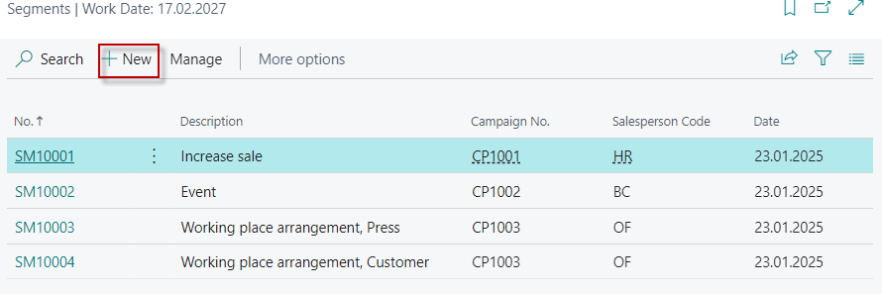
Contact Segmentation

Slide 12
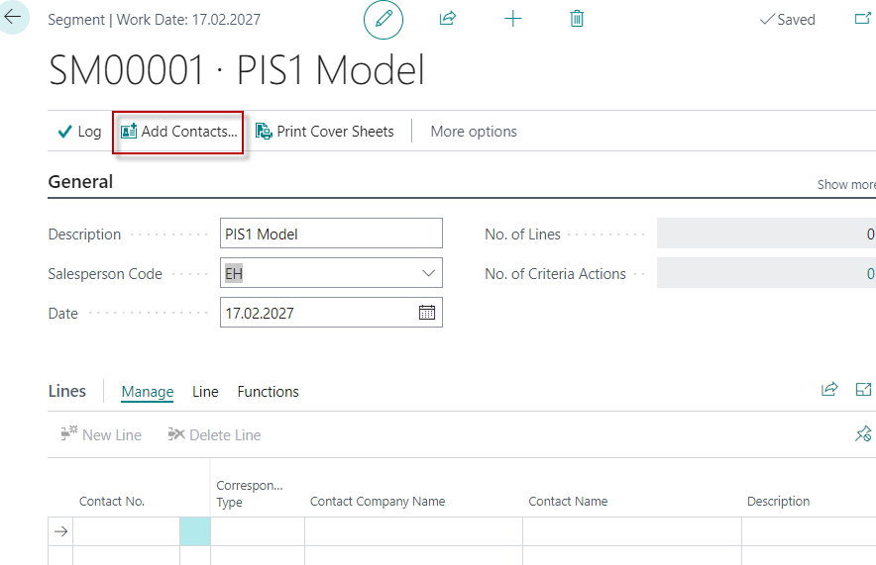
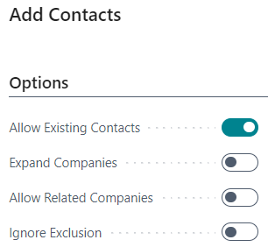
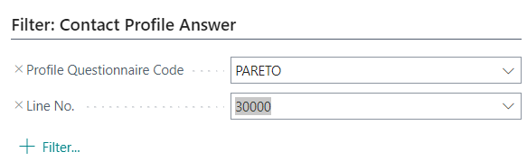
Contact Segmentation – Add contact Pareto B
B

Slide 13
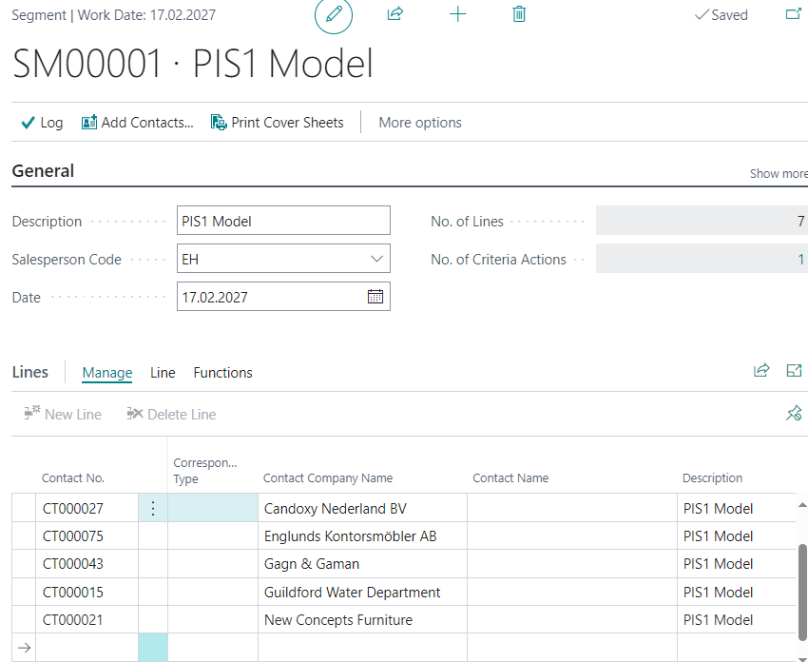
Contact segmentation – Conctacts type Pareto B

Slide 14
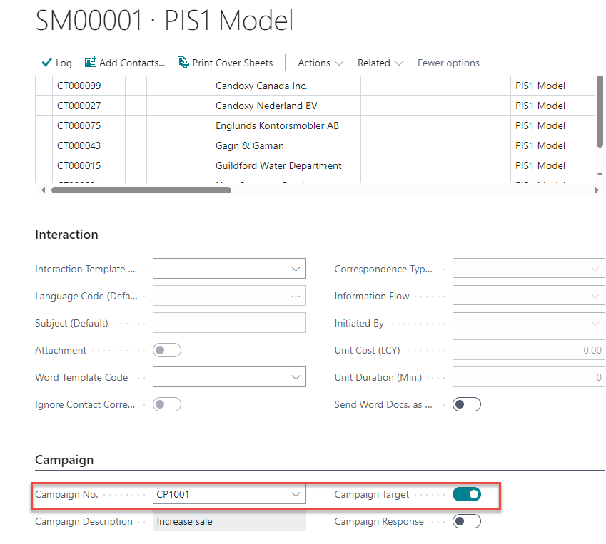
Contact segmentation ->Campaign added for Pareto B contacts

Slide 15
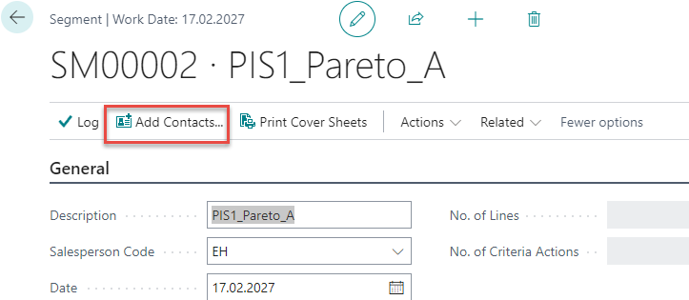
Contact Segmentation – Add contact Pareto A

Slide 16
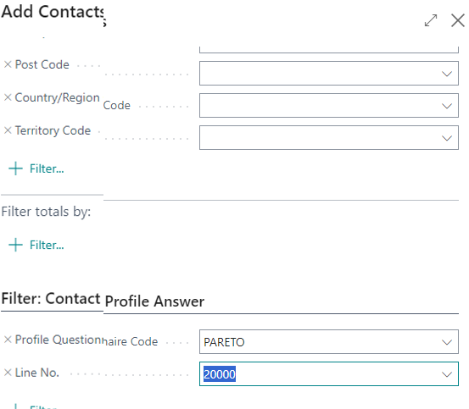
Contact segmentation – Pareto A contacts
A

Slide 17
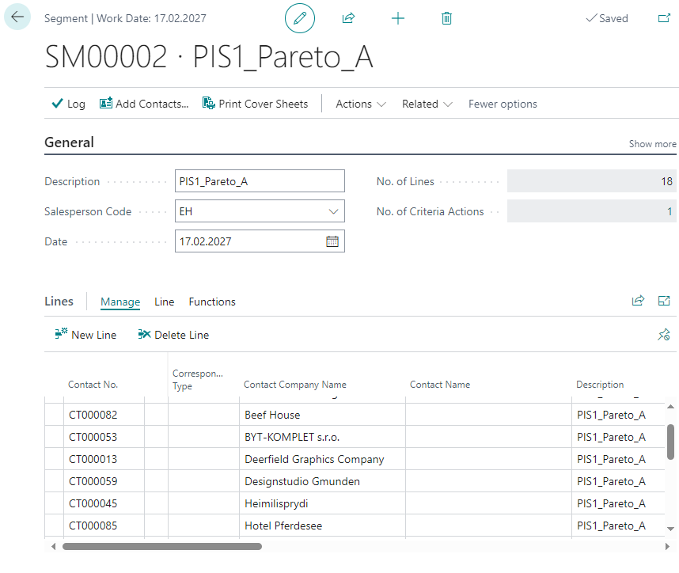
Contact segmentation – Pareto A contacts

Slide 18
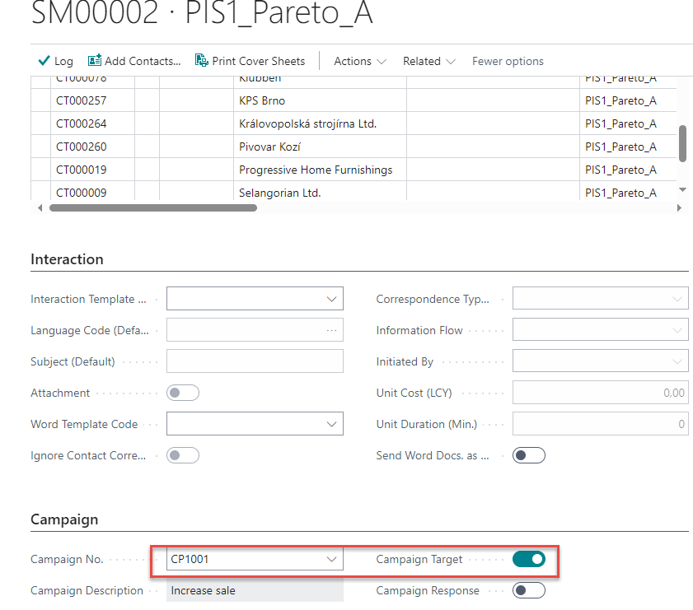
Contact segmentation ->Campaign added for Pareto A contacts

Slide 19
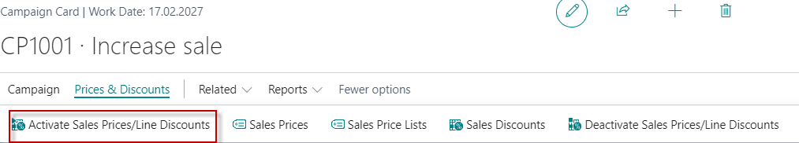

Activation of Sales Price lists for chosen
Customer Segments Parte A nad B and related campaign CP1001
Before activating discounts for a selected campaign, it is first necessary
to select a segment of customers according to the selected criteria (Pareto)
and assign this segment to the campaign being set up

Slide 20
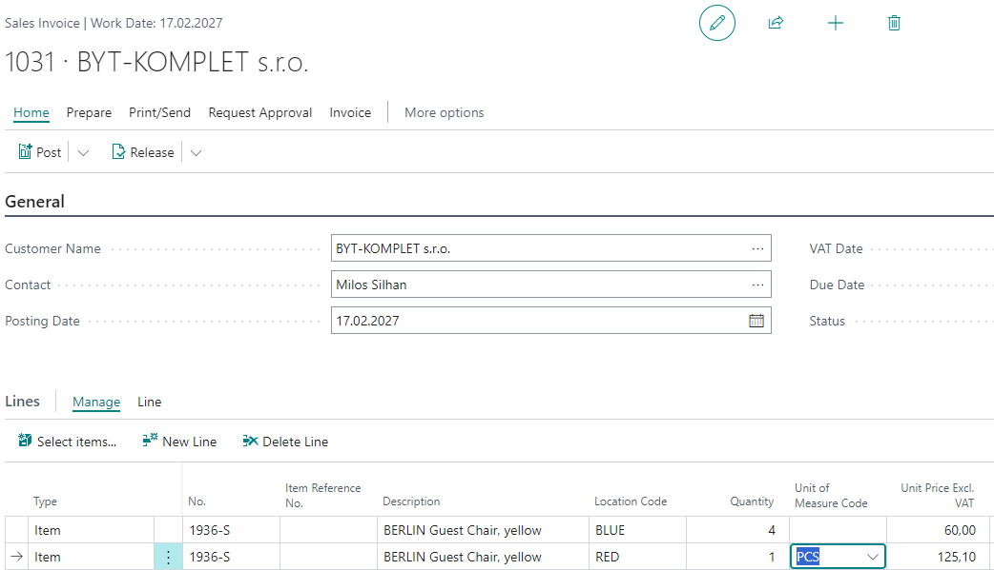
Sales Invoice for contact (Customer) Pareto A

Slide 21
Blokové schéma postupu příkladu
Nové zboží X
Nový zákazník
Přiřadit kampaň K1 vytvořenému segmentu
Prodej služby
Pareto analýza
Kampaň K1
V segmentu A zaškrtnout cíl kampaně
Prodejní ceník na zboží X (prod.cena a řád. sleva %)
Aktivovat slevy v kampani
Nový Segment (A)
PO (PF) pro klienta z vybraného segmentu
na zboží X
Selling a service to a new customer so that the contact
is classified as type A after updating the Pareto questionnaire

Slide 22
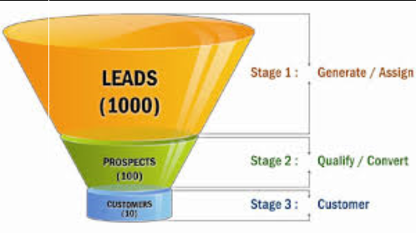
End of the section
(Customer Relationship Management)

Slide 23


