Slide 1
Yield Management Introduction
Ing.J.Skorkovský, CSc,
Department of Business Management
FACULTY OF ECONOMICS AND ADMINISTRATION
Masaryk University Brno
Czech Republic

Slide 2
Yield Management (YM) - definition I.
YM seeks to maximize yield or profit from
Time-sensitive products and services
Used in industries with flexible and expensive capacities, perishable products (fresh fish, flowers, bakery products) and uncertain demand (nejistý charakter poptávky).
It is part of revenue management
Type of problems:
overbooking (airlines, hotel industry,..)
partitioning demand into fare classes
single order quantities
YIELD: to produce or furnish (payment, profit, or interest): a trust fund that yields ten percent interest annually; that investment will yield a handsome return.

Slide 3
Yield Management (YM) - definition II.
Simply put, the purpose of Yield Management is to achieve maximum revenue/profit.
To get Max Revenue/Profit, a yield management strategy needs forward-looking approach – see next slide
Yield managers should also attain a clear and detailed understanding of what has happened before and what is happening now.
The most efficient way to do this is to draw from historical data to predict what may happen in the future.
So, the process of effective yield management involves understanding, anticipating, and reacting to consumer behavior (to maximize revenue ultimately).

Slide 4
Forward-looking approach
V širším smyslu může být forward-looking approach chápán jako plánování nebo strategie zaměřená na budoucnost, která zahrnuje předvídání trendů, potenciálních příležitostí a rizik. Tento přístup může být aplikován nejen v obchodním světě, ale také v osobním rozvoji, vzdělávání, technologickém vývoji a dalších oblastech, kde je důležité myslet dopředu a připravit se na budoucí výzvy a změny.

Slide 5
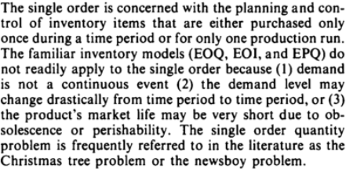
Single Order Quantity
Newsboy problem – see next slide and slide number 11 as well !!!
Economic Order Interval: period between orders
that minimizes the total inventory cost under
the given assumptions.
EOI is estimated by comparing the cost of placing an order with the cost of holding inventory.
EQO – viz soubor 07 EOQ basics
EPQ =Economic production quantity model
(also known as the EPQ model) determines
the quantity a company or retailer should
order to minimize the total inventory
costs by balancing the inventory
holding cost and average fixed ordering cost.

Slide 6
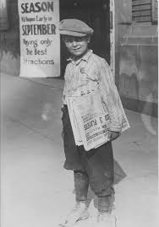
Newsboy problem
Often managers have to make decisions about inventory level over a very limited period. This is the case, for example with seasonal goods such as Christmas cards that should satisfy all demand in December, but any cards left in January have almost no value.
These single-period decision models are phrased as the Newsboy Problem. For a newsboy who sells papers on a street corner, the demand is uncertain, and the newsboy must decide how many papers to buy from his supplier.
If he buys too many papers, he is left with unsold papers that have no value at the end of the day.
If he buys too few papers, he has lost the opportunity of making a higher profit.

Slide 7
Prices and demand
Prices can be determined by:
Service
Group of services
Market (consumer type or geographical area) or
A combination of the above
Demand side is characterized with:
Variability of demand
Variability of value (time, area, type of client, type of service)

Slide 8
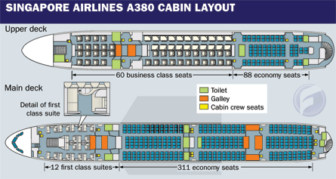
Overbooking (hotels, airlines,..) - example
7 % out of 311=22
10%-30 % of a no-show (traveler who reserved ticket, but canceled it at the last minute).
Therefore, airline companies overbook their capacities. The no-show ratio is often
lower than the overbooking ratio, so „bumped“ client will be compensated by providing
the free of charge service at another time or place. They are so-called „offloaded“ to other routes.
Example:
311 economy seats, estimation of 10 % no-show-> 31 places would be lost (only 311-31=280 seats occupied).
If overbooked by 10 % (31 more tickets offered) and no-show ratio on reality is only 7 %->only 22 clients
cancelled - > 311-22=289 seats occupied ->289 + 31=320->320-311=9 clients have to be „bumped“
(or 31-22=9) and provided by free air tickets, which is better than the loss of not sold 31 places.
You have to calculate the loss of 31 places -22 sold tickets =amount which must cover expenses for 9 bumped clients

Slide 9
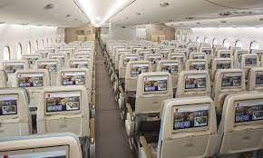
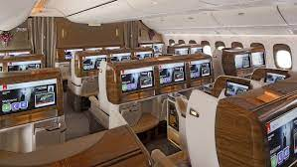
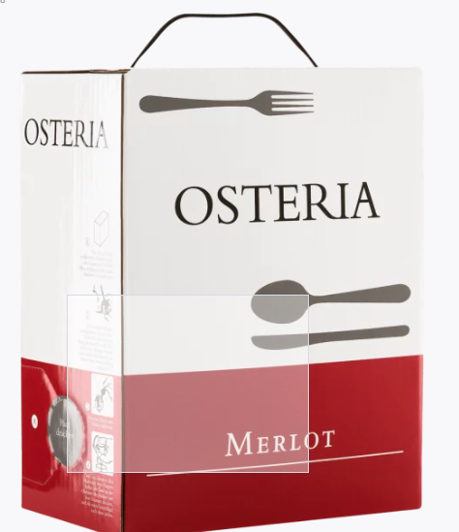
Basic calculations - example
Air ticket in economy class =10000
31 no-show = loss = 310 000= 31*10000
9 bumped travellers – granted business class instead of economy class ->one air ticket =30000
Cost of bumping = 270 000 =9*30000
Difference = 310000-270000 = 40000 profit
Economy
Business Class

Slide 10
Overbooking<->No-Show (home study)
Full Aircraft
Planned
No-show
Planned
No-show
Overbooked
Reality
NS
Overbooked
Final status
OB
B
B
= bumped passeners
Overbooked
NS
= no-show passengers
OB
B
OB
= overbooked passengers
Cost of B < Cost of No-show

Slide 11
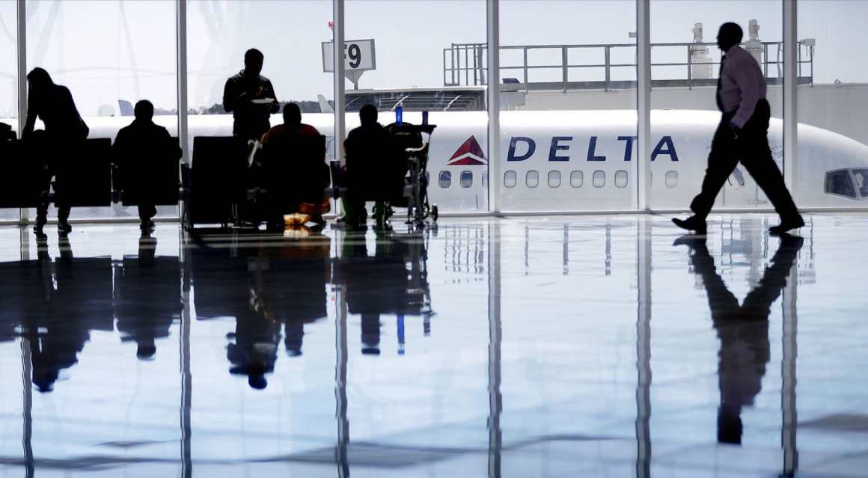
Overbooking - claims
Do not settle! Do not worry about it! Instead get up to €600 + luxury hotel + meals + additional expenses + wellness + new ticket + stay in the airport lounges!
Delta Air Lines has increased the amounts passengers can be offered to give up their seats to up to almost US$10,000 in extreme cases — something passengers can take advantage of if they act in collusion (secret deal).

Slide 12
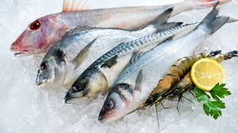
Single order quantities
Newspapers
Magazines
Florists
Bakeries
Fresh fishes

Slide 13
Single order quantities (home study)
N = number of items that can be sold (estimated optimum)
X = number of items ordered by Sales Manager (you buy more than N)
C0 = Cost of over-estimating demand (cost of remaining faded flowers not sold)
Cu = Cost of under-estimating demand (customers like to buy more flowers and you do not have enough)
Cu > = C0
P(N<X) = probability of over-estimating demand or no-show
P(X<=N)= probability of under-estimating demand or no-show
P(X<=N)*Cu >= P(N<X)*C0
P(X<=N) +P(N< X) =1 -> P(X<=N) = 1-P(N<X)
(1-P(N<X))*Cu >= P(N<X) * C0 -> OPTIMUM PROBABILITY
Cu
P(N<X) <= ----------
Cu + C0
(1-p)*Cu>=pCo
Cu+pCu >=pCo
Cu>=>p(Cu+Co)
Final formula for over-estimating demand

Slide 14
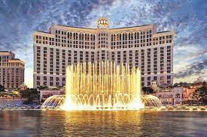
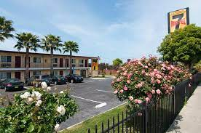
Las Vegas hotel (Bellagio)
Manager Simon Stein
Po<= Cu/(Cu+Co)
Po =P(N<X) = probability of over-estimating demand or no-show

Slide 15
Example 1 ->Single Order Quantity -hotel industry
Manager Simon Stein of the Bellagio in Las Vegas is tired of customers who make
reservation and do not show up. Rooms rent is 100 USD per night and cost 25 USD to maintain
per day.
Overflow („bumped“) customers can be sent to Motel 7 for only 70 USD per night.
Simon´s records of no-show over past six months are given below. Should Bellagio start overbooking? If so, how many rooms should be overbooked?
No-Show | Probability
0 | 0,15
1 | 0,25
2 | 0,30
3 | 0,30
Solution : C0 = 70 USD - cost of overestimating demand
Cu = 100 USD-25 USD =75 USD - cost of underestimating demand
Simon Stein Statistics
Cu
P(N<X) <= ---------- = 75/(75+70)=75/145 = 0,517 Cu + C0
No-Show | Probability | P(N<X)
0 | 0,15 | 0,00
1 | 0,25 | 0,15
2 | 0,30 | 0,40
3 | 0,30 | 0,70
Probabilities are cumulating and choice in 0,40->0,517
Optimal probability of no-show falls between
0,40 and 0,70. So if we take less of equal to 0,517,
so next lower value is 0,40. So two rooms have to be overbooked !!!
0,15+0,25=0,40 and 0,40+0,30=0,70…

Slide 16
Example 2 ->Single Order Quantity - Airlines (home study)
FlyUS Airlines is unhappy with the number of empty seats (same with hotel rooms) on its NY-Miami flights. To remedy the problem, the airline is offering a special discounted rate of 89 USD instead of standard full fare 169 USD, but only for 7-days advance purchases and for a limited number of seats per flight. The aircraft flown from NY to Miami holds max 100 passengers. Last month´s distribution of full-fare passengers is shown below. How many seats FlyUS reserve for full–fare passengers ?
Aircraft capacity |  |  | 100
Full fare | No-Show | Frequency | Probability | P(N<X)
50 | 50 | 15 | 0,15 | 0,00
55 | 45 | 20 | 0,20 | 0,15
60 | 40 | 35 | 0,35 | 0,35
65 | 35 | 20 | 0,20 | 0,55
70 | 30 | 10 | 0,10 | 0,65
Cu = 169-89=80,Co =89
P(N<X) <=Cu/(Cu+Co)=80/169=0,473
So 60 full-fare passengers have to be
reserved
100= 50+50 = 55+45=60+40=65+35=70+30 (the number of passengers)

Slide 17
Thanks for your attention

