Slide 1
Gartner Magic Quadrant Tool
Ing.J.Skorkovský, CSc, Department of Business Management FACULTY OF ECONOMICS AND ADMINISTRATION Masaryk University Brno Czech Republic

Slide 2
Agenda related to MQ Matrix
Positioning Technology Players within a specific market
Giving you a wide-angle view of the relative positions of the market's competitors
Helps to digest how well technology providers are executing against their stated vision

Slide 3
MQ Matrix
Challengers
Leaders
Niche=mezera na trhu
(gaps)
Ability to execute –schopnost řídit firemní procesy
Niche players (gap in the market)
Visionaries
Completeness of vision (míra vizí)

Slide 4
MQ Matrix explanation
Leaders execute well against their current vision and are well positioned for tomorrow (make money now and in the future - TOC statement).
Visionaries understand where the market is going or have a vision for changing market rules, but do not yet execute well (stand ups)
Niche Players focus successfully on a small segment, or are unfocused and do not out-innovate or outperform others
Challengers execute well today or may dominate a large segment, but do not demonstrate an understanding of market direction.

Slide 5
MQ Matrix „A“ better than „B“ and „B“ Better than“C“
Challengers
Leaders
Ability to execute
A
B
Niche players
C
Visionaries
Completeness of vision

Slide 6
MQ Matrix Using colors in order to show progress (Red =bad, Green = good)
Challengers
Leaders
B
A
Ability to execute
B
A
Niche players
C
Visionaries
Completeness of vision

Slide 7
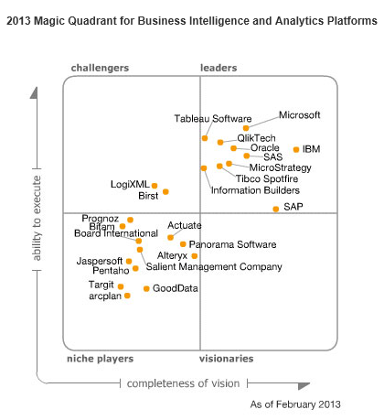
MQ for BI

Slide 8
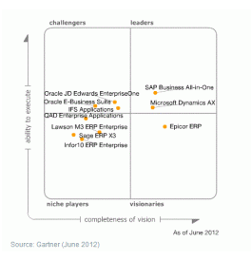
MQ for ERP

Slide 9
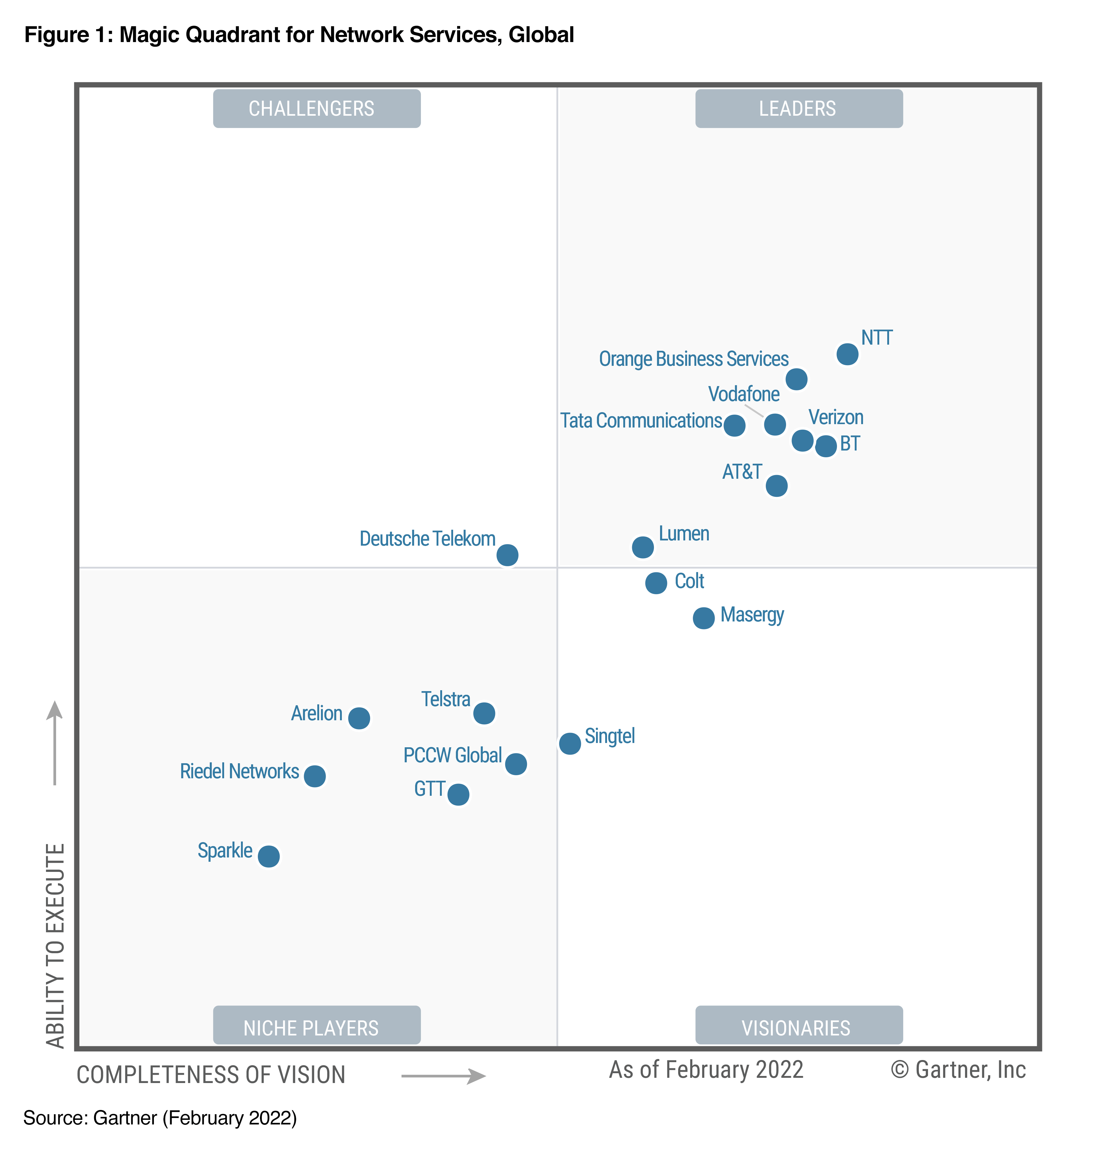
MQ for Network Services

Slide 10
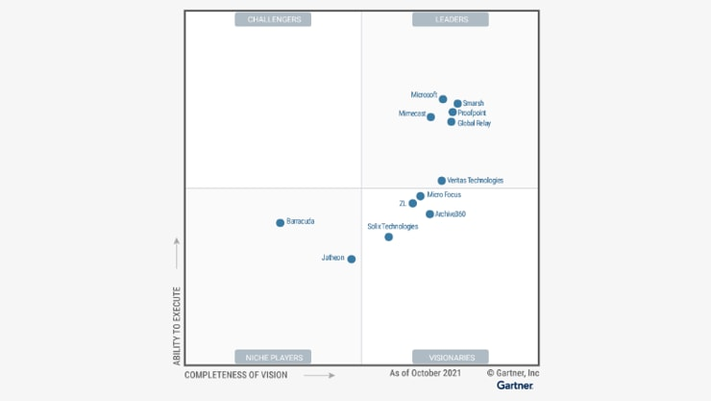
Studie Magic Quadrant pro oblast archivace podnikových informací

Slide 11
End of section

