Slide 1
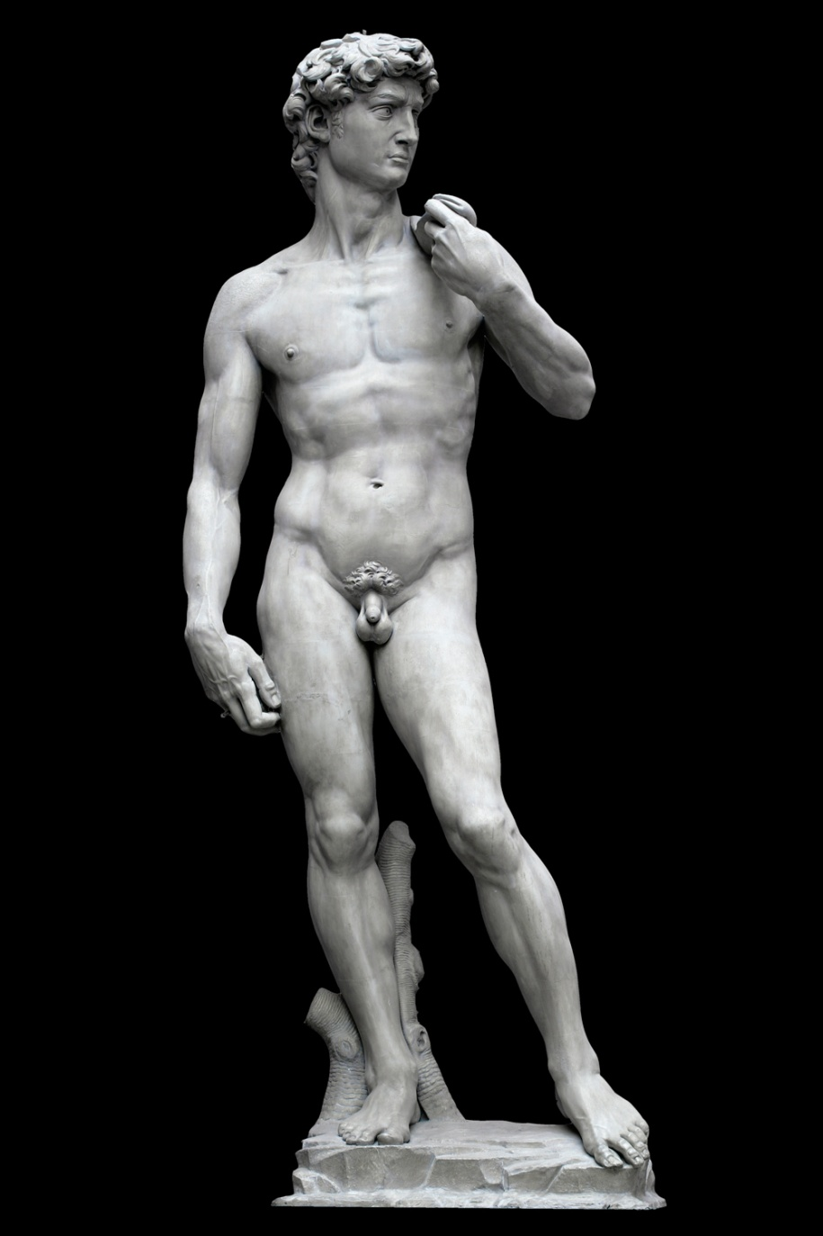
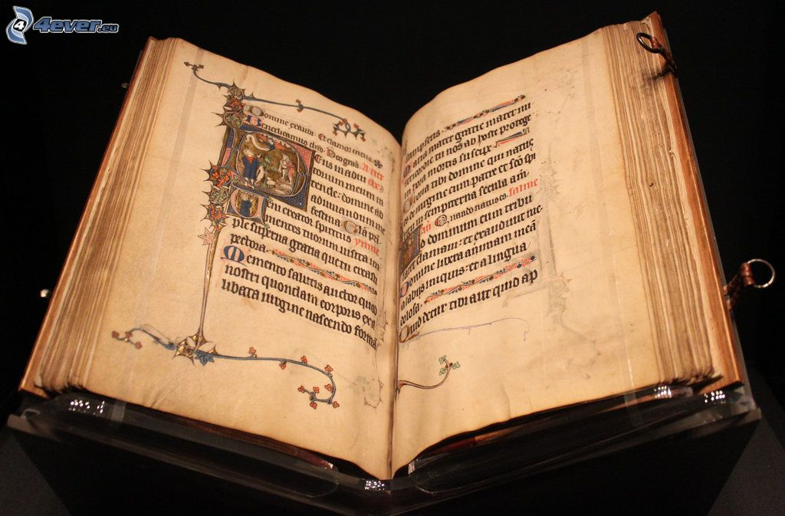
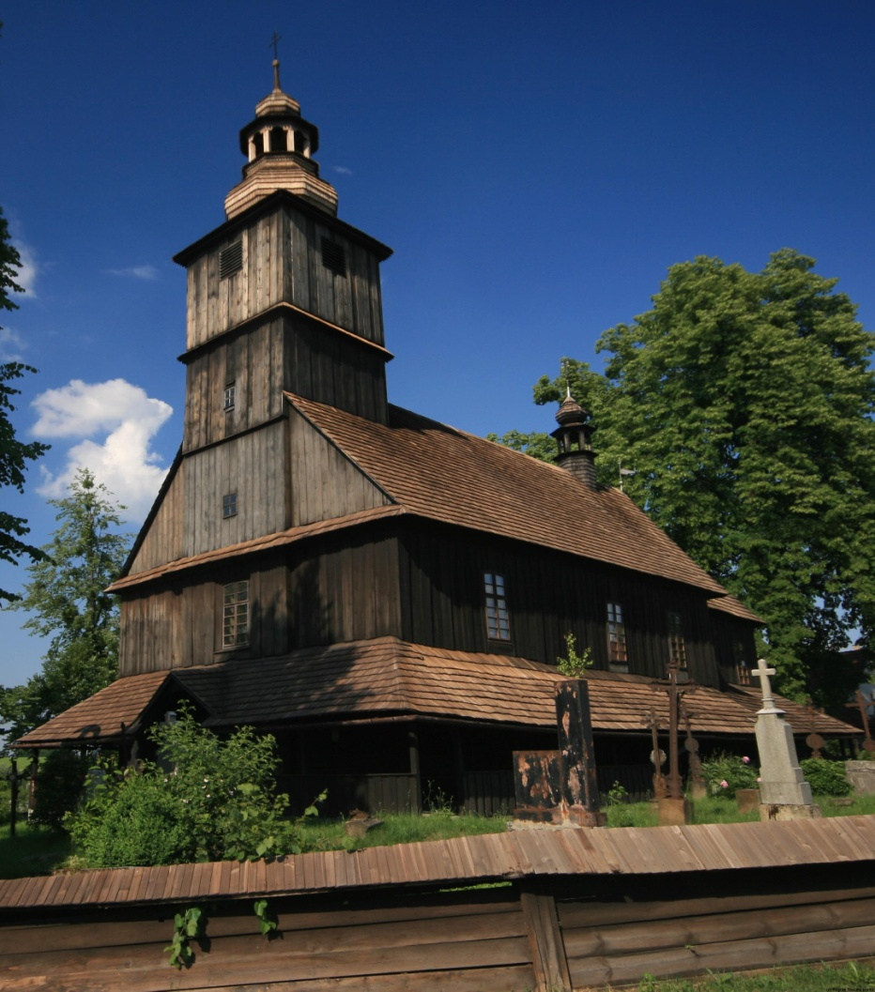
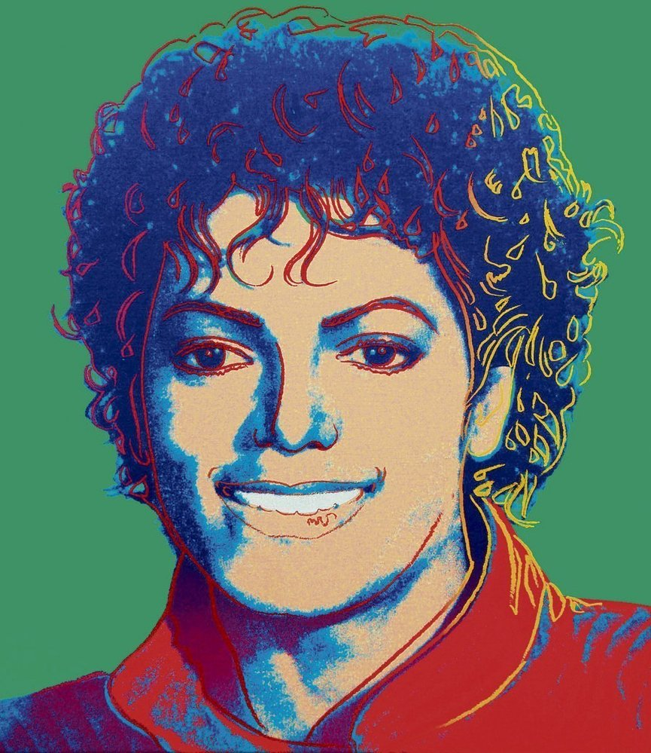
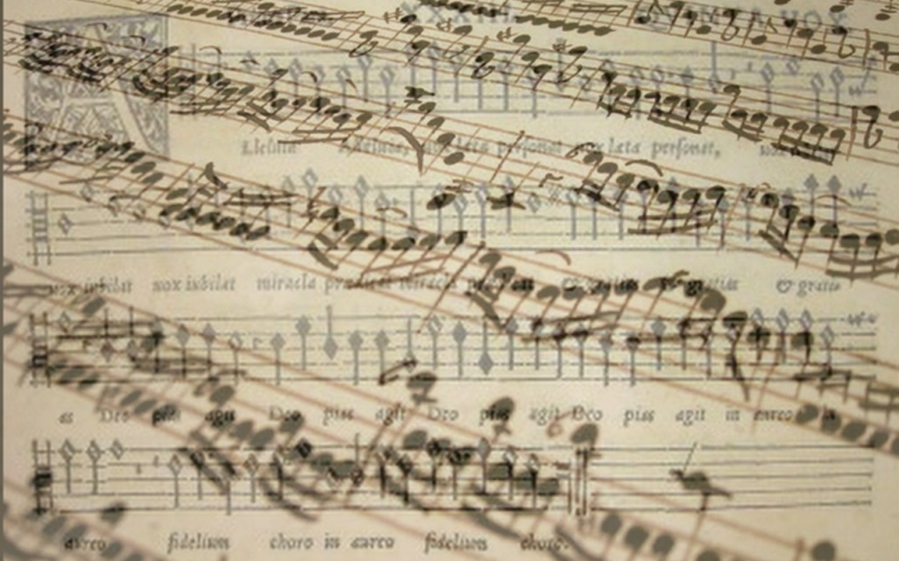
Public support of culture

Slide 2
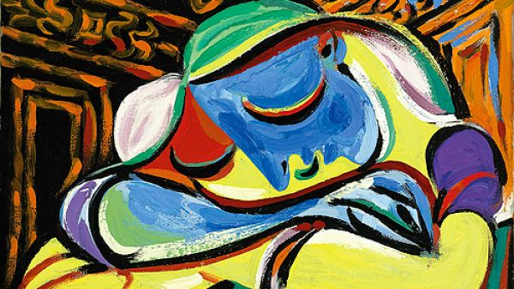
1. Financial Self sufficiency of cultural organization

Slide 3
Financial self-sufficiency
Key factors of self sufficiency
Financially self sufficient areas
Popular culture
Financially dependent areas
Traditional culture

Slide 4
2. Arguments for and against public support of culture

Slide 5
Dominant arguments for public support of culture
Equality of opportunity
Positive externalities
Culture as a public good
Support of new forms of art
Culture as a symbol of prestige
Merit good
Multiplier effect
Low productivity of area of culture

Slide 6
Dominant arguments against public support of culture
Redistribution from poor to rich
Deformation of market by public subsidies
Low multiplier effect

Slide 7
Dominant arguments against public support of culture

Slide 8
3. Alternative models of public support of culture

Slide 9
Alternative models of public support of culture
Hillman-Chartrand model of relationship:
Role of government as:
Facilitator
Patron
Architect
Engineer

Slide 10
Alternative models of public support of culture
FACILITATOR
Government doesn't intervene in the process of production
The position of artists is mostly dependent on income from production(ability to attract audiences)
Important role of donators
Homogenization of culture
little space for artistic experiments
E.g. USA

Slide 11
Alternative models of public support of culture
PATRON
Creation of Arts Councils
Support of high culture production
Distance between state and art
The role of state is to decide about the volume of support
The specific distribution of support is managed by councils
Focus on self-sufficiency
E.g. VB

Slide 12
Alternative models of public support of culture
ARCHITECT
Support of art through state institutions (ministries)
Artists are often employees of cultural institutions
High dependence on support from public funds (mainly subsidies)
Risk of artistic stagnation, moral hazard
E.g. France

Slide 13
Alternative models of public support of culture
ENGINEER
The aim may not be an artistic experience, but a political goal
The government owns all funds for support of culture
The government form a resolution about
Size of support
Supported activities, institutions and artist
Artist are absolutely depended on state support
Membership in artists' unions - enforceable, censorship
E.g. the Czech Republic before 89, totalitarian regimes (North Korea, SSSR…)

Slide 14
4. What does indirect and direct state support mean?

Slide 15
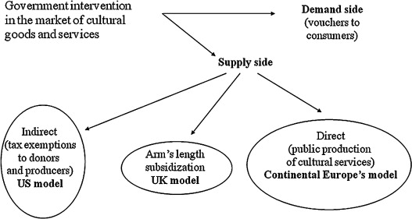
Government intervention in market of cultural goods and services

Slide 16
Indirect support
-Indirect support is represented by activities which support those who are supporting directly some culture activity
-main characteristic is that the support doesn't directed to specific culture organization
Tax reduces for donators
Social contributions

Slide 17
Direct support
Money from sales revenues
Foundations and foundations funds
Other founds (e.g. state fund for Czech cinematography)
Communal obligations to support local organizations
Donations and sponsorship
Lottery and bets
Public collections

Slide 18
5. How does state lottery works?

Slide 19
State lottery
Long tradition several countries
UK
20% of profit come into culture
Finland
Profit is divided in sport and cultural activities

Slide 20
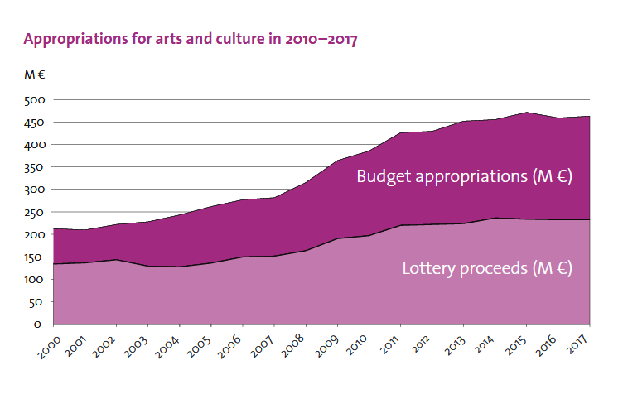
Finland state lottery

Slide 21
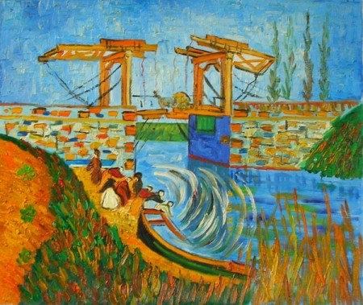
6. Mission of ministry of culture

Slide 22
Ministry of culture
Competence of the Ministry
State administrative body for
the arts;
cultural and educational activities;
cultural monuments;
matters relating to churches and religious societies;
matters relating to the press, including publication of the non-periodical press and other information means;
the preparation of draft laws and other legal regulations in the area of radio and television broadcasting;
implementation of the Copyright Act;
production and trade in the area of culture

Slide 23
Ministry of culture
Expenditures of ministry
660 mil. euros
0,75 % of state expenditures

Slide 24
7. Financing of religions

Slide 25
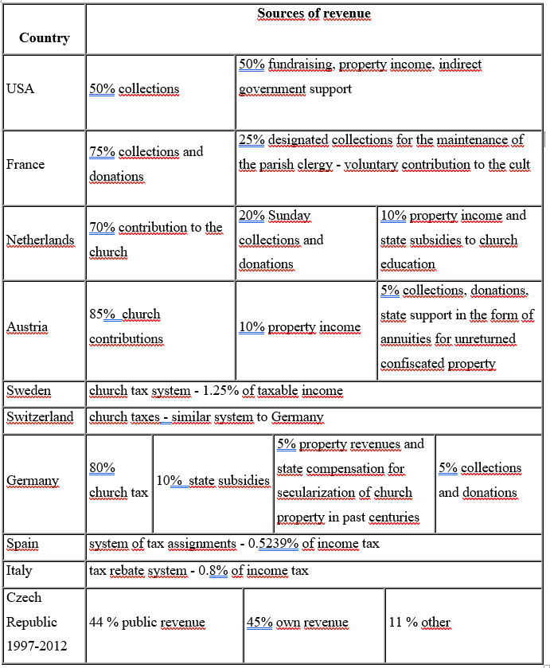

Slide 26
Financing of religions
Options of relation between state and religions
Religions are independent Cultural services
USA
Czech republic (since 2012)
Religions are part of public sector
Germany-tax for religions
Czech Republic (before 2012)
Religions are semi independent
Italy – tax assignation (0,8 % of personal revenue tax)
Spain – tax assignation (0,52 % of personal revenue tax)

Slide 27
Financing of religions
Options of relation between state and religions
Religions are independent Cultural services
USA
Czech republic (since 2012)
Religions are part of public sector
Germany-tax for religions
Czech Republic (before 2012)
Religions are semi independent
Italy – tax assignation (0,8 % of personal revenue tax)
Spain – tax assignation (0,52 % of personal revenue tax)

Slide 28
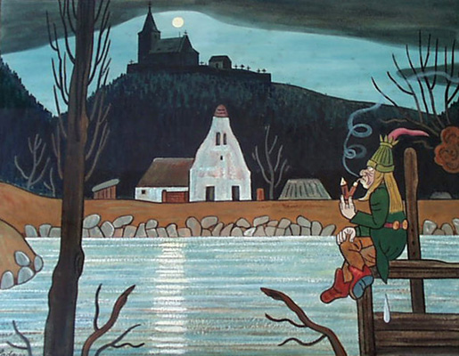
Conclusion

Slide 29
Conclusion
Culture can be financing by market, private support, public support
Most of culture segment are not self-sufficient
They are dependent on the support
State support has two forms
Direct (sponsorship, lotteries, communal obligations, founds and foundations funds…)
Indirect (tax reduction, social contribution )
Government spend 1 % of total expenditures for culture

Slide 30
Usefull links
(1)
http://web.ccsu.edu/faculty/harmonj/atlas/definitions.html
http://www.yourdictionary.com/high-culture
https://dictionary.cambridge.org/dictionary/english/pop-culture
(5) http://minedu.fi/documents/1410845/4150031/The+State+supports+arts+and+culture/bb45a827-60ba-4c16-8cda-3882fc74fe97
(6) http://ec.europa.eu/eurostat/statistics-explained/index.php/File:Mean_household_cultural_expenditure_by_expenditure_purpose,_2010.png
(7) https://ec.europa.eu/eurostat/statistics-explained/images/8/8f/Total_general_government_expenditure_on_recreation%2C_culture_and_religion%2C_2016_%28%25_of_GDP_%25_of_total_expenditure%29.png

