Slide 1
Capacity planning and its planning

Slide 2
What is service capacity?
“..defined as the maximum level of value-added activity over a period of time that a service process can consistently achieve under normal operating conditions” (Johnston et al., p.285); e.g.
  No of calls customer service agents can handle over the course of a shift
  No of meals served by a restaurant during the lunchtime period
  No of repair calls made by a computer service engineer during an 8-hour day
  “..ensuring the service process has ‘sufficient resources' to deal with the anticipated levels of customer demand in such a way that quality of service meets pre-set targets in the most cost effective way”
    Restaurant may encourage customers to leave their table when they have completed their meal,, but customers may feel service is ‘rushed’ and has deteriorated ... Is increased productivity and desired service concept maintained?

Slide 3
The coping zone
The coping zone is a point where managers find it difficult to cope with increasing demand. At these levels of resource utilization, things get too busy:
Staff gets stressed
Everything becomes a problem
Perceived quality (customer satisfaction) declines
This breakpoint is usually reached before 100% utilization:
1.It is not possible to run a resource to 100% (at least not human)
2.Several resources may be involved
Also, too low levels of utilization affect staff and customer satisfaction.

Slide 4

Difficulties in the assessment of service capacity
service mix
the impact of location
the extent of intangibility in the service
The ease of identification of resource constraints
?
(Johnston et al., p.287)

Slide 5
Difficulties in the assessment of service capacity
service mix (if mix contains fluctuate in volumes of repeaters and strangers, routine versus complex calls in the call centre)
the impact of location (a service engineer operating in the city and in countryside)
the extent of intangibility in the service (knowledge workers differ in their abilities. so managers cannot easily assess their capacity)
The ease of identification of resource constraints (in complex tasks, the identification of key resource constraint may not be seen from the beginning)
(Johnston et al., p.287)
Notes:
In determining capacity, a number of factors make the assessment of service capacity difficult:
Service mix.If the service mix is made up of high volumes of 'runners', and fluctuating volumes of 'repeaters' and 'strangers
The impact of location.There is considerable difference between operating in a major city and rural communities.
The extent of intangibility in the service.Services with low degrees of intangibility are relatively easy to deal with. The number of short transactions per hour in a fast-food restaurant is relatively consistent. However, the customer-facing staff in a gourmet restaurant may have greater discretion as to how to carry out their task. They may perhaps spend time with customers in 'building relationships', with the result that the individual's capacity becomes more difficult to define.
The ease of identification of resource constraints. The capacity of a process is determined by resource constraints or bottlenecks. For more complex systems, the identification of the key resource constraints may be rather harder.

Slide 6
Predictable Demand Patterns and Their Underlying Causes
Predictable Cycles of Demand Levels
Underlying Causes of
Cyclical Variations
  employment
  billing or tax payments/refunds
  pay days
  school hours/holidays
  seasonal climate changes
  public/religious holidays
  natural cycles
  (e.g., coastal tides)
  day
  week
  month
  year
  other

Slide 7
From Excess Demand to Excess Capacity
Excess demand
Too much demand relative to maximum capacity
Demand exceeds optimum capacity
Service quality is perceived to have deteriorated
Optimum capacity
Staff is not overworked and customers receive good service
Excess capacity
Too much capacity relative to demand

Slide 8
Variations in Demand Relative to Capacity
VOLUME DEMANDED
Demand > Capacity
(business is lost)
CAPACITY UTILIZED
Maximum Available
Demand >
Capacity
optimum capacity
(quality declines)
Optimum Capacity
(Demand ≈ Supply)
Excess capacity
Low Utilization
(wasted resources)
(may send bad signals)
TIME CYCLE 1
TIME CYCLE 2

Slide 9
Purpose of capacity planning & control
Long-range plans (over one year)
Capacity decisions critical to long range plans
Issues:
Research and Development
New product plans
Capital investments
Facility location/expansion
Top executives
Intermediate-range plans (3 to 18 months)
Issues:
Sales and operations planning
Production planning and budgeting
Setting employment, inventory,
subcontracting levels
Analyzing operating plans
Operations managers with sales and operations planning team
Short-range plans (up to 3 months)
Scheduling techniques
Issues:
Job assignments
Ordering
Job scheduling
Dispatching
Overtime
Part-time help
Operations managers, supervisors, foremen
Responsibility
Planning tasks and time horizons

Slide 10
Hierarchical Nature of Planning
Production Planning
Capacity Planning
Resource Level
Short- to medium-term term decisions taken to ensure sufficient capacity of the right type is available at the right time to meet demand
It involves:
Measuring demand
Measuring capacity
Reconciling capacity and demand
Items
Product lines or families
Aggregate production plan
Resource requirements plan
Plants
Individual products
Master production schedule
Rough-cut capacity plan
Critical work centers
Material requirements plan
Capacity requirements plan
All work centers
Components
Manufacturing operations
Shop floor schedule
Input/ output control
Individual machines

Slide 11
Aggregate Planning
Determine the resource capacity needed to meet demand over an intermediate time horizon
  Aggregate refers to product lines or families
  Aggregate planning matches supply and demand
Objectives
  Establish a company wide game plan for allocating resources
  Develop an economic strategy for meeting demand
Objectives - examples
  Restaurants - Aggregate planning is directed toward smoothing production rate and finding the size of workforce to be employed
  Airline industry - Aggregate planning consists of schedules for number of flights in and out of each city, number of flights on all routes, number of passengers and number of personnel at each airport

Slide 12
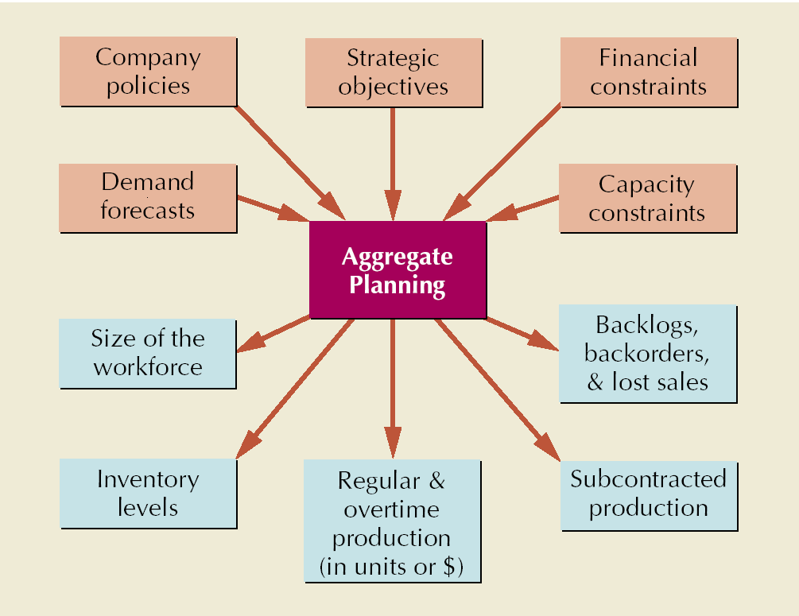
Aggregate Planning in Services
Most services use combination strategies and mixed plans
Controlling the cost of labor is critical
  Accurate scheduling of labor-hours to assure quick response to customer demand
  An on-call labor resource to cover unexpected demand
  Flexibility of individual worker skills
  Flexibility in rate of output or hours of work

Slide 13
Level Production vs. Chase Demand vs. Demand management
Change demand
Inventory?
Adjust output to match demand
Absorb demand

Slide 14
Short-to medium-term capacity strategies
LEVEL CAPACITY (also PEEK DEMAND)
  Scarce or expensive resources are maintained at a constant level
CHASE STRATEGY
  match supply to demand as much as possible by building flexibility into the operating system, AND
  maintain fast response times/avoid Queues
DEMAND MANAGEMENT
Rather than change capacity of the service operation, encourage customers to alter their demand patterns to take the pressure off the resources.

Slide 15
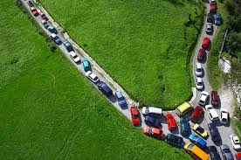
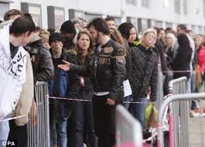
Level Strategy
Aims to set processing capacity at a uniform level (usually to meet average demand levels) regardless of fluctuations in demand
  In manufacturing, inventory (stock) is used to absorb variations in demand
  In services, queue management is used to absorb variations in demand

Slide 16
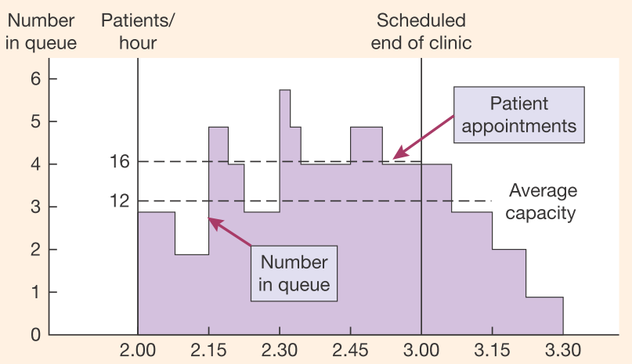
Level strategy example (Johnston et al., p.291)
Resource utilisation goals are frequently achieved at the expense of customer satisfaction
Customers may receive inconsistent service levels
Customers (patients) accept (or suffer) this poor level of service because the service is valuable to them and there may be no or few alternatives
There is a danger that the service provider may become complacent and not make attempts to cut the emotional cost of waiting for the customer, making it potentially vulnerable to competition (in this case private healthcare).
Solution: queue management/yield management

Slide 17
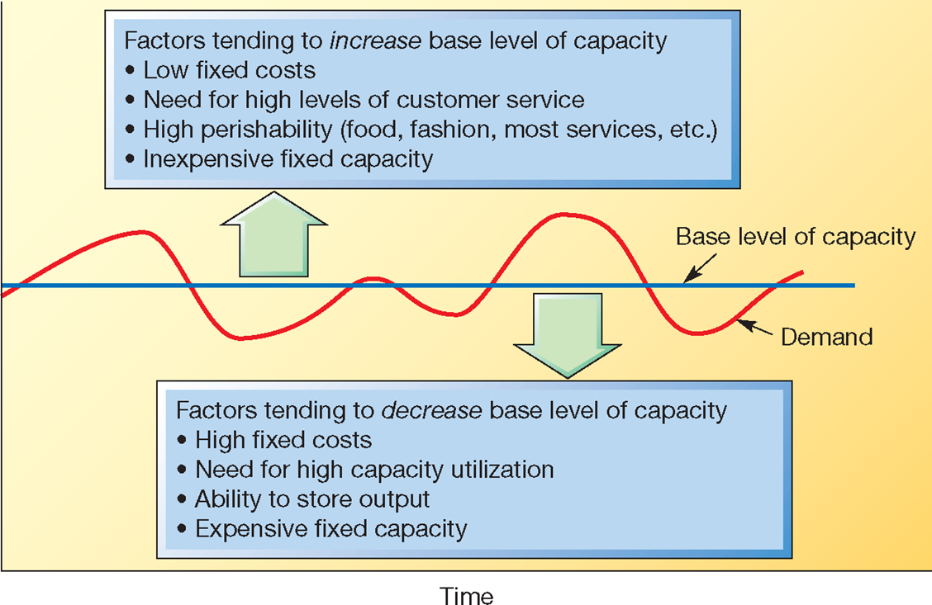
Base level of capacity should reflect the relative importance of the operations’ performance objectives

Slide 18
Chase - Adjust output to match demand
Stretch and shrink:
  Offer inferior extra capacity at peaks (e.g., bus/train standees)
  Use facilities for longer/shorter periods
  Reduce amount of time spent in process by minimizing slack time
Adjusting capacity to match demand
  Rest during low demand
  Cross-train employees
  Use part-time employees
  Customers perform self-service
  Ask customers to share
  Create flexible capacity
  Rent/share facilities and equipment

Slide 19
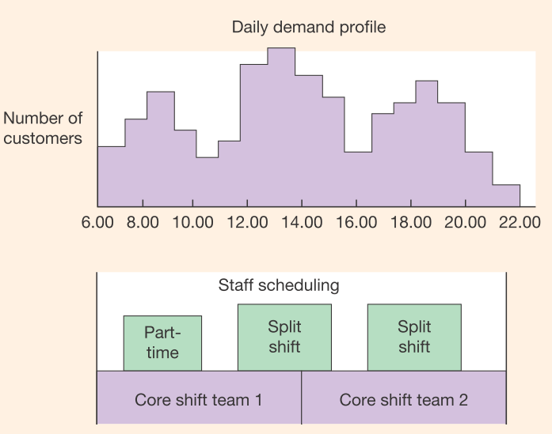
Chase strategy – example (Johnston et al., p.293)

Slide 20

Ways of reconciling capacity and demand
?
Demand
Demand
Demand
Capacity
Capacity
Capacity
Chase demand
Demand management
Level capacity

Slide 21
Managing Demand
Interventionist approach
  Reduce demand in peak periods / Increase demand when there is excess capacity (change in price and other nonmonetary costs )
  Restricted servise at peek times
  Specialist service channles
  Advertising and promotion
Inventorying demand until capacity becomes available
  Formal wait and queuing system
  Reservation system
Produce products with complementary demand patterns

Slide 22
Price per
room night
B_{l}
B_{h}
T_{h}
T_{l}
T_{h}
B_{h}
B_{l}
T_{l}
Quantity of rooms demanded at each price
by travelers in each segment in each season
B_{h} = business travelers in high season
B_{l} = business travelers in low season
T_{h} = tourist in high season
T_{l} = tourist in low season
Note: hypothetical example

Slide 23

Sequencing and allocation of capacity
Most organizations have rules or policies for allocation of capacity, either informal or formal. It is impossible to satisfy all possible customer demands and remain a viable organization. To deal with this issue, sequencing rules are created to manage the prioritization of allocation:
FIFO –consumer service usually
LIFO – unusual (driving out parcels e.g.)
Most valuable customer first
Most critical first –emergency services e.g.
Least work content first (When demand >> supply, this approach makes it possible to satisfy many customers quickly
Most work content firsto (Using this rule alone usually - poor performance)

Slide 24
Queue management – perceptions
Good /bad real life examples, experience?
1.Unoccupied time feels longer than occupied time
2.Pre-process waits feel longer than in-process waits
3.Anxiety makes the wait feel longer
4.Uncertain waits are longer than known, finite waits
5.Unexplained waits seem longer than explained
6.Unfair waits are longer than equitable waits
7.The more valuable the service, the longer will the customer wait
8.Solo waiting feels longer than group waiting
9.Uncomfortable waits feel longer than comfortable waits
10.New/infrequent users feel they wait longer than frequent user

Slide 25
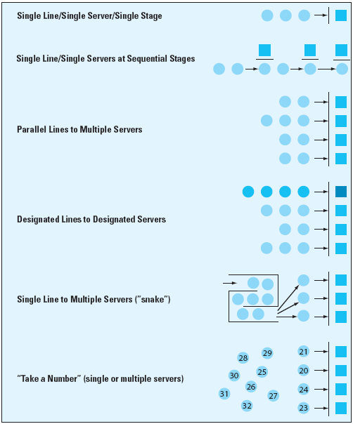
Managing Waiting Lines
Rethink design of queuing system
Install a reservations system
Tailoring the queuing system to different market segments
Manage customer behavior and perceptions of wait
Redesign processes to shorten transaction time

Slide 26
Queuing Systems can be Tailored to Market Segments
Urgency of job
  Emergencies vs. non-emergencies
Duration of service transaction
  Number of items to transact
  Complexity of task
Payment of premium price
Importance of customer
  Frequent users/high volume purchasers vs. others

Slide 27
Improving resource utilization
Yield/Revenue management
Building flexibility
Reducing capacity leakage
Getting organizational support for resource utilization (Many issues need to be resolved by the organization as a whole)

Slide 28
Building flexibility
New product flexibility
Product mix flexibility
Delivery flexibility
Volume flexibility
Things to consider
Range –how much flexibility is required
Response –how quickly must the change be made
Effectiveness across the range –most processes have an optimum range
Cost of providing the flexibility
Approaches to building flexibility:
Flexible employee contracts
Overtime
Short-term outsourcing
  Menu-driven service (standardization)
  Creation of runner activitie so“Dell” approach
Teamwork/ Multi-functional teams

Slide 29
Reducing capacity leakage - reasons
Absenteeism
  Due to overload?
Labor underperformance
  Insufficient training?
  Employee “churn” –employees leaving just when they are becoming effective
Scheduling losses - Overutilization/underutilization from time to time because:
  Demand profiles not fully understood
  Demand profiles too volatile
  Staff preferences for work patterns do not fit with the business needs
Cost of complexity
  The more “unusual” tasks, the more inefficiencies and rework
Quality failures
  Having to deal with poor quality is loss of resources

Slide 30
Revenue Management
Allocating resources to customers at prices that will maximize revenue
  Service or product can be sold in advance of consumption
  Demand fluctuates
  Capacity is relatively fixed
  Demand can be fairly clearly segmented
  The service cannot be stored in any way
  Variable costs are low and fixed costs are high/ the marginal cost of making a sale is relatively low.

Slide 31
Revenue Management Example
Room sales
Demand Curve
Figure 13.5
Potential customers exist who are willing to pay more than the $15 variable cost of the room, but not $150
100
Passed-up contribution
Some customers who paid $150 were actually willing to pay more for the room
50
Total
$ contribution
= (Price) x (50
rooms)
= ($150 - $15)
x (50)
= $6,750
Money left on the table
$15
Variable cost
of room
$150
Price charged for room
Price

Slide 32
Revenue Management Example
Room sales
Demand Curve
Figure 13.6
Total $ contribution =
(1st price) x 30 rooms + (2nd price) x 30 rooms =
($100 - $15) x 30 + ($200 - $15) x 30 =
$2,550 + $5,550 = $8,100
100
60
30
$15
Variable cost
of room
$100
Price 1
for room
$200
Price 2
for room
Price

Slide 33
Revenue Management Approaches
Airlines, hotels, rental cars, etc.
  Tend to have predictable duration of service and use variable pricing to control availability and revenue
Movies, stadiums, performing arts centers
  Tend to have predicable duration and fixed prices but use seating locations and times to manage revenue
Restaurants, golf courses, ISPs
  Generally have unpredictable duration of customer use and fixed prices, may use “off-peak” rates to shift demand and manage revenue
Health care businesses, etc.
  Tend to have unpredictable duration of service and variable pricing, often attempt to control duration of service

Slide 34
Making Revenue Management Work
Multiple pricing structures must be feasible and appear logical to the customer
Forecasts of the use and duration of use
Changes in demand

