Slide 1
MPH_SOMA Operations Management
Service Improvement
Feybi Ariani Goni, M.IT., Ph.D. Assistant Professor
Mail Room 539, Lipová 507/41a, 602 00 Brno E-mail Feybi.Ariani.Goni@econ.muni.cz Tel +420 778790553

Slide 2
Learning Goals
To understand the importance of service improvement
To explore different service improvement methodologies
To learn how to implement service improvement initiatives

Slide 3
What is Service Improvement?
The term is an elusive concept, framed alongside other terms closely associated with improvement such as effectiveness, efficiency, excellence, performance, reform and so on (Hodgson et al, 2007).
It refers to the systematic approach to enhancing service quality, efficiency, and effectiveness.
It aims to optimize customer satisfaction, operational performance, and overall business outcomes.

Slide 4
Key components of service Improvement?
Service improvement: Emphasizes ongoing enhancements to processes, services, and customer experiences.
Innovation: Encourages creative solutions and new approaches to meet evolving customer needs.
Problem-solving: Focuses on identifying and addressing root causes of service issues to prevent recurrence.

Slide 5
Service improvement methodologies
Improved Customer Satisfaction: Enhancing service quality leads to higher customer loyalty and retention.
Cost Reduction: Streamlining processes reduces operational costs and enhances profitability.
Competitive Advantage: Differentiates businesses by offering superior services compared to competitors.
Regulatory Compliance: Ensures adherence to industry standards and regulations.

Slide 6
What are the examples of service improvement across industries?

Slide 7
Service Improvement methodologies
LEAN MANAGEMENT:
A systematic approach to optimizing processes and eliminating waste in order to maximize value for customers.
Core concepts of Lean Management:
Waste reduction (Overproduction, waiting, unnecessary transportation, excess inventory, defects, overprocessing, and underutilized talent) using some strategies: Just-in-Time (JIT) production, Kanban systems, and 5S workplace organization.
Respect for people: empowering employees to identify and solve problems, and fostering a culture of collaboration, teamwork, and continuous learning.

Slide 8
Key principles of Lean Management

Slide 9
Key principles of Lean Management
Identifying Value: Understanding what adds value from the customer's perspective.
Mapping Value Stream: Visualizing the end-to-end process to identify value-adding and non-value-adding activities.
Creating Flow: Ensuring smooth and efficient flow of work or materials through the process.
Establishing Pull: Producing based on actual customer demand to avoid overproduction.
Continuous Improvement (Kaizen): Encouraging ongoing efforts to enhance processes and eliminate waste.

Slide 10
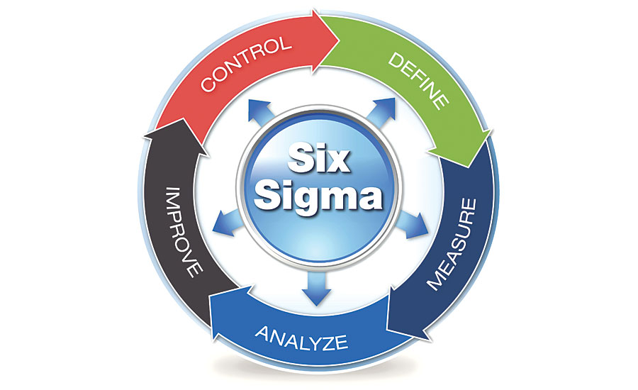
Service Improvement methodologies
SIX SIGMA:
A data-driven methodology aimed at reducing defects and variations in processes to achieve near-perfect quality.

Slide 11
Key principles of Six Sigma
Focus on Customer Requirements: Identifying and prioritizing customer needs and expectations.
Data-Driven Decision Making: Using statistical tools and analysis to drive process improvements.
Process Improvement: Applying structured methodologies like DMAIC (Define, Measure, Analyze, Improve, Control) and DMADV (Define, Measure, Analyze, Design, Verify).
Proactive Problem-Solving: Addressing root causes of issues to prevent recurrence.
Cross-Functional Collaboration: Involving stakeholders from different areas to drive collective improvement efforts.

Slide 12
Core concepts of Six Sigma
Defining CTQs (Critical-to-Quality): identifying key parameters critical to meeting customer requirements.
Measurement Systems Analysis (MSA): ensuring data accuracy and reliability through effective measurement techniques.
Statistical Tools: utilizing tools like Pareto analysis, control charts, hypothesis testing, and regression analysis to analyze and improve processes.

Slide 13
Phases in Six Sigma
Establish control measures to sustain improvements and monitor ongoing performance.
Define project goals, customer requirements, and scope.
Implement solutions to address root causes and optimize processes.
Define project goals, customer requirements, and scope.
Identify root causes of defects or variations using statistical methods.

Slide 14
Key differences between Lean Management and Six Sigma
 | Lean Management | Six Sigma
Focus | Waste reduction and efficiency improvement | Quality improvement and defect reduction
Methodology | Emphasizes process optimization through waste elimination and continuous improvement (Kaizen) | Employs statistical analysis and data-driven approaches to identify and eliminate root causes of defects
Tools and techniques | Value Stream Mapping and Kanban are geared towards process flow and waste reduction | Statistical Process Control (SPC) and Design of Experiments (DOE) are used for statistical analysis and problem-solving
Applicability | Applicable to a wide range of industries beyond manufacturing | Widely adopted across various sectors but often initially associated with manufacturing
Goals | Enhance efficiency and flow | Achieve consistent quality and process performance

Slide 15
Implementation strategies of service improvement
Define clear objectives
Engage stakeholders
Establish cross-functional teams and training
Utilize effective improvement methodologies
Identify and prioritize improvement opportunities
Develop action plans
Implement continued monitoring
Promote change management
Learn from failures and best practices

Slide 16
Challenges of implementing service improvement
Resistance to change
Resource constraints
Lack of leadership support
Siloed mindset and communication
Unrealistic expectations
Measurement and evaluation challenges
Sustainability and integration

Slide 17
Key success factors of implementing service improvement
Leadership commitment and support
Clear objectives and goals
Stakeholder engagement and collaboration
Data-driven decision making
Continues learning and adaptation
Change management and communication
Sharing best practices

