Slide 1
Measuring, controlling and managing

Slide 2
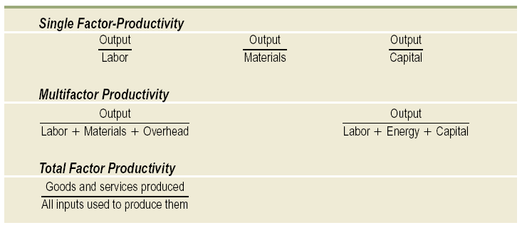
Revision: productivity
Measures of Productivity

Slide 3
Dimensions of Performance Metrics
Measures
  Require no calculations and are uni-dimensional
Metric
  Requires calculation and often contains several measures
Index
  Combines two or more metrics into a single value

Slide 4
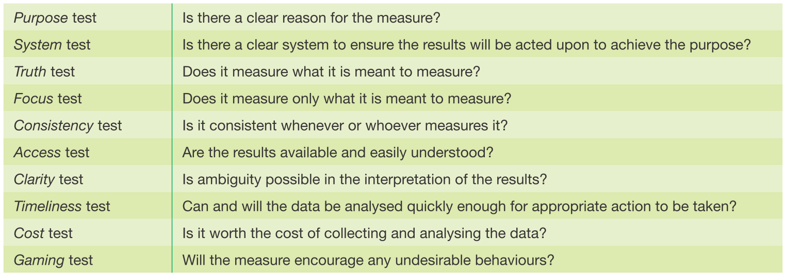
Purpose of measuring and managing performance
Control, Improvement, Communication, Motivation

Slide 5
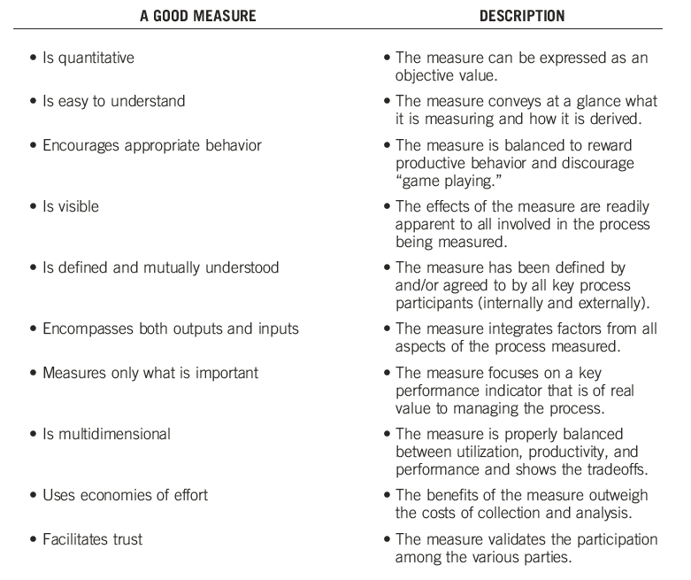
Figure 5.1
Characteristics of a Good Measure
Source: Koebler, Durtsche, Manrodt, & Ledyard, Keeping score: Measuring the business value of logistics in the supply chain (Univ. Tennesee Council of Logistics Management, 1999) p8

Slide 6
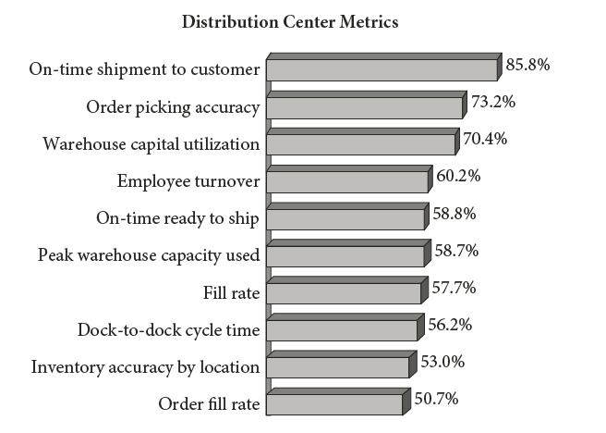
Figure 5.2
Distribution Center Metrics
Source: 2010 Metrics Report, WERC, (May 26, 2010).

Slide 7
Problems in the use of the data
Resource hunger
Lack of impact
(Customer) Satisfaction versus success
Openness to manipulation
Customer assessment?
The rational approach - a weighted average?
The incident approach

Slide 8
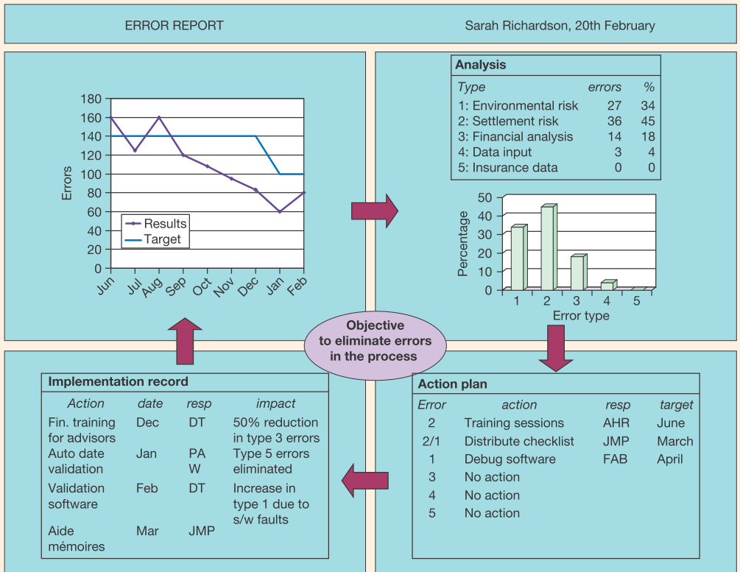
Performance reporting
the purpose/objective
the person responsible
trends over time
performance against target
supporting data and analysis
identiﬁcation of causes/problems
action to be taken, by whom and by when
an assessment of action taken

Slide 9
Performance measurement is certainly NOT about profit alone
By early 1980s, Johnson and Kaplan highlighted the shortfalls of financial performance measures to reflect changes in the competitive environment and strategies of organisations
The 1990s saw a “performance measurement revolution” (Eccles, 1991; Neely, 1999) and a proliferation of frameworks that integrate wider criteria:
  Balanced Scorecard (Kaplan and Norton, 1992)
  Performance Measurement Matrix (Keegan et al, 1989)
  SMART Pyramid (Lynch and Cross, 1991)
  Baldrige Criteria for Performance Excellence
  Performance Prism (Kennerley and Neely, 2000)
  European Foundation for Quality Management (EFQM) Excellence Model
  Six Sigma

Slide 10
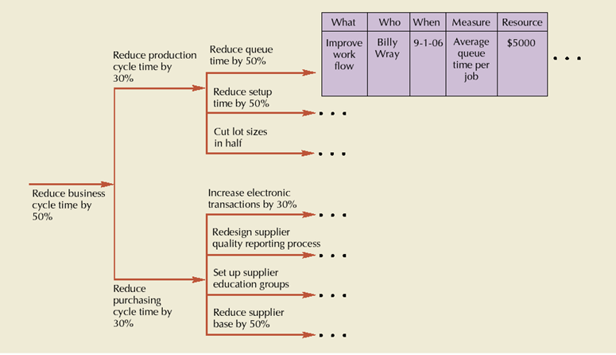
Link to the strategy- Policy Deployment
Translating corporate strategy into measurable objectives

Slide 11
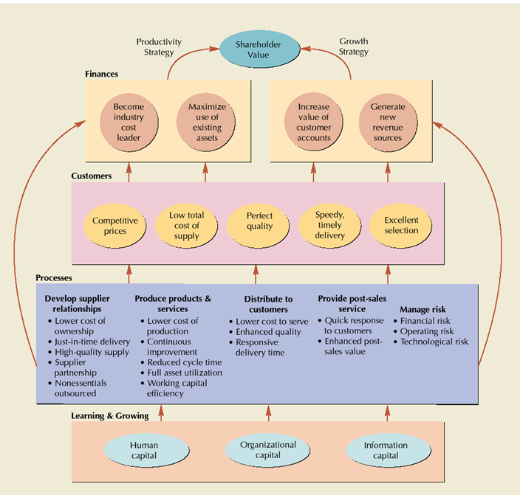
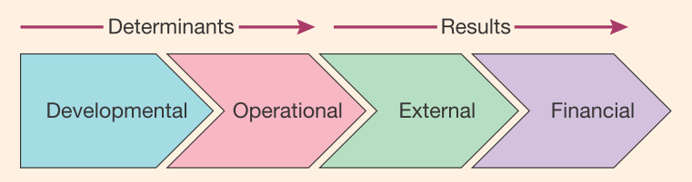
Key Performance Indicators
Source:
Robert Kaplan and David
Norton, Strategy Maps:
Converting Intangible
Assets into Tangible
Outcomes (Boston:
Harvard Business School
Press, 2004), Figure 3-2,
p. 67

Slide 12
Balanced Scorecard
Balanced scorecard
  measuring more than financial performance
    finances
    customers
    processes
    learning and growing
Key performance indicators
  a set of measures that help managers evaluate performance in critical areas

Slide 13
Balanced Scorecard
Balanced Scorecard Worksheet

Slide 14
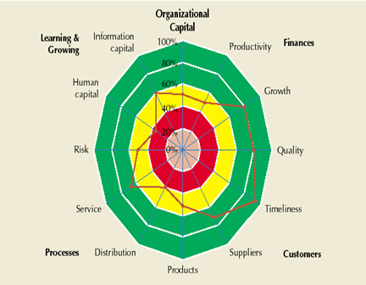
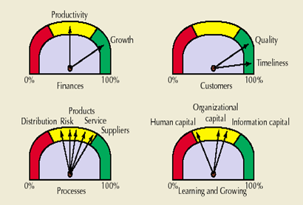
Balanced Scorecard
Radar Chart
Dashboard

Slide 15
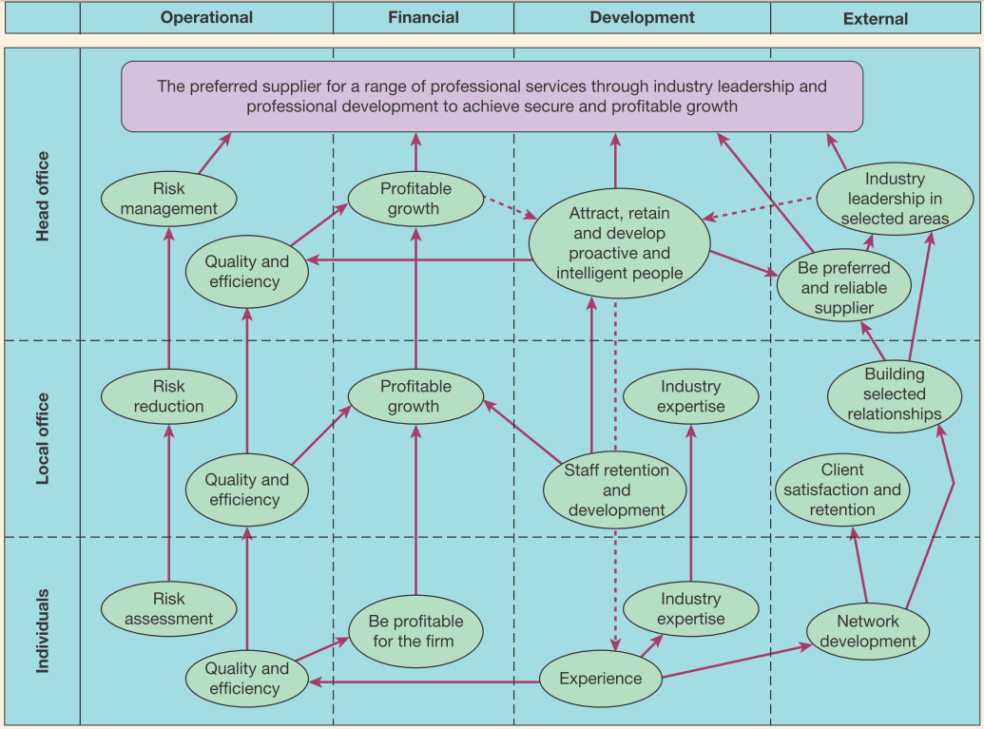
strategic linkage models

Slide 16
Supply Chain Operations Reference Model (SCOR):Basic Management Processes
Plan-Source-Make-Deliver-Return
Plan
Deliver
Source
Make
Deliver
Source
Make
Deliver
Source
Make
Deliver
Source
Supplier’s
Supplier
Return
Return
Return
Return
Return
Return
Customer’s Customer
Supplier (Internal or External)
Customer (Internal or External)
Your Company
Plan-Source-Make-Deliver-Return provide the organizational structure of the SCOR-model

Slide 17
Supply Chain Operations Reference Model (SCOR)
SCOR:
  Integrates Business Process Reengineering, Benchmarking, and Process Measurement into a cross-functional framework.
Capture the “as-is” state of a process and derive the desired “to-be” future state
Quantify the operational performance of similar companies and establish internal targets based on “best-in-class” results
Characterize the management practices and software solutions that result in “best-in-class” performance
Capture the “as-is” state of a process and derive the desired “to-be” future state
Quantify the operational performance of similar companies and establish internal targets based on “best-in-class” results
Characterize the management practices and software solutions that result in “best-in-class” performance
Business Process
Reengineering
Benchmarking
Best Practices
Analysis
Process Reference
Model

Slide 18
Supply Chain Operations Reference Model (SCOR)
The Primary Use of SCOR:
  To describe, measure and evaluate supply chain configurations.
SCOR contains:
  Standard descriptions of management processes
  A framework of relationships among the standard processes
  Standard metrics to measure process performance
  Management practices that produce best-in-class performance
Enables the companies to:
  Evaluate and compare their performances with other companies effectively
  Identify and pursue specific competitive advantages
  Identify software tools best suited to their specific process requirements

Slide 19
Scopes of Basic Management Processes
Plan (Processes that balance aggregate demand and supply to develop a course of action which best meets sourcing, production and delivery requirements)
  Balance resources with requirements
  Establish/communicate plans for the whole supply chain
Source (Processes that procure goods and services to meet planned or
actual demand)
  Schedule deliveries (receive, verify, transfer)
Make (Processes that transform product to a finished state to meet planned or actual demand)
  Schedule production
Deliver (Processes that provide finished goods and services to meet planned or actual demand, typically including order management, transportation management, and distribution management)
  Warehouse management from receiving and picking product to load and ship product.
Return (Processes associated with returning or receiving returned products)
  Manage Return business rules

Slide 20
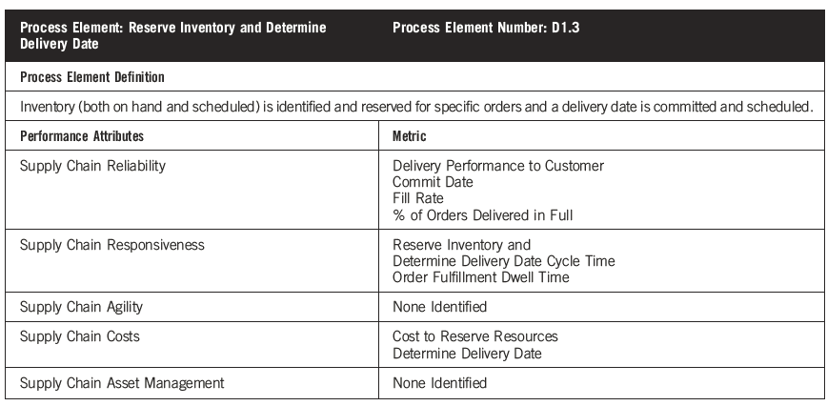
SCOR Model: Process D1.3 Metrics
Source: Adapted from Supply Chain Council 2011

Slide 21
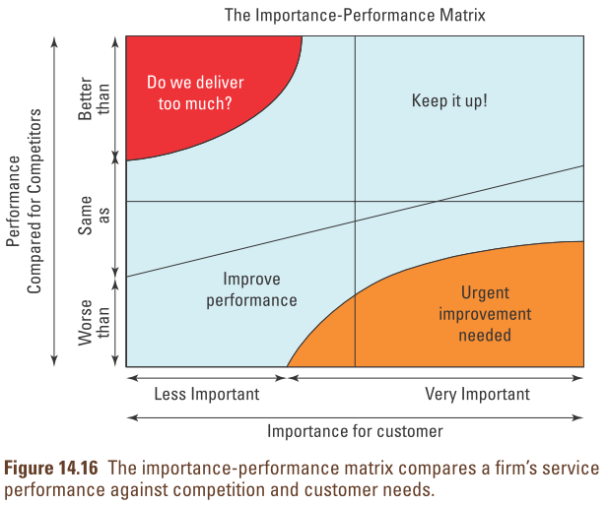
Assess Costs and Beneﬁ ts of Quality Initiatives

Slide 22
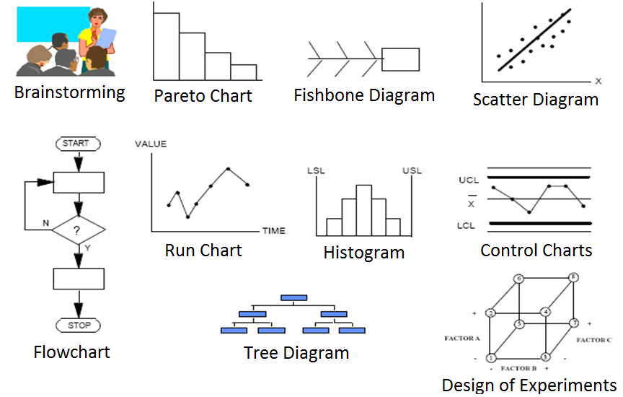
Tools for Root Cause Analysis
Notes:
22
Add diagrams Diagrams

