Slide 1
Basics of Statistical Process Control
Statistical Process Control (SPC)
monitoring production process to detect and prevent poor quality
Sample
subset of items produced to use for inspection
Control Charts
process is within statistical control limits
UCL
LCL

Slide 2
Variability
Random
common causes
inherent in a process
can be eliminated only through improvements in the system
Non-Random
special causes
due to identifiable factors
can be modified through operator or management action

Slide 3
Quality Measures
Attribute
a product characteristic that can be evaluated with a discrete response
good – bad; yes - no
Variable
a product characteristic that is continuous and can be measured
weight - length

Slide 4
Applying SPC to Service
Nature of defect is different in services
Service defect is a failure to meet customer requirements
Monitor times, customer satisfaction

Slide 5
Applying SPC to Service
Hospitals
timeliness and quickness of care, staff responses to requests, accuracy of lab tests, cleanliness, courtesy, accuracy of paperwork, speed of admittance and checkouts
Grocery stores
waiting time to check out, frequency of out-of-stock items, quality of food items, cleanliness, customer complaints, checkout register errors
Airlines
flight delays, lost luggage and luggage handling, waiting time at ticket counters and check-in, agent and flight attendant courtesy, accurate flight information, passenger cabin cleanliness and maintenance
Fast-food restaurants
waiting time for service, customer complaints, cleanliness, food quality, order accuracy, employee courtesy
Catalogue-order companies
order accuracy, operator knowledge and courtesy, packaging, delivery time, phone order waiting time
Insurance companies
billing accuracy, timeliness of claims processing, agent availability and response time

Slide 6
Where to Use Control Charts
Process has a tendency to go out of control
Process is particularly harmful and costly if it goes out of control
Examples
at the beginning of a process because it is a waste of time and money to begin production process with bad supplies
before a costly or irreversible point, after which product is difficult to rework or correct
before and after assembly or painting operations that might cover defects
before the outgoing final product or service is delivered

Slide 7
Control Charts
A graph that establishes control limits of a process
Control limits
upper and lower bands of a control chart
Types of charts
Attributes
p-chart
c-chart
Variables
range (R-chart)
mean (x bar – chart)

Slide 8
Process Control Chart
Out of control
Upper
control
limit
Process
average
Lower
control
limit
1
2
3
4
5
6
7
8
9
10
Sample number

Slide 9
Normal Distribution
95%
99.74%
-3σ
-2σ
-1σ
μ=0
1σ
2σ
3σ

Slide 10
A Process Is in Control If …
… no sample points outside limits
… most points near process average
… about equal number of points above and below centerline
… points appear randomly distributed

Slide 11
Control Charts for Attributes
p-charts
uses portion defective in a sample
c-charts
uses number of defects in an item

Slide 12
p-Chart
UCL = p + zσ_{p}
LCL = p - zσ_{p}
z = number of standard deviations from process average
p = sample proportion defective; an estimate of process average
σ_{p} = standard deviation of sample proportion
p(1 - p)
n
σ_{p} =

Slide 13
p-Chart Example
NUMBER OF PROPORTION
SAMPLE DEFECTIVES DEFECTIVE
1 6 .06
2 0 .00
3 4 .04
: : :
: : :
20 18 .18
200
20 samples of 100 pairs of jeans

Slide 14
p-Chart Example (cont.)
total defectives
total sample observations
p =
= 200 / 20(100) = 0.10
p(1 - p)
n
0.10(1 - 0.10)
100
UCL = p + z = 0.10 + 3
UCL = 0.190
p(1 - p)
n
0.10(1 - 0.10)
100
LCL = p - z = 0.10 - 3
LCL = 0.010

Slide 15
p-Chart Example (cont.)
0.20
0.18
UCL = 0.190
0.16
0.14
0.12
Proportion defective
p = 0.10
0.10
0.08
0.06
0.04
0.02
LCL = 0.010
2
4
6
8
10
12
14
16
18
20
Sample number

Slide 16
c-Chart
UCL = c + zσ_{c}
σ_{c} = c
LCL = c - zσ_{c}
where
c = number of defects per sample

Slide 17
c-Chart (cont.)
Number of defects in 15 sample rooms
NUMBER
OF
DEFECTS
SAMPLE
190
15
1 12
2 8
3 16
: :
: :
15 15
190
c = = 12.67
UCL = c + zσ_{c}
= 12.67 + 3 12.67
= 23.35
LCL = c + zσ_{c}
= 12.67 - 3 12.67
= 1.99

Slide 18
c-Chart (cont.)
24
UCL = 23.35
21
18
c = 12.67
15
Number of defects
12
9
6
3
LCL = 1.99
2
4
6
8
10
12
14
16
Sample number

Slide 19
Control Charts for Variables
Mean chart ( x -Chart )
uses average of a sample
Range chart ( R-Chart )
uses amount of dispersion in a sample

Slide 20
x-bar Chart
x₁ + x₂ + ... x_{k}
k
=
x =
=
=
UCL = x + A₂R LCL = x - A₂R
where
x = average of sample means
=

Slide 21
x-bar Chart Example
OBSERVATIONS (SLIP- RING DIAMETER, CM)
SAMPLE k 1 2 3 4 5 x R
1 5.02 5.01 4.94 4.99 4.96 4.98 0.08
2 5.01 5.03 5.07 4.95 4.96 5.00 0.12
3 4.99 5.00 4.93 4.92 4.99 4.97 0.08
4 5.03 4.91 5.01 4.98 4.89 4.96 0.14
5 4.95 4.92 5.03 5.05 5.01 4.99 0.13
6 4.97 5.06 5.06 4.96 5.03 5.01 0.10
7 5.05 5.01 5.10 4.96 4.99 5.02 0.14
8 5.09 5.10 5.00 4.99 5.08 5.05 0.11
9 5.14 5.10 4.99 5.08 5.09 5.08 0.15
10 5.01 4.98 5.08 5.07 4.99 5.03 0.10
50.09 1.15
Example 15.4

Slide 22
x- bar Chart Example (cont.)
x
k
50.09
10
=
x = = = 5.01 cm
UCL = x + A₂R = 5.01 + (0.58)(0.115) = 5.08
LCL = x - A₂R = 5.01 - (0.58)(0.115) = 4.94
=
=
Retrieve Factor Value A₂

Slide 23
x- bar Chart Example (cont.)
5.10 –
5.08 –
5.06 –
5.04 –
5.02 –
5.00 –
4.98 –
4.96 –
4.94 –
4.92 –
UCL = 5.08
=
Mean
x = 5.01
LCL = 4.94
|
1
|
2
|
3
|
4
|
5
|
6
|
7
|
8
|
9
|
10
Sample number

Slide 24
R- Chart
UCL = D₄R LCL = D₃R
R
k
R =
where
R = range of each sample
k = number of samples

Slide 25
R-Chart Example
OBSERVATIONS ()
SAMPLE k 1 2 3 4 5 x R
1 5.02 5.01 4.94 4.99 4.96 4.98 0.08
2 5.01 5.03 5.07 4.95 4.96 5.00 0.12
3 4.99 5.00 4.93 4.92 4.99 4.97 0.08
4 5.03 4.91 5.01 4.98 4.89 4.96 0.14
5 4.95 4.92 5.03 5.05 5.01 4.99 0.13
6 4.97 5.06 5.06 4.96 5.03 5.01 0.10
7 5.05 5.01 5.10 4.96 4.99 5.02 0.14
8 5.09 5.10 5.00 4.99 5.08 5.05 0.11
9 5.14 5.10 4.99 5.08 5.09 5.08 0.15
10 5.01 4.98 5.08 5.07 4.99 5.03 0.10
50.09 1.15
Example 15.3

Slide 26
R-Chart Example (cont.)
R
k
1.15
10
UCL = D₄R = 2.11(0.115) = 0.243
LCL = D₃R = 0(0.115) = 0
R = = = 0.115
Retrieve Factor Values D₃ and D₄
Example 15.3

Slide 27
R-Chart Example (cont.)
0.28 –
0.24 –
0.20 –
0.16 –
0.12 –
0.08 –
0.04 –
0 –
UCL = 0.243
R = 0.115
Range
LCL = 0
|
1
|
2
|
3
|
4
|
5
|
6
|
7
|
8
|
9
|
10
Sample number

Slide 28
Using x- bar and R-Charts Together
Process average and process variability must be in control
It is possible for samples to have very narrow ranges, but their averages is beyond control limits
It is possible for sample averages to be in control, but ranges might be very large

Slide 29
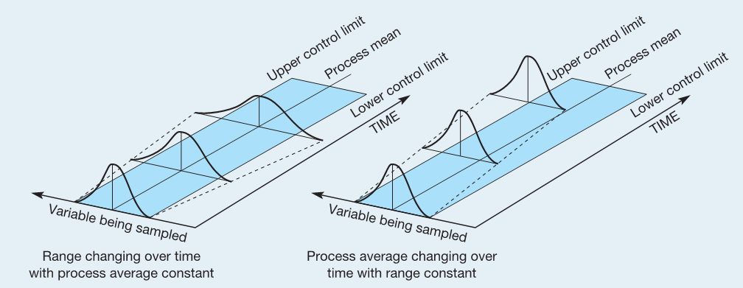

Slide 30
Control Chart Patterns
UCL
UCL
LCL
Sample observations
consistently below the
center line
LCL
Sample observations
consistently above the
center line

Slide 31
Control Chart Patterns (cont.)
UCL
UCL
LCL
Sample observations
consistently increasing
LCL
Sample observations
consistently decreasing

Slide 32
Process Capability
Tolerances
design specifications reflecting product requirements
Process capability
range of natural variability in a process what we measure with control charts

Slide 33
Process Capability
Design Specifications
(a) Natural variation exceeds design specifications; process is not capable of meeting specifications all the time.
Process
Design Specifications
(b) Design specifications and natural variation the same; process is capable of meeting specifications most of the time.
Process

Slide 34
Process Capability (cont.)
Design Specifications
(c) Design specifications greater than natural variation; process is capable of always conforming to specifications.
Process
Design Specifications
(d) Specifications greater than natural variation, but process off center; capable but some output will not meet upper specification.
Process

