Slide 1
Sustainable service business models

Slide 2
content
Sustainable and sustainability concepts
Business model (BM) definitions
BM and servitisation
Digitalisationa and servitisation…sustainability of BM
Digital servitisation
BM and sustainability and sustainable BM (SBM)
Product Service Systems
Cicular BM and SBM
Digital services and Cicrular economy (CE)

Slide 3
Sustainable and sustainability
Often mixed together
If very very correct:
Sustainable business model = b.m. which is able to continue, to be realized over a period of time
But in practice…both – also a business model for sustainability, is a framework for how organisations create, deliver and capture value based on sustainable development principles (e.g. focused on SDG).
Not only focused ON PROFIT, but….it can help organisations to tackle sustainability challenges whilst continuing to operate profitably. By addressing a range of ecological and social issues within the framework, companies can evolve their purpose, products and processes whilst contributing positively to the planet and to people.

Slide 4
Business model
help understand how a firm does business and can be used for analysis, comparison and performance assessment, management, communication, and innovation
concerned with how the firm defines its competitive strategy through the design of the product or service it offers to its market, how it charges for it, what it costs to produce, how it differentiates itself from other firms by the value proposition, and how the firm integrates its own value chain with those of other firm’s in a value network
a holistic description on ‘how a firm does business’ and how the company will convert resources and capabilities into economic value.
the organisational and financial ‘architecture’ of a business and includes implicit assumptions about customers, their needs, and the behaviour of revenues, costs and competitors
a business model CANVAS = a series of elements: the value proposition (product/service offering, customer segments, customer relationships), activities, resources, partners, distribution channels (i.e. value creation and delivery) and cost structure, and revenue model (i.e. value capture).
a consolidated view of the components of a business models as: the value proposition (i.e. the offer and the target customer segment), the value creation and delivery system, and the value capture system.
an activity-based perspective, including the selection of activities (‘what’), the activity system structure (‘how’), and who performs the activities (‘who’).
Bocken, N. M., Short, S. W., Rana, P., & Evans, S. (2014). A literature and practice review to develop sustainable business model archetypes. Journal of cleaner production, 65, 42-56.

Slide 5
Business model and servitisation
Servitisation = providing customers with a bundled package of products, services and support, training and self-service knowledge
= The transformational processes whereby a company shifts from a product-centric to a service-centric business model and logic.
It is more than a SERVICE INFUSUION = The process whereby the relative importance of service offerings to a company or business unit increases, amplifying its service portfolio and augmenting its service business orientation.
The TRANSFORMATIONAL PROCESS involves a redeployment and reconfiguration of a company's resource base and organizational capabilities and structures; a redefinition of the mission of the firm; and a revamping of routines and shared norms and values. A service business model means that the supplier commits to improving customers' value in use, so assuming greater responsibility for the overall value-creating process as compared to product-centric, transaction-based business model (Kowalkowski, C., Gebauer, H., Kamp, B., & Parry, G. (2017). Servitization and deservitization: Overview, concepts, and definitions. Industrial Marketing Management, 60, 4-10.)
The main driving force = manufacturers can no longer compete by making and selling high quality products alone. In most markets products become increasingly similar, leaving limited room for product differentiation and profitability. To overcome this problem, firms have to go downstream, closer to the customers – selling services, integrated solutions and even experiences – to capture value throughout the value chain. Servitization is also driven by customer demands, changing from products to solutions over the past decades. (Yang, M., & Evans, S. (2019). Product-service system business model archetypes and sustainability. Journal of Cleaner Production, 220, 1156-1166).
Categories and motives:
(1) Customer service to improve the quality of the customer relationship (demand-based motivations);
(2) Product-related services (Services Supporting Products or SSPs to ensure the correct functioning of the product (competitive motivations);
(3) Services supporting business needs (Services Supporting Clients or SSCs), which support the operational needs of customers and enable new revenue streams to be developed (economic motivations). (Raddats, C., Baines, T., Burton, J., Story, V. M., & Zolkiewski, J. (2016). Motivations for servitization: the impact of product complexity. International Journal of Operations & Production Management, 36(5), 572-591.)
CONTINUUM - ONLY PRODUCT CENTRIC B. M………ONLY SERVICE-CENTRIC B.M.

Slide 6
Digitalisation and servitisation of business model – dig. also enabler of sustainable b.m.
Paschou, T., Rapaccini, M., Adrodegari, F., & Saccani, N. (2020). Digital servitization in manufacturing: A systematic literature review and research agenda. Industrial Marketing Management, 89, 278-292.

Slide 7
Digital servitisation
Paschou, T., Rapaccini, M., Adrodegari, F., & Saccani, N. (2020). Digital servitization in manufacturing: A systematic literature review and research agenda. Industrial Marketing Management, 89, 278-292.

Slide 8
Business model and sustainability
incorporate a triple bottom line = The triple bottom line is an accounting framework that incorporates three dimensions of performance: social, environmental, and financial. These three facets can be summarized as "people, planet, and profit. (https://www.investopedia.com/terms/t/triple-bottom-line.asp)
important in driving and implementing corporate innovation for sustainability, can help embed sustainability into business purpose and processes
NEED FOR A a fundamental shift in the purpose of business and almost every aspect of how it is conducted
Features of a route to a sustainable economy:
A system that encourages minimising of consumption, or imposes personal and institutional caps or quotas on energy, goods, water, etc.;
A system designed to maximise societal and environmental benefit, rather than prioritising economic growth;
A closed-loop system where nothing is allowed to be wasted or discarded into the environment, which reuses, repairs, and remakes in preference to recycling;
A system that emphasises delivery of functionality and experience, rather than product ownership;
A system designed to provide fulfilling, rewarding wok experiences for all that enhances human creativity/skills;
A system built on collaboration and sharing, rather than aggressive competition (Bocken et al., 2014)

Slide 9
Sustainable business models
Goni, F. A., Gholamzadeh Chofreh, A., Estaki Orakani, Z., Klemeš, J. J., Davoudi, M., & Mardani, A. (2021). Sustainable business model: A review and framework development. Clean Technologies and Environmental Policy, 23, 889-897.

Slide 10
Example of the environemntal SBM
Joyce, A., & Paquin, R. L. (2016). The triple layered business model canvas: A tool to design more sustainable business models. Journal of cleaner production, 135, 1474-1486.

Slide 11
Example of the social SBM
Joyce, A., & Paquin, R. L. (2016). The triple layered business model canvas: A tool to design more sustainable business models. Journal of cleaner production, 135, 1474-1486.

Slide 12
Example of the economic SBM
Joyce, A., & Paquin, R. L. (2016). The triple layered business model canvas: A tool to design more sustainable business models. Journal of cleaner production, 135, 1474-1486.

Slide 13
Sustainable business model archetypes
describe groupings of mechanisms and solutions that may contribute to building up the business model for sustainability.
The aim of these archetypes is to develop a common language that can be used to accelerate the development of sustainable business models in research and practice.
The archetypes are:
Maximise material and energy efficiency;
Create value from ‘waste’;
Substitute with renewables and natural processes;
Deliver functionality rather than ownership;
Adopt a stewardship role;
Encourage sufficiency;
Re-purpose the business for society/environment; and
Develop scale-up solutions
Bocken, N. M., Short, S. W., Rana, P., & Evans, S. (2014). A literature and practice review to develop sustainable business model archetypes. Journal of cleaner production, 65, 42-56.

Slide 15
Lean manufacturing
Factor 4 and Natural Capitalism
Industrial symbiosis, is a process orientated solution turning
waste outputs from one process into feedstock for another process or product line
Closed-loop business models include products and business processes designed in a manner that enables waste at the end of the use phase of a product to be used to create new value
Cradle-to-Cradle incorporates the idea of a closed loop technical nutrient cycle with a biological open-loop cycle
Under-utilised assets and capabilities as a form of wasted value
might be re-captured through sharing e shared ownership, and
collaborative consumption approaches

Slide 16
Focus = addressing resource constraints ‘limits to growth’
associated with non-renewable resources and current production systems
Substitution with renewable (non-finite) resources
Local renewable energy solutions
Environmentally benign materials and production processes
Product Service Systems (PSS) and
Servitisation = how companies shift the business model from offering a manufactured product to offering a combination of products and services….see further

Slide 17
Aim = maximise the positive societal and environmental impacts of the firm on society by ensuring long-term
health and wellbeing of stakeholders (including society and the environment)….usually a combination of other SBMs
Employee welfare and living wages
Community development: Education, health, livelihoods
Sustainable growing and harvesting of food and other crops, minimising chemical fertilisers and pesticides, water consumption, and top soil erosion
Environmental resource and bio-diversity protection and
regeneration
Aim = radical reduction in consumption
Energy and water saving
Product durability and longevity through product redesign
Market places for second-hand goods
Frugal business models - provision of products
and services to low-income markets – or core product/service

Slide 18
Value not only for customers but also for other stakeholders
Social enterprises or hybrid bus. models
Driven by a social mission;
Generate positive externalities (spill overs) for society;
Recognise the centrality of the entrepreneurial function;
Achieve competitiveness on markets through effective planning and management.
Why: Emerging examples of businesses are being built on sound sustainability principles using combinations of the aforementioned archetypes. Albeit positive, these are often small scale.
Franchising, licensing, collaborative models (peer-to-peer models, crowd-sourcing, and open Innovation) –
= rapid replication with localised adaptation and local financing
+ bring like-minded individuals, firms, and investors,
together to drive adoption of business ideas and have the potential to radically change consumption patterns across the world, and radically influence production models

Slide 19
Product Service Systems
Some explanations:
Product related – e.g.: a maintenance contract, a financing scheme or the supply of consumables, but also a take-back agreement when the product reaches its end of life.
Product renting/sharing) - the main difference to product leasing is that the user does not have unlimited and individual access; others can use the product at other times. The same product is sequentially used by different users.
Product pooling. This greatly resembles product renting or sharing. However, here there is a simultaneous use of the product.
Functional result. Here, the provider agrees with the client the delivery of a result - a functional result is meant in rather abstract terms, which is not directly related to a specific technological system. The provider is, in principle, completely free as to how to deliver the result. Typical examples of this form of PSS are companies who offer to deliver a specified ‘pleasant climate’ in offices rather than gas or cooling equipment, or companies who promise farmers a maximum harvest loss rather than selling pesticides.
Tukker, A. (2004). Eight types of product–service system: eight ways to sustainability? Experiences from SusProNet. Business strategy and the environment, 13(4), 246-260.

Slide 20
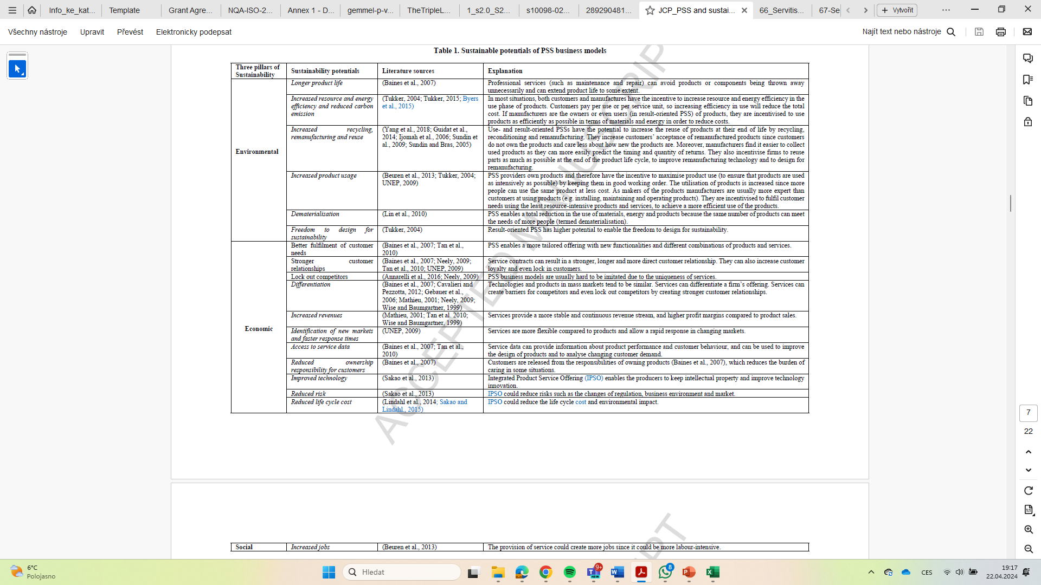
(Yang, M., & Evans, S. (2019). Product-service system business model archetypes and sustainability. Journal of Cleaner Production, 220, 1156-1166).

Slide 21
(Yang, M., & Evans, S. (2019). Product-service system business model archetypes and sustainability. Journal of Cleaner Production, 220, 1156-1166).

Slide 22
Business model and circular economy
CE = generic term for an industrial economy that is, by design or intention, restorative and in which
material flows are of two types, biological nutrients, designed to re-enter the biosphere safely, and technical nutrients, which are designed to circulate at high quality without entering the biosphere
Geissdoerfer, M., Pieroni, M. P., Pigosso, D. C., & Soufani, K. (2020). Circular business models: A review. Journal of cleaner production, 277, 123741.

Slide 23
Geissdoerfer, M., Pieroni, M. P., Pigosso, D. C., & Soufani, K. (2020). Circular business models: A review. Journal of cleaner production, 277, 123741.

Slide 24
RESOLVE framework and CBM
The Ellen MacArthur Foundation, 2015 - ReSOLVE proposes six CE-based business model development strategies:
Regenerate – This model focuses on a shift to renewable energy and material. Biological cycles circulate flows of energy and materials and convert organic waste into sources of energy and raw material for other chains.
•Share – This model has a shared economy perspective in which individuals share goods and assets; and ownership loses importance. Products are designed to last longer, and maintenance focuses on reuse of products and extending their life. Coordination between individuals is necessary for model viability. The “internet of things” can facilitate asset sharing (The Ellen MacArthur Foundation, 2015).
•Optimise – This model is technologically centred. Organisations use digital manufacturing technologies, such as sensors, automation, radio-frequency identification (RFID), big data, and remote steering to reduce waste in production systems and supply chains. Organisations benefit through a performance improvements; for instance, predictive maintenance schemes can be planned using real-time data (The Ellen MacArthur Foundation, 2015).
•Loop – This model uses biological and technical cycles. Biological cycles, for example, anaerobic digestion, can recapture the value of organic waste. Technical cycles can restore the value of post-consumption products and packaging through repair, reuse, remanufacturing, and recycling activities. Collaboration and coordination in supply chains is essential to close the loop and convert waste into useful resources. The use of intelligent devices, physical objects that are able to sense, record and communicate information about themselves and their surroundings for instance, provide information on location, condition, and availability of post-consumption products; supporting the loop strategy (The Ellen MacArthur Foundation, 2015).
•Virtualise – This model is a service-focused strategy. This model replaces physical products with virtual and dematerialised products implying the enhancement of customers' satisfaction. Smart connected products, linking with the internet of things, enable data gathering for the technical cycle (Spring and Araujo, 2017).
•Exchange – This model encompasses transferring old and non-renewable goods into advanced and renewable ones. Additive manufacturing using 3D printers can shift traditional mass production systems. Traditional mass production may produce more than the necessary to satisfy actual and potential demand; 3D printing may produce only when and what is needed at the source of demand. 3D printers are also be used for product parts repair implying a reduction of consumption of materials and of inventory (Despeisse et al., 2017).
Jabbour, C. J. C., de Sousa Jabbour, A. B. L., Sarkis, J., & Godinho Filho, M. (2019). Unlocking the circular economy through new business models based on large-scale data: an integrative framework and research agenda. Technological Forecasting and Social Change, 144, 546-552.

Slide 25
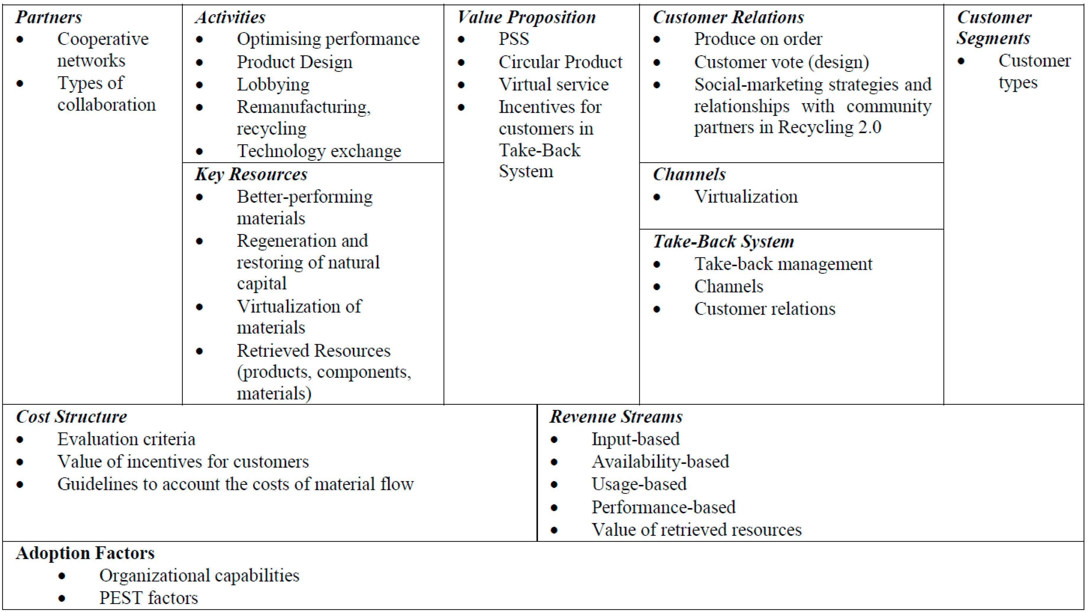
Circular business model canvas
Lewandowski, M. (2016). Designing the business models for circular economy—Towards the conceptual framework. Sustainability, 8(1), 43.

Slide 26
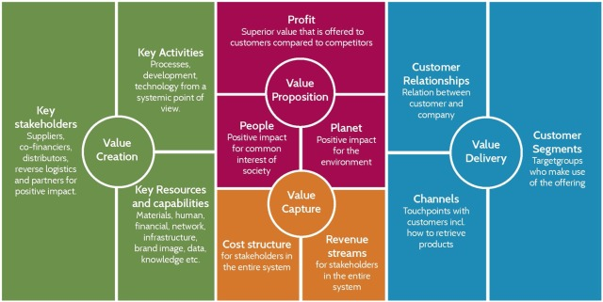
Circular business model
Bocken, N.M.P., Schuit, C.S.C., Kraaijenhagen, C., 2018. Experimenting with a circular business model: lessons from eight cases. Environ. Innovat. Soc. Transit. 28, 79e95

Slide 27
https://www.threebility.com/_files/ugd/b67836_7bd275b345cf4f20bc560590113a8f47.pdf

Slide 28
Digital services and CE
Operational performance:
(i) Manufacturing operations: this includes asset management, smart manufacturing, end-to-end transparency, performance optimization, and human resource management;
(ii) Maintenance and production asset management: involving the tracking and tracing of assets to ensure high quality, enhanced functionality/performance, and to monitor the degradation of assets; (iii) Field services: these are value-added services such as installation, maintenance, and repairs.
DIGITALISATION = the capable connection between service design and a circular product through streamlined data sharing among stakeholders.
With BM – DIGITALISATION support creating value by reducing operating costs through end-to-end integration. At the same time, servitisation increases the efficiency of remanufacturing, reusing, and recycling systems due to analytical algorithms that process big data collected at different stages of production. It is a dual-dimensional, conceptual representation of a firm’s value creation and value capturing profitably and sustainably. (Atif, S., Ahmed, S., Wasim, M., Zeb, B., Pervez, Z., & Quinn, L. (2021). Towards a conceptual development of Industry 4.0, servitisation, and circular economy: A systematic literature review. Sustainability, 13(11), 6501.)

