Slide 1
Policy evaluation methods
22.3.2023

Slide 2
Purposes for and steps of evaluation
Detect status (sometimes referred to as monitoring) Assess the state of affairs
Objectively Formally Normative (influence of values)
Explain the process leading to the result Provide arguments and options for decision-makers

Slide 3
Forms of Rationality
There are multiple rational bases underlying most policy choices:
Technical (Comparing alternatives according their capacity to promote effective solution.)
Economic (efficient solution)
Legal (legal conformity to established rules, norms, precedents)
Social (capacity to maintain or improve valued social institutions)

Slide 4
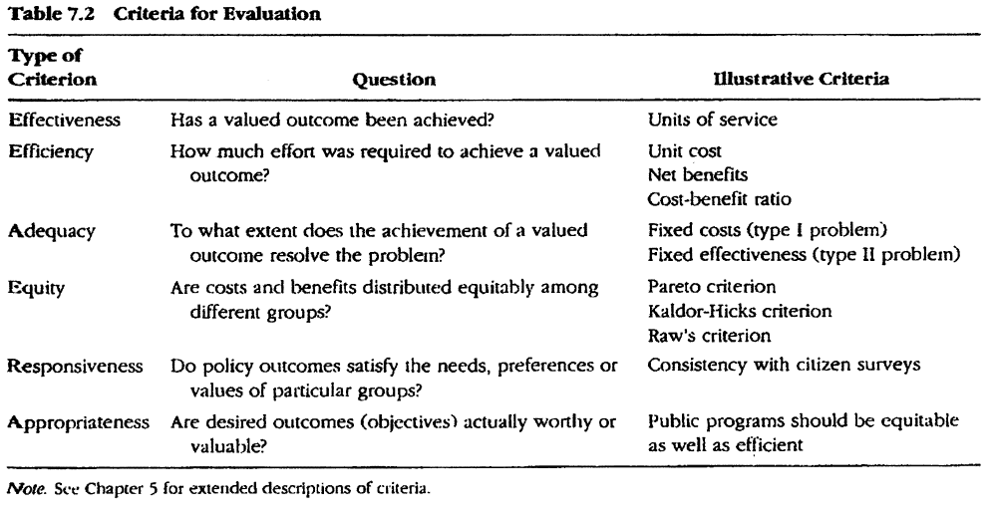
Evaluation criteria
Notes:
Dunn page 354

Slide 5
Evaluation components according to the European Commission
Past results
needs and
inequlitoes
Potencial analysis,
perspective
impact
strategy
objective
resources
outputs
outcome
operations

Slide 6
Policy
Problem
Policy
Policy outputs
Policy outcomes
Effectiveness
Efficiency =
Economy & Effectiveness

Slide 7
According to UNIDO
Criteria: economy, efficacy, efficiency, sustainability
Efficacy is getting things done. It is the ability to produce a desired amount of the desired effect, or success in achieving a given goal. Efficiency is doing things in the most economical way. It is the ratio of the output to the inputs of any system (good input to output ratio).
Structure: inputs, outputs, activities, immediate goal, structural objectives.
Results: milestones, effects, outcomes, impact.

Slide 8
Essence of economic evaluation
The essence of the economic approach to analysis and evaluation is the application of the criterion of rationality of the actions of stakeholders in the sense that rational action consists in the efficient use of limited resources in order to achieve the objectives or desired uses as much as possible. The methods of economic evaluation aim to demonstrate measurably the benefits and costs of the different choices and, on this basis, to select those alternatives that are best able to contribute to the growth of social well-being.

Slide 9
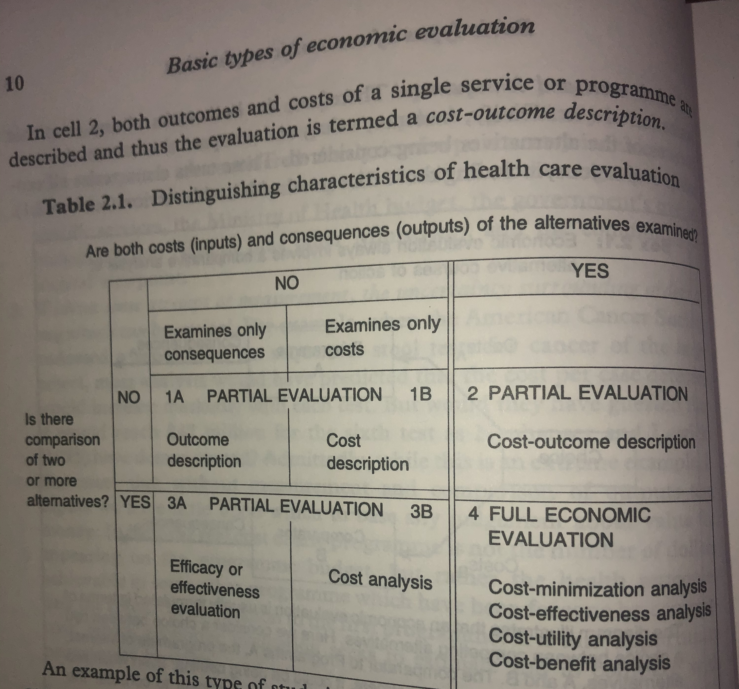

Slide 10
Long history
The history of analyses of public projects begins at the beginning of our century. In 1902, the River and Harbor Act came into force in the US, which for the first time rightly regulated the state's obligation to evaluate the costs and utility of river and port facilities designed by the So-called Corps of Engineers.
Flood Control Act... 1936 Planning-programming-budgeting system (PPBS) in the army ... 1961 Extended to other ministries in 1965 France 1967 - system of budgetary elections

Slide 11
Cost-benefit analysis (CBA)
The main feature, but also a prerequisite for the use of CBA, is the possibility to express all its costs and uses in money terms (€, $).
This requirement is the source of the most common problems encountered during its processing.
However, because of that, we can generally compare policies delivering very different types of benefits. (Universally appliable)

Slide 12
Basic Steps:
Identification of the set of possible projects that are eligible Identification of all meanings of these projects (all their inputs and outputs) Estimate of the price of individual inputs and outputs Convert all prices to the current discounted value Add up all costs and revenues of individual projects to estimate the overall profitability of the project

Slide 13
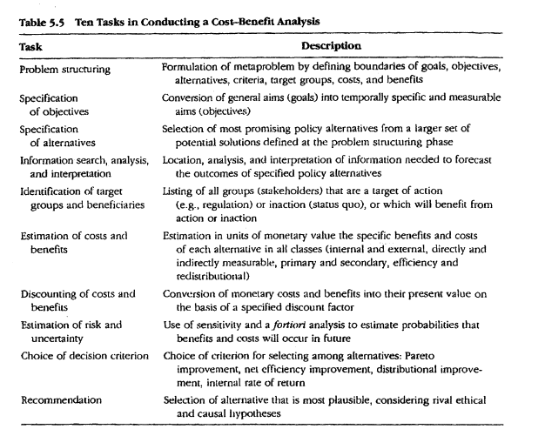

Slide 14
Costs
Costs represent a sum of the monetary expenditure and non-monetary elements necessary to use different resources to obtain a specific product.
Non-monetary elements may include restrictions arising from state regulatory measures, damage suffered by other entities or environmental degradation (negative externalities) and "opportunity costs", which indicate the benefits of otherwise using the same resources.

Slide 15
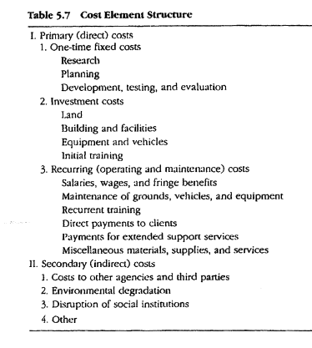

Slide 16
Benefits
Benefits represent the sum of the satisfaction of individuals, a group of individuals or a community generated by a public policy measure or expenditure programme. They may primarily take monetary and non-monetary form. For some specific benefits, it is extremely difficult to conduct the valuation, but the exclusion of immeasurable benefits from the analysis can be extremely harmful.

Slide 17
Market prices rectification - Shadow Pricing
When is it proper to conduct? In a case of:
imperfect competition
incomplete use of resources occurrence of taxes, subsidies and public (price) regulations external trade and financial protection

Slide 18
How to work it out?
Comparable prices – substitutes
Consumer choice (from real choices – value of time from price difference of different transportation alternatives slower x faster)
Derived demand (costs paid to be able to enjoy intangible benefit)
Survey analysis
Willingness to be compensated

Slide 19
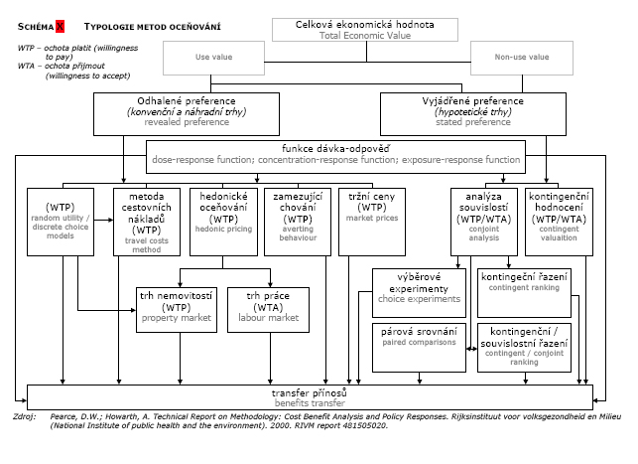
A scheme of evaluation methods for non-tangible C/Bs

Slide 20
Valuation of intangibles
There is no easy answer to the question of how far to pursue the valuation of non-market items. However, the following criteria can help in making decisions:
Is it likely that gathering more information on non-market items will change the outcome of the analysis? Can we afford to inn the costs needed to obtain this information? If we value non-market costs and costs, will this increase the quality of our decision-making?

Slide 21
Discounting
Discounting is a procedure for estimating the present value of costs and benefits that will be realized in the future. Discounting is a way to take into account the effects of time when making policy recommendations.
FV = PV . (1+ r)^{n}
PV = FV /(1 + r)^{n}
The key point is the choice of discount rate (interest rate) Lower one prefers long-lasting projects, higher one discriminates against them Private (market) and a "social" rate

Slide 23
