Slide 1
Cultural and social factors contributing to gender gaps in the labour market
Lena Adamus
12.03.2024 Brno

Slide 2
Gender equality index - EU
Notes:
https://eige.europa.eu/gender-equality-index/2022

Slide 3
Gender equality index - CR

Slide 4
CR vs EU

Slide 5
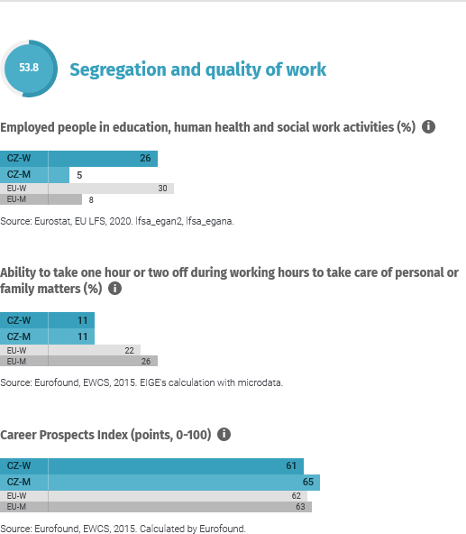
Work

Slide 6
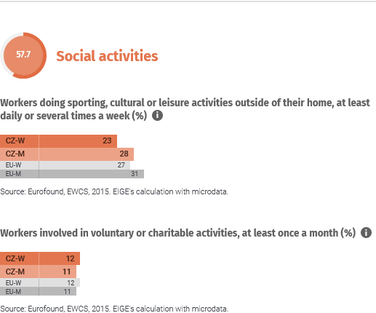
Time

Slide 7
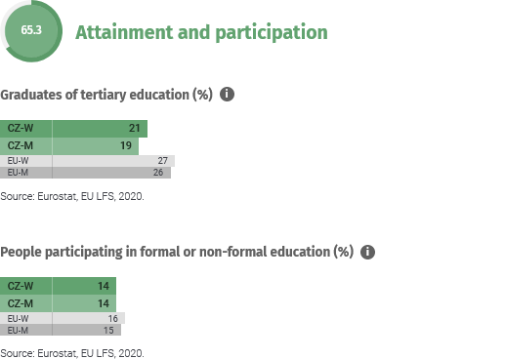
Education

Slide 8
Important concepts
Glass ceiling
Sticky floor
Glass escalator
Matilda effect
Motherhood penalty
Notes:
Diagnosis – not an explanation

Slide 9
Important concepts
Glass ceiling: a metaphorical barrier preventing women from advancing in a work hierarchy.
Sticky floor: a metaphor indicating that women tend to occupy lower-paid occupations with lower mobility potential.
Glass escalator: in female-dominated occupations, men tend to advance faster that women. A premium for being a man in a female-dominated field.
Matilda effect: attributing female scientific achievements to their male peers (e.g., Skłodowska-Curie, Rosalind Franklin).
Motherhood penalty: percentage wage decrease after every child born by a woman. The larger the drop, the more incline women are not to come back to work.
Notes:
Diagnosis – not an explanation

Slide 10
Presentation tips
How does the gender gaps look in your country? What are legal regulations in your country?
How changes in labour force participation affect wellbeing, household work arrangement (and vice versa)?

Slide 11
A not-so-funny game

Slide 12
Further read
Williams, A. (2020). Why women are poorer than men and what we can do about it?

Slide 13
Presentation tips
Which occupations are female-dominated and which are male-dominated in your country?
How occupational seggregation (both vertical and horizontal) contribute to gender wage gap?
Are the female-dominated jobs less paid?

Slide 14
So what is gender?
Politically correct term for sex?
The term sex refers to “biologically determined aspects of men and women’s behaviour, whereas gender denotes male-female differences that are shaped by sociocultural factors” (Ashmore & Sewell, 1998, p. 378).
When referring to men and women as members of a social group one should use the term gender, while sex is more appropriate in contexts where biological differences predominate.
Sex characteristics are attributes that are directly related to biological features, while gender characteristics are those that are culturally associated with a person because of his or her biological sex.
Two debates: heredity vs. environment (nature-nurture) and essentialism vs. constructivism

Slide 15
Economics of gender
Definition: Gender Economics is the area in economics that explicitly considers the effects of having two sexes as they interact in families, firms, and markets.
Theoretical models including two sexes;
Empirical work addressing differences between the sexes;
Analysis of policies that affect genders in different ways;
The ultimate question: why men and women differ?

Slide 16
Answers to the why questions on various level:
Individual and biological
Institutional
Social and cultural
Notes:
The drawback of focusing on individual level is that when we divide population into two subsamples, we are likely to find a difference. When the sample is sufficiently large, the difference is even likely to be statistically significant. The key point is thus to think about actual meaning of the detected difference. When we find differences between men and women, we often tend to think that their sources are rooted in biology or genetics. But without considering other possible sources, we should not make hasty conclusions. For instance, in economics, we like to think that whenever there is a difference, it can be traced back to individual differences (e.g. personality or cognitive skills), preferences and motivation. Indeed, it sounds plausible and may even be correct. Of course only under one assumption: that the portfolio of feasible options is the same for both men and women. Only if the playing field is equal for all actors. But is it? If we finish our analysis satisfied with results with a dummy variable we may never know.

Slide 17
Key conepts
Cultural differences
Stereotypes
Discrimination
Backlash

Slide 18
Focus Why are women underrespresented in science?
There are proportionally fewer women in science and math careers, both in academia and private industry. In early 2005, economist and president of Harvard University Lawrence Summers sparked an enormous public debate over why this is the case. In his comments, Summers indicated that he believed that men are more likely to be on the tails of the bell curve of mathematical ability. Assuming that scientists are would be drawn from the high scorers, this implies that men would outnumber women in the mathematically oriented professions. He also cited the reluctance or inability of women with children to work 80-hour weeks. His focus on innate ability angered a number of women scientists. The women scientists argued that Summers discounted discrimination and social factors in general, including opportunities and encouragement for women to enter scientific careers, instead jumping to a biologically based explanations. Summers apologised publicly, but along with other issues related to his outspokenness, this led to his resignation as Harvard’s president in 2006. (see Jacobsen, 2012)

Slide 19
Culture, gender and math
Guiso, L., Monte, F., Sapienza, P., & Zingales, L. (2008), Culture, gnder and math, Science, 320, 1164-1165.

Slide 20
Anecdotical evidence
Shortly after I changed sex, a faculty member was heard to say: Ben Barres gave a great seminar today, but then his work is much better than his sister’s.
Barres, B. (2006). A commentary, Nature, 442, 133-136

Slide 21
Further read
Maney, D.L. 2016. Perils and pitfalls of reporting sex differences. Phil. Trans. R. Soc. B 371: 20150119.

Slide 22
Presentation tips
Does reversing the general educational gender gap contribute to closing wage gap?

Slide 23
Cross-culture approach Are you WEIRD?
Gneezy, Leonard, & List (2009)
Used a controlled experiment to explore whether there are gender differences in selecting into competitive environments across distinct societies: the Maasai in Tanzania and the Khasi in India.
The Maasai represent an example of a patriarchal society, whereas the Khasi are matrilineal.
Similar to the extant evidence drawn from experiments executed in Western cultures, Maasai men opt to compete at roughly twice the rate as Maasai women.
Interestingly, this result is reversed among the Khasi: women choose the competitive environment more often than Khasi men, and even choose to compete weakly more often than Maasai men.

Slide 24
Cross-culture approach Are you WEIRD?
Finucane et al. (2000)
Data collected as part of a national telephone survey designed to test hypotheses about risk perceptions over a range of hazards. The survey contained questions about worldviews, trust, and a range of demographic variables.
All respondents were asked to consider health and safety risks `to you and your family' and to indicate whether there is almost no risk, slight risk, moderate risk, or high risk from each of 13 hazardous activities and technologies (for example, blood transfusions; motor vehicles; nuclear power plants; vaccines) and safety risks from 19 hazards for `the American public’.
Claimed that there are no universal gender differences, there is only a “white male effect”.

Slide 25
Eurobarometer on stereotypes

Slide 26
Further read
Henrich, J. (2020). The WEIRDest people in the world: How the West became psychologically perculiar and particularly prosperous?
Henrich, J., et al. (2010). The weirdest people in the world? Behavioural and brain sciences, vol. 33, pp. 61-83. doi:10.1017/S0140525X0999152X
Cukrowska-Torzewska, E. & Lovasz, A. (2019). The role of parenthood in shaping the gender wage gap – A comparative analysis of 26 European countries

Slide 27
Discrimination
Discrimination = „the valuation in the market place of personal characteristics of the worker that are unrelated to worker productivity”
Statistical discrimination = imperfect productivity information → use of statistic information/stereotypes to evaluate a person (judging by belonging to a group rather than individual competences and skills)

Slide 28
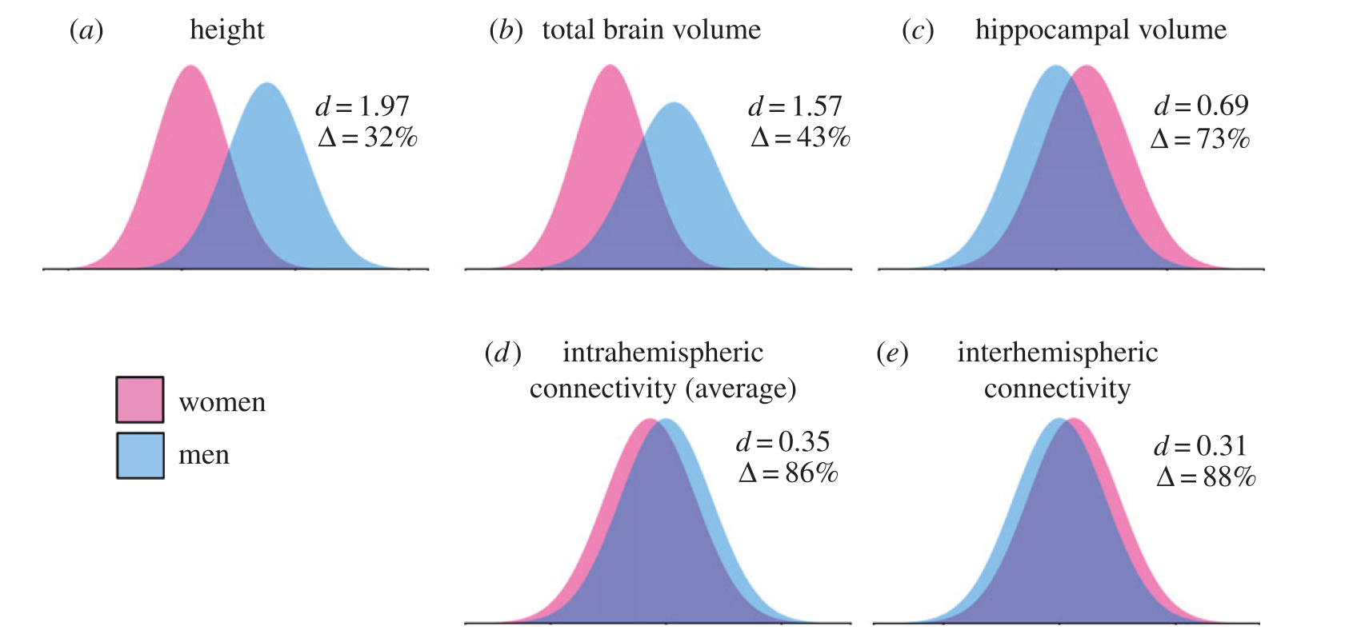
Understanding statistics
d=.2 (small), d=.5 (medium), d=.8 (large)
https://sexdifference.org/

Slide 29
Discrimination
Discrimination = „the valuation in the market place of personal characteristics of the worker that are unrelated to worker productivity”
Statistical discrimination = imperfect productivity information → use of statistic information/stereotypes to evaluate a person (judging by belonging to a group rather than individual competences and skills)

Slide 30
Further read
Arrow, K. (1973). The theory of discrimination. In: O. Ashenfelter and A. Rees (eds.), Discrimination in Labor Markets, Princeton, NJ: Princeton University Press.
Phelps, E. (1972). "The Statistical Theory of Racism and Sexism". American Economic Review. 62 (4): 659–661.

Slide 31
Stereotypes
Gender stereotypes = reflections of observed behaviour
May be biased or incorrect
Two types of stereotypes: descriptive and prescriptive

Slide 32
Gender stereotypes and identity
Men and women are socialised to different roles.
Speciﬁcally, already at an early stage of development, boys and girls learn gender-appropriate activities and behaviours (Eagly, 1987).
Boys are socialised to be masculine (instrumental or agentic) and to develop traits such as aggression, independence, ambition and rationality.
Girls are praised for being feminine (expressive or communal) and encouraged to be warm, caring, emotional and socially-oriented (Bem, 1974).

Slide 33
Gender stereotypes and identity
Consequently, occupations are not gender-neutral either, with some being considered appropriate for men and some reserved almost exclusively for women.
Gender stereotypes can, thus, distort individuals ’ preferences for occupations.
Congruence theory (Eagly and Karau, 2002) further explains that the preferences are likely to be distorted because of the biases against adopting masculine roles by individuals with predominantly feminine characteristics (and vice versa).
Consequently, individuals who perceive themselves as incongruent with the gendered notion of a given job are likely to feel discouraged from pursuing it as a potential career.

Slide 34
Backlash
Backlash = a strong negative reaction
In the gender context = social desirability (expectations) of behaviour increases when it is consistent with prescriptions applicable to one’s gender;
Individuals are likely to be penalized for non-conforming behaviour—i.e., inconsistent with gender-relevant prescriptive norms
Often related to a trade-off faced by women: they may be perceived as either competent or likeable
Trade-off: maintaining identity or pursuing a career

Slide 35
Further read
Akerlof, G. & Kranton, R. (2010). Identity Economics. Princeton University Press.
Eagly, A.H. (1987), Sex Differences in Social Behaviour: A Social-Role Interpretation, Lawrence Erlbaum, London.
Eagly, A.H. and Karau, S.J. (2002), Role congruity theory of prejudice toward female leaders, Psychological Review, 109(3), pp. 573-598.
Eagly, A.H. and Steffen, V.J. (1984), Gender stereotypes stem from the distribution of women and men into social roles, Journal of Personality and Social Psychology, 46(4), pp. 735-754.

Slide 36
Presentation tips
How gender stereotypes contribute to gender gaps across countries?
How strongly are gender stereotypes associated with labour market outcomes in your country?

Slide 37
Case study - entrepreneurship
Entrepreneurs impact positively economics, poverty and development

Slide 38
Gender and EI
Entrepreneurs impact positively economics, poverty and development
Attractive alternative for formal employment

Slide 39
Gender and EI
Entrepreneurs impact positively economics, poverty and development
Attractive alternative for formal employment
For women?

Slide 40
Gender and EI
Entrepreneurs impact positively economics, poverty and development
Attractive alternative for formal employment
For women?
Why there are so few female entrerepreneurs?

Slide 41
Gender and EI
Entrepreneurs impact positively economics, poverty and development
Attractive alternative for formal employment
For women?
Why there are so few female entrerepreneurs?
The key role of entrepreneurial intentions

Slide 42
Sample & procedure

Slide 43
Sample & procedure
The survey respondents were 552 Slovaks (49.5% women) aged 19 to 65, who were not entrepreneurs.

Slide 44
Sample & procedure
The survey respondents were 552 Slovaks (49.5% women) aged 19 to 65, who were not entrepreneurs.
Recruited through an external participant recruitment agency.

Slide 45
Sample & procedure
The survey respondents were 552 Slovaks (49.5% women) aged 19 to 65, who were not entrepreneurs.
Recruited through an external participant recruitment agency.
Representative of the general population in terms of gender and age.

Slide 46
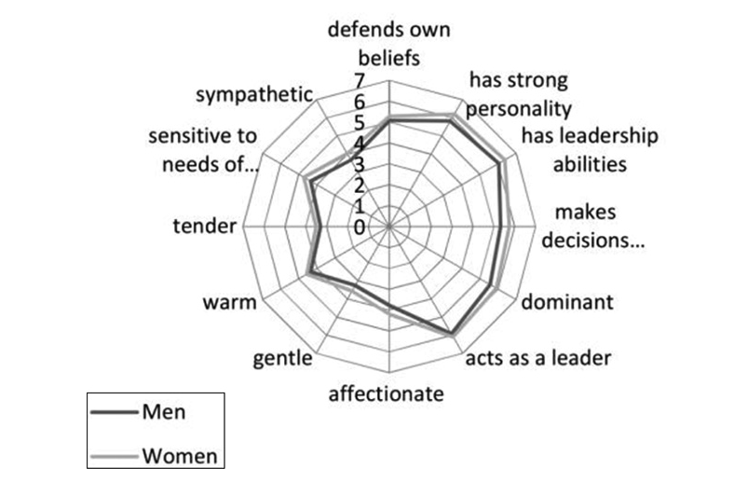
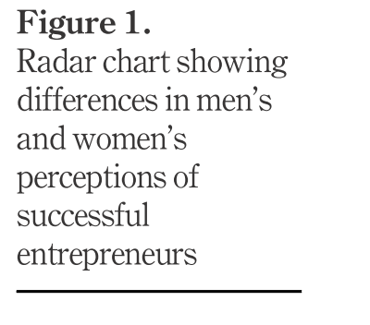
Results in brief

Slide 47
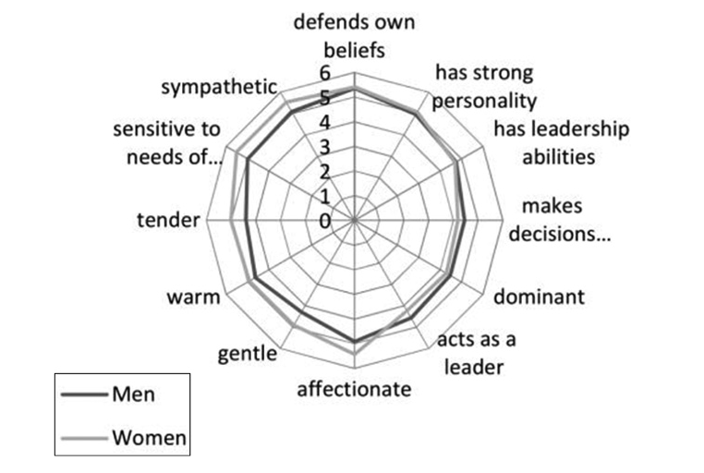
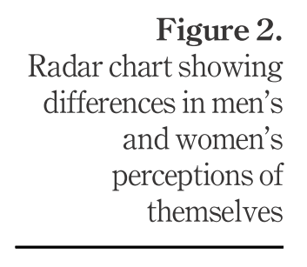
Results in brief

Slide 48
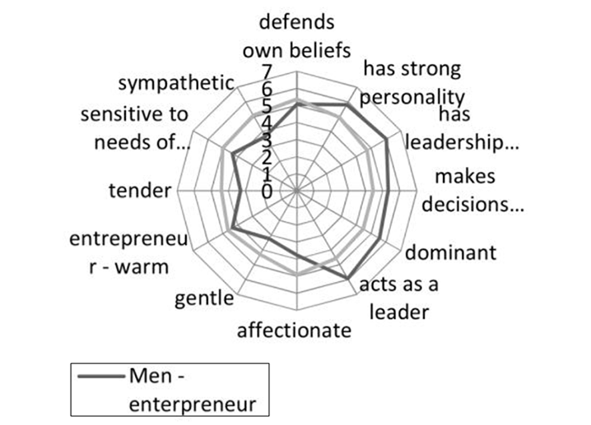
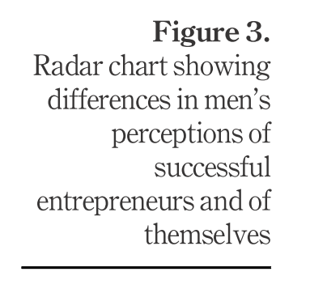
Results in brief

Slide 49
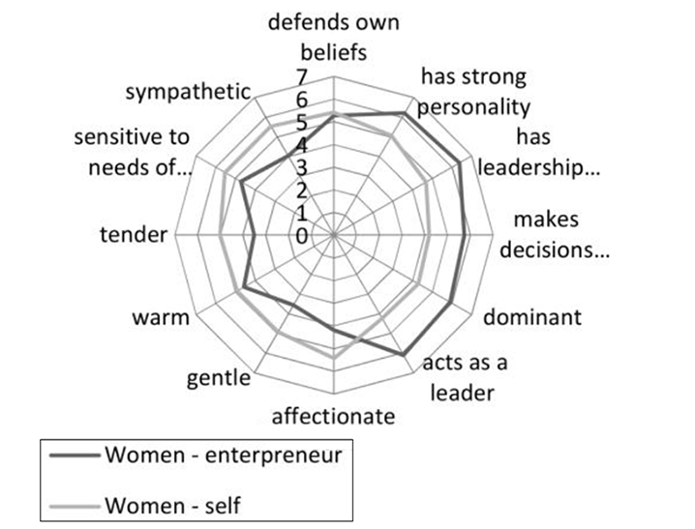
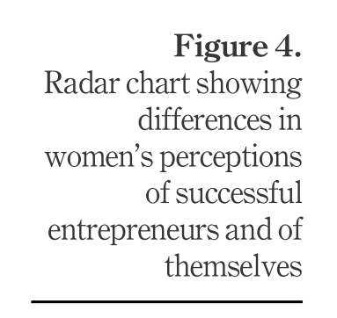
Results in brief

Slide 50
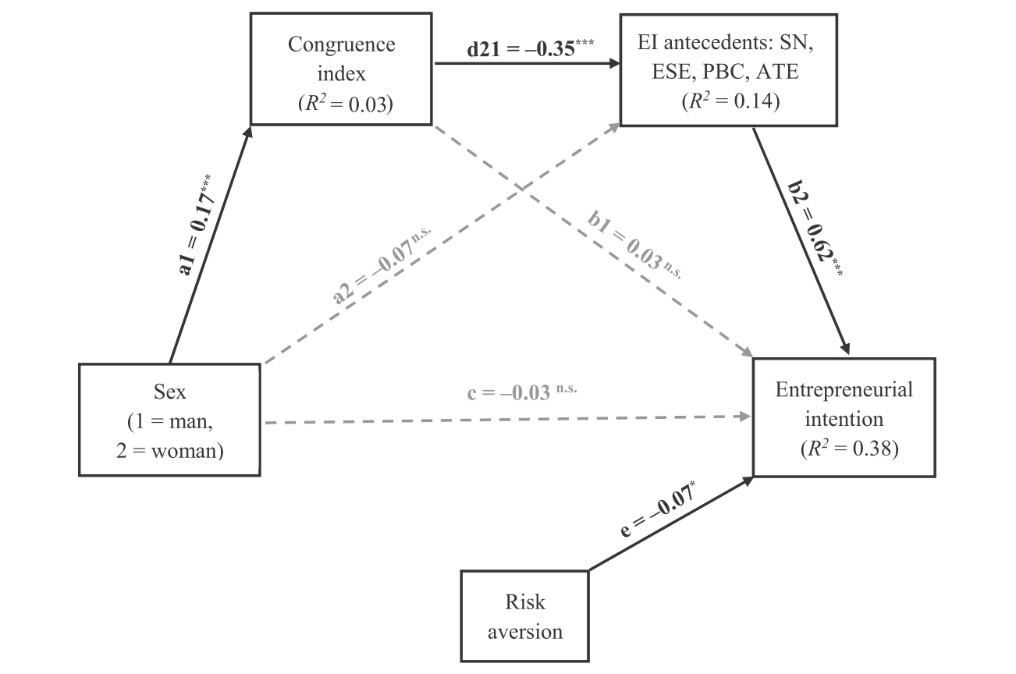
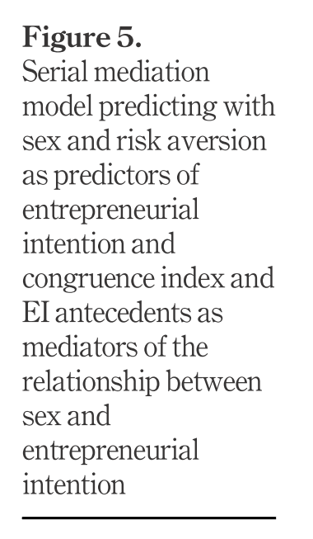
Results in brief

Slide 51
Results in brief

Slide 52
Further read
Rudman, L. A. & Glick, P. (2001). Prescriptive Gender Stereotypes and Backlash Toward Agentic Women. Journal of Social Issues, 57(4), 743–762.
Rudman, L. A. & Mescher, K. (2013). Penalizing Men Who Request a Family Leave: Is Flexibility Stigma a Femininity Stigma? Journal of Social Issues, 69(2), 322–340.
Rudman, L. A., Moss-Racusin, C. A., Phelan, J. E. & Nauts, S. (2012). Status incongruity and backlash effects: Defending the gender hierarchy motivates prejudice against female leaders. Journal of Experimental Social Psychology, 48(1), 165–179.

Slide 53
Gender biases in starting a business

Slide 54
Business plans evaluation
Do evaluators assess men’s and women’s business plans differently?

Slide 55
Business plans evaluation
Do evaluators assess men’s and women’s business plans differently?
N=498 entrepreneurs

Slide 56
Business plans evaluation
Entrepreneurs often become evaluators in BP pitch contests
Do evaluators assess men’s and women’s business plans differently?
N=498 entrepreneurs

Slide 57
Business plans evaluation
Entrepreneurs often become evaluators in BP pitch contests
Do evaluators assess men’s and women’s business plans differently?
N=498 entrepreneurs
3 BP: (i) cosmetics production,
(ii) services provision and
(iii) software development

Slide 58
Business plans evaluation
Entrepreneurs often become evaluators in BP pitch contests
Do evaluators assess men’s and women’s business plans differently?
N=498 entrepreneurs
All 3 BP presented as either male or female
3 BP: (i) cosmetics production,
(ii) services provision and
(iii) software development

Slide 59
Business plans evaluation
Entrepreneurs often become evaluators in BP pitch contests
Do evaluators assess men’s and women’s business plans differently?
N=498 entrepreneurs
All 3 BP presented as either male or female
3 BP: (i) cosmetics production,
(ii) services provision and
(iii) software development
Applicants’ competence, likeability, and the ability to succeed in business.

Slide 60
Business plans evaluation
Entrepreneurs often become evaluators in BP pitch contests
Do evaluators assess men’s and women’s business plans differently?
N=498 entrepreneurs
All 3 BP presented as either male or female
3 BP: (i) cosmetics production,
(ii) services provision and
(iii) software development
Applicants’ competence, likeability, and the ability to succeed in business.
Evaluators indicated also success chances of each plan, the amount they would be willing to invest in each of the start-ups, and selected the most prospective applicant

Slide 61
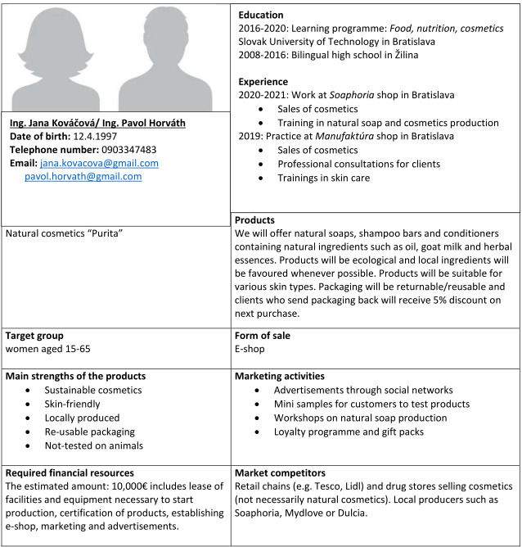

Slide 62
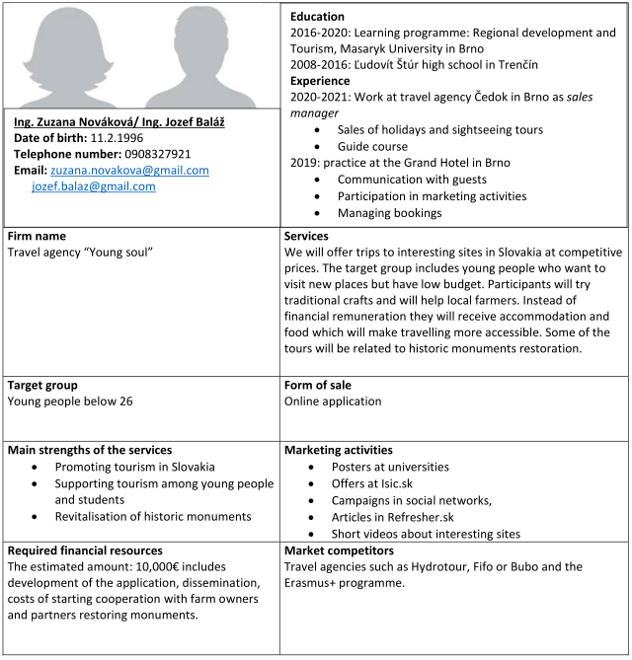

Slide 63
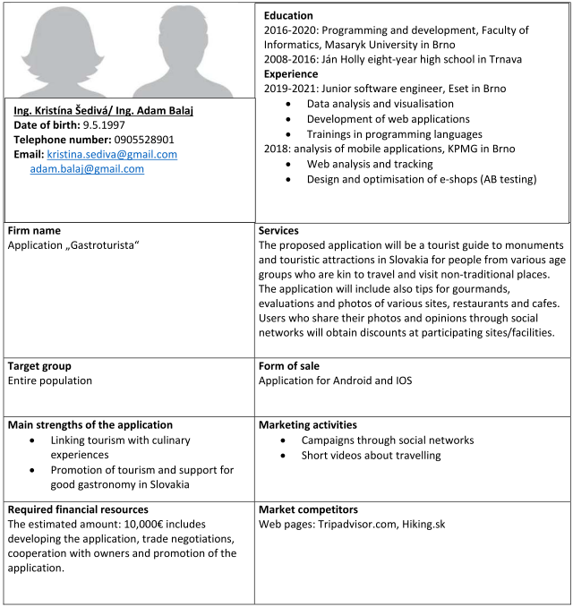

Slide 64
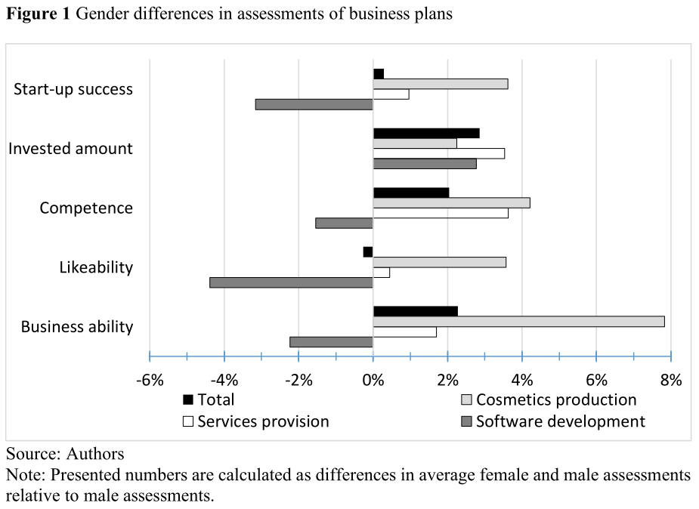
Results

Slide 65
Results
More positive assessment of women

Slide 66
Results
More positive assessment of women
More positive assessment of men

Slide 67
Results
More positive assessment of women
More positive assessment of men

Slide 68
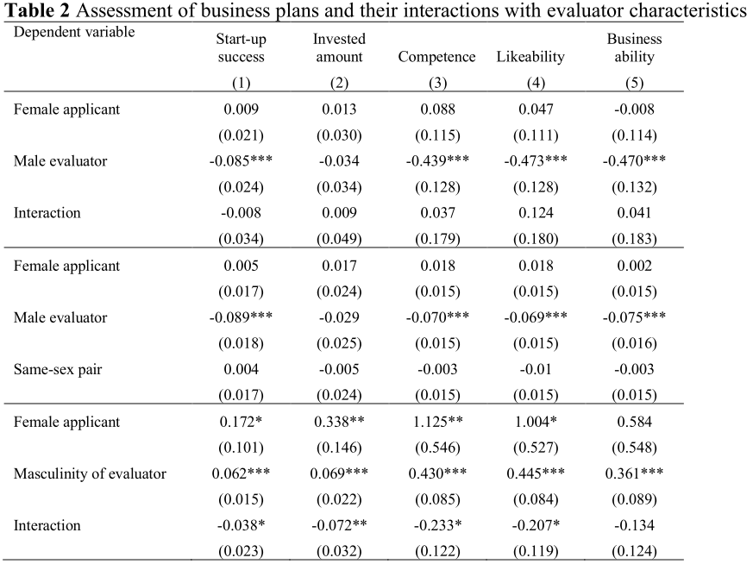
Results

Slide 69
Results
Male evaluators give lower evaluations on average than women evaluators, but no differences are confirmed when men assess female applicants or when evaluators assess applicants of same sex (i.e., the interaction effects are not significant).

Slide 70
Results
Our results indicate that masculine evaluators give higher assessments on average but negative interaction terms imply that masculine evaluators are harsher to women applicants in terms of start-up success, invested amount, competence, and likeability.

Slide 71
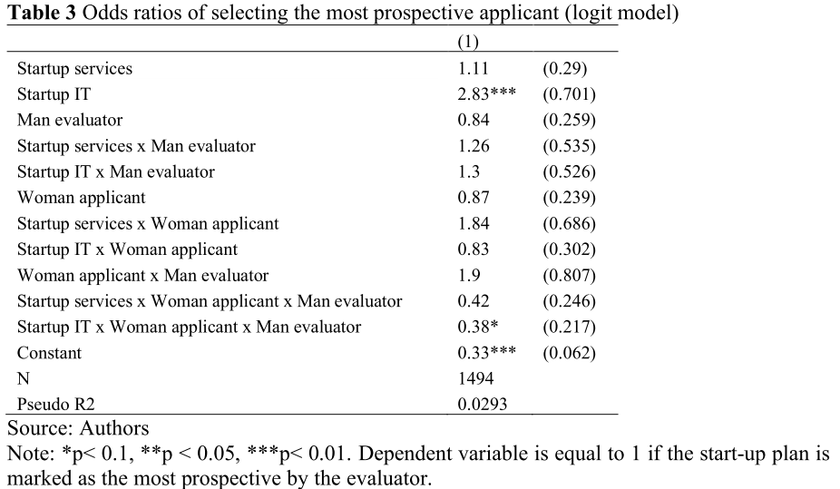
Results

Slide 72
Results
The woman applicant in IT sector has 2.6 times lower probability (odds ratio of 0.38) to be selected as the most prospective applicant in the situation when the start-up is submitted by a woman applicant and evaluated by a man. This result points to the stereotype thinking of men about the potential success of women in different fields

Slide 73
Results and conclusions

Slide 74
Results and conclusions
1: Business plans written by women are assessed more negatively in sectors stereotypically associated with men.

Slide 75
Results and conclusions
The study corroborates the view that from early phase of the business creation women may be disadvantaged when aspiring to become an entrepreneur
1: Business plans written by women are assessed more negatively in sectors stereotypically associated with men.

Slide 76
Results and conclusions
The study corroborates the view that from early phase of the business creation women may be disadvantaged when aspiring to become an entrepreneur
1: Business plans written by women are assessed more negatively in sectors stereotypically associated with men.
2: The evaluators’ masculinity may have an adverse effect on the evaluation.

Slide 77
Results and conclusions
The study corroborates the view that from early phase of the business creation women may be disadvantaged when aspiring to become an entrepreneur
1: Business plans written by women are assessed more negatively in sectors stereotypically associated with men.
2: The evaluators’ masculinity may have an adverse effect on the evaluation.
Culture-specific barriers that could slow
down women’s progress in entrepreneurship.

Slide 78
Results and conclusions
The study corroborates the view that from early phase of the business creation women may be disadvantaged when aspiring to become an entrepreneur
1: Business plans written by women are assessed more negatively in sectors stereotypically associated with men.
2: The evaluators’ masculinity may have an adverse effect on the evaluation.
Culture-specific barriers that could slow
down women’s progress in entrepreneurship.
3: Female evaluators described themselves as more masculine than men

Slide 79
Results and conclusions
The study corroborates the view that from early phase of the business creation women may be disadvantaged when aspiring to become an entrepreneur
1: Business plans written by women are assessed more negatively in sectors stereotypically associated with men.
2: The evaluators’ masculinity may have an adverse effect on the evaluation.
Culture-specific barriers that could slow
down women’s progress in entrepreneurship.
Hyper-masculine stereotypes about successful entrepreneurs may lead to self-selection of potential female entrepreneurs.
3: Female evaluators described themselves as more masculine than men

Slide 80
Take-home message
Caution is advised when recommending to increase the number of female evaluators of business plans in pitch competitions. If women who get involved in entrepreneurship are excessively masculine and masculinity is associated with less favourable evaluation of potential female entrepreneurs, such policies could backfire against women putting them in more disadvantaged position.

Slide 81
Case study – discrimination & backlash

Slide 82
Case study – discrimination & backlash
Is there differential treatment?

Slide 83
Case study – discrimination & backlash
Is there differential treatment?
Sample
155 HR managers
Notes:
Apart from studying discrimination, previous research has attempted to identify sources of the disparity indicating that distinct preferences, motivations, and life choices could contribute to the unequal distribution of household chores, occupational segregation and the gender wage gap. Although there is empirical evidence supporting the hypothesis that women have different risk, loss and competiveness preferences, make different educational choices, are less mobile in the labour market, value more flexibility even at a cost of lower wages and take jobs in sectors offering lower compensations and prefer fixed over volatile compensation schemes (Petrongolo and Ronchi, 2020; Dohmen et al. 2012; Francesconi and Parey, 2018; Bonin et al. 2007; Bertrand, 2018; Jaeger et al., 2010; Chapman and Benis, 2017; Pearlman, 2018; Pearlman, 2019; Croson and Gneezy, 2009; Gneezy, Niederle, and Rustichini, 2003; Dohmen and Falk, 2011; Kalinowski, 2019), it is still possible that some of the persistent labour market disparities are attributable to discrimination and gender biases. As Blau and Kahn (2017) observed, even after controlling for human capital (including educational attainment and professional experience), cognitive and non-cognitive skills, number of working hours, gender division of non-market work, parenthood, vertical and horizontal occupational segregation, a substantial portion of the gender wage gap remains unexplained. Although some of the persisting gap may be due to factors not included in the analyses, it seems likely that at least some portion of the disparity is caused by various forms of discrimination and gender norms regulating men and women choices and preferences.
Usually it is assumed that the gap that remains after controlling for other significant factors is attributable to discrimination.
In this study, we have decided to investigate discrimination and differential treatment directly

Slide 84
Case study – discrimination & backlash
Is there differential treatment?
Sample
155 HR managers
Two critical stages
Notes:
Apart from studying discrimination, previous research has attempted to identify sources of the disparity indicating that distinct preferences, motivations, and life choices could contribute to the unequal distribution of household chores, occupational segregation and the gender wage gap. Although there is empirical evidence supporting the hypothesis that women have different risk, loss and competiveness preferences, make different educational choices, are less mobile in the labour market, value more flexibility even at a cost of lower wages and take jobs in sectors offering lower compensations and prefer fixed over volatile compensation schemes (Petrongolo and Ronchi, 2020; Dohmen et al. 2012; Francesconi and Parey, 2018; Bonin et al. 2007; Bertrand, 2018; Jaeger et al., 2010; Chapman and Benis, 2017; Pearlman, 2018; Pearlman, 2019; Croson and Gneezy, 2009; Gneezy, Niederle, and Rustichini, 2003; Dohmen and Falk, 2011; Kalinowski, 2019), it is still possible that some of the persistent labour market disparities are attributable to discrimination and gender biases. As Blau and Kahn (2017) observed, even after controlling for human capital (including educational attainment and professional experience), cognitive and non-cognitive skills, number of working hours, gender division of non-market work, parenthood, vertical and horizontal occupational segregation, a substantial portion of the gender wage gap remains unexplained. Although some of the persisting gap may be due to factors not included in the analyses, it seems likely that at least some portion of the disparity is caused by various forms of discrimination and gender norms regulating men and women choices and preferences.
Usually it is assumed that the gap that remains after controlling for other significant factors is attributable to discrimination.
In this study, we have decided to investigate discrimination and differential treatment directly

Slide 85
Case study – discrimination & backlash
Is there differential treatment?
Sample
155 HR managers
Two critical stages
recruitment
Notes:
Apart from studying discrimination, previous research has attempted to identify sources of the disparity indicating that distinct preferences, motivations, and life choices could contribute to the unequal distribution of household chores, occupational segregation and the gender wage gap. Although there is empirical evidence supporting the hypothesis that women have different risk, loss and competiveness preferences, make different educational choices, are less mobile in the labour market, value more flexibility even at a cost of lower wages and take jobs in sectors offering lower compensations and prefer fixed over volatile compensation schemes (Petrongolo and Ronchi, 2020; Dohmen et al. 2012; Francesconi and Parey, 2018; Bonin et al. 2007; Bertrand, 2018; Jaeger et al., 2010; Chapman and Benis, 2017; Pearlman, 2018; Pearlman, 2019; Croson and Gneezy, 2009; Gneezy, Niederle, and Rustichini, 2003; Dohmen and Falk, 2011; Kalinowski, 2019), it is still possible that some of the persistent labour market disparities are attributable to discrimination and gender biases. As Blau and Kahn (2017) observed, even after controlling for human capital (including educational attainment and professional experience), cognitive and non-cognitive skills, number of working hours, gender division of non-market work, parenthood, vertical and horizontal occupational segregation, a substantial portion of the gender wage gap remains unexplained. Although some of the persisting gap may be due to factors not included in the analyses, it seems likely that at least some portion of the disparity is caused by various forms of discrimination and gender norms regulating men and women choices and preferences.
Usually it is assumed that the gap that remains after controlling for other significant factors is attributable to discrimination.
In this study, we have decided to investigate discrimination and differential treatment directly

Slide 86
Case study – discrimination & backlash
Is there differential treatment?
Sample
155 HR managers
Two critical stages
recruitment
dismissal
Notes:
Apart from studying discrimination, previous research has attempted to identify sources of the disparity indicating that distinct preferences, motivations, and life choices could contribute to the unequal distribution of household chores, occupational segregation and the gender wage gap. Although there is empirical evidence supporting the hypothesis that women have different risk, loss and competiveness preferences, make different educational choices, are less mobile in the labour market, value more flexibility even at a cost of lower wages and take jobs in sectors offering lower compensations and prefer fixed over volatile compensation schemes (Petrongolo and Ronchi, 2020; Dohmen et al. 2012; Francesconi and Parey, 2018; Bonin et al. 2007; Bertrand, 2018; Jaeger et al., 2010; Chapman and Benis, 2017; Pearlman, 2018; Pearlman, 2019; Croson and Gneezy, 2009; Gneezy, Niederle, and Rustichini, 2003; Dohmen and Falk, 2011; Kalinowski, 2019), it is still possible that some of the persistent labour market disparities are attributable to discrimination and gender biases. As Blau and Kahn (2017) observed, even after controlling for human capital (including educational attainment and professional experience), cognitive and non-cognitive skills, number of working hours, gender division of non-market work, parenthood, vertical and horizontal occupational segregation, a substantial portion of the gender wage gap remains unexplained. Although some of the persisting gap may be due to factors not included in the analyses, it seems likely that at least some portion of the disparity is caused by various forms of discrimination and gender norms regulating men and women choices and preferences.
Usually it is assumed that the gap that remains after controlling for other significant factors is attributable to discrimination.
In this study, we have decided to investigate discrimination and differential treatment directly

Slide 87
Case study – discrimination & backlash
Is there differential treatment?
Sample
155 HR managers
Two critical stages
recruitment
dismissal
Notes:
Apart from studying discrimination, previous research has attempted to identify sources of the disparity indicating that distinct preferences, motivations, and life choices could contribute to the unequal distribution of household chores, occupational segregation and the gender wage gap. Although there is empirical evidence supporting the hypothesis that women have different risk, loss and competiveness preferences, make different educational choices, are less mobile in the labour market, value more flexibility even at a cost of lower wages and take jobs in sectors offering lower compensations and prefer fixed over volatile compensation schemes (Petrongolo and Ronchi, 2020; Dohmen et al. 2012; Francesconi and Parey, 2018; Bonin et al. 2007; Bertrand, 2018; Jaeger et al., 2010; Chapman and Benis, 2017; Pearlman, 2018; Pearlman, 2019; Croson and Gneezy, 2009; Gneezy, Niederle, and Rustichini, 2003; Dohmen and Falk, 2011; Kalinowski, 2019), it is still possible that some of the persistent labour market disparities are attributable to discrimination and gender biases. As Blau and Kahn (2017) observed, even after controlling for human capital (including educational attainment and professional experience), cognitive and non-cognitive skills, number of working hours, gender division of non-market work, parenthood, vertical and horizontal occupational segregation, a substantial portion of the gender wage gap remains unexplained. Although some of the persisting gap may be due to factors not included in the analyses, it seems likely that at least some portion of the disparity is caused by various forms of discrimination and gender norms regulating men and women choices and preferences.
Usually it is assumed that the gap that remains after controlling for other significant factors is attributable to discrimination.
In this study, we have decided to investigate discrimination and differential treatment directly

Slide 88
Study design – vignette study
Two critical stages

Slide 89
Study design – vignette study
Two critical stages
recruitment
Task 1

Slide 90
Study design – vignette study
Two critical stages
recruitment
dismissal
Task 1
Task 2

Slide 91
Sample
Sample
155 HR managers

Slide 92
Sample
Sample
155 HR managers
Selection criterion:
Experience in HR processes

Slide 93
Sample
Sample
155 HR managers
Selection criterion:
Experience in HR processes
97 female

Slide 94
Sample
Sample
155 HR managers
Selection criterion:
Experience in HR processes
97 female
M_{age} = 41.48, SD_{age} = 9.57

Slide 95
Task 1: recruitment
155 HR managers

Slide 96
Task 1: recruitment
155 HR managers
Cover story

Slide 97
Task 1: recruitment
155 HR managers
Regional sales manager in a winery
Cover story

Slide 98
Task 1: recruitment
155 HR managers
Regional sales manager in a winery
Cover story
Split sample

Slide 99
Task 1: recruitment
155 HR managers
Regional sales manager in a winery
Cover story
Split sample
3 female CVs
3 male CVs

Slide 100
Task 1: recruitment
155 HR managers
Regional sales manager in a winery
Cover story
Split sample
3 female CVs
3 male CVs
Competence
Likeability
Hireability
Wage proposal
Competence
Likeability
Hireability
Wage proposal

Slide 101
Task 1: instrument

Slide 102
Task 1: instrument

Slide 103
Task 1: instrument

Slide 104
Task 1: instrument
Table 1 Vignette factors and factor levels
Factor | Factor levels
gender | 2 levels | male/female
age | 3 levels | 35, 36, 37 years
educational attainment | 3 levels | 3 universities with different quality
professional experience | 3 levels | 8 years and small team, 10 years and medium team, 11 years and big team
vocational training | 3 levels | considerable and job-related, average, none

Slide 105
Task 1: questionnaire
Competence (3 items): 1. Did the applicant strike as competent? 2. How likely is that the applicant has the necessary skills for this job? 3. How qualified you think the applicant is? Scale: 1 (not at all) to 7 (very much);
Hireability (3 items): 1. How likealy would you be to invite the applicant to interview for the job? 2. How likely would you be to hire the applicant for the job? 3. How likely do you think it is thay the applicant was actually hired? Scale: 1 (not at all) to 7 (very much);
Likeability (3 items): 1. How much did you like the applicant? 2. Would you characterize the applicant as someone you want to get to know better? 3. Would the applicant fit well with other team members? Scale: 1 (not at all likely) to 7 (very likely);
Wage proposal: starting and after probation

Slide 106
Task 1: results
Table 2 Descriptive statistics of measured variables and differences between assessment of men and women applicants
 |  | men applicants |  |  |  | women applicants
CV |  | N | ω | M | SD | N | ω | M | SD | t | df | p | d
best | competence | 77 | .910 | 5.74 | 0.93 | 78 | .992 | 5.73 | 1.08 | 0.059 | 153 | .953
 | hire-ability | 77 | .893 | 5.51 | 1.08 | 78 | .987 | 5.67 | 1.02 | -0.949 | 153 | .344
 | likeability | 77 | .879 | 5.41 | 0.88 | 78 | .990 | 5.61 | 0.94 | -1.403 | 153 | .163
 | starting wage | 77 | - | 1230.39 | 451.86 | 78 | - | 1055.77 | 295.64 | 2.845 | 152 | .005 | .459
 | average wage | 77 | - | 1498.55 | 531.91 | 78 | - | 1314.03 | 361.49 | 2.513 | 151 | .013 | .406
Note: N – number, ω – reliability (omega), M – mean, SD – standard deviation, t – t-test value, df – degree of freedom, p – significance, d – Cohen’s d

Slide 107
Task 1: results
Table 2 Descriptive statistics of measured variables and differences between assessment of men and women applicants
 |  | men applicants |  |  |  | women applicants
CV |  | N | ω | M | SD | N | ω | M | SD | t | df | p | d
best | competence | 77 | .910 | 5.74 | 0.93 | 78 | .992 | 5.73 | 1.08 | 0.059 | 153 | .953
 | hire-ability | 77 | .893 | 5.51 | 1.08 | 78 | .987 | 5.67 | 1.02 | -0.949 | 153 | .344
 | likeability | 77 | .879 | 5.41 | 0.88 | 78 | .990 | 5.61 | 0.94 | -1.403 | 153 | .163
 | starting wage | 77 | - | 1230.39 | 451.86 | 78 | - | 1055.77 | 295.64 | 2.845 | 152 | .005 | .459
 | average wage | 77 | - | 1498.55 | 531.91 | 78 | - | 1314.03 | 361.49 | 2.513 | 151 | .013 | .406
Note: N – number, ω – reliability (omega), M – mean, SD – standard deviation, t – t-test value, df – degree of freedom, p – significance, d – Cohen’s d

Slide 108
Task 1: results
Table 2 Descriptive statistics of measured variables and differences between assessment of men and women applicants
 |  | men applicants |  |  |  | women applicants
CV |  | N | ω | M | SD | N | ω | M | SD | t | df | p | d
best | competence | 77 | .910 | 5.74 | 0.93 | 78 | .992 | 5.73 | 1.08 | 0.059 | 153 | .953
 | hire-ability | 77 | .893 | 5.51 | 1.08 | 78 | .987 | 5.67 | 1.02 | -0.949 | 153 | .344
 | likeability | 77 | .879 | 5.41 | 0.88 | 78 | .990 | 5.61 | 0.94 | -1.403 | 153 | .163
 | starting wage | 77 | - | 1230.39 | 451.86 | 78 | - | 1055.77 | 295.64 | 2.845 | 152 | .005 | .459
 | average wage | 77 | - | 1498.55 | 531.91 | 78 | - | 1314.03 | 361.49 | 2.513 | 151 | .013 | .406
Note: N – number, ω – reliability (omega), M – mean, SD – standard deviation, t – t-test value, df – degree of freedom, p – significance, d – Cohen’s d

Slide 109
Task 1: results
Table 2 Descriptive statistics of measured variables and differences between assessment of men and women applicants
 |  | men applicants |  |  |  | women applicants
CV |  | N | ω | M | SD | N | ω | M | SD | t | df | p | d
best | competence | 77 | .910 | 5.74 | 0.93 | 78 | .992 | 5.73 | 1.08 | 0.059 | 153 | .953
 | hire-ability | 77 | .893 | 5.51 | 1.08 | 78 | .987 | 5.67 | 1.02 | -0.949 | 153 | .344
 | likeability | 77 | .879 | 5.41 | 0.88 | 78 | .990 | 5.61 | 0.94 | -1.403 | 153 | .163
 | starting wage | 77 | - | 1230.39 | 451.86 | 78 | - | 1055.77 | 295.64 | 2.845 | 152 | .005 | .459
 | average wage | 77 | - | 1498.55 | 531.91 | 78 | - | 1314.03 | 361.49 | 2.513 | 151 | .013 | .406
Note: N – number, ω – reliability (omega), M – mean, SD – standard deviation, t – t-test value, df – degree of freedom, p – significance, d – Cohen’s d
Medium and least competent men significantly less likeable than identical women

Slide 110
Task 1: results
Table 3 Correlations between hire-ability, competence and likeability
 | women applicants |  | men applicants
 | hire-ability | likeability | hire-ability | likeability
competence | .875** | .817** | .842** | .729**
hire-ability |  | .870** |  | .756**
Note: **correlation is significant at the .01 level

Slide 111
Task 1: results

Slide 112
Task 1: results
Gap between 7 and 15%
~ 20% in Slovakia (GEI)
Two patterns
Better qualified = greater gap
Men achieve an additional premium for being perceived as highly skilled?
Greater uncertainty concerning female candidates even though they were perceived as equally competent?
Lower gap after probation
Notes:
The scope of the wage proposals gap in our study was lower (between 7 and 15 percent) than the raw gender wage gap for Slovakia (about 20% according to GEI).
We have observed two interesting patterns related to the gap.
First, the greatest difference occurred for the best and the smallest for the worst pair of candidates.
The wider gap for better qualified candidates indicates that men achieve an additional premium for being perceived as highly skilled.
Second, we found that the gap tends to decrease for the wage proposed following the probation period, suggesting that there is greater uncertainty concerning female candidates even though they were perceived as equally competent.
Nevertheless, after they prove they are valuable employees, they can expect their wages to increase more compared to men.
They would still receive significantly less than their male counterparts.

Slide 113
Task 2: dismissal
155 HR managers

Slide 114
Task 2: dismissal
155 HR managers
Split sample

Slide 115
Task 2: dismissal
155 HR managers
Split sample
6 preselected employees

Slide 116
Task 2: dismissal
155 HR managers
Split sample
6 preselected employees
Identical except of gender

Slide 117
Task 2: dismissal
155 HR managers
Split sample
6 preselected employees
Identical except of gender
Which one to dismiss?

Slide 118
Task 2: dismissal
155 HR managers
Split sample
6 preselected employees
Identical except of gender
Which one to dismiss?
Why?

Slide 119
Task 2: dismissal
Table 4 Choice of applicant to fire
 | form A, n = 77 |  | form B, n = 78
applicant | sex, % | reasoning | sex, % | reasoning
36, 6 years in Co., almost no absences | w, 0.0% |  | m, 1.3%
37, 7 years in Co., almost no absences | m, 0.0% |  | w, 0.0%
35, 5 years in Co., some absences | w, 1.3% |  | m, 12.8% | absences, fewer years in Co., a man, young
36, 6 years in Co., some absences | m, 2.6% |  | w, 1.3%
37, 7 years in Co., frequent absences | w, 9.1% | absences | m, 41.0% | absences, fewer years in Co., a man (too much absences), young
38, 5 years in Co., frequent absences | m, 87.0% | absences, fewer years in Co., a man | w, 43.6% | absences, fewer years in Co., young
Note: w – woman, m – man

Slide 120
Task 2: dismissal
Table 4 Choice of applicant to fire
 | form A, n = 77 |  | form B, n = 78
applicant | sex, % | reasoning | sex, % | reasoning
36, 6 years in Co., almost no absences | w, 0.0% |  | m, 1.3%
37, 7 years in Co., almost no absences | m, 0.0% |  | w, 0.0%
35, 5 years in Co., some absences | w, 1.3% |  | m, 12.8% | absences, fewer years in Co., a man, young
36, 6 years in Co., some absences | m, 2.6% |  | w, 1.3%
37, 7 years in Co., frequent absences | w, 9.1% | absences | m, 41.0% | absences, fewer years in Co., a man (too much absences), young
38, 5 years in Co., frequent absences | m, 87.0% | absences, fewer years in Co., a man | w, 43.6% | absences, fewer years in Co., young
Note: w – woman, m – man

Slide 121
Task 2: dismissal
Table 4 Choice of applicant to fire
 | form A, n = 77 |  | form B, n = 78
applicant | sex, % | reasoning | sex, % | reasoning
36, 6 years in Co., almost no absences | w, 0.0% |  | m, 1.3%
37, 7 years in Co., almost no absences | m, 0.0% |  | w, 0.0%
35, 5 years in Co., some absences | w, 1.3% |  | m, 12.8% | absences, fewer years in Co., a man, young
36, 6 years in Co., some absences | m, 2.6% |  | w, 1.3%
37, 7 years in Co., frequent absences | w, 9.1% | absences | m, 41.0% | absences, fewer years in Co., a man (too much absences), young
38, 5 years in Co., frequent absences | m, 87.0% | absences, fewer years in Co., a man | w, 43.6% | absences, fewer years in Co., young
Note: w – woman, m – man

Slide 122
Task 2: dismissal
Table 4 Choice of applicant to fire
 | form A, n = 77 |  | form B, n = 78
applicant | sex, % | reasoning | sex, % | reasoning
36, 6 years in Co., almost no absences | w, 0.0% |  | m, 1.3%
37, 7 years in Co., almost no absences | m, 0.0% |  | w, 0.0%
35, 5 years in Co., some absences | w, 1.3% |  | m, 12.8% | absences, fewer years in Co., a man, young
36, 6 years in Co., some absences | m, 2.6% |  | w, 1.3%
37, 7 years in Co., frequent absences | w, 9.1% | absences | m, 41.0% | absences, fewer years in Co., a man (too much absences), young
38, 5 years in Co., frequent absences | m, 87.0% | absences, fewer years in Co., a man | w, 43.6% | absences, fewer years in Co., young
Note: w – woman, m – man

Slide 123
Task 2: dismissal
Table 4 Choice of applicant to fire
 | form A, n = 77 |  | form B, n = 78
applicant | sex, % | reasoning | sex, % | reasoning
36, 6 years in Co., almost no absences | w, 0.0% |  | m, 1.3%
37, 7 years in Co., almost no absences | m, 0.0% |  | w, 0.0%
35, 5 years in Co., some absences | w, 1.3% |  | m, 12.8% | absences, fewer years in Co., a man, young
36, 6 years in Co., some absences | m, 2.6% |  | w, 1.3%
37, 7 years in Co., frequent absences | w, 9.1% | absences | m, 41.0% | absences, fewer years in Co., a man (too much absences), young
38, 5 years in Co., frequent absences | m, 87.0% | absences, fewer years in Co., a man | w, 43.6% | absences, fewer years in Co., young
Note: w – woman, m – man

Slide 124
Conclusions
Differential treatment?

Slide 125
Conclusions
Differential treatment?
Women

Slide 126
Conclusions
Differential treatment?
Women
Direct discrimination

Slide 127
Conclusions
Differential treatment?
Women
Direct discrimination
Lower wages

Slide 128
Conclusions
Differential treatment?
Women
Men
Direct discrimination
Lower wages

Slide 129
Conclusions
Differential treatment?
Women
Men
Direct discrimination
Implicit biases
Lower wages

Slide 130
Conclusions
Differential treatment?
Women
Men
Direct discrimination
Implicit biases
Backlash effect
Lower wages

Slide 131
Conclusions
Differential treatment?
Women
Men
Direct discrimination
Implicit biases
Backlash effect
Lower wages
Lower likeability

Slide 132
Conclusions
Differential treatment?
Women
Men
Direct discrimination
Implicit biases
Backlash effect
Lower wages
Lower likeability
Greater „dismissability”

Slide 133
Conclusions
Differential treatment?
Women
Men
Direct discrimination
Implicit biases
Backlash effect
Lower wages
Lower likeability
Women’s greater preference for flexibility and part-time work
Greater „dismissability”

Slide 134
Conclusions
Differential treatment?
Women
Men
Direct discrimination
Implicit biases
Backlash effect
Lower wages
Lower likeability
Women’s greater preference for flexibility and part-time work
Greater „dismissability”

Slide 135
Conclusions
Differential treatment?
Women
Men
Direct discrimination
Implicit biases
Less work-life balance
Backlash effect
Lower wages
Lower likeability
Women’s greater preference for flexibility and part-time work
Greater „dismissability”

Slide 136
Conclusions
Differential treatment?
Women
Men
Direct discrimination
Implicit biases
Less work-life balance
Less wellbeing
Backlash effect
Lower wages
Lower likeability
Women’s greater preference for flexibility and part-time work
Greater „dismissability”

Slide 137
Conclusions
Differential treatment?
Women
Men
Direct discrimination
Implicit biases
Less work-life balance
Less wellbeing
Developmental issues
Backlash effect
Lower wages
Lower likeability
Women’s greater preference for flexibility and part-time work
Greater „dismissability”

