Slide 1
Micro and Macro Approaches to Technology Management

Slide 2
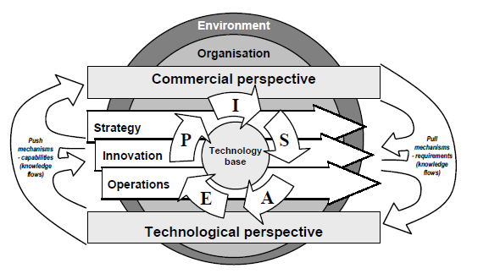
Recap of Technology Management Framework
Think about, how can the technology management framework be applied in a real-world scenario? Provide an example.
Notes:
the major tools and techniques include strategic planning, portfolio management, project management, human resource management, and information management. They should also mention that these tools and techniques should be used in a dynamic and flexible manner to adapt to the changing technological landscape.
However, students should mention that the framework addresses the dynamic capability of an organization by focusing on the micro-level analysis of technology management. It emphasizes the need for organizations to continuously adapt their technology management practices in response to changes in the technological landscape.
However, students should provide a specific example of a company or industry where the technology management framework can be applied. They should explain how the company or industry can use the tools and techniques mentioned in the framework to manage their technology in a dynamic and flexible manner.
The Technology Management ™ framework by Cetindamar et al. is a dynamic capability model that provides a systematic approach to managing technology in a company¹. It emphasizes that there’s no single best way to manage technology, and success isn’t mechanistic but dynamic¹.
Let’s consider a hypothetical example of a company in the renewable energy sector to illustrate the application of this framework:
Identification of Technologies: The company identifies solar power and wind energy as key technologies that could drive their growth in the renewable energy market.
Selection of Technologies: After a thorough analysis of the market trends, technological feasibility, and alignment with the company’s strategic goals, the company decides to invest more in solar power due to its wider acceptance and falling costs.
Acquisition of Technologies: The company could acquire the necessary technology through various means such as in-house development, licensing, or buying patents.
Exploitation of Technologies: Once the technology is acquired, the company would then integrate it into their products or services. This could involve designing solar panels and related equipment, and offering installation and maintenance services.
Protection of Technologies: The company would need to protect their technology through patents to ensure they maintain a competitive edge in the market.
Learning: The company should continuously learn from its TM activities and the market, to feed into their future technology identification and selection processes.
This is a simplified example, and real-world applications would involve much more complexity and iterations among these steps. The key is that the TM framework provides a structured approach to making and executing strategic decisions related to technology¹.
Sure, let’s consider a practical example of a software development company to illustrate the application of the Technology Management ™ framework by Cetindamar et al.
Identification of Technologies: The company identifies cloud computing and artificial intelligence as key technologies that could drive their growth in the software market.
Selection of Technologies: After analyzing market trends, technological feasibility, and alignment with the company’s strategic goals, the company decides to invest more in artificial intelligence due to its potential to create innovative products and services.
Acquisition of Technologies: The company could acquire the necessary technology through various means such as in-house development, partnerships with AI research institutions, or hiring AI specialists.
Exploitation of Technologies: Once the technology is acquired, the company would then integrate it into their products or services. This could involve developing AI-powered software solutions for various industries such as healthcare, finance, and retail.
Protection of Technologies: The company would need to protect their technology through patents and copyrights to ensure they maintain a competitive edge in the market.
Learning: The company should continuously learn from its TM activities and the market, to feed into their future technology identification and selection processes.
This is a simplified example, and real-world applications would involve much more complexity and iterations among these steps. The key is that the TM framework provides a structured approach to making and executing strategic decisions related to technology.

Slide 3
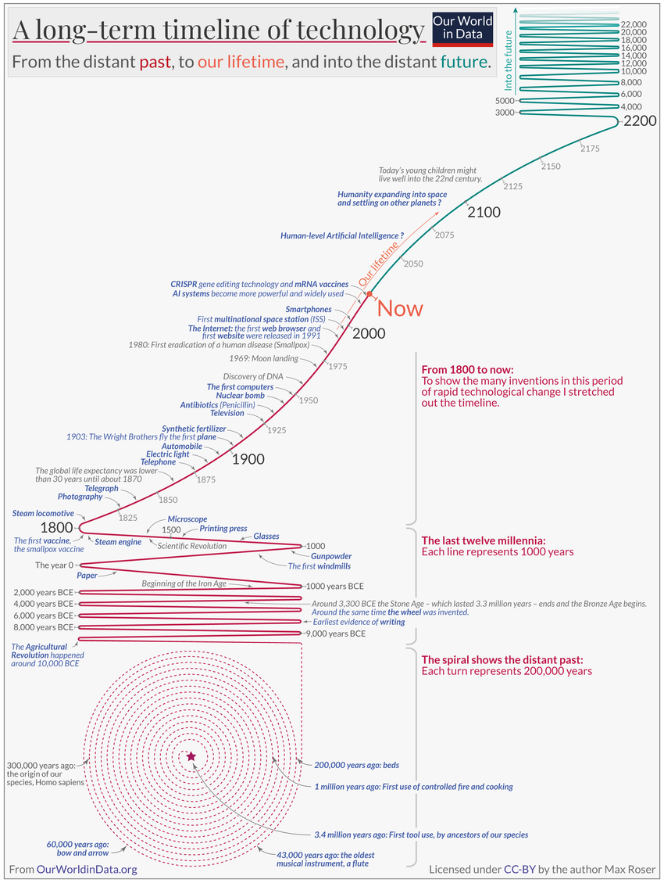
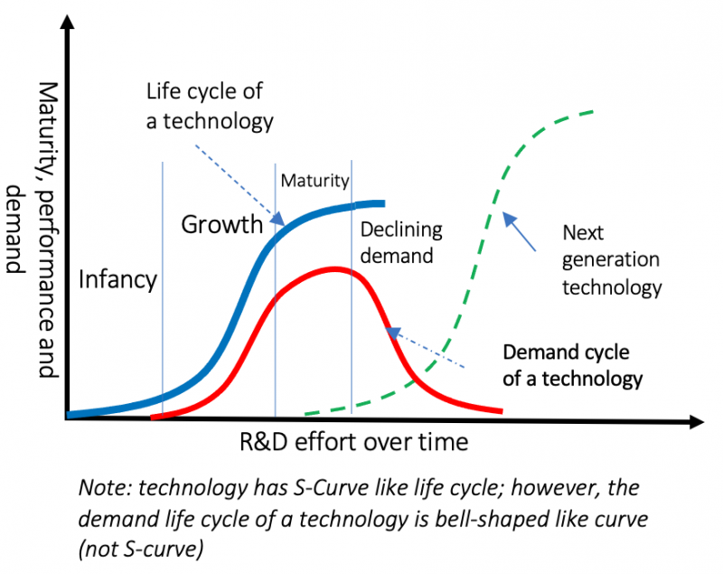
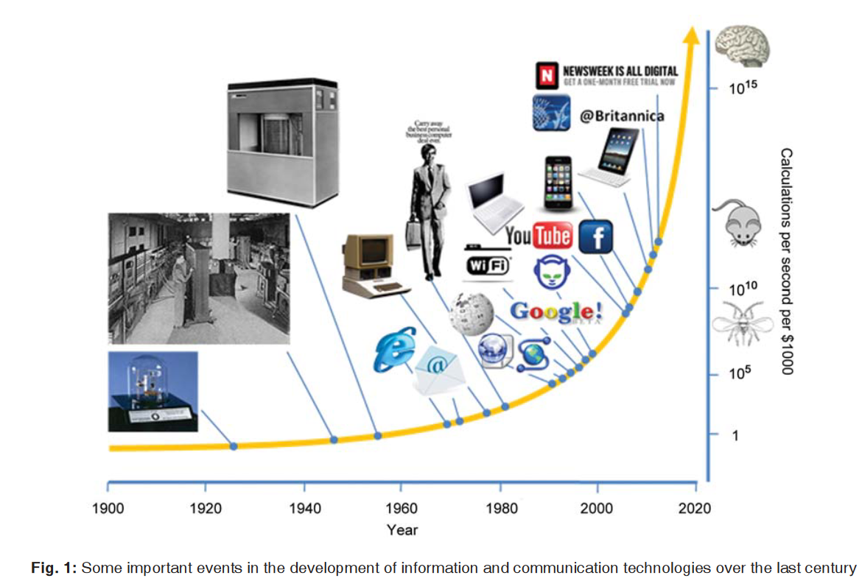
Technology is changing our lives
Notes:
Podniky chtějí podporovat inoavce v podniku za tím účelem hledají

Slide 4
Content of the lecture
Macro view
Technology s-curve,
Technology cycle and dominant design
Technology diffusion
Triple helix model
Micro views
Technology adoption model
Absorptive capacity
Communities of practice
Stage-gate model
Notes:
Technology S-Curve:
The Technology S-Curve illustrates the typical pattern of technology advancement, showing slow growth at the initial stages, followed by rapid growth, and eventually reaching a plateau as the technology matures.
Technology Adoption Model (TAM):
The Technology Adoption Model focuses on how users adopt and utilize new technologies. It helps in understanding the stages of technology adoption, including innovators, early adopters, early majority, late majority, and laggards.
Technology Cycle and Dominant Design:
The Technology Cycle describes the life cycle of a technology from inception to obsolescence. Dominant Design refers to the standard set by the industry for a particular technology, influencing product development and market acceptance.
Technology Diffusion:
Technology Diffusion explores how innovations spread through markets or societies. It considers factors like communication channels, social networks, and adoption rates to understand how technologies become widely accepted.
The relationship between these models lies in their collective contribution to understanding technology evolution, adoption, diffusion, and market dynamics. The Technology S-Curve and Technology Cycle provide insights into technology development stages, while the Technology Adoption Model and Technology Diffusion focus on user acceptance and market penetration. Dominant Design acts as a standard-setting element that influences technological development and market competition. Together, these models offer a comprehensive view of how technologies evolve, are adopted, diffuse through markets, and establish dominant positions in industries.

Slide 5

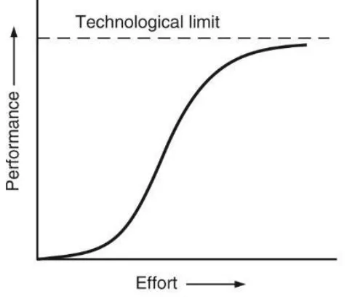
Technology s-curves
Depict how a technology develops and declines
enables the analysis of the evolution of the performance of any technology
Brought to the mainstream by Everett Rogers in 1962
https://synthesis.capital/insights/s-curve-adoption-our-house-view-on-alternative-protein-market-growth
Notes:
The S-curve in technology management has a rich history and has been used as a tool to understand and predict the path of technological innovation and adoption.
Schumpeter (1939): The cyclical pattern in technology trajectories was first discovered by Schumpeter in 1939¹.
Fisher & Pry (1971): Many years later, Fisher & Pry created a mathematical model designed to forecast the path of a technology, marking the start of a research paradigm that is still used today¹.
Everett Rogers (1962): The popularization of the S-curve in the realm of technology adoption and innovation is largely credited to Everett Rogers, a professor of communication studies. His seminal work, “Diffusion of Innovations” first published in 1962, brought the concept into mainstream academic discourse and business strategy². The S-curve can also be used to depict the diffusion of innovations in a culture over time³.
Clayton M. Christensen: In his work, Christensen used information from the technological history of the disk drive industry to examine the usefulness of the S-curve framework for managers at the firm level in planning for new technology development⁴.
The S-curve pattern of innovation highlights the fact that as an industry, product, or business model evolves over time, the profits generated by it gradually rise until the maturity stage. As a product approaches its maturity stage, a business should ensure that it has new offerings in place to capture future profit opportunities⁵.
The S-curve has become a centerpiece in thinking about technology strategy. It represents an inductively derived theory of the potential for technological improvement, which suggests that the magnitude of improvement in the performance of a product or process occurring in a given period of time or resulting from a given amount of engineering effort differs as technologies become more mature⁴.
I hope this gives you a good overview of the history of the S-curve in technology management. If you have any more questions or need further clarification, feel free to ask! 😊

Slide 6
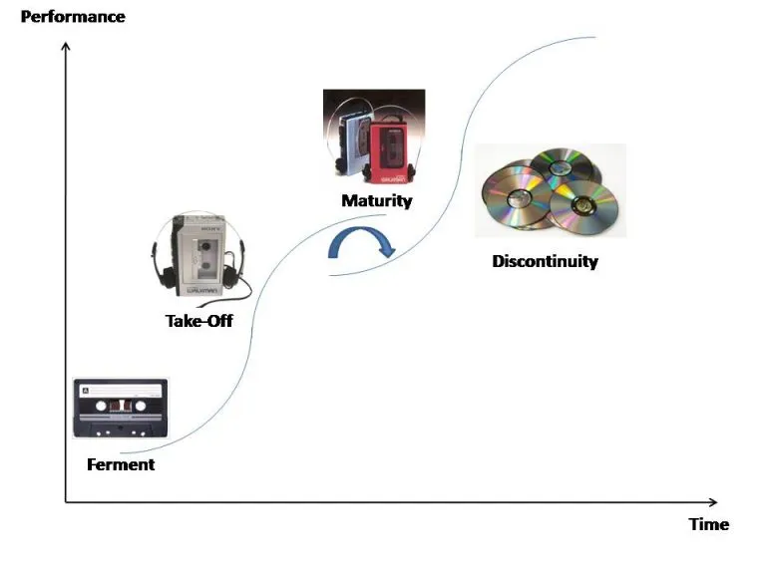
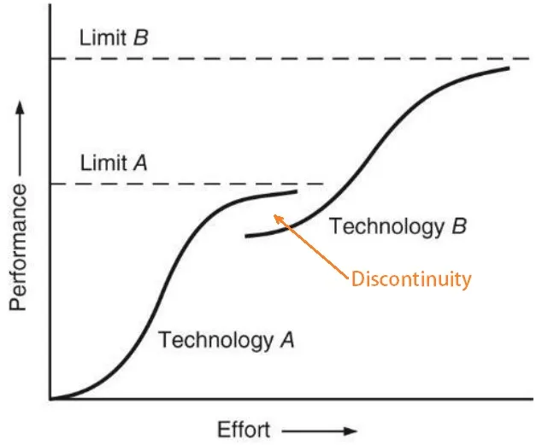
Technology s-curves
Discontinuity and innovation:
Source: https://extrudesign.com/what-is-technology-s-curve/
Notes:
Each technology has some limit, top ceiling, thank the technology becomes vulnerable at the top of s-curve
What happens in each phase?
n the fermentation phase, the technology is in its infancy, and improvements are slow as it’s being understood and developed. The takeoff phase represents a period of rapid growth and improvement as the technology is adopted and optimized. Finally, the maturity phase is when the technology reaches its peak potential, and improvements slow down as the technology saturates.
Limitations and Opportunities: The S-curve also highlights the limitations of a current technology (as it reaches the upper bend of the ‘S’) and signals when it might be time to invest in the development of a new technology that could potentially start a new S-curve.
Limits: predicability
Technological progress can be influenced by a variety of unpredictable factors such as breakthrough innovations, changes in market demand, or regulatory changes.
Predictability: The S-curve assumes a predictable and smooth path of technology development, which is often not the case in reality. Technological progress can be influenced by a variety of unpredictable factors such as breakthrough innovations, changes in market demand, or regulatory changes.
Timing: It’s challenging to accurately determine where a technology is on the S-curve. Misjudging the phase could lead to incorrect strategic decisions. For example, a technology might seem to be leveling off, when in fact it’s on the verge of a breakthrough that propels it into a new phase of rapid growth.
Not All Technologies Follow an S-Curve: Some technologies may not follow an S-curve pattern. They might experience continuous rapid growth, or they might plateau without ever experiencing a takeoff phase.
Overemphasis on Technological Determinism: The S-curve model tends to focus on the technology itself, potentially overlooking the importance of social, economic, and political factors that can significantly influence the adoption and development of a technology.
Difficulty in Identifying the Start of a New S-Curve: It can be challenging to identify when one S-curve ends and a new one begins. This can make it difficult to plan for the transition to a new technology.
Telegraph: The telegraph technology saw a slow start in the early 19th century, then rapidly grew as it became the primary means of long-distance communication, and finally reached a plateau as telephones became more prevalent.
Incandescent Light Bulbs: After their invention, incandescent light bulbs slowly improved in efficiency and lifespan. The technology then took off as electric power became widely available. However, the technology matured and is now being replaced by more efficient lighting technologies like LEDs.
Personal Computers: The personal computer (PC) had a slow start in the 1970s, then saw explosive growth in the 1980s and 1990s with the advent of more user-friendly operating systems and affordable hardware. The market has since matured, with growth slowing as the technology has become ubiquitous.
Smartphones: Early smartphones were expensive and had limited functionality, leading to slow initial adoption. With the introduction of the iPhone in 2007, the technology entered a phase of rapid growth. The market is now maturing, with most people in developed countries owning a smartphone.
Yes, not all technologies follow the S-curve pattern. Here are a few examples:
Blockchain Technology: Blockchain technology, which underpins cryptocurrencies like Bitcoin, has not followed a traditional S-curve. Its development and adoption have been marked by periods of intense hype followed by disillusionment, with significant volatility in between. This is partly due to the fact that it’s a foundational technology that could potentially disrupt many industries, but its practical applications are still being explored and understood.
Quantum Computing: Quantum computing is another technology that hasn’t followed the S-curve. While there’s been steady progress in the field, the technology is still in its early stages and hasn’t reached the takeoff phase due to significant technical challenges that need to be overcome.
Artificial Intelligence (AI): While certain aspects of AI, such as machine learning, have seen rapid growth and could be said to follow an S-curve, AI as a whole has not. This is because AI is a broad field with many sub-disciplines, each of which is at a different stage of development. Some areas, like natural language processing, are advancing rapidly, while others, like artificial general intelligence, are still largely theoretical

Slide 7

Technology s-curves
Select three social media platforms that have been around for a while and plot the S-curve for your chosen platforms.

Slide 8
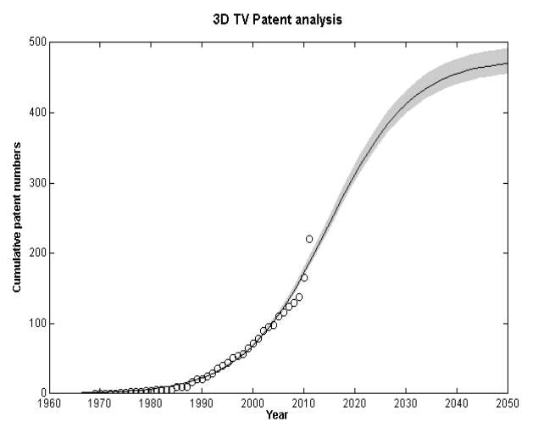
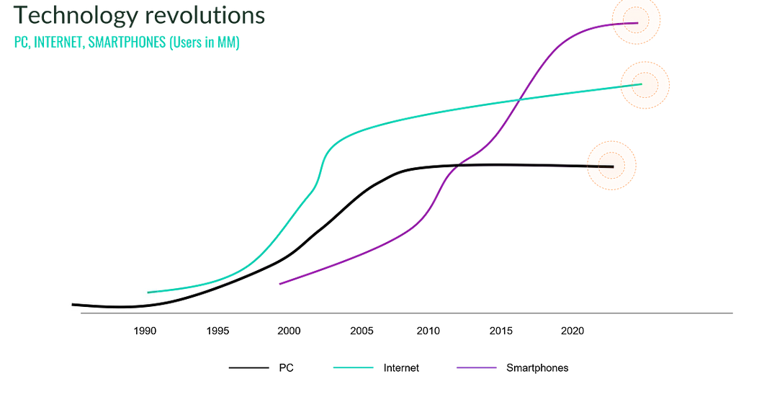
Technology s-curves
How to use S-curves (methodologically):
Longitudinal data collection based on a performance metric.
Observing or forecasting the evolution and plotting the curve.
Using the resulting curve for planning and decision making.
Notes:
Technology parametrs on the y axis, sometimes also patent data are used and bibliometric data for generating technology and logsititcs groeth to forecast technology

Slide 9
Technology s-curves
Discuss with your neighbors: How can technology managers make use of the s-curve for planning and decision making? For instance, think of activities by linking s-curves with the technology management framework by Phaal et al. (2004).

Slide 10
Technology s-curves
Main advantages of using the S-curve
Evaluating the different stages of a technology.
Pointing out the importance of being ready for technological discontinuities highlighting the importance of strategic positioning in case of a decline in gains.
Giving the company the opportunity to be the first mover within a market.

Slide 11

S-curves benefits and shortcommings
Evaluating the different stages of a technology.
Pointing out the importance of being ready for technological discontinuities highlighting the importance of strategic positioning in case of a decline in gains.
Giving the company the opportunity to be the first mover within a market.
The S-curve does not provide suggestions on how strategists should react to discontinuities in their technology.
The advantage to be gained from new technologies cannot be quantified by the model.
It is hard to conclude when to invest in new, and dispose of current, R&D.
The S-curve does not reveal how the new technology could be foreseen by others or by whom it will be introduced.
S-curves might not reflect the dynamic product or market changes.
(Fichman and Kemerer, 1995):
→ S-curves are largely seen as descriptive rather than analytical.
Christensen, 1992):
Notes:
However, not all products strictly follow this S-curve pattern. For instance:
Commodities or Basic Necessities: Products like rice, wheat, salt, etc., which have been in use for a long time and have already reached their saturation point, may not exhibit an S-curve as their demand is relatively constant and does not change dramatically over time.
Fad Products: These are products that become very popular in a short amount of time and then quickly fade out of popularity. They might not follow the S-curve because their lifecycle is typically short and does not have a long maturity or decline phase.
Disruptive Innovations: Sometimes, a new product can disrupt the existing S-curve of a product. This is common in technology where a new innovation can make existing technology obsolete.
Products in Highly Competitive Markets: In markets where there is intense competition and frequent introduction of new products, the S-curve may be disrupted as consumers switch between different products.

Slide 12
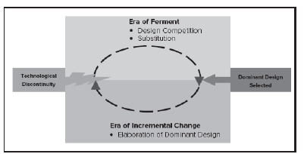
Dominant design within technology cycle
Dominant design: A product design that is adopted by the majority of producers, typically creating a stable architecture on which the industry can focus its efforts.
Source: Schilling/Shankar (2019)
Anderson, P., & Tushman, M. L. 1990. Technological discontinuities and dominant designs: A cyclical model of technological change. Administrative science quarterly: 604-633. (→ background reading on Moodle)

Slide 13
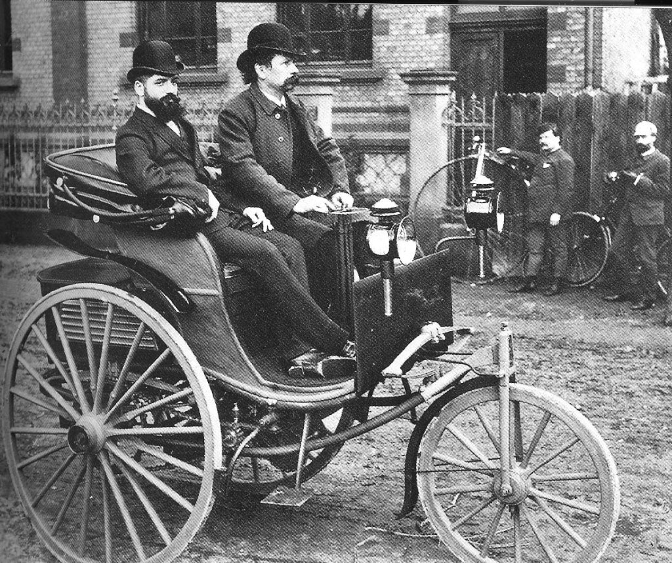
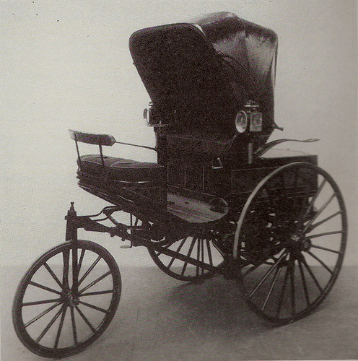
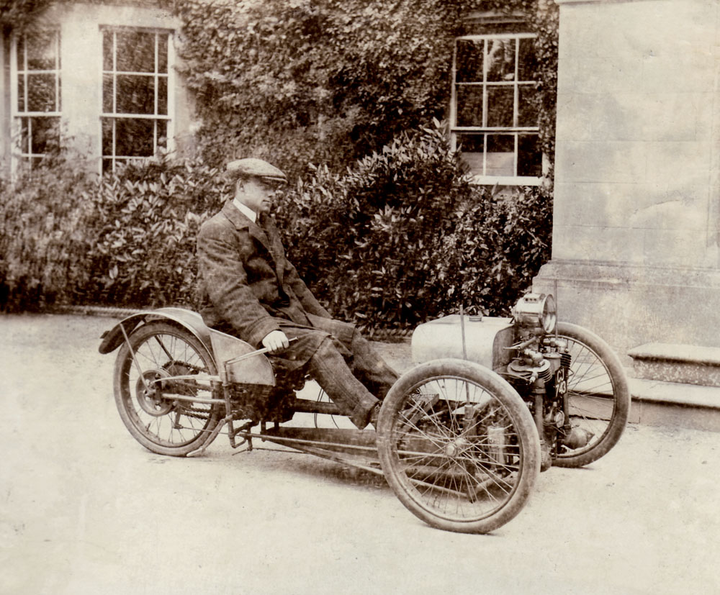
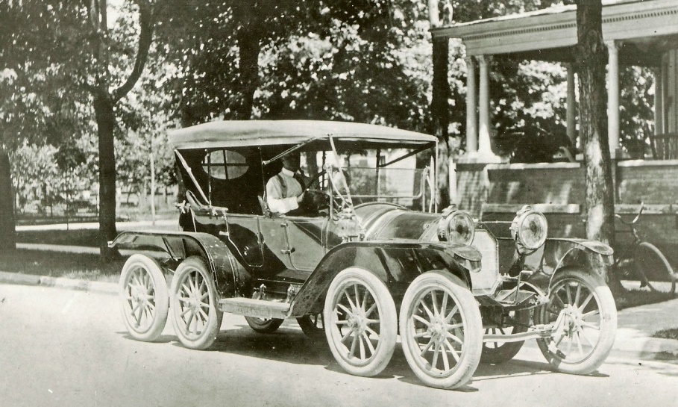
Design competition
How many wheels for a car?

Slide 14
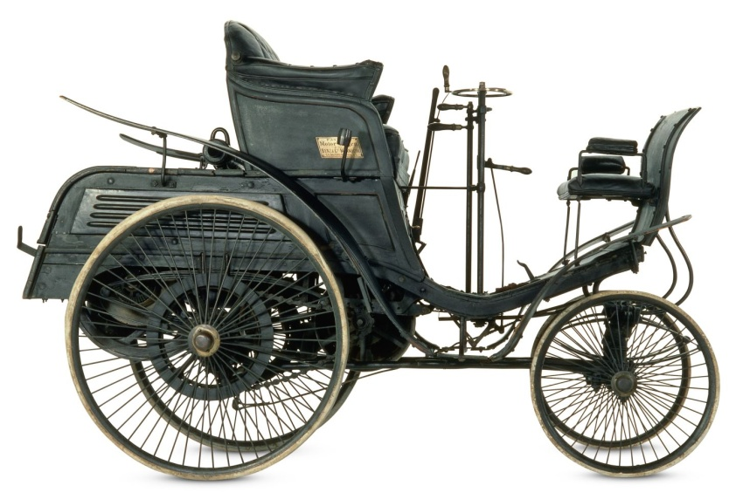
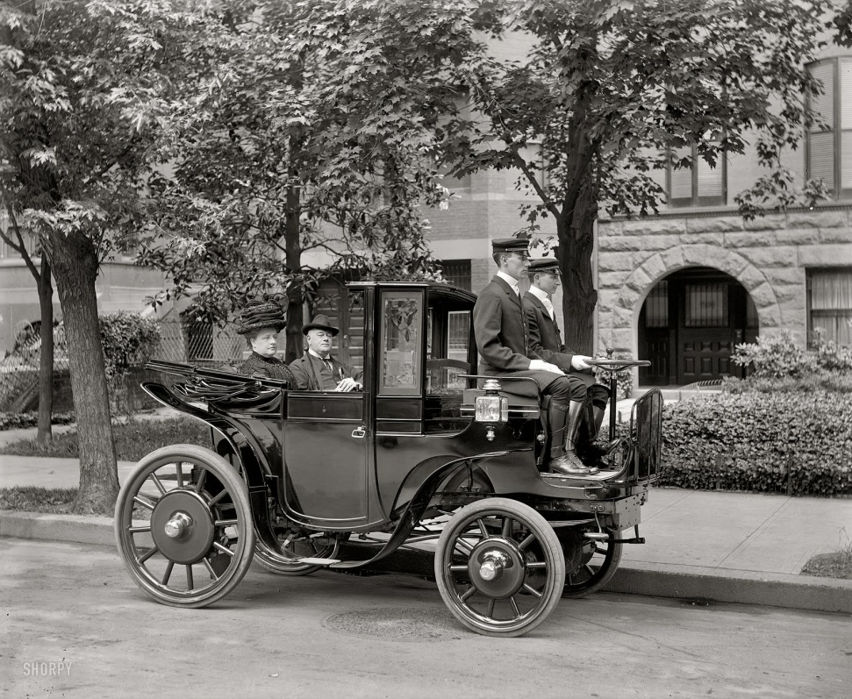
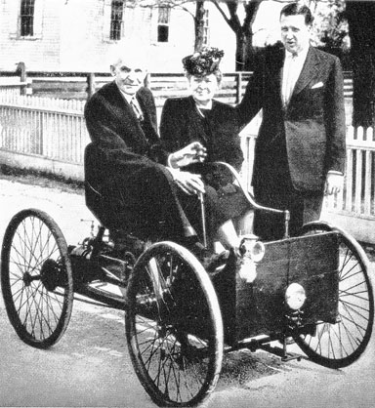
Design competition
What type of steering ?

Slide 15
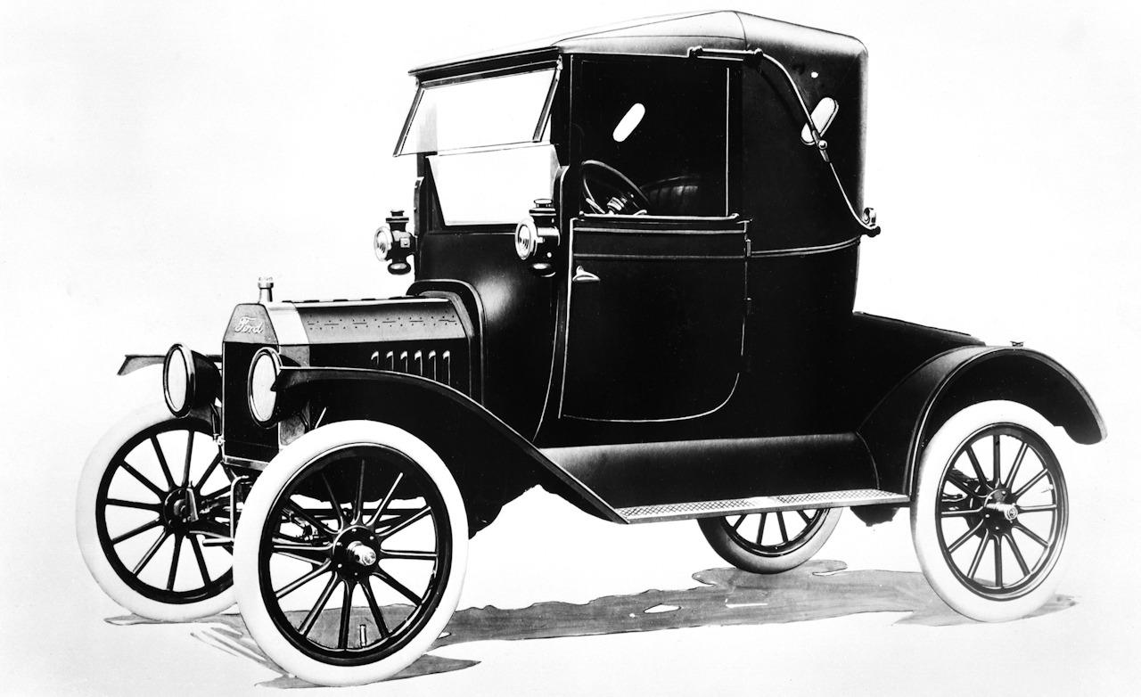
Dominant design selection
Dominant design: A product design that is adopted by the majority of producers, typically creating a stable architecture on which the industry can focus its efforts.
Ford Model T introduced in 1908
Notes:
Design competition in the context of dominant design refers to the period in the technology life cycle when multiple designs or technologies are competing for market dominance¹².
During this phase, different companies might introduce various designs, each offering unique features and approaches³. These designs compete with each other in the marketplace, with consumers and businesses evaluating them based on factors like performance, cost, compatibility, and user experience¹².
Over time, as the market matures, one design typically emerges as the winner, becoming the dominant design³. This is the design that wins the allegiance of the marketplace, the one to which competitors and innovators must adhere if they hope to command significant market following¹²⁴.
It’s important to note that the dominant design may not necessarily be the best or most efficient design. It simply incorporates a set of key features that sometimes emerge due to technological path-dependence and not necessarily strict customer preferences².
The emergence of a dominant design is a major milestone in an industry’s evolution and changes the way firms compete in an industry². After a dominant design has been established, competition often shifts from product design to other areas like cost, quality, and service².
Is there a dominant design within Smart phone technology?
A dominant design emerges through a complex process involving technological innovation, strategic behavior by firms, and co-evolution of technology and industry structure. It becomes standardized as it gets widely adopted and as complementary products and services start to align with it. This standardization often happens through formal or informal agreement in the industry, or simply because the benefits of using a common design outweigh the benefits of using different designs.
For instance, in the computer industry, the QWERTY keyboard layout became the dominant design despite not being the most efficient layout. In the automotive industry, the internal combustion engine became the dominant design over electric and steam engines in the early 20th century. In the software industry, Microsoft’s Windows operating system became the dominant design in personal computer operating systems.
Yes, there is a dominant design in the smartphone industry. The dominant design in smartphones is characterized by a rectangular shape with rounded corners, a touchscreen interface, and an app-based operating system¹. This design became widely accepted and adopted after the introduction of the iPhone in 2007².
However, it’s important to note that while there is a dominant design, there is still significant product differentiation among manufacturers, and the smartphone market continues to evolve³. For instance, some smartphones differentiate themselves with unique features like advanced camera systems, foldable screens, or stylus input.
Moreover, the dominant design in smartphones has influenced product features and technologies, leading to the development of a wide range of complementary products and services, such as app ecosystems, mobile payment systems, and wearable devices⁴.
So, while the basic design of smartphones has become standardized, there is still plenty of room for innovation and differentiation within this framework¹. This is a great example of how a dominant design can provide stability and direction for an industry, while also fostering ongoing innovation and competition¹.

Slide 16
dominant design
What factors contribute to firms winning the design competition in the era of ferment?

Slide 17
Technology adoption
Some research questions:
Will anyone use what I’ve built?
How can I get more people to use it?
And why do people leave after a few days?

Slide 18
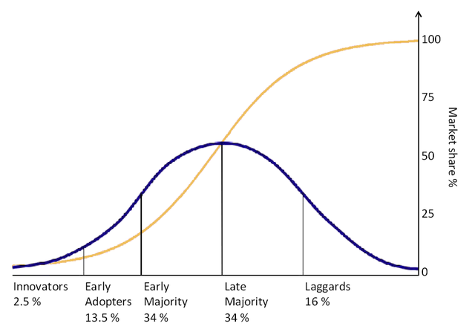





Diffusion of technology
Based on Rogers (2003). Diffusion of Innovations. New York: Free Press. 5th Ed.
Notes:
Diffusion
Diffusion is the process by which an innovation is communicated through certain channels over time among the members of a social system.
Rogers emphasizes the perception of newness. When discussing the diffusion of innovations, we don’t care whether an innovation is truly novel. It just has to be perceived as such.
Innovations are diffused through communication channels: A communication channel is the means by which messages get from one individual to another.
Yet, first and foremost, Rogers identifies two distinct classes of channels: mass media and interpersonal channels.
For example, software developers use Twitter to be exposed to new ideas, but also to connect with other practitioners. In fact, in one study, the median software developer used twelve different channels in their work.
Mass media broadcast messages — such as news, educational information, or entertainment — from a sender to many receivers. Conversely, interpersonal channels exist between individuals and allow for exchanges between them that can go back and forth.
While mass media are initially important to spread awareness about an innovation, interpersonal networks become more important over ti
Time is also an important aspect: diffusion is a process that unfolds over time. Thus, time is relevant when investigating how an individual or other unit of adoption gradually changes their internal state (e.g. knowledge or decision to adopt) and overt behavior (actual adoption or rejection).
Time is also an important measure when categorizing adopters into different categories (see below) or when determining an innovation’s rate of adoption — the number of adopters for an innovation in a given period.
Finally, diffusion always happens within a social system.
me as people turn to their peers for opinions on and evaluations of new ideas.
Social System
A social system is defined as a set of interrelated units that are engaged in joint problem solving to accomplish a common goal. The members or units of a social system may be individuals, informal groups, organizations, and / or subsystems.
For social systems, diffusion research distinguishes between two different structures. The social structure influences diffusion through values, norms, roles, and hierarchies. Furthermore, the communication structure determines how messages may flow through the social system, e.g. by providing communication links between individuals.
The adoption rate is also influenced by the social system in which an innovation diffuses. Rogers mentions weak ties, opinion leaders, social learning, and critical mass as important concepts that help understand the diffusion of innovations through social networks.
Connected with adoption: Will anyone use what I’ve built? How can I get more people to use it? And why do people leave after a few days? how and why people adopt new ideas, p
The adoption curve concept, also known as the diffusion of innovations theory, was first introduced by Everett Rogers in his 1962 book, “Diffusion of Innovations.” Rogers was a sociologist who studied how new ideas and technologies spread within communities.
Rogers categorised people into five groups: innovators, early adopters, early majority, late majority, and laggards. He found that each group had its own characteristics and adopted new technology at a different rate.
The model has been widely used in many areas of business and has implications for all companies, not just those selling technology-based products and services. For example, marketers use the model to understand better consumer behaviour and how to approach an audience with new concepts. And in learning and development, it has a role to play in helping employees adopt new workplace technology.
In recent years, the model has been criticised, especially regarding its linearity and the assumption that all adopters are alike. However, it’s an influential model in technology management and marketing to explain and predict technology adoption and remains widely used in many fields, including the adoption of new medical practices, the spread of political ideologies, and the diffusion of new consumer products.ractices, or tools. Model Diffusion of Innovations.
Sometimes called technology adoption lifecycle where five main segments are recognized: innovators, early adopters, early majority, late majority and laggards.^{[citation needed]}

Slide 19
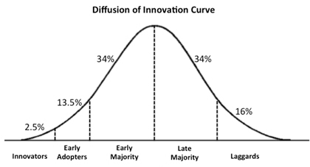

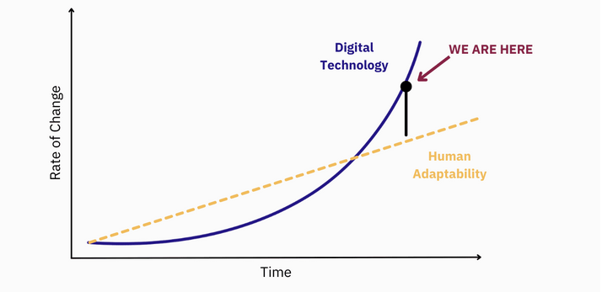
Early adopted but not with majority. What would you do?
Technology adoption curve chasm
Based on Moore (1991). Crossing the Chasm. Harper Business Essentials. 1st edition
Notes:
Convincing the early majority to adopt the product involves building a polished and reliable product with a marketing message emphasizing the technology’s practical benefits..
Successfully crossing the chasm involves targeting a niche market within the early majority. This will help create a customer base that is referenceable. The user experience enjoyed by this niche target segment ultimately determines the word-of-mouth reputation within different segments of the early majority. This reputation becomes a key factor in determining if the product will cross the chasm.
Only when a technology successfully crosses the chasm can it achieve mainstream adoption. The product can be scaled significantly when it crosses the chasm. The ability to cross the chasm is considered a key factor in the long-term success of a technology product or company.
According to Moore, anyone with an innovation or new product should focus on one group of customers at a time, using each group as a base for marketing to the next group. The most difficult step is making the transition between visionaries (early adopters) and pragmatists (early majority). This is the chasm that he refers to. If a successful firm can create a bandwagon effect in which enough momentum builds, then the product becomes a de facto standard, by creating a complete solution for one intractable problem in one business vertical before building out services in adjacent verticals and expanding on from there.
The technology adoption curve chasm, also known as the “chasm” or the “early market chasm,” refers to the gap between the early adopters and the early majority in the technology adoption curve. This gap represents a challenge for retailers, as it can be difficult to transition from early adopters to the early majority.
According to Geoffrey Moore, who wrote the book “Crossing the Chasm“, the reason for the gap is that early adopters are willing to take risks and try new products, while the early majority is more sceptical and requires more evidence before making a purchase. The early majority also tends to be more mainstream, and their purchasing decisions are influenced by the opinion leaders in their community.
To cross the chasm, retailers need to tailor their marketing and sales efforts to the early majority by offering them more evidence-based information about the product, such as case studies and customer testimonials, and addressing the specific concerns and objections of this group.
Tactics could include:
Targeting a specific market segment.
Ensuring a strong product-market fit and addressing product weaknesses.
Having a clear value proposition and messaging that appeals to the early majority.
Building partnerships and alliances with established companies and industry leaders.
Providing education and support to help early majority customers feel confident adopting the new technology.
The chasm model does have its critics. MIT Sloan School of Management professor Erik Brynjolfsson has argued that it oversimplifies the role of technology in the market, and Alexander Osterwalder, a prominent business strategy consultant, criticised the theory for its limited applicability to current market conditions. However, the concept of a chasm in the technology adoption curve is widely recognised as a challenge that retailers must overcome to bring products to market successfully.
Everett Rogers, tvůrce teorie šíření inovací, která je základem teorie propasti, zpochybnil koncept propasti slovy: "Dosavadní výzkumy nepotvrzují tvrzení o propasti mezi určitými kategoriemi osvojitelů. Naopak, inovativnost, pokud je správně měřena, je spojitá proměnná a mezi sousedními kategoriemi osvojitelů neexistují žádné ostré zlomy nebo diskontinuity (i když mezi nimi existují významné rozdíly)"[2][3].Translated with DeepL.com (free version) Moore's theories are only applicable for novel or discontinuous innovations in a B2B marketplace; adoption of continuous innovations — ones that do not force a significant change of behavior by the customer — are still best described by the original technology adoption lifecycle.[editorializing][citation needed]

Slide 20
Interaction
Work with your neighbors: Discuss how the three macro views are connected by establishing a link between
s-curves
technology cycles and dominant design
technology diffusion theory.
Use drawings to connect the approaches.
Source: https://extrudesign.com/what-is-technology-s-curve/

Slide 21
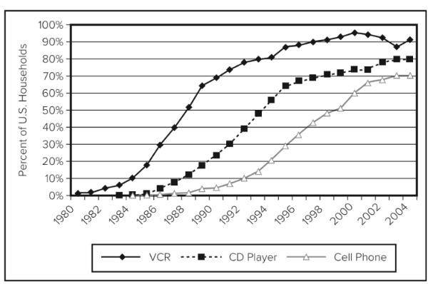
S-curves and the diffusion of innovation
Source: Schilling/Shankar (2019)

Slide 22
Collaborative concepts
Modern technology development is a collaborative enterprise between various actors, in different combinations, and at different stages of the technology development process.
Collaborative Concept | The big idea | Starting reference | Key Authors
Triple Helix | Interactions between government-industry-universities with each fulfilling both their traditional and non-traditional role. | Cai & Etzkowitz, 2020 | Henry Etzkowitz
Open Innovation | A view of collaborations of an individual firm that focusses on inflows & outflows of intellectual property. | West & Bogers, 2014 | Henry Chesborough
Networks | Enduring inter-organisational ties involving the exchange of knowledge and other economic resources | Birkinshaw, Bessant & Delbridge, 2007 | Ron Burt
Eco-systems | Loosely inter-connected network of innovation actors that co-evolve technology capabilities | Furr, O’Keeffe & Dyer, 2016 | Annabelle Gawer

Slide 23
Triple-helix model
“A new mode of [technology] production is emerging based on linkages among academia, industry and government.”
(Etzkowitz/Leydesdorff, 1995)
What role do a) universities, b) industry, and c) government and policy organizations play for the production of new technologies?

Slide 24
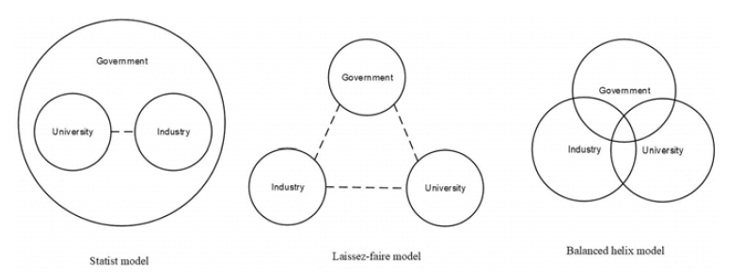
Triple-helix model
Cai, Y., & Etzkowitz, H. 2020. Theorizing the Triple Helix model: Past, present, and future. Triple Helix, 7(2-3): 189-226.

Slide 25
Triple-helix model
What are the implications of the triple-helix model for
a) the innovating firm (e.g., Bose, Mellanox, SAP, Siemens Mobility, Vestas Wind) and
b) the technology (e.g., sustainable packaging, quantum computing, biotechnology, 5G technology)?

Slide 26
Agenda
Macro views
Technology s-curve,
Technology cycle and dominant design
Technology diffusion
Triple helix model
Micro views
Technology adoption model
Absorptive capacity
Communities of practice
Stage-gate model
Notes:
Technology S-Curve:
The Technology S-Curve illustrates the typical pattern of technology advancement, showing slow growth at the initial stages, followed by rapid growth, and eventually reaching a plateau as the technology matures.
Technology Adoption Model (TAM):
The Technology Adoption Model focuses on how users adopt and utilize new technologies. It helps in understanding the stages of technology adoption, including innovators, early adopters, early majority, late majority, and laggards.
Technology Cycle and Dominant Design:
The Technology Cycle describes the life cycle of a technology from inception to obsolescence. Dominant Design refers to the standard set by the industry for a particular technology, influencing product development and market acceptance.
Technology Diffusion:
Technology Diffusion explores how innovations spread through markets or societies. It considers factors like communication channels, social networks, and adoption rates to understand how technologies become widely accepted.
The relationship between these models lies in their collective contribution to understanding technology evolution, adoption, diffusion, and market dynamics. The Technology S-Curve and Technology Cycle provide insights into technology development stages, while the Technology Adoption Model and Technology Diffusion focus on user acceptance and market penetration. Dominant Design acts as a standard-setting element that influences technological development and market competition. Together, these models offer a comprehensive view of how technologies evolve, are adopted, diffuse through markets, and establish dominant positions in industries.
Certainly, these three topics - Communities of Practice (CoP), Technology Adoption Model (TAM), and Absorptive Capacity - are interconnected and can be related in the context of technology management. Here’s how you can approach it:
1. Communities of Practice (CoP):
Start by explaining what CoP is - informal networks of professionals or people with shared interests who learn from each other through interaction.
Discuss how CoP can facilitate knowledge sharing and learning, which are crucial for understanding and adopting new technologies.
2. Technology Adoption Model (TAM):
Then, introduce the TAM, which explains how users come to accept and use a technology. Highlight the factors that influence this process, such as perceived usefulness and perceived ease of use.
Discuss how CoP can influence these factors. For example, through shared learning and experience, members of a CoP can help each other perceive a new technology as useful and easy to use, thereby influencing its adoption.
3. Absorptive Capacity:
Next, introduce the concept of absorptive capacity, which is an organization’s ability to recognize the value of new information, assimilate it, and apply it to commercial ends.
Discuss how both CoP and TAM can contribute to an organization’s absorptive capacity. CoP, through shared learning and knowledge exchange, can enhance an organization’s ability to assimilate and apply new knowledge. Meanwhile, understanding TAM can help an organization recognize the value of a new technology and strategize its adoption process effectively.
4. Bringing It All Together:
Finally, bring all these concepts together. Discuss how fostering CoP, understanding TAM, and building absorptive capacity can collectively enhance an organization’s ability to manage and adopt new technologies effectively.
Remember, the goal is to not only convey information but also to engage students in discussion and critical thinking about these concepts and their interrelationships. Encourage questions and discussion to ensure understanding and engagement.

Slide 27

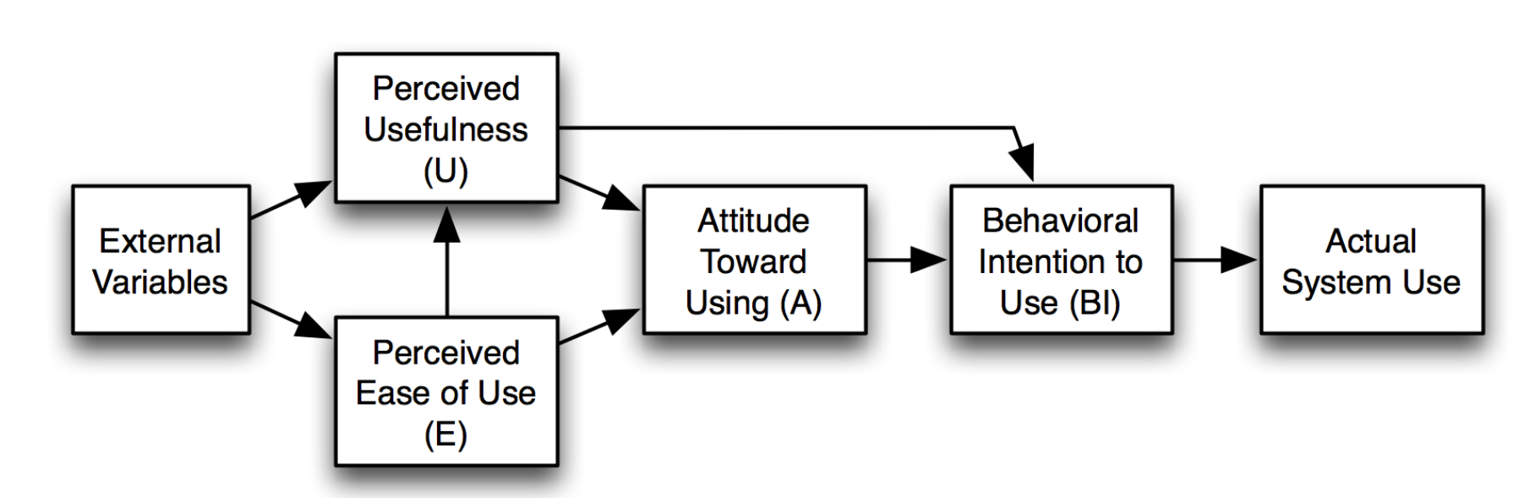
Technology acceptance model (TAM)
explains how users come to accept and use a technology
Constantly under criticism
Davis, F. D. (1989), "Perceived usefulness, perceived ease of use, and user acceptance of information technology", MIS Quarterly, 13 (3): 319–340, doi:10.2307/249008, JSTOR 249008, S2CID 12476939
Notes:
1. Definition of Technology Adoption Model
Start by defining the Technology Adoption Model (TAM). It’s a model that explains how users come to accept and use a technology. The model suggests that when users are presented with a new technology, a number of factors influence their decision about how and when they will use it.
2. Key Components of TAM
Discuss the key components of the model: Perceived Usefulness (PU) and Perceived Ease of Use (PEOU). PU is the degree to which a person believes that using a particular system would enhance his or her job performance. On the other hand, PEOU is the degree to which a person believes that using a particular system would be free from effort.
3. Practical Examples
Provide practical examples of TAM in action. For instance, you could discuss how a company introduced a new software system and how employees’ perceptions of its usefulness and ease of use affected their adoption of the system.
4. Importance of TAM in Business
Explain why understanding TAM is important for businesses. When introducing a new technology, businesses can use TAM to better understand how users will receive it and to design strategies to encourage its adoption.
5. Limitations of TAM
Discuss the limitations of TAM. While it’s a useful model, it doesn’t take into account factors like social influence, individual personality traits, and the specific context in which the technology is used.
Remember, the goal is to not only convey information but also to engage students in discussion and critical thinking about the model and its applications. Encourage questions and discussion to ensure understanding and engagement.

Slide 28
Technology acceptance model (TAM)
Imagine new software system you started to use in the past and think about your behaviour. How did you percieve uselfulness and ease of use and did it affect your adoption of the systém?

Slide 29
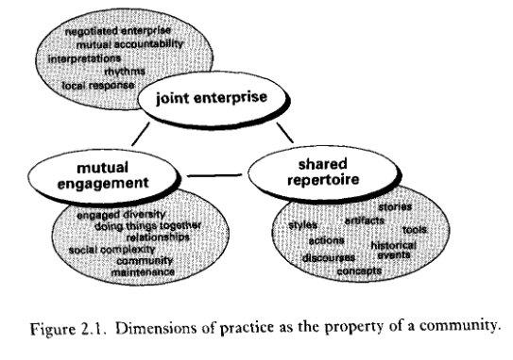
Communities of Practice CoP
Based on „Wenger, Etienne. Communities of Practice: Learning, Meaning, and Identity. Cambridge University Press, 1998.
groups of people who share a concern or passion for something they do and learn how to do it better through regular interaction.
Dimensions of practice within community: mutual engagement, joint enterprise, and a shared repertoire
Learning viewed as a social participation
Dynamic boundaries defind by practice rather than institutionally
Knowledge is a key asset
Notes:
Ethiene Charles Wenger is a founder. Learnng is necessary for develiping of human identity. People are develping their shared identity through the active the participation in social commuitites. It is something natural. Not new concept. Charles sanders Peirce and Deweys community of inquiry (lived in 19th centrury the end), or deey learning through occupation.
Therea are varios types of CoP – formal informal,
People understood as an important resource though the prism of community
Theory about social learning – not repalcin ´g other theories
Communities of Practice are groups of people who share a concern, a set of problems, or a passion about a topic, and who deepen their knowledge and expertise by interacting on an ongoing basis
Mutual Engagement:
Members of a CoP are engaged in actions whose meanings they negotiate with each other. This engagement is essential to the existence of the practice, and it is through this mutual engagement that the community is defined.
Joint Enterprise:
This refers to the collective process of negotiating the purpose and goals of the community. It is not a set, predefined objective but a dynamic process shaped by the members' interactions and the context they operate within.
Shared Repertoire:
The shared repertoire includes routines, words, tools, ways of doing things, stories, symbols, etc., that the community has developed over time. These elements become resources for negotiating meaning within the community.
Learning in a CoP is seen as a process of social participation. It involves becoming a part of the social fabric of the community and engaging with its practices. This approach shifts the focus from teaching to facilitating opportunities for learning through participation..
defined by knowledge rather than by task as in teams, and exists because participation has value to its members.
fundamentally self-organizing systems.
it is not only a network of relationships, it is "about" something

Slide 30
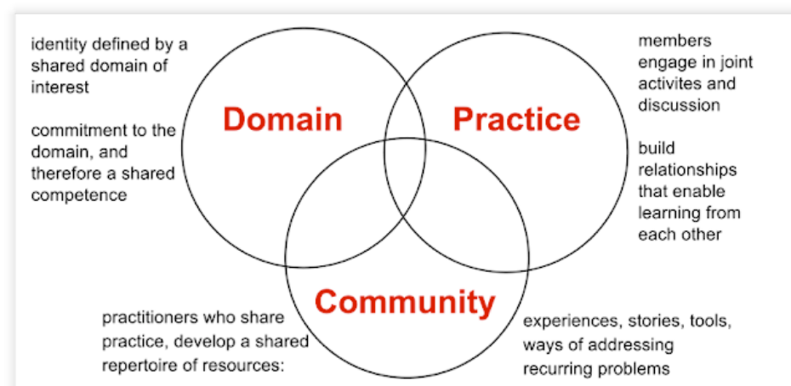
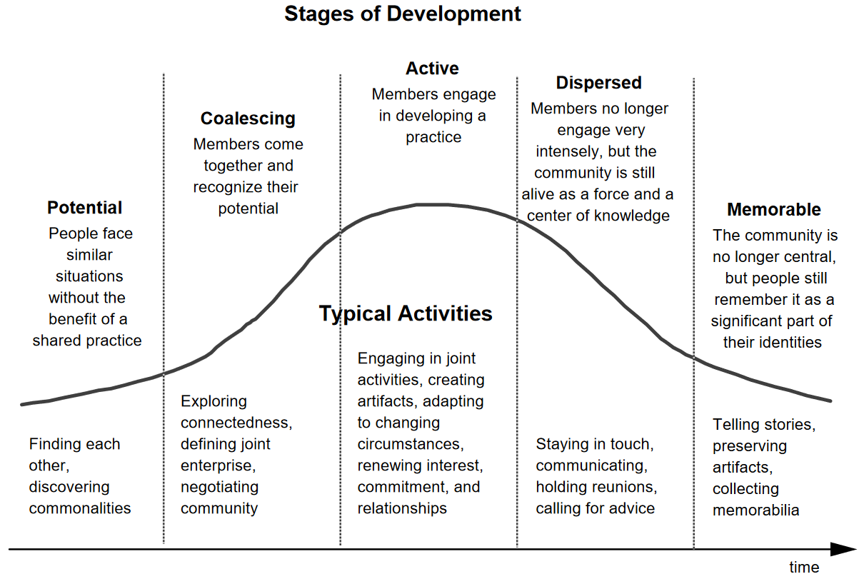
Communities of practice CoP
http://andrearabin.blogspot.com/2015/08/task-4-communities-of-practice.html

Slide 31
Communitits of practice to discuss
Discuss how do CoP differ from other types of social groups like teams, networks, interest groups, functional department
Notes:
Challenges and Dynamics:
CoPs are not always harmonious; they can involve conflicts, power dynamics, and competition. However, these challenges can also drive learning and innovation as members navigate and negotiate their differences.
. Challenges and Sustainability
While CoPs offer many benefits, they also face challenges such as sustaining member engagement, managing conflicts, and aligning the community's goals with those of the larger organization.
Knowledge Sharing: They facilitate the exchange of information and best practices among members.Learning and Development: Members enhance their skills and knowledge through participation.Innovation: CoPs provide a platform for developing new ideas and solutions through collective problem-solving.
Encourage students to compare CoPs with other social structures like teams, interest groups, or networks, highlighting the unique aspects of CoPs.

Slide 32
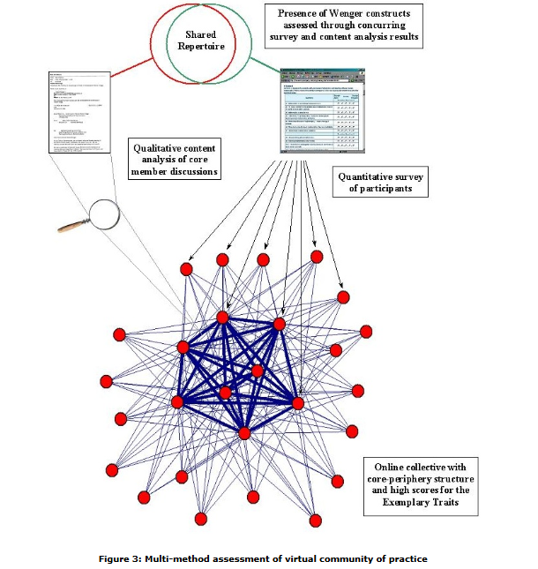
Communities identification
https://files.eric.ed.gov/fulltext/EJ837276.pdf

Slide 33
Absorptive capacity
Absorptive capacity is “The ability of a firm to recognize the value of new, external information, assimilate it, and apply it to commercial ends” (Cohen & Levinthal, 1990)
Recognising the value of knowledge and external ideas, for instance by collaborating
Assimilating knowledge: Synthesising and disseminating information/knowledge internally
Applying knowledge for commercial ends: Embedding knowledge in products, services, processes

Slide 34
Absorptive capacity
Type of ACAP | Capability | Meaning | Elements
Potential | Acquisition | The capability to identify and acquire externally generated knowledge that is critical to its operations (e.g., technology development) | Prior knowledge Prior investments
 | Assimilation | The routines and processes that allow it to analyse, process and interpret information from external sources. | Understanding
Realised | Transformation | The capability to refine and combine existing knowledge, newly acquired and assimilated knowledge | Internalisation Conversion
 | Exploitation | The routines that allow firms to deploy existing competencies or to create new ones by incorporating acquired and transformed knowledge into its operations | Implementation
Based on Zahra, S.A., George, G. (2002) → see Moodle

Slide 35
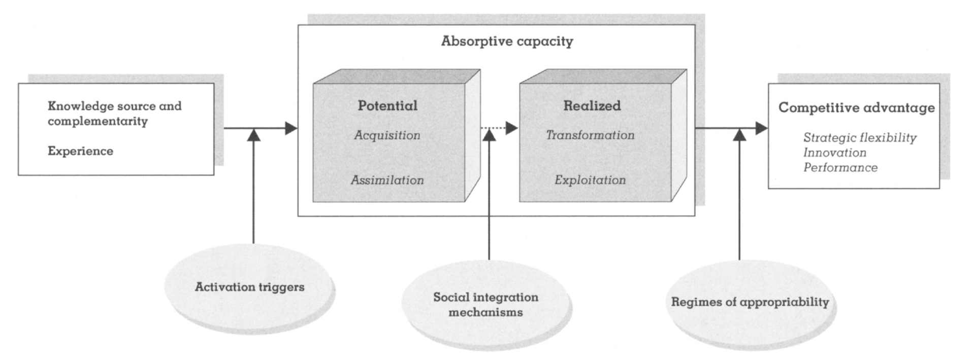
Absorptive capacity
Assignment tip:
Social integration mechanisms speak (among others) to the internal networks of a firm. Does your company have the network structures (i.e., social integration mechanisms) that allow transforming potential into realized absorptive capacity?
Regimes of appropriability: Institutional and industry dynamics that effect of firms ability to protect the advantages of any benefit from new technologies.
Source: Zahra, S.A., George, G. (2002) → see Moodle

Slide 36
CoP and Absorptive capacity
What are the challenges organizations face in leveraging CoPs to develop absorptive capacity, and how can these be addressed?
How do Communities of Practice facilitate the acquisition, assimilation, transformation, and exploitation of knowledge within an organization?

Slide 37
Conclusions
S-curves are a useful (descriptive) approach to understand the development of technologies
S-curves, dominant design, and diffusion models are inherently linked
Modern technology development is a collaborative enterprise as reflected for instance in the triple helix model
Absorptive capacity is key to reap value from collaboration
Firm-internal social networks help translate potential into realized absorptive capacity

Slide 38
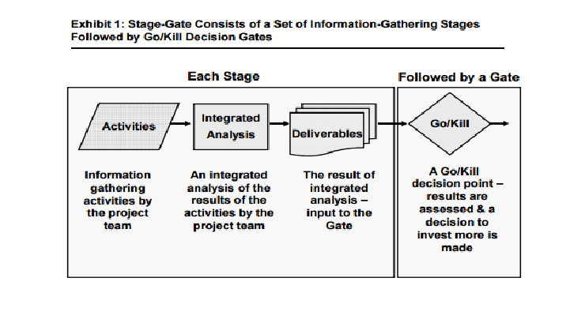
Stage gate model
Notes:
Stage-Gate Model:
After discussing CoP, TAM, and Absorptive Capacity, introduce the Stage-Gate Model, which is a project management technique in which an initiative or project (e.g., new product development, process improvement, business change) is divided into stages (or phases) separated by gates.
At each gate, continuation is decided by (typically) a manager or a steering committee. The decision is based on the information available at the time, including the business case, risk analysis, and availability of necessary resources (e.g., money, people with correct competencies).
This model can be particularly useful in managing the development and launch of new technologies. It provides a structured approach that allows organizations to carefully review and assess the progress of a project at each stage, ensuring that only the most promising ideas are pursued.
Discuss how the Stage-Gate Model can complement the other concepts you’ve discussed. For example, CoP can support knowledge sharing and problem-solving throughout the stages of the model, TAM can inform the development of user-friendly technologies that are more likely to be adopted, and a strong absorptive capacity can enhance an organization’s ability to learn and adapt throughout the process.
Remember, the goal is to not only convey information but also to engage students in discussion and critical thinking about these concepts and their interrelationships. Encourage questions and discussion to ensure understanding and engagement.

Slide 39
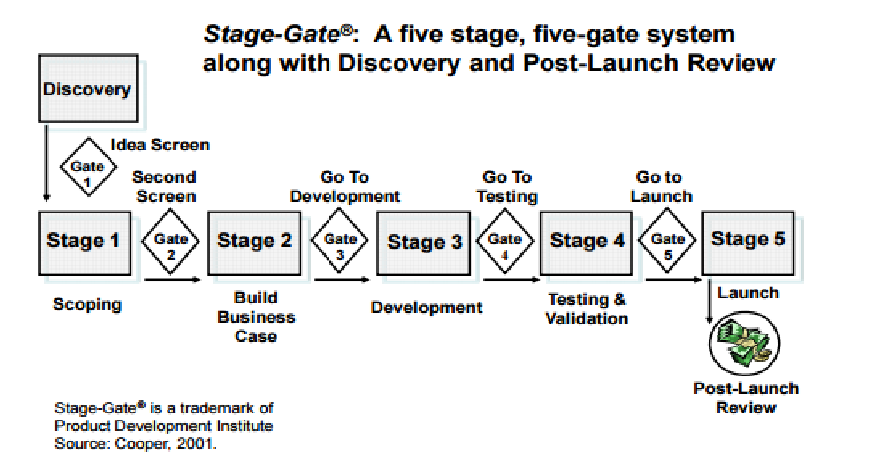
Stage-gate model

Slide 40
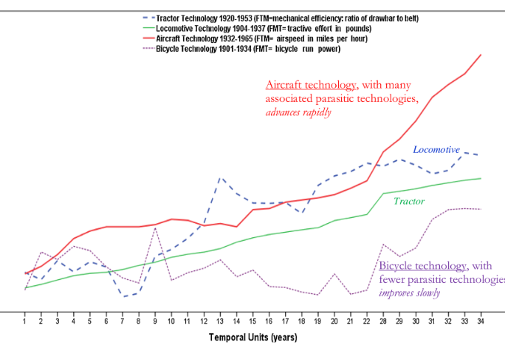
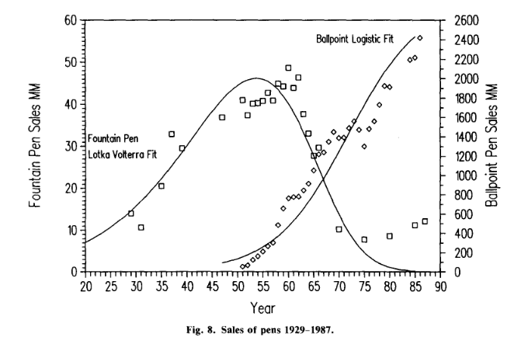
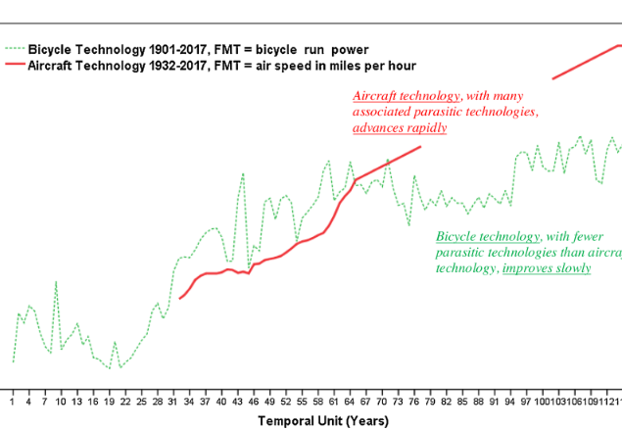
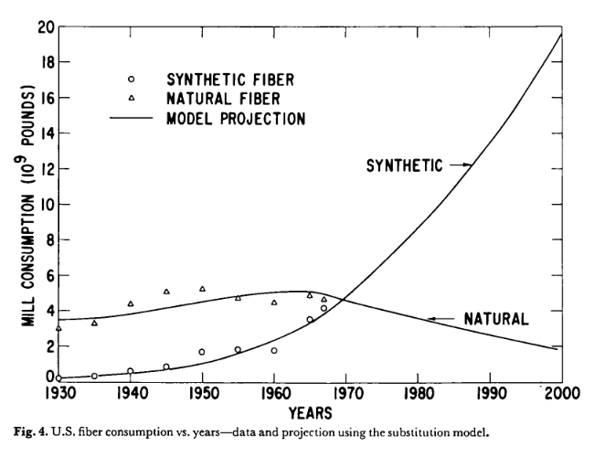
Technology evolution
Relation between new and old technologies
Doscuss with your neigbours relation between new and old technology
  Competitive subsititution (Fisher and Pry, 1971), predator-prey relation (Farrell,
  Symbiosis, host-parasite relation – Theory of technological parasitism

Slide 41
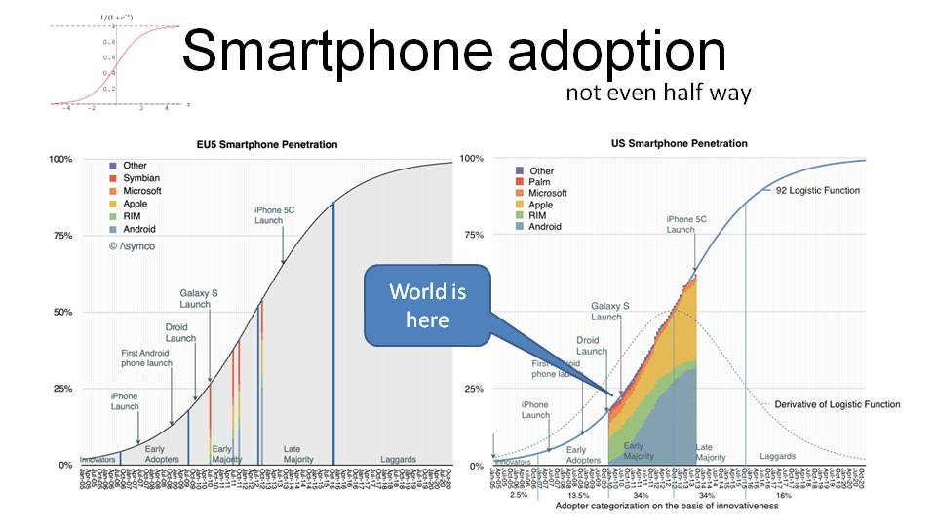
https://edblogging.wordpress.com/wp-content/uploads/2013/11/webcongress-miami-2013-why-does-superman-wear-his-underwear-outside.jpg

