Slide 1
Vymezení logistiky a SCM, logistika v nákladovém kontextu, problémy logistiky
LSCM_jaro2025

Slide 2
Kdy si nejvíce všímáme logistiky?

Slide 3
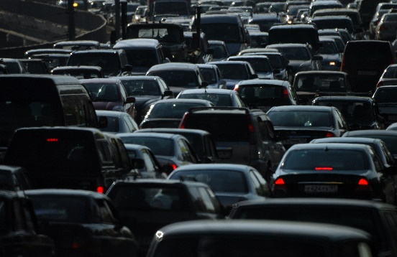

Logistika v běžném životě

Slide 4
K tomu malý příklad
Rozhlížejte se ve svém prostředí v tuto chvíli tak dlouho dokud neuvidíte nějaký světelný zdroj ( žárovku, zářivku nebo něco podobného ). Otázka pro Vás zní „Jakou dobu vyžaduje tento světelný zdroj ( v evropském průměru ), než jsou svezeny jeho části na jedno místo, než je zdroj vyroben, zabalen, opět rozbalen, zamontován a než se tam, kde nyní nachází, poprvé rozsvítí ?“
Trvalo to :
a) 50 minut ?
b) 22 hodin ?
c) 5 měsíců 29 dní ?
d) 6 měsíců ?
z pramene: VOLVO

Slide 5
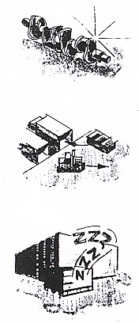
„ skutečná doba přípravy a zpracování“
( 50 minut odpověď a, )
„ skutečná doba dopravy v rámci firmy i mimo ni “ ( 22 hodin ) odpověď b,
„doba skladování mezi jednotlivými
zhodnocovacími kroky“ ( 5 měsíců 29 dní, odpověď c , )

Slide 6
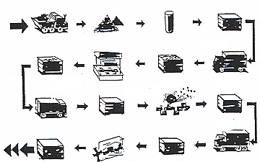

Slide 7
Jak se k vám dostal(a)?

Slide 8
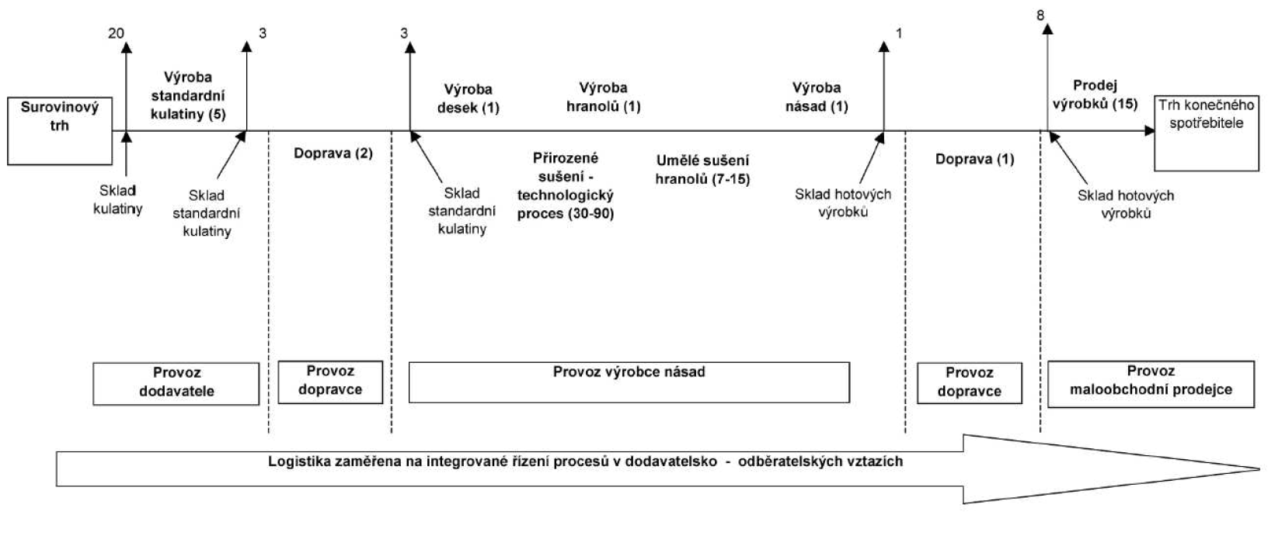
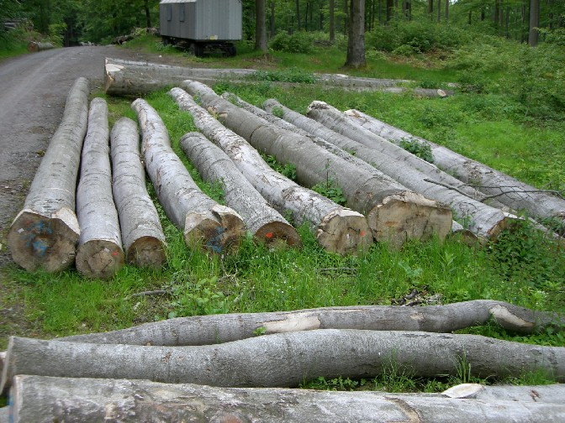


Slide 9
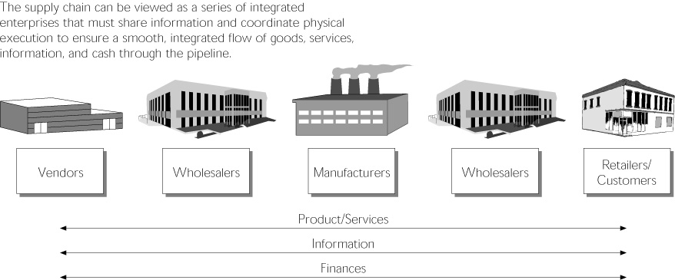

Slide 10
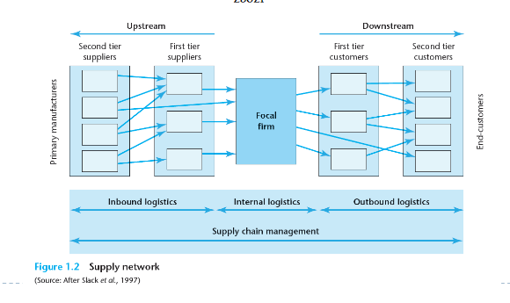
Prvky logistického řetězce

Slide 11
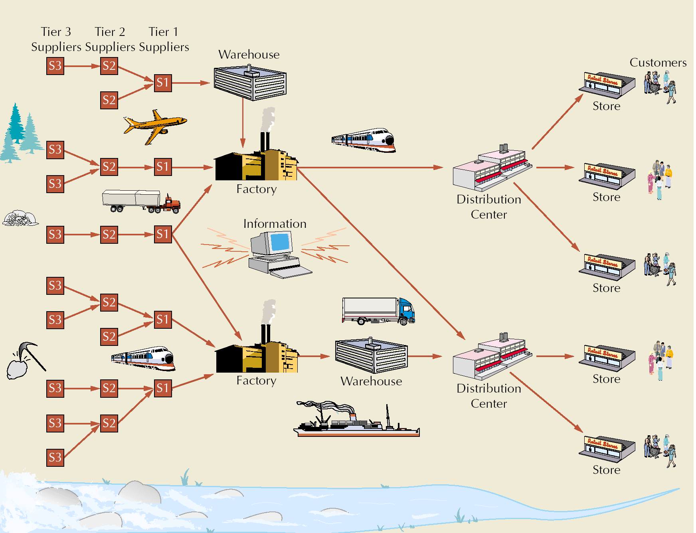
Logistický řetězec jako síť
Source: John Wiley

Slide 12
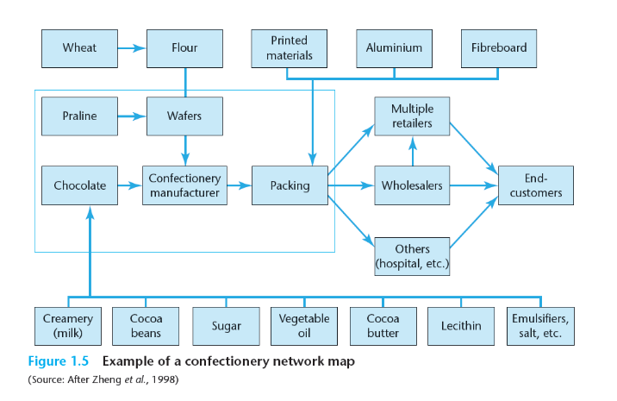
Síť v případě výroby čokolády

Slide 13
Co je podstatou SCM?

Slide 14
Supply Chain Management (SCM) as defined by the Council of Supply Chain Management Professionals (CSCMP):
"Supply Chain Management encompasses the planning and management of all activities involved in sourcing and procurement, conversion, and all logistics management activities. Importantly, it also includes coordination and collaboration with channel partners, which can be suppliers, intermediaries, third-party service providers, and customers.
In essence, supply chain management integrates supply and demand management within and across companies..."
Notes:
Logistics is a part of the supply chain — but it isn’t the supply chain itself. […] Logistics, on the other hand, is the process of planning, implementing and controlling the flow and storage of goods. Hence, it is mainly about movement and transportation of products as well as management of inventory and warehousing. Logistics activities include transportation management, inventory management, order fulfillment, packaging and distribution of goods and services. The goal of logistics is to ensure that the right product will be in the right place at the right time in the most cost-efficient way based on customers’ needs.”

Slide 15
Logistics Management: As defined by the Council of Supply Chain Management Professionals (CSCMP):
"Logistics management is that part of supply chain management that plans, implements, and controls the efficient, effective forward and reverse flow and storage of goods, services, and related information between the point of origin and the point of consumption in order to meet customers' requirements….
LOGISTICS is the function responsible for the flow of materials from suppliers into an organisation, through operations within the organisation, and then out to customers.
- mainly about movement and transportation of products as well as management of inventory and warehousing
Notes:
Logistické řízení (logistika) je proces plánování, realizace a kontroly efektivního a výkonného
toku a skladování zboží (materiálů, polotovarů, hotových výrobků), služeb a s nimi spojených
informací z místa vzniku do místa spotřeby za účelem uspokojení požadavků zákazníků.
Uvedená organizace považuje logistické řízení za součást řízení dodavatelského řetězce
(supply chain management), které vymezuje následujícím způsobem:
Řízení dodavatelského řetězce zahrnuje plánování a řízení všech činností spojených s
opatřováním zdrojů, jejich zpracováním a všechny činnosti logistického řízení. Podstatné je,
že obsahuje rovněž koordinaci a spolupráci s partnery v řetězci, kterými mohou být
dodavatelé, prostředníci, poskytovatelé logistických služeb a zákazníci. Řízení
dodavatelského řetězce v podstatě integruje řízení dodávek a poptávky uvnitř a napříč
společnostmi.

Slide 16
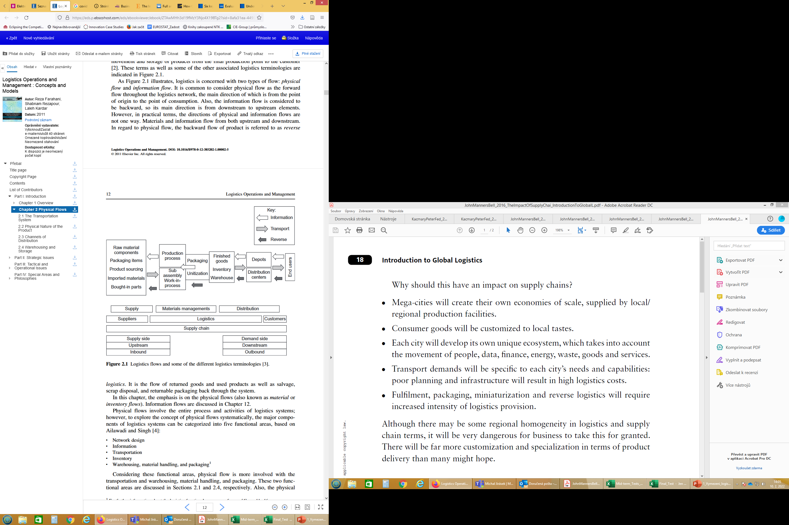
Klíčové logistické činnosti
Zákaznický servis
Prognózování / plánování poptávky
Řízení stavu zásob
Logistická komunikace
Manipulace s materiálem
Vyřizování objednávek
Balení
Podpora servisu a náhradní díly
Stanovení místa výroby a skladování
Pořizování/nákup
Manipulace s vráceným zbožím
Zpětná logistika
Doprava a přeprava
Skladování

Slide 17
Hodnota jako perspektiva SCM
Hodnotový řetězec
  every step from raw materials to the eventual end user
  ultimate goal is delivery of maximum value to the end user
Supply chain
  activities that get raw materials and subassemblies into manufacturing operation
Terms are used interchangeably
  A supply chain is a network of partners who collectively convert a basic commodity (upstream) into a finished product (downstream) that is valued by end-customers, and who manage returns at each stage (Harisson et al, 2014
Notes:
every product that reaches an end user represents the cumulative effort of multiple
organizations. And secondly, organizations have to pay attention to what is happening outside
their “four walls” and manage the entire chain of activities that ultimately delivers products to
the final customer in order to maximize profits.

Slide 18
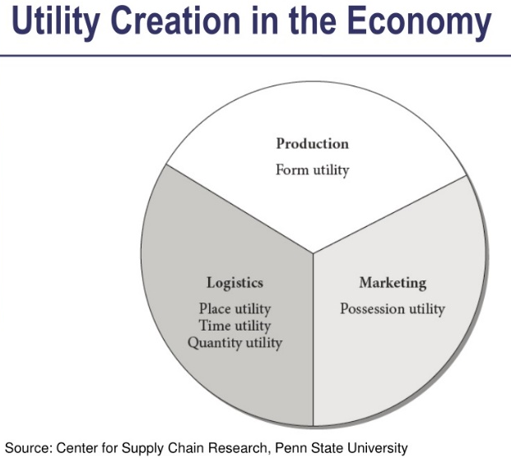
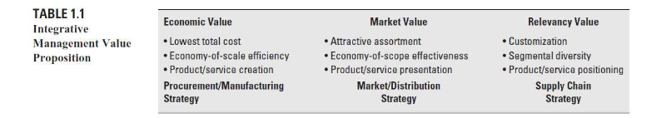
Add values to product/services
Also referred to as the seven Rs --- Right product, Right quantity, Right condition, Right place, Right time, Right customer, and Right cost.
Bowersox definuje následující hodnoty tvořené pro zákazníky
Notes:
Je třeba vnímat integraci logistiky do celopodnikového systému z pohledu tvorby hodnoty pro zákazníka : 1) Economic value: díky možnost ovlivňovat náklady – maximální využití fixního kapitálu, úspory z rozsahu, maximalizovat efficiency, minimul total costs – zákazníkovi nabídnout požadovanou kvalitu za nízkou cenu
2. Tržní hodnota – nabízet atraktivní sortiment, v pravý čas a na pravém místě aby byla dosažena efektivnost, efektivnost z rozsahu – na více místech – různá místa prodeje – zákazníkovi nabídnout vhodný produkt
3. Relevance znamená vytvořit produkt, který bude zajímavý pro daný segment – zákazník získává unikátní produkt s unikátními službami

Slide 19
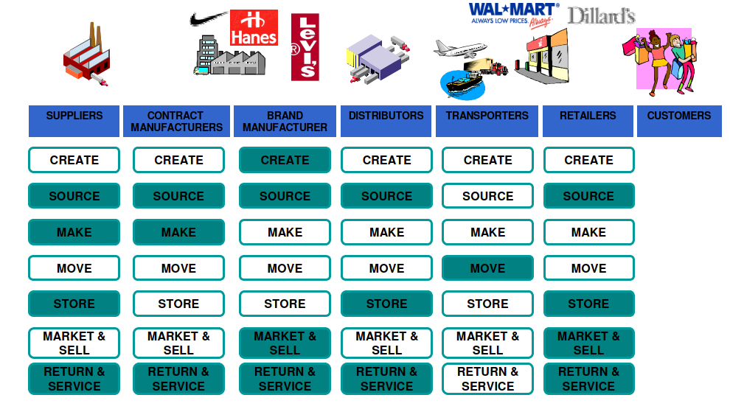
SCM process map

Slide 20
Co si představit pod náklady na logistiku?

Slide 21
Vztahy logistických činností a logistických nákladů
Náklady z nedostatečné úrovně zákaznického servisu (ztráta prodejních příležitostí)
Přepravní náklady
Skladovací náklady (změna počtu nebo umístění skladů)
Náklady na vyřízení objednávky a informační systém
Množstevní náklady (spojené se změnami v nakupovaných množstvích a se změnami ve výrobě)
  Přípravné náklady
  Ztráty kapacity
  manipulace s matriálem
  cenové rozdíly
  náklady na objednávky
Náklady na udržování zásob (kapitálové, služby, skladování, rizika)
Notes:
Zákazznický servis – i poprodejní náklady spojné s vrácením zvoží, musí vyzvednout atd…- zpětný tok, mohou dosahovat až 9ti násobku nákladů směrem od výrobce k nám zpět k výrobci, manipulace s maým množstvím, takže relativně vysoké náklady vznikají
Přepravní - Jsou ovlivneny velikostí objednávky, hmotností, přepravcem, vzdáleností, místo původupřesun s místa vzniku do místa spotřeby, největší samostatná nákladová položka
Nákaldy na udržování zásob – kapitálové, náklady na pořízení, skladovací, náklady na likvidaci zastaralého, procentně náklady na udržování zásob představují zhrba 18-30 % hodnoty zásob (pojištění, správa ksladu, skladování odpisy, doprava a maniulace, ztráta rozbití, stárnutí, vázaný kapitál)

Slide 22
Koncept celkových nákladů
Cílem organizace by mělo být, spíše než izolované sledování jednotlivých činností, snižování celkových nákladů na logistické činnosti jako celku. (TCO)
Nárůst v jedné oblasti nákladů může vyvolat pokles v jiné oblasti nákladů, vlivem změny vstupních veličin způsobených snížením nákladů v jedné z oblastí
Logistika s minimem celkových nákladů je stav při dosažení požadované úrovně zákaznického servisu s minimem součtu vše nákladů

Slide 23
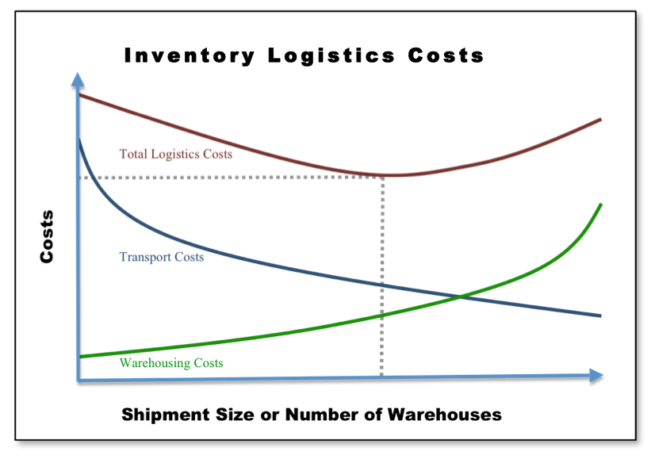
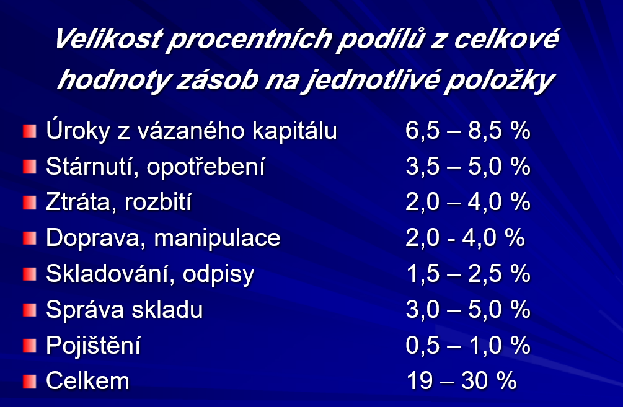
Notes:
Rozhodování v rámci jednotlivých činností ovlivňuje výši jednotlivých nákladů

Slide 24
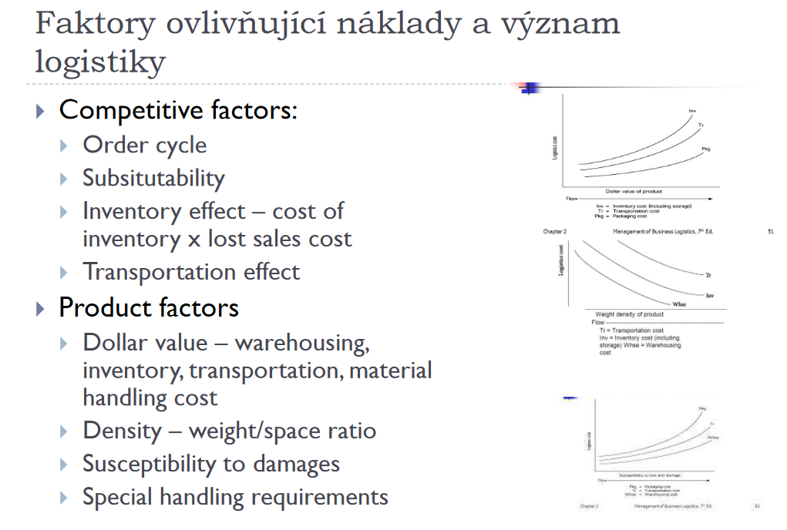
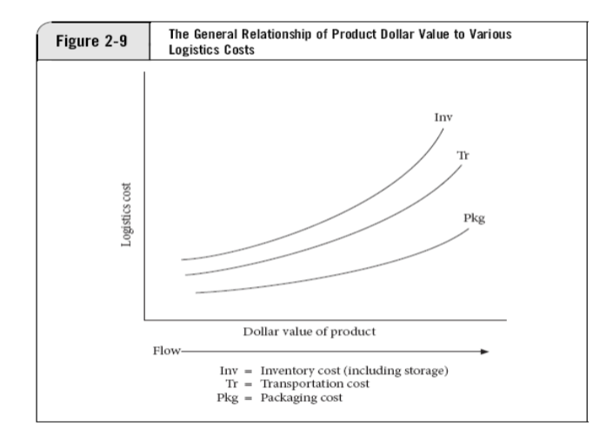
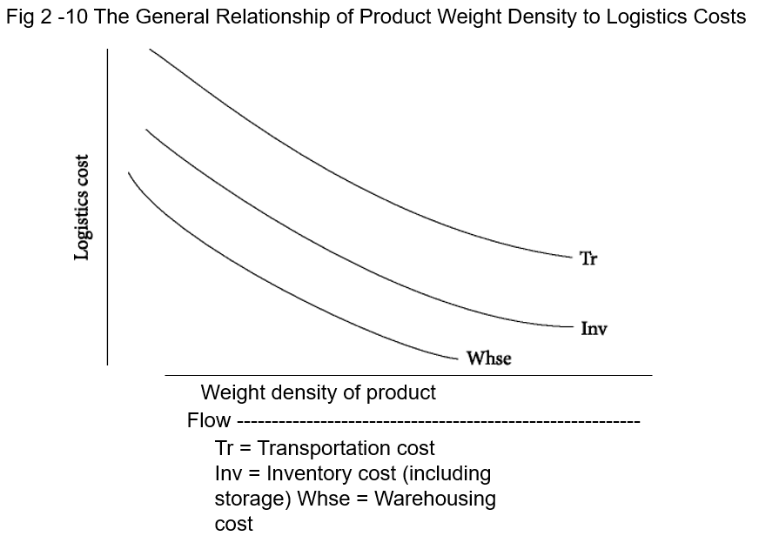
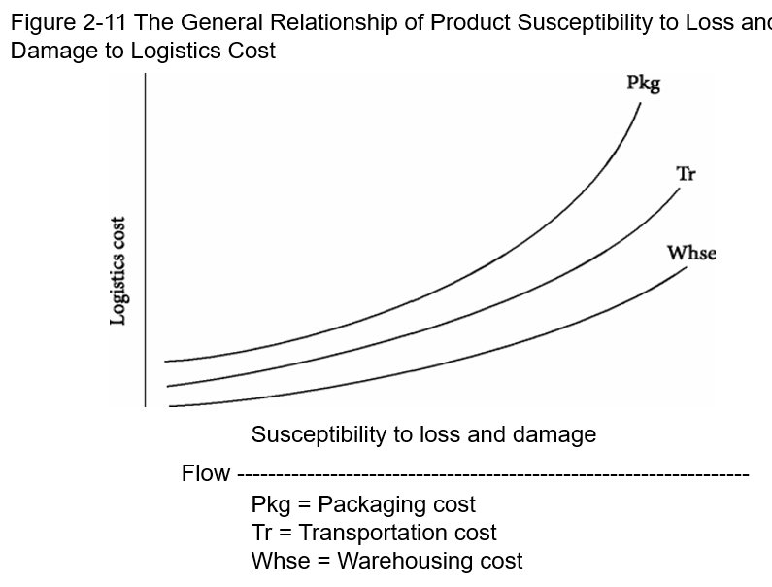
Notes:
Hodnota produktů, hustota produktů

Slide 25
Nákladové vazby mezi zákl. složkami marketingu a logistiky
Produkt
Cena
Propagace
MARKETING
Místo/úroveň zákaznického servisu
Náklady na udržování zásob
Přepravní náklady
LOGISTIKA
Množstevní náklady
Skladovací náklady
Náklady na vyřizování objednávek.
Source: Adapted from Douglas M. Lambert, The Development of an Inventory Costing Methodology: A Study of the Costs Associated with Holding Inventory (Chicago, IL: National Council of Physical Distribution Management, 1976), p. 7.

Slide 26
Logistics Interfaces with Marketing
The Marketing Mix – Four Ps
  (i) Price
  (ii) Product
  (iii) Promotion
  (iv) Place
Notes:
Cena? Carrier pricing
Generally, since the larger the shipment, the cheaper the transportation rate, shipment sizes should be tailored to the carrier’s vehicle capacity where possible.
Matching schedules
Quantity discounts should be tied to carrier quantity discounts.
Volume relationships
Volumes sold will affect inventory requirements.
Produkt - Consumer packaging
Generally, since the size, shape, weight and other physical characteristics of the product impact on its storage, transportation and handling, the logistics managers should be included in any decisions regarding these product traits.
A minor correction in any of the above could conceivably cost (or save) millions of dollars in logistical costs.
Logistics costs are not necessarily paramount, but they need to be considered in the decision making process.
Promotion
Promotion
Push versus pull
The most important factor is that the logistics division is aware of any changes in demand patterns so that it can plan for any consequences.
Pull strategies tend to be more erratic.
Push strategies tend to more predictable.
Channel competition
The more popular a product, the easier it is to persuade channel members to promote your product.
Distribution
Wholesalers
Generally, since wholesalers are combining purchases for multiple retailers, the shipment sizes tend to be larger and the number of transactions that have to be processed are fewer, with the result that logistics costs are smaller.
Retailers
With the exception of very large retailers who act more like wholesalers, smaller sales are the norm. These generally cost more for transportation and order processing.

Slide 27
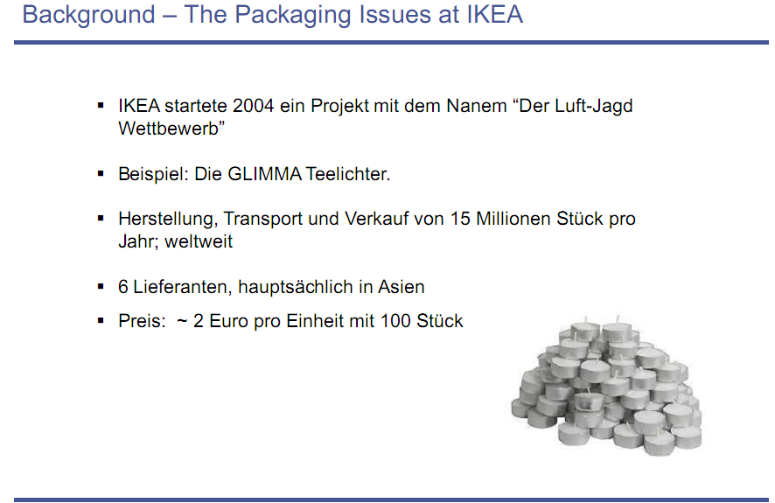

Slide 28
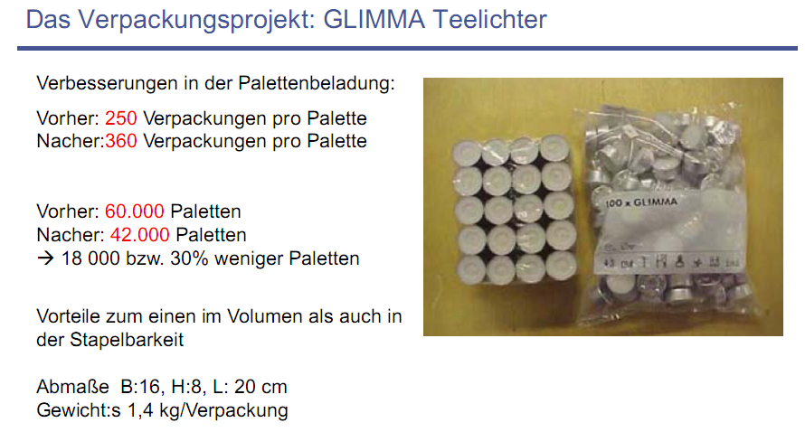

Slide 29
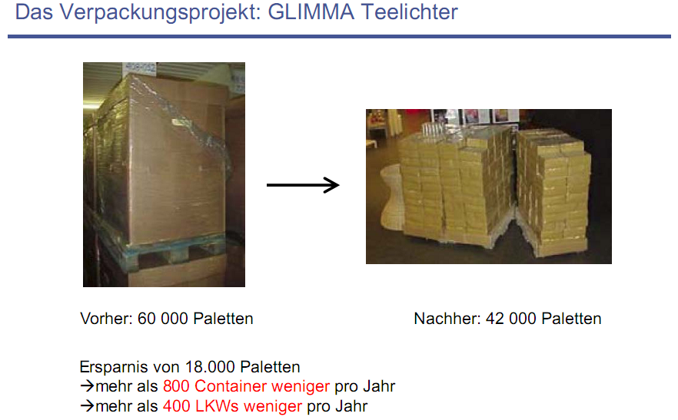

Slide 30
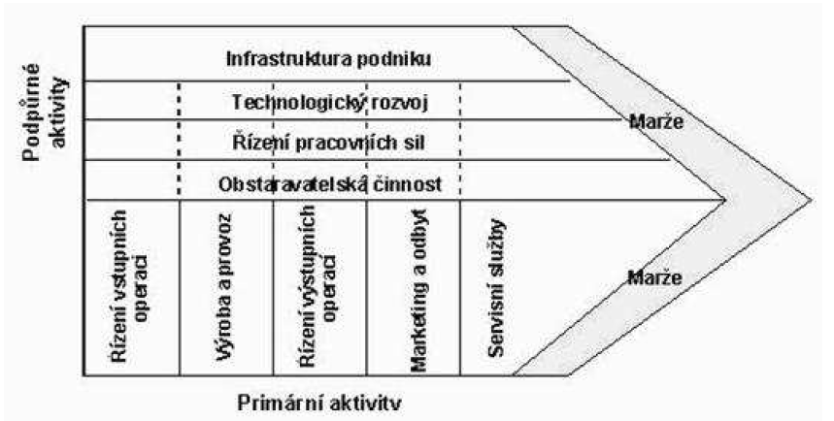
Jaké části podniku logistika ovlivňuje?
Notes:
Manufacturing and marketing are probably the two most important internal, functional interfaces with logistics.
Finance – snaha maximalizovat cashflow x logistiika – minimalizace SKU
Logistics can have a major impact on return on assets and return on investment (rozhodování o investicích)
Logistics costs reported by cost systems measure supply chain trade-offs and performance.

Slide 31
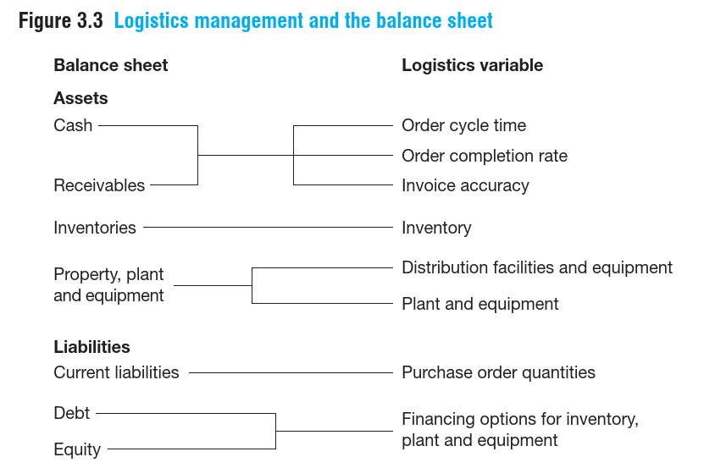
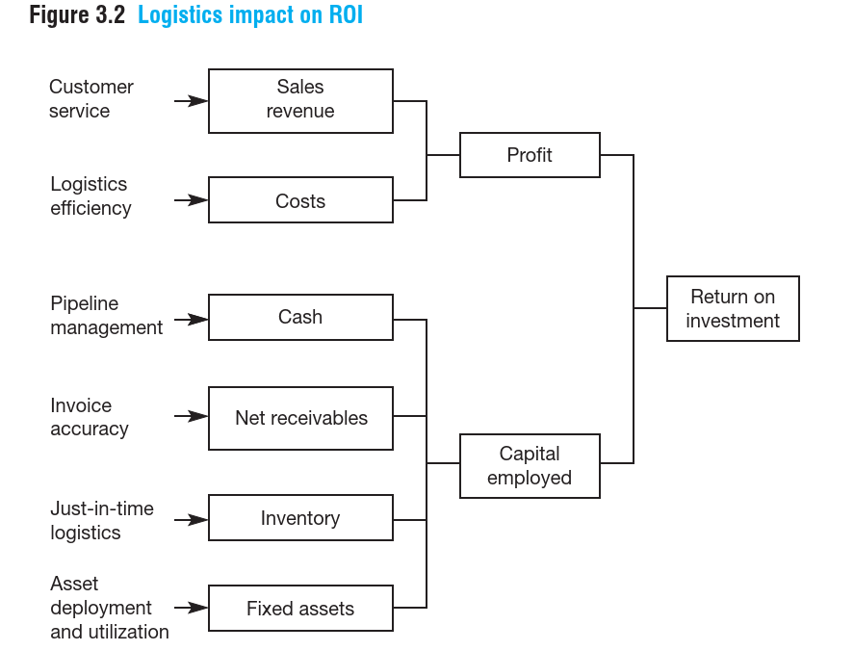
Dopad na finanční výkonnost
Notes:
Snaha posunout iso-křivku ROI doprava. Posun po křivce – stejné ROI
Logistika jako významný nositel uživatel fixních aktiv – jakých? Skaldy, distribuční centra, vozy, informační systémy
Rozhodování je ovlivněno požadavkem na zisk, CF a ROI (Chritopher, 2011, str.59

Slide 32
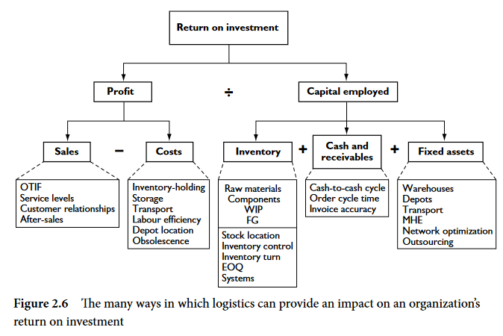
Notes:
Logistics can have a variety of different impacts on an organization’s financial performance.
Logistics has traditionally been seen as an operational necessity that cannot be avoided; however,
a good logistics operation can also offer opportunities for improving financial performance.
integrated Logistics and the supply Chain 23
For many companies, a key measure of success is the return on investment (ROI): the ratio
between the net profit and the capital employed in the business. For improved business
performance, this ratio needs to be shifted to increase profits and reduce capital employed.
There are many different ways in which logistics can have both a positive and a negative
impact on the ROI. These are outlined in Figure 2.6. This shows ROI as the key ratio of profit
and capital employed, with the main elements broken down further as sales revenue less cost
(representing profit) and inventory plus cash and receivables plus fixed assets (representing
capital employed)
Profit can be enhanced through increased sales, and sales benefit from the provision of high
and consistent service levels. One of the aims of many service level agreements is to try to
achieve OTIF (on time in full) deliveries – a key objective of many logistics systems. On the
other hand, costs can be minimized through efficient logistics operations. There are a number
of ways that this might happen, including:
• more efficient transport, thus reducing transport costs;
• better storage leading to reduced storage costs;
• reduced inventory holding leading to less cash being tied up in inventory;
• improved labour efficiency, thus reducing costs.

Slide 33
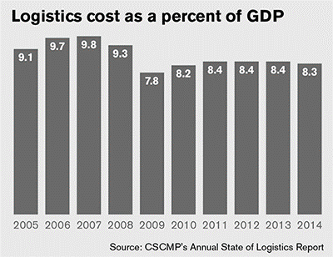
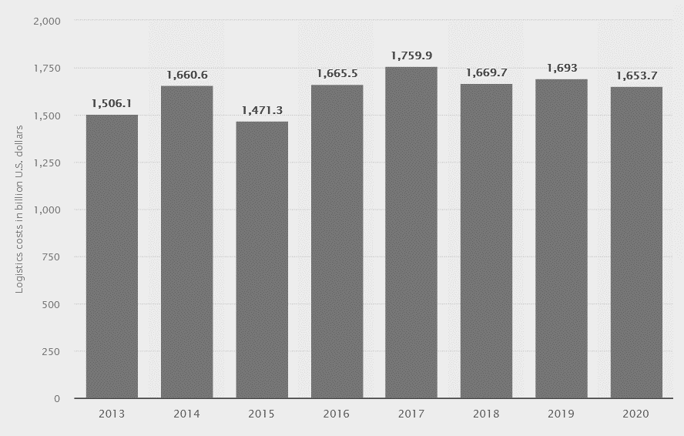
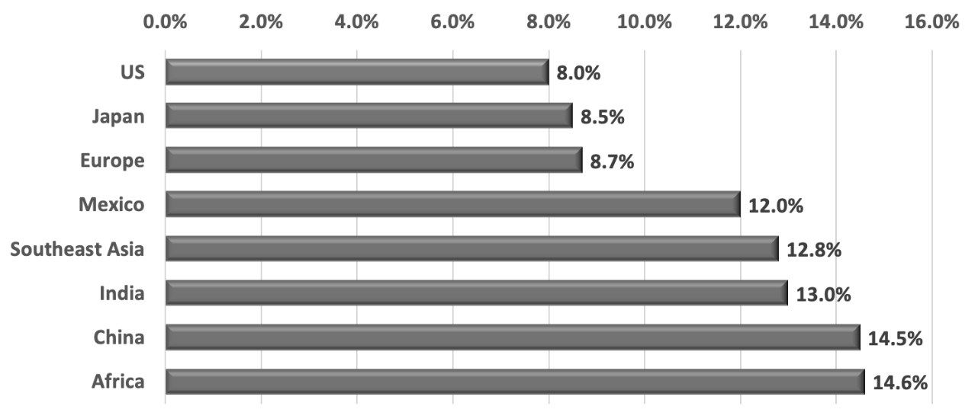
Logistics costs MACRO VIEW
Jaké logistické náklady jsou podle vás nejvýznamnější z pohledu HDP?
Notes:
You may not be aware of this, but in 1981, when interest rates were high and before U.S. companies started implementing lean practices, logistics costs as a percentage of GDP were 16.2%
At that time, inventory carrying costs were 8.3% of GDP. Transportation costs were about 7.3% of GDP. Administration made up the difference. How have logistics costs changed since the 1980s? V 9 tých letech bylo zkrouhnuto na polovinu u carrying cost na 4%Transportation byly 6
Over the past few years, logistics costs have remained in the mid 7% range until surging by 11.4% in 2018 because of rising prices as a result of robust economic growth and strong demand for logistics services.

Slide 34
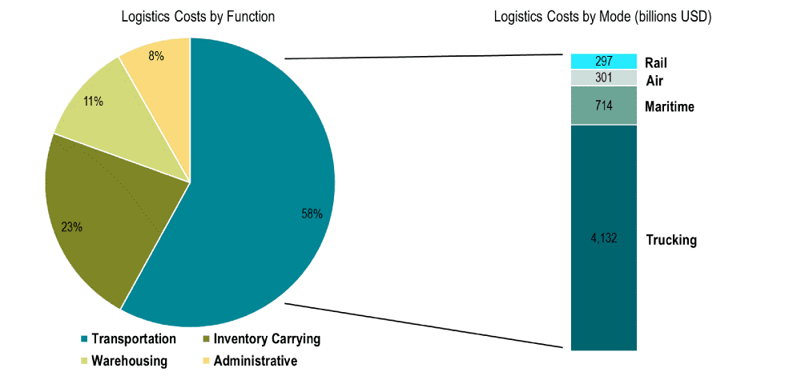
Jaký je podíl jednotlivých druhů logistických nákladů na celkových logistických nákladech? (Armstrong and Associates, 2018)
Notes:
9

Slide 35
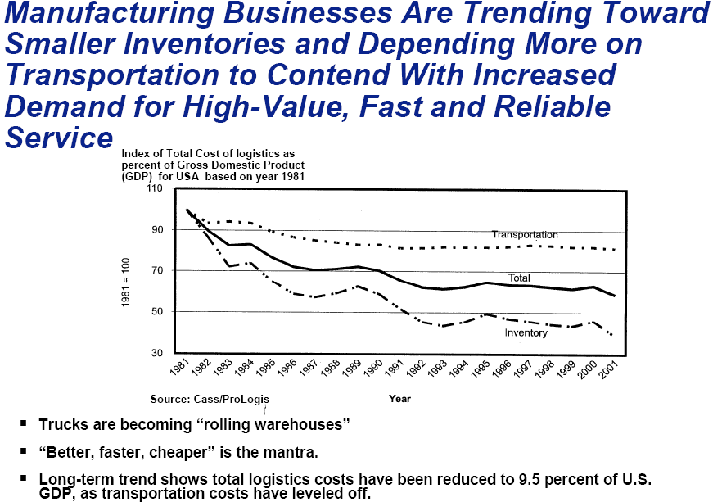
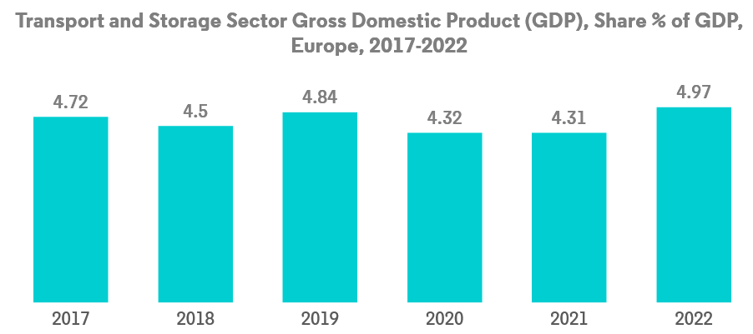

Slide 36
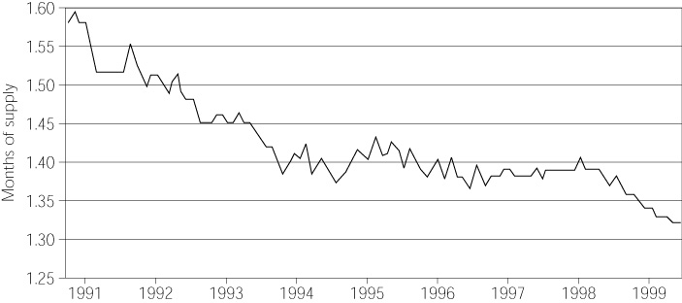
Figure 2-4:
Inventory Sales Ratio

Slide 37
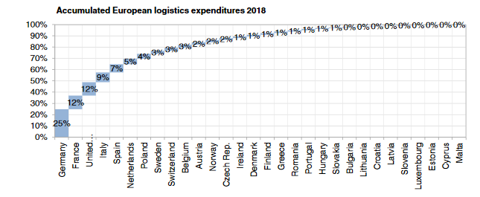
Notes:
In the year 2014 for the first time the overall transaction volume of logistics increased above € 1,000 bn. and from then on rose steadily to the most recent figure.

Slide 38
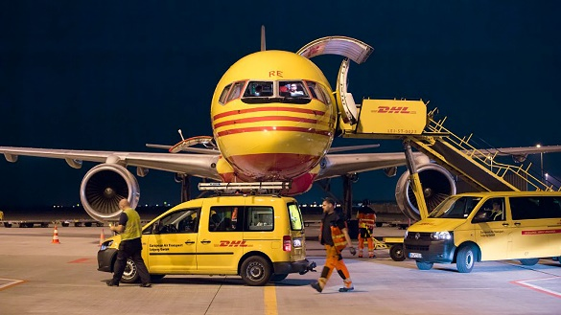
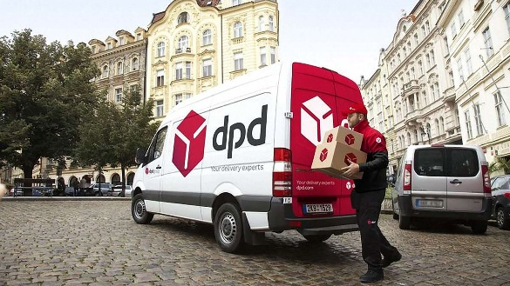
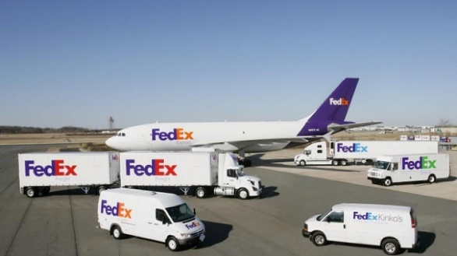
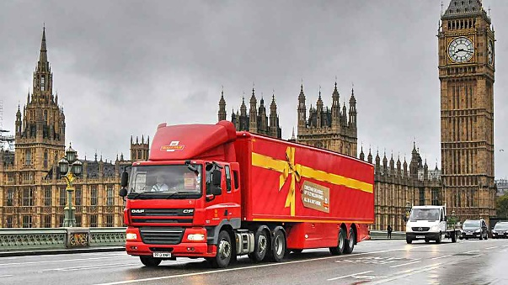
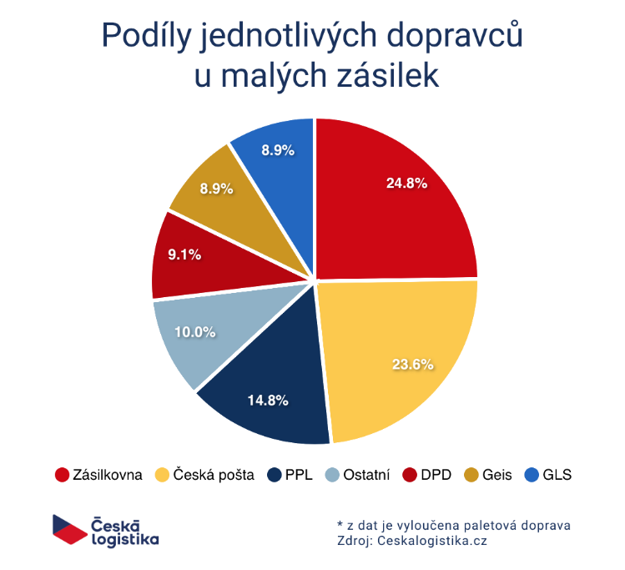
DHL is world-wide leader in e-commerce
Notes:
Royal mail, GLS service Top 10 European E-commerce Logistics Companies, 2021

Slide 39
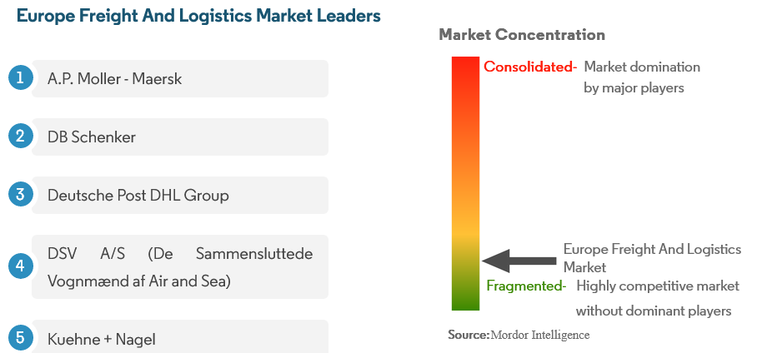
Notes:
Other important companies include C.H Robinson, Dachser, Expeditors International, FedEx, Hapag-Lloyd, Mainfreight, United Parcel Service
Source: https://www.mordorintelligence.com/industry-reports/european-freight-logistics-market

Slide 40
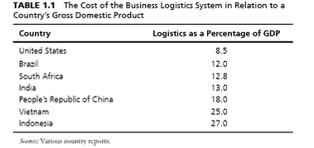
Factors Affecting National Logistics Costs
Geographical situation. Usually, countries that are close to ports, airports, economic hubs and logistically developed countries have better logistics systems with lower logistics costs.
Logistics infrastructures. Distribution network and communication network are important components of this part.
Human resource. It is interesting to know that one of the factors which led to increasing logistics costs in USA in 2005 was lack of vehicle driver (Cooke 2006).
Administration. In most methods for estimating national logistics costs, share of administration costs is assumed to be 4% of total costs. But actually, this 4% has a significant effect on the remaining 96%.
Technology. Researchers believe that development in ICT is one of the reasons for reducing trend of logistics costs in past decades. They also believe that there is still greater potentiality in technology to further reduce cost in future.
Political and economical stability. This factor can reduce or increase the risks and affect the insurance costs. In addition, political and economical stability can play an important role in attracting investment in national logistics activities.
Business legal rules. Customs, taxes and insurance laws are components of this part. Compatibility of these rules with logistics processes and activities could affect logistics costs.
Rate of interest. This factor is more important in inventory costs because of direct relation between them.
Energy price. increase especially in fuel prices that is used in logistics activities makes inflation in logistics costs, especially in transportation because of nature of its related activities.

Slide 41
Logistics Performance Index ranking
The LPI is a multidimensional assessment of logistics performance, rated on a scale from one (worst) to five (best). It uses more than 5,000 individual country assessments made by nearly 1,000 international freight forwarders to compare the trade logistics pro-files of 155 countries.
Better logistics performance is strongly associated with trade expansion, export diversification, ability to attract foreign direct investments, and economic growth. In other words, trade logistics matter.
The most important aspects of the current logistics environment:
  Efficiency of the customs clearance process.
  Quality of trade and transport-related infrastructure.
  Ease of arranging competitively priced shipments.
  Competence and quality of logistics services.
  Ability to track and trace consignments.
  Frequency with which shipments reach the consignee within the scheduled or expected time.
  Nezohledňuje zásoby
Notes:
World Bank to help countries identify the challenges and opportunities they face in their performance on trade logistics and what they can do to improve their performance.^{[2]} It is the weighted average of the country scores on six key dimensions: customs performance, infrastructure quality, ease of arranging shipments, logistics services quality, consignments tracking and tracing and timeliness of shipments.

Slide 42
LPI ranking and scores 2018: results
disparities remain between the top performers and many developing countries.
Identified eight megatrends likely to drive the future of logistics:
1. Logistics skill shortages.
2. Restructuring global value chains.
3. Supply risk and recovery (resilience).
4. Digital transformation of supply chains.
5. Sustainability of supply chains.
6. E-commerce driving demand chains.
7. Logistics property and infrastructure.
8. Collaborative business models.
Respondents in developing countries see the most severe skill shortage at the managerial level—for example, in filling senior supply chain management positions. In developed countries, the most severe shortage is for a qualified blue-collar workforce, such as truck drivers
Commerce and production have been disrupted by natural events and man-made disasters, such as civil wars or, recently, cyber-disasters.
Environmentally friendly supply chains are associated with higher logistics performance
23% of all energy-related emissions can be attributed to transport, about 7% of global CO 2 emissions can be attributed to freight transport, which is estimated to have emitted 3.2 gigatons of CO 2 in 2015. This number is estimated to rise in the next decades, with a higher growth in emerging economies than in Europe.
Zdroj: https://openknowledge.worldbank.org/bitstream/handle/10986/29971/LPI2018.pdf
Notes:
Results in 2010 Countries with low LPI scores tend to have higher average times to import or export. Efficient border management and coordination of the various agencies involved in border clearance is increasingly important.
Information technology infrastructure is widely available and widely used for trade processing, even in low-income countries. Countries in the intermediate range of logistics performance tend to be relatively more impacted by the quality and availability of physical infrastructure (ports or roads). Rail services receive very low scores almost everywhere.
The “logistics gap” persists: LPI scores are on average about 45 percent higher for high-income countries than for low-income countries

Slide 43
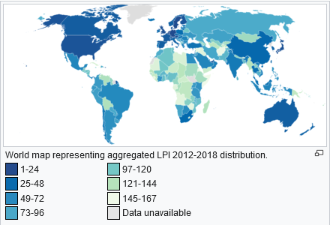
LPI ranking and scores 2018: results
http://siteresources.worldbank.org/TRADE/Resources/239070-1336654966193/LPI_2012_final.pdf

Slide 44
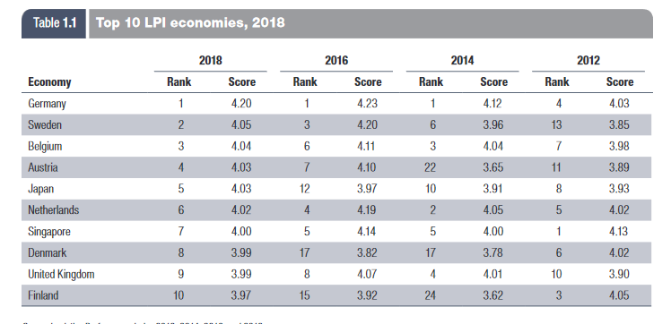
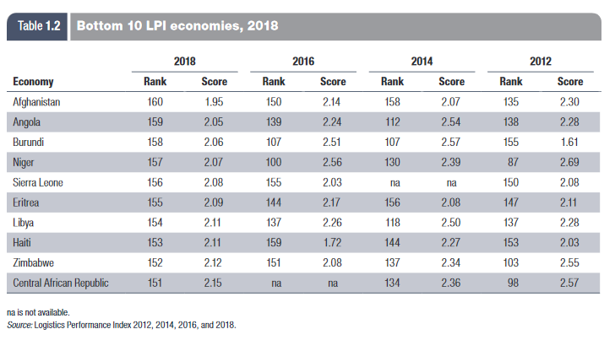
Notes:
The bottom 10 countries in the ranking are mostly low-income and lower-middle-income countries in Africa or isolated areas (table 1.2). These are either fragile economies affected by armed conflict, natural disasters, and political unrest or landlocked countries naturally chal-lenged by geography or economies of scale in connecting to global supply chains.
the efficiency of customs
and border management clearance, the quality of trade
and transport infrastructure, the ease of arranging
competitively priced shipments, the competence and
quality of logistics services, the ability to track and trace
consignments, and the frequency of on-time deliveries.

Slide 45
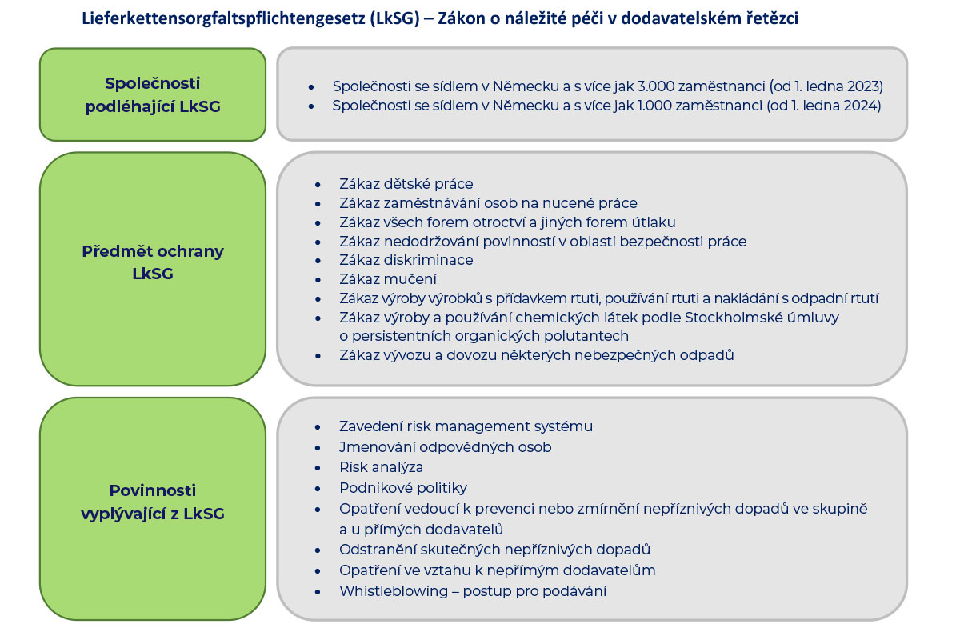
Vliv legislativy
zákona o náležité péči v dodavatelských řetězcích – zaveden v Německu 1.1. 2023
Lieferkettengesetz, či zkráceně LkSG – standard v Německu pro korporace se sídlem nebo pobočkou v Německu a zaměstnávají více jak 3000 zaměstnanců (i vyslaných mimo NSR), od 1.1. 2024 1000 zaměstnanců (4800 podniků)
Předchází CSDD nebo CS3D (Corporate Sustainability Due Diligence Directive) pro EU (předpoklad od roku 2026 v EU)
Notes:
ochrana lidských a sociálních práv, jakož i vybraných složek životního prostředí v rámci globálních dodavatelských řetězců, které mají své ústředí, hlavní sídlo anebo hlavní pobočku na území Spolkové republiky Německo a jež naplňují stanovená kritéria celkového počtu zaměstnanců. půjde v tomto směru nejen o přímé dopady na dceřiné společnosti, ale i o dopady na jinak „nezávislé“ české společnosti, které jsou do příslušného dodavatelského řetězce zapojeny z titulu svého postavení přímého či nepřímého dodavatele. Není omezeno odvětvím, i dodavatele služeb apod.
Dodavatelský řetězec[3] je přitom v zákoně vymezen jako globální řetězec, který se vztahuje na všechny výrobky (zboží) a služby podniku, a zahrnuje přitom všechny činnosti, postupy a procesy probíhající na území Spolkové republiky Německo a v zahraničí, jež jsou potřebné k výrobě zboží nebo poskytování služeb. Pro upřesnění zákon dokonce tuto definici dále precizuje formulací, že dodavatelský řetězec zahrnuje vše „od těžby surovin až po dodání zboží nebo poskytnutí služby konečnému zákazníkovi“.
ochrana lidských práv (včetně sociálních) a vybraných aspektů životního prostředí v rámci dodavatelských řetězců, a to formou řízení a minimalizace lidskoprávních a environmentálních rizik.
Na tomto místě je třeba poukázat na skutečnost, že povinnosti náležité péče podle LkSG zahrnují celou řadu dílčích povinností, a to konkrétně povinnost:
vytvoření systému rizik (Risikomanagement)
stanovení vnitropodnikové příslušnosti a odpovědnosti
provádění pravidelných analýz rizik (Risikoanalyse)
vydání prohlášení o zásadách (Grundsatzerklärung)
zavedení preventivních opatření ve vlastní podnikatelské činnosti a vůči přímým dodavatelům
přijímání opatření k nápravě
zřízení postupu pro podání stížností (Beschwerdeverfahren)
uplatňování povinností náležité péče ve vztahu k rizikům u nepřímých dodavatelů
vedení příslušné dokumentace
podávání pravidelné výroční Zprávy o plnění povinností náležité péče (Bericht über die Erfüllung der Sorgfaltspflichten).

Slide 46
Shrneme
Logistiku je třeba vnímat v kontextu celého dodavatelského řetězce (SCM)
Dodavatelský řetězec není jen o toku materiálu, informací a financí, ale je třeba ho vnímat jako „VALUE CHAIN“
Logistika ovlivňuje ostatní podnikové činnosti
Nejvýznamnější logistické náklady souvisí s přepravou
Náklady na logistiku je třeba vnímat v kontextu celé logistické činnosti
Klesá podíl nákladů na logistiku na celkovém HDP

