Slide 1
Vymezení logistiky a SCM, logistika v nákladovém kontextu, problémy logistiky
LSCM_jaro2025

Slide 2
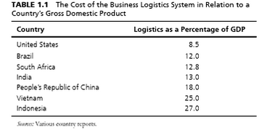
Factors Affecting National Logistics Costs
Geographical situation. Usually, countries that are close to ports, airports, economic hubs and logistically developed countries have better logistics systems with lower logistics costs.
Logistics infrastructures. Distribution network and communication network are important components of this part.
Human resource. It is interesting to know that one of the factors which led to increasing logistics costs in USA in 2005 was lack of vehicle driver (Cooke 2006).
Administration. In most methods for estimating national logistics costs, share of administration costs is assumed to be 4% of total costs. But actually, this 4% has a significant effect on the remaining 96%.
Technology. Researchers believe that development in ICT is one of the reasons for reducing trend of logistics costs in past decades. They also believe that there is still greater potentiality in technology to further reduce cost in future.
Political and economical stability. This factor can reduce or increase the risks and affect the insurance costs. In addition, political and economical stability can play an important role in attracting investment in national logistics activities.
Business legal rules. Customs, taxes and insurance laws are components of this part. Compatibility of these rules with logistics processes and activities could affect logistics costs.
Rate of interest. This factor is more important in inventory costs because of direct relation between them.
Energy price. increase especially in fuel prices that is used in logistics activities makes inflation in logistics costs, especially in transportation because of nature of its related activities.

Slide 3
Logistics Performance Index ranking
The LPI is a multidimensional assessment of logistics performance, rated on a scale from one (worst) to five (best). It uses more than 5,000 individual country assessments made by nearly 1,000 international freight forwarders to compare the trade logistics pro-files of 155 countries.
Better logistics performance is strongly associated with trade expansion, export diversification, ability to attract foreign direct investments, and economic growth. In other words, trade logistics matter.
The most important aspects of the current logistics environment:
Efficiency of the customs clearance process.
Quality of trade and transport-related infrastructure.
Ease of arranging competitively priced shipments.
Competence and quality of logistics services.
Ability to track and trace consignments.
Frequency with which shipments reach the consignee within the scheduled or expected time.
Nezohledňuje zásoby
Notes:
World Bank to help countries identify the challenges and opportunities they face in their performance on trade logistics and what they can do to improve their performance.^{[2]} It is the weighted average of the country scores on six key dimensions: customs performance, infrastructure quality, ease of arranging shipments, logistics services quality, consignments tracking and tracing and timeliness of shipments.

Slide 4
LPI ranking and scores 2018: results
disparities remain between the top performers and many developing countries.
Identified eight megatrends likely to drive the future of logistics: 1. Logistics skill shortages. 2. Restructuring global value chains. 3. Supply risk and recovery (resilience). 4. Digital transformation of supply chains. 5. Sustainability of supply chains. 6. E-commerce driving demand chains. 7. Logistics property and infrastructure. 8. Collaborative business models.
Respondents in developing countries see the most severe skill shortage at the managerial level—for example, in filling senior supply chain management positions. In developed countries, the most severe shortage is for a qualified blue-collar workforce, such as truck drivers
Commerce and production have been disrupted by natural events and man-made disasters, such as civil wars or, recently, cyber-disasters.
Environmentally friendly supply chains are associated with higher logistics performance
23% of all energy-related emissions can be attributed to transport, about 7% of global CO 2 emissions can be attributed to freight transport, which is estimated to have emitted 3.2 gigatons of CO 2 in 2015. This number is estimated to rise in the next decades, with a higher growth in emerging economies than in Europe.
Zdroj: https://openknowledge.worldbank.org/bitstream/handle/10986/29971/LPI2018.pdf
Notes:
Results in 2010 Countries with low LPI scores tend to have higher average times to import or export. Efficient border management and coordination of the various agencies involved in border clearance is increasingly important.
Information technology infrastructure is widely available and widely used for trade processing, even in low-income countries. Countries in the intermediate range of logistics performance tend to be relatively more impacted by the quality and availability of physical infrastructure (ports or roads). Rail services receive very low scores almost everywhere.
The “logistics gap” persists: LPI scores are on average about 45 percent higher for high-income countries than for low-income countries

Slide 5
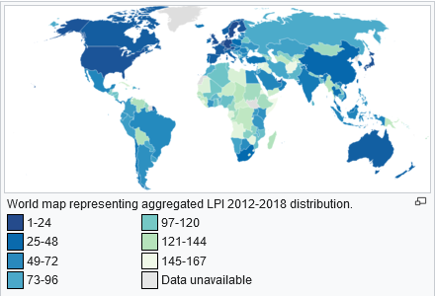
LPI ranking and scores 2018: results
http://siteresources.worldbank.org/TRADE/Resources/239070-1336654966193/LPI_2012_final.pdf

Slide 6
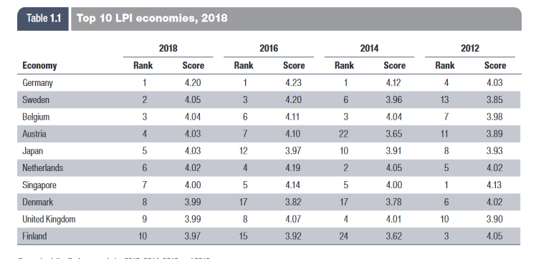
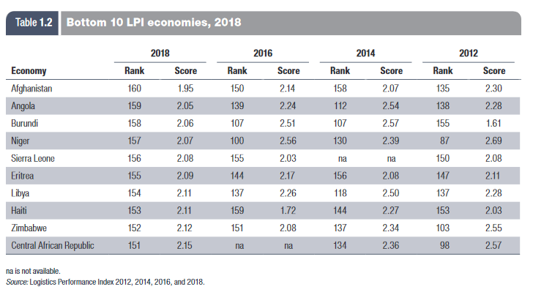
Notes:
The bottom 10 countries in the ranking are mostly low-income and lower-middle-income countries in Africa or isolated areas (table 1.2). These are either fragile economies affected by armed conflict, natural disasters, and political unrest or landlocked countries naturally chal-lenged by geography or economies of scale in connecting to global supply chains.
the efficiency of customs
and border management clearance, the quality of trade
and transport infrastructure, the ease of arranging
competitively priced shipments, the competence and
quality of logistics services, the ability to track and trace
consignments, and the frequency of on-time deliveries.

