Slide 1
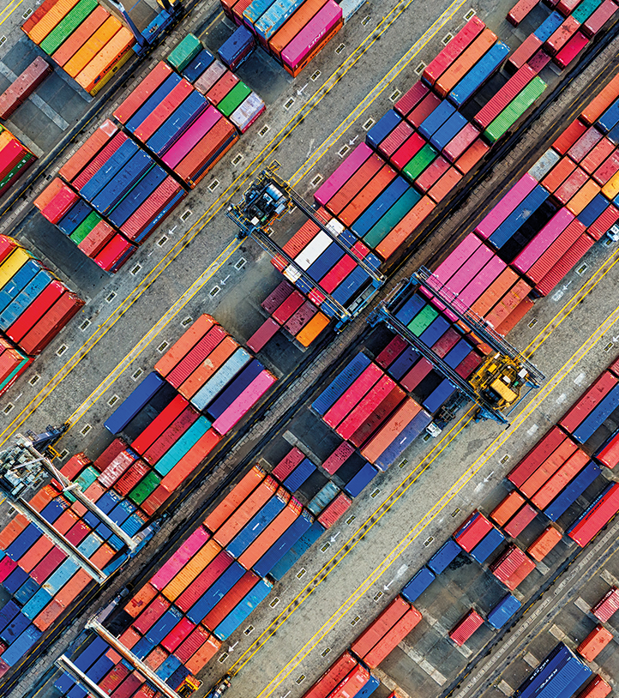
Terms of Sale and of Payment
Ondrej Castek
castek@econ.muni.cz

Slide 2
When and where:
title to the goods
responsibility (insurance)
care for shipment
responsibility for paying and arranging changes
payment for the goods
Notes:
1. ownership
3. e.g. livestock – cows, pigs, etc.

Slide 3
Terms of sale
Cost of the product
Risk of physical loss
Cost of moving
Jurisdiction: Incoterms
Notes:
1. Not too low – dumping, not too high – „hard currency flight“, import duties and other charges: matters, where does the goods come from
2. Theft (high value), breakage (fragile), infestation (insect), infection (bacteries, viruses), rust and oxidation, dent and scratch, thawing (unfreez) and spoilage, sensitive to heat and humidity, delayed (seasonal goods), deliberate scuttling
man-made hazards (next to theft and scuttling): war, civil commotion (= public protest/unrest), strikes, negligence, piracy, collision, sinking, fire
Even with good insurance inconveniences: time lost etc.
3. a) transportation: domestically door – door, internationaly becoming as a standard as well, outsourcing, a need to decide, who pays for what part of the transportation
b) movement facilitation: documentation – import-export documents of entry, licenses, permits, declarations. Where and when to present.
4. legal suits complicated, application of international law

Slide 4
Examples of customs duties
Third Country Duty: This is a standard customs duty applied to goods imported from non-EU countries. For instance, electronics imported from the United States might be subject to a specific duty rate.
Anti-Dumping Duties: These are additional duties imposed on imports believed to be priced below fair market value. For example, certain steel products from China have faced anti-dumping duties to protect EU manufacturers.
Notes:
1. Not too low – dumping, not too high – „hard currency flight“, import duties and other charges: matters, where does the goods come from
2. Theft (high value), breakage (fragile), infestation (insect), infection (bacteries, viruses), rust and oxidation, dent and scratch, thawing (unfreez) and spoilage, sensitive to heat and humidity, delayed (seasonal goods), deliberate scuttling
man-made hazards (next to theft and scuttling): war, civil commotion (= public protest/unrest), strikes, negligence, piracy, collision, sinking, fire
Even with good insurance inconveniences: time lost etc.
3. a) transportation: domestically door – door, internationaly becoming as a standard as well, outsourcing, a need to decide, who pays for what part of the transportation
b) movement facilitation: documentation – import-export documents of entry, licenses, permits, declarations. Where and when to present.
4. legal suits complicated, application of international law

Slide 5
Examples of customs duties
Product: Bicycles
Tariff Code: 8712 00 30
Duty Rate: 14%
Bicycles imported into the EU from non-EU countries are subject to a 14% customs duty¹.

Slide 6
Examples of customs duties
Today
(October 8th, 2024, aktualne.cz)
China has changed its stance. It will impose a provisional duty of up to 39 percent on brandy imports from the European Union
China will impose provisional anti-dumping duties of 30.6 to 39 percent on brandy imports from the European Union. This was announced today by the Chinese Ministry of Commerce.

Slide 7
Examples of quotas
Tariff Quotas: These allow a certain quantity of goods to be imported at a reduced duty rate. For example, the EU has tariff quotas for agricultural products like sugar and beef, allowing a set amount to be imported at lower tariffs.
Preferential Tariff Quotas: Under trade agreements, the EU grants reduced tariffs for a specific volume of goods from certain countries. For instance, under the EU-Mercosur agreement, there are quotas for beef imports from South American countries.
Autonomous Tariff Quotas: These are set for raw materials or semi-finished goods not sufficiently available within the EU. For example, certain chemicals and industrial components might be imported under these quotas to support EU industries.

Slide 8
Examples of quotas
Product: Beef
Tariff Quota: Under the EU’s tariff rate quota (TRQ) system, a specific quantity of beef can be imported at a reduced duty rate.
Quota Details: For example, the EU allows a quota of 45,000 tonnes of high-quality beef to be imported annually at a reduced tariff rate¹.
Quantities exceeding this quota are subject to higher duty rates. This system helps manage the supply of beef in the EU market while supporting local producers.

Slide 9
Examples of dumping prices
Currently, several products are under scrutiny for potential dumping in the EU market. Here are a few examples:
Automotive Products: There have been concerns about certain automotive parts and vehicles from China being sold at prices below fair market value¹.
Metals: Various metal products, including steel and aluminum, are often investigated for dumping, particularly from countries like China¹.
Chemicals: Specific chemicals, such as polyethylene terephthalate (PET), have been subject to anti-dumping duties to protect EU industries².
These investigations aim to ensure fair competition and protect EU industries from unfair pricing practices.

Slide 10
Terms of sale
Cost of the product
Risk of physical loss
Cost of moving
Jurisdiction: Incoterms
Notes:
1. Not too low – dumping, not too high – „hard currency flight“, import duties and other charges: matters, where does the goods come from
2. Theft (high value), breakage (fragile), infestation (insect), infection (bacteries, viruses), rust and oxidation, dent and scratch, thawing (unfreez) and spoilage, sensitive to heat and humidity, delayed (seasonal goods), deliberate scuttling
man-made hazards (next to theft and scuttling): war, civil commotion (= public protest/unrest), strikes, negligence, piracy, collision, sinking, fire
Even with good insurance inconveniences: time lost etc.
3. a) transportation: domestically door – door, internationaly becoming as a standard as well, outsourcing, a need to decide, who pays for what part of the transportation
b) movement facilitation: documentation – import-export documents of entry, licenses, permits, declarations. Where and when to present.
4. legal suits complicated, application of international law

Slide 11
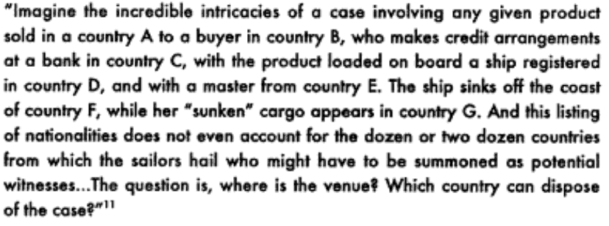
Example

Slide 12
Incoterms: selling terms (2020 edition)
Group E – Departure
EXW – Ex Works (named place)
This trade term places the greatest responsibility on the buyer and minimum obligations on the seller. The Ex Works term is often used when making an initial quotation for the sale of goods without any costs included.
EXW means that a seller has the goods ready for collection at his premises (Works, factory, warehouse, plant) on the date agreed upon.
The buyer pays all transportation costs and also bears the risks for bringing the goods to their final destination.
Group F – Main carriage unpaid
FCA – Free Carrier (named places)
  The seller hands over the goods, cleared for export, into the custody of the first carrier (named by the buyer) at the named place. This term is suitable for all modes of transport, including carriage by air, rail, road, and containerised / multi-modal sea transport. This is the correct "freight collect" term to use for sea shipments in containers, whether LCL (less than container load) or FCL (full container load).
FAS – Free Alongside Ship (named loading port)
  The seller must place the goods alongside the ship at the named port. The seller must clear the goods for export. Suitable only for maritime transport only but NOT for multimodal sea transport in containers. This term is typically used for heavy-lift or bulk cargo.
Notes:
EXW - makes it particularly clear that this term is suitable only for domestic trade and no longer suitable for export because the buyer is responsible for export clearance in the seller's country. Clearly with modern security concerns this is almost impossible

Slide 13
Incoterms: selling terms
Group F – Main carriage unpaid
FOB – Free on board (named loading port)
  The seller must themself load the goods on board the ship nominated by the buyer, cost and risk being divided at ship's rail. The seller must clear the goods for export. Maritime transport only but NOT for multimodal sea transport in containers. The buyer must instruct the seller the details of the vessel and port where the goods are to be loaded, and there is no reference to, or provision for, the use of a carrier or forwarder. It DOES NOT include Air transport. This term has been greatly misused over the last three decades ever since Incoterms 1980 explained that FCA should be used for container shipments.
Group C – Main carriage paid
CFR– Cost and Freight (named destination port)
  Seller must pay the costs and freight to bring the goods to the port of destination. However, risk is transferred to the buyer once the goods have crossed the ship's rail. Maritime transport only and Insurance for the goods is NOT included. Insurance is at the Cost of the Buyer.
CIF – Cost, Insurance and Freight (named destination port)
  Exactly the same as CFR except that the seller must in addition procure and pay for insurance for the buyer. Maritime transport only.
CPT – Carriage Paid To (named place of destination)
  The general/containerised/multimodal equivalent of CFR. The seller pays for carriage to the named point of destination, but risk passes when the goods are handed over to the first carrier.
CIP – Carriage and Insurance Paid (To) (named place of destination)
  The containerised transport/multimodal equivalent of CIF. Seller pays for carriage and insurance to the named destination point, but risk passes when the goods are handed over to the first carrier.

Slide 14
Incoterms: selling terms
Group D – Arrival
DAP (Delivered at Place)
Seller delivers the goods when they are placed at the disposal of the buyer on the arriving means of transport ready for unloading at the named place of destination. Parties are advised to specify as clearly as possible the point within the agreed place of destination, because risks transfer at this point from seller to buyer. If the seller is responsible for clearing the goods, paying duties etc., consideration should be given to using the DDP term.
DPU (Delivered at Place Unloaded)
  Seller delivers when the goods, once unloaded from the arriving means of transport, are placed at the disposal of the buyer at a named terminal at the named port or place of destination. "Terminal" includes quay, warehouse, container yard or road, rail or air terminal. Both parties should agree the terminal and if possible a point within the terminal at which point the risks will transfer from the seller to the buyer of the goods. If it is intended that the seller is to bear all the costs and responsibilities from the terminal to another point, DAP or DDP may apply.
DDP – Delivered Duty Paid (named destination place)
  This term means that the seller pays for all transportation costs and bears all risk until the goods have been delivered and pays the duty. Also used interchangeably with the term "Free Domicile". The most comprehensive term for the buyer. In most of the importing countries, taxes such as (but not limited to) VAT and excises should not be considered prepaid being handled as a "refundable" tax. Therefore, VAT and excises usually are not representing a direct cost for the importer since they will be recovered against the sales on the local (domestic) market.
Notes:
DAP
Responsibilities
Seller bears the responsibility and risks to deliver the goods to the named place
Seller is advised to obtain contracts of carriage that match the contract of sale
Seller is required to clear the goods for export
If the seller incurs unloading costs at place of destination, unless previously agreed they are not entitled to recover any such costs
Importer is responsible for effecting customs clearance, and paying any customs duties
DPU
Responsibilities
Seller is responsible for the costs and risks to bring the goods to the point specified in the contract
Seller should ensure that their forwarding contract mirrors the contract of sale
Seller is responsible for the export clearance procedures
Importer is responsible to clear the goods for import, arrange import customs formalities, and pay import duty
If the parties intend the seller to bear the risks and costs of taking the goods from the terminal to another place then the DAP term may apply

Slide 15
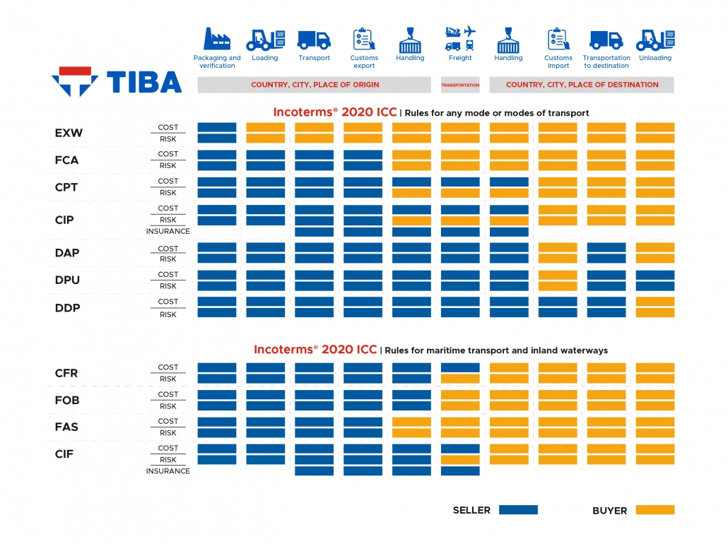

Slide 16
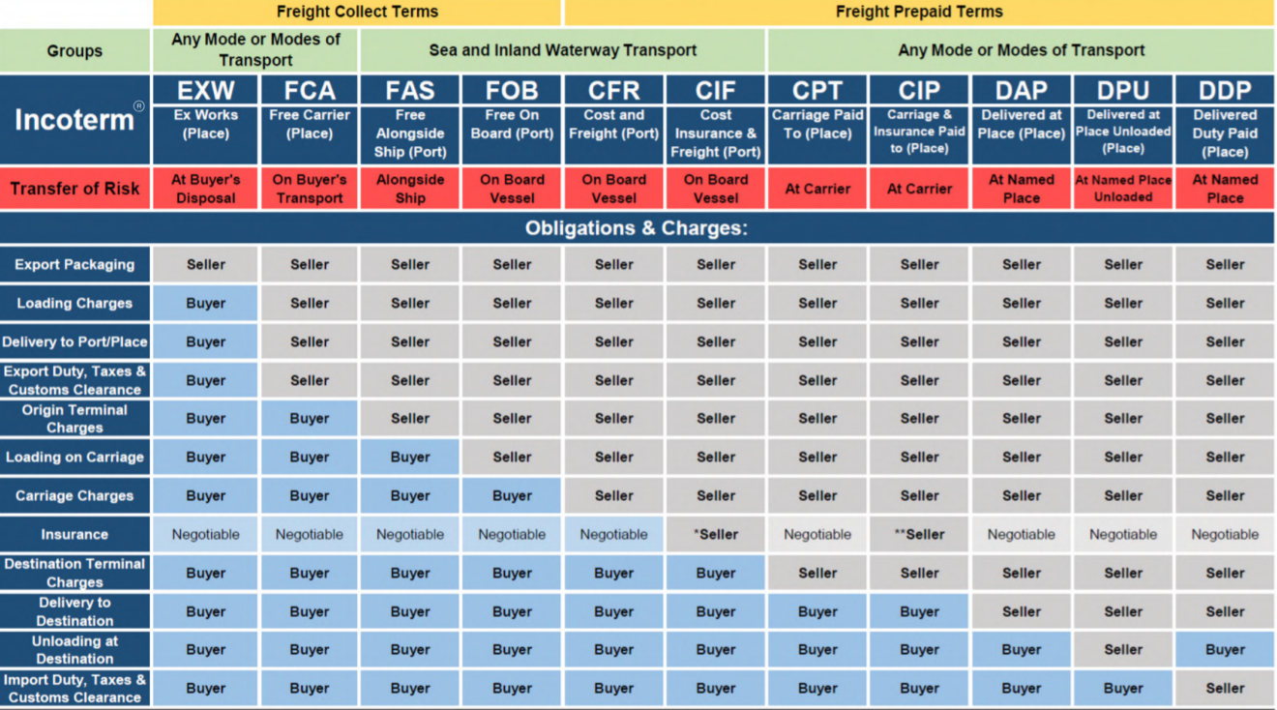
Incoterms

Slide 17
Incoterm Guide

Slide 18
Incoterm Guide
Notes:
One cannot forget about Force majeure: crop failure etc.
Bargaining for the risk and gain – at least one of them (seller/buyer) has to be willing to accept some risk.
Find closest Incoterm and list and describe all exceptions:
CIF Hamburg plus export packing Incoterms 2010
Sometimes plus conditions laid down by governments – against currency flights or market protection
A problem is also the volatility of shipping prices, the client does not know the exact price until very last moment and the contracts are up to one year in advance
First time importers/exporter prefer to let most of the issues on the other party. Being able to take care of that is a sign of firms’ maturity:
1987 Korea to US, 70% FAS or FOB, 1992 70% CIF

Slide 19
Incoterms
Pros
Easily understood terms
International standardization
Updated and clarified by an international body (ICC)
Cons
Differences between buyer and seller preferences when choosing terms
Certain terms can expose one party to inflated costs

Slide 20
Terms of Payment
amount of supplier‘s credit
direct deal or intermediaries
open accounts, progress payments, options, bonuses and penalties
risk of being paid and of receiving the goods – how to solve it
Notes:
Amount of credit the seller is willing to extend to the buyer. Money come from owners, sales and credits. Credit not as a bank loan as we are used to in GE and CZ.
2. intermediaries – banks as collection agents

Slide 21
Documents related to terms of sale
Bill of Exchange (sight, documents against acceptance, date/time)
Bill of Lading (more details next week)
Documentary Letters of Credit
Notes:
1. Bill of exchange is a demand for payment, payable on presentation or on a specified date (most likely after the delivery of goods). replaces the goods
risks: buyer gets documents and does not pay, buyer pays and does not get the cargo, bank can become insolvent, foreing exchange issues
Bill o/E can be endorsed „in blank“ or to a certain person or company (bill of lading also). Once endorsed can be traded: discounting, discounted draft. It becomes a special security.
2. bill of lading – replacement of goods in marine cargo shipments – can be traded etc. It is „title to goods“ = means ownership. Blank endorsed bill of lading.
3. Matter of two contracts: between buyer and „opening/issuing“ bank and between this bank and the seller. Documentary because the bank deals with documents only. Must be 100% exact. Seller has to review LoC upon reception as detailed as possible.

Slide 22
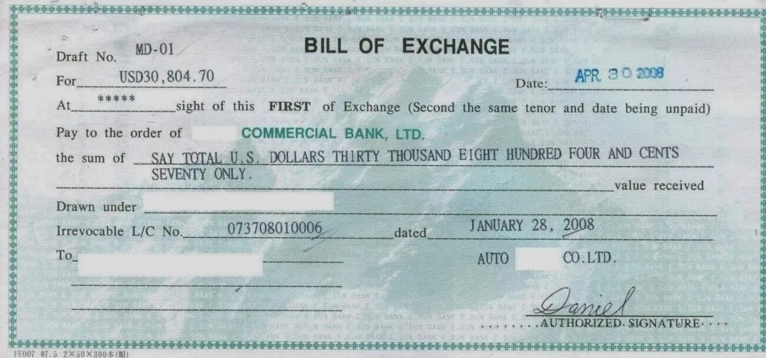
Notes:
Picture from: https://umitgumusten.com/bill-of-exchange-the-key-payment-instrument-in-international-trade-finance/

Slide 23
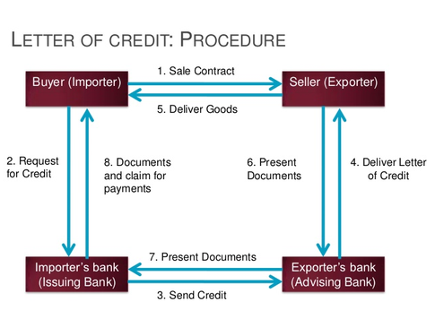
Letter of Credit
Notes:
No direct deals between buyer and seller after issuing LoC.
Revocable x irrevocable
Advised – second bank notifies seller what documents when to present, no obligation of this bank to the seller
Confirmed – second bank, usually in seller‘s country confirms the LoC, is obligated to pay the money to seller if buyer does not. Usually if extra political or economical risk in buyer’s country.
LoC sometimes required by governments.
LoC under terms of Uniform Customs and Practices For Documentary LoC, issued by International Chamber of Commerce – like Incoterms
Exact conformity with requirements – extra L case
Sodium chloride x salt
Shipment required from Cleveland and point of loading Baltimore
Picture from: https://www.portlogy.com/wp-content/uploads/sites/6/2015/11/letter-of-credit-import-export-payment.jpg

Slide 24
UCP500
Facsimile signed documents
Banks treat a facsimile signature as the equivalent of a hand signature. Accordingly, a document that appears to bear the document issuer’s facsimile signature is also treated as an original document.
Photocopies
Banks treat as non-original any document that appears to be a photocopy of another document. If, however, a photocopy appears to have been completed by the document issuer’s hand marking the photocopy, then, consistent with . . . , the resulting document is treated as an original document unless it indicates otherwise. . . .
Notes:
Uniform Customs and Practices For Documentary LoC

Slide 25
Example
Subj.: Your enquiry of 8Th April
In reply to your letter, we are pleased to quote for the hotel furniture and fittings which interest you.
Prices: CIF Alexandria, Incoterms 2010
Packing: one 40’ container
Payment: by L/C on our bank BNM Agenzia 4
Delivery: by the end of July as requested if order received before 20th May 2010

Slide 26
Since the UCP 500 (Uniform Customs and Practice for Documentary Credits - International Chamber of Commerce Publication No. 500) came into effect in January 1, 1994, introducing the new rules governing letters of credit (or documentary credits) operations, there have been many disputes over the conformity of the bills of lading to the UCP 500 articles. The main reason is that certain bills of lading that were compliant under the old UCP 400 rules are now no more acceptable by the banks.
As a result, 90% of bills of lading in the U.S.A. and 60% in the U.K. are rejected by the banks. This does not in fact affect the carriers or the banks, even though the bills of lading cannot meet the bankers' requirements under the new rules. The customers of the banks or the carriers, for example, the shippers, the consignees and the notified parties, are the ones that suffer, even though they have done nothing wrong.

Slide 27
Payment modes
Cash in advance
Letters of credit
Sight drafts/documents against payment
Date drafts/documents against acceptance
Open account
Notes:
Risk and costs, sellers’ and buyer’s view
LoC fees: 0,5% - 2% or more, minimum fees, amendment fees (50 – 100 USD per amendment)

Slide 28
Exercise
Which Incoterms represent the minimum and maximum obligation for the supplier respectively?
Which Incoterms refer specifically to transport by sea?
What does the customer have to pay for under FOB terms?
At what point of a business transaction has the supplier fulfilled his/her obligations under FAS terms?
What is the main difference between DAP terms and DPU terms?
Does the supplier bear more responsibility under CIF or CIP terms?

Slide 29
Study material: Chapter 11
International Logistics (2nd Edition)
Wood, Donald F. Barone, Anthony Murphy, Paul
Pages: 456, Publisher: AMACOM Books
ISBN: 9780814426739
Available at:
http://site.ebrary.com/lib/masaryk/

